Slide 1
Light Pole Safety Project – at Historic Sites
Click to update the date or subtitle – January 1, 2018
Click to update the date or subtitle – January 1, 2018
Click to update the date or subtitle – January 1, 2018
Presenter Name, Title
Presenter Name, Title
Presenter Name, Title

Slide 2
Outline
Project Scope
Why Are The Light Poles Being Removed?
Proposed Design
Timeline & Budget

Slide 3
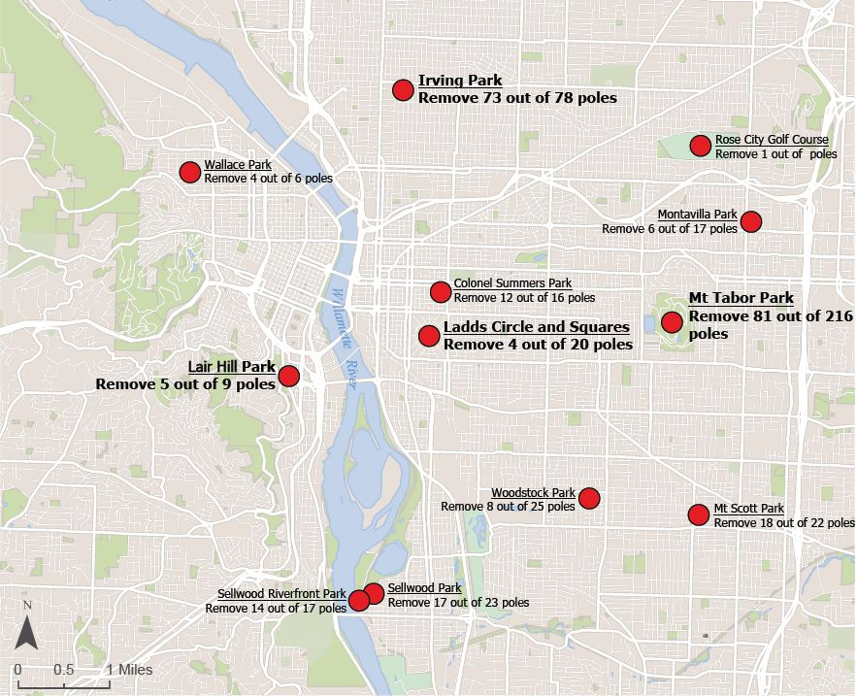
Project Scope
Remove and replace 243 light poles across 12 parks
Four are in historic parks:
Irving Park: 73 poles of 78 poles
Mt Tabor Park: 81 of 216 poles
Ladd’s Circle & Squares: 4 of 20 poles
Lair Hill Park: 5 of 9 poles

Slide 4
Why Are the Light Poles Being Removed?
Portland Parks & Recreation (PP&R) recently evaluated a specific type of light pole in the park system.
The process identified a flaw with the anchoring system of 243 poles located in 12 Portland parks.
This flawed anchoring system may pose life and safety hazards to the public.
PP&R will remove these 243 poles to help ensure the community’s safety.
PP&R began removing poles on February 22, 2023.
More information: https://www.portland.gov/parks/construction/light-pole-safety-project

Slide 5
Mt Tabor Fixtures
Polygonal Lantern Style
Glass Globe
Original 1920s era Light Fixture
Existing Lights – all 81, from the 1950s and 1980s

Slide 6
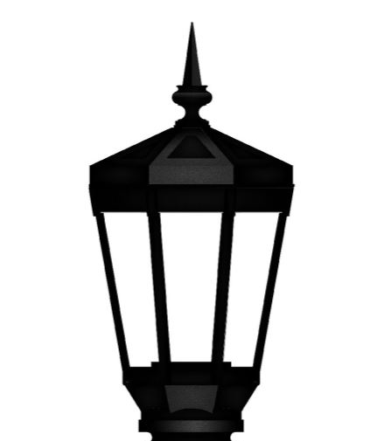
Proposed Design
Proposed Light Pole
Proposed Fixture
(color will be black)
Flared Lantern
+
Octagonal Shape
Flared Lantern
Existing Light Pole
and Fixture
Octagonal Shape

Slide 7
Timeline
Light poles are currently being removed at the 12 parks through the end of April
Only have funding to replace light poles at Irving Park and Mt Scott Park
Light poles at Irving and Mt Scott will be replaced as soon as possible, and may take up to 16 months
Budget
$5,000,000 to remove all light poles and replace light poles at Irving Park and Mt Scott
Approximately $10,000,000 funding gap to replace the remainder of the light poles

Slide 8
Questions and Discussion

