Slide 1
Tryon Creek Fish Passage Improvement E11427 Council Item 139 Portland City Council | February 15, 2023
Kerry Rubin, P.E.,
Project Management Division Manager
Ali Young,
Project Manager
MINGUS MAPPS, COMMISSIONER
MICHAEL JORDAN, DIRECTOR
Notes:
Good morning and thank you for your time. We come to you today to request authorization to advertise the construction contract for the Tryon Creek Fish Passage Improvement project.
My name is Ali Young, and I am the Project Manager for Environmental Services.

Slide 2
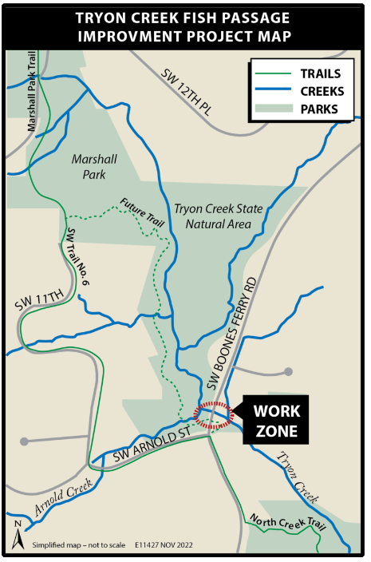
Presentation Outline
Location
Background
Project Goals
Outreach
Estimate & Schedule
Questions
Notes:
We have a short presentation with 5 slides that provide an overview on the Tryon Creek Fish Passage Improvement project.

Slide 3
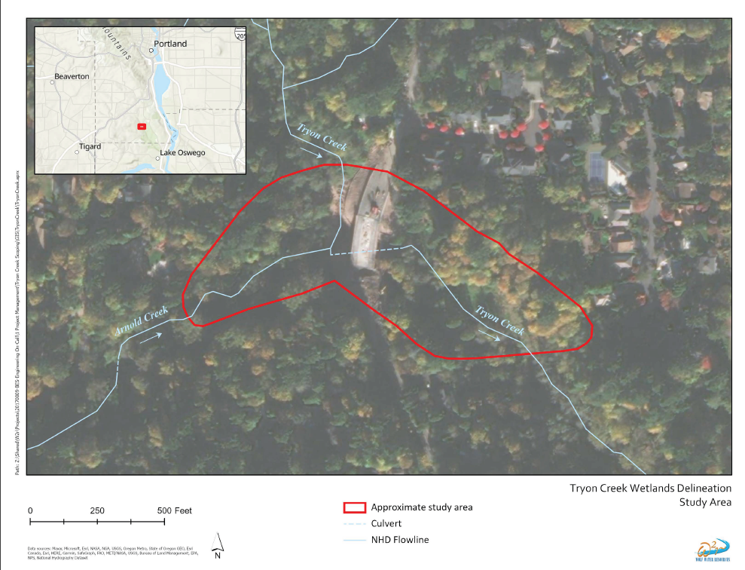
Project Location
Notes:
The project is located on Tryon Creek at the SW Boones Ferry Road crossing. Tryon Creek flows from the southwest in Portland to the southeast into the Willamette River in the City of Lake Oswego.
Arnold Creek enters Tryon Creek at the upstream end of the new Boones Ferry Road bridge.
Downstream of Boones Ferry Road, Tryon Creek flows through Tryon Creek State Park.

Slide 4
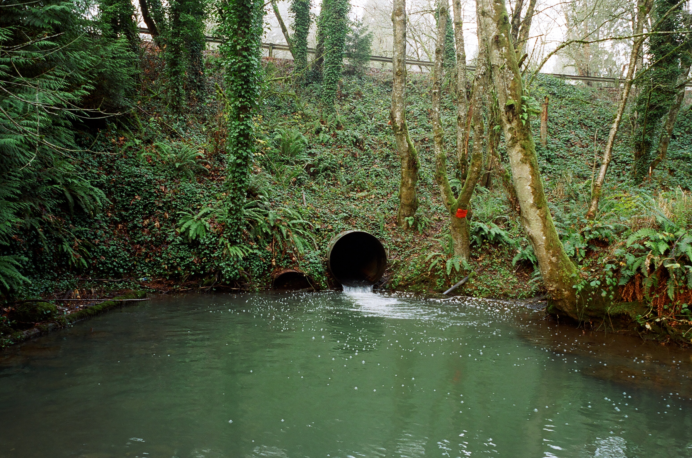
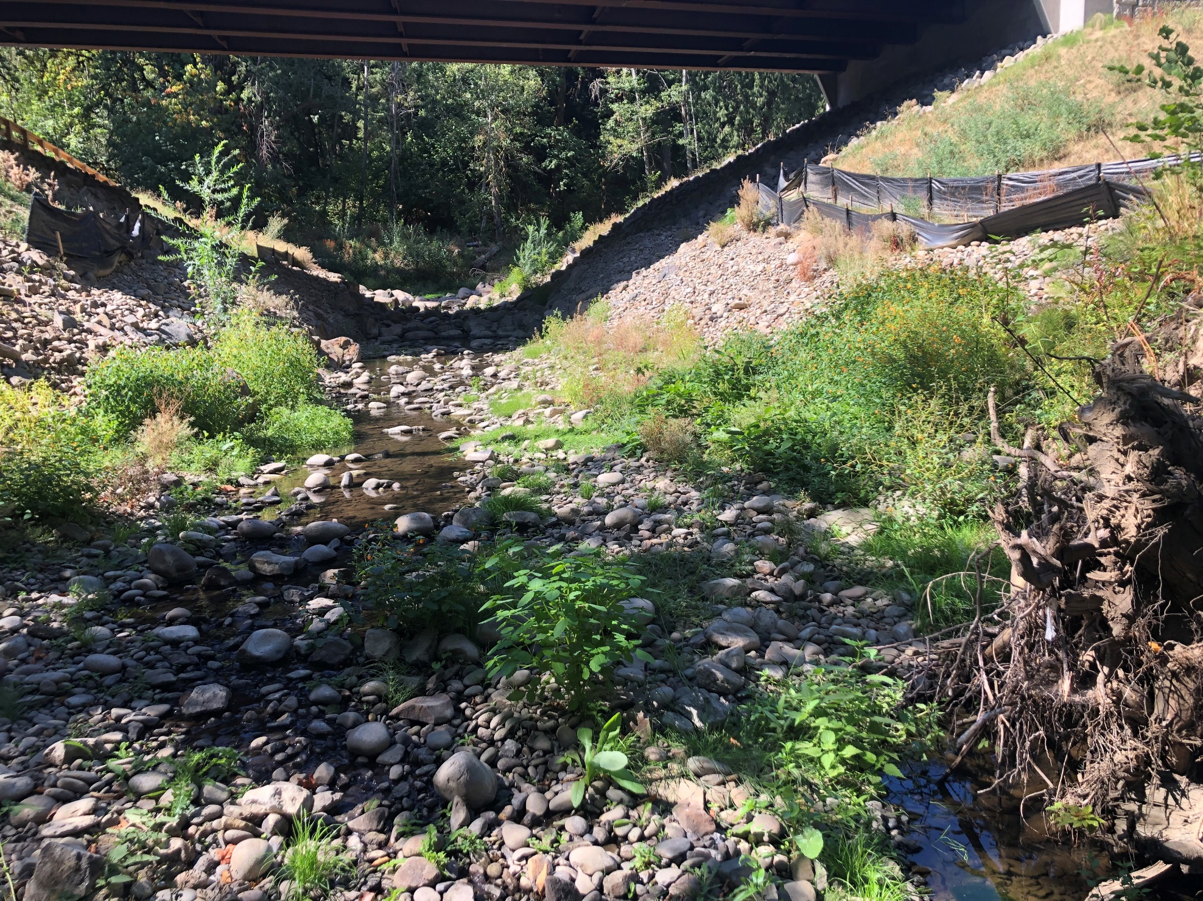
2020 project and Oregon DSL Consent Order
Before Bridge was built
After bridge built- during low flow
Notes:
In spring 2022, Environmental Services completed the Boones Ferry Bridge Project which removed an undersized culvert in Tryon Creek and replaced it with a new bridge, restoring connections for fish, wildlife, and people. While the creek is now flowing freely, the fish passage elements have not held up to severe flows, failing to meet Oregon Department of Fish and Wildlife’s (ODFW) fish passage requirements, and violating our permit with Oregon Department of State Lands (DSL). The City is now under a legally binding consent order with DSL to resolve permit violations by providing fish passage by September 2023. To comply, we will make improvements to ensure the creek is passable for fish species moving upstream to the areas opened by the bridge project.
Additionally, an 18" sewer pipe upstream of the bridge was re-exposed creating a public health risk along with a partial fish passage barrier at low flow.

Slide 5
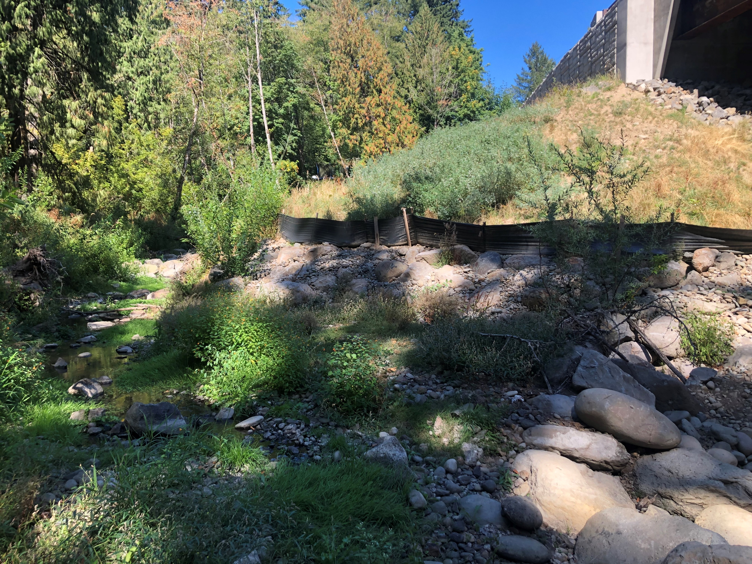
Project Goals
Provide fish passage per DSL Consent Order and ODFW approval
Bury exposed sewer pipe in stream channel
Stabilize channel and improve the natural process that allow erosive energy to dissipate
Augment fish and wildlife habitat
Enhance native plant communities
Notes:
Our project will meet ODFW requirements for fish passage per the DSL consent order.
Additionally, our project will incorporate natural processes to help dissipate energy, address active bed and bank erosion, and protect and re-bury the exposed sewer pipe. Our project will enhance riparian, wetland, and upland native plant diversity and structural complexity in areas of disturbance. We will incorporate natural elements like large wood and other native materials to help enhance habitat.

Slide 6
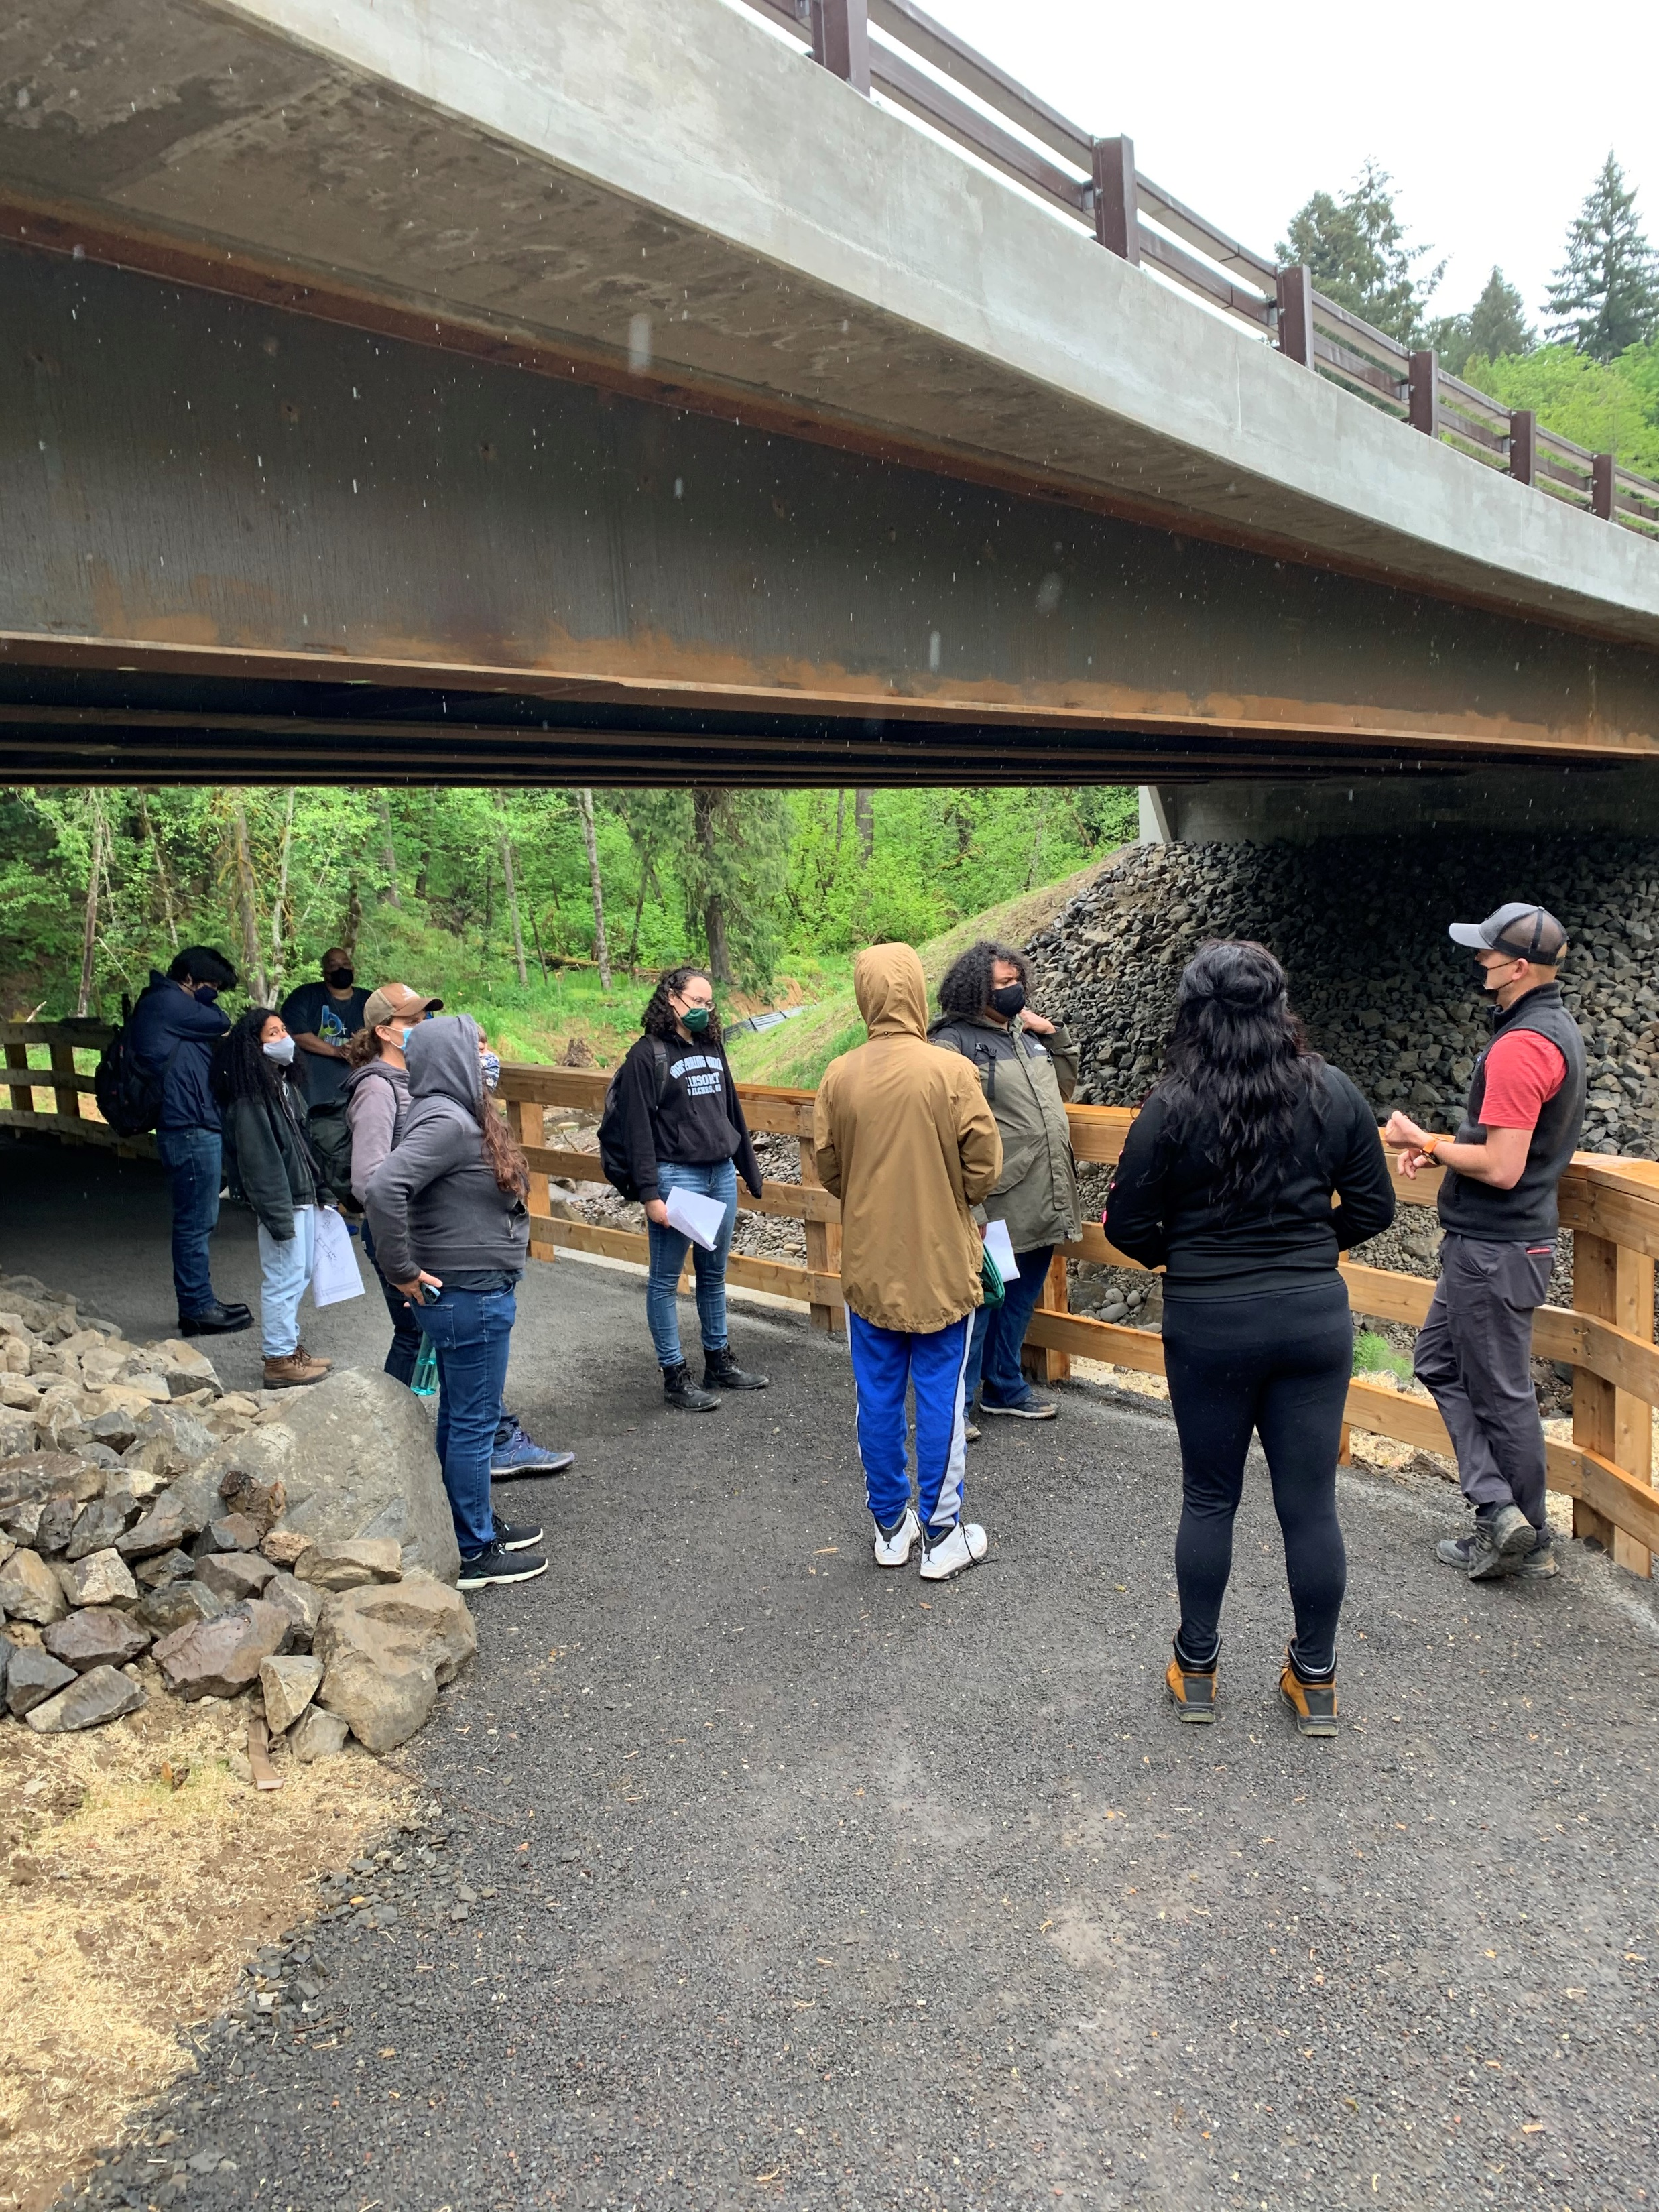
Community Outreach and Engagement
Project webpage
Project update mailers
Email updates
Social media posts
Focused outreach to adjacent property owners
Contact with PPS Transportation to coordinate any school bus impacts
Public presentations to Friends of Tryon Creek and the Tryon Creek Watershed Council
Individual correspondence to answer community questions, take input, and address concerns.
Notes:
Regular monthly updates to Tryon Creek Watershed Council at their board meetings (which includes Arnold neighbors and Friends of Tryon and West Multnomah Soil & Water Conservation District). We gave the board a tour last year.

Slide 7
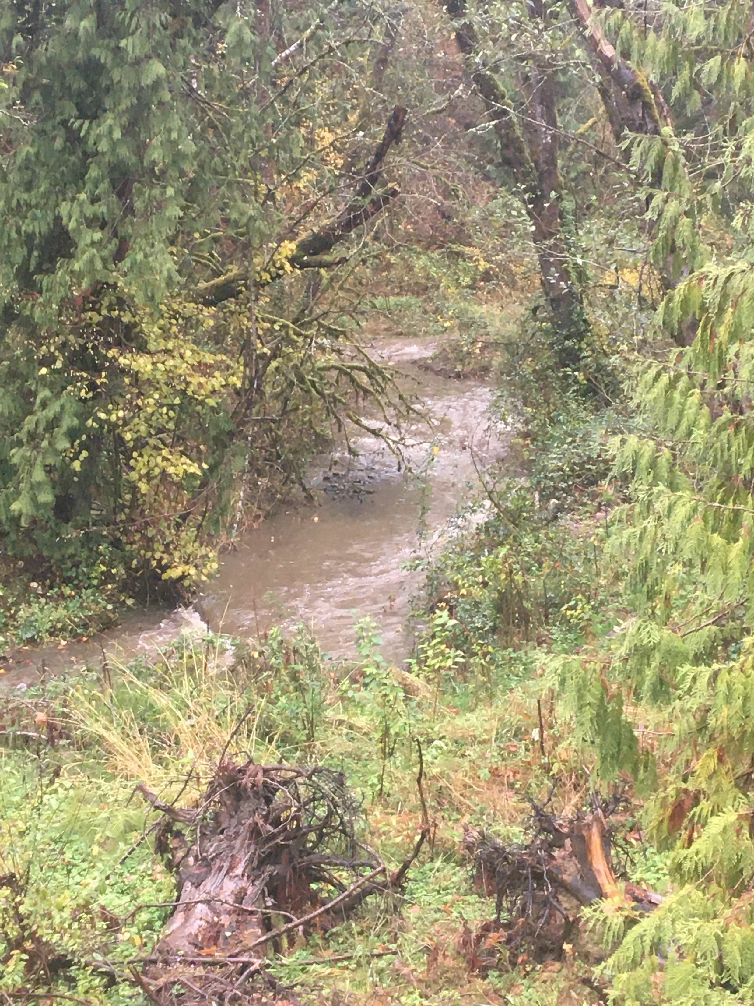
Engineer’s Estimate & Schedule
Engineer’s Estimate:
$1,247,000
High Confidence Level
Advertise Project:
February 2023
Begin Construction:
June 2023
Construction Duration:
5 months
Consent Order Deadline:
September 2023
Notes:
The estimated construction cost for this project is $1,247,000. This estimate has a high level of confidence and is based on final construction drawings.
The project is scheduled to Advertise in February 2023 and begin construction in June 2023. Construction can only take place during an In Water Work Window regulated by ODFW for migratory fish protection. It is important to align construction with this window and construction is estimated to last approximately 5 months, meeting the September 2023 consent order deadline.

Slide 8
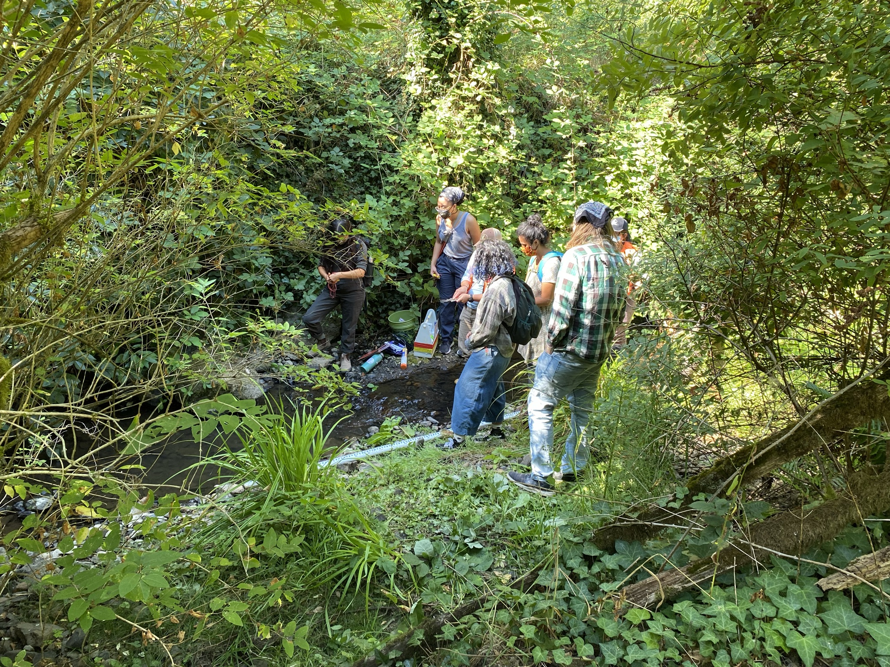
Thank You!
Contact:
ali.young@portlandoregon.gov

