Slide 1
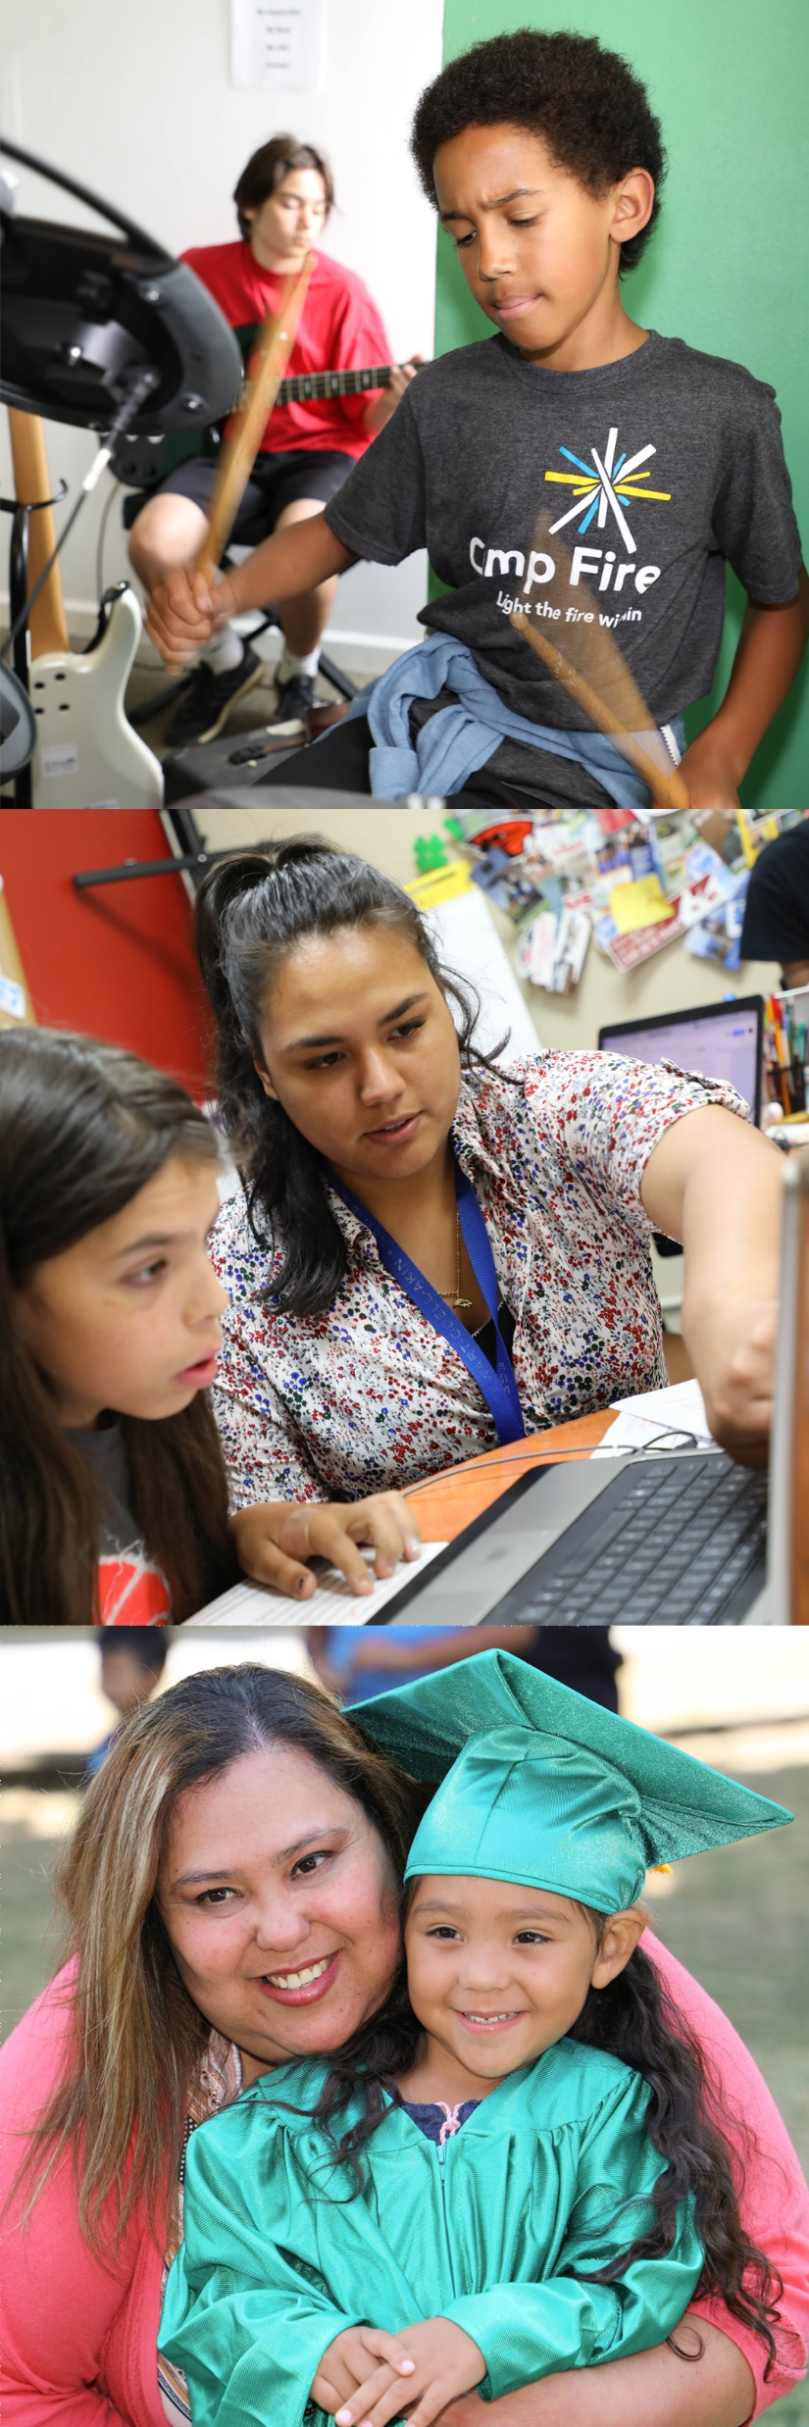

City Council
February 15, 2023

Slide 2

Overview
Portland Children’s Levy (“PCL”) is a local option property tax measure
Grew out of a need to increase opportunities for all Portland’s children and youth
First passed in 2002; overwhelmingly renewed by voters 3 times
83% of voters approved the 2018 renewal
Invests $23 million annually in proven programs
Tax rate = $0.4026 (4.062¢) per $1,000
Currently funds 91 programs for children from birth thru 24
Administrative costs limited to 5%; audited annually

Slide 3
Mission
The Portland Children’s Levy strives to:
Change the trajectory of the disparities in outcomes for children and youth navigating poverty and children and youth of color
By supporting community-based programs that help:
    Prepare children for school,
    Support them to be successful in and out of school, and
    Eliminate racial and ethnic disparities in child and youth outcomes.

Slide 4
PCL Governance
5-Member Allocation Committee sets policy and oversees implementation
All grants recommended by Allocation Committee are reviewed and approved by City Council
Grants are made through a competitive process
Grant performance metrics include number of people served, level of service, participation and participant outcomes, alignment with PCL mission

Slide 5
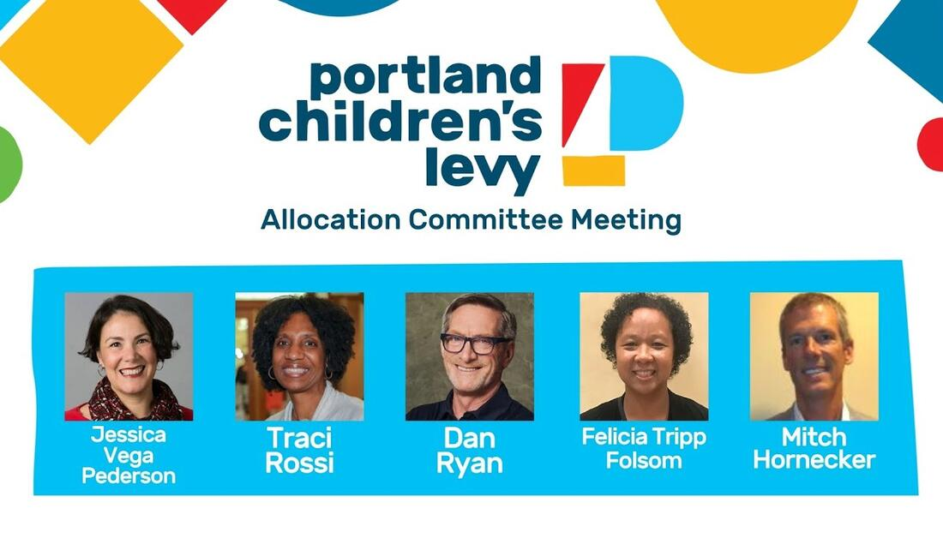
PCL Allocation Committee

Slide 6
PROGRAMS & GRANTEES

Slide 7
Programs
Currently funds 91 programs for children and youth, from birth through age 24, in six program areas
Program services include:
  Home visiting for young children and their parents
  Therapeutic classrooms and respite care for stressed families
  After-school tutoring and enrichment
  Caring adult mentorship that provides group and 1:1 support for youth
  College and career transition support for foster youth
  Daily access to nutritious food

Slide 8
Community-Based Agencies
Supports more than 45 community-based agencies including:
  Ethiopian and Eritrean Cultural Resource Center
  Elevate Oregon
  Immigrant and Refugee Community Organization
  Latino Network
  Lifeworks NW
  Metropolitan Family Service
  Native American Youth and Family Center
  Self Enhancement, Inc.
  PCL-funded programs support 750+ jobs at community-based agencies.
  Many PCL grantees provide first employment experiences for parents and youth who were once program participants.

Slide 9
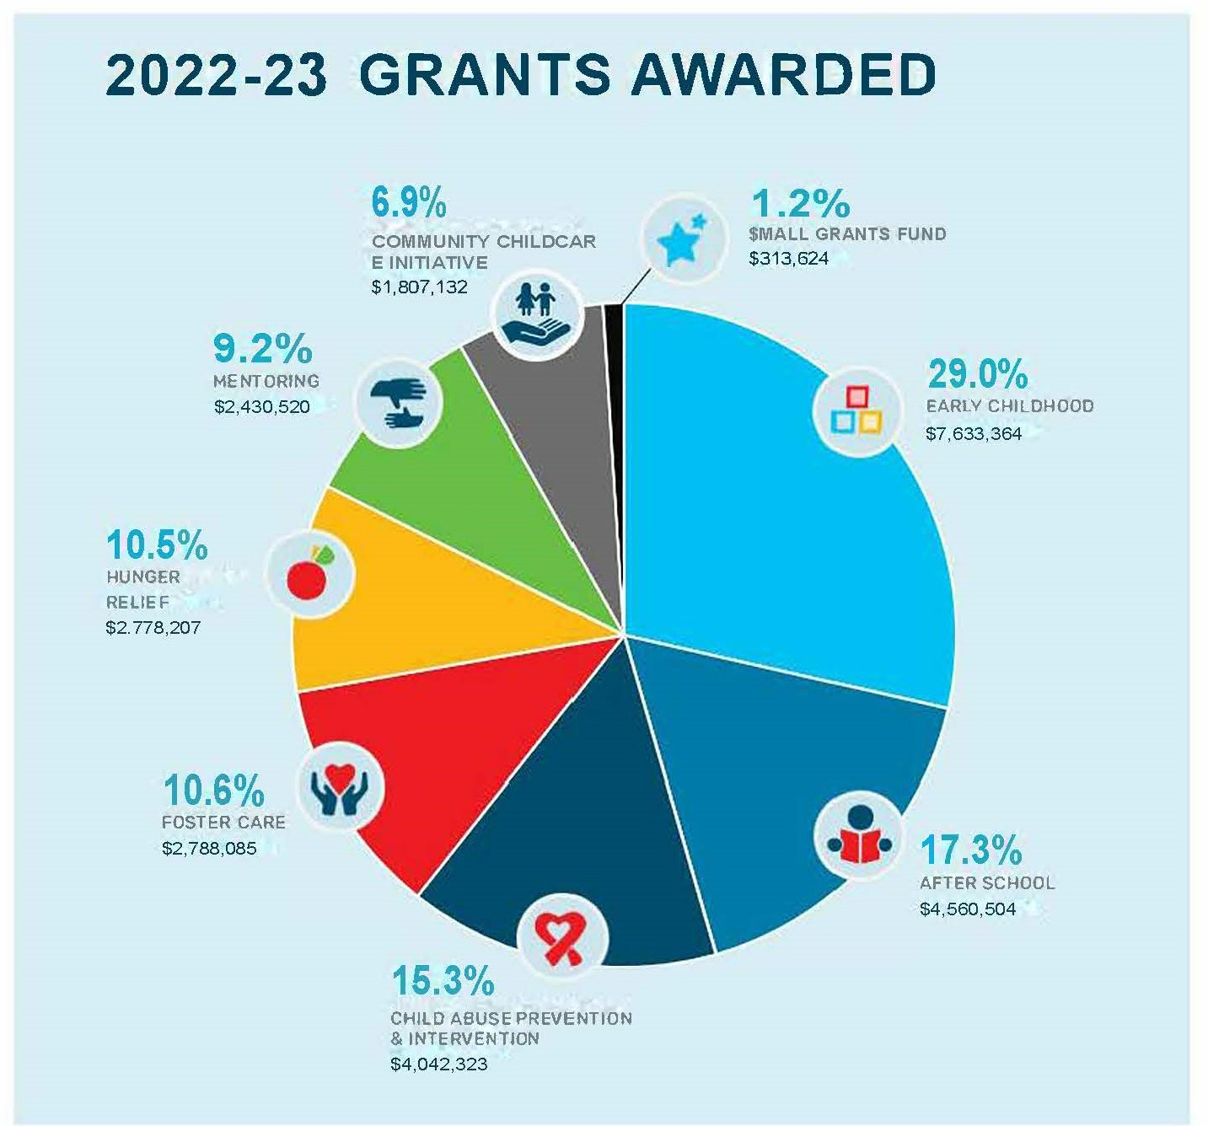

Slide 10
POPULATIONS SERVED

Slide 11
Populations Served
Average of 10,000 children served annually (non-hunger relief)
  75-80% identify as Black, Indigenous or children/youth of color
  35-40% live/go to school in East Portland
  40-45% from homes where primary language is not English
12,000-17,000 children and families receive hunger relief services
Notes:
Demographic data here reflects ranges from data collected 2018-19 through 2021-22.
Approximately 10,000 children are served annually in early childhood, child abuse prevention, foster care, aftershool, and mentoring programs; annual service numbers vary depending on programs funded. The pandemic impacted the number of children served.
12-17,000 children and their families receive hunger relief services annually. In the first year of the pandemic, 20,000 children received hunger relief/emergency food services from PCL-funded programs.
90-95% of children are from families with an income of 185% of the federal poverty level or less (low income)
Levy programs are supporting our community’s most vulnerable children and families

Slide 12
Population Served: Race/Ethnicity

Slide 13
Population Served: Primary Language
Notes:
Languages in pie chart are those that OHER/COP requests bureau track/report
12% of children serve: no language data reported
Grantees reported over 50 other primary languages spoken in the home: Akateko, Amharic, Arabic, Burmese, Cambodian, Chuj , Creole, Dari, Eriterian, Farsi, French, Fulani, Hadiyya, Haitian, Hausa, Hindi, Hmong, Iu Mien, Japanese, Kachin, Karen, K'iche, Kirundi, Korean, Krio, Kunama, Kurdish, Lao, Maay-Maay, Malay, Mayan, Mien, Mixteco, Oromo, Palauan, Pashto, Pohnpei, Portuguese, Purpecha, Quiche', Rohingya, Santali, Serbian, Swahili, Tagalog, Telugu, Thai, Tigrinya, Tongan, Tzotzil, Urdu, Zapoteco, Zomi
other languages, over 50 languages reported

Slide 14
OUTCOMES

Slide 15


Outcomes, 2021-22
Program Area | Results for some Common Outcomes
Early Childhood | 87% of children met expected developmental milestones.
Early Childhood | 91% of children not on track with developmental milestone(s) referred for additional support.
Early Childhood | 97% of parents/caregivers met parenting goals.
Child Abuse Prev.& Interv. | 86% of parents met parenting practice goals.
Child Abuse Prev.& Interv. | 86% of parents reported increased safety and stability.

Slide 16



Outcomes, 2021-22
Program Area | Results for some Common Outcomes
Foster Care | 96% of youth met academic goals.
Foster Care | 100% of youth met positive youth development goals.
After School | 95% of children & youth met youth development outcomes.
Mentoring | 97% of youth met school engagement outcomes.
Small Grants | 92% of youth met academic goals.

Slide 17
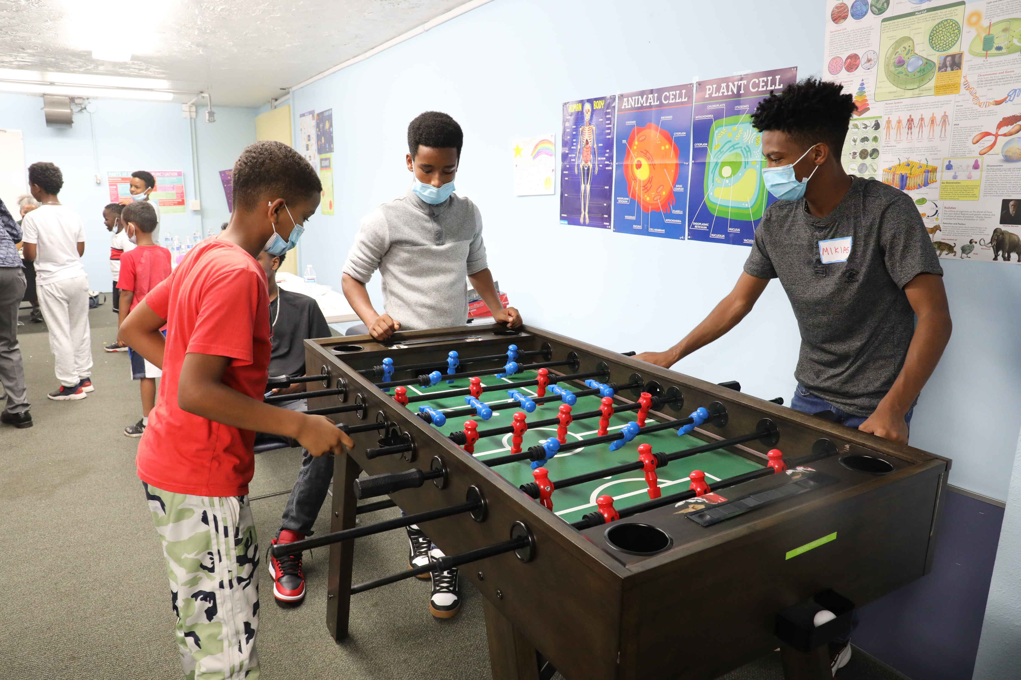
COMMUNITY ENGAGEMENT

Slide 18
Community Engagement
PCL Response to Community Feedback:
  Created small grants fund to improve equitable access to Levy funding for smaller organizations with barriers to applying for PCL grants
  Created 12-member Community Council to advise staff and Allocation Committee on community engagement practice, policy and funding
    Volunteers for this Committee represent and have experience with PCL-served communities:
      BIPOC
      LGBTQIA+
      Children and youth with disabilities
      Houseless families, and
      Families experiencing poverty and food insecurity

Slide 19
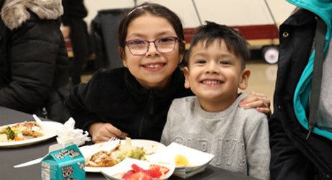

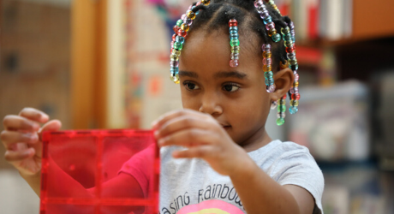
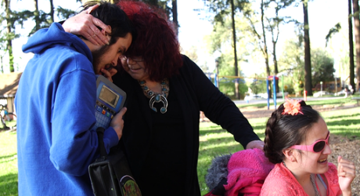
BUDGETING & THE FUTURE OF PCL

Slide 20


PCL Historical Budget Data
FISCAL YEAR | PCL REVENUE (millions) | AMOUNT GRANTED (millions) | TOTAL NO. OF GRANTS | PCL ADMIN COSTS (audited yearly by independent third-party)
2018-2019 | $21.7 | $19.0 | 74 | 4.65%
2019-2020 | $21.9 | $19.2 | 70 | 4.69%
2020-2021 | $22.3 | $23.8 | 85 | 4.70%
2021-2022 | $22.8 | $27.0 | 92 | 4.68%

Slide 21
Funds Raised v. Grants Awarded
Before a competitive funding round, City economist projects revenues for the grant period.
Fund balance can accrue when revenues exceed projections, and/or grant budgets are not fully expended.
Grant contracts are paid on a reimbursement basis; staffing shortages impact grant spending.
Before the 2019-20 funding round, the full fund balance accrued to date was added to projected revenues for allocation in the funding round.
The pandemic-related staffing shortages impacted grant spending in FY 2021 and 2022 which resulted in fund balance declining more slowly.

Slide 22
5-Year Priorities & Long-Term Financial Outlook
Revenues include an allocation from the Parks Levy to PCL to offset increased compression of PCL
Levy revenues are projected to be sufficient to meet current grant commitments and projected 2-year renewal grants through 2024-2025, assuming voter renewal of PCL
Upon voter renewal, PCL resources should be sufficient to maintain current program investment levels over next 5 years.

Slide 23
Post-Pandemic Need is Great
Children and youth struggled to maintain academic achievement, school attendance, social skills and connections and mental health during the pandemic
Additional factors of increased houselessness and increased community violence add to disruptions in education
Post-pandemic, children and youth need community support more than ever

