Slide 1
Amendments to Recommended Draft: Changes to Outdoor Shelters
Prohibit outdoor shelters in greenway and river setbacks
Continue to apply the Johnson Creek Basin Plan District – South Subdistrict standards to outdoor shelters
Continue to apply standards for archeological resources in the Columbia South Shore and PDX International Airport Plan Districts and the River Overlay Zone
Replace documents (see next slide)
Notes:
SANDRA
The amendment contains changes to standards for outdoor shelters to better protect greenway, environmental, and archeological resources.
As shown on the slide, the amendment is in four parts. The actual changes to the code language are shown in the Shelter to Housing Continuum – Part 2 – As-Amended Draft that is linked to this item on the Council agenda.
I will discuss these in more detail at the end of the presentation.

Slide 2
Part D – Replace documents attached to the ordinance to reflect Parts A-C:
Replace Exhibit A – Findings, dated January 19, 2023 with the As-Amended Findings, dated February 6, 2023
Replace Exhibit B – Shelter to Housing Continuum – Part 2 - Recommended Draft dated January 19, 2023 with the Shelter to Housing Continuum -Part 2 -As-Amended Draft, dated February 2023.
Amend finding 22 and 23 and directives a, b, and c to refer to the As-Amended Draft dated February 2023
Notes:
SANDRA
Part D of the amendment is to replace the documents shown on this slide with new documents that reflect Part A-C of the amendment.
Commissioner Rubio…thank you for moving this amendment. We appreciate you making this important change.

Slide 3
City Council
Hearing
Feb 8, 2023
Technical Amendments Package
Sandra Wood
JP McNeil
Notes:
SANDRA
Good afternoon, Mayor and Commissioners.
We are here today to hold a hearing on the Shelter-to-Housing Continuum Project.
This project was recommended to you by the Planning and Sustainability Commission.
The proposal includes technical zoning code amendments to rules that were adopted by City Council in April 2021.
My name is Sandra Wood and with me today is JP McNeil. We are both planners with the Bureau of Planning and Sustainability.

Slide 4
Shelters are allowed:
Long-Term / Permanent
Temporarily during a designated emergency (for the duration of the emergency)
Temporarily without a designated emergency (up to 180 days)
Notes:
SANDRA
The Shelter to Housing Continuum (“S2HC”) project, passed by Council in April 2021, created flexibility in siting shelters and expanded the City’s ability to site shelters as a permanent use.
As a reminder, shelters can be operated by a variety of providers – the City, the County, non-profit and religious organizations.
This slide shows the three ways shelters are allowed – permanently, temporarily during a designated emergency and temporarily without a designated emergency.
Prior to S2HC, most outdoor shelters, such as Safe Rest Villages, could only be sited as temporary emergency activities under the Zoning Code.
The project created a pathway for shelters to be built and operated without the need for an emergency declaration.
As shelter providers began to develop long-term shelters, such as Kenton Women’s Village, the new code has presented some unexpected technical barriers to implementation.
This project fixes those technical issues.
BACK POCKET:
These amendments are NOT needed to site temporary outdoor shelters.
The Zoning Code already allows all shelters, including Safe Rest Villages, as temporary activities for the duration of an emergency and for up to 180 days per year without an emergency.
The proposed amendments do not change that allowance.

Slide 5
Community Involvement
Housing Continuum Workgroup discussion
District coalitions and neighborhood groups meetings - September/October 2022
Safe Rest Village and Joint Office of Homeless Services - ongoing
Public notices mailed —September 2022
Public hearing at the PSC — October 11, 2022
Public hearing at City Council— February 8, 2023
Notes:
SANDRA
During the project we conducted community outreach.
Most notably, we met with the Joint Office of Homeless Services and with the Safe Rest Village program team in Commissioner Ryan’s office.
I’ll pass the slides to JP to present the proposal.

Slide 6
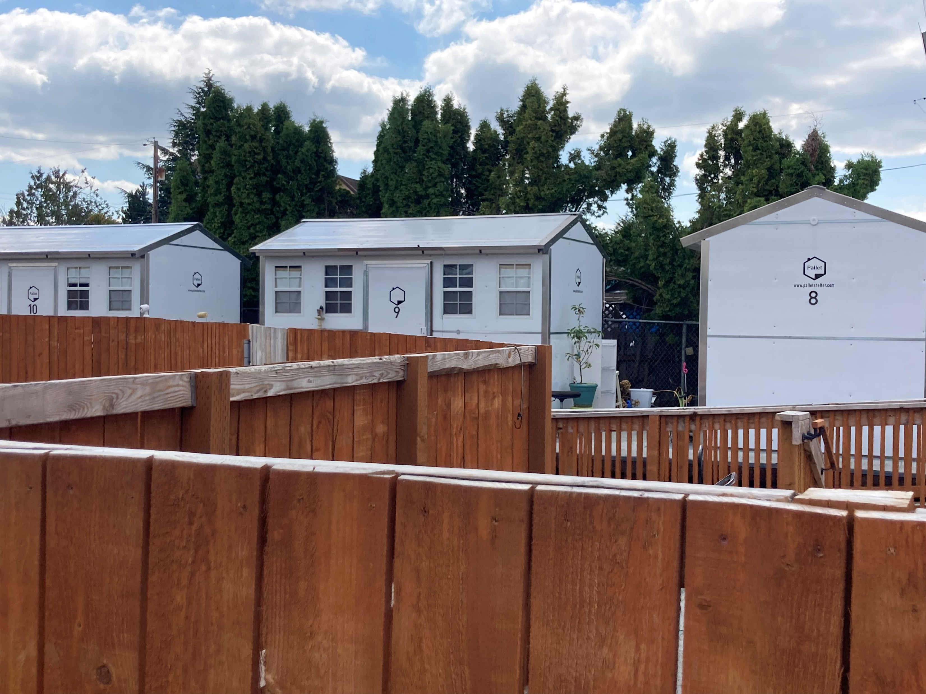
Recommended Zoning Changes
Key change:
Outdoor shelter standards*
Additional changes:
Outdoor shelters siting rules
Sites with conditional uses
Temporary activities rules
Notes:
JP:
Thanks Sandra. Introduce
The recommended draft includes four proposals, one of which is really the key change with this project and the other additional changes are more technical in nature.
The first proposal, the key change, is an amendment to exempt shelters from base zone, overlay zone, and plan district development standards. So, the proposal creates a blanket exemption and Instead, we’ve created a limited set of standards specific to outdoor shelters for maximum height, setbacks and screening.
Note the asterisk is to flag that the amendment proposed by Commissioner Rubio includes some changes to this proposal.
The second change is amendments to clarify how large of an Industrial site an outdoor shelter can occupy.
The next proposal includes amendments to exempt outdoor shelters that are allowed uses on a site with an existing CU in some cases from an additional CU review.
Finally, there is a proposal to clarify how shelter operations are regulated under the Temporary Activities chapter.

Slide 7
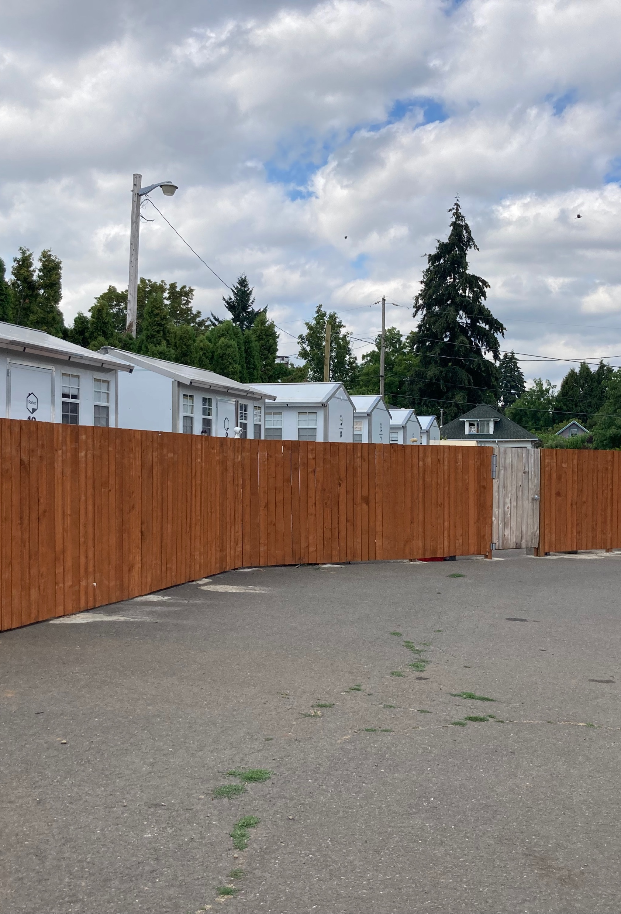
Outdoor Shelter Standards
Blanket exemption to base zone, overlay zone and plan district standards
Create outdoor shelter standards for:
Height – 20 feet
Setbacks – 5 feet from all adjacent properties
Screening – Modify screening standards to allow a partially sight-obscuring 6-foot fence
Notes:
JP:
To dig in to the proposals a little deeper:
This key change would grant a blanket exemption to base and overlay zone and plan district standards, with some exceptions that Sandra mentioned that are included with Commissioner Rubio’s amendment, and instead create a limited set of standards that outdoor shelters must meet in all zones. These are:
Height – create a standard that structures for an outdoor shelter cannot be more than 20 feet tall. Currently no height standards specific to outdoor shelters.
Setbacks – This proposal is for a setback of 5 feet from all adjacent properties . This is a change from the adopted S2HC code. Under the current rules, outdoor shelters abutting residentially-zoned properties must be setback 25-feet from the property line.
What we heard from shelter providers is that these large setbacks make it impractical to impossible for small-scale shelters on smaller lots because too much of the site is given over to these setbacks. The 5-foot setbacks are more aligned with the typical setback size.
Screening: The original S2HC code included screening standards to include a 6-foot fully obscuring fence. We are proposing to change that standard to allow for 6-foot partially-obscuring fences (NEXT SLIDE)

Slide 8
Notes:
JP:
Here you can see a diagram of the two types of fences. What we’ve heard from shelter operators is a general preference for the totally-sight obscuring fence as they provide more privacy and security than chain-link fences. If you to look at most of the outdoor shelters that are operating today you will see mostly 6-foot, fully sight-obscuring wooden fences surrounding them.
This change is being proposed to give more flexibility as there have been some cases where there is an existing chain link fence on a site. It is far less costly and wasteful to allow operators to keep the existing fence and modify it with plastic slats for a partially sight-obscuring fence rather than remove the chain link fence and install a wooden fence. A partially sight-obscuring fence still meets the intent of providing some privacy and security but at a much lower cost.

Slide 9
Outdoor Shelter Sites
Clarifies that outdoor shelters can be located on sites larger than 2 acres in Industrial Zones
Notes:
JP:
These next three proposals are additional technical amendments.
This amendment brings the size limitation for outdoor shelters in industrial zones into alignment with the original intent of the S2HC project. The intent of the maximum size limitation was to limit the size of the outdoor shelter itself to 2 acres but not necessarily to exclude sites larger than 2 acres in size from hosting an outdoor shelter. In industrial zones, sites tend to be large, and in many cases are much larger than 2 acres. The use of the words “site size” versus “size” in the adopted amendment changed the meaning of the limitation. This proposal clarifies that the outdoor shelter area is limited to 2 acres on an industrial property but the site itself can be larger. An example of this would be say an unused portion of a parking lot on an industrially-zoned site.

Slide 10
Conditional Use Sites
Exempt outdoor shelters on sites with a CU in some cases:
Adding floor area
Adding exterior activity area
Removing up to 50% of parking
Notes:
JP:
This proposal would exempt outdoor shelters from CU review in some cases on sites with an existing CU approval. This is modeled after affordable housing CU exemptions that were added with EOAH project several years that allowed institutional uses to add affordable housing their sites.
What we’re talking about here are shelters on sites with a Conditional Use
Example is church in a residential zone that wants to add outdoor shelter, which is an outright allowed use up to a certain size
Originally this church would have received CU approval through CU review that would have included conditions specific to that site, such as conditions for a certain number of parking spaces or hours of operation
Typically, when changes are made to a site with a CU, there are certain thresholds that trigger another CU review, e.g. changes to parking, size of the operation or use
This proposal raises the threshold for shelters needing a new CU review
The cases in which a CU review would not be triggered are:
READ SLIDE
In all other cases where a CU is triggered, the review would be required

Slide 11
Temporary Activities Rules
Clarifying the rules for shelters operated as temporary activities on parking areas
Clarifies that temporary structures can be added to a site for shelters operating under the Temporary Activities chapter
Notes:
JP:
These amendments clarify the rules for shelters operated as a temporary activity. – This is different from the outdoor shelters that we’ve been talking about, which are permitted as permanent uses.
As Sandra noted earlier, the Temp Activities chapter allows shelters to operate for up to 180 days as a temporary activity. This proposal does not change that but makes some clarifications to the rules for shelters operating under these provisions.
The first clarifies that parking areas can be used for shelters operating as a temporary activity.
The second has to do with allowing things like mobile units with a temporary activity.. This says you can have temporary structures with a temporary activity. Previously BDS was interpreting the code as written to prohibit that
Back pocket parking: This language clarifies that an outdoor shelter can occupy a parking area on a site. The existing language was ambiguous and could be read to meant that an outdoor shelter is prohibited from occupying a parking area.

Slide 12
Amendment to Recommended Draft: Exceptions to Outdoor Shelter Standards
Notes:
JP
Those were the proposals in the Rec Draft. As Sandra and Commissioner Rubio described, there is a proposal to add exceptions for outdoor shelter standards
The recommended approach created a set of simplified standards for outdoor shelters.
It includes a blanket exemption to zoning standards that created a few gaps for important resources that we want to protect.
These are standards relate to greenway, environmental and archeological protections.

Slide 13
Part A: Greenway and River Setbacks
Prohibit outdoor shelters in greenway and river setbacks
Amend 33.285.050.C.1
C. Outdoor shelters. Outdoor shelters are exempt from development standards in base zones, overlay zones, and plan districts. Outdoor shelters are subject to the following standards:
1. An outdoor shelter is prohibited in the following:
a. Environmental overlay zones;
b. Pleasant Valley Natural Resource overlay zone;
c. River Natural overlay zones;
d. River Environmental overlay zones;
e. Scenic overlay zone; and
f. Within and riverward of the greenway setback;
g. Within and riverward of the river setback; and
fh. The special flood hazard area.
Notes:
JP
These apply along the Willamette River.
This adds those areas to the list of areas where outdoor shelters are prohibited
Part A.
The greenway and river setbacks apply along the Willamette River and generally exist to ‘Protect, conserve, enhance, and maintain the natural, scenic, historical, economic, and recreational qualities of lands along” the Willamette River and “Increase public access to and along the Willamette River for the purpose of increasing recreational opportunities, providing emergency vehicle access, assisting in flood protection and control, providing connections to other transportation systems, and helping to create a pleasant, aesthetically pleasing urban environment” While much of these setback areas are already protected in the by some sort of environmental designation, in which shelters are prohibited, some are not. Exemption from these standards could allow outdoor shelters within these setbacks which should continue to be preserved for their natural, scenic, and recreational qualities. This amendment proposes to add the greenway and river setbacks to the list of areas where outdoor shelter are exempt, such as the environmental zones and the special flood hazard area.

Slide 14
Part B: Johnson Creek South
Continue to apply the Johnson Creek Basin Plan District – South Subdistrict standards to outdoor shelters
Proposed amendment:
Add 33.285.050.C.9
9. An outdoor shelter located in the South Subdistrict of the Johnson Creek Basin plan district is subject to the development standards in section 33.537.140.
Notes:
JP
These rules limit tree removal and impervious surfaces to capture or slow stormwater runoff and help to mitigate flooding and landslides in the Johnson Creek Basin.
Part B
JCBPD-SSD standards are intended to mitigate negative impacts from development in this area where there are higher than average risk of flooding and landslides in the hilly areas on the south side of the Johnson Creek in outer SE Portland. Similar to the greenway and river setbacks, much of this area is located within an environmentally-zoned area or in the 100-year floodplain, in which outdoor shelters are prohibited. For the portion of the subdistrict outside of those areas, the SSD standards limiting tree removal and the amount of new impervious surfaces work together to capture or slow runoff and thereby help to mitigate flood and landslide hazards in the SSD

Slide 15
Part C: Archeological Resources
Continue to apply standards for archeological resources in the Columbia South Shore and Portland International Airport Plan Districts and the River Overlay Zone
Proposed amendment:
Add 33.285.050.C.10
10. An outdoor shelter located in a River overlay zone, the Columbia South Shore plan district, or the Portland International Airport plan district is subject to the respective archeological resource protection standards of the overlay zones or plan districts.
Notes:
JP
These rules provide a process to survey areas with a high probability of having archeological resources prior to ground disturbing activities.
I’ll hand it back to Sandra for the next part
Part C
The archeological resource protection standards in the River Overlay Zone, Columbia South Shore Plan District, and the Portland International Airport Plan District provide a process to survey areas with a high probability of having archeological resources prior to ground disturbing activities and development to protect any identified archeological resources. Given the value of the resources and the importance of identifying and preserving them, these standards should continue to apply to outdoor shelters to protect these irreplaceable resources.

Slide 16
Part D: Replace Documents
Replace Exhibit A – Findings, dated January 19, 2023 with the As-Amended Findings, dated February 6, 2023
Replace Exhibit B – Shelter to Housing Continuum – Part 2 - Recommended Draft dated January 19, 2023 with the Shelter to Housing Continuum -Part 2 -As-Amended Draft, dated February 2023.
Amend findings 22 and 23 and directives a, b, and c to refer to the As-Amended Draft dated February 2023
Notes:
SANDRA
housekeeping

Slide 17
The Record of Evidence
There is 1 piece of written testimony in the Map App:
portlandmaps.com/bps/mapapp/proposals/#/shelter-to-housing
Additional evidence supporting this ordinance can be found on the Auditor’s Office website:
efiles.portlandoregon.gov/record/15371642
Notes:
SANDRA
housekeeping

Slide 18
City Council Action
Recommend that City Council:
Vote on the amendment;
Adopt the Shelter to Housing – Part 2: Technical Amendments-As Amended Draft; and
Amend the Zoning Code as shown in the Shelter to Housing – Part 2: Technical Amendments-As Amended Draft.
Notes:
SANDRA

