Slide 1


Slide 2
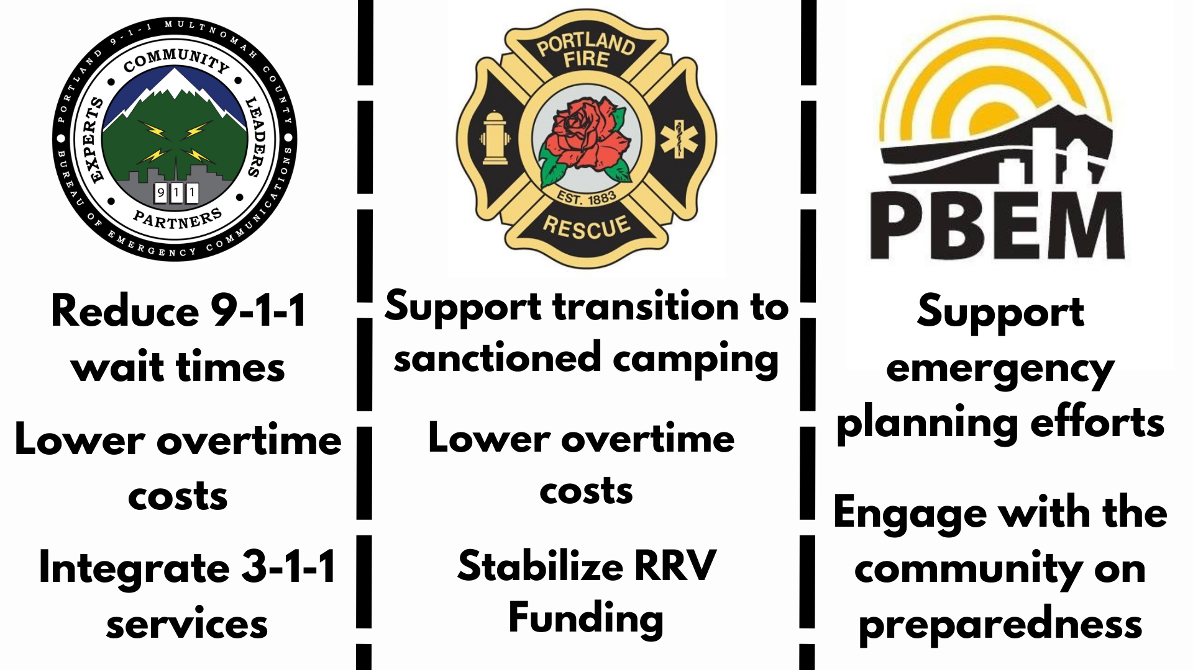

Slide 3
Homelessness

Slide 4

Evaluate All Bureau Policies – Are the Encouraging Move to Sanctioned Camps
Focusing in particular distribution of tents by Portland Bureaus

Slide 5
Evaluate Municipal Court

Slide 6
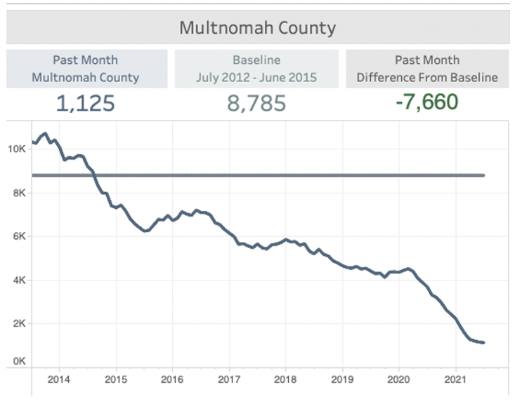
Multnomah County essentially stopped imposing prison sentences for property and drug trafficking offenses.
Source: Oregon Criminal Justice Commission (CJC) JRI dashboard for Multnomah County

Slide 7
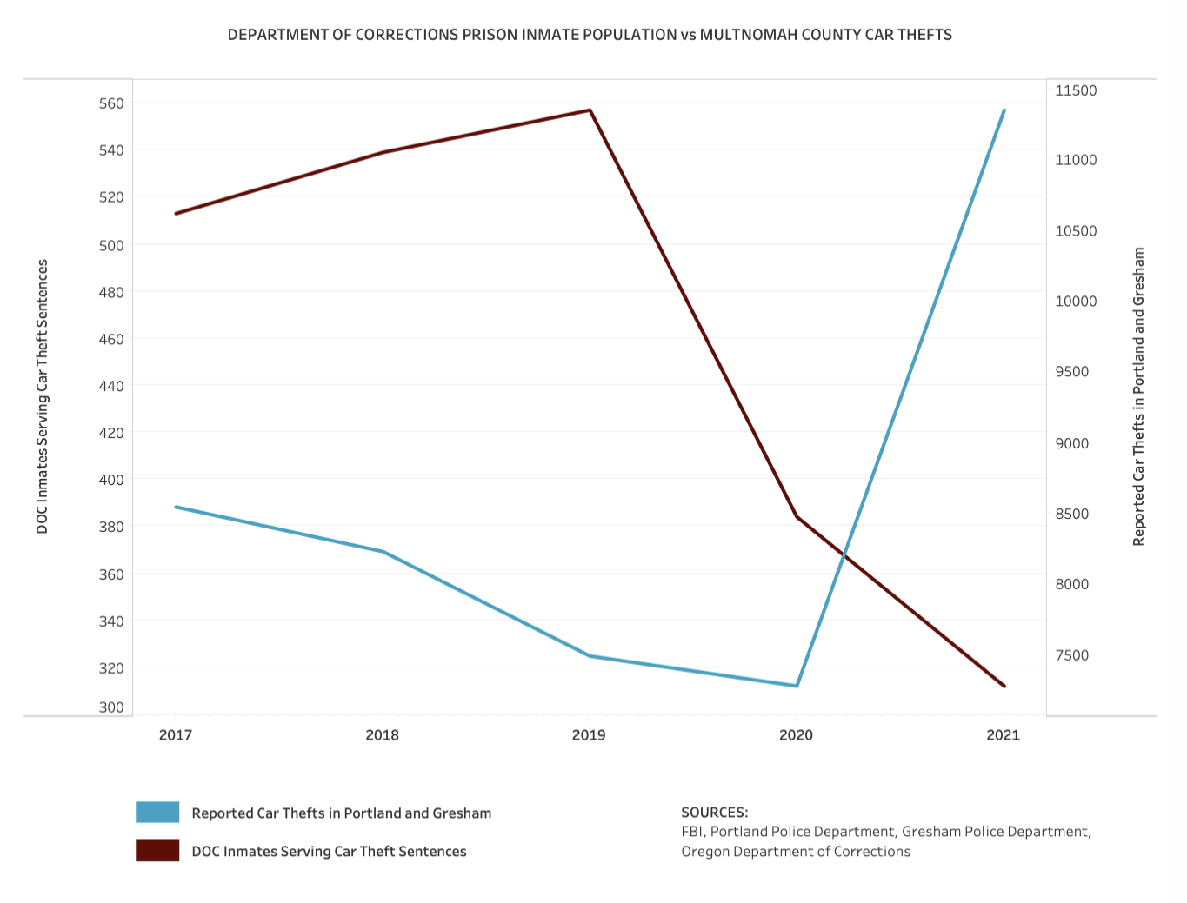
Car thieves in prison vs. car thefts
As the number of Oregon prison inmates serving car theft sentences has declined dramatically, the incidence of car thefts has increased dramatically.

Slide 8
Bookings into the County jail have decreased
Many fewer go to jail in Multnomah County.
Sources: 2005-2019 Multnomah County historical budgets and MCSO adopted budgets

