Slide 1

Surveillance Technologies binding resolution
City Council Public hearing
February 1st, 2023

Slide 2

What is this policy about?
This policy recognizes that technology can bring benefits and create harms. It directs the Smart City PDX program and the Office of Equity and Human Rights to implement baseline infrastructure for responsible use of surveillance technologies.

Slide 3
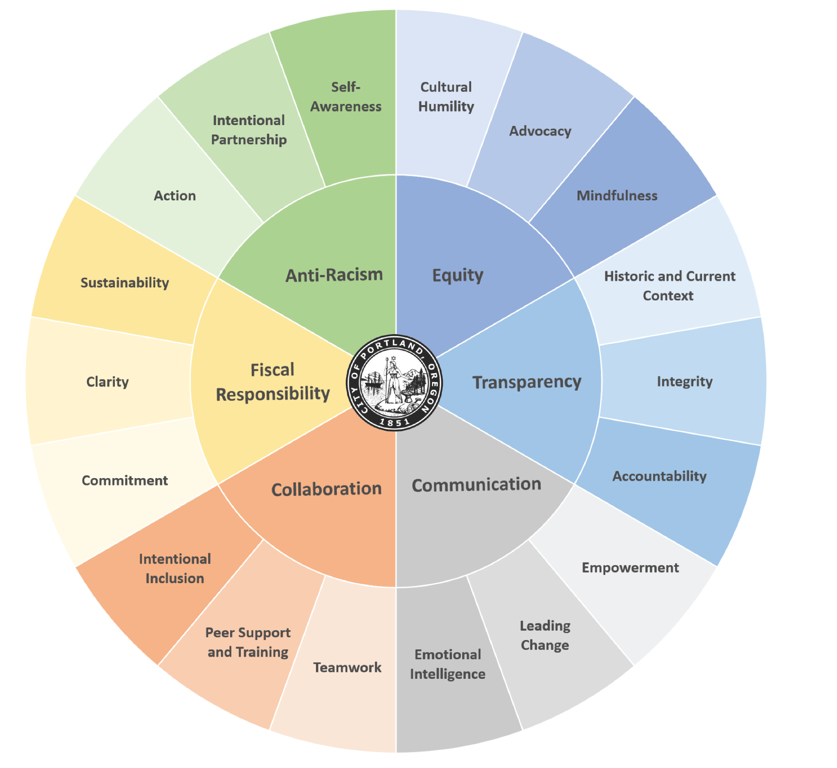
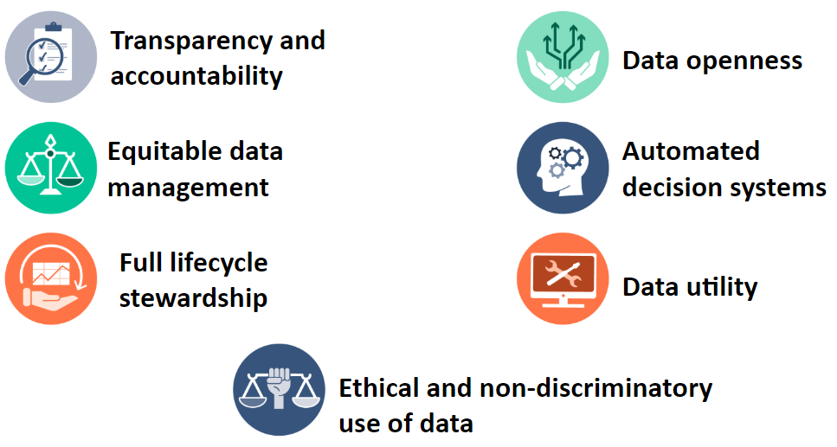
Privacy principles (2019) and Portland values

Slide 4
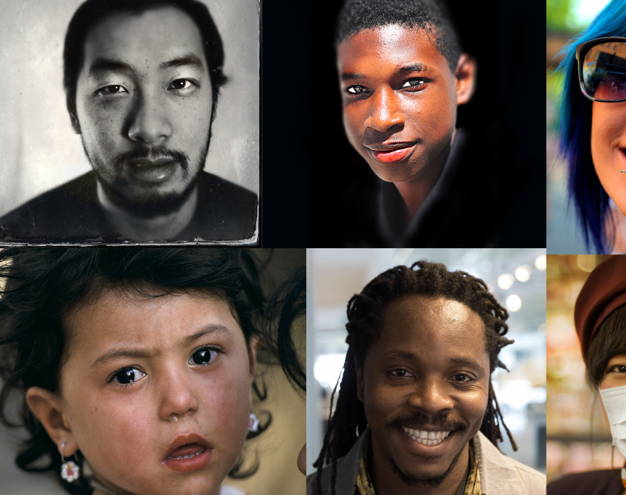
Privacy is a Human Right
Article 12. UN The Universal Declaration of Human Rights
No one shall be subjected to arbitrary interference with his privacy, family, home or correspondence, nor to attacks upon his honor and reputation.
Privacy is an evolving right

Slide 5
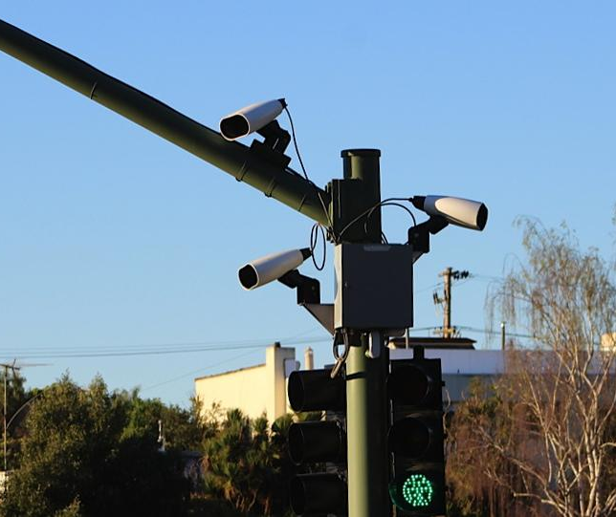
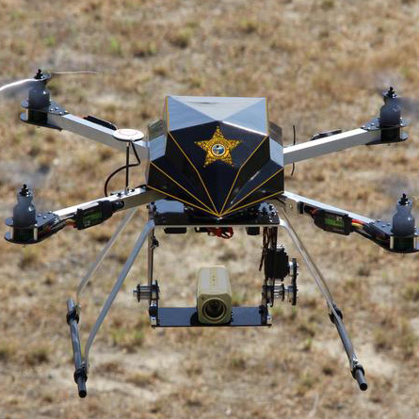
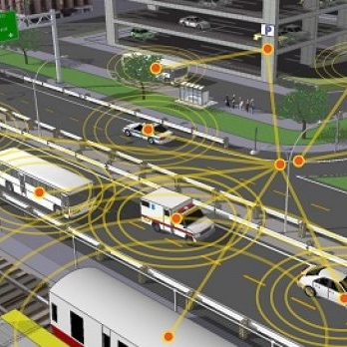
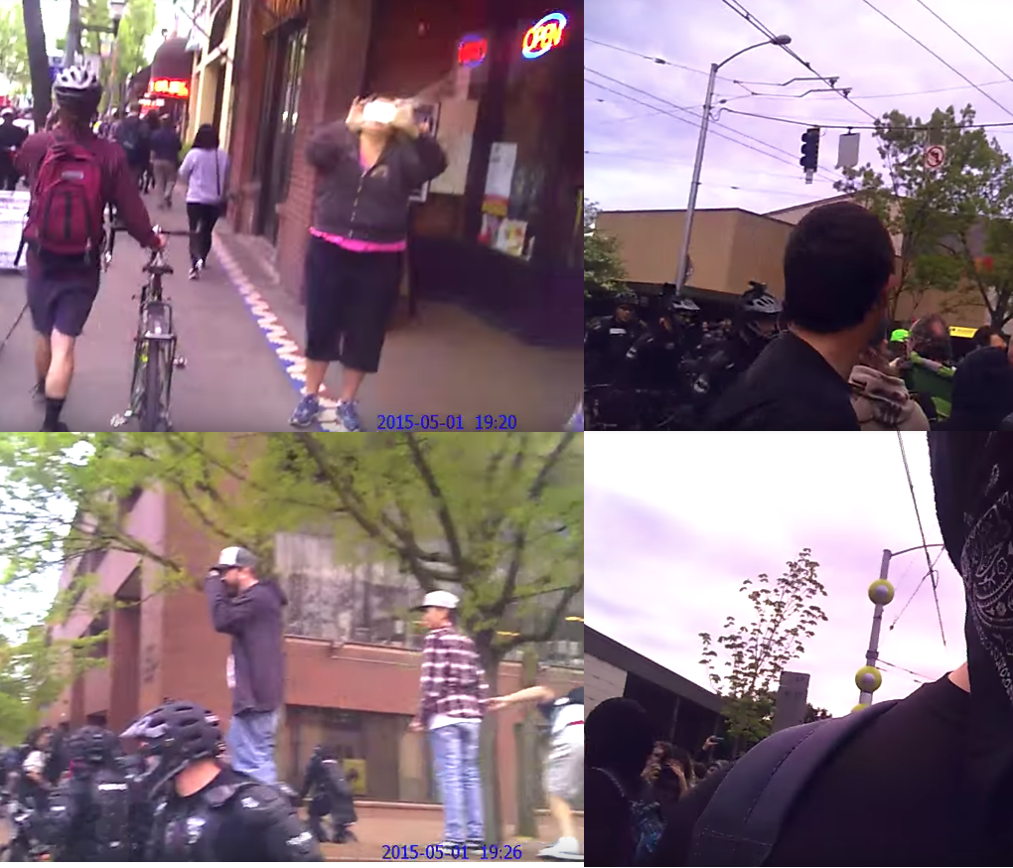
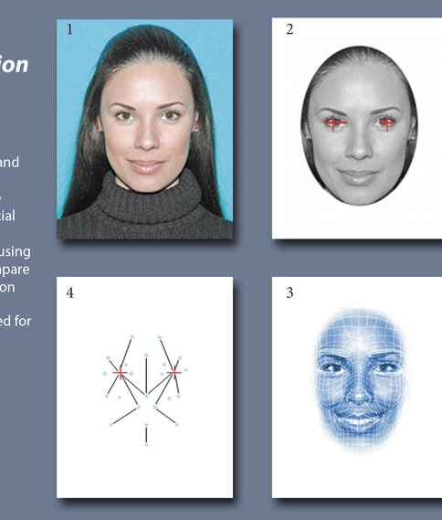
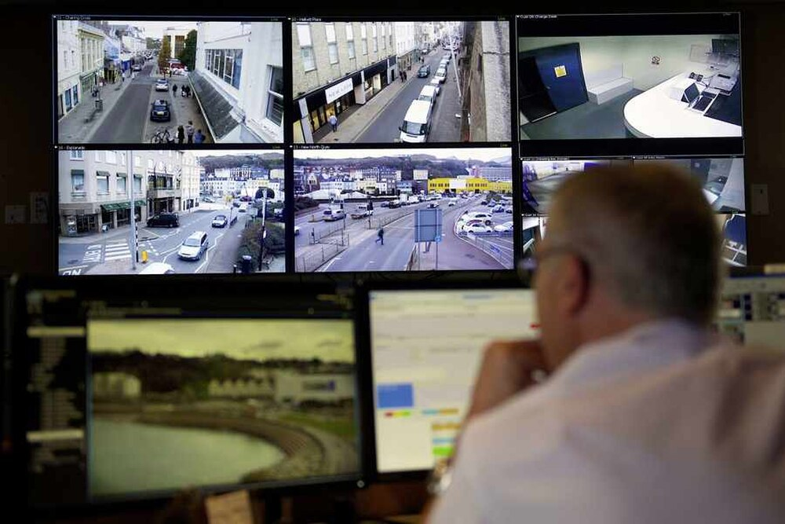
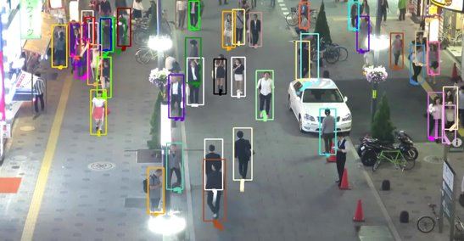
Smart or Surveillance City?
Surveillance technologies monitor and track behavior, activities, or information from a specific individual or group for the purpose of gathering information, influencing, managing or providing direction.
Notes:
Examples of Surveillance Technologies:
Automated License Plate Readers
Body worn cameras
CCTV and security cameras
Cell-Site Simulators/IMSI Catchers
Connected Transportation
De-Identification of Public Data
Digital Kiosks
Drones
Gunshot Detectors
Red light cameras
Facial Recognition
Geolocation Services
Public Broadband
RFID/Bluetooth sensors
Smart Cards/Payment
Smart Grid/Smart meters
Social Networks Monitoring
Environmental Sensors
Satellite imagery

Slide 6
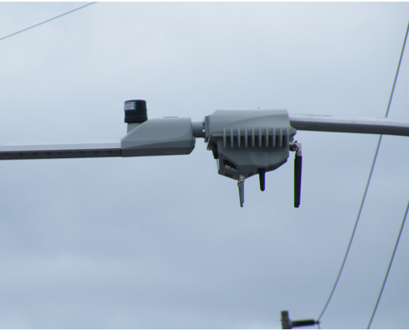
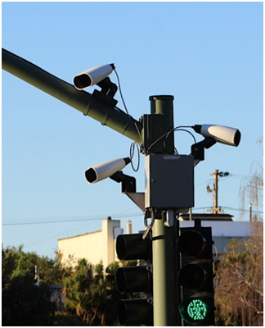
What are the problems we are trying to solve?
Better use of data and technology is necessary to address City and community priorities.
Technological solutions evolve quickly, and we need proactive processes to evaluate them.
Surveillance technologies can create significant harm if not used responsibly.
Black, Indigenous, and People of Color are more negatively impacted by surveillance technologies.
Limited public trust in how the City uses technology, which constrains positive impacts.

Slide 7

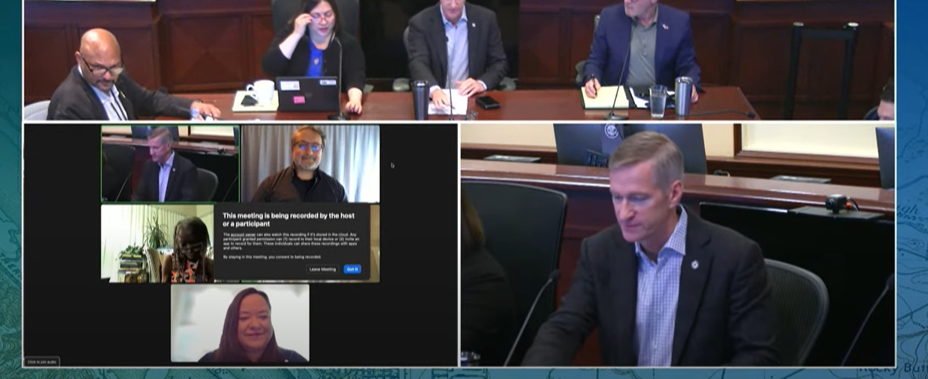
How we got here
Two City Council work sessions in 2022.
More than a year of public engagement and internal bureau outreach, 17 different public events, more than 400 Portlanders participating, direct community work. Comments compiled in Exhibit A.
Support from a Citywide privacy workgroup since 2019
Notes:
Judith Mowry

Slide 8


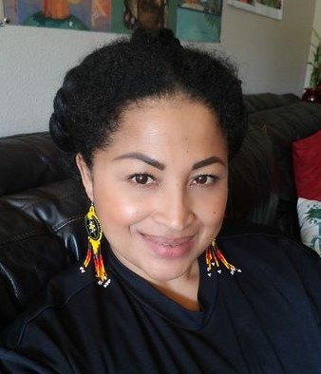
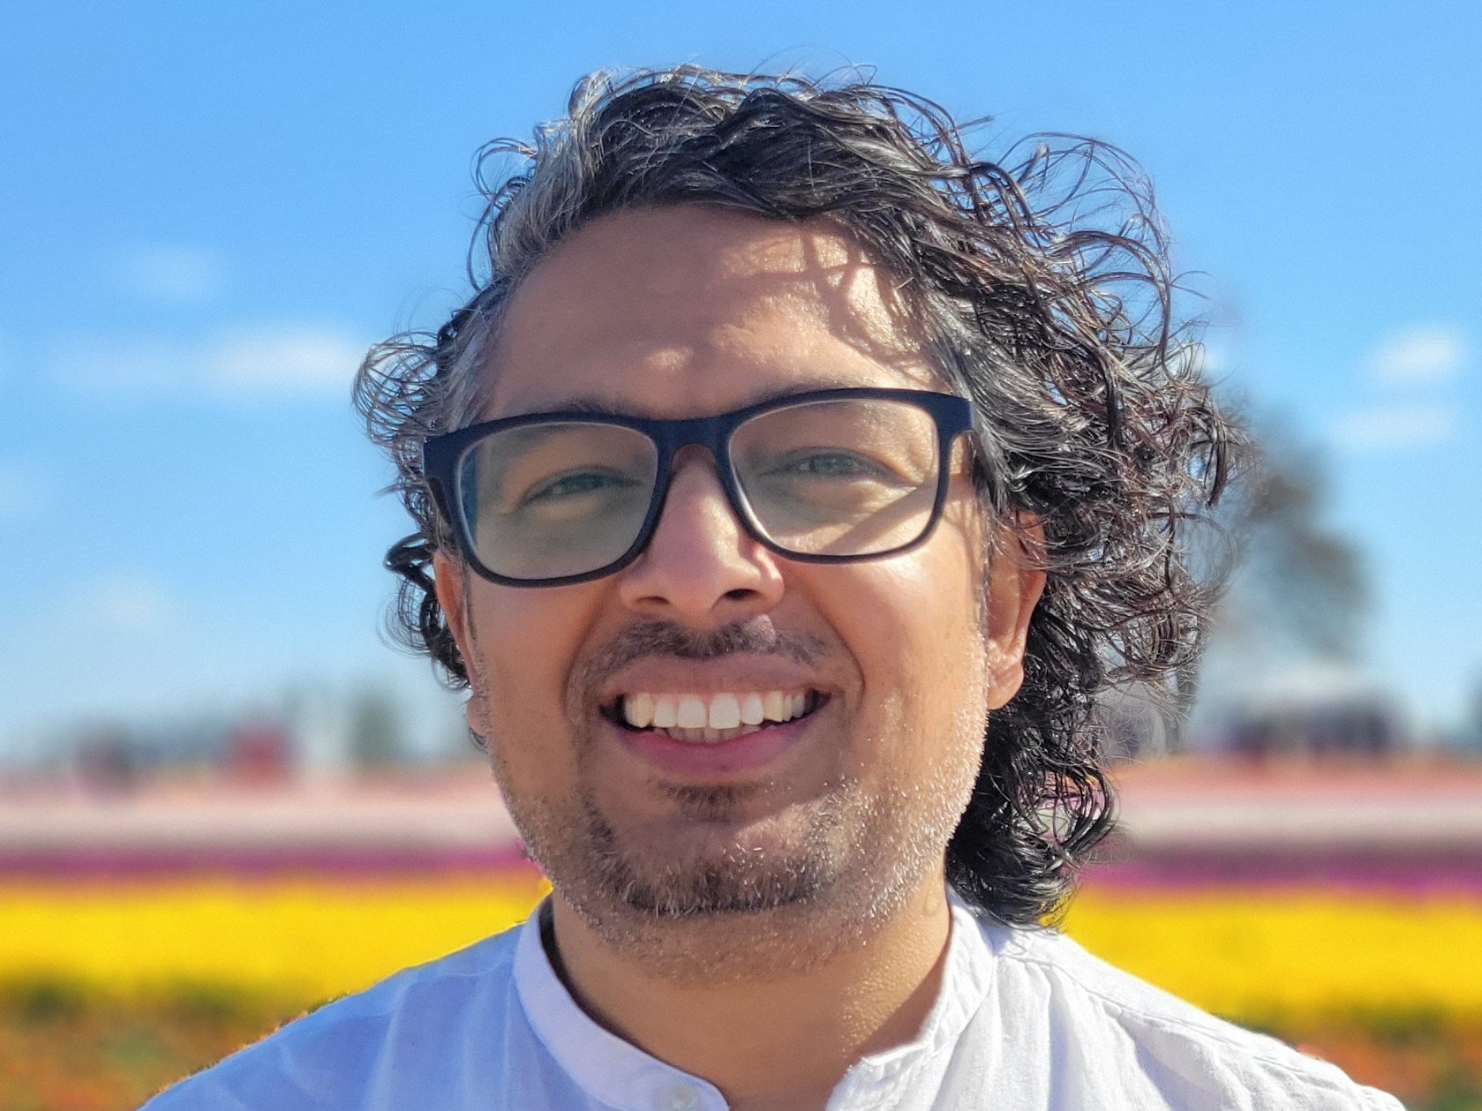
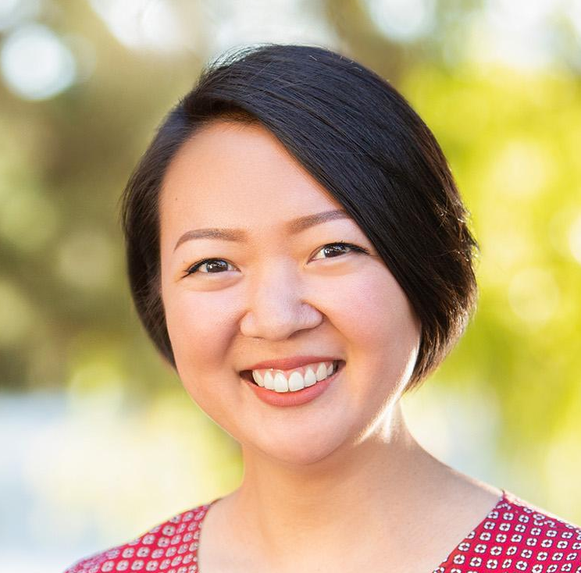

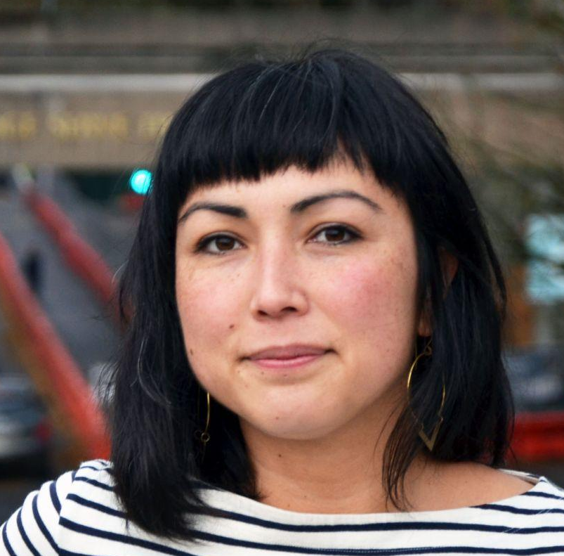

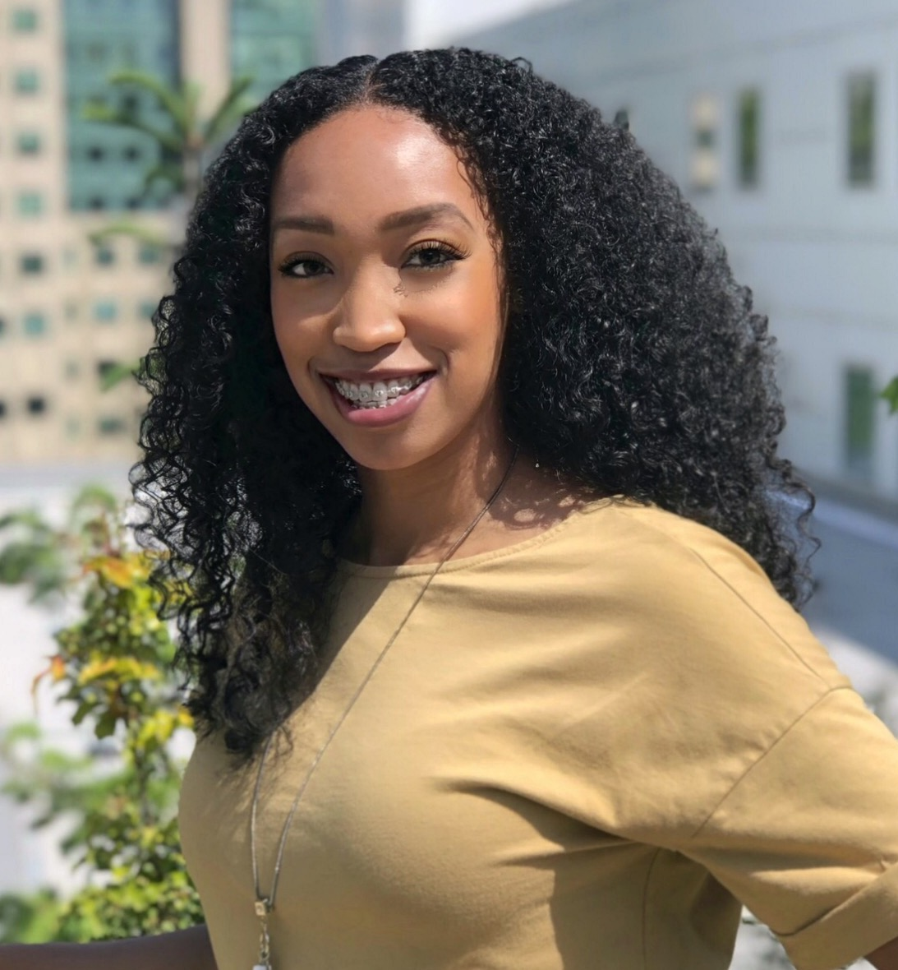
Participatory policymaking
Community leads
Notes:
Judith Mowry: Community Leads: Yoana Molina, Surya Raj Joshi, Irene Kim (Cascadia Partners), Rosalie Lee, Alysia Macasya, O'Nesha Cochran-Dumas, Sachi Arakawa (Cascadia Partners)

Slide 9
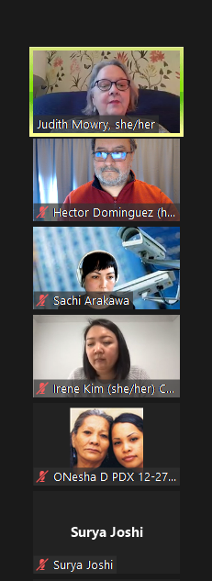
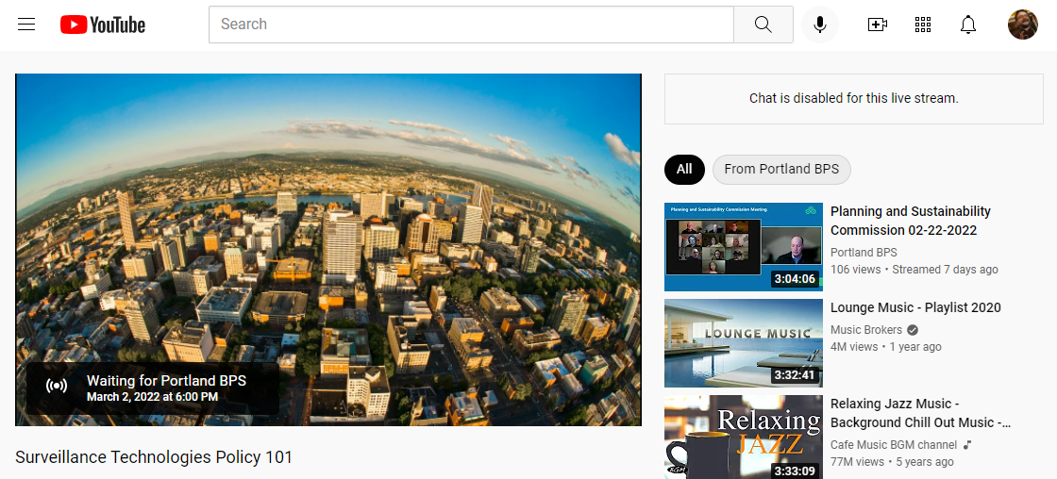
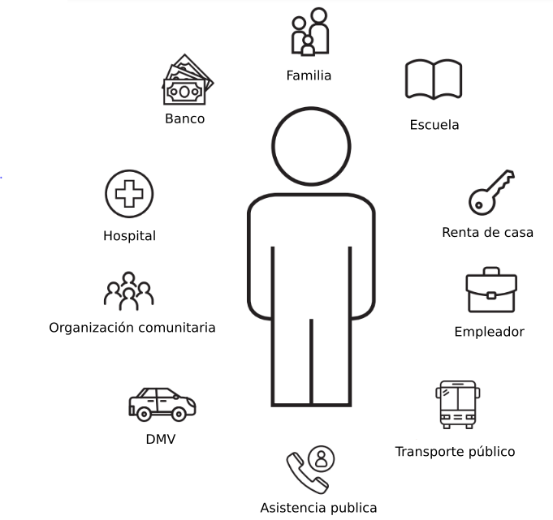
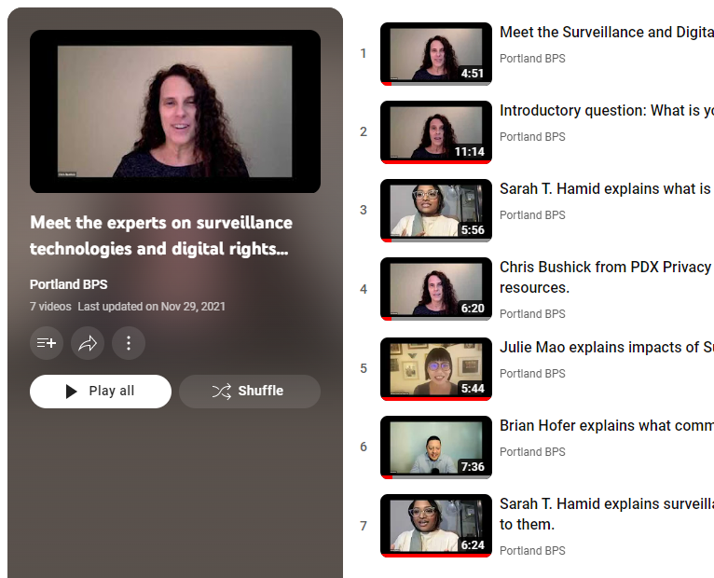
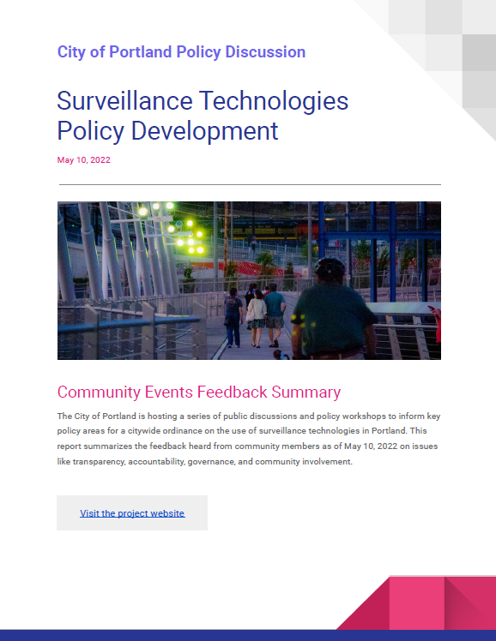
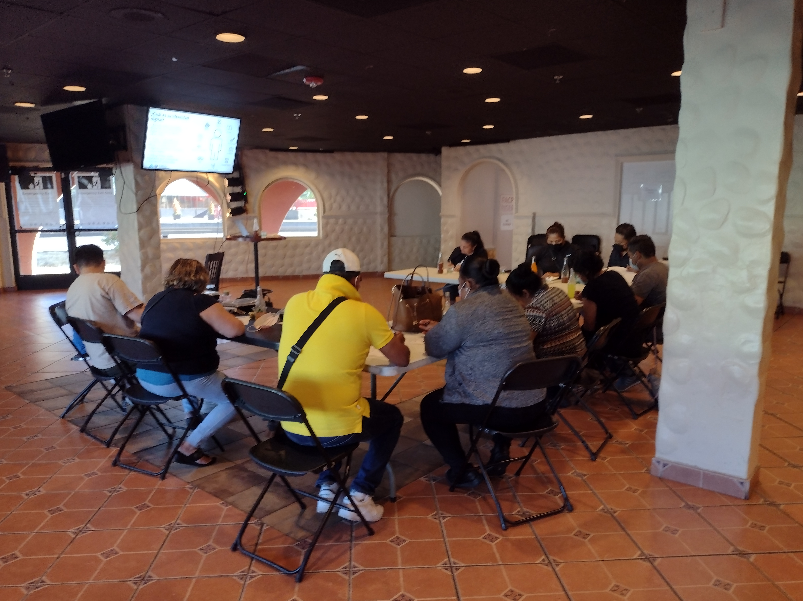
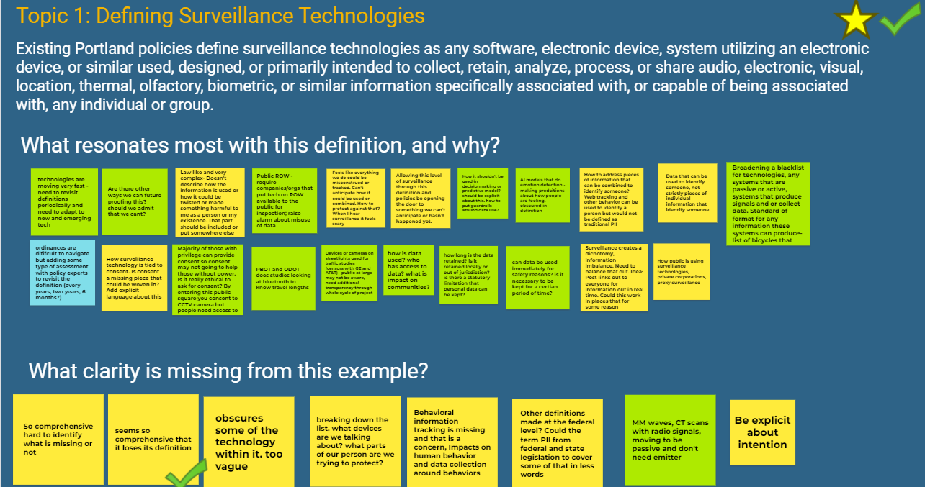
Open and accessible public-engagement process
Notes:
We open to public participation, offered options to join online, in-person, watch recordings, and additional materials. However, there is a huge need to inform the Portland community and its residents about the opportunities and risks that the digital world has to offer. The Pandemic created several barriers to many, and the collaboration with other city efforts (cybersecurity, digital divide and broadband deployments, data governance) needs to keep evolving in the context of digital rights.

Slide 10
What are the main directives of this policy?
The creation of a citywide inventory of surveillance technologies by March 2024
Implementation of impact and risks assessments for surveillance technologies

Slide 11

This policy:
Applies to all City bureaus
Builds capacity and infrastructure for better use of data and technology
It drives public technology on transparency and public trust
Builds on existing resources, capacity, and previous policies
It does not:
Ban any specific technology
Impact bureau budgets

Slide 12

Working towards solid infrastructure
This policy also directs the design of a new privacy program to explore more effective and meaningful ways of technology oversight and public involvement.

Slide 13
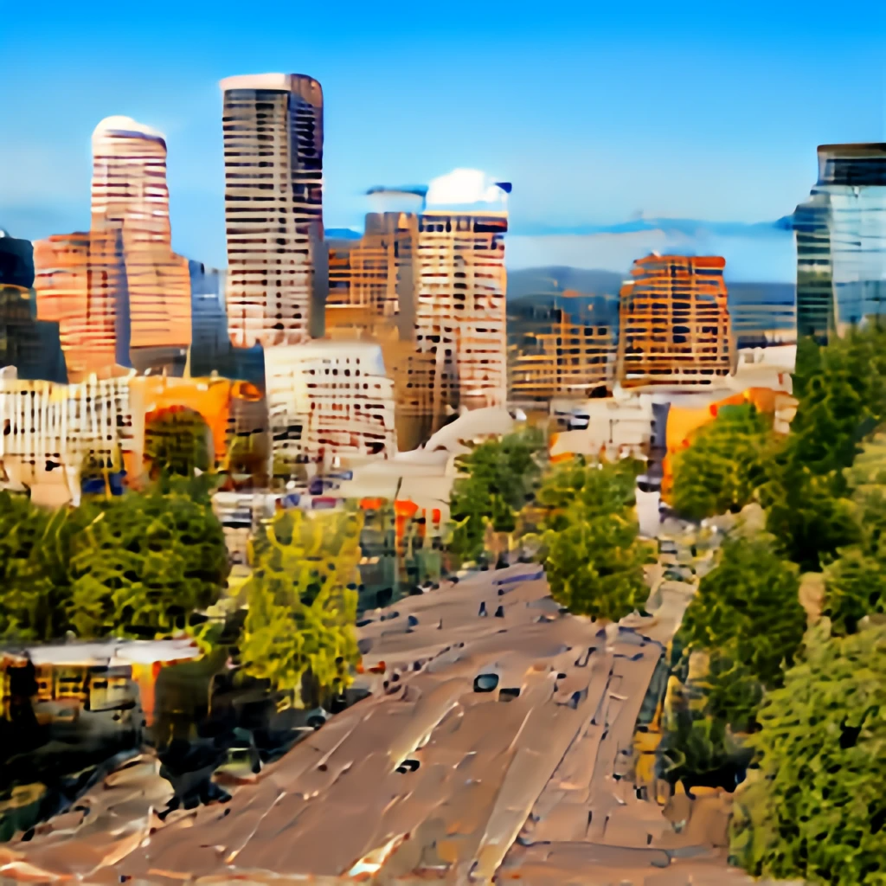
Building Portland's Digital City
This policy directs work on assessing automated decision systems like artificial intelligence and other algorithms.

Slide 14




THANK YOU!
To all the Portland community and individuals who joined our public events
z

Slide 15

Contact:
Hector Dominguez
hector.dominguez@portlandoregon.gov
Open data and privacy coordinator
Smart City PDX Program -
https://www.smartcitypdx.com/
City of Portland
z

