Slide 1
Bond Oversight Committee Meeting
Thursday, February 2, 2023

Slide 2
Welcome! Hybrid Meeting Protocols and Tips
Be patient and respectful.
Check speakers and microphone work properly. Speak clearly so all attendees can hear you.
Mute your microphone/phone when not speaking. Keep in-person side conversations to a minimum.
Introduce yourself before speaking.
Virtual attendees can use Chat for tech questions and Public Testimony.*
*This public meeting will be recorded, including the chat.
Bond Oversight Committee Meeting | 2/2/2023 | Portland's Housing Bond

Slide 3
Agenda
TOPIC | LEAD | TIME
Welcome, Roll Call, Minutes | Dr. Steven Holt | 9:30 – 9:35
Public Testimony (2 minutes per person) | Dr. Steven Holt | 9:35 – 9:40
Portland’s Housing Bond Updates | PHB Staff | 9:40 – 9:55
Housing Bond Audit Update | Gena Scott | 9:55 – 10:00
Project Team Presentations | Project Teams | 10:00 – 10:20
Interim Director’s Update | Molly Rogers | 10:20 – 10:35
Closing Remarks | Dr. Steven Holt | 10:35 – 10:40
Bond Oversight Committee Meeting | 2/2/2023 | Portland's Housing Bond

Slide 4
Public Testimony
Two minutes per person
Sign up in person or in Zoom Chat
Verbal or written testimony
Summit written testimony via the Chat feature
Bond Oversight Committee Meeting | 2/2/2023 | Portland's Housing Bond

Slide 5
Portland's Housing Bond Updates
Bond Oversight Committee Meeting | 2/2/2023 | Portland's Housing Bond

Slide 6
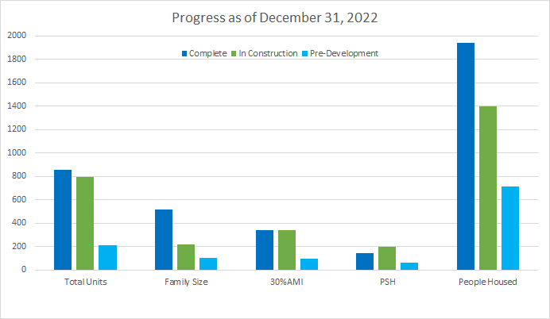
Bond Projects Dashboard Report
Bond Oversight Committee Meeting | 2/2/2023 | Portland's Housing Bond
Notes:
Jill – note the flip from construction to complete / lease-up

Slide 7
Issues & Risks
Fully funded projects with Portland & Metro bonds received private activity bonds/4% LIHTC pre-app
Interest rates continued risk
Construction risks/completion delays (PGE/PPL, supplies)
Multiple PSH causing stress and cost/safety concerns
Projected operating costs insufficient
Need for alignment of State, regional and local resources
Bond Oversight Committee Meeting | 2/2/2023 | Portland's Housing Bond
Notes:
Jill –
Less construction

Slide 11
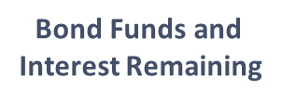
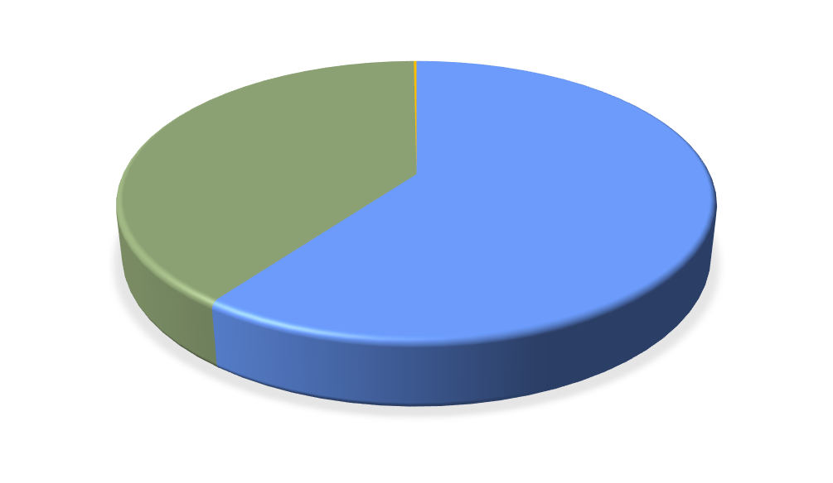
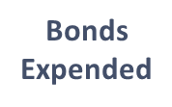
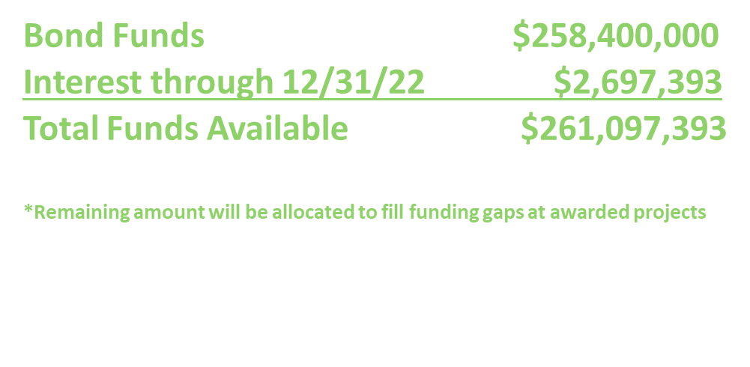
Expenditure Report Highlights (as of 12/31/2022)
​ | Total $​ | % Totals​ | % Change - last Qtr.​
Expended​ | $156.8M​ | 60.1%​ | +4.5%​
Committed​ | $103.8M​ | 39.8%​ | -4.0%​
Reserved​ | $0​ | 0.0%​ | n/a​
Remaining*​ | $457.3K​ | 0.2%​ | -79.9%​
Bond Oversight Committee Meeting | 2/2/2023 | Portland's Housing Bond

Slide 12
Housing Bond Audit: Financial Performance from Fiscal Year 2020-2021
Bond Oversight Committee Meeting | 2/2/2023| Portland's Housing Bond

Slide 13
Housing Bond Audit Highlights
• Recommendations from the FY 2019-20 audit implemented
• Documentation for disbursements shown to be consistent with the
Bond Measure
• PHB's process documents shown to be comprehensive
• No audit findings; 37 disbursements examined
• Staff will implement 4 audit recommendations.
Bond Oversight Committee Meeting | 2/2/2023 | Portland's Housing Bond

Slide 14
Bond Project Team Presentations
Bond Oversight Committee Meeting | 2/2/2023 | Portland's Housing Bond

Slide 15
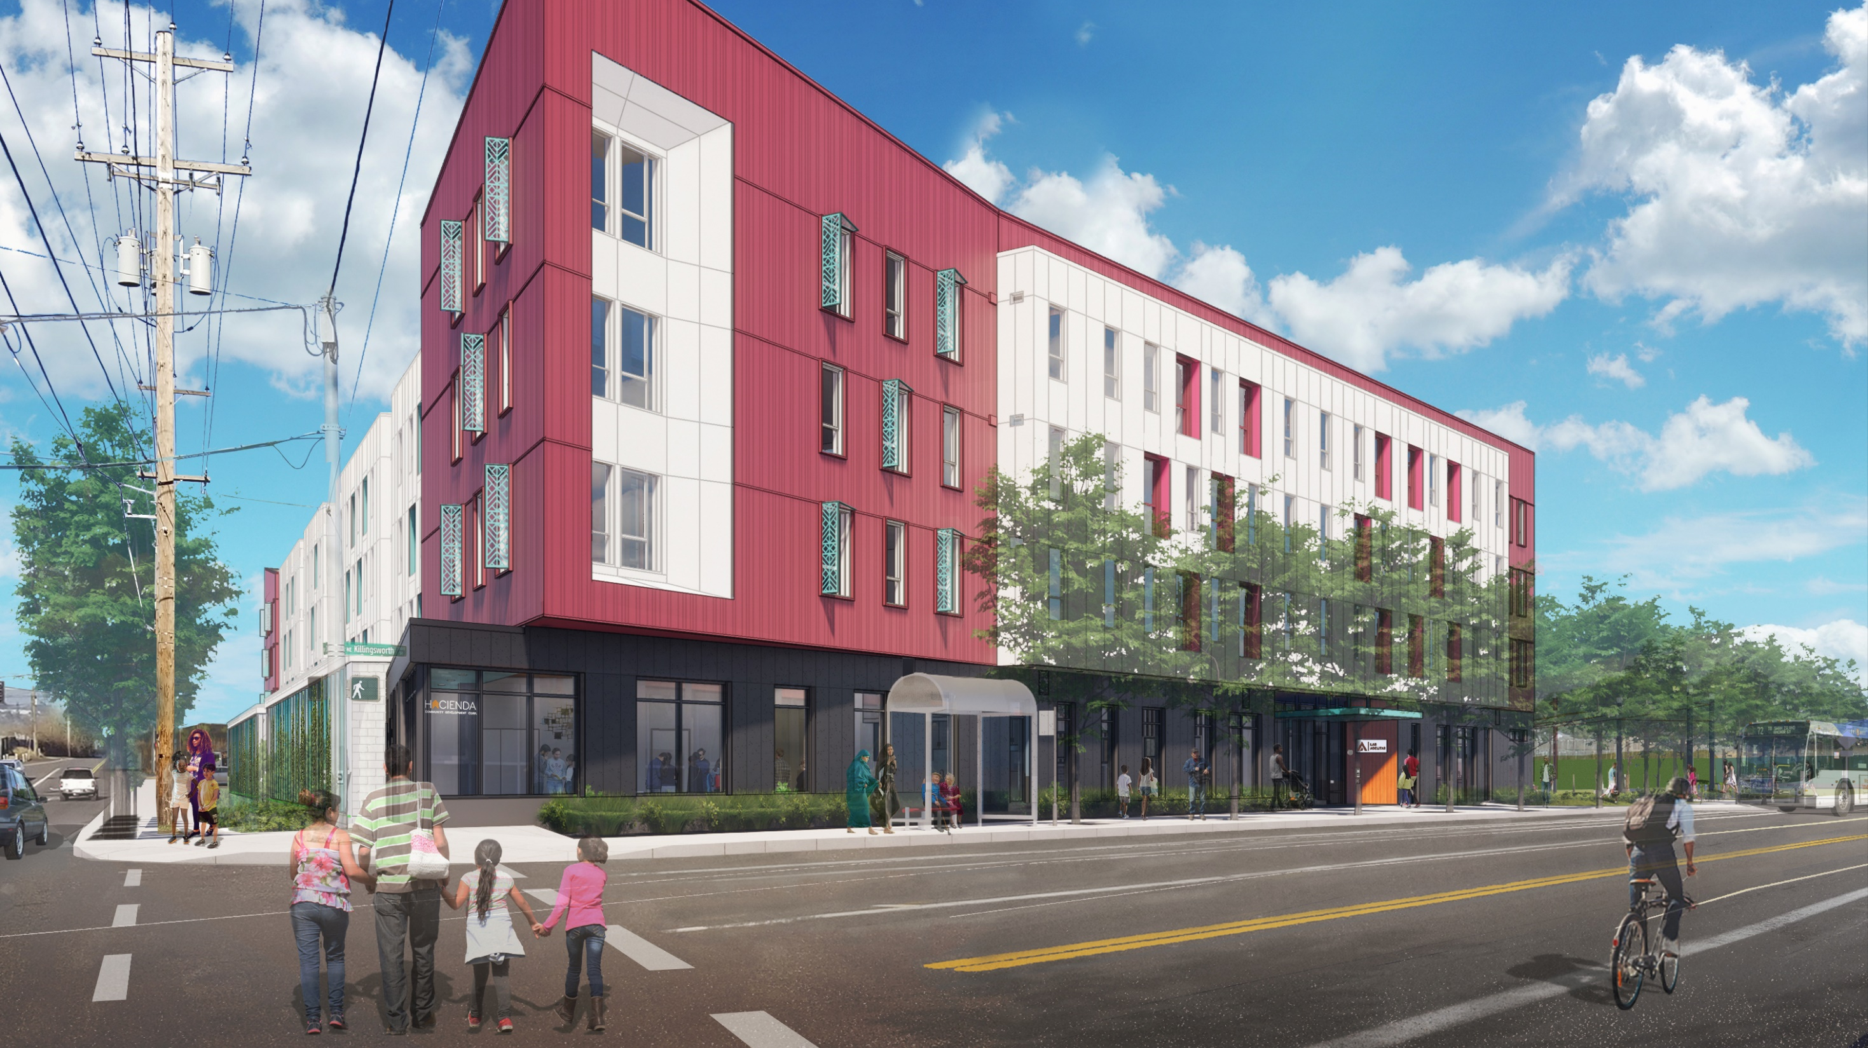
Las Adelitas
6735 NE Killingsworth Street
Hacienda CDC

Slide 16
Project Team
Hacienda CDC | Developer and Service Provider
Cascade Management Inc. | Property Manager
Salazar Architect | Architect of Record
LMC Construction | General Contractor
Project Schedule Milestones
Dec 16 | TCO Received
Dec 16 | Lease Up Began
Feb 17 | Project Completion and CoO
Mar 9 | Grand Opening
July 31 | 95% leased
Current stage of development
Wrapping up Construction & Back-Punching
21% Leased-up
Project Overview
&
Development
Progress

Slide 17
Project highlights
Unit Mix
Target Population | Families, Households Experiencing Homelessness
Onsite amenities | Plaza, Laundry, Community Room, Niño’s, Community Event Space and Kitchen
Design features | Earth Advantage Platinum, ADA, Rooftop Solar
Project
Development
Unit-Mix
Tenant AMI | Studio | 1bd | 2bd | 3bd | Total | Family Size | PSH
30% | 15 | 27 | 9 | 4 | 55 | 13 | 18
60% | 0 | 0 | 64 | 22 | 86 | 86
MGR |  |  | 1 |  | 1
TOTAL | 15 | 27 | 74 | 26 | 142 | 123 | 18

Slide 18
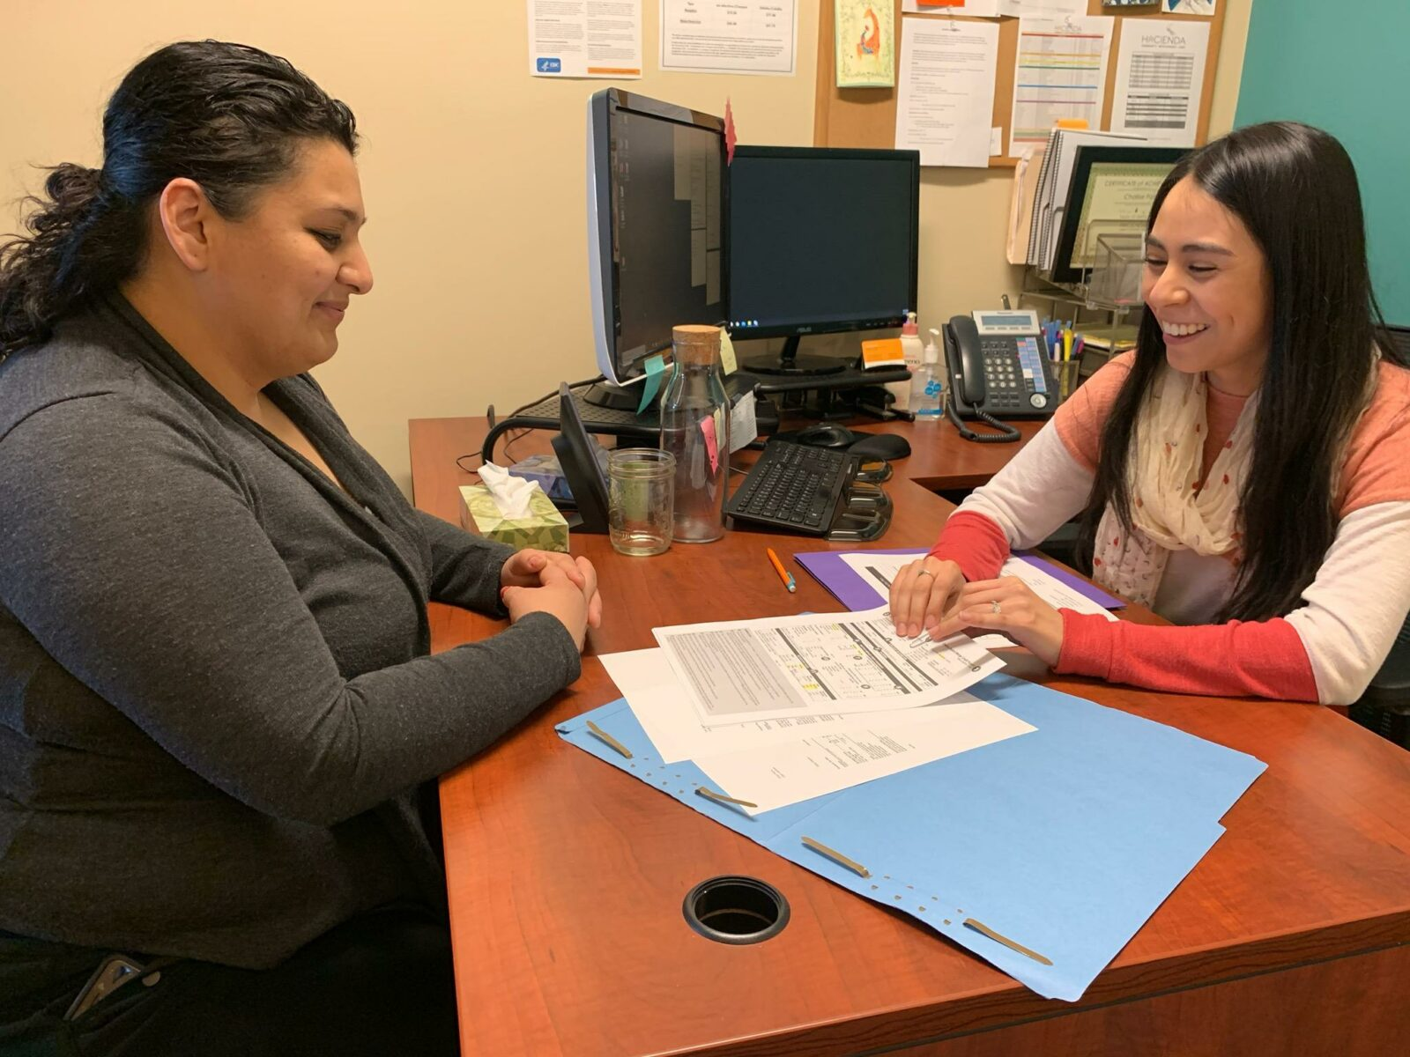
Outreach Strategies to Increase Housing Access for BIPOC/Priority Communities
Bilingual marketing materials ie. Spanish & Somali
Application Release Event marketed in multiple languages
Provided on-site interpretation during application event
Marketing and Leasing Strategies and Outcomes
Outcomes – ​ Initial Tenant Demographics ​
Applications: 450+​
Referrals (PSH):
16/18 in process​
Leasing: 30 move-ins
since 12/16 - 21% leased

Slide 19
DMWESB-SDV Contracts
General Contractor: LMC Construction
Professional Consultants: Salazar Architect
% Construction Complete: 98.2%
Equitable Contracting Outcomes
 | PHB Goal | Project Outcomes
Hard Cost Contracts | 30% | 40.43%
Professional Services/Soft Costs | 20% | 68.43%
*contracting outcomes on property management contracts are not required by PHB.
Notes:
Operation Contracts data is not required by PHB. This is an optional field. Examples of “Operations” contracts could include property management-related vendors, such as landscape maintenance, janitorial services, etc.

Slide 20
Workforce Diversity
Equitable Contracting Outcomes
 | PHB Goal |  | Project Outcomes
 | POC | Women | POC | Women
Apprentice hours | 22% | 9% | 47% | 19%
Journey Level hours | 22% | 6% | 71% | 2%

Slide 21
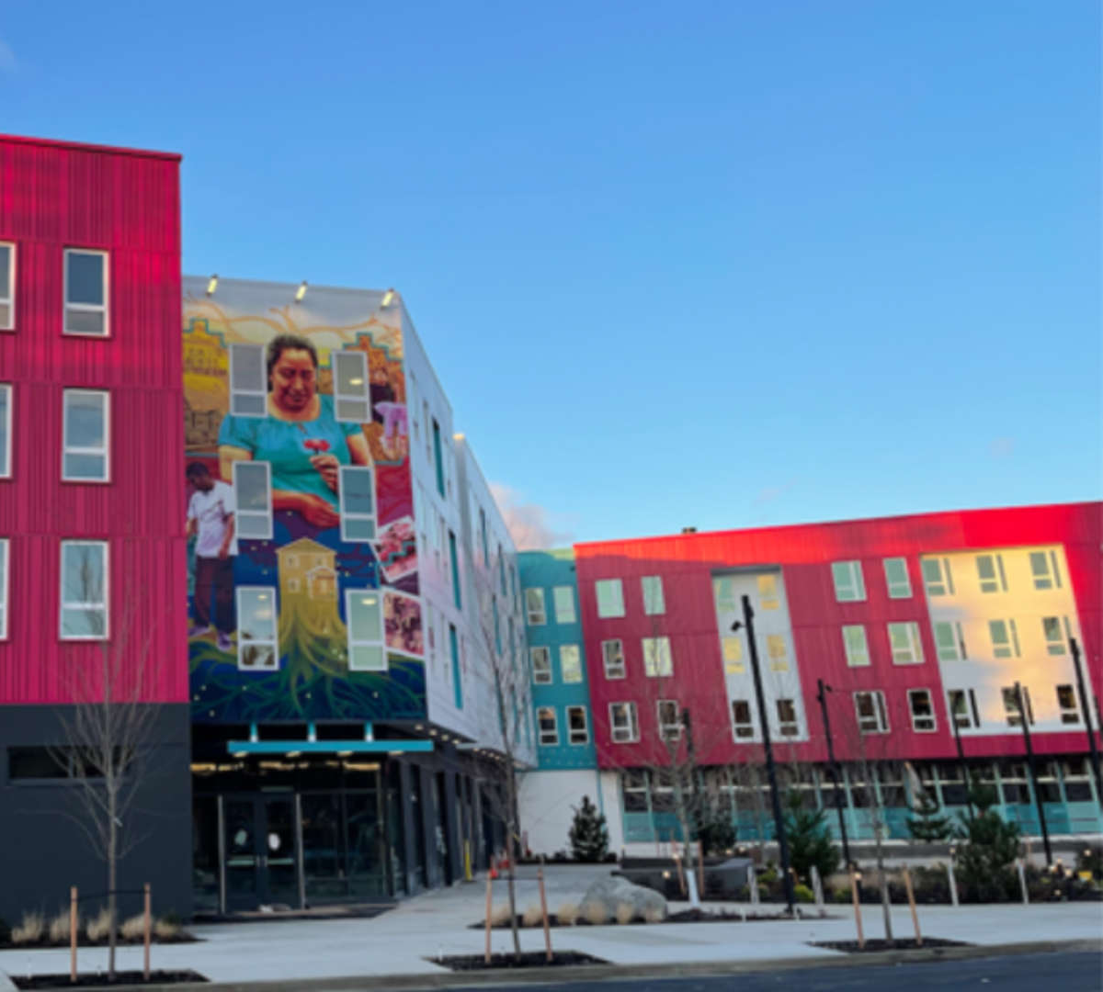
Community Engagement Updates
Community Engagement Activities
Site Design Charrette presentation with Cully Association of Neighbors
Community Focus groups in English and Spanish discussing unit sizes, layout, amenities, etc.
Community Information Sessions provided in English and Spanish discussing leasing process
Engagement Partnerships Verde, Living Cully, Cully Association of Neighbors, SUMA
Participant Demographics POC, low-income, older adults, limited English, immigrants/refugees, homeless, existing tenants, etc.
Outcomes Final unit mix, building and in-unit amenities, courtyard design, open community spaces, bilingual Resident Services Coordinator
Notes:
Highlight community engagement efforts, including outreach strategy and any engagement that has been conducted to date to inform project design and future marketing/lease-up. This may include summarizing feedback heard from groups reached, dates, locations, etc.

Slide 22
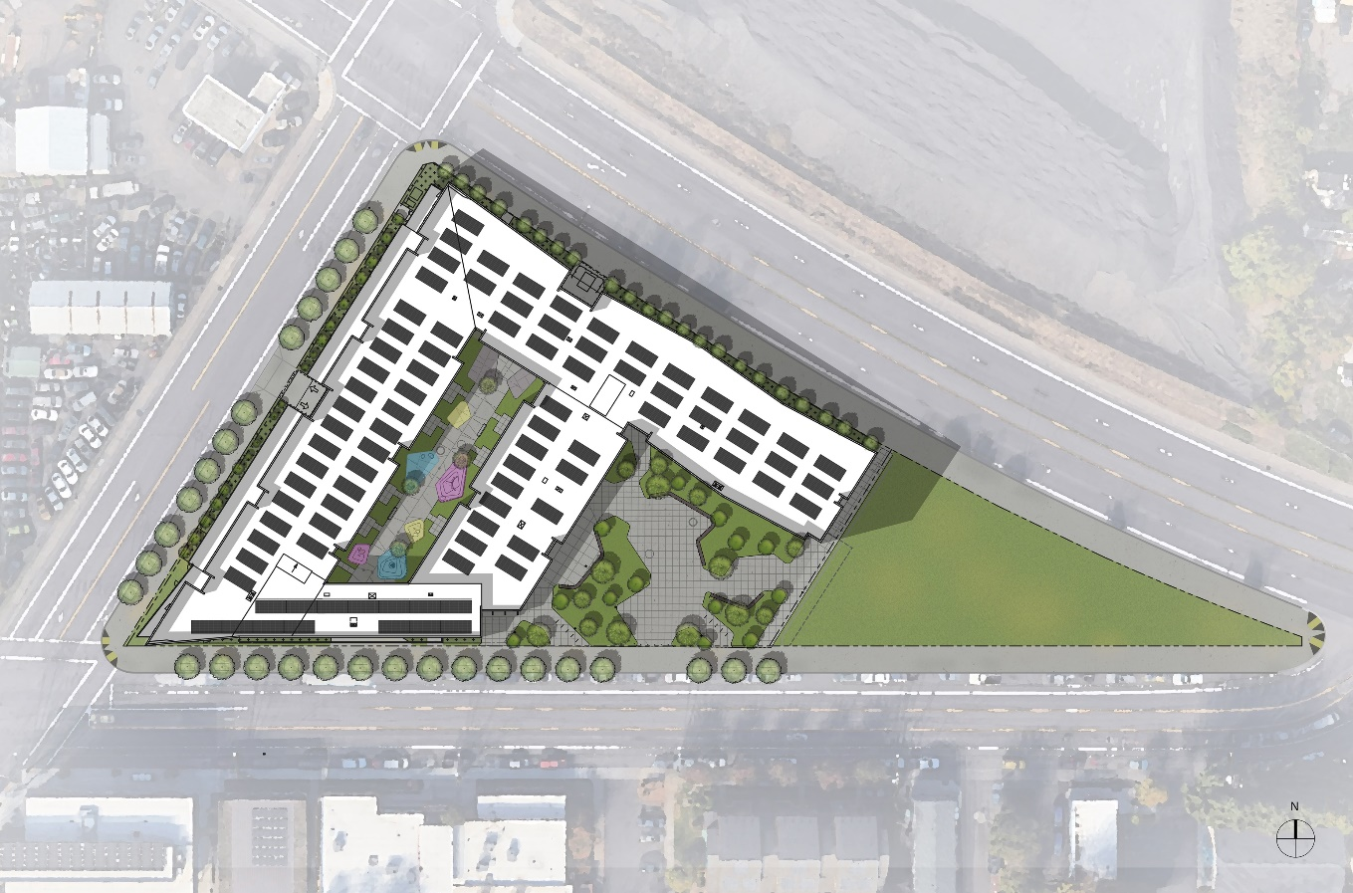
Project Funding Sources
Portland Housing Bonds | $15,020,934
Low Income Housing Tax Credits + Federal Energy Credits | $21,417,309
Senior Commercial Debt | $9,455,000
OHCS LIFT | $4,446,240
Deferred Fee | $2,150,000
Sponsor Loan (OR-MEP, Energy Trust incentive, Metro TOD, OHCS Grant, additional grants) + Hacienda contribution | $3,454,040
SDC Waivers | $2,438,002
Total Funding | $58,381,525
Gap in Funding, if any | $0
Total Project Costs | $58,381,525
Portland’s Housing Bond funding = $15,020,934
Bond Oversight Committee Meeting | 2023 | Portland's Housing Bond

Slide 23
Describe any material changes that have occurred since funding award
Awarded RLRA for 10 PSH units
Market conditions: interest rates increases, lumber and material cost escalations, labor shortages, disruptions to supply chain
Project schedule: TCO and CO had been impacted due in part to market conditions listed above.
Material Changes
Bond Oversight Committee Meeting | 2023 | Portland's Housing Bond

Slide 24
Interim Director’s Update
Bond Oversight Committee Meeting | 2/2/2023 | Portland's Housing Bond

Slide 25
Closing Remarks
Next Meeting Date: April 6, 2023
Bond Oversight Committee Meeting | 2/2/2023 | Portland's Housing Bond

