Slide 1
2035 Comprehensive Plan
Policy 5.35 Inclusionary housing
Use inclusionary zoning and other regulatory tools to effectively link the production of affordable housing to the production of market-rate housing. Work to remove regulatory barriers that prevent the use of such tools.
Matthew Tschabold Interim Deputy Director
Dory Van Bockel Development Incentives Manager
December 7, 2022

Slide 2
Portland’s Inclusionary Housing Units
Projected Minimum:
Confirmed 60% AMI Units:
Confirmed 80% AMI Units:
Undetermined:
1,664 units
1,045 units
556 units
63 units
City of Portland, Portland Housing Bureau, December 2022

Slide 3
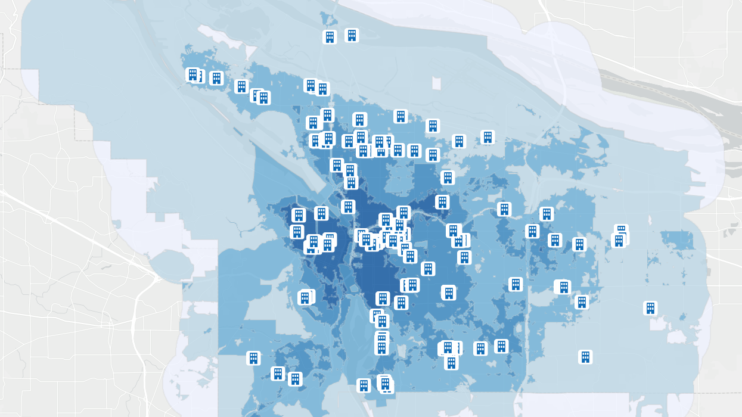
IH MULTE Applications
23rd & Marshall Apartments
1137 NW 23rd Ave
City of Portland, Portland Housing Bureau, December 2022

Slide 4
23rd & Marshall Apartments
Project Overview
Developer Options
15% of units at 80% AMI
8% of units at 60% AMI
Fee-in-lieu
Off-site
Bedroom reconfiguration
Building
74-unit building (Avg. SqFt: 428 studio, 590 one-bed, 859 two-bed, & 1,177 three-bed)
IH Units: 1 Studio, 2 Three-Bedroom at 60% AMI
Rents
Similar market-rate*: $1,643 (studio); $5,259 (3 bedroom)
IH maximum: $1,119 (studio); $1,662 (3 bedroom)
Property Tax Exemption
$4,245 per IH unit, per year (for 10 years)
$132 per year of affordability (for 99 years)
Housing Bureau recommends approval as IH rents are below new construction rents and there is a need for affordable 3-bedroom units in this neighborhood.
*Market estimates today, market rents may be higher after construction

Slide 5
Questions?

