Slide 1
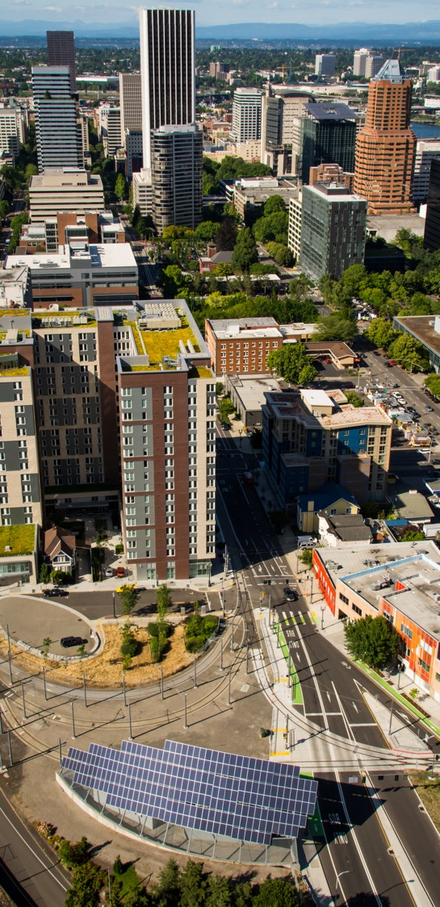
Portland’s Renewable Fuel Standard (RFS) Code UPDATE
Portland City Code Title 16.60
Second Reading

Slide 2

Proposed code changes
Phases in higher blends of renewable fuels through 2030.
Adds renewable diesel as an allowable fuel.
Adds a carbon intensity standard.

Slide 3
Minimum biofuel content requirements
Fuel Type (by percent) | Current RFS | 2020 (Reported) | 2024 | 2026 | 2030
Renewable Fuel | 5% | 11% | 15% | 50% | 99%
Diesel | 95% | 89% | 85% | 50% | 1%

Slide 4

Flexible and informed implementation
07/31/23: TAC established
10/15/25: TAC reports to BPS Director (7 months prior to 50% blending requirement)
02/15/26: BPS reports to Council
10/15/29: TAC reports to BPS Director (7 months prior to 99% blending requirement)
02/15/30: BPS reports to Council

Slide 5
Examples of different RD feedstocks
CI (gCO2e/MJ) | Approved Fuel Pathway
25.5 | North American used cooking oil; processed in Louisiana; trucked to Oregon
37.0 | North American animal fats; processed in Louisiana; trucked to Oregon
42.8 | Globally sourced animal fats; transported and processed in Singapore; transported to California by Ocean tanker and trucked to Oregon.
58.4 | US Soybean oil; processed in Wyoming; transported to Oregon

Slide 6
Examples of different BD feedstocks
CI (gCO2e/MJ) | Approved Fuel Pathway
11.0 | Used cooking oil; collected and processed in Washington; trucked to Oregon
34.2 | U.S. Rendered animal fat; processed in Missouri; transported to Oregon by rail
54.0 | U.S. Canola Oil; processed in Iowa; transported by truck and rail to Oregon
59.3 | Midwest soybean oil; processed in Illinois; transported to Oregon by Rail

Slide 7
Top renewable diesel producers
(with products below CI 40)
The vendors with approved RD products below 40 include:
  Neste (6)
  REG (12)
  BP (2)
74% of DEQ-approved RD products have a 40 CI or less.

Slide 8
Top Biodiesel Producers
(with products below CI 40)
REG (22)
Sequential (5)
High Plains Bioenergy (3)
Delek Renewables, LLC (3)
Future Fuel Company (2)
Dansuk Industrial Company (1)
Consolidated Biofuels LTD (1)
Thumb Bioenergy (1)

Slide 9
For questions contact Andria Jacob
Climate Policy + Program Manager
andria.jacob@portlandoregon.gov

