Slide 1
Alder 9 funded by the Portland Housing Bond and Central Eastside TIF
Molly Rogers, Interim Director
December 7, 2022

Slide 2
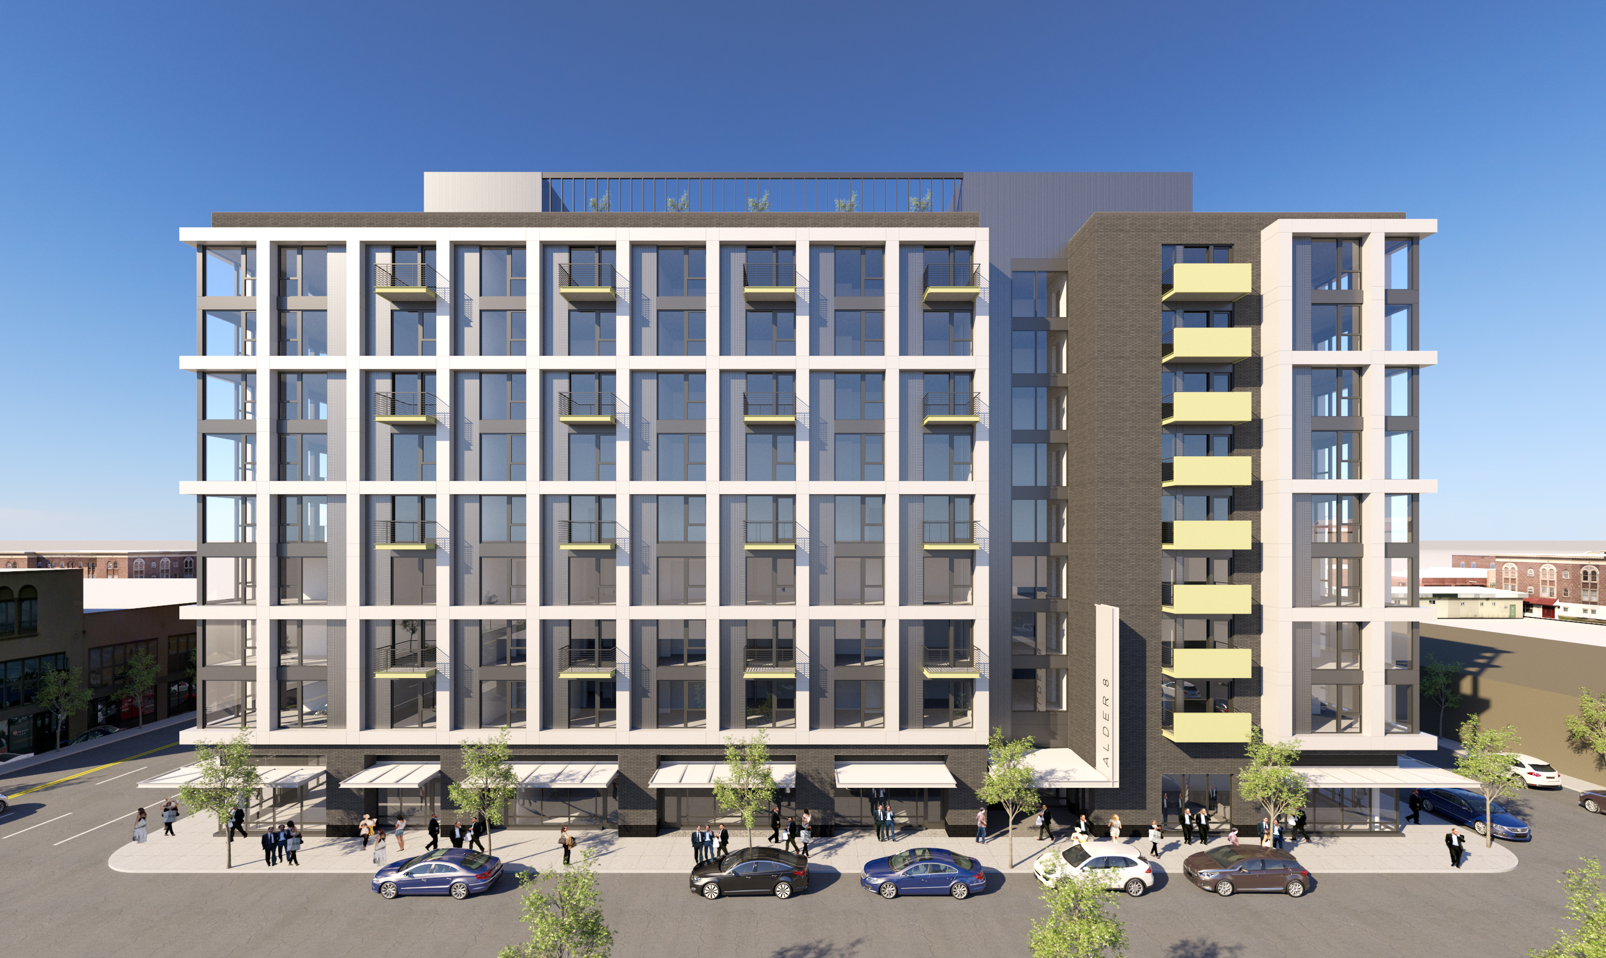



Notes:
MOLLY TALKING POINTS:
Thank you, Commissioner Ryan.
For the record …. my name is Molly Rogers and I am the Interim Director of the Portland Housing Bureau.
We are here today to request your approval for funding for the Alder 9 affordable housing project sponsored by Related NW and Centro Cultural.

Slide 3
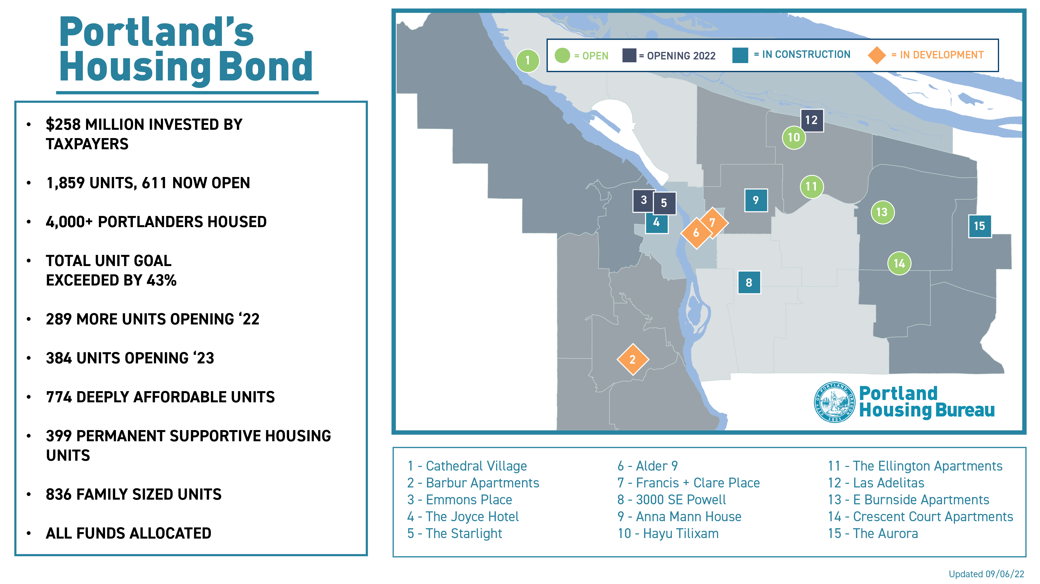
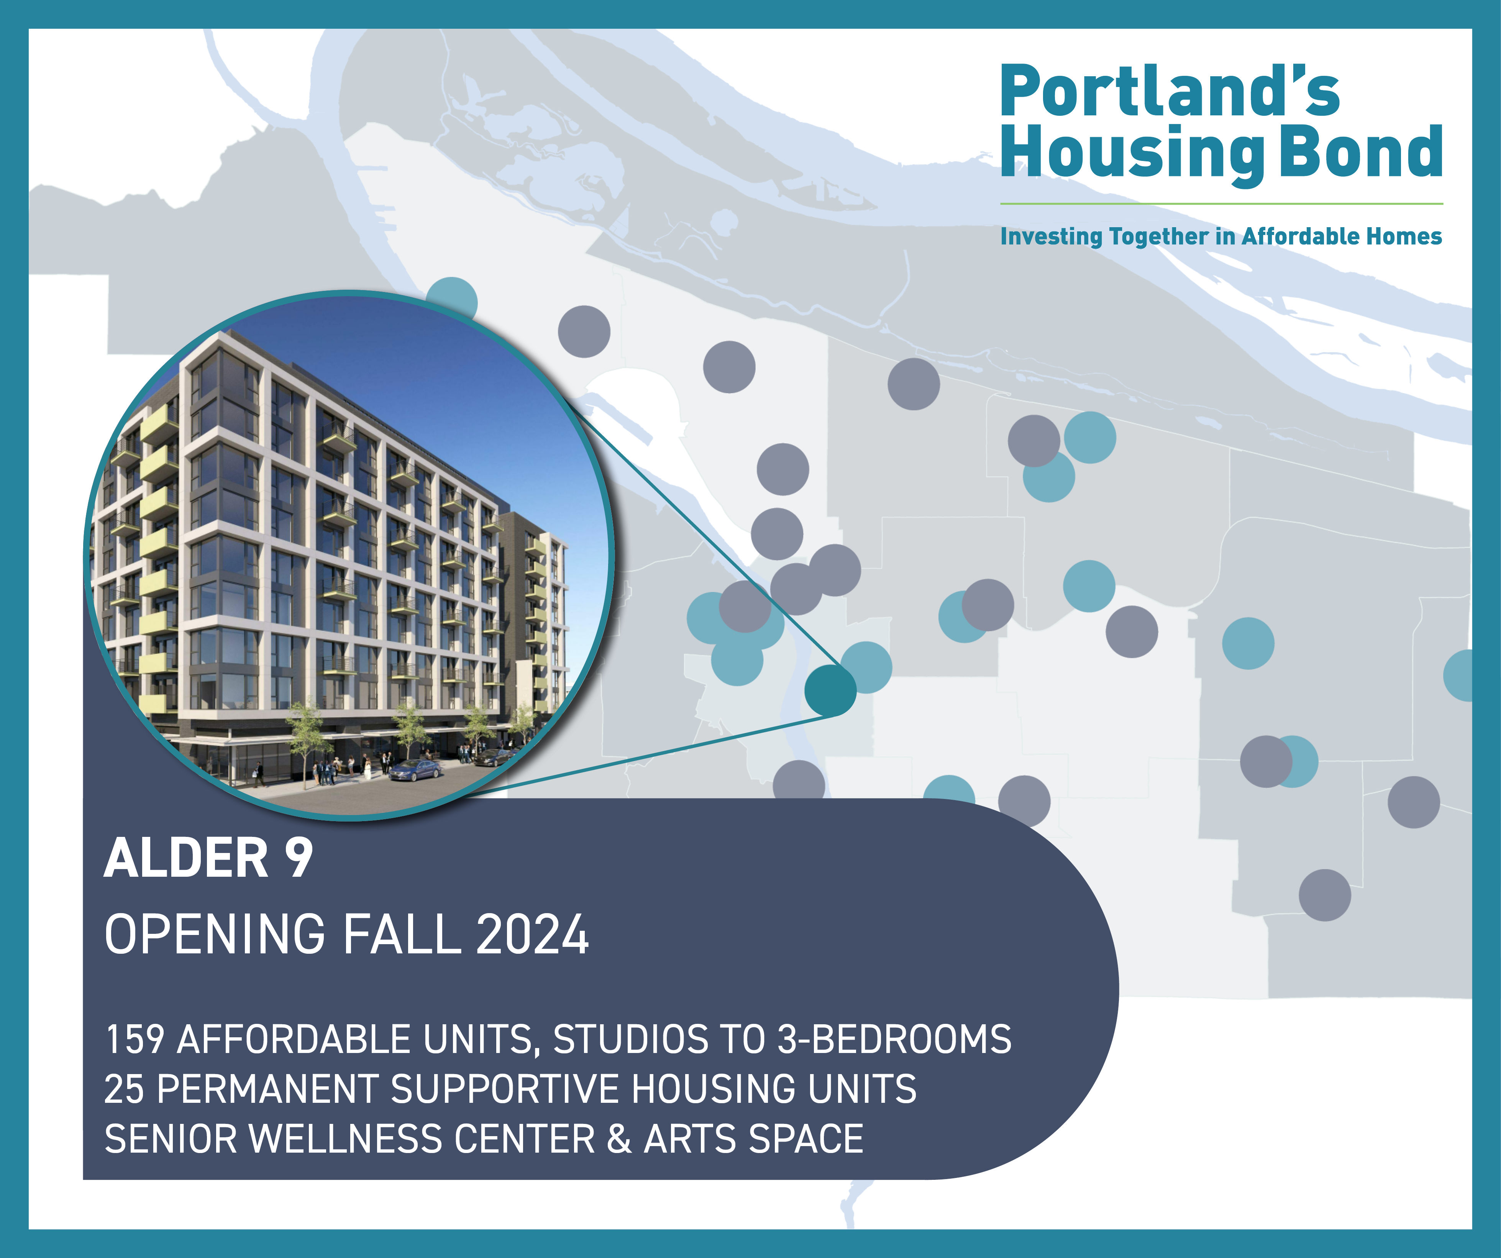
Notes:
MOLLY TALKING POINTS:
Before we jump into the project, we are pleased to provide a short update on the voter approved Portland Housing Bond.
Portland Housing Bureau (PHB) is well on its way to implementing the City’s goals. As you can see on this map, there are 611 units already serving Portlanders, 4 are under construction, and another 3 are in pre-development. The circled #6 diamond in inner southeast is the project we are talking about today.
In total, 1,859 units are funded by Portland Housing Bonds, exceeding our commitments to Portlanders by 43%. These homes are anticipated to house over 4,000 Portlaners. 399 homes are dedicated to serve those coming out of the JOHS Coordinated Access.
On December 1st, we welcomed the Grand Opening of the Starlight in Old Town with Commissioner Ryan. The Starlight will house people exiting from homelessness. Another Grand Opening is next week for Hayu Tilixam, a development sponsored by CDP and NAYA that is focused on families- especially those underserved from BIPOC and native American communities. In the next few weeks, Las Adelitas will begin welcoming new residents to 141 affordable units targeting families in the Cully neighborhood.

Slide 4
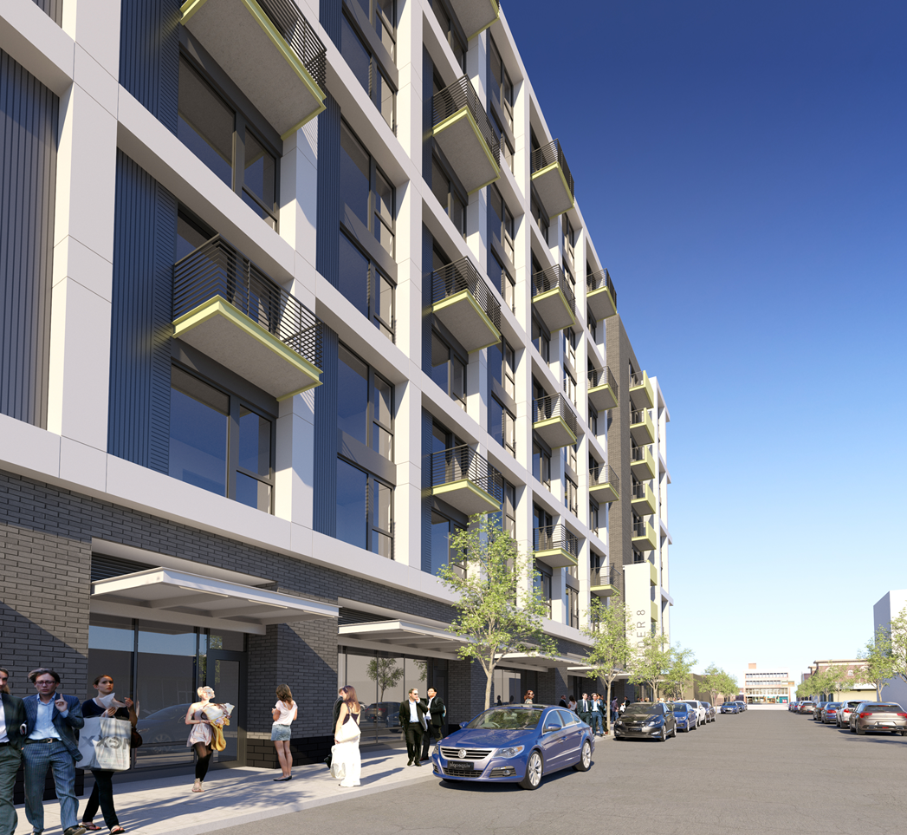
Project Highlights
9-story new construction in Central Buckman
Targeted to seniors and their families
159 new units close to transit and amenities
42 units are family-sized
25 units of permanent supportive housing
99-year Affordability Period
Construction begins January 2023
Completion Oct 2024
Notes:
MOLLY TALKING POINTS:
Alder 9 is a multifamily affordable rental project with 159 rent-regulated units located at the intersection of SE 9th Avenue and SE Alder Street, close to transit and amenities.
The Project will be targeted to serve senior households (55+) and their families, including intergenerational and BIPOC households. 42 units are family sized. And 25 are PSH units to support homeless seniors as Alder 9 is also an integrated supportive housing project.
Construction will start in early 2023 and families would be able to move in during fall 2024. The Borrower will enter into regulatory agreements with PHB in accordance with City policies to maintain the affordability of the Project for 99 years and comply with Portland Bond requirements for 20 years.

Slide 5
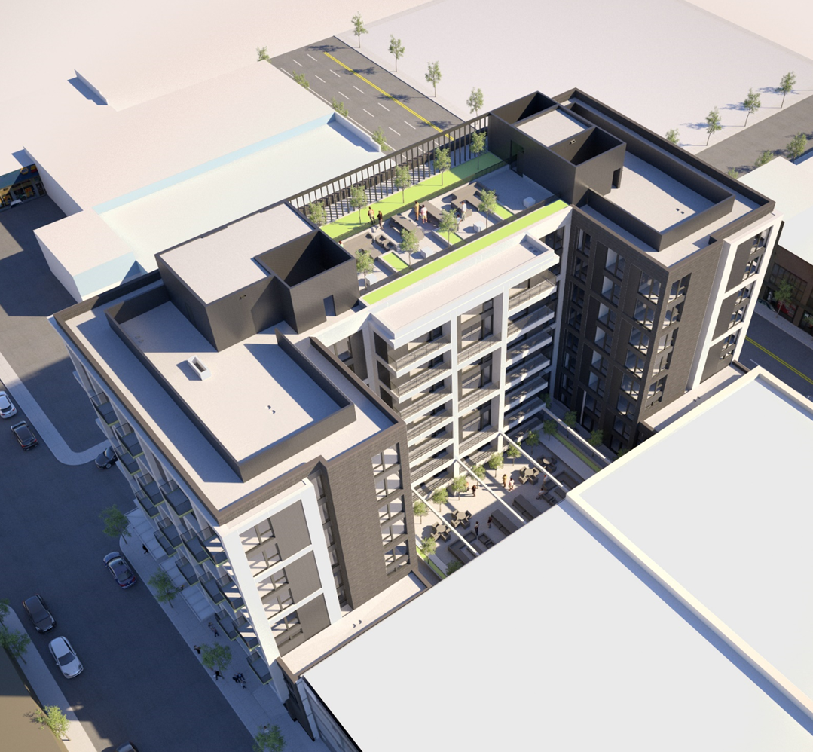
Amenities & Contracting
Senior wellness center and employment/education hub on ground floor
BBQ area and community garden
Performance art/maker space
Several large, flexible amenity spaces
Earth Advantage Gold Certification
30%+ DMWESB Contracting Goal
Notes:
MOLLY TALKING POINTS:
Project Amenities include a senior wellness center and employment and education hub on the ground floor, an outdoor courtyard with BBQ area, community garden, and a performance art and maker space. (rooftop terrace was eliminated in Value Engineering)
The Project is on track to earn Earth Advantage Multifamily Gold certification. It has many environmentally friendly components including Energy Star appliances, LED lighting, zoning controls for lighting, upgraded windows, high efficiency boilers, low VOC materials, and low flow plumbing fixtures.
The project team expects to exceed PHB’s equity in contracting goals of 30% DMWESB (Disadvantaged, Minority, Women, Emerging Small Business firms) utilization for hard costs and 20% utilization for professional services- (currently tracking 31.5% hard cost and 24% soft costs)

Slide 6
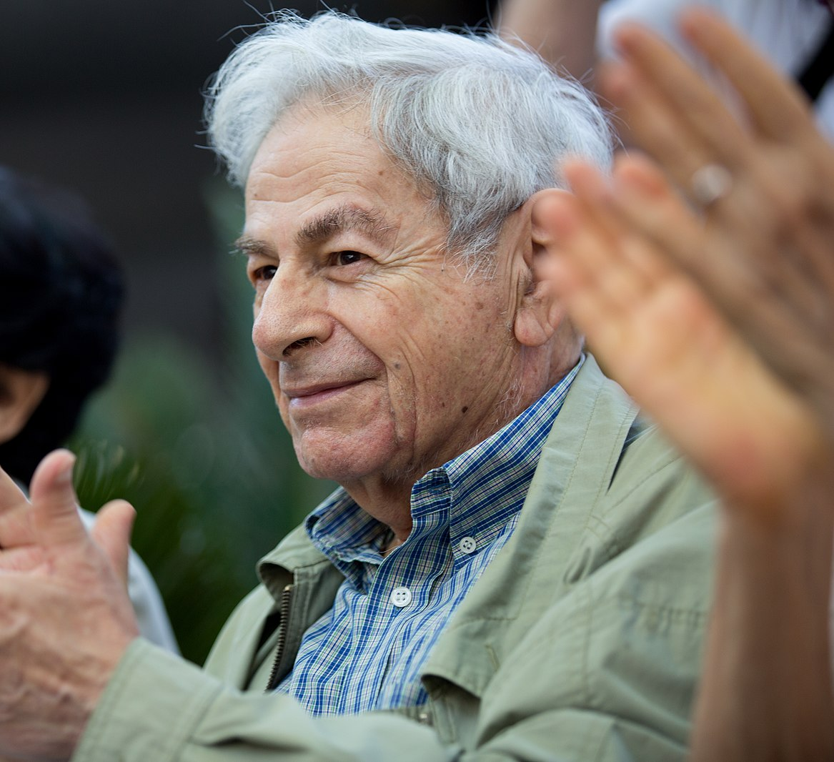
Unit Mix
159 units
  55 studios
  62 1-BR
  36 2-BR
  6 3-BR
53 units at 30% or below
106 units at 60% or below
25 supportive housing units
Notes:
MOLLY TALKING POINTS:
The Project is comprised of 55 studios, 62 one-bedroom units, 36 two-bedroom units, and 6 three-bedroom units.
Fifty-three (53) units in the Project will be affordable to individuals earning up to 30% of area median income (which is slightly less than $32,000 for a family of four)
One hundred and six units (106) units will be affordable to individuals earning up to 60% of AMI. And 25 will be dedicated to those coming out of homelessness supported by the JOHS.

Slide 7



Permanent Supportive Housing
Project-based Vouchers
PSH units supported by federal project-based vouchers via Home Forward
JOHS Operating Support
Wrap around Service Support for homeless households is $10,000 per PSH unit, per year
Service Provider
A program manager, housing specialists, and a wellness specialist provide case management and other supports for PSH households
Notes:
MOLLY TALKING POINTS:
The twenty-five (25) Permanent Supportive Housing (PSH) units in the Project will receive funding for wrap around service support provided by the Joint Office of Homeless Services (JOHS) totaling up to $10,000 per year per unit.
PSH units are intended to serve the chronically homeless or those at risk of homelessness. All twenty-five (25) of the PSH units will have rental support from Project-Based Section 8 vouchers awarded by Home Forward.
Impact Northwest will provide onsite supportive services to PSH residents including mental health case management, peer support, and access to culturally specific and supportive programming.

Slide 8





Funding Sources
Sources | Amount
PHB Portland Housing Bond | $27,231,500
PHB Central Eastside TIF | $3,133,000
4% LIHTC Equity | $36,898,698
Permanent Loan (Citibank) | $12,258,401
Metro TOD | $550,000
Deferred Development Fee | $4,400,000
Sponsor Cash | $25,000
SDC Exemptions (estimated) | $2,016,432
TOTAL | $86,513,031
PHB resources leveraged 1.85x other private & public sources
Notes:
MOLLY TALKING POINTS:
The proposed City funding is leveraged almost 2x raising over $56 million of other public and private financing.
On November 3, 2022, the PHB Housing Investment Committee recommended approval of the use of Portland Housing Bonds and Central Eastside Tax Increment Financing (TIF) funds. Total PHB direct funding support is proposed at $30,364,500
Private funding is contributed by investor Bank of America and lender Citibank and public support is from Metro and the Oregon Housing and Community Services Department.

Slide 9
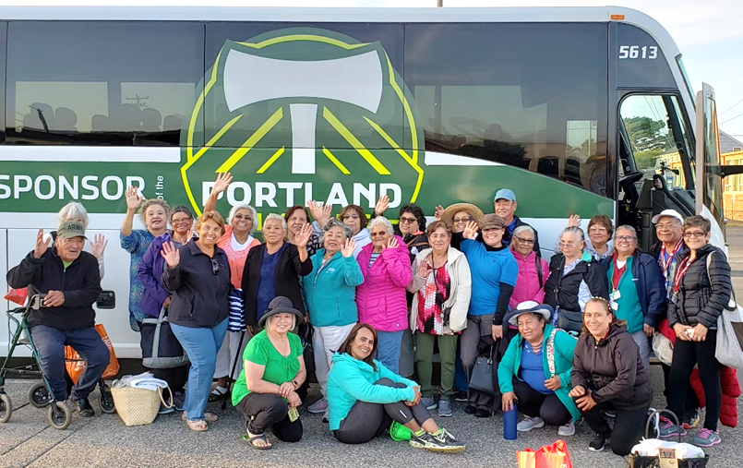


Resident Services
Centro Cultural and EngAGE Northwest
Resident Services will provide systems navigation and referrals, assistance enrolling in public assistance, food bank delivery days, cultural event celebrations, and workforce training in addition to hosting classes on computers and technology, volunteerism, intergenerational activities, and community building.
Replace this photo
Notes:
MOLLY TALKING POINTS:
The project will have robust Resident Services from Centro Cultural and EngAGE Northwest
They will provide onsite services such as housing stability support, computer and technological training, intergenerational activities, and assistance accessing social services and community benefits.

Slide 10
City Council Request
Authorize funding of up to $30,364,500 to Alder Street Partners Limited Partnership or an affiliate of Related Northwest & Centro Cultural
Authorize the Interim Director of PHB to approve amendments and execute any related documents necessary to advance the project within the maximum approved amounts
Notes:
MOLLY TALKING POINTS:
In conclusion, we are asking City Council to
Authorize funding of up to $30,364,500 to the project
Authorize the Interim Director of PHB to approve amendments and execute any related documentation as needed to complete the project within the maximum approved amounts
I am joined here today with Stef Kondor, Senior Vice President of Development, Related Northwest, SKondor@Related.com and we would be happy to take your questions.

