Slide 1
Fulton Pump Mains
Water Main Replacement Project
Jodie Inman, P.E.
Chief Engineer

Slide 2
Distribution Mains Program Background
Approximately 2,250 miles of water main
Asset Management used to identify projects based on condition and risk
Main replacement goal of 35,000 to 50,000 ft/yr.
Goals of distribution main contract projects:
Increase footage replaced to meet asset management goal
Provide a variety of contract opportunities to the community
Reduce risks
Notes:
Approximately 2,250 miles of water main
The Portland Water Bureau uses Asset Management to identify main replacement projects based on condition and risk.
Asset Management identified a main replacement goal of 35,000 to 50,000 ft/yr
This project is one of several contract projects coming forward with goals of:
increasing footage replaced
providing different

Slide 3
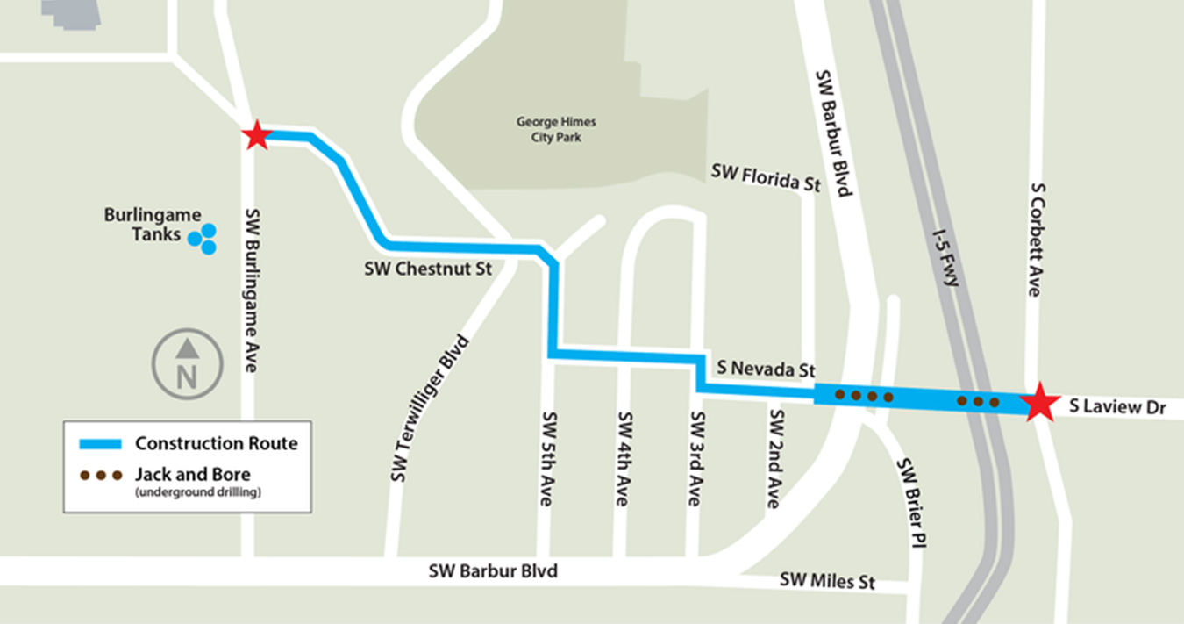
Why we’re replacing this water main
Improve the reliability
History of leaks and breaks
3,300 lf of new main
Improve resiliency
Seismic resiliency
Encasing pipe under I-5 & SW Barbur Blvd.
Reduce risk
Mitigates high risk areas
This project will benefit over 42,000 people served by the main.
Notes:
This project will benefit over 42,000 people served by the main by helping to make sure they will continue to receive safe and reliable for generations to come.
This project will:
Replace water mains in the area that are 60 to 109 years old and have a history of leaks and breaks.
Inspections show that these pipes have reached the end of their useful life
Make the water system more resilient in an earthquake
The Burlingame Tank system is considered a backbone of our water system. The construction of the Hannah Mason Pump Station called for an updated pump main system for the supply of water to Burlingame Tanks, and this project will replace the existing high risk pump mains.
We'll use a jack and bore method to drill holes for the sections of pipe that go underneath the I-5 freeway, Southwest Barbur Boulevard, and Southwest Brier Place. This means we won't have to disrupt traffic by digging trenches across the two state highways.
Asset Management at work!

Slide 4
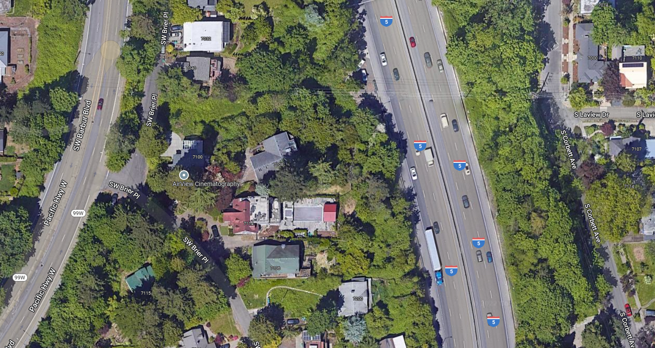
Addressing high risks
10 & 12-inch Steel Pipes Installed 1912 & 1946
16-inch Steel Pipe Installed 1958
Remaining years of useful life
16” = 68 years
12” = 16 years
10” = 2 years
Notes:
Project Fact:
Currently an uncased 16-inch steel pipe (1958) runs under the I-5 and splits into a 10-inch steel pipe (1912) and 12-inch steel pipe (1946) which run under SW Barbur Blvd. All three of these pipes have a high risk rating when evaluated using the Consequence and Likelihood Evaluation Methodology
The 10-inch steel pipe has a remaining useful life of 2 years.
The 12-inch steel pipe has a remaining useful life of 16 years.
The 16-inch steel pipe that feeds the pumped water to the 10-inch & 12-inch has a remaining useful life of 68 years. Not seismically resilient and located under key transportation infrastructure, failure could also impact Washington County supply line in the same corridor.

Slide 5
Request
Authorize bid solicitation and contracting with the lowest responsive and responsible bidder for construction of the Fulton Pump Mains Replacement Project.
Estimated cost: $4,700,000
Start date: Spring or Summer 2023

Slide 6
Questions?
Jodie Inman
503 823-1289
portland.gov/water/FPmains
PortlandWater
PortlandWaterBureau
PortlandWaterBureau
E-News: eepurl.com/gcWEjj

Slide 7
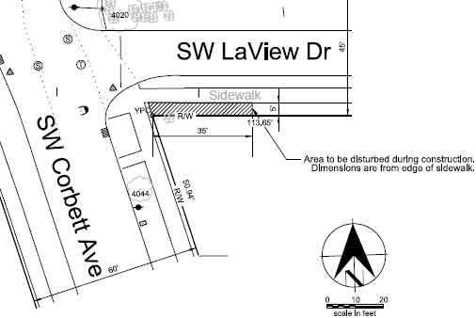
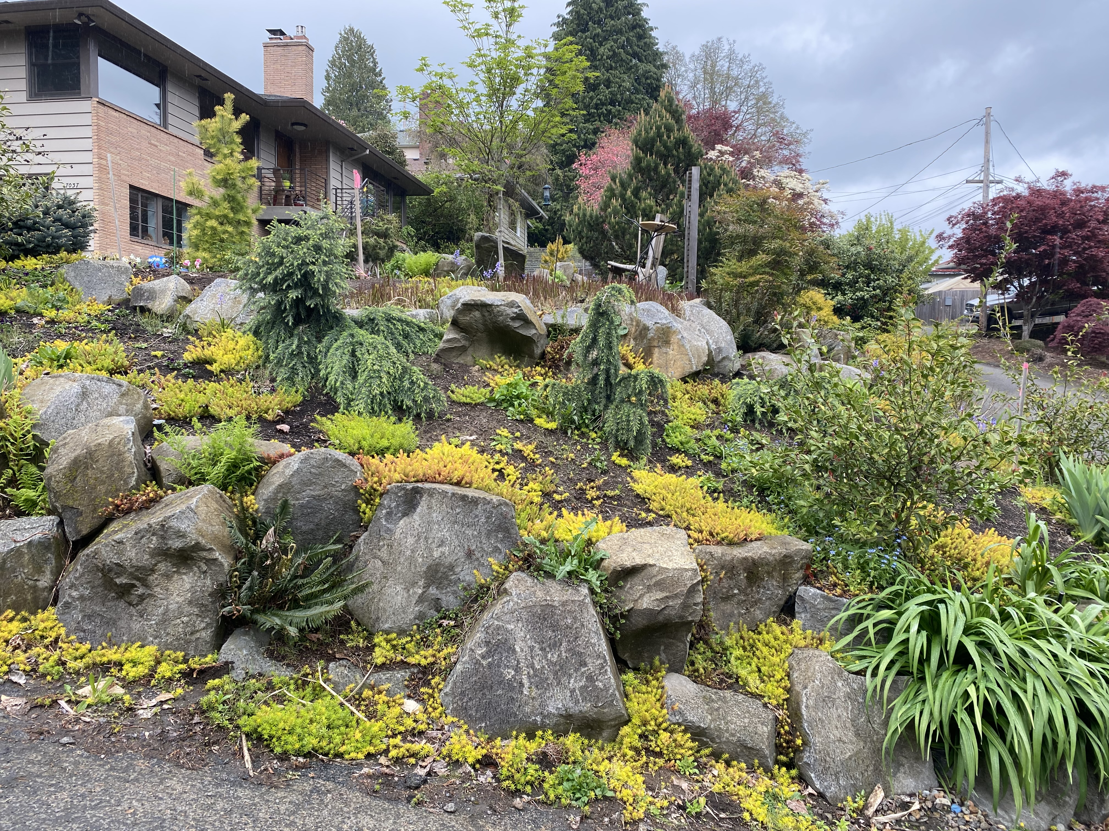
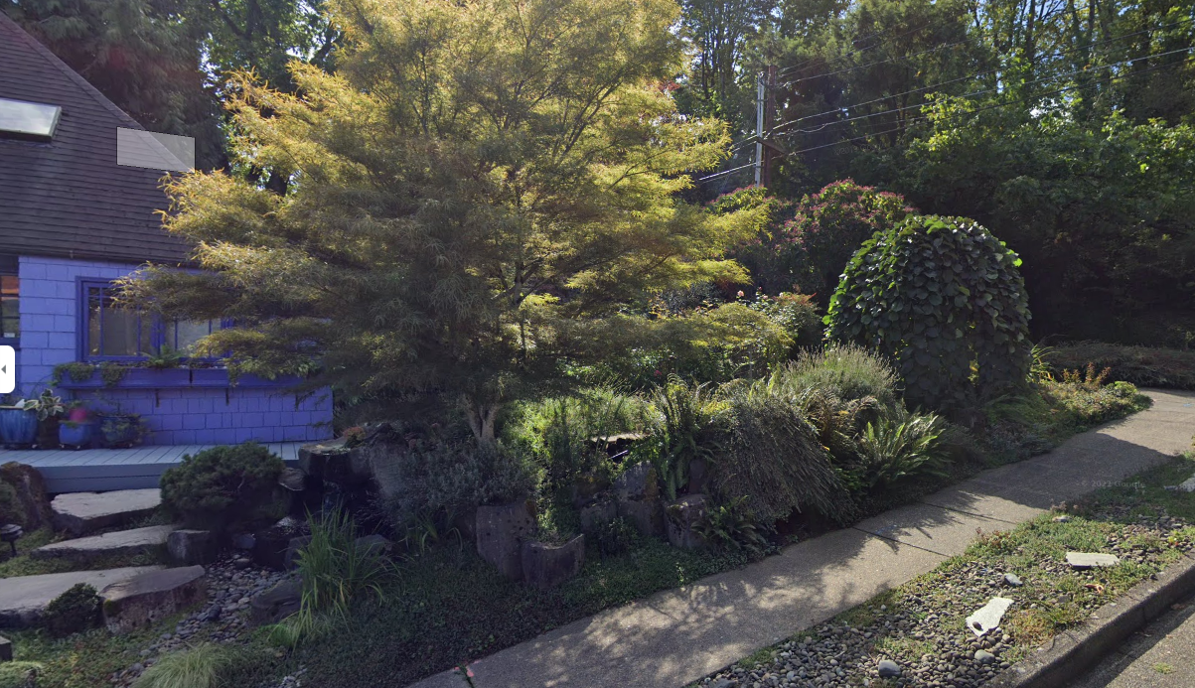
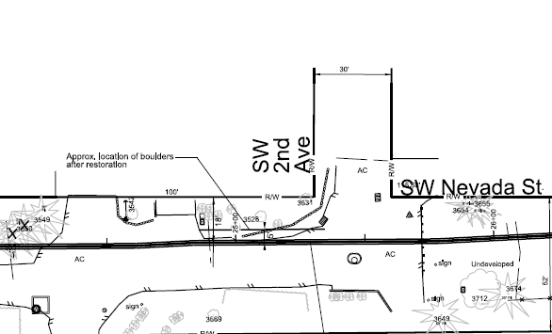
Landscaping in the Right-of-Way
Notes:
There are a few properties with unapproved improvements in the right of way that will be impacted. The two most significant are pictured here – SW Corbett and Laview and at SW 2nd and Nevada. You can see there is some pretty elaborate landscaping in the ROW where the pipes will need to go but staff have met with both property owners at their property to help them understand what is needed and give them time to move anything that they would like to keep.
We have also provided notice and offered to meet with other property owners along SW Nevada and SW 3^{rd,} who will have trees, hardscaping, or driveways in the ROW that will be impacted.
There is limited space in these areas to accommodate our pipes and other utilities in the area but we are able to keep the infrastructure and the construction in the ROW and off private property so no temporary or permanent acquisitions will be needed to complete this project.
Details if needed for properties with impacted private improvements in the right of way:
7107 S Laview Drive (Michele Laraia)– Impact to landscaping in ROW and sidewalk in LaView.
We met with this property owner twice at their home.
The work area in the right-of-way includes 35x5 ft along the inside edge of the sidewalk along SW Laview Drive
The property owner said she would:
Remove any smaller rocks in the street strip and plants in the project area that she wants to keep
Remove any irrigation or lighting systems that is in the project area
The Water Bureau said we would:
Move large rocks to upper pathway on property
Avoid water fountain if possible
Cover any roots of trees after project with topsoil
7037 SW 2nd Ave (Robert and Deborah Kessler) - Impact to landscaped slope in ROW at corner of 2nd & Nevada
Met with property owner twice at their home and responded to several email inquiries.
Alignment right along property line and trench will impact boulders that are acting as a retaining wall, trees, and shrubs.
The property owner said she would:
Remove any plants in the project area they want to keep
Remove any irrigation or lighting systems that is in the project area
The Water Bureau said we would:
Save a few plants/trees in the ROW (noted in photos sent to the property owner)
Move boulders to the staging area TBD by property owner
Re-use boulders to create retaining wall approximately 5 feet back from the alignment of the pipe and create a 1:1 slope when construction is complete
7032 SW 3rd Ave (Marilyn Stubbs)– Impact to hardscaping and plants along 3rd, tree removal at corner of 3rd & Nevada, stair railing on Nevada
We met with this property owner once at their home (8/12/21)
Understands the impacts. Does not intend to remove anything on their own. Open to having working with construction team remove what is needed.
7031 SW 3rd (Bruce Ballweber - Now Realty Group) – Impact to large black berry bushes/shrub, gravel driveway
Leased property
No response form Ballweber, made contact with Now Realty Group by phone and sent letter but no additional response
237 SW Nevada St (Vantage Homes – property owner) -Tree removal or relocation, impact to driveways in ROW
Leased property
Reached Vantage Homes by phone – no concerns
249 SW Nevada St (Margaret Cairns) - Tree removal or relocation, impact to driveways in ROW
Sent letters and attempted to reach by phone with no response

Slide 9
Backflow
LAWN IRRIGATION SYSTEMS
SWIMMING POOLS
BACKFLOW PREVENTER
INDUSTRIAL SYSTEMS
PUBLIC DRINKING WATER SUPPLY
MEDICAL SYSTEMS
Clean water
HEATING + COOLING
Backflow preventers keep contaminants from flowing back into the drinking water supply.
FIRE + SPRINKLER SYSTEMS

