Slide 1
Cully TIF District City Council Hearing November 9, 2022
Notes:
KIMBERLY
Thank you for opportunity to present about this work. My name is Kimberly Branam and I’m the Executive Director of Prosper Portland.
I’m joined today by several community partners – Candace Avalos, Executive Director of Verde, Edy Martinez, District Manager of Our 42nd Avenue and Oscar Arana, Community Development Manager at NAYA, as well as the Interim Director of the Portland Housing Bureau, Molly Rogers.
I also just want to take a minute and acknowledge that the proposal before you today is the product of co-creation between the City and community partners. This type of collaborative work requires a vast amount of time, communication, patience and trust – and I just want to thank anyone and everyone who gave time and energy to this work.
In that spirit of co-creation, we felt it was important to show up as partner today, so with that, I’ll hand it over to Candace to kick us off.

Slide 2
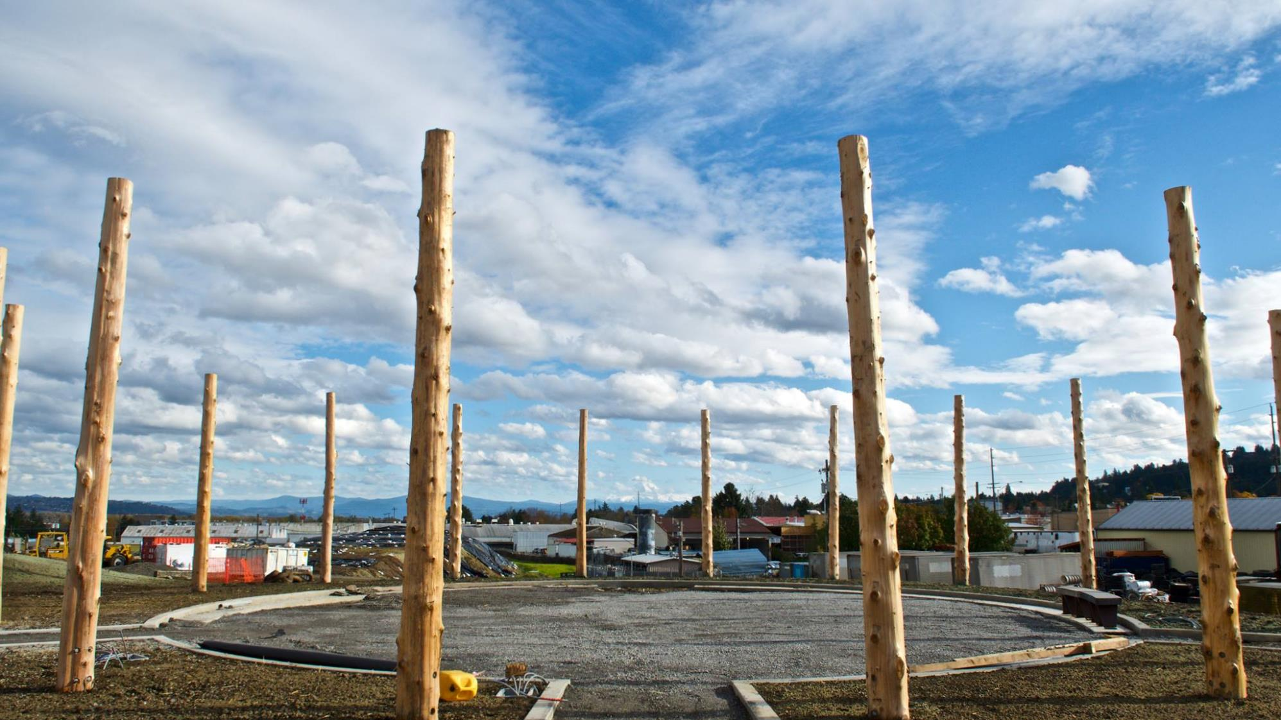
Our Agenda
Background on Cully TIF Exploration
Overview of Proposed TIF District Plan
Financial Implications
Proposed District Governance & Accountability
Next Steps
Notes:
CANDACE
Thanks, Kimberly.
As Kimberly mentioned, it was incredibly important for us to show up here together today, community and City leadership, to share about this work that began four years ago.
We’ll kick off with a little refresher from Edy Martinez on the Cully TIF exploration process
Molly Rogers and Kimberly Branam will then provide more detail on the Proposed TIF District Plan itself, what makes it different, as well as it’s financial implications
Oscar Arana will present about the governance charter, accountability and how the co-creation process will be carried forward in implementation
Then together, Molly and I will wrap up with next steps and future City Council touchpoints.

Slide 3
Exploring a New TIF Model Partnership with the Cully Community
What’s similar?
But what’s different?
Property tax-based funding tool
Action Plans guide investments
Influenced by economic and real estate market trends
Outreach & engagement to gather input on projects
City Council, Prosper Board have defined decision making authority, legal liability
3
Notes:
CANDACE
But first, a little grounding about what’s similar between this TIF proposal and prior districts: TIF is a property tax-based funding tool; project viability and community need is influenced by economic and real estate market trends; and City Council and the Prosper Portland board retain defined decision-making authority and legal liability.
But what’s different? That’s the question we know everyone is asking and what we really want to focus on. So today, as we review the exploration process, the Plan itself and the Governance Charter, we’ll start off by highlighting what’s different about each.

Slide 4
1. Background on Cully TIF Exploration
What’s Different?
Community asked question, “What if TIF could be different?”
Community-initiated and led exploration process
Early & prioritized focus on the needs of groups vulnerable to displacement
Notes:
EDY
Thanks Candace. My name is Edy Martinez and I’m the District Manager for Our 42nd Avenue – and also a member of the Exploration Leadership Committee.
I wanted to give a brief refresh of the exploration process that we highlighted in October.
What’s different: It’s important to remember that this work originated in community. Small-scale TIF, through the Neighborhood Prosperity Network, has been used in Cully for a decade, building capacity and supporting local businesses – but resources needed to be scaled up. There were some who had deep reservations about a fully scale TIF District in Cully. But we asked ourselves – “What if larger-scale TIF could be different?” What would that look like? We knew that the needs of vulnerable community members had to lead the conversation – and early outreach needed to prioritize their needs in order to develop a plan by and for what we call “Priority Communities” in the Plan.

Slide 5
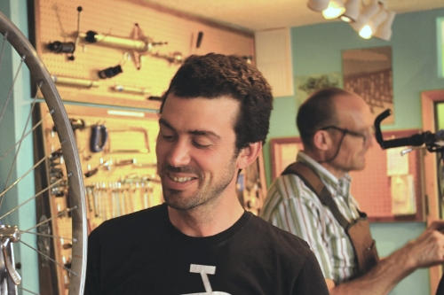
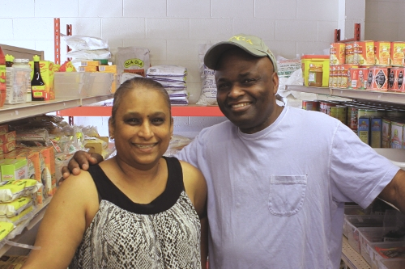
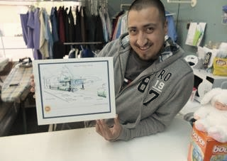
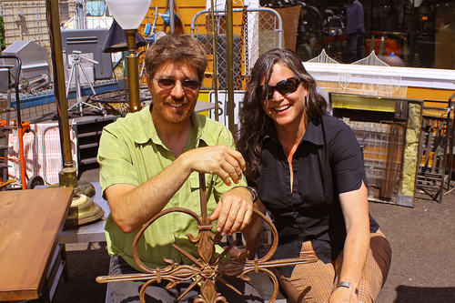
We have been using TIF in Cully for 10 years
Notes:
EDY
As mentioned earlier, through the NPNs, we’ve had access to small amounts of TIF funds for a decade.
We’ve used this money to:
Administer small scale TIF grant funding to respond to community economic development needs, from physical improvements for small business to community plazas, to managing and tenanting affordable commercial space
Highlight 2-3 different, specific grants (Edy)
These supports were critical for keeping Cully businesses afloat prior to and during the pandemic – but funds are very limited. By creating a TIF District, we can scale up this work, and additionally support affordable housing, to really help stabilizing vulnerable folks in Cully.

Slide 6
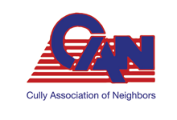
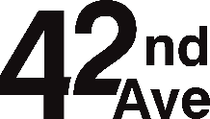
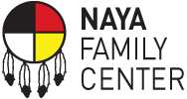
Who are the Cully Partners?
Partners + Community members at large = Exploration Leadership Committee
Cully Community Members
Notes:
EDY
As we mentioned last time, the two NPNs in Cully, the Cully Boulevard Alliance and Our 42nd Avenue, joined with other community partners, as well as general community members, to form a coalition to explore the use of TIF in Cully. This group was called the Exploration Leadership Committee.
It’s really important to highlight that this initiative and TIF district proposal was brought by the community and community partners to Prosper Portland, not the other way around. And many of the questions we received from Commissioners last time were great and really resonated with us – they’re questions we asked ourselves, and collectively worked through together with our City partners, bringing questions to focus groups and open houses to gather more input to inform our work.

Slide 7
Community Engagement
BROAD: PLACE-BASED ENGAGEMENT
Prosper Portland & Portland Housing Bureau led
DEEP: COMMUNITY-BASED ENGAGEMENT
ELC Subcommittee-led
Latine community
African American Community
Rose City Park Neighborhood Association
Cully Association of Neighbors
Beaumont-Wilshire Neighborhood Association
Low-income homeowners
Open Houses
Houseless people
Employers
Mobile home park residents
Concordia Neighborhood Association
Indigenous and tribal communities
Roseway Neighborhood Association
Small business owners & workers
Somali community
Sumner Neighborhood Association
Notes:
EDY
The Community Engagement Committee of the ELC led community-specific focus groups and other types of engagement for deep community based engagement with a strong equity lens which are described here in purple
The ELC’s engagement was both critical to drafting the preliminary community report that the ELC issued and formed a foundation for the TIF Plan and Report development. It was an iterative process.
It has also been an ongoing way that the ELC has checked back in on key issues as they arose during the TIF Plan and Report finalization, on areas like priority communities language that Molly will touch on as they discuss what’s in the TIF report
In response to broader community and Council inquiries and feedback, Prosper and PHB led broader, place-based engagement with more institutional organizations, like neighborhood associations, and large employers, and we also held public open houses to share updates on our work and gather broad input

Slide 8
Community Priorities We Heard
Community spaces for recreation, education and connection
Buy and bank land
Remove opportunity access barriers
TIF funds should be targeted on stabilization rather than broadly spent on infrastructure
Invest in stabilizing, affordable housing
Stabilize Communities Vulnerable to Displacement!
Secure additional benefits from projects and investments
Provide inclusive oversight opportunities
Support local BIPOC business
Support historical and cultural public art
Drive equitable economic opportunity
Safety-related transportation investments
Need more natural areas
Notes:
EDY
What did we hear?
We heard about the desire to ensure current residents benefit. We heard about removing access barriers. We heard about the need to buy land for future affordable housing. More than anything, we heard that above all else, we need to stabilize community – so they can stay in place, and their children can stay in the neighborhood – prospering, rather than being displaced by the growth that’s coming to Cully.

Slide 9
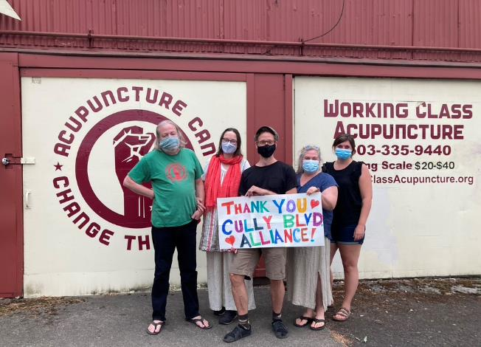
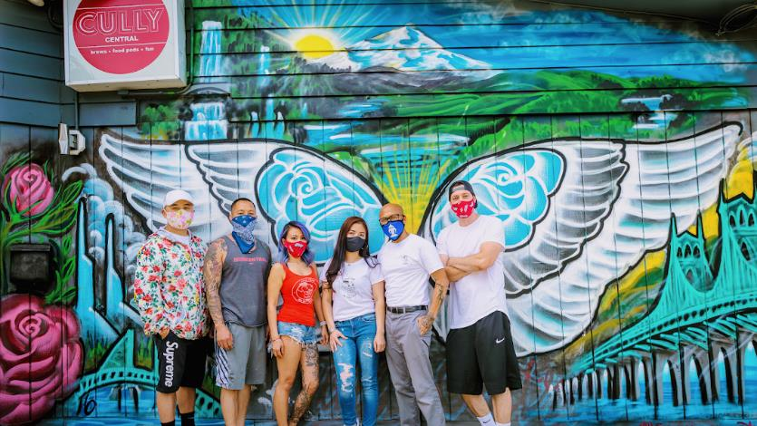
From Preliminary Report to the Plan: The Vision
Notes:
EDY
The original vision was set forth in the Community-led Preliminary Report – and was carried forward into the TIF District Plan, and will be carried forward in subsequent Action Plans.
The vision reads:
The community’s long-term vision is to transform Cully into a place that provides a sense of belonging for its residents, particularly for Priority Communities. This means Cully will have plentiful safe, affordable housing, thriving Black-, Indigenous-, and People of Color (BIPOC)-owned businesses, rewarding employment opportunities, safe and accessible transportation options, parks and open spaces, a clean and healthy environment, climate resiliency, with places and programs that reflect the cultural diversity of BIPOC individuals.

Slide 10
2. Overview of Proposed Cully TIF District Plan
What’s Different?
Co-created vision, priorities, and goals
Focus on phasing and early stabilizing investments; benefits to current residents
Priority Communities
Limit on general infrastructure spending
Notes:
KIMBERLY
Thanks Edy. My name is Kimberly Branam and I’m the Executive Director of Prosper Portland.
Molly Rogers and I are going to discuss some specifics about the plan, and then go into financial implications, but again, we wanted to highlight some thing about this plan that are different and unique:
The Plan, Report and Governance Charter were all co-created with the Exploration Leadership Committee, informed by multiple years of both broad and focused engagement.
There’s an emphasis on phasing investments to stabilize community members first, before considering larger investments to meet the Community’s Vision.
Throughout the Plan, you’ll see references to Priority Communities. We’ll come back to this later in the presentation, but in this Plan, we explicitly describe the intended beneficiaries for future investments.
And lastly, in the Plan’s Project List, there is an explicit limitation on funding for general public infrastructure, unless it’s connected to another TIF project or helps directly stabilize Priority Communities. There is a need for additional public infrastructure in Cully, but this infrastructure can be extremely expensive, and there’s a desire to reserve TIF funds to more directly stabilize residents and businesses.

Slide 11
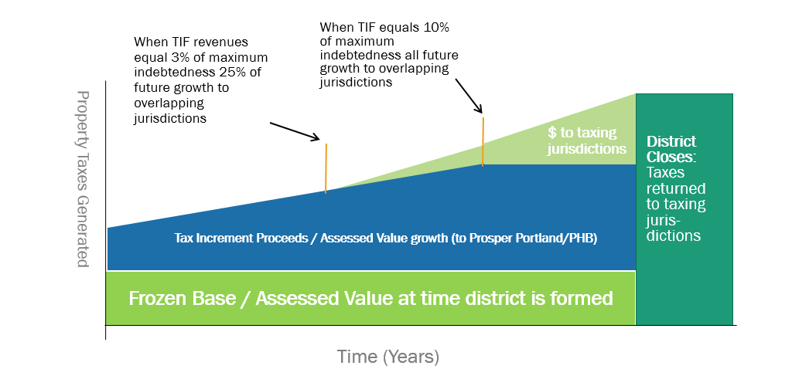
How Does TIF Work?
11
Notes:
KIMBERLY
How does TIF work?
Frozen Base – Total assessed value of all properties in the TIF area when it’s formed. This frozen based revenue stream continues to go to the regular taxing jurisdictions
When property values increase over time, taxes on this growth are referred to as the tax increment. These funds go to Prosper Portland and the Portland Housing Bureau and are available to finance projects in the Plan.
Revenue Sharing – Once a district is generating significant increment each year, a portion of the increment is shared back with affected taxing jurisdictions.
NOTES:
Will it Affect My Taxes?
Yes, but only a tiny bit. In most cases, the result will be that Prosper Portland and PHB will collect taxes that would have otherwise gone to the City of Portland, Multnomah County, and other taxing jurisdictions, not an increase in taxes.
However, the Fire and Police Disability and Retirement Fund (FPD&R) Plan is required to be fully funded. This requirement means that tax collections must be enough to provide both the amount requested for the FPD&R Plan and for TIF plans. Taxpayers pay an additional amount of taxes for this levy as a result of how taxes are assessed and collected throughout the city. The additional tax rate for the FPD&R Plan for the Cully TIF District is an estimated $0.0014 per $1,000 of assessed value in the first year of the plan, resulting in an extra $0.70 in taxes for a homeowner whose house has an assessed value of $500,000. The FPD&R rate will vary over time depending on the requirements of the plan in any given year compared to total taxable assessed value available to calculate the rate.

Slide 12
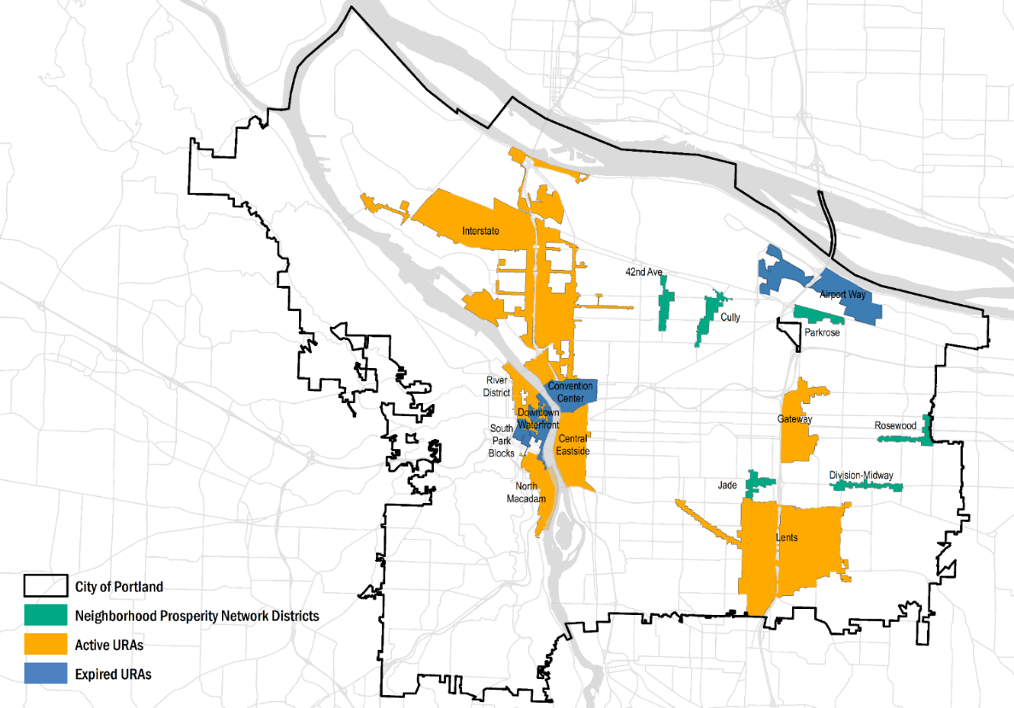
Where are Portland's TIF Districts?
Notes:
KIMBERLY
A little context setting. This map shows existing TIF Districts. The yellow represents active districts while the blue shows expired districts.
The green highlights Neighborhood Prosperity Network Districts, and you’ll notice in the Cully area, there are two of these – Our 42nd Avenue and the Cully Boulevard Alliance. You’ll be hearing more about these two partner organizations, and their role in this project, throughout the presentation.

Slide 13
Proposed Cully TIF Boundary
What’s Different?
Iterative, community-led, strategic conversations with adjacent geographies
1,623 Acres
56% single-family
25% employment/ industrial
11% multi-dwelling
4% commercial
2% mobile home parks
1% open space
Cully Park
De La Salle High School
Kʰunamokwst Park
Notes:
KIMBERLY
As you’re aware, the TIF district boundaries sets where resources can legally be invested
The process for determining the boundary was community-led, and required multiple, and often iterative conversations with adjacent geographies to determine a boundary that aligned with the goals of the Plan around residential stabilization and business support.
The boundary show on this map includes 1623 acres and is bound by 82nd Avenue on the eastern side and 42nd Avenue on the western side
The majority of the land is zoned residential in the district but the two NPNs districts – Our 42nd Avenue and the Cully Blvd Alliance capture Commercial property.
And the boundary to the north captures some of the industrial lands along Columbia Blvd to ensure resources are available to support employment lands and supporting jobs expansion opportunities to serve the community.

Slide 14
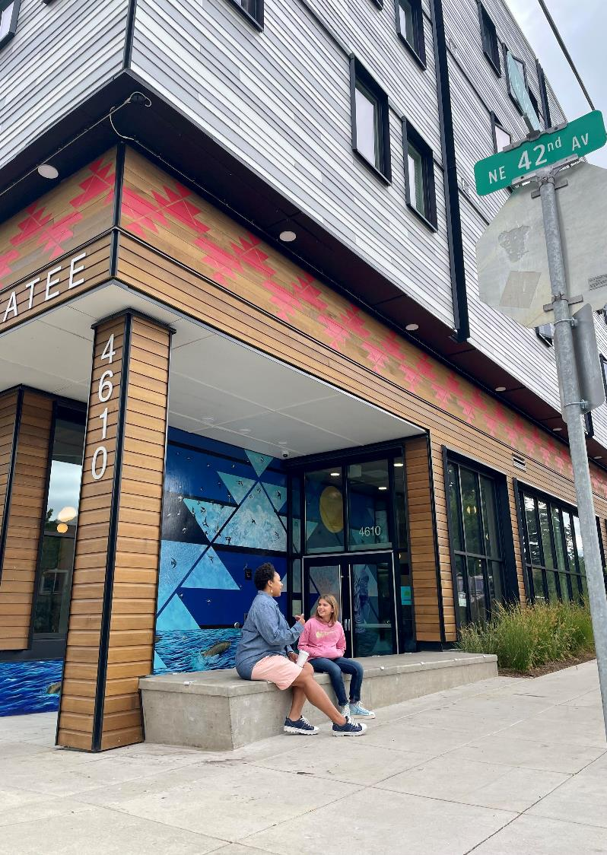
District Goals
Prevent displacement
Preserve existing opportunities for affordable housing and economic prosperity, and create new opportunities
Ensure that current resident benefit from investments
Ensure that those most affected will play lead roles
Develop and inspire a new model for TIF
Actively work to remove access barriers
Spur innovation of environment and climate change
Notes:
MOLLY
Thanks Kimberly – my name is Molly Rogers and I’m the Interim Director of the Portland Housing Bureau. I’m going to provide some additional information about the Plan itself.
The District Goals are very people focused, as you see
Preventing displacement of vulnerable people, communities, businesses and community-based institutions from Cully.
Preserve existing opportunities for affordable housing and economic prosperity activities and create new opportunities for Priority Communities
Ensure that current residents benefit from investments and neighborhood change, and that opportunities for housing and economic prosperity activities will be preserved and expanded for future generations.
Ensure that Priority Communities, those often most affected by market and displacement pressure, play lead roles in guiding decisions about investments and policies that affect them and their communities.
Develop and inspire a new model for the creation of future TIF districts in Portland and beyond.
Actively work to remove barriers that could preclude community members from accessing TIF-funded projects and opportunities, including barriers such as immigration status, credit history, legal history, rental history, eviction history, and experience of domestic violence.
Spur innovation to be a part of solution to combat climate change initiatives in TIF projects.

Slide 15
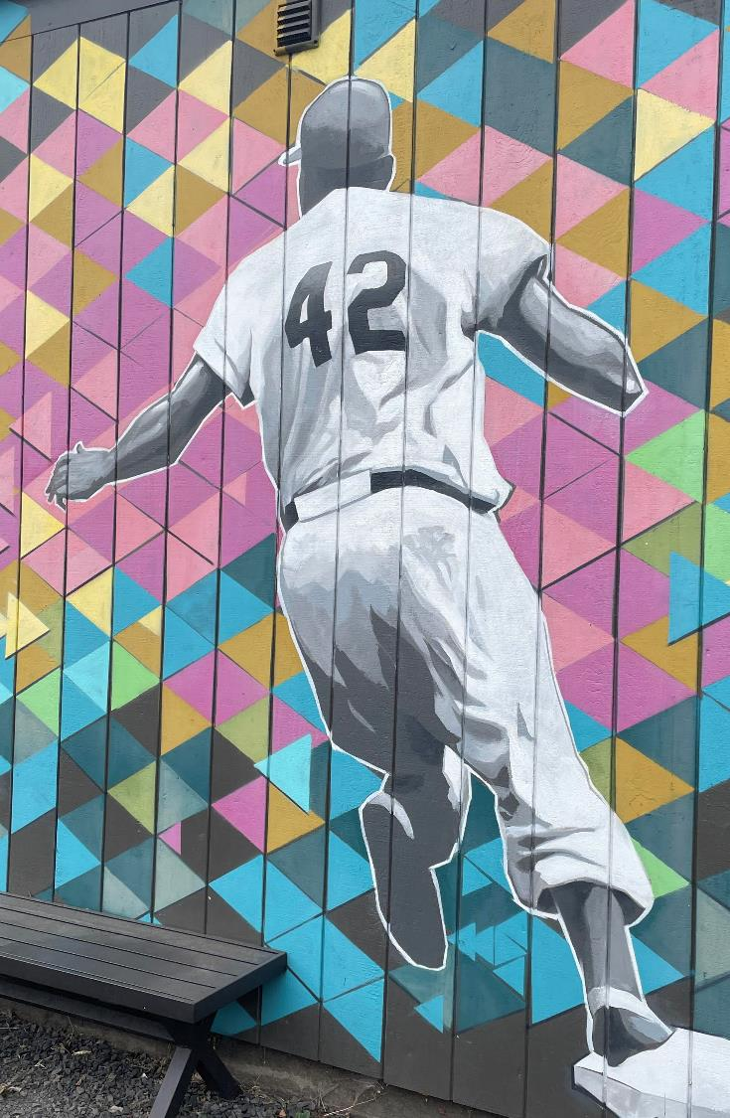
Priority Communities
“Priority Communities” refers to the intended beneficiaries of the Cully TIF District: African American and Black persons; Indigenous and Native American persons; persons of color; immigrants and refugees of any legal status; renters; mobile home residents; persons with disabilities; low-income people; houseless people; and other population groups that are systemically vulnerable to exclusion from Cully due to gentrification and displacement.
Notes:
MOLLY
Kimberly mentioned earlier that the Plan describes Priority Communities as the intended beneficiaries of the Plan. While I don’t typically read slides, this language is incredibly important and reflects weeks of collaborative efforts to craft language. So I’d like to make an exception.
“Priority Communities” refers to the intended beneficiaries of the Cully TIF District: African American and Black persons; Indigenous and Native American persons; persons of color; immigrants and refugees of any legal status; renters; mobile home residents; persons with disabilities; low-income people; houseless people; and other population groups that are systemically vulnerable to exclusion from Cully due to gentrification and displacement.
A note on this – we’ve had a number of questions around why Latine/Latinx was not called out specifically in this definition, particularly because Cully has such a large Spanish-speaking population. This was a topic of discussion among ELC members. The point of view was that not everyone who speaks Spanish identified as Latinx, and further there are many White folks who identify as Latinx but are not systemically vulnerable to displacement. Spanish-speaking community members are included in the definition, under one of more of the following categories: people of color, Indigenous, black, immigrants, refugees, or other population groups systemically vulnerable to exclusion.

Slide 16
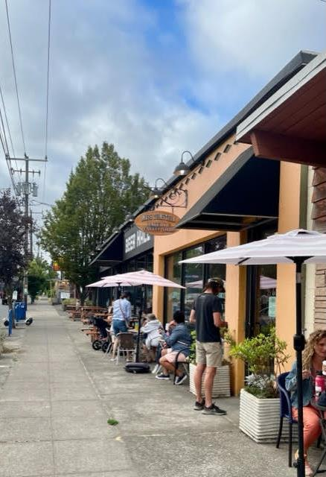
Eligible Projects List
Affordable housing, homeownership and home repairs
Business support, property acquisition, development and renovation
Arts, culture and signage
Land acquisition and land banking
Recreational improvements
Infrastructure improvements
Notes:
MOLLY
These District Priorities help inform eligible projects. Its important to highlight here, that the use of TIF is still bound by the Physical permanent improvements that develop and renovate property, within in the Boundary Identified with in the Plan. This project list is identifying the what and is important that the who (identified in the Priority Communities) is closely connected to the what to ensure the vision for the District.
The eligible project list (or the what) are:
Affordable housing, homeownership, and home repairs Examples: down payment assistance, single family home repairs, new affordable rental housing, preserving affordable housing Commercial property acquisition, development, and renovation Examples: affordable commercial space, mixed-use development that combines commercial space with affordable housing, supporting employment of community members and access to high-wage employment
Arts, culture, and signage Examples: seek opportunities to include historical and cultural public art & signage (not meant specifically for beautification)
Land acquisition and land banking Examples: buying properties for future projects, remediation of land for development
Recreational improvements Examples: community centers, community gardens and natural areas, athletic facilities (such as basketball courts), safe space for community gathering
Infrastructure improvements Examples: This is an example of a change in focus. Although infrastructure improvements are eligible project it is important to the community that these improvements are linked to projects that stabilize community

Slide 17
How TIF Plan relates to Action Plan
The TIF Plan creates a legally allowable “menu” for future TIF investments & guides action plans
TIF Plan
30-year Vision, Values, Goals
Principles that Guide Implementation
TIF Eligible Projects
Action Plans
5-year Priorities
Identify Specific Projects
Identify budget
The Action Plan sets forth a strategy for implementation: project & budget prioritization, measures of success, and accountability & oversight
Notes:
MOLLY
The TIF Plan includes the long-term vision, implementation principles and the legally allowable “menu” for future TIF investments
The 5-year action plans set forth a shorter-term implementation strategy, project and budget priorities, and measures of success, accountability and oversight.

Slide 18
3. Financial Implications

Slide 19
Maximum Indebtedness
District anticipated to reach maximum indebtedness in FY 2054-55
Proposed Uses of TIF
Affordable Housing (At least 45%) | $143.7M
Economic & Community Development (45% to 55%) | $175.7M
Debt Administration, Issuance Costs & Reserves | $30.6M
Total Maximum Indebtedness | $350M
Notes:
KIMBERLY
We discussed earlier how TIF funds are generated, and the boundary and frozen base help us estimate how much funding will be captured for the project over the life of the district to implement this work.
We are estimating this TIF District will generate a total maximum indebtedness of $350 million over the life of the district
After the financing and administrative costs, there is a net of about $319M for investment in affordable housing to small business support​.
The City Housing Set Aside policy ensures that at least 45% of TIF are allocated to the Affordable Housing Project that are with in the Portland Housing Bureau portfolio ($143.7 million)
The remaining 55% remains in the Prosper Portland portfolio. 45% minimum is allocated to economic and community development work, and the remaining 10% may be used for either affordable housing or economic and community development, depending on the specific priorities identified in the current Action Plan.

Slide 20
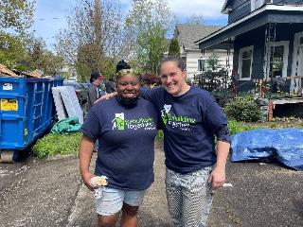
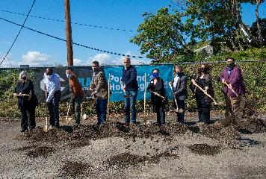
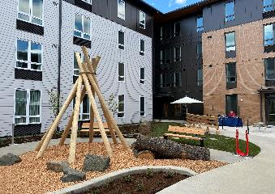
Sample Phasing and Type/Scale of Investments Years 1 - 15
 |  |  |  | Potential Investments & Sequencing​
District​ Timeline​ | Affordable Housing​ | Economic Development​ | Total​ | Stabilizing grants and loans | Land acquisition | Predev/Dev of acquired properties | Significant investment in new development
Years 1-5​ | $11M​ | $14M | $25M*​
Years 6-10 ​ | $14M​ | $16M​ | $30M​
Years 11-15​ | $22M​ | $27M​ | $49M​
Stabilizing residents
Photo Credit: Chere Nichole
Land acquisition & predevelopment
New affordable & mixed-use development
Stabilizing businesses
* Includes bonding issued at year five.​
Notes:
KIMBERLY
We’ve talked about phasing and how the amount of increment available increases over time, so we wanted to bring those pieces together.
The slide shows roughly how much money will be available for affordable housing and economic development during the first three 5-year Action Plan cycles.
In the first cycle, we’re looking mostly at smaller, stabilizing grants and loans for Priority Community residents and businesses at risk of displacement. There’s also an interest in opportunistic land acquisition for later development.
In the second cycle, we’d continue with stabilizing efforts and land acquisition, and might begin predevelopment or development work on acquired properties.
In the third cycle, we’d continue prior work, and begin to look at significant investments in new development.
Specific recommendations and priorities for each Action Plan will be developed in co-creation with a new Community Leadership Committee, which Oscar will describe later in the presentation.
The photos here show different types of TIF-funded work:
IMAGE 1: Home Repair Client
IMAGE 2: Prosperity Investment Program (PIP) grant recipient - Hair Unlimited by Chere Nichole, a salon and training facility
IMAGE 3. A Shovel Ceremony
IMAGE 4: Lents Commons.– a collaboration between Prosper Portland and the Portland Housing Bureau, which is a mixed-use, mixed-income project with 54 units of housing and retail spaces on the ground floor, including affordable commercial space.

Slide 21
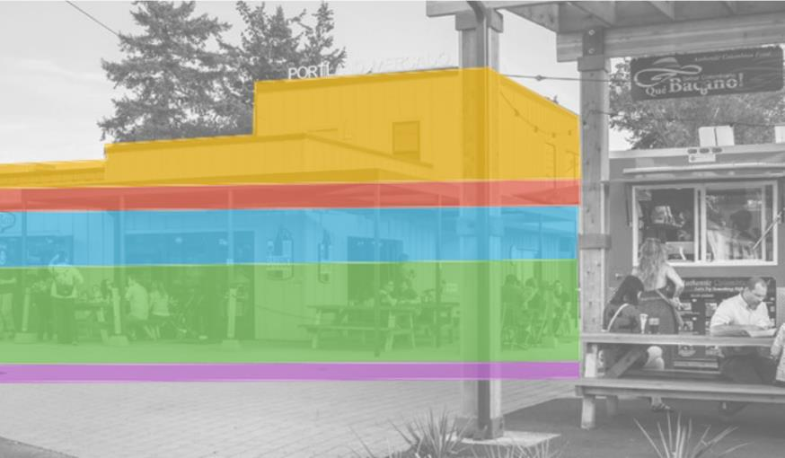
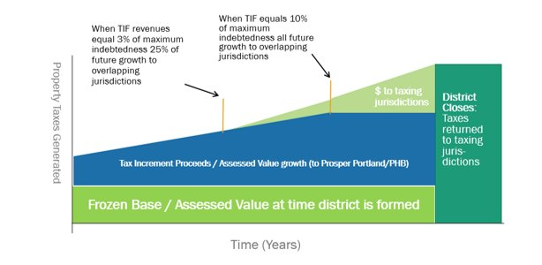
Community Development Project Examples
Portland Mercado
$0.9M Prosper Portland TIF loan
$0.2M New Markets Tax Credits
$0.6M foundation grants
$1.0M federal grants
$0.2M Prosper Portland TIF grant
Notes:
KIMBERLY
A place for dining in, taking to go and grocery shopping for the surrounding Lents & East Portland neighborhoods
Developed by Hacienda CDC
Recorded over 2.5 million in sales for 19 small businesses in the first year
Created 114 new jobs in the first year of business
Welcomed an average of 580 people per day

Slide 22
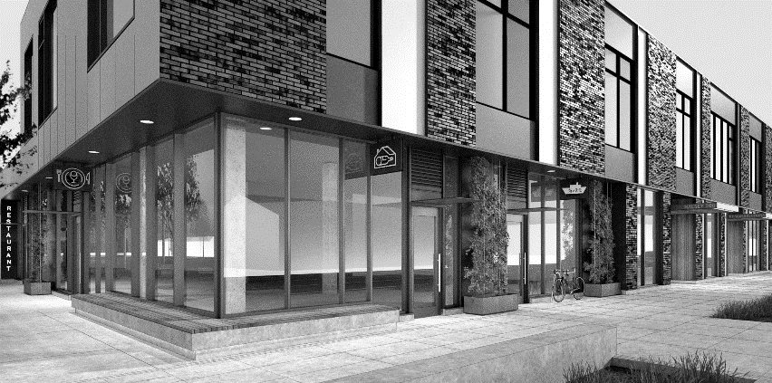
Community Development Project Examples
The Nick Fish
$0.9M
Developer equity
$1.1M
Grants + SDC Waivers
$3.5M
Prosper Portland equity
$4.0M
Bank loans
$6.0M Prosper Portland TIF loans
$7.4M PHB TIF loan
$9.6M NMTC + LIHTC Tax Credit Equity
Notes:
KIMBERLY
This slide is animated – one click for each level. The same slide later in the PPT is not animated.
This slide shows the sources side of the financing for the Halsey/106th Project. The industry jargon for this is “capital stack” because it’s exactly that: a vertical stack of money by source.
This project is a great case study. Here Prosper owned the land, Prosper also had TIF available. [The next points will depend on which project we end up using] In addition to those sources of resources, the developer also brought ?? And ?? And ??. This combining of multiple sources of funds is very common in public private partnerships and it is one of the many reasons that government partners with private developers: they have the knowledge and ability to assemble these funds and thereby bring the project to fruition.

Slide 23
Impact on Taxing Jurisdictions Revenue share anticipated to begin in FY 2038-39
General Government
Education
 | Total Impact* | Average Annual
City of Portland | $116M | $3.2M
Multnomah County | $110M | $3.05M
Multnomah County Library | $31M | $861K
FPDR Fund | $76M | $2.1M
Other (Metro, Port, East Mult. Soil & Conservation) | $7M | $55K-$83K
SUBTOTAL | $339M | $9.4M
 | Total Impact* | Average Annual
Portland Public Schools SSF | $9M $127M | $250K $3.53M
Portland Comm. College | $5M | $139K
Multnomah ESD | $8M | $222K
SUBTOTAL | $140M | $3.9M
*High end of range of impact.
Notes:
KIMBERLY
This slide shows a projection of the revenue impact to the City, County and Education based on the creation of a Cully TIF District. The total impact could be as much as $479M to pay for interest on long-term bonds as modeled for the draft Plan.
RANGES: If we only due short-term debt – the impact will be $350 million since no tax increment will be needed to pay interest; this about 72% of the high-level impact - $79M for Multnomah County and $91M to the State School Fund (or $6M to PPS). If we do a reduced amount of long-term borrowing (like half the amount) the impact will be closer to $410M; or 86% of the high-level impact - $95 million for the County and $109M (or $8M to PPS)
Lastly putting into context the returning tax increment from other TIF Districts: as we have discussed around the financial sustainability plan, existing tax increment districts are in the process of paying off and will result in substantial amount of revenues flowing back to the City, County and education districts. This is estimated to be over $330 million to the City of Portland, $341 million Multnomah County, and $375M to the State School Fund/PSPS in total over the next 10 years. Over that same period the foregone revenues related to Cully not received by the City of Portland will be $6.6 million, $6.3 million to Multnomah County, and $7.2 million to the SSF/PPS. In summary, the foregone tax impact from Cully is a small portion of the amount of additional revenue that will be coming back from existing districts.
Notes in case of questions:
Government entities affected include the City of Portland, Multnomah County, Multnomah County Library District, Metro, Port of Portland, East Multnomah Soil and Conservation District and the Fire and Police Disability and Retirement Fund.
Education entities affected include Portland Public Schools, Portland Community College and Multnomah ESD.
Important note re PPS impact: $9M impact to PPS is a very high-level estimate that is subject to number of students over 36 years in PPS, number of students over 36 years statewide, and total state school funding provided by the legislature over 36 years. Estimate provided by DOE – every $1M of foregone property tax revenue (from any jurisdiction) results in a loss statewide funding of $1.5 per average daily attendance. Calculation for PPS based on $48,500 students
Rate/1,000
$4.5770
$4.3434
$1.2100
$0.0966
$0.0701
$0.1000
$3.0000
$13.3971
Rate/1,000
$4.7743
$0.2828
$0.4576
$5.5147

Slide 24
City Taxes Returned & Taxes Foregone
Notes:
KIMBERLY:
It’s also important to look at the impacts in context. While a new Cully TIF District would redirect City funds, the amount pales in comparison to the amount being returned to the taxing jurisdictions in coming years as other districts expire.

Slide 25
4. Proposed District Governance & Accountability
What’s Different?
Joint Prosper Portland/City Committee
Co-creation roles, expectations, processes and consequences detailed in Governance Charter
Community-based staffing to support CLC and connect Priority Communities to resources
Notes:
OSCAR:
Thanks Kimberly. I am going to be talking about Governance and Accountability, and again, want to start with what’s different.
For starters, this will be the first, joint Prosper Portland/City Committee, which should help immensely with coordination.
Second, while we were developing the Governance Charter, we were all aware that few if any of us would be in our current positions 20 years from now. While we built personal relationships and good amount of trust over the last few years – we all recognized that we can’t depend on that. Because this is a 30 year plan, we wanted to really set strong expectations around co-creation, respective roles, expectations and processes; as well as consequences for not working in co-creation. This Governance Charter is a key element of the District’s long-term success.
Lastly, we all envision community-based staffing, boots on the ground if you will, to proactively connect Priority Community members to TIF resources.

Slide 26
Community Governance Charter
Goal: Lean into partnership, documenting expectations and processes to ensure TIF Plan implementation reflects in–depth guidance from Cully residents and stakeholders for the life of the district.
Community Leadership Committee (CLC)
Co-creation roles, processes, expectations
Accountability
Notes:
OSCAR
The Community Governance Charter has three major components:
It establishes the Community Leadership Committee
Establishes co-creation roles, processes and expectations
Outlines accountability measures.

Slide 27
Community Leadership Committee
Joint Prosper Portland/PHB Committee
Purpose: Provide recommendations and guidance on different types of decisions
Membership: 13 members; must live, work, worship, have kids enrolled in school or have been displaced from Cully
Representation: Individuals represent Priority Community members rather than personal or organizational interests
Notes:
OSCAR
First Joint Committee
Purpose: Advise Decision Makers on different types of decisions, providing essential guidance, recommendations, and oversight regarding the City of Portland’s and Prosper Portland’s implementation of the TIF Plan.
Membership: All 13 Committee members must either live, work, worship, have children enrolled in school, or have been displaced from within the Cully TIF District boundary; Distinct from the Exploration Leadership Committee
This Committee would be formed if/when the Plan is adopted and exist for the life of the District – really help to ensure that Priority Community voices are centered in guiding the implementation of the Plan and holding the City accountable to the goals of the Plan

Slide 28
Co-creation Roles, Expectations and Processes
CITY COUNCIL/PROSPER PORTLAND BOARD
Make final decisions
Co-created Recommendations
COMMITTEE
CITY
Reflect the needs and priorities of the Cully community, both current and future generations, as described in the TIF Plan
Make recommendations through a vote or other procedure
Comply with Cully TIF Plan
Respect Partnerships and Co-creation
Provide technical support, research, legal review, draft documents
Ensure notice to committee on public meetings related to Cully TIF District
Implement program offerings
Public input & engagement
Notes:
OSCAR
This diagram highlights the co-creation process, roles and responsibilities outlined in the Governance Charter.
Committee members are responsible for reflecting the needs and priorities of the community, making recommendations to the City.
The City provides technical support and draft documents, ensures proper notice of public meetings, and implements program offerings.
Both the committee and City promise to comply with the contents of the TIF Plan and respect the partnership.
Together, they will co-create recommendations by working through challenges together, and jointly bring them to decision-makers.
It’s also important to note that this process doesn’t happen in a vacuum. All Committee meetings will be open to the public, and additional engagement to get broader public input will be conducted as part of Action Planning.

Slide 29
Accountability
Co-creation Missteps: Gives examples of breakdowns in the co-creation process
Escalation Paths: Charter defines escalation paths for all parties if they feel another party is not acting in co-creation
Annual Report: Committee will submit a report to City Council summarizing their perspective, concerns and recommendations. As part of the report, the Committee may recommend termination of the District.
Notes:
OSCAR
Governance charter gives examples of co-creation breakdowns and defined clear escalation paths in case problems arise.
The Charter also states that the Committee will submit an annual report to City Council summarizing their perspective on how the District is working. It spells out in the Charter, that as part of that report, the Community Leadership may recommend termination of the district.

Slide 30
5. Next Steps
What’s Different?
Community-based staffing to support the Leadership Committee and proactively connect Priority Community members to resources
Community Leadership Committee (CLC) is first City/Prosper Portland advisory body
Notes:
CANDACE
But we’re not done.
On the next slide, I’m going to touch on next steps and touchpoints with City Council, but in the spirit of highlighting what’s different, I want to highlight a few things.
We are working with Prosper Portland and PHB on a community-based staffing proposal to help with engagement, support and co-coordinate the new Community Leadership Committee, and to proactively connect Priority Community members with TIF resources. We are developing scopes of work and determining what is and isn’t TIF eligible, and we may be back to discuss the proposal once complete.
Second, before we can kick off the inaugural Action Plan, we need to get the Community Leadership Committee in place. The Governance Charter spells out the desired qualities of a member of this body, which will be the first joint City/Prosper Portland advisory body – and we’ll be coming back to City Council to appoint that committee. Those appointments will be critical, and we hope the Council can appoint members who support and align with the desired vision, goals and principles in the TIF Plan.

Slide 31
City Council’s Role in Implementation
Community Staffing Proposal
Spring 2023
CLC
Appointments
Summer 2023
Cully TIF 5-year Action Plan
2024
Annual Accountability Report
2024
Notes:
CANDACE does 1 and 4; MOLLY does 2 and 3
1. Community Staffing Proposal (Spring 2023):
Support CLC members, connect Priority Community members to TIF resources
Co-create scopes of work for community-based staff
Identify ongoing funding sources for staff
2. CLC Appointments (Summer 2023)
Appoint slate of 13 Committee members
Ensure Committee members support stabilization goals of TIF Plan
Ensure Committee members represent Priority Community needs
3. Cully TIF 5-year Action Plan (2024)
Identify investment priorities for first five years of district
Identify specific projects for investment, funding for non-TIF eligible items
Identify accountability metrics for Plan priorities
4. Annual Accountability Report (2024)
Annual report on the status and functioning of the District
Identify challenges, recommendations for improvement
May recommend termination of TIF District

Slide 32
Questions?
Notes:
CANDACE
And with that, we’re happy to take any questions you might have. Thank you.

Slide 33
Parking Lot Slides - briefings
Notes:
Roger + All

Slide 34
Demographics
Race & Ethnicity
Black Population by Year
Race | Cully % (2010) | Cully % (2020) | Cully # (2020) | Portland %
White | 66% | 67% | 17,900 | 69%
Black | 13% | 7% | 1,870 | 6%
American Indian/Alaska Native | 0% | 1% | 297 | 1%
Asian | 5% | 5% | 1,400 | 9%
Native Hawaiian/APO | 0% | 0% | 8 | 1%
Other Race | 0% | <1% | 100 | <1%
Two or More Races | 2% | 4% | 1,200 | 5%
Hispanic | 13% | 14% | 3,800 | 10%
Year | Black Population
2000 | 2,260
2013 | 4,120
2014 | 3,500
2017 | 2,450
2019 | 1,960
2020 | 1,870
Source (above): State of Housing Reports, Roseway-Cully Neighborhood Profiles, PHB; 2020 data ECONorthwest. Source (left): ECONorthwest

Slide 35
Multifamily Rental Housing
 | Cully TIF | Portland
Exiting Multifamily Units | 2,000 | 108,100
Q1 2022 Vacancy Rate | 2.8% | 6.2%
Average Rent | $1,107 per unit | $1,475 per unit
Average Rent per sf | $1.56 | $2.03
Average Studio Rent | $1,250 | $1,200
Average 1BR Rent | $1,030 | $1,420
Average 2BR Rent | $1,140 | $1,680
Average 3BR Rent | $1,340 | $1,840
35

Slide 36
Commercial Real Estate Market
Cully TIF
Portland
Existing Square Feet | 421,400 | 58,935,100
Q1 2022 Vacancy Rate | 5.3% | 15.5%
Base Rent/Sq Ft. | $17.36 | $26.98
OFFICE
Existing Square Feet | 962,800 | 40,591,000
Q1 2022 Vacancy Rate | 1.4% | 4.3%
NNN Rent/Sq Ft. | $31.57 | $19.98
RETAIL
Existing Square Feet | 3,564,400 | 95,890,700
Q1 2022 Vacancy Rate | 1.9% | 5.1%
NNN Rent/Sq Ft. | $8.83 | $9.89
INDUSTRIAL

Slide 37
Key TIF Transportation Investments Since 2000
Light Rail
MAX Red Line ($8.6M, Airport Way of $23M total pre-2000)
MAX Yellow Line ($30M, Interstate)
MAX Green Line ($21M, Lents/Gateway/Downtown)
MAX Orange Line/Tilikum Crossing ($10M, N Macadam)
Streets & Streetcar
Streetcar/Streetcar Loop ($40M CES, OCC, DT, N. Macadam)
Burnside-Couch Couplet ($5.6M Downtown/Central Eastside)
SW 4th Avenue ($1M North Macadam)
Earl Blumenauer Bridge ($4.5M Oregon Convention Center)
3rd and 4th Streetscapes ($7.2M Downtown)
Front Avenue/Naito ($2.9M Downtown)
South Waterfront: Tram ($9M North Macadam)
South Waterfront: Central District Streets ($6.7M N. Macadam)
South Waterfront: Bond Avenue ($4.1M North Macadam)
Halsey/Weidler: ($2.7M Gateway)
Foster (52nd to 89th) and 122nd ($3.3M Lents)
Interstate/Killingsworth Street/Scape Improvements ($11.5M)
MLK Jr Blvd/Alberta Improvements ($7M OCC)

Slide 38
TIF Project/Program Expenditures
FY 2000-21 to FY 2021-22 - $1.8 Billion

Slide 39
Recent TIF Investments in PBOT Projects FY 2015-2021 - $24M
102nd Crossing | $100,000
10th and Yamhill Garage | $5,000,000
Bond Avenue Design and Construction | $4,101,000
Central City Transportation Study | $95,114
Earl Blumenauer Bridge | $4,500,000
Foster Streetscape | $650,000
Foster Streetscape Final Design | $1,453,596
Foster Streetscape Preliminary Engineering | $486,200
Halsey Weidler Phase II | $1,647,600
Halsey Weidler Streetscape | $192,944
Killingsworth Phase II Construction | $2,065,672
Lombard Pedestrian crossings | $1,000,000
Springwater connector | $700,000
SW 4th Avenue Design and Construction | $944,860
West Burnside Circulation | $1,108,130

Slide 40
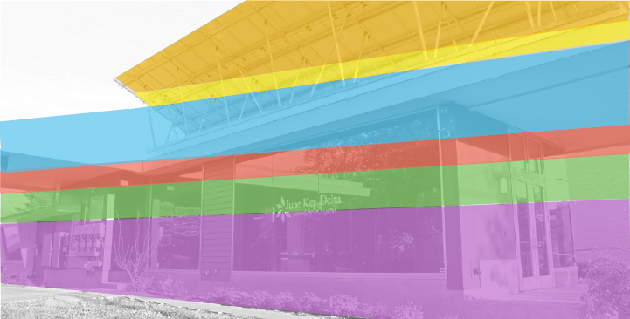
Community Development Project Examples
June Key Delta Community Center
$135K Prosper Portland TIF loan
$35K Business Energy Tax Credits
$250K Capital Campaign
$73K Other grants (including ETO)
$117K City of Portland grant
$320K Prosper Portland TIF grant

Slide 41
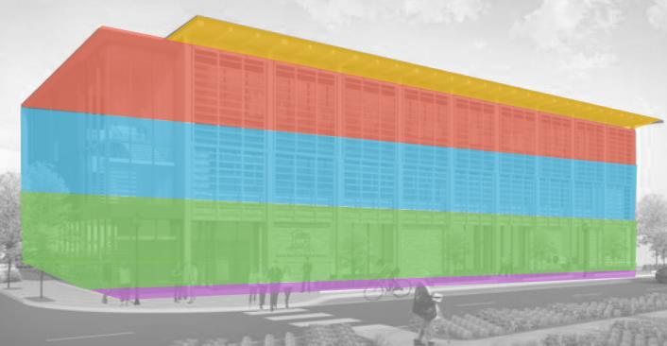
Community Development Project Examples
Asian Health & Service Center
$1.3M bank loan
$4.9M Prosper Portland TIF loan
$5.1M New Markets Tax Credits
$4.6M Capital Campaign
$0.02M ETO and Prosper Portland TIF grant
Notes:
30,000 square foot commercial building with the mission of bridging between Asian and American cultures, reducing health inequity, and improving health care quality for all Asians
Offices for 25 employees, community and clinic services, and event space
Rooftop garden and on-site parking

Slide 42
Community Development Project Examples
Portland Mercado
$0.9M Prosper Portland TIF loan
$0.2M New Markets Tax Credits
$0.6M foundation grants
$1.0M federal grants
$0.2M Prosper Portland TIF grant
Notes:
A place for dining in, taking to go and grocery shopping for the surrounding Lents & East Portland neighborhoods
Developed by Hacienda CDC
Recorded over 2.5 million in sales for 19 small businesses in the first year
Created 114 new jobs in the first year of business
Welcomed an average of 580 people per day

Slide 43
Community Development Project Examples
The Nick Fish
$0.9M
Developer equity
$1.1M
Grants + SDC Waivers
$3.5M
Prosper Portland equity
$4.0M
Bank loans
$6.0M Prosper Portland TIF loans
$7.4M PHB TIF loan
$9.6M NMTC + LIHTC Tax Credit Equity
Notes:
This slide is animated – one click for each level. The same slide later in the PPT is not animated.
This slide shows the sources side of the financing for the Halsey/106th Project. The industry jargon for this is “capital stack” because it’s exactly that: a vertical stack of money by source.
This project is a great case study. Here Prosper owned the land, Prosper also had TIF available. [The next points will depend on which project we end up using] In addition to those sources of resources, the developer also brought ?? And ?? And ??. This combining of multiple sources of funds is very common in public private partnerships and it is one of the many reasons that government partners with private developers: they have the knowledge and ability to assemble these funds and thereby bring the project to fruition.

Slide 44
Affordable Housing Set Aside 2006-2019
TIF District | 0 – 30% AMI Rental | 31-60% AMI Rental | 31-60% AMI Ownership | 61-100% AMI Ownership | Predev/ Acquisition/ Cmty Facilities
Gateway | $0.5M | $6.0M | $0.8M | $0.1M | $2.3M
Interstate | $8.3M | $13.6M | $2.7M | $11.6M | $8.3M
Lents | $4.2M | $20.7M | $5.0M | $11.6M | $2.7M
North Macadam | $8.3M | $21.8M | - | - | $7.3M
Downtown Waterfront | $11.3M | $5.9M | - | - | $0.1M
River District | $21.6M | $51.9M | - | - | $31.4M
South Park Blocks | $26.8M | $8.3M | - | - | $5.7M

Slide 45
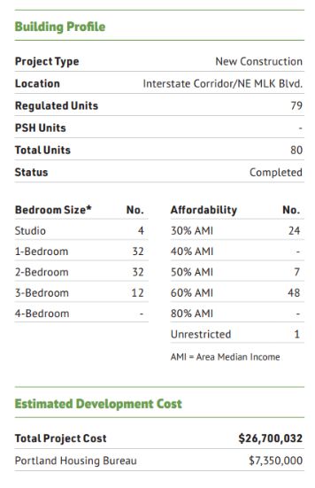
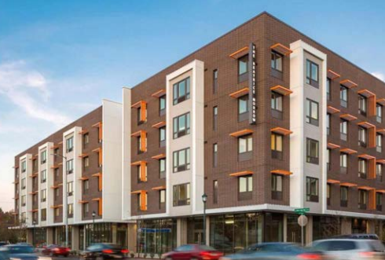
Affordable Housing Project Examples
Beatrice Morrow
Development Team:
PCRI, Sponsor
Carleton Hart Architecture, Architect
Colas Construction Inc., General Contractor
Edlen & Co., Construction Firm
Cascade Management, Property Management

Slide 46
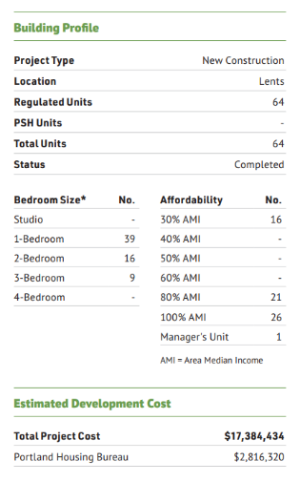
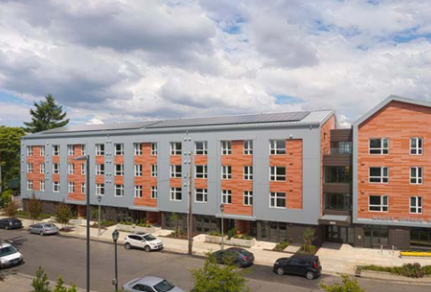
Affordable Housing Project Examples
Woody Guthrie/Lents TIF District
Development Team:
Rose CDC, Sponsor & Developer
Carleton Hart Architects, Architect
Walsh Construction Company, General Contractor
Cascade Management Inc, Consultant

Slide 47
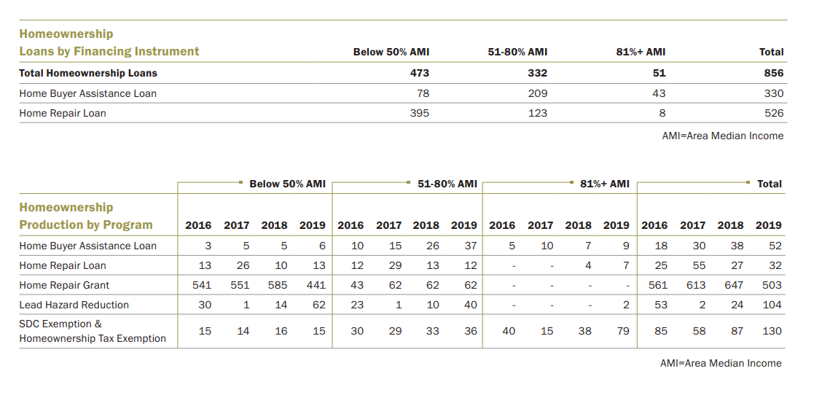
Home Ownership Program

Slide 48
Parking Lot Slides - ?s
Notes:
Roger + All

Slide 49
Will this affect my property taxes?
Year 1: ↑ 70₵
Year 10: ↑ $5.40
$500,000 home
Notes:
Yes, but only a tiny bit.
Tax increment raised to pay for the Cully Urban Renewal Plan is generated by applying the tax rates of overlapping jurisdictions (City, County, School Districts) to the growth in assessed value.
In most cases, the result will be taxes foregone by the City, County, and School Districts and not an increase in taxes.
However, the Fire and Policy Disability and Retirement Fund (FPD&R) Plan is levied at a rate required to fully fund the plan. Taxpayers need to make up the difference.
Assuming 0.005/1,000 is the portion of FPDR to Cully, a $500,000 house would pay about an extra $0.70 in the first year of the Plan and $5.40 in year 10 of the plan.

Slide 50
2. Priority Community Engagement
Strategies:
8 community leaders
44 public meetings with Priority Communities; 4 advertised for all
Interpretation as needed; 1-on-1 as needed
Multilingual materials
2 online surveys, nearly 400 responses
RACE
* 49 individuals did not respond to question.
HOUSING STATUS
* Additional 7 individuals responded “other.”
* 13 individuals did not respond to question.
Notes:
Share additional detail on the engagement of Priority Communities?
Engagement of Priority Communities. The Exploration Leadership Committee (ELC) Community Engagement Committee (CEC) led deep equity centered engagement. The CEC consisted of ELC members, additional staff from the partner organizations, and community members at-large. The CEC contracted Community Leaders from Priority Communities to tap into a deeper network and support outreach to community members that CEC members did not already have connections with.
Engagement strategies/practices. To inform development of the TIF Plan, a variety of methods were used to engage Priority Community members, with engagement led and performed by Cully-based community organizations:
Involved eight Community Leaders from priority communities in engagement planning so that it would be culturally relevant and accessible.
44 public meetings with Cully Priority Community members and four meetings open to all and promoted to the entire Cully neighborhood, for a total of 500 participants across all 48 meetings.
Zoom meetings with interpretation as needed.
1-on-1 conversations with community members who did not have access to online meetings.
Multilingual phone, direct email, text message, social media, fliers, and in person communication to promote meetings and surveys.
Two online surveys focused on Priority Communities, both in English and Spanish, for a combined total of 389 qualifying response. Non-qualifying responses were spam, duplicates or from individuals not from Priority Communities.

Slide 51
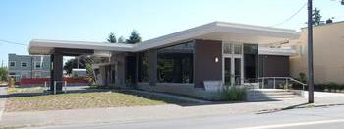
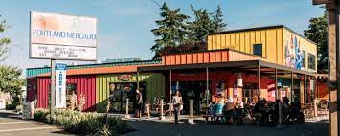
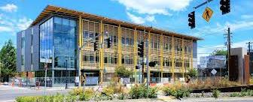
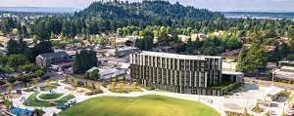
4. Examples of Stabilizing Investments
Affordable Housing
June Key Delta Community Center (2011)
Portland Mercado (2016)
Asian Health & Service Center (2018)
The Nick Fish (2021)
Total Regulated Units | 5,999
30% AMI | 1,338
40% AMI | 327
45% AMI | 132
50% AMI | 1,582
55% AMI | 118
60% AMI | 2,307
65% AMI | 3
80% AMI | 155
Total Projects | 98
Central Eastside | 4
Downtown Waterfront | 15
Gateway RC | 2
Interstate Corridor | 41
Lents Town Center | 13
North Macadam | 2
Oregon Convention Cntr | 3
River District | 11
South Park Blocks | 7
Notes:
Examples of projects you would point to as stabilization investments in other TIF districts?
June Key Delta Community Center (2011). A “green” living building project developed, owned, and operated by the Portland Alumnae Chapter of Delta Sigma Theta Sorority, Inc. that provides and sustains the needs of the multi-cultural neighborhood it serves, encouraging sound and healthy social, educational, artistic, economic, and environmental development and awareness. Development of the project included a $135,000 Prosper Portland TIF loan and a $320,000 Prosper Portland TIF grant.
Portland Mercado (2016). The Mercado is a hub for Latino culture in Portland the provides affordable retail space for businesses to launch and grow. An initiative of Hacienda CDC, the dream was to develop the first Latino public market in Portland in response to wealth disparities in the region and the strong community desire to have a center for commerce based on Latino Heritage. Development of the project included a $900,000 Prosper Portland TIF loan and a $200,000 Prosper Portland TIF grant.
Asian Health & Service Center (2018). The Center, called the House of Love and Kindness, serves as a permanent home for AHSC to provide healthcare, education, essential services and information through programs like the Ethnic Meals Program, Health Insurance Assistance, Wellness Groups, the Anti-Asian Hate Project and Wraparound Support. Development of the project included a $4.9M Prosper Portland TIF loan and a $20,000 ETO and Prosper Portland TIF grant.
The Nick Fish (2021). A multi-partner collaboration between Prosper Portland, PHB, Our Just Future (Human Solutions) and Gerding Edlen, the Nick Fish is a mixed-use, mixed-income catalytic project in the Gateway Regional Center TIF District adjacent to Gateway Discover Park. The lobby art was commissioned by Our Just Future (formerly Human Solutions) and includes the history of the site and the diverse cultures associated with it. The project provides nine retail spaces and 75 total housing units, 52 of which are affordable at or below 60% MFI and an additional five at or below 80% MFI. Development of the project included $3.5M in Prosper Portland equity, $6M in Prosper Portland TIF loans and $7.4M in PHB TIF loans.
Numerous affordable housing projects, including projects like the Beatrice Morrow in the Interstate TIF District and the Woody Guthrie in the Lents TIF District. There are 98 TIF-supported projects across nine TIF Districts, for a total of 5,999 total regulated units. AMI levels for these units, as well as the number of projects per district, are below. Additional information can be found in the PHB memo at the end of this document.

Slide 52
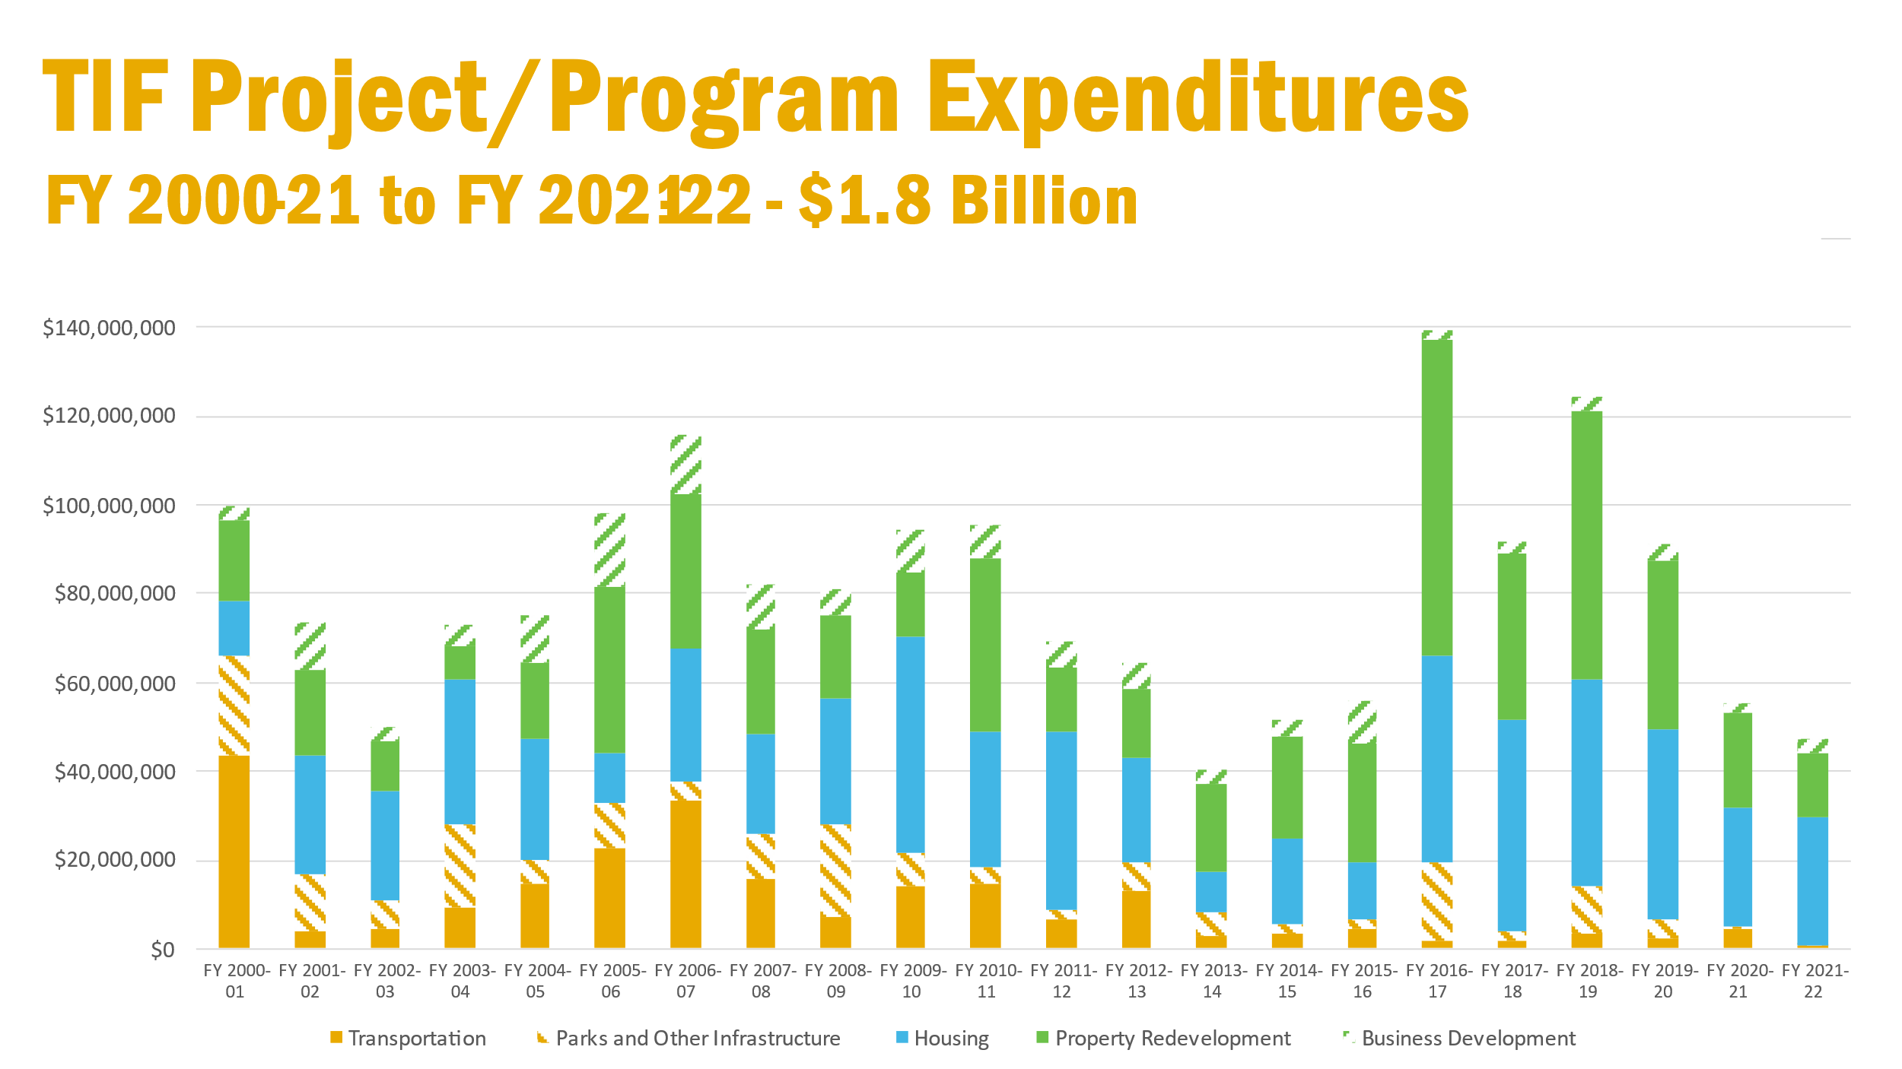
5. TIF Resources – Transportation, Infrastructure
Notes:
How have TIF resources been used, specifically related to transportation & infrastructure investments?
Over the last 20 years, approximately 23 percent of TIF expenditures have gone toward transportation, parks and other infrastructure (orange and orange hatch). Property redevelopment investments (via small business tenant improvements and commercial property loans; land acquisitions; and public/private redevelopment project investments) in green and affordable housing (via multifamily affordable rental project investments and home ownership grant programs) in blue comprise the largest categories of spending, at 33 and 36 percent respectively, and business development in green hatch comprises the remaining 8 percent.
Whereas early investments in Lents, Gateway and Interstate focused heavily on a local match to mass transit investments, the levels of funding for each project/program type have intentionally shifted over time, with the percentage of money allocated to transportation/parks/infrastructure (solid and orange hatch) declining and funding for housing (blue) and property redevelopment (solid green) increasing.
The proposed Cully TIF District Plan envisions the allowance of TIF funds on infrastructure, but only when they are “triggered by or directly support community stabilization for Priority Community members, or the implementation of other investments in this Plan, but not for general infrastructure improvements.” (p. 30)

Slide 53
6. Financial fundamentals
District Timeline | Affordable Housing | Economic Development | Total
Years 1-5 | $11M | $14M | $25M
Years 6-10 | $14M | $16M | $30M
Years 11-15 | $22M | $27M | $49M
Years 16-20 | $21M | $25M | $46M
Years 21-25 | $30M | $37M | $67M
Years 26-30 | $46M | $57M | $103M
Total | $144M | $176M | $319M
Affordable Housing
Affordable Rental Preservation and Development
Homeowner Assistance
Economic Development
Business tenant and storefront improvement loans
Small business tenant and storefront improvement (PIP) grants
Anchor nonprofit (CLG) interior or façade improvement grants to buildings and spaces serving community functions
Land acquisition
Loans for smaller scale development (often redevelopment)
Loans for larger scale development (often new developments)
Notes:
6. Please explain the financial fundamentals of the TIF District
The following table reflects the amount of money available for projects in 5-year tranches. It’s important to note that the majority of funds in years 1-5 comes at the end of the period as part of bonding issued at year five.
[TABLE]
For affordable housing, funds shall be dedicated pursuant to the Tax Increment Financing Set Aside for Affordable Housing Policy and may be used for:
Affordable Rental Preservation and Development. The development, preservation and rehabilitation of housing and related income guidelines that make housing affordable to households with incomes of 0-60% Median Family Income.
Homeownership Assistance. The development of, or homebuyer assistance to encourage homeownership within the City of Portland for families with children to the extent permitted under federal, state, and local Fair Housing Laws
For economic development, funds may be used in the following ways:
Business tenant and storefront improvement loans. Usually smaller in scale, in the $50,000- $200,000 range. Prosper Portland recently provided a $78,000 TI loan to a BIPOC owned men’s wear store in OTCT and a $410k TI loan to a majority BIPOC-owned bakery in Central Eastside.
Small business tenant and storefront improvement (Property Improvement Program) grants. Up to $75,000 grants per project.
Anchor nonprofit (Community Livability) interior or façade improvement grants to buildings & spaces serving community functions. Typical grants range from $10,000-$50,000. The total maximum grant for an organization is $300,000.
Land acquisition. Usually starting at $750,000 or $1,000,000 and upward per site depending on the size of the parcel; this does not include additional site work costs - like environmental or demolition costs to prepare the site for development
Loans for smaller scale development (often redevelopment). Up to $2,000,000 per project. For example, lower density new development or redevelopment of retail or office use commercial buildings; or upgrades and/or renovations of commercial buildings. These loans also include predevelopment loans, which are not available from traditional lending institutions. Prosper Portland recently approved a $100,000 predevelopment loan to a woman-owned development firm that is planning a middle-income housing project in NE Portland.
Loans for larger scale development (often new developments). $5,000,000 to $10,000,000 and upwards with ongoing costs related to longer term affordable commercial space (leasing, build out, property management). For example, higher density new development or redevelopment of commercial or mixed-use, multi-family with ground floor retail buildings. The most recent loan of this size funded by Prosper Portland was $5.6M provided to Human Solutions for the construction of the Nick Fish building, a 75-unit apartment project on NE 106th & Halsey.

Slide 54
15. Accountability Measures
Annual Report to Council
Priority Communities Language
Governance Charter
Transparent Public Contracting
Project List
5-Year Action Plans
Guiding Principles
Community Staffing
Notes:
How have TIF resources been used, specifically related to transportation & infrastructure investments?
Over the last 20 years, approximately 23 percent of TIF expenditures have gone toward transportation, parks and other infrastructure (orange and orange hatch). Property redevelopment investments (via small business tenant improvements and commercial property loans; land acquisitions; and public/private redevelopment project investments) in green and affordable housing (via multifamily affordable rental project investments and home ownership grant programs) in blue comprise the largest categories of spending, at 33 and 36 percent respectively, and business development in green hatch comprises the remaining 8 percent.
Whereas early investments in Lents, Gateway and Interstate focused heavily on a local match to mass transit investments, the levels of funding for each project/program type have intentionally shifted over time, with the percentage of money allocated to transportation/parks/infrastructure (solid and orange hatch) declining and funding for housing (blue) and property redevelopment (solid green) increasing.
The proposed Cully TIF District Plan envisions the allowance of TIF funds on infrastructure, but only when they are “triggered by or directly support community stabilization for Priority Community members, or the implementation of other investments in this Plan, but not for general infrastructure improvements.” (p. 30)

Slide 55
Parking Lot Slides - General
Notes:
Roger + All

Slide 56
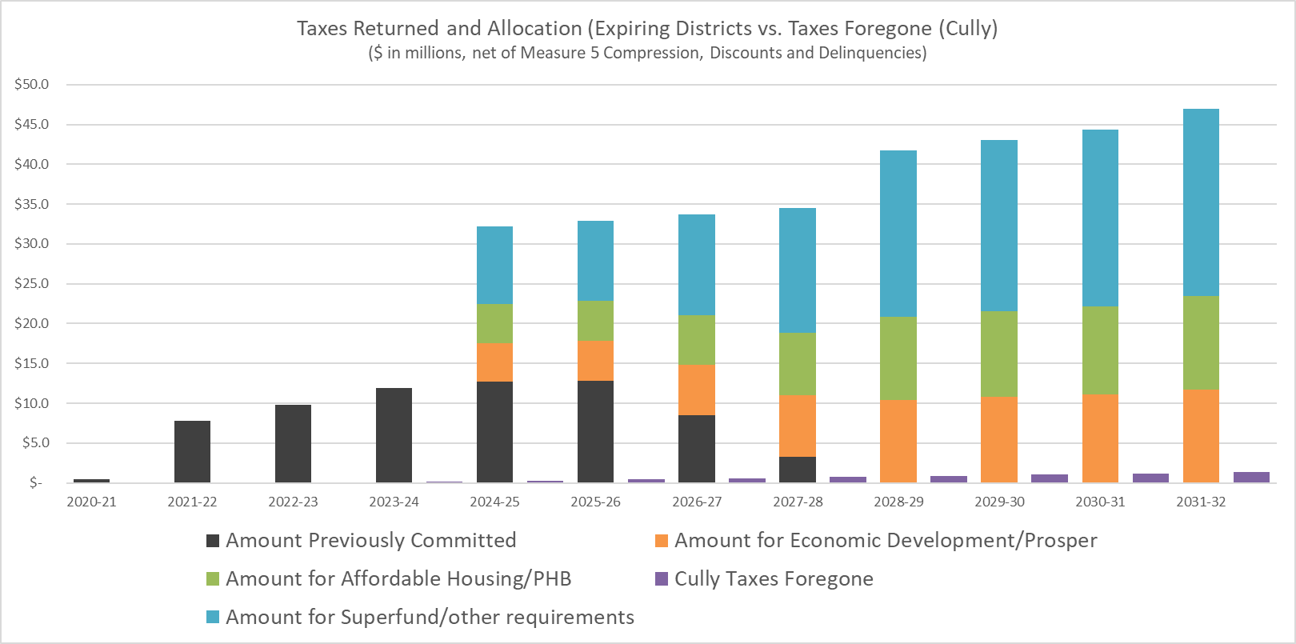
City of Portland General Fund
Impact in First 10 Years:
Taxes returned from expiring districts: $338M
Taxes foregone – to Cully: $6.6M
Net taxes returned: $331M

Slide 57
Program Offerings & Implementation
Action Plan Priority
Program offering
Yes
PHB/PP Implement Approved Program Offerings
CLC/PHB/PP RFP/NOFA Development as needed, Recommendation
No
TIF Plan Eligible
Yes
CLC/PHB/PP Recommendation
No
Decision Maker Support
Yes
City Council would need to amend TIF Plan
No
Notes:
KIMBERLY
This flow chart illustrates how a program or project would be considered for implementation.
First, one would see if it’s identified in the current Action Plan as a priority. If it is, it would go straight to PHB and Prosper Portland to implement, with additional input from the Committee to develop RFPs and NOFA’s as needed.
If the item is not in the Action Plan, but is eligible for funding because it was identified in the TIF District Plan, it would go to the Committee for discussion. In collaboration with PHB and Prosper Portland, a co-created recommendation would be made to the appropriate decision maker. If it is approved, it moves to implementation; if it is not approved, it doesn’t progress.
If the item is not in the Action Plan and is not eligible for TIF funding in the District Plan, it does not progress.

