Slide 1
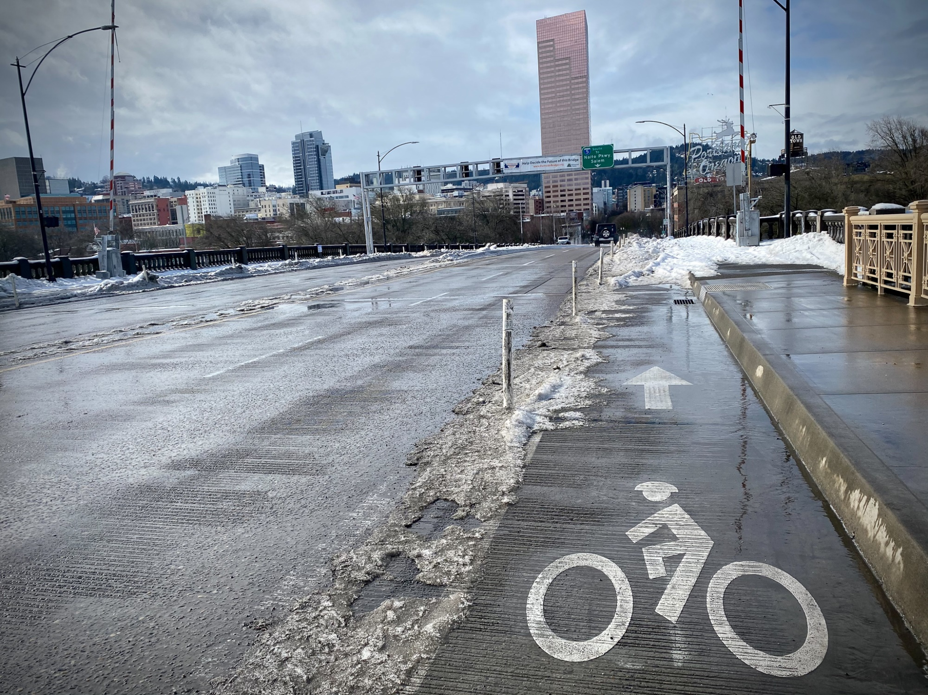
Portland Mitigation Action Plan
Jonna Papaefthimiou
Chief Resilience Officer
Portland Bureau of Emergency Management
Beth Gilden
Associate Director for Regional
Partnerships and Projects
Institute for Sustainable Solutions,
Portland State University
November 9, 2022
Notes:
“For the record, my name is…”
I’m here to present the mitigation action plan

Slide 2
PBEM – ISS partnership
Institute for Sustainable Solutions matches the passion and expertise of PSU faculty and students with the experience and needs of community to build a more sustainable and resilient region. ISS focuses on collaboration as a foundation of their work.
ISS has worked for many years with the City on issues related to climate change and resilience. ISS leverages academic resources, including grant funding, applied research, internships, and class engagements to augment and inform City efforts.
Notes:
Beth covers this slide

Slide 3
Steering Committee
Bureau of Emergency Management: Jonna Papaefthimiou, Chief Resilience Officer; Aaron Fox, Operations Specialist
Bureau of Environmental Services: Nishant Parulekar, Resilience Team Lead; Kate Carone, Environmental Program Coordinator
Parks and Recreation: Chris Silkie, Asset Management Program Manager; Laura Lehman, Senior Environmental Planner
Bureau of Planning and Sustainability: Sallie Edmonds, Environmental Planning Manager; Mindy Brooks, Environmental Planner
Office of Equity and Human Rights: Nickole Cheron, ADA Title II & Disability Equity Manager
Police Bureau: Edina Na Songkhla, Operations Specialist
Water Bureau: Kim Anderson, Emergency Manager
Bureau of Transportation: Emily Tritsch, Asset Manager; Courtney Duke, Senior Transportation Planner
Bureau of Development Services: Ericka Koss, Geotechnical Engineer; Anne Castleton, Emergency Management Project Manager
Portland Fire: Kim Kosmas, Senior Public Education Officer; Louisa Jones, Emergency Management Liaison; Steve Bregman, Emergency Operations Chief
Clackamas County: Jay Wilson, Resilience Coordinator
Multnomah County: David Lentzner, Senior Emergency Management Analyst
Notes:
Ten City bureaus and two counties.

Slide 4
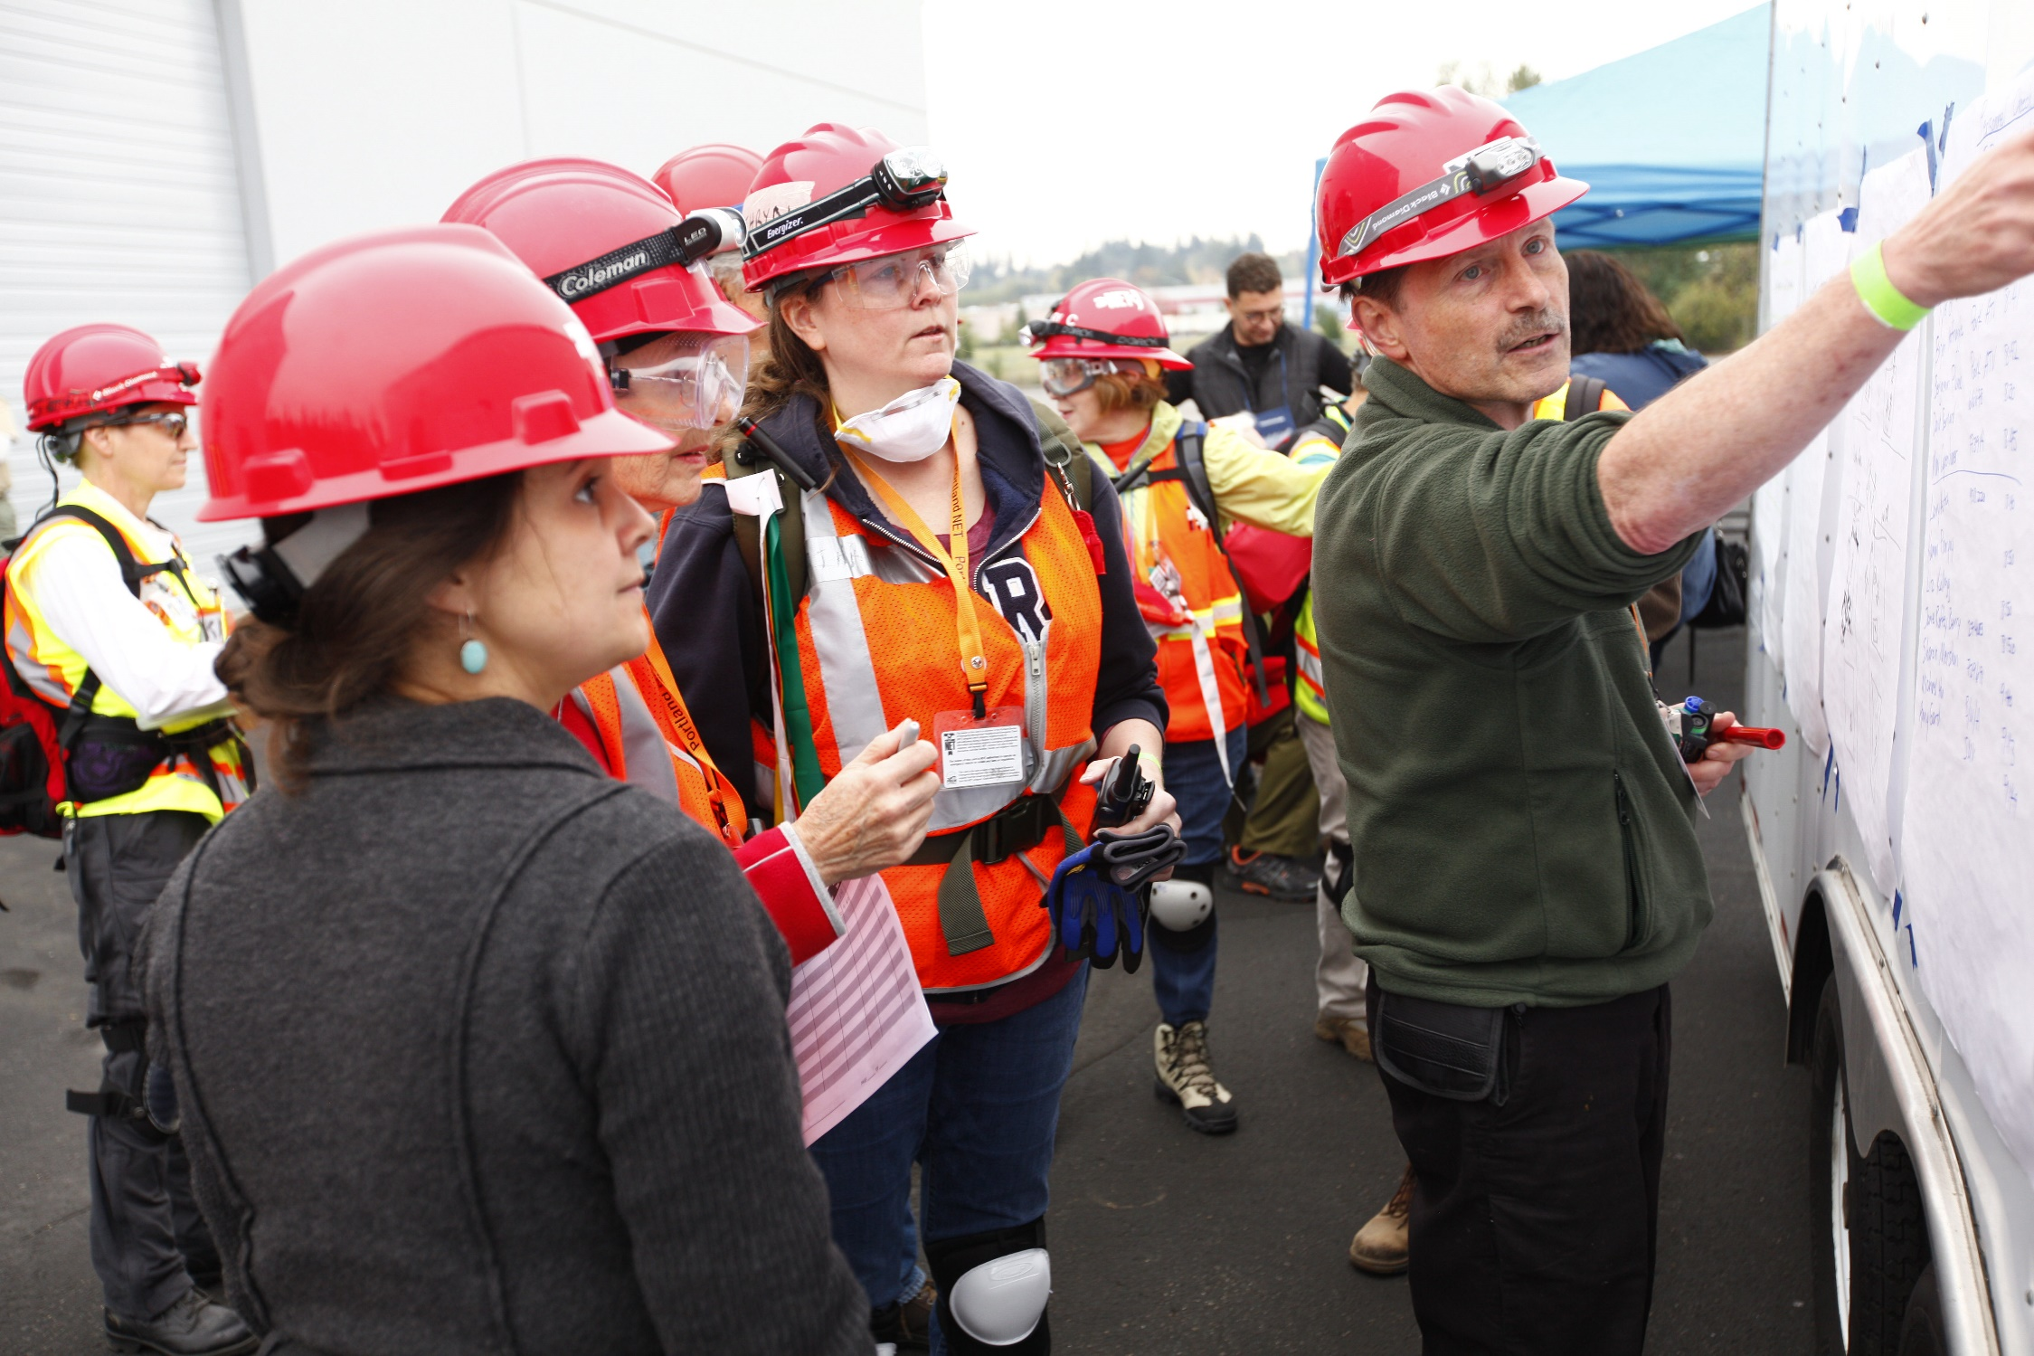
Presentation Overview
Purpose of the plan
Hazard summary
Planning process
Mitigation project highlights
Next steps
Notes:
Purpose of the plan
What we plan for
How we did the work
What we came up with
What’s next

Slide 5
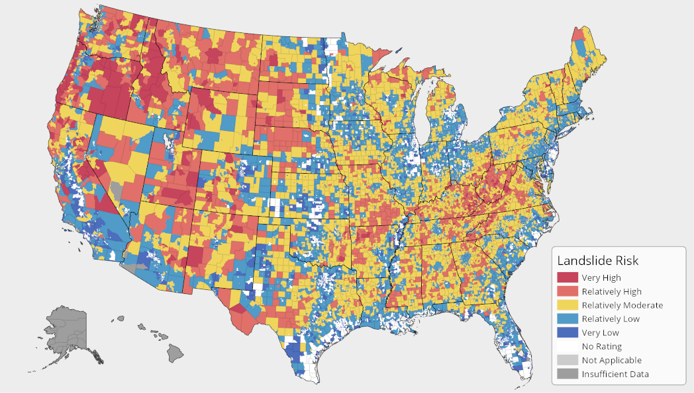
Purpose of the plan
Systematic assessment of risk
Strategy to reduce exposure
Address disparate impacts
Get money from FEMA
Notes:
People worry too much about sharks and tornadoes and not enough about traffic accidents and hypertension. As an organization, we need to be collectively smarter. The plan makes a systematic, statistical assessment of our natural hazard exposures and losses, and the lays out a strategy to reduce those potential losses over time. That’s the main concept of a hazard mitigation plan. The other foundational concept of our plan – prepare for the right things instead of worrying about the wrong things – is the recognize that disasters don’t impact evenly across the community, and that our assessment and our strategy needs to incorporate knowledge of disparate impacts. Finally, the reason every jurisdiction does a plan like this is to get money from FEMA. A FEMA-approved plan is required to be eligible for many federal grants. FEMA has already reviewed our plan and affirmed that it meets their standards.

Slide 6
Disparate Impacts of Disasters
Disasters worsen economic inequalities.
Use US Dept. of Health and Human Services Social Vulnerability index (SoVI):
  Socioeconomic status (below poverty, unemployed, no high school diploma)
  Household composition & disability (aged 65 or older, aged 17 or younger, older than age 5 with a disability, single-parent households)
  Minority status & language (minority, speak English “less than well”)
  Housing type & transportation (multi-unit structures, mobile homes, crowding, no vehicle, group quarters)
Notes:
Although we might think of a disaster like an earthquake impacting people equally across the City, that’s not at all true. The shaking itself will be felt differently depending on what soil you’re standing on. And similarly, the impacts of the disaster will be felt differently depending on the foundations of wealth and health. People who are able-bodied, have some savings, insurance, a family safety net, skills to navigate the intense bureaucracy of federal assistance - they can recover from even a big disaster. But for people with access to fewer resources will struggle much more. People who are physically less able to protect themselves will struggle more too. And in our society, wealth, insurance, and access also track to race, disability, and immigration status. Which mean that disasters tend to increase economic and social inequities.

Slide 7

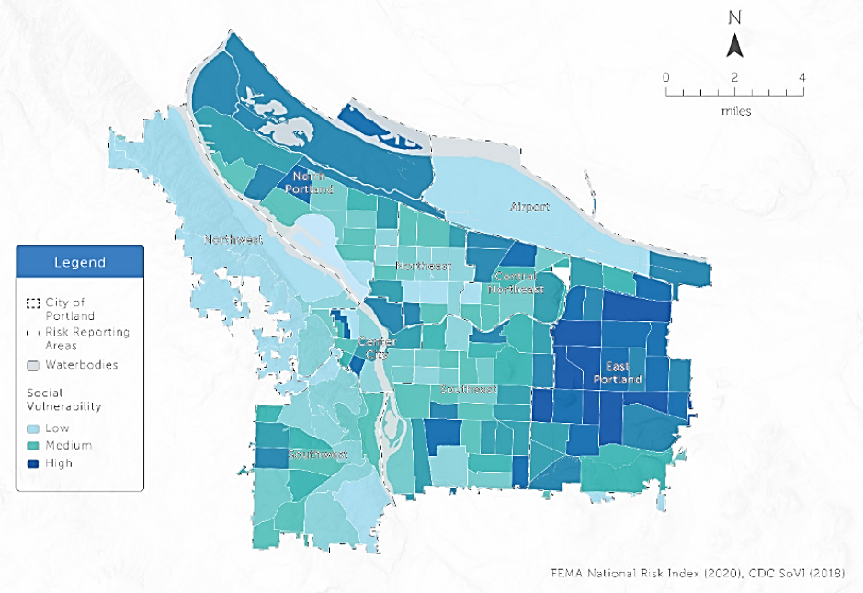
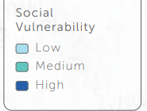

Portland Social Vulnerability Map
Notes:
This map shows social vulnerability in Portland based on the SOVI characteristics – income, race, disability status, education, householder status. Probably no surprises as we see neighborhoods east of 82 and in north Portland fare less well, as do some close-in neighborhoods with many low-rent apartments.

Slide 8
Hazard profiles
Notes:
OK, this is the little bit sad part of the presentation where we talk about what could go wrong. For each hazard, my goal is to inform you of the likelihood it will occur, the impacts if id did, who would be most affected, and then what we can do about it.

Slide 9
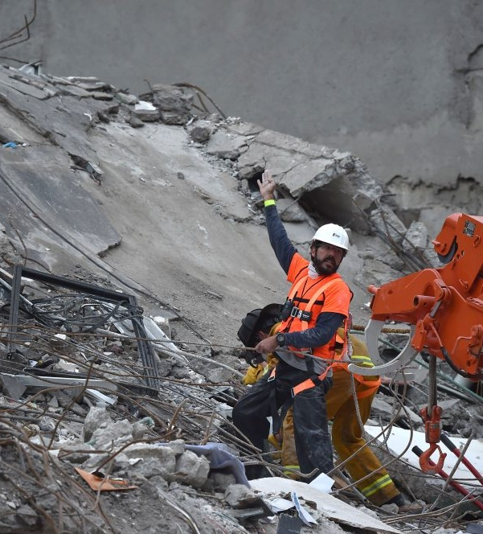
Earthquake
Earthquake > M 8.0 is 16-22% likely in the next 50 years
Will severely damage physical environment and economy:
  Buildings, transportation systems, and utilities damaged or destroyed
  $26 – $39 Trillion in losses
  Estimated 2,500 - 15,000 injuries
Citywide impacts, with special risks in liquefaction areas.
Mitigation strategies:
  Seismic retrofits of buildings and infrastructure
  Implement earthquake early warning
Notes:
Let’s start with the big one. EARTHQUAKE!
ECONorthwest study of a few years ago incidated $26-$39 Trillion in losses and up to 15,000 injuries in Portland – that means about a 2% chance that you will be in injured. Good news, still just a 0.1% chance you will be killed.
Response strategies like our awesome NET program, but in terms of mitigation – preventing harm in the first place – we need to retrofit buildings and infrastructure and implement earthquake early warning.
100 - 900 fatalities. In worst case, there is a 2% chance your special person will be injured, and 0.1% likelihood that your special person will be killed.
Massive fuel spill in Linnton neighborhood

Slide 10
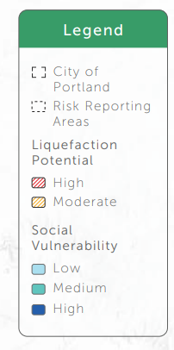
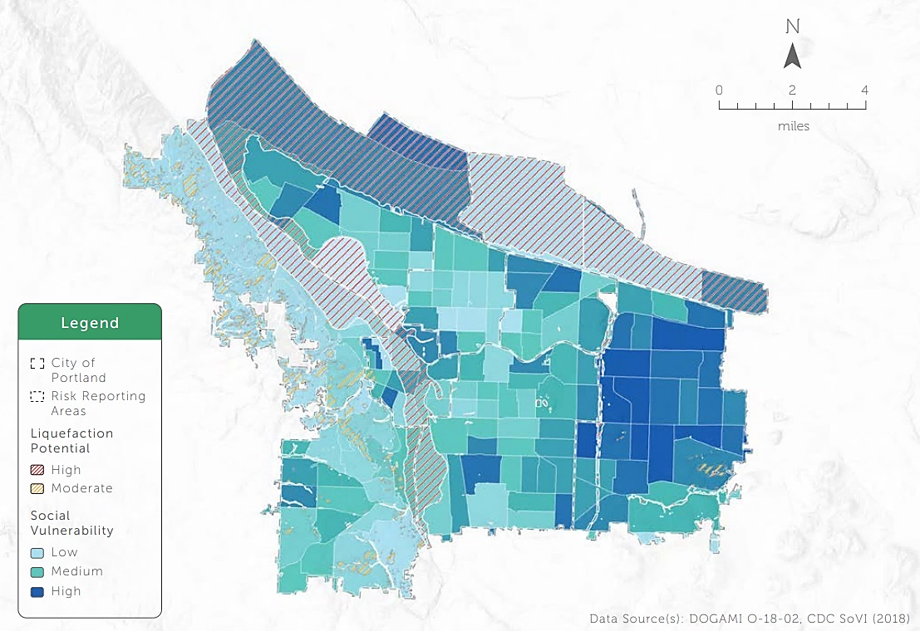
SoVI + Earthquake Liquefaction Risk

Slide 11
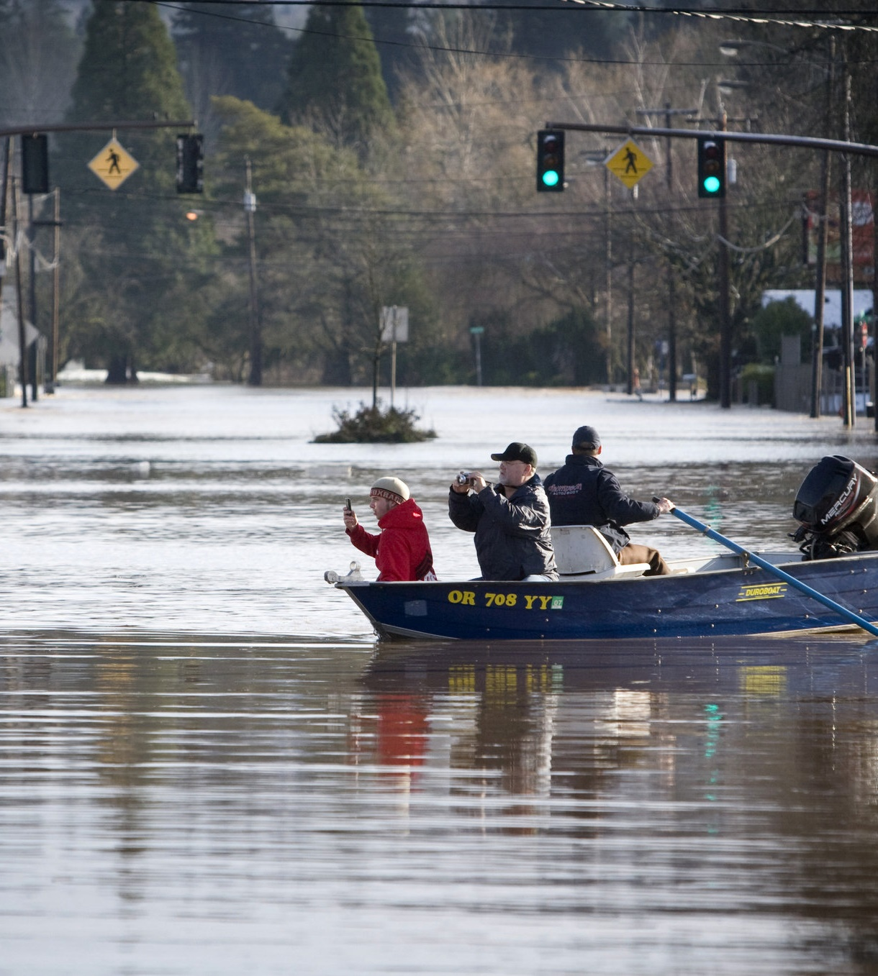
Flood
1.3% of Portland’s buildings are in floodplains
Floods are predictable; fatalities are rare.
Property and economic damage are high; jobs displaced.
Floods will increase due to climate change.
27 levees along the Columbia River are inadequate per US Army Corps of Engineers.
Mitigation strategies:
  restore floodplains
  strengthen levees
  harden pumps in flood areas
  strengthen flood control infrastructure
Notes:
When we think of flooding, we generally consider the 100-year flood, which means the flood that has a 1% chance of happening in any given year. Flooding occurs primarily along the Willamette and Columbia Rivers and Johnson Creek. The Willamette and Columbia River systems are huge hydraulic systems and we live relatively near the end of the line, so floods in our location can be predicted days ahead. If we’re doing our job, fatalities are almost entirely preventable. The folks facing the greatest risk are urban campers in flood plains, who would be impacted even in minor flood events, and are harder to reach. But major property damage including long-lasting infrastructure damage is possible. Restoring floodplains (and not camping in them) is a good way to improve safety and reduce flooding, as is strengthening levees, pumps stations, and other infrastructure that is necessarily located in the floodplain.

Slide 12
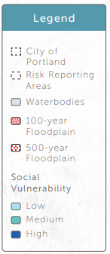
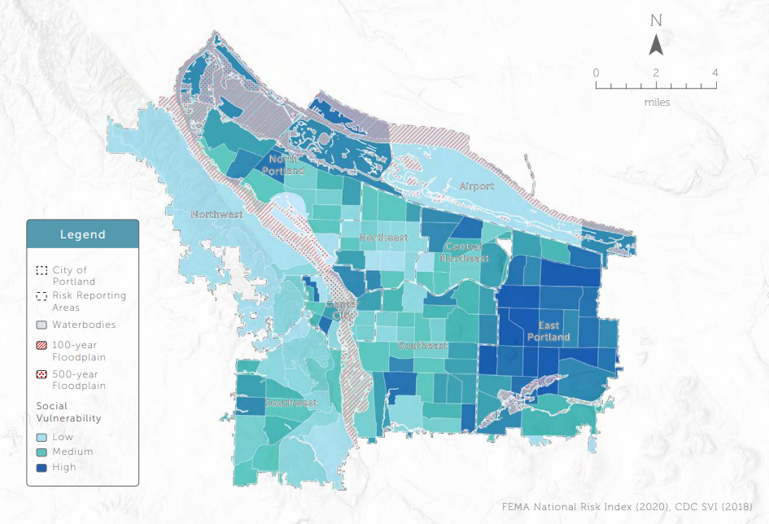
SoVI and 100/500 year floodplains
Notes:
This map really illustrates how impactful floods are on employment areas both in the Columbia Corridor and downtown. They could also really snarl transportation at the airport and over bridges.

Slide 13
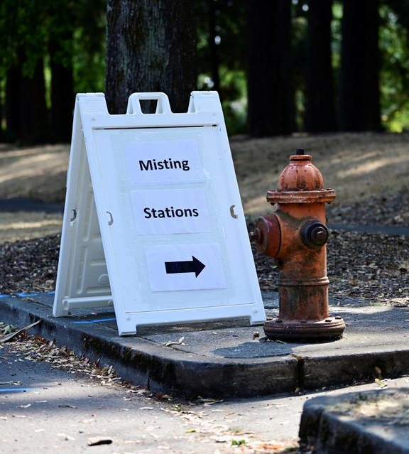
Severe Heat
Heat is the deadliest natural hazard.
Elders, children, and people with disabilities have higher risks. Socially isolated people without a/c are most likely to perish.
Heat disrupts business and puts workers at risk.
Extreme heat is increasing due to climate change.
The “urban heat island” (UHI) causes a disparity of up to 17°F in air temperature.
Mitigation strategies:
  tree planting
  increase number of residences with a/c
  require landlords to ensure cool rooms
  increase public locations with a/c
  all-hazards strategies to improve public communication and strengthen social safety nets.
Notes:
Heat is the silent killer. And while Portland is not among the hottest US cities, our climate is changing so fast we are facing heat that our buildings and infrastructure were not designed for. Estimating likelihood of severe heat is difficult because the climate is changing quickly.

Slide 14
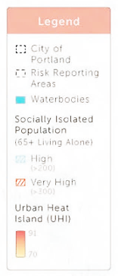
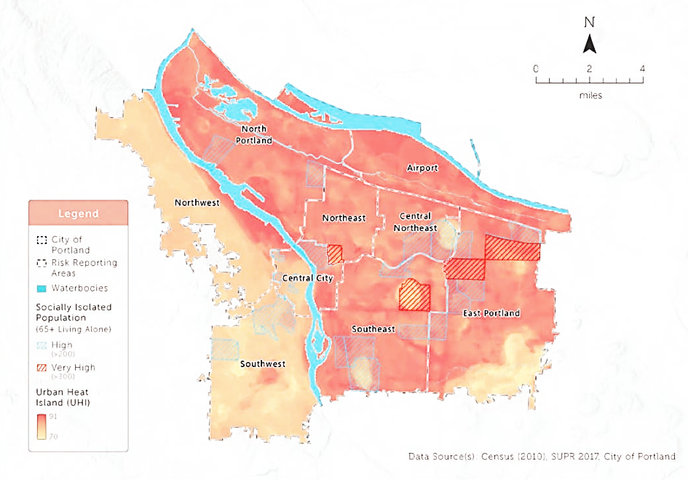
SoVI and Heat

Slide 15
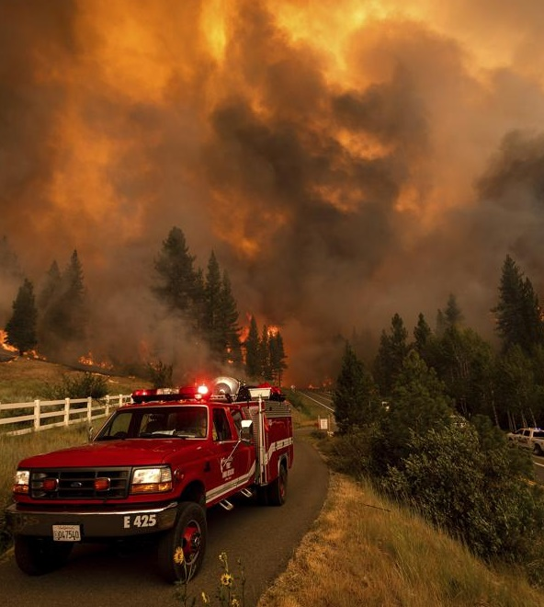
Wildfire & Smoke
Many natural areas are considered “fire-prone.”
More than 8,000 homes and other structures worth more than $2.5 billion are in or close to these areas.
Climate change creates longer fire seasons and more frequent and intense fires.
Wildfire smoke from outside the City impacts Portland residents; disproportionately harms elders, youth, and people with underlying conditions.
Mitigation strategies:
  natural area maintenance (inclu. controlled burns)
  fire road maintenance
  fire-safe landscaping and design of structures
  improved HVAC systems in public buildings.
Notes:
Portland and other parts of the west have always had fire risk. But also because of climate change, it’s not possible to lay odds on a forest fire impacting the City in any given year. We do know the risk is going up. And that significant property is at risk. Portland had no unhealthy air days due to wildfire smoke until 2015, when we had two days. Between 2016 and 2020, we had 21 days of unhealthy air including 5 days of hazardous air.

Slide 16
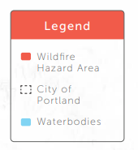
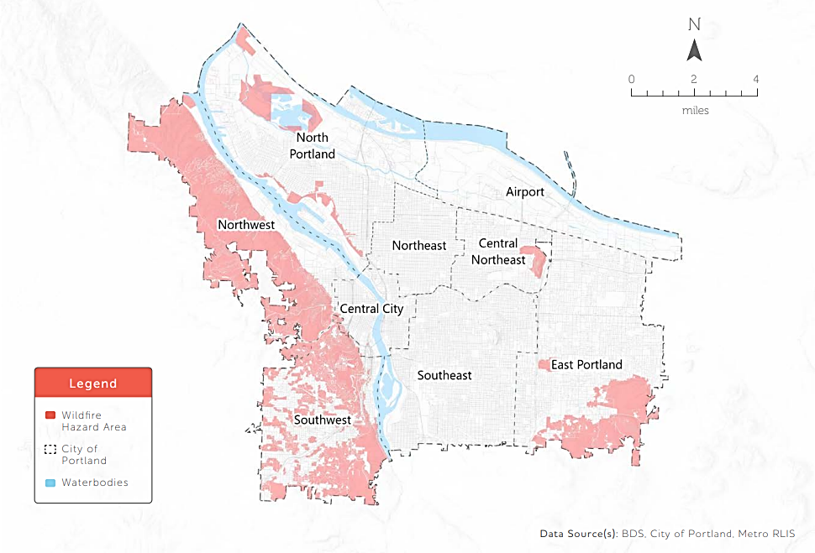
Wildfire Hazard

Slide 17
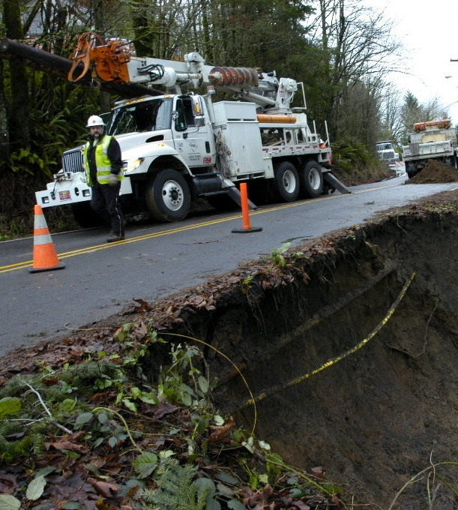
Landslide
20+ landslides annually likely cause $1 M+ in private property damage.
Cost and traffic disruptions can be significant.
Mitigation strategies:
  hardening key routes against landslide damage
  reducing development in areas of high risk
  Property owner education
  active stormwater management in areas of known risk.
Notes:
There is a nearly 100% likelihood of landslides in Portland each year – it’s a part of natural cycles.

Slide 18
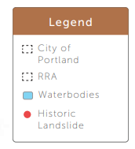
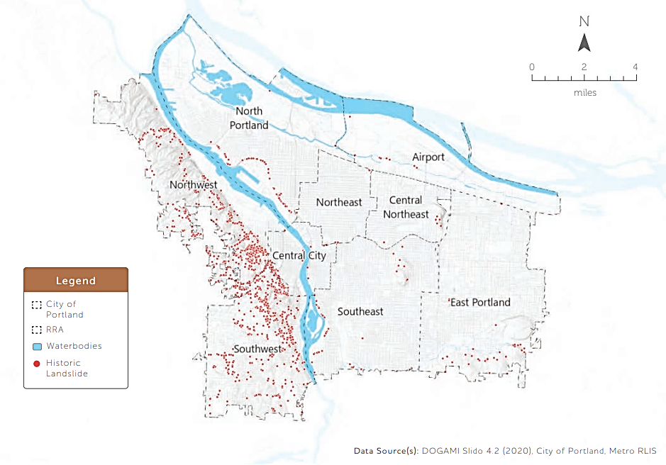
Landslide Hazard

Slide 19
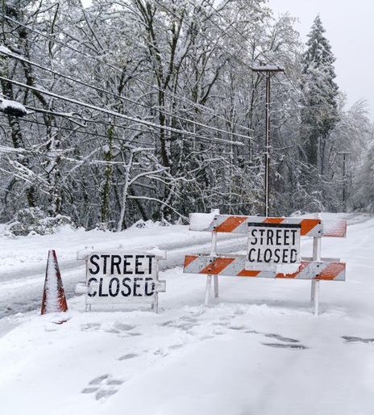
Winter Storms
ART
Second-deadliest hazard here; 11+ people have perished from severe cold in the last ten years. All were houseless.
Ice and snow causes property damage.
Power outages and slippery conditions close businesses.
Climate change is likely to reduce severe cold over time.
Mitigation strategies:
  all-hazard strategies to improve public communications and social safety nets
  Increase access to emergency shelters.

Slide 20
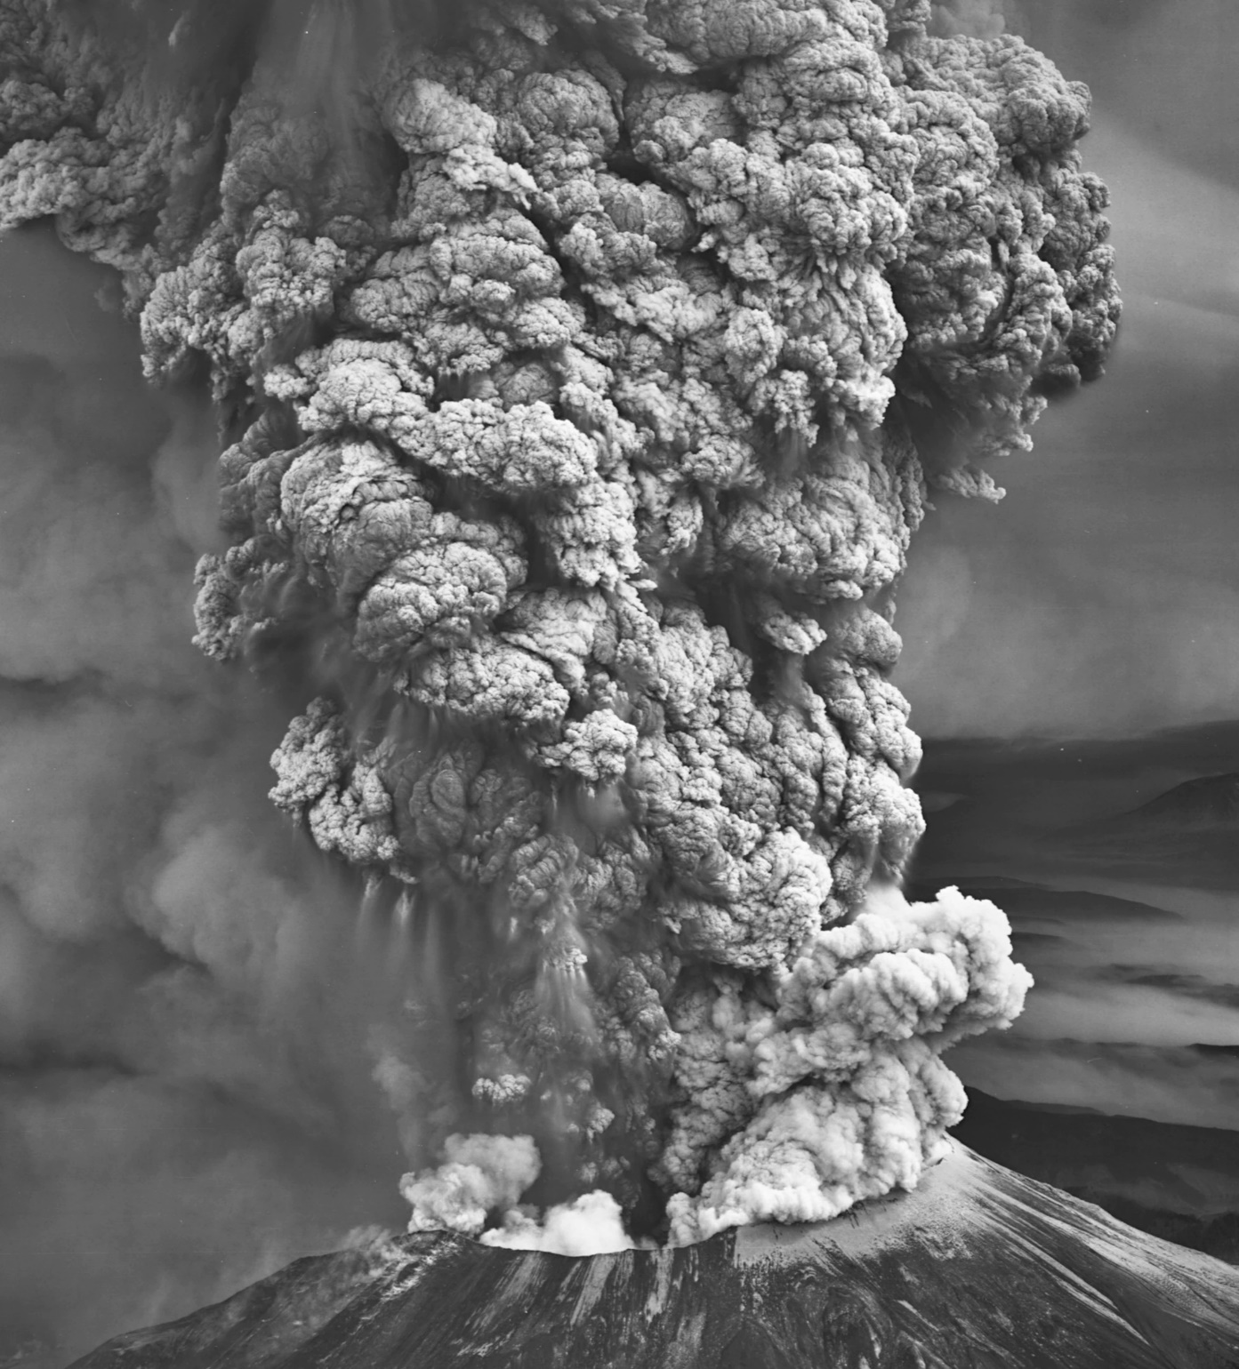
Drought, Volcanoes & Windstorms
ART
Mt Hood and Mt St Helens are “high-threat” volcanoes.
Drought is increasing due to climate change.
Extra-tropical cyclones have occasionally reached Portland.
Drought and volcano are directly harmful to other parts of Oregon.
Follow-on effects are primarily economic.
Mitigation strategy:
  all-hazard strategies to improve public communications and strengthen social safety nets.
Notes:
1980 Mt St Helens eruption killed 57 people.
Columbus Day Storm in 1962 killed 46 people. 116 MPH winds were measured on the Morrison Bridge – equivalent to a category IV hurricane.

Slide 21
Planning Process

Slide 22
Timeline
Fall 2020 Project scoping, contracting, and steering committee invitations
January 2021 Steering committee kick-off
Spring 2021 Plan development with steering committee, hazard assessments
Summer 2021 Community outreach
Fall 2021 Mitigation project refinement
Winter 2021 Plan completed
Spring 2022 Plan submitted to Oregon Emergency Management
Summer 2022 Plan submitted to FEMA Region 10
Fall 2022 Plan accepted pending adoption
Notes:
Grant was awarded in fall 2020

Slide 23
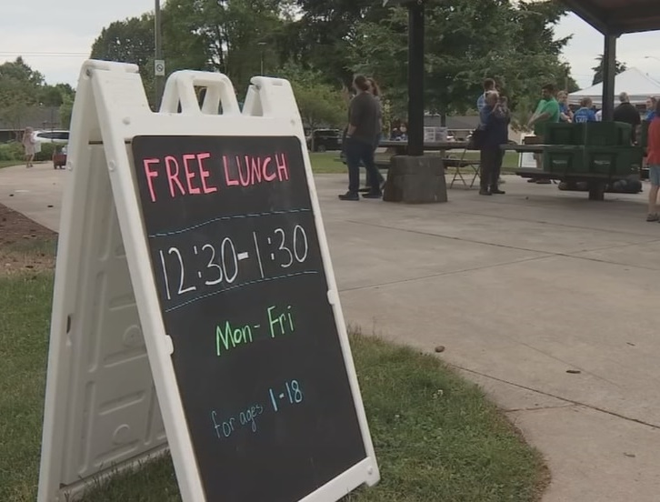
Community Engagement
Incorporated findings from past engagement efforts
  Black barbershop surveys
  Focus groups with Voz, APANO, and Latino Network
Focused interviews with community-based organizations working on pandemic response
Direct outreach at Summer Lunch and Play Events
Email and website updates and comment opportunities

Slide 24
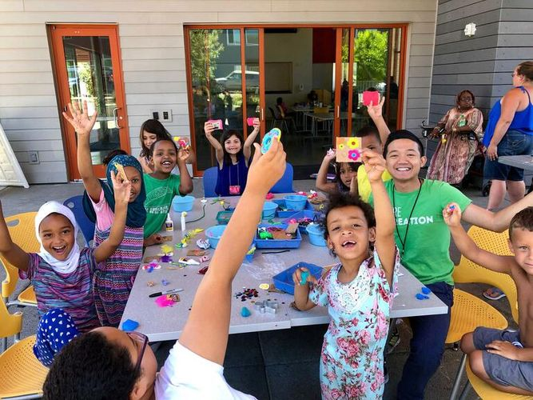
Community Voice
Earthquakes, wildfires, and extreme heat are top concerns
Knowledge, money, and storage space are barriers to preparedness
Disaster resilience is connected to efforts to reduce the inequities that intensify the impacts of hazards
Ongoing partnerships are needed to build resilience in communities with disparate risks
Government can’t do it all; desire for information and resources to prepare at home

Slide 25
Project overview

Slide 26
115 Projects Total
Bureau | No. projects
BDS | 6
BES | 21
BPS | 15
Multi-bureau | 9
PBEM | 12
PBOT | 3
PF&R | 7
Parks | 5
Water | 37
Type of project | No. projects
Education | 10
Plans & regulations | 40
Natural systems | 10
Infrastructure | 55

Slide 27
Three priority projects:
$1 M for tree planting in East Portland
  Heat mitigation; climate-driven risk
  Lead by Parks and Recreation
$200K for Fanno Creek slope stabilization plan
  Flood mitigation on emergency transportation route; risk increased by climate
  Lead by Bureau of Transportation
$5 M to East Portland Community Center solar + microgrid
  Multi-hazard mitigation; risks increased by climate
  Lead by Parks and Recreation
Notes:
$2.3 Billion dollars available this year

Slide 28
Community Rating System (CRS)
National Flood Insurance Program provides discounted flood insurance to communities that participate in CRS
Portland saves homeowners $600,000 annually through CRS; important to low-income homeowners
The Mitigation Action Plan support CRS
Accepting reports on implementation of CRS is a requirement of the program

Slide 29
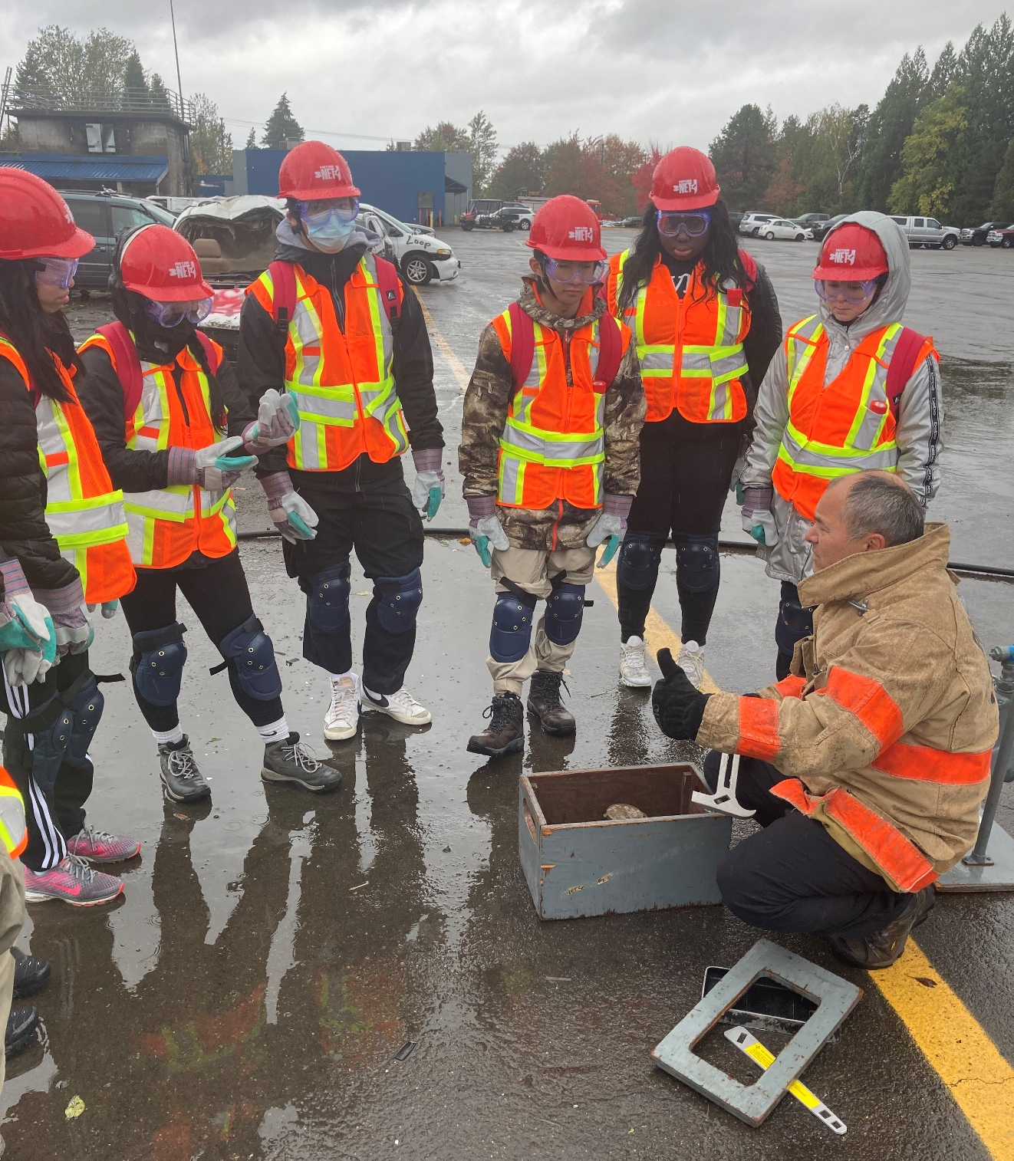
Best resilience work
Collaboration across bureaus and jurisdictions
Right-sized engagement that centers at-risk communities
Projects that earn broad support

Slide 30
Questions and next steps
Adopt plan
Apply for BRIC grants
Accept CRS reports
Keep resilience work moving forward

