Slide 1

Home Forward ERAP IGA
Amendment Ordinance
for Emergency Rent Assistance
October 26, 2022
Notes:
Introductions (Matt, Jennifer)
Good morning, Mayor Wheeler and City Commissioners.
My name is Jennifer Chang (she/her), and I’m the Senior Policy Coordinator at the Portland Housing Bureau.
For the past couple years, I’ve been closely involved in developing and overseeing the City’s COVID emergency rent assistance program. I’m pleased to have the opportunity this morning to provide you with an update on progress, as part of the background on the request for today’s Home Forward IGA amendment ordinance.
Since the Summer of 2020, PHB has worked closely with Multnomah County, Home Forward and community partners to make rental assistance available to renters throughout the pandemic.
We have prioritized the funding, design and implementation of the program to reach and assist BIPOC communities, who historically have been, and continue to be, disproportionately affected by the pandemic and lack of affordable housing.

Slide 2
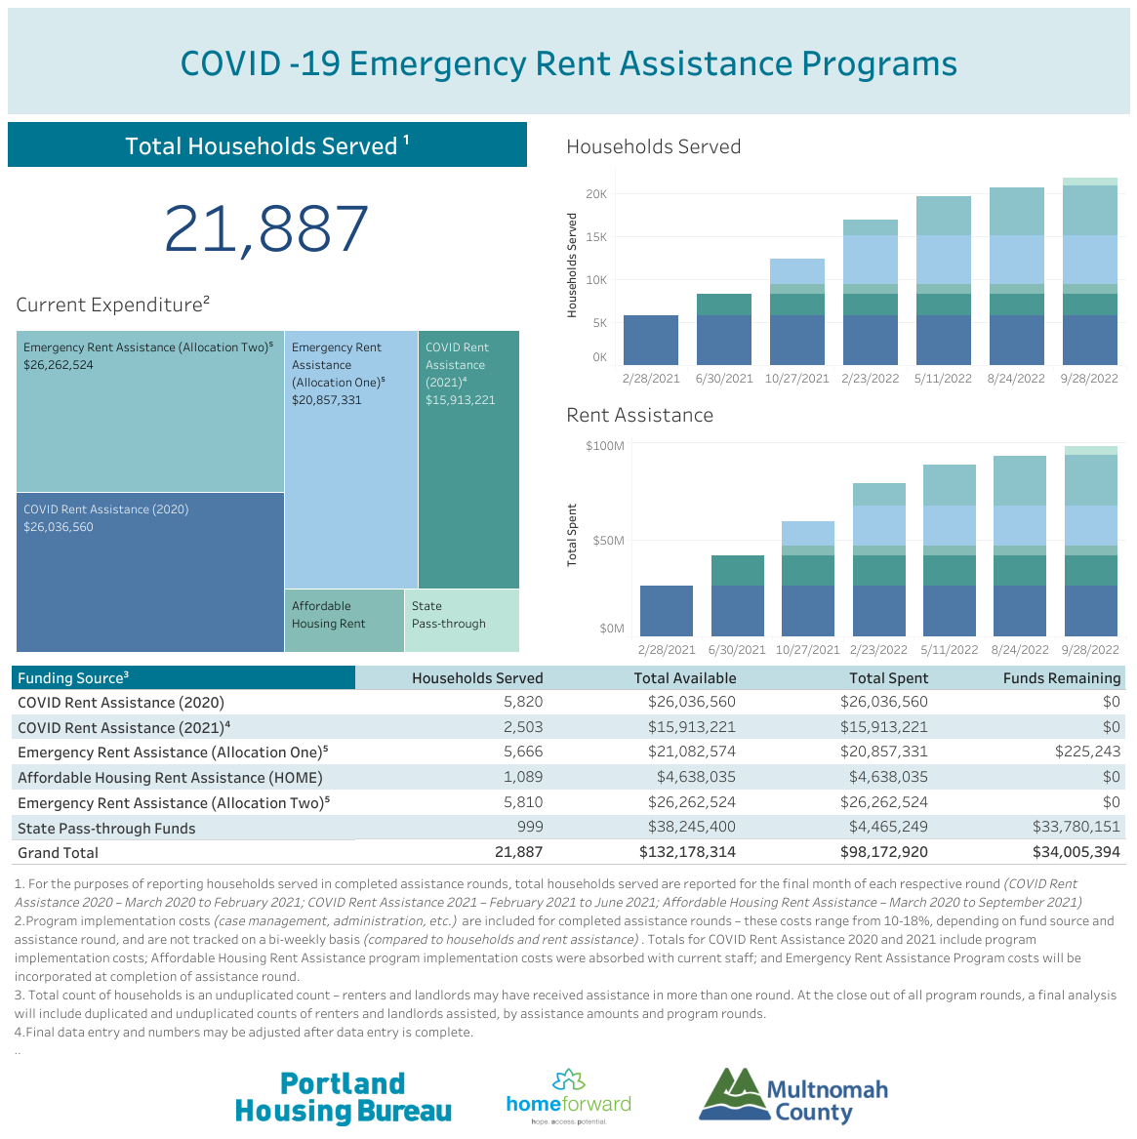
Households Served:
21, 887
Funding Expended:
$98 million
Notes:
As of September 2022, close to 22,000 households have been assisted through our local program. $98 million has been expended, which represents several funding sources from both the City and County.
The vast majority have been federal funds (CARES, ERAP1 and ERAP2), as well as some local City and County funds.
The different fund sources appear as different color shadings on this chart, and for more details we can go to the link of this table on PHB’s website.
Dark blue (bottom) – CARES
Turquoise (near top) – ERAP2
In terms of demographics, over the last fiscal year (21-22):
65% with incomes between 0-30% AMI
78% BIPOC – 36% Black/African American; 20% Latinx, 5% Indigenous, 5% Asian, 3% NH/PI, 8% African, 1% Middle Eastern and Slavic
22% - white
54% female
43% male
3% other
For more details, can link to PHB tableau:
https://public.tableau.com/app/profile/portland.housing.bureau/viz/COVIDEmergencyRentAssistancePrograms/Dashboard1?publish=

Slide 3



































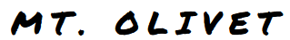












Rent Assistance Partners
Expanded Partner Network
Short Term Rent Assistance Network
Worksystems Inc. Network
County Programs
Intellectual & Developmental Disabilities
Maternal, Child & Family Health Services
Notes:
Several networks of agencies and programs have partnered in getting funding out into communities.
This includes agencies in the Short-Term Rent Assistance network, which has delivered rent assistance support for many years. We also increased the system’s capacity by adding new partners through the City’s Expanded Partners Network – comprised of 18 agencies, mostly culturally specific, who prior to the pandemic had not provided rent assistance support.
-----------------------------------------------------------------------------------------------------------------------------------------------
1. Short Term Rent Assistance (STRA) network - 19 non-profit organizations engaged in year round, and Covid-19 rent assistance. STRA includes the Domestic Violence continuum.
2. Worksystems Inc network - 14 providers who are part of the WSI workforce development system who provide rent assistance to work force training program participants.
3. Expanded Partners Network - a new network of 16 culturally specific organizations who are supporting the community to receive rent assistance.
4. County Programs - including Bienestar de la Familia, Intellectual and Developmental Disabilities, and Maternal Family Health in the Health Department.

Slide 4
Additional RA funds: $1.5 million
Sources: CDBG-CV, ERAP-1 and ERAP-2 (all federal funds)
Launch Date: October 1, 2022
Spend by: December 9, 2022
Funds will be allocated to the Expanded Partner Network and will assist an estimated 350-400 households by year’s end.
Portland Housing Bureau – 10/26/22
Notes:
This brings us to the main purpose of today’s ordinance. In the last two months, the City through PHB has identified $1.5 million, to add to the emergency rent assistance program.
The funds are comprised primarily of the first ERAP reallocation ($1.1 million) from U.S. Treasury announced in Aug 2022. It also includes portions of ERAP 1 and 2 interest earnings and CDBG-CV funds ($235k) reflected in PHB’s Fall BMP budget adjustments.
The ordinance, (item #898), is to amend Home Forward’s existing ERAP IGA to add these funds so they can continue their role in processing and making rent assistance payments for the program.
Funding will also be allocated to agencies in the City’s Expanded Partners Network to conduct outreach and application assistance, with a continued focus in reaching BIPOC communities.
The funding is intended to be spent by the end of the calendar year and will provide rent assistance to an estimated 350-400 additional households by year’s end.
Rent Assistance amount: $1.6 million (all federal sources – ERAP and CDBG-CV)
(Total Amount: $2.1 million, remainder to partners for program implementation costs ~$500k)

Slide 5

Questions and Comments
Portland Housing Bureau – 10/26/22

