Slide 1
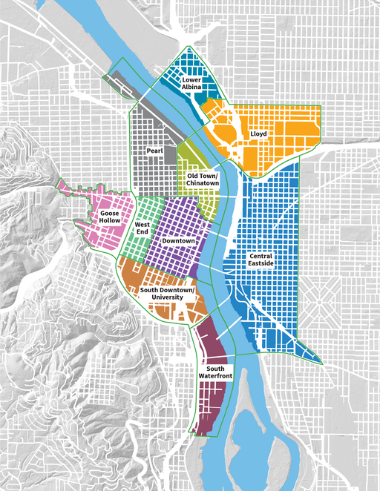
Expediting Groups

Slide 2
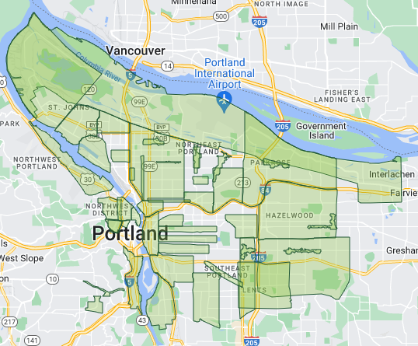
Expediting Groups

Slide 3
Central City Expediting Group
Difference in Districts
* ECONorthwest/Prosper Portland; Portland Post-Pandemic Performance and Economic Recovery

Slide 4
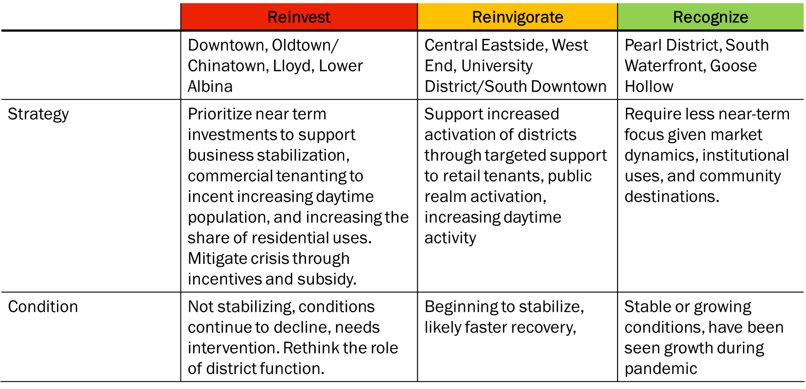
Central City Expediting Group
* ECONorthwest/Prosper Portland; Portland Post-Pandemic Performance and Economic Recovery

Slide 5
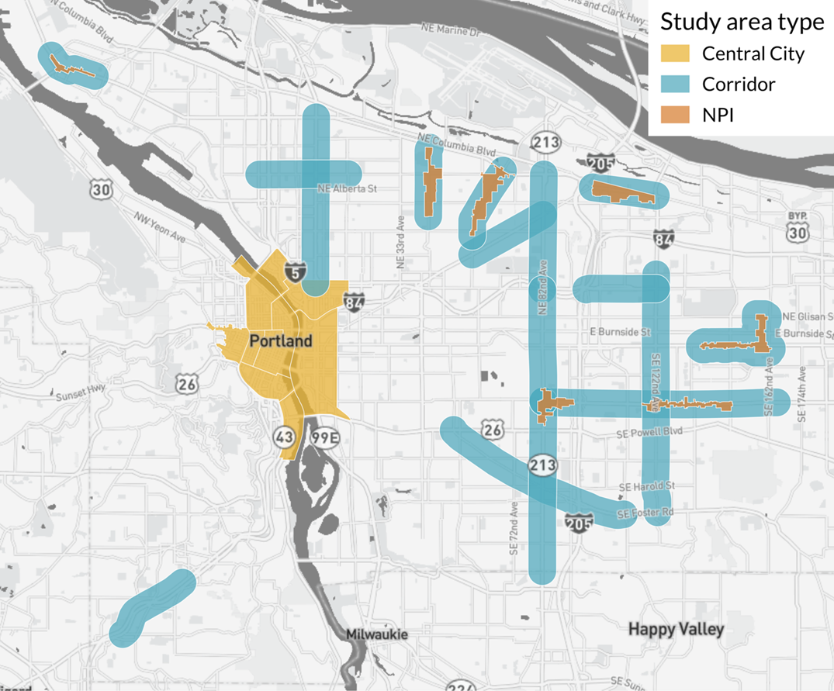
Business District Expediting Group
Difference in Districts
* ECONorthwest/Prosper Portland; Portland Post-Pandemic Performance and Economic Recovery

Slide 6
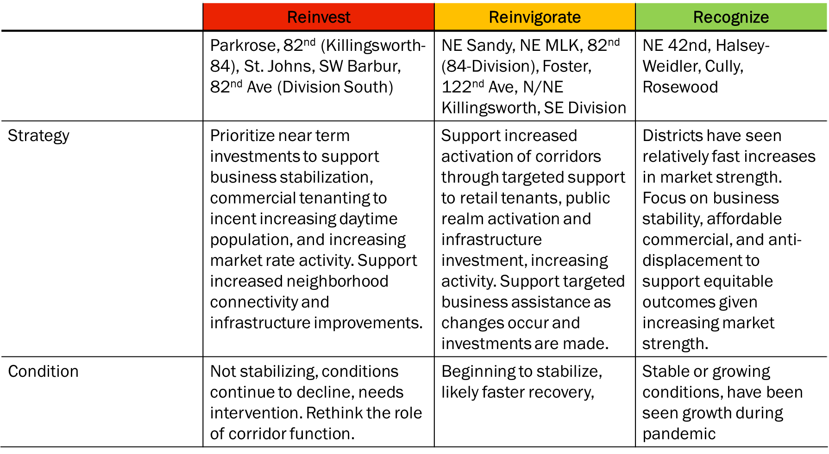
Business District Expediting Group
* ECONorthwest/Prosper Portland; Portland Post-Pandemic Performance and Economic Recovery

Slide 7
Breakout Groups- Brainstorm
Returning Workers
Right-of-Way Improvements
& Activation
Increased Housing
DEC
Steady Wednesday
DEC
Holiday Presence
DEC
Policy Implemented
Wednesday is clearly felt as the busiest day in the central city. Pop-up services can predict needs for the new year.
Heavy holiday ground floor activation. Limited/zero ongoing window breaks. Wayfinding displays installed.
A seismic upgrade “package” exists for O2H.
NOV
Events & Places
NOV
OCT
Street Tree Lighting
NOV
Program Roll-out
Expand in-person events, Tuesday/Thursday options. Communicate & advertise amenities that are open
Maximize street tree lighting- targeted areas and any others that are “ready”. Align with board & graffiti removal.
Program rules are developed and ready for implementation.
OCT
“Every Wednesday”
OCT
SEP
Plywood/Ground Activation
OCT
Seismic: SDC/Exempt
Critical Mass on Wednesdays. Reduced transit fee? Coffee speakers bureau- networking events.
Vendors for pop up window space, expedite window replacement, tree lighting incentive. Expand street cleaners
SDC Waiver and Seismic Exemption are before council for consideration and adoption. MultCo considers.
SEP
Incentives/Programs
SEP
Graffiti/Store Front Audit
SEP
Policy Development
Gym Membership/In-Building conversion. Pop-up childcare, pet care. Parking/TriMet fee. Afternoon programming; HH, Coffee Break
Audit complete. Abatement underway. Regular abatement patrol schedule established. 3/month focus in central.
Gather a market estimate of eligible buildings.
Public Safety Improvements

Slide 8
Expediting Groups
Discussion
Eric Zimmerman
Eric.Zimmerman@portlandoregon.gov
503-823-8582 –city cell

