Slide 1
2021-22 Parks Levy Annual Report
October 26, 2022

Slide 2
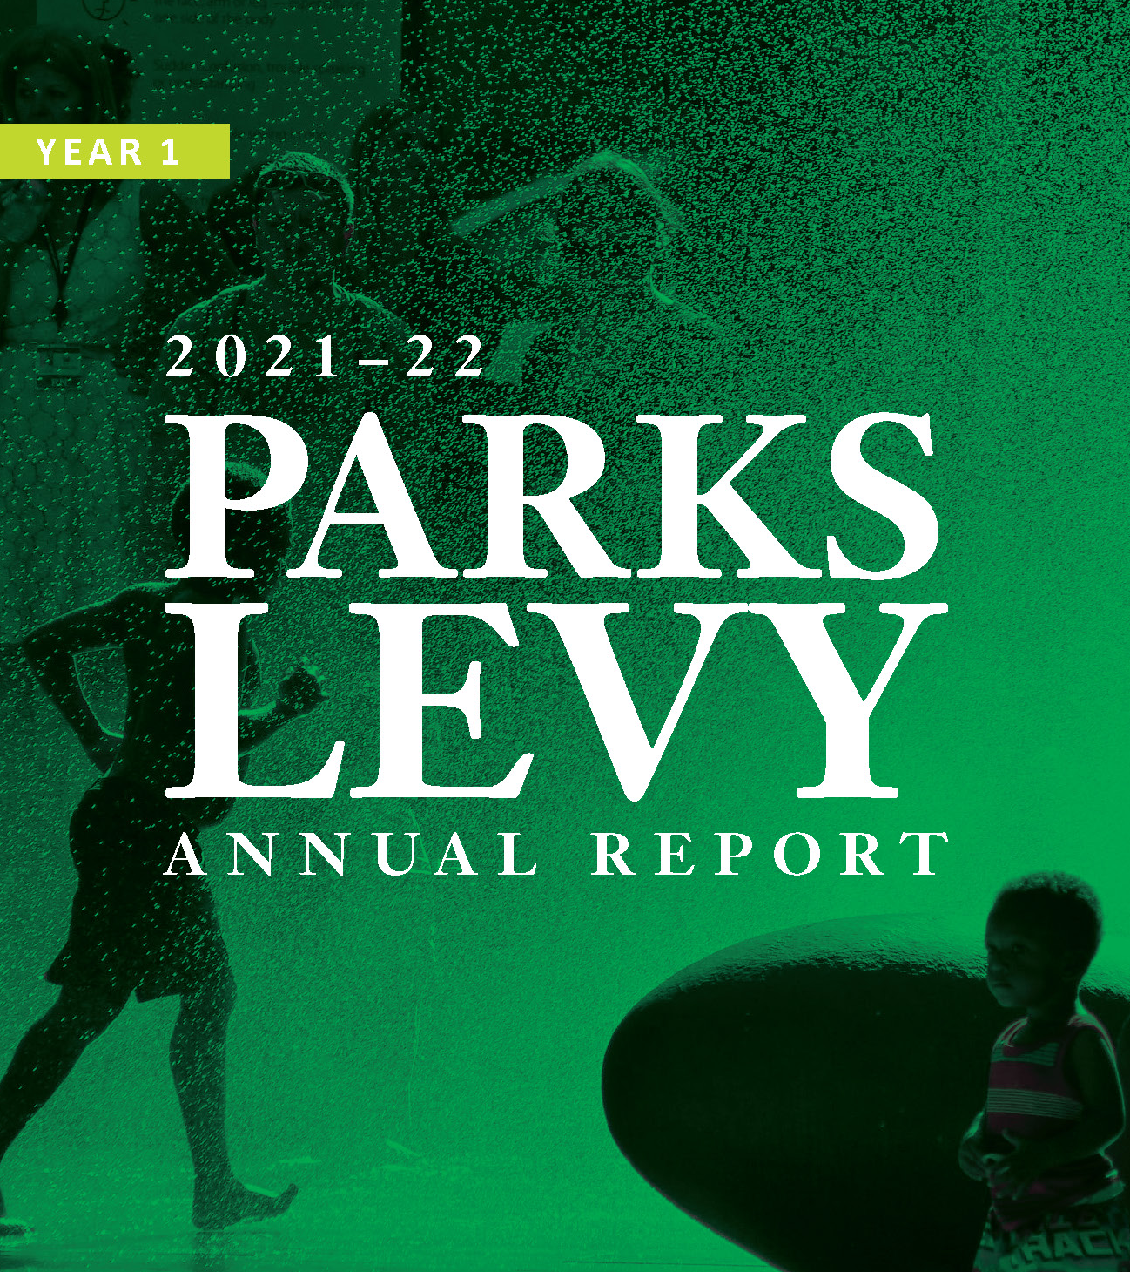
2021-22 PARKS LEVY ANNUAL REPORT
Key Themes
15 commitments from the voter pamphlet
Centering equity
Year 1 as planting the seeds
Maximizing the Parks Levy – leveraged funding and report outcomes
Notes:
Bullets with image(s) to go with it

Slide 3
2021-22 PARKS LEVY ANNUAL REPORT
Prevent cuts to recreation programs, closures of community centers and pools.
Deliver recreational programs, including, but not limited to, environmental education and access to nature for youth, summer camps, family-friendly movies and concerts, fitness and arts classes, teen- and senior focused programs, life-saving swim lessons, and a summer playground program serving free lunches to children experiencing hunger.
Remove financial barriers for low-income households by ending current dependence on recreation fee revenues, allowing an equity-focused delivery of community events and programs and reducing the likelihood of further cuts to recreation offerings.
Recreation for All
Notes:
Text Slide with bullets

Slide 4
2021-22 PARKS LEVY ANNUAL REPORT
Prevent cuts to recreation programs, closures of community centers and pools.
Successful in preventing cuts and closures to recreation programs and facilities in FY 2021-22
$2.15 million of Parks Levy funding spent on this commitment (a portion of the $6.39 million in total expenses focused on recreation facility operations)
Delivered on the promise of restoration of summer programs in 2021:
More than 15,000 swim lessons
Summer camps for more than 7,500 kids
100,000+ nutritious meals served in the summer at over 30 sites
Fitness in the Park classes for more than 2,000 people
Provided Recreation Services with revenue stabilization
“I knew that as soon as the pools opened back up, I wanted to come back.”
– Corryn Pettingill
Assistant Manager, Pier Pool

Slide 5
2021-22 PARKS LEVY ANNUAL REPORT
Deliver recreational programs, including, but not limited to, environmental education and access to nature for youth, summer camps, family-friendly movies and concerts, fitness and arts classes, teen- and senior focused programs, life-saving swim lessons, and a summer playground program serving free lunches to children experiencing hunger.
Succeeded in delivering recreational programs in FY 2021-22
$2.90 million of Parks Levy funding spent on this commitment (a portion of the $10.69 million in total expenses for providing services associated with this commitment)
Numbers limited by COVID restrictions in first half of FY 2021-22, and by difficulty in hiring staff to provide registered activities
Performance Measures | FY 2021—22
Free meals served | 173,190
Annual scans for TeenForce Passes | 22,788
Total estimated attendance | 874,780
Total volunteer hours (Recreation) | 174,596

Slide 6
2021-22 PARKS LEVY ANNUAL REPORT
Remove financial barriers for low-income households by ending current dependence on recreation fee revenues, allowing an equity-focused delivery of community events and programs and reducing the likelihood of further cuts to recreation offerings.
Provided more financial assistance through two pilot initiatives (Pay What You Can and the Access Discount) in FY 2021-22 than previously provided under the scholarship model
Total financial assistance provided in FY 2021-22 was $1.11 million to 7,948 unique people
PP&R continues to provide free programming such as Summer Free for All, SUN Community School programming, and teen programming

Slide 7
2021-22 PARKS LEVY ANNUAL REPORT
Enhance and preserve parks, rivers, wetlands, trees, and other important natural features in urban areas for the benefit of all Portlanders and wildlife. and
Protect water quality and wildlife habitat, control erosion, remove invasive species in 8,000 acres of natural area.
Increase opportunities for communities of color and children experiencing poverty to connect with nature.
Enhance park maintenance to keep parks clean and safe, including litter and hazardous waste removal, restroom cleaning, and playground safety. and
Clean litter and hazardous waste in parks and natural areas, maintain grounds and landscaping, provide safety checks on play equipment, improve preventative and traditional maintenance. and
Keep public restrooms open and cleaner.
Plant new trees in communities where today canopy coverage is lower, to improve air and water quality, diminish the impacts of climate change, and provide wildlife habitat. and
Protect Portland’s 1.2 million park trees by performing proactive maintenance, safety checks, hazard removal, and replacement of damaged trees in parks and natural areas.
Modernize data systems to improve internal efficiency.
Protect and Grow Nature
Notes:
Text Slide with bullets

Slide 8
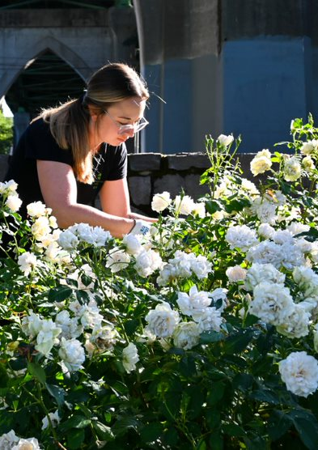
2021-22 PARKS LEVY ANNUAL REPORT
Enhance and preserve parks, rivers, wetlands, trees, and other important natural features in urban areas for the benefit of all Portlanders and wildlife. and Protect water quality and wildlife habitat, control erosion, remove invasive species in 8,000 acres of natural area.
$817,194 of Parks Levy funding spent on these commitments (a portion of the $2.38 million expenses focused on natural area maintenance).
Hired 23 of 68 approved new positions focused on maintenance, including natural features and natural areas
Performance Measures | FY 2021—22
Number of acres of invasive weeds treated annually | 874.55
Total volunteer hours (Nature) | 150,411
“As we're going through these harder weather events, additional capacity just makes us able to help some of these plants deal with the extreme stressors we're currently experiencing.”
– Heather Humphrey
North Zone Horticulturalist

Slide 9
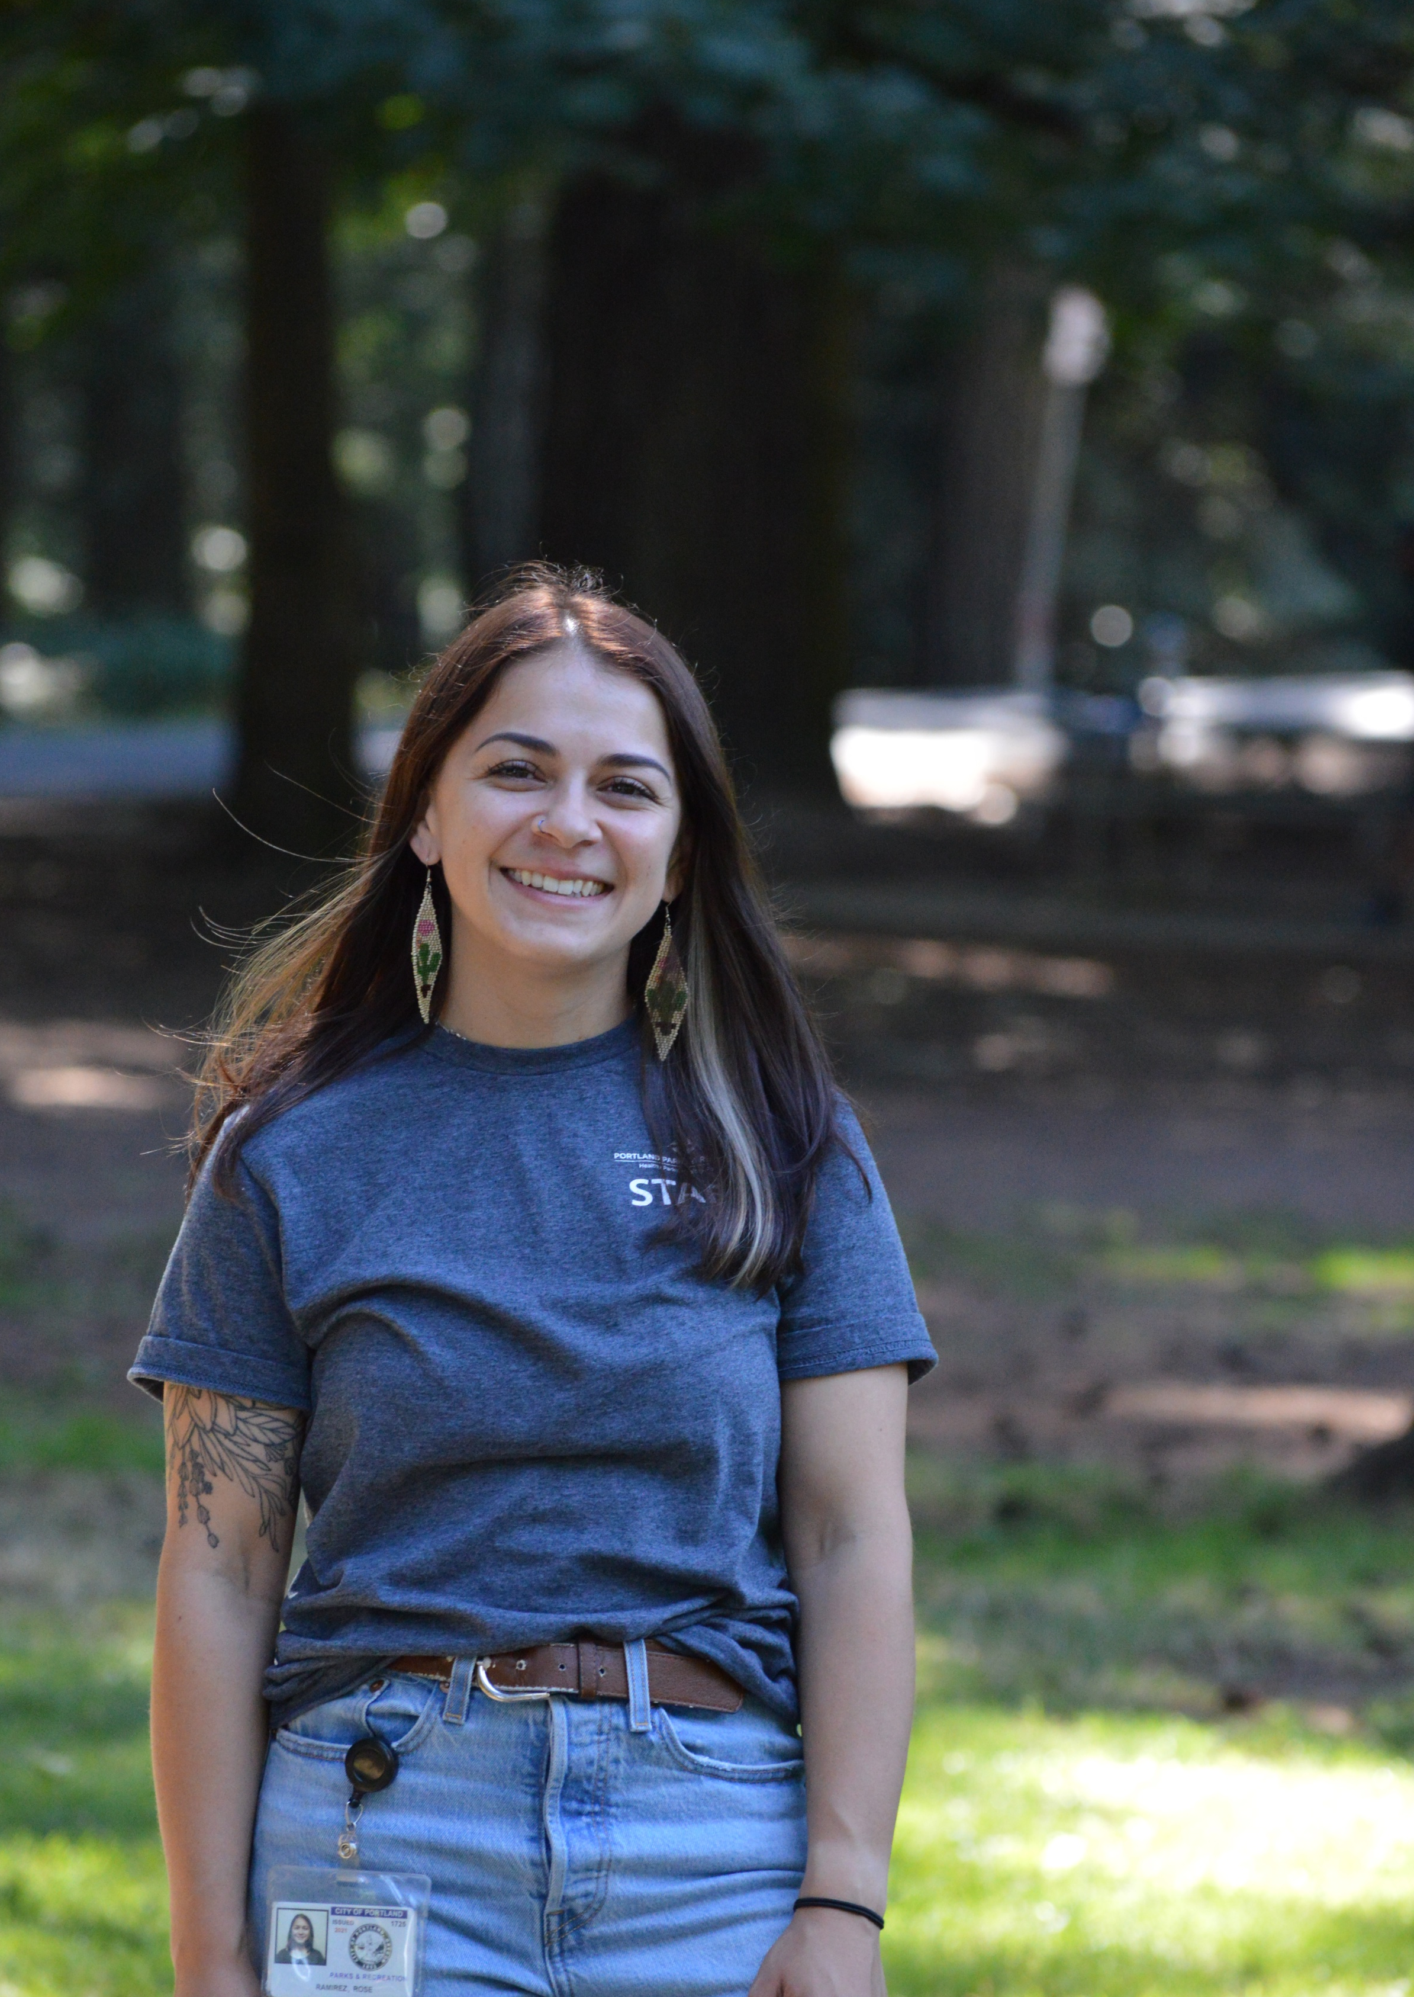
“With the Parks Levy, we're giving children the opportunity to come to parks and get to know them.”
– Rose Ramirez
EE Camps & Classes Coordinator
2021-22 PARKS LEVY ANNUAL REPORT
Increase opportunities for communities of color and children experiencing poverty to connect with nature.
Increased the number of Environmental Education (EE) participants in FY 2021-22
$445,866 of Parks Levy funding spent on this commitment—a portion of the $1.41 million EE expenses.
Performance Measures | FY 2021—22
Total participants in EE programming | 2,667

Slide 10
2021-22 PARKS LEVY ANNUAL REPORT
Enhance park maintenance to keep parks clean and safe, including litter and hazardous waste removal, restroom cleaning, and playground safety. and Clean litter and hazardous waste in parks and natural areas, maintain grounds and landscaping, provide safety checks on play equipment, improve preventative and traditional maintenance (D4). and Keep public restrooms open and cleaner.
Performance Measures | FY 2021—22
Percentage of work orders that are preventative | 12%
Percentage of built assets rated in good or very good condition | 7%
Percentage of open restrooms visited for daily cleaning | 82%
Pounds of trash collected | 3,107,384
$8.40 million of Parks Levy funding spent on these commitments (a portion of the total $26.5 million expenses for park and operational maintenance)
68 new positions approved with Parks Levy funding that will assist with maintenance (both park and natural area) as of FY 2021-22

Slide 11
2021-22 PARKS LEVY ANNUAL REPORT
Plant new trees in communities where today canopy coverage is lower, to improve air and water quality, diminish the impacts of climate change, and provide wildlife habitat. and Protect Portland’s 1.2 million park trees by performing proactive maintenance, safety checks, hazard removal, and replacement of damaged trees in parks and natural areas.
Performance Measures | FY 2021—22
Annual trees planted in Planting Priority neighborhoods | 1,467
Arborist hours dedicated to park trees | 7,842
City-wide canopy cover | 29.8% (2020)
Percentage of trees planted by the Urban Forestry Tree Planting Program that are medium or large form | 95%
$1.81 million of Parks Levy funding on these commitments
(a portion of $6.41 million in tree-related expenses)
12 arborists positions approved to assist with proactive maintenance and establish proactive maintenance for park trees

Slide 12
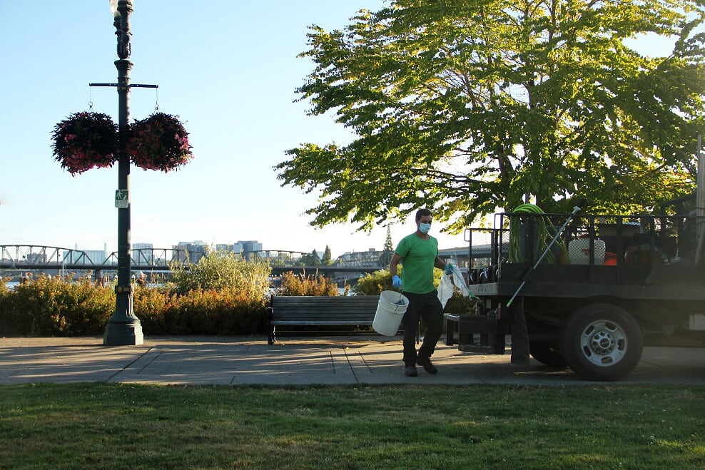
2021-22 PARKS LEVY ANNUAL REPORT
Modernize data systems to improve internal efficiency.
Purchased new volunteer management software in FY 2021-22
Allocated $5 million to upgrade PP&R’s maintenance work order system

Slide 13
2021-22 PARKS LEVY ANNUAL REPORT
A community oversight committee will be appointed to review Parks Levy expenditures and to report annually to City Council. The Measure also directs the Bureau to provide for a performance audit to ensure that services funded by the levy are consistent with voter intent.
Prioritize services for communities of color and households experiencing poverty, including equity-centered engagement and outreach, community partnership grants, and increased engagement with volunteer and partner groups.
Provide park and recreation services to diverse populations including communities of color, seniors, teens, households experiencing poverty, immigrants and refugees, and people living with disabilities.
Community Partnerships
Notes:
Text Slide with bullets

Slide 14
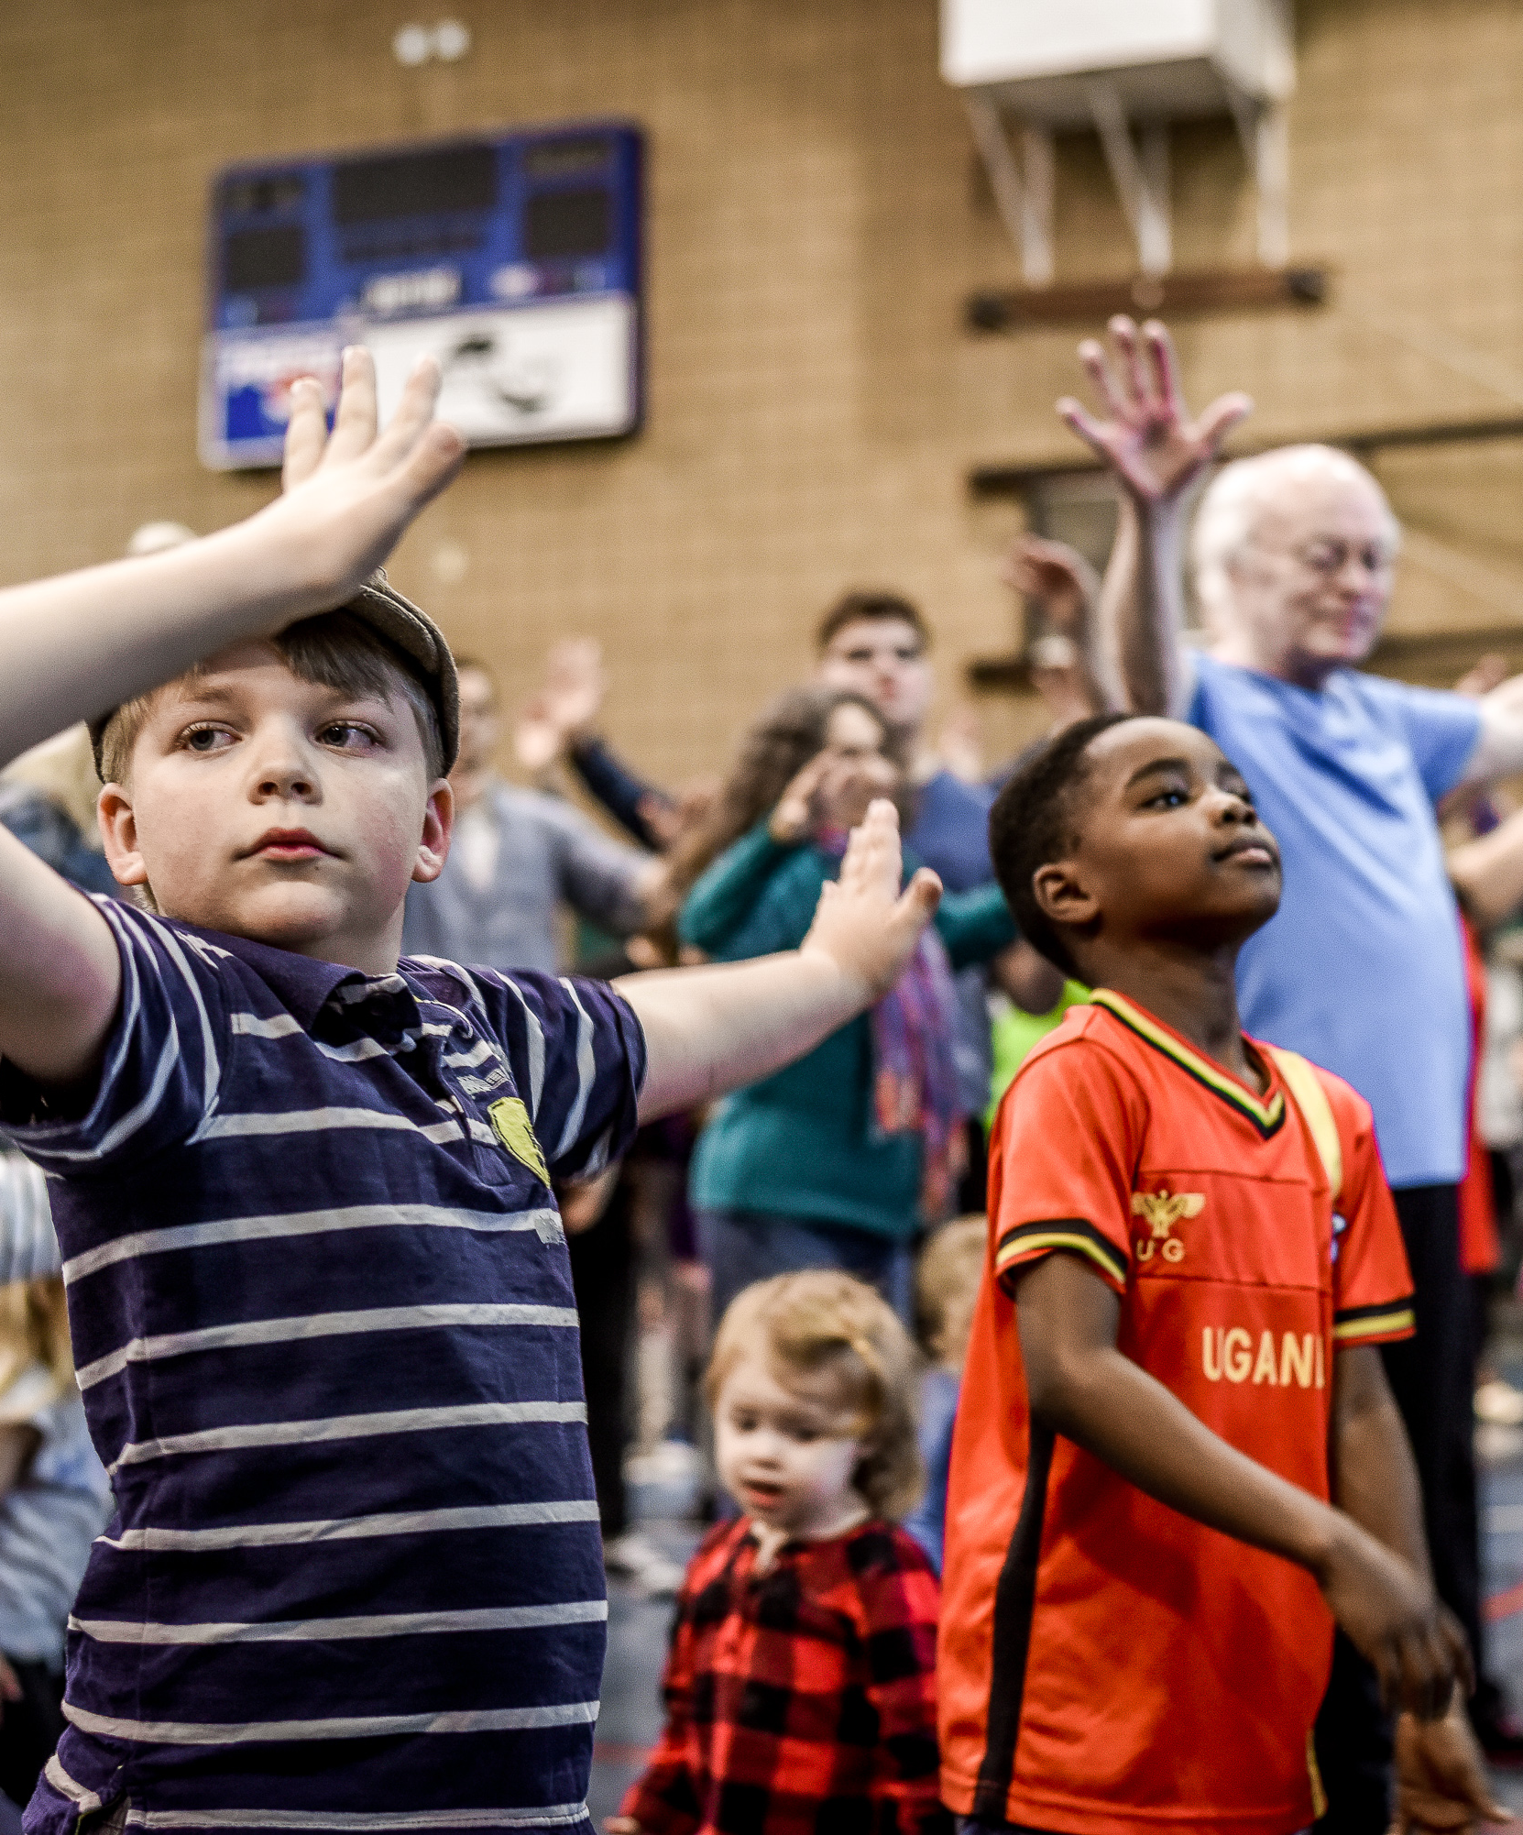
2021-22 PARKS LEVY ANNUAL REPORT
A community oversight committee will be appointed to review Parks Levy expenditures and to report annually to City Council. The Measure also directs the Bureau to provide for a performance audit to ensure that services funded by the levy are consistent with voter intent.
Parks Levy Oversight Committee (PLOC) established in July 2021
$100,879 of Parks Levy funding spent on this commitment and related transparency and accountability efforts (a portion of the $293,443 in total expenses, including those for the oversight committee, Parks Levy communications and graphics, annual report, calculation of compression actuals, and other Sustainable Future Program initiatives)
Performance audit planned to be conducted following Year 3

Slide 15
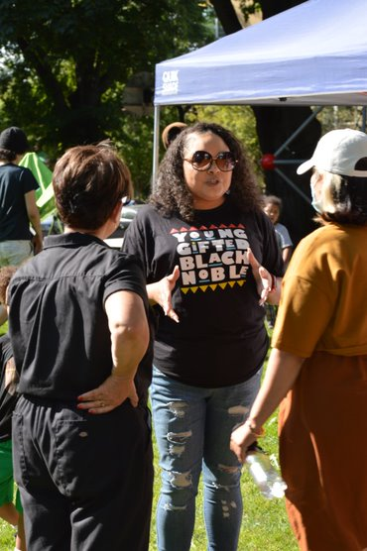
2021-22 PARKS LEVY ANNUAL REPORT
Prioritize services for communities of color and households experiencing poverty, including equity-centered engagement and outreach, community partnership grants, and increased engagement with volunteer and partner groups.
$2.10 million of Parks Levy funding spent on this commitment (a portion of the approximately $6.44 million in community engagement and equity services expenses)
Used the Racial Equity Lens in the budget Decision Support Tool
Established a new Community Partnership Program for grants to partner organizations
“Making space for our families where they can share their true experiences and offering culturally-specific programming and events is great.”
– Leigh Bohannon
Black Parent Initiative
Performance Measures | FY 2021—22
Total volunteer hours | 328,181

Slide 16
PP&R YEAR 1 PARKS LEVY DRAFT REPORT
Provide park and recreation services to diverse populations including communities of color, seniors, teens, households experiencing poverty, immigrants and refugees, and people living with disabilities.
In FY 2021–22 PP&R successfully delivered park and recreation services to a wide variety of users and implemented initiatives such as early registration, Community Partnership Program grants, and work order prioritization to directly serve communities of color, seniors, teens, households experiencing poverty, immigrants and refugees, and people living with disabilities.
“The Lifelong Recreation staff has been so wonderful. They connected me with the TV exercise and a lot of other park and recreation programs.”
– Dharini “Tammy” Balajee
Lifelong Recreation Participant

Slide 17
2021-22 PARKS LEVY ANNUAL REPORT
Parks Levy Commitment |  | Sum of Total Expense* | Parks Levy Portion of Total
Recreation for All |  | $17,079,992.47 | $5,050,567.00
Protect and Grow Nature |  | $36,757,914.29 | $11,470,915.00
Community Partnerships |  | $6,731,752.92 | $2,203,565.00
 | Total (PP&R Program and Service Expenses) | $60,569,659.68 | $18,725,047.00
Financial Actuals
(JULY 2021 THROUGH JUNE 2022)
Children’s Levy Compression + $379,962.00
Grand Total (All Parks Levy Expenditures) $19,105,009.00
Notes:
Text Slide with bullets

Slide 18
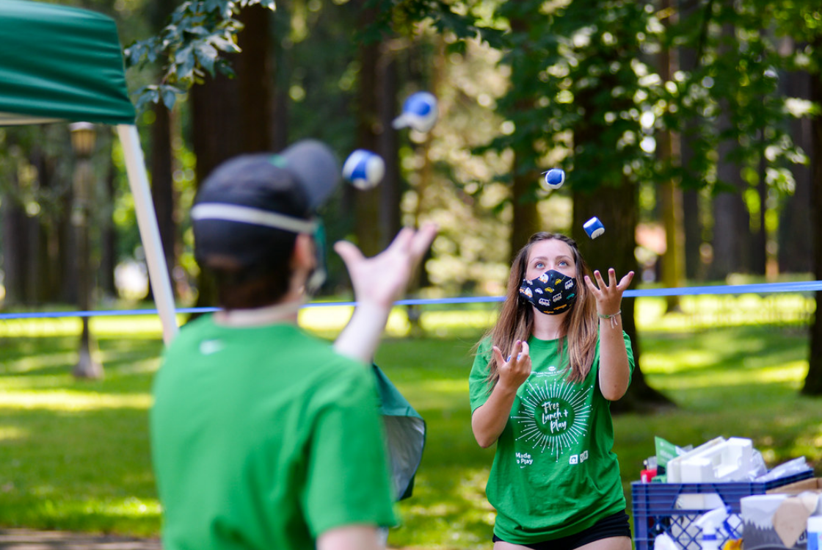
2021-22 PARKS LEVY ANNUAL REPORT
Translations and Accessibility
Web versions available in plain text
PP&R Year 1 Parks Levy Report
Full report available in English
Executive Summary available in four most common languages in Portland (Spanish, Vietnamese, Chinese, Russian)
PLOC Annual Report
Full report available in English and Portland’s four most common languages

Slide 19
PARKS LOCAL OPTION LEVY – FY21-22 ANNUAL REPORTS
Parks Levy Oversight Committee Annual Report

Slide 20
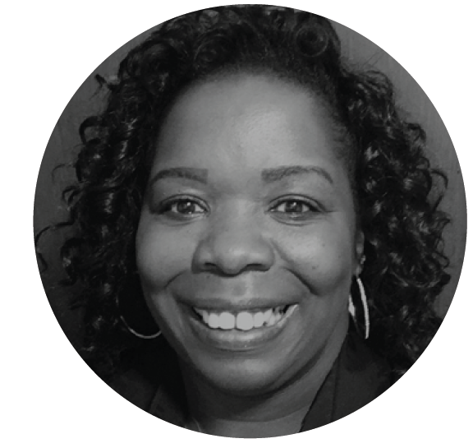
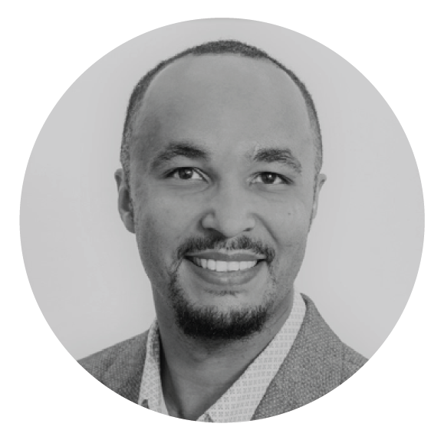
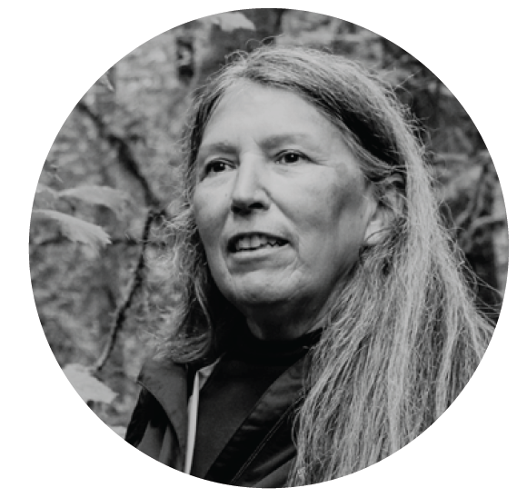
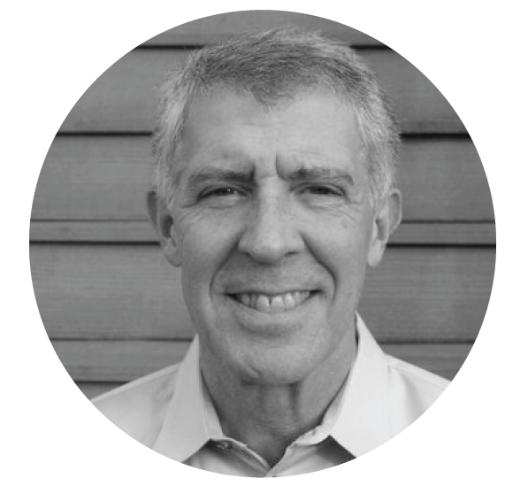
PARKS LEVY OVERSIGHT COMMITTEE ANNUAL REPORT
Alescia Blakely
Maria Velez
Silas Sanderson
Judy BlueHorse Skelton
Paul Agrimis
Notes:
Text Slide with bullets

Slide 21
PARKS LEVY OVERSIGHT COMMITTEE ANNUAL REPORT
Adherence to Ballot Language
Use of 15 commitments from ballot to track progress, program decisions and actions
Creation of systems and tracking mechanisms directly related to ballot language
Recommendation: Use Equity and Anti-Racism Lens, existing community engagement, and feedback cycles to hear from the community how PP&R can build on voter commitments to best serve the community.

Slide 22
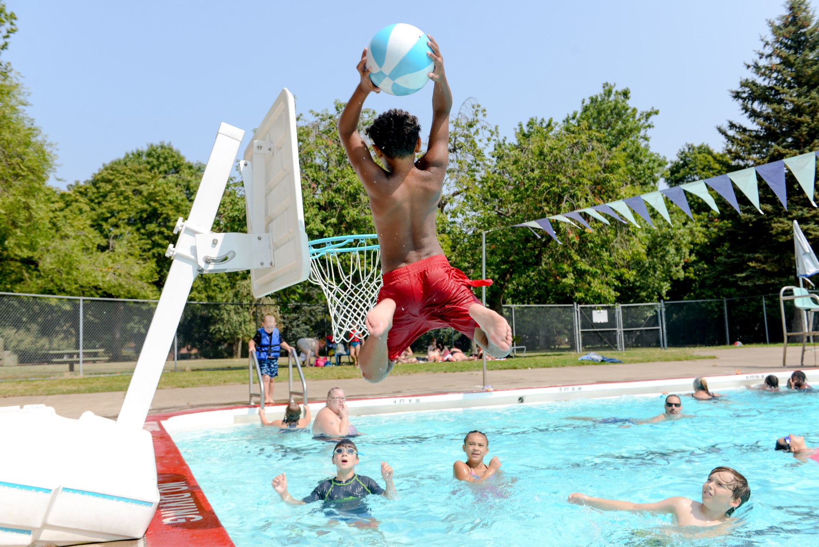
PARKS LEVY OVERSIGHT COMMITTEE ANNUAL REPORT
Fiscal Accountability
Presented various financial decision points and information to oversight committee throughout the year
Use of the Leveraged Funding Model to maximize Parks Levy funding
Current mechanisms are transparent, auditable, and effective
Recommendation: Continue use of the Leveraged Funding Model in the implementation of Parks Levy Funding

Slide 23
PARKS LEVY OVERSIGHT COMMITTEE ANNUAL REPORT
Transparency
Oversight committee meetings are open to the public and meeting materials are posted to the web
Responsive to committee’s topical interests
Expansion of community engagement and outreach around planning and decision-making
Recommendation: Continue to share meeting materials with the general public and meaningfully engage community partners and individuals through community engagement processes

Slide 25
Notes:
Photo slide

Slide 26
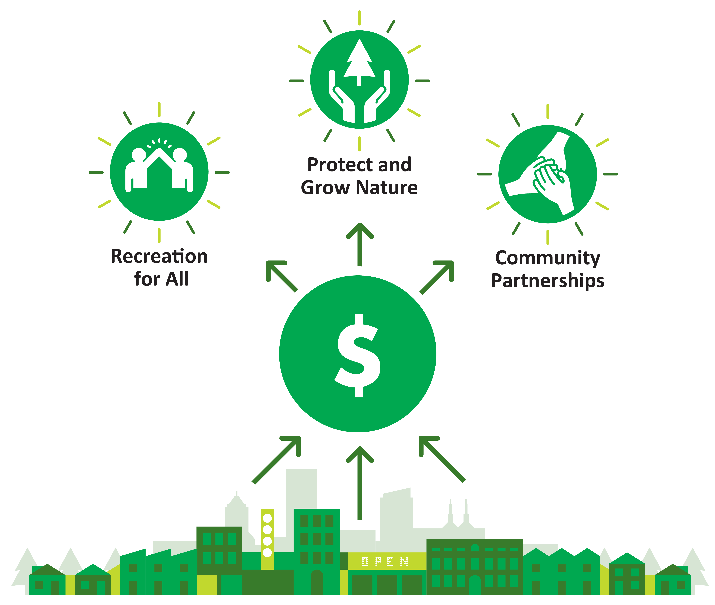
2021-22 PARKS LEVY ANNUAL REPORT
What is the Parks Levy?
Funding to support Portland Parks & Recreation operations
A FIVE-YEAR, ANNUAL PROPERTY TAX FOR PP&R OPERATIONS
Expected to raise about $48M per year
$0.80 per $1,000 assessed value. Median residential homeowner will pay about $13/month.
Notes:
What is it

Slide 27
2021-22 PARKS LEVY ANNUAL REPORT
Parks Levy Commitment | Parks Levy Commitment | Sum of Total Expense* | Parks Levy Portion of Total
Recreation for All |  | $17,079,992.47 | $5,050,567.00
C4 | Prevent cuts to recreation programs, closures of community centers and pools. | $6,393,906.90 | $2,153,676.00
D2 | Deliver recreational programs, including, but not limited to, environmental education and access to nature for youth, summer camps, family-friendly movies and concerts, fitness and arts classes, teen- and senior-focused programs, lifesaving swim lessons, and a summer playground program serving free lunches to children experiencing hunger. | $10,686,085.57 | $2,896,891.00
D3 | Remove financial barriers for low-income households by ending current dependence on recreation fee revenues, allowing an equity-focused delivery of community events and programs and reducing the likelihood of further cuts to recreation offerings. | N/A (included in net expenses for other commitments) | N/A
Notes:
Text Slide with bullets

Slide 28
2021-22 PARKS LEVY ANNUAL REPORT
Parks Levy Commitment | Parks Levy Commitment | Sum of Total Expense* | Parks Levy Portion of Total
Protect and Grow Nature |  | $36,757,914.29 | $11,470,915.00
C3 | Increase opportunities for communities of color and children experiencing poverty to connect w/ nature. | $6,393,906.90 | $2,153,676.00
C1 D1 | Enhance and preserve parks, rivers, wetlands, trees, and other important natural features in urban areas for the benefit of all Portlanders and wildlife Protect water quality and wildlife habitat, control erosion, remove invasive species in 8,000 acres of natural area. | $2,379,899.05 | $817,194.00
C5 D4 D5 | Enhance park maintenance to keep parks clean and safe, including litter and hazardous waste removal, restroom cleaning, and playground safety. Clean litter and hazardous waste in parks and natural areas, maintain grounds and landscaping, provide safety checks on play equipment, improve preventative and traditional maintenance. Keep public restrooms open and cleaner. | $26,559,594.77 | $8,397,281.00
D6 D7 | Plant new trees in communities where today canopy coverage is lower, to improve air and water quality, diminish the impacts of climate change, and provide wildlife habitat. Protect Portland’s 1.2 million park trees by performing proactive maintenance, safety checks, hazard removal, and replacement of damaged trees in parks and natural areas. | $6,409,925.50 | $1,810,574.00
D8 | Modernize data systems to improve internal efficiency. | N/A (project-level) | N/A
Notes:
Text Slide with bullets

Slide 29
PP&R YEAR 1 PARKS LEVY DRAFT REPORT
Parks Levy Commitment | Parks Levy Commitment | Sum of Total Expense* | Parks Levy Portion of Total
Community Partnerships |  | $6,731,752.92 | $2,203,565.00
D | A community oversight committee will be appointed to review Parks Levy expenditures and to report annually to City Council. The Measure also directs the Bureau to provide for a performance audit to ensure that services funded by the Parks Levy are consistent with voter intent. | $293,443.02 | $100,879.00
C2 | Provide park and recreation services to diverse populations including communities of color, seniors, teens, households experiencing poverty, immigrants and refugees, and people living with disabilities. | N/A (included in net expenses for other commitments) | N/A
D9 | Prioritize services for communities of color and households experiencing poverty, including equity-centered engagement and outreach, community partnership grants, and increased engagement with volunteer and partner groups. | $6,438,309.90 | $2,102,686.00
Notes:
Text Slide with bullets

Slide 30
2021-22 PARKS LEVY ANNUAL REPORT
Adherence to Ballot Language
Organized the Year 1 report by the 15 commitments in the voter pamphlet to show progress on each commitment
Key actions, Parks Levy funding, and relevant performance measures are listed for each commitment
Fiscal Accountability
Overview and clarity on Leveraged Funding Model
Parks Levy funds are only spent on service areas that are legally eligible and aligned with the voter commitments
Appendix D has full list of expenses by service area and work group
Transparency
Draft report shared with PLOC for feedback
Many elements of the report were shared with the PLOC throughout FY 2021-22
Accountability to PLOC Review
Notes:
Text Slide with bullets

