Slide 1
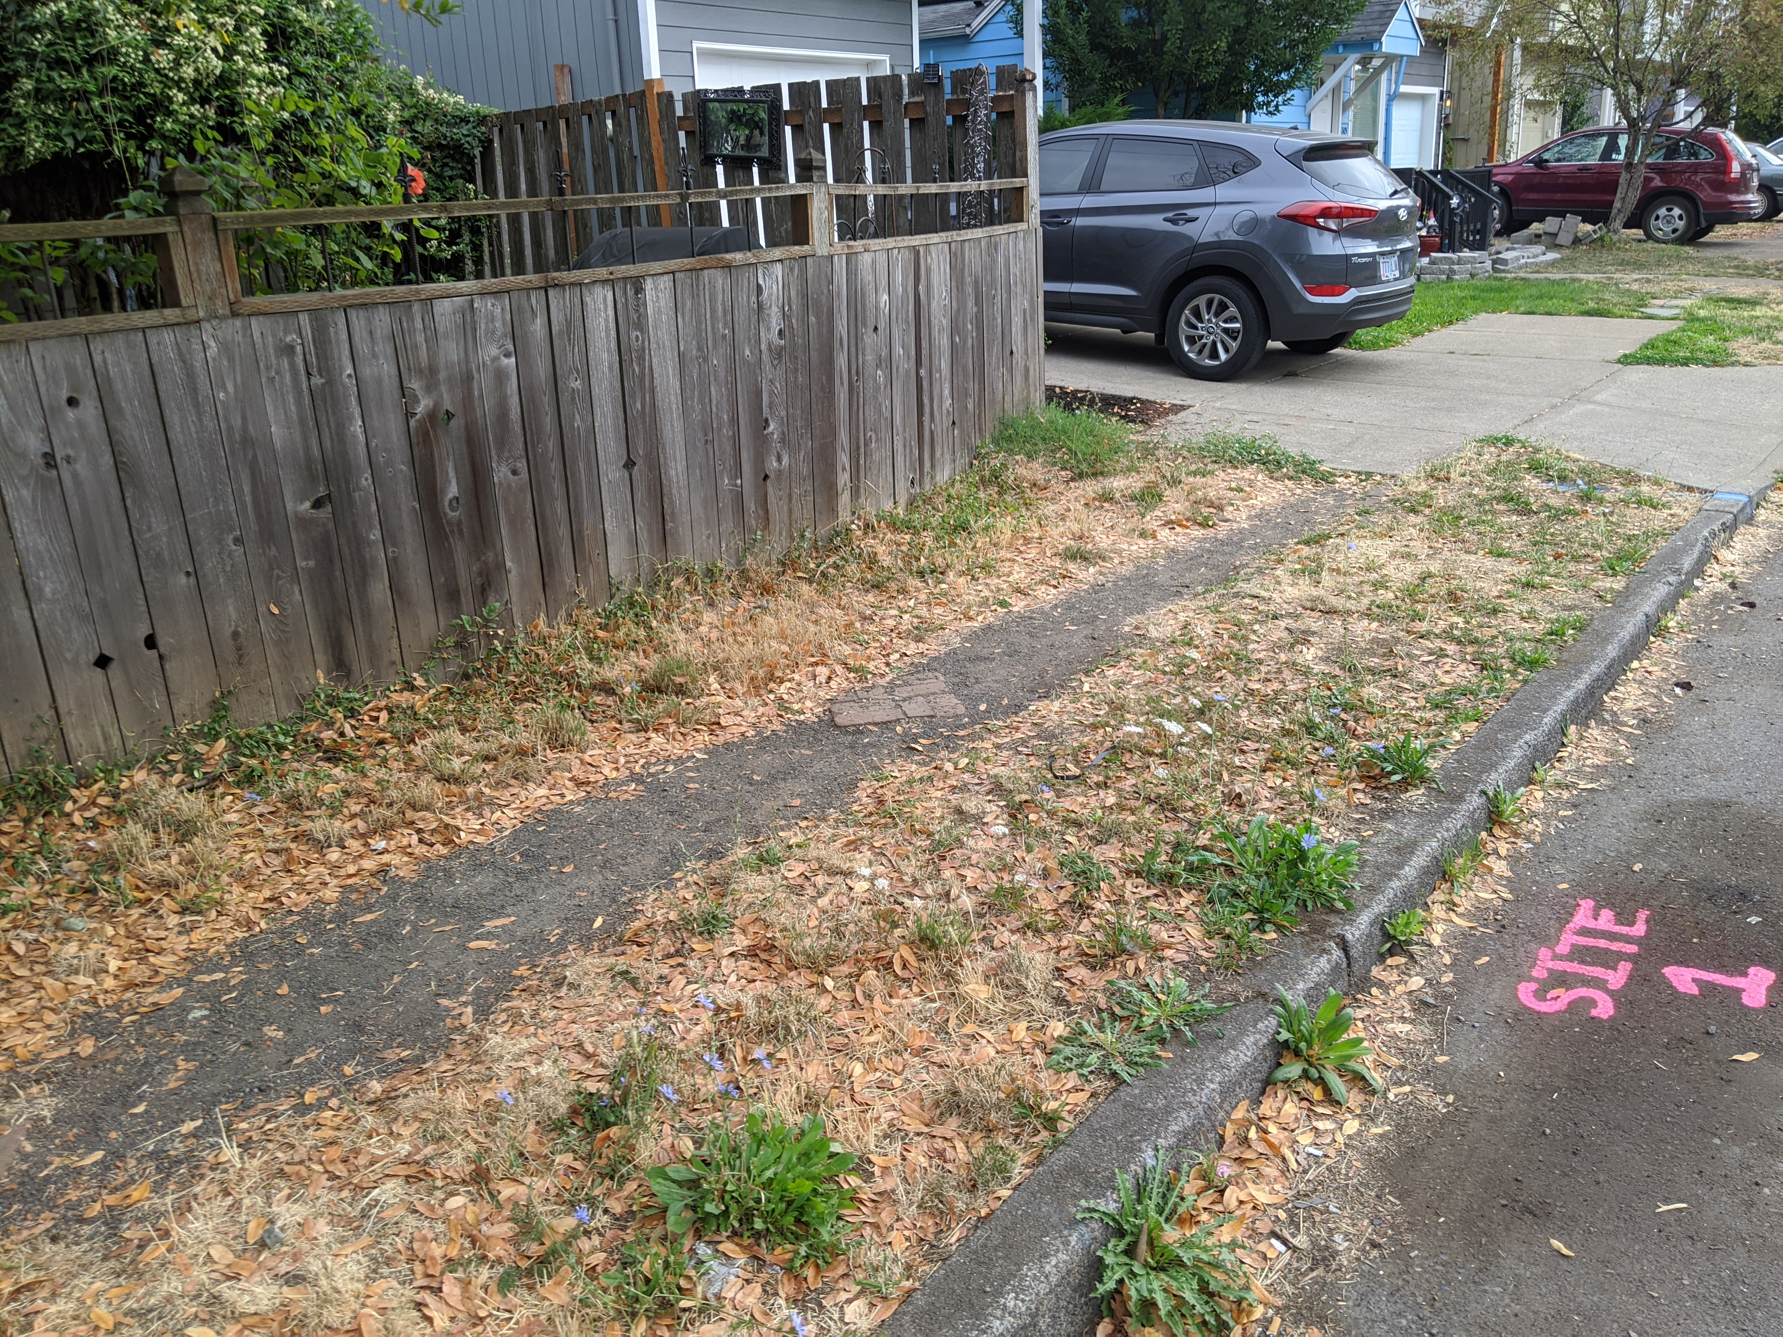
Brentwood Darlington Transportation Improvements
Portland City Council
October 12, 2022
Notes:
A 1932 photo from the City Archives, taken at present-day SE Martin Luther King Jr. Blvd (formerly Union Ave) and Washington Street. The men in the middle of the intersection are repairing the sewer. In the background you can see “H. Smith Produce,” and “Whitely and Clark Co.” stores.

Slide 2
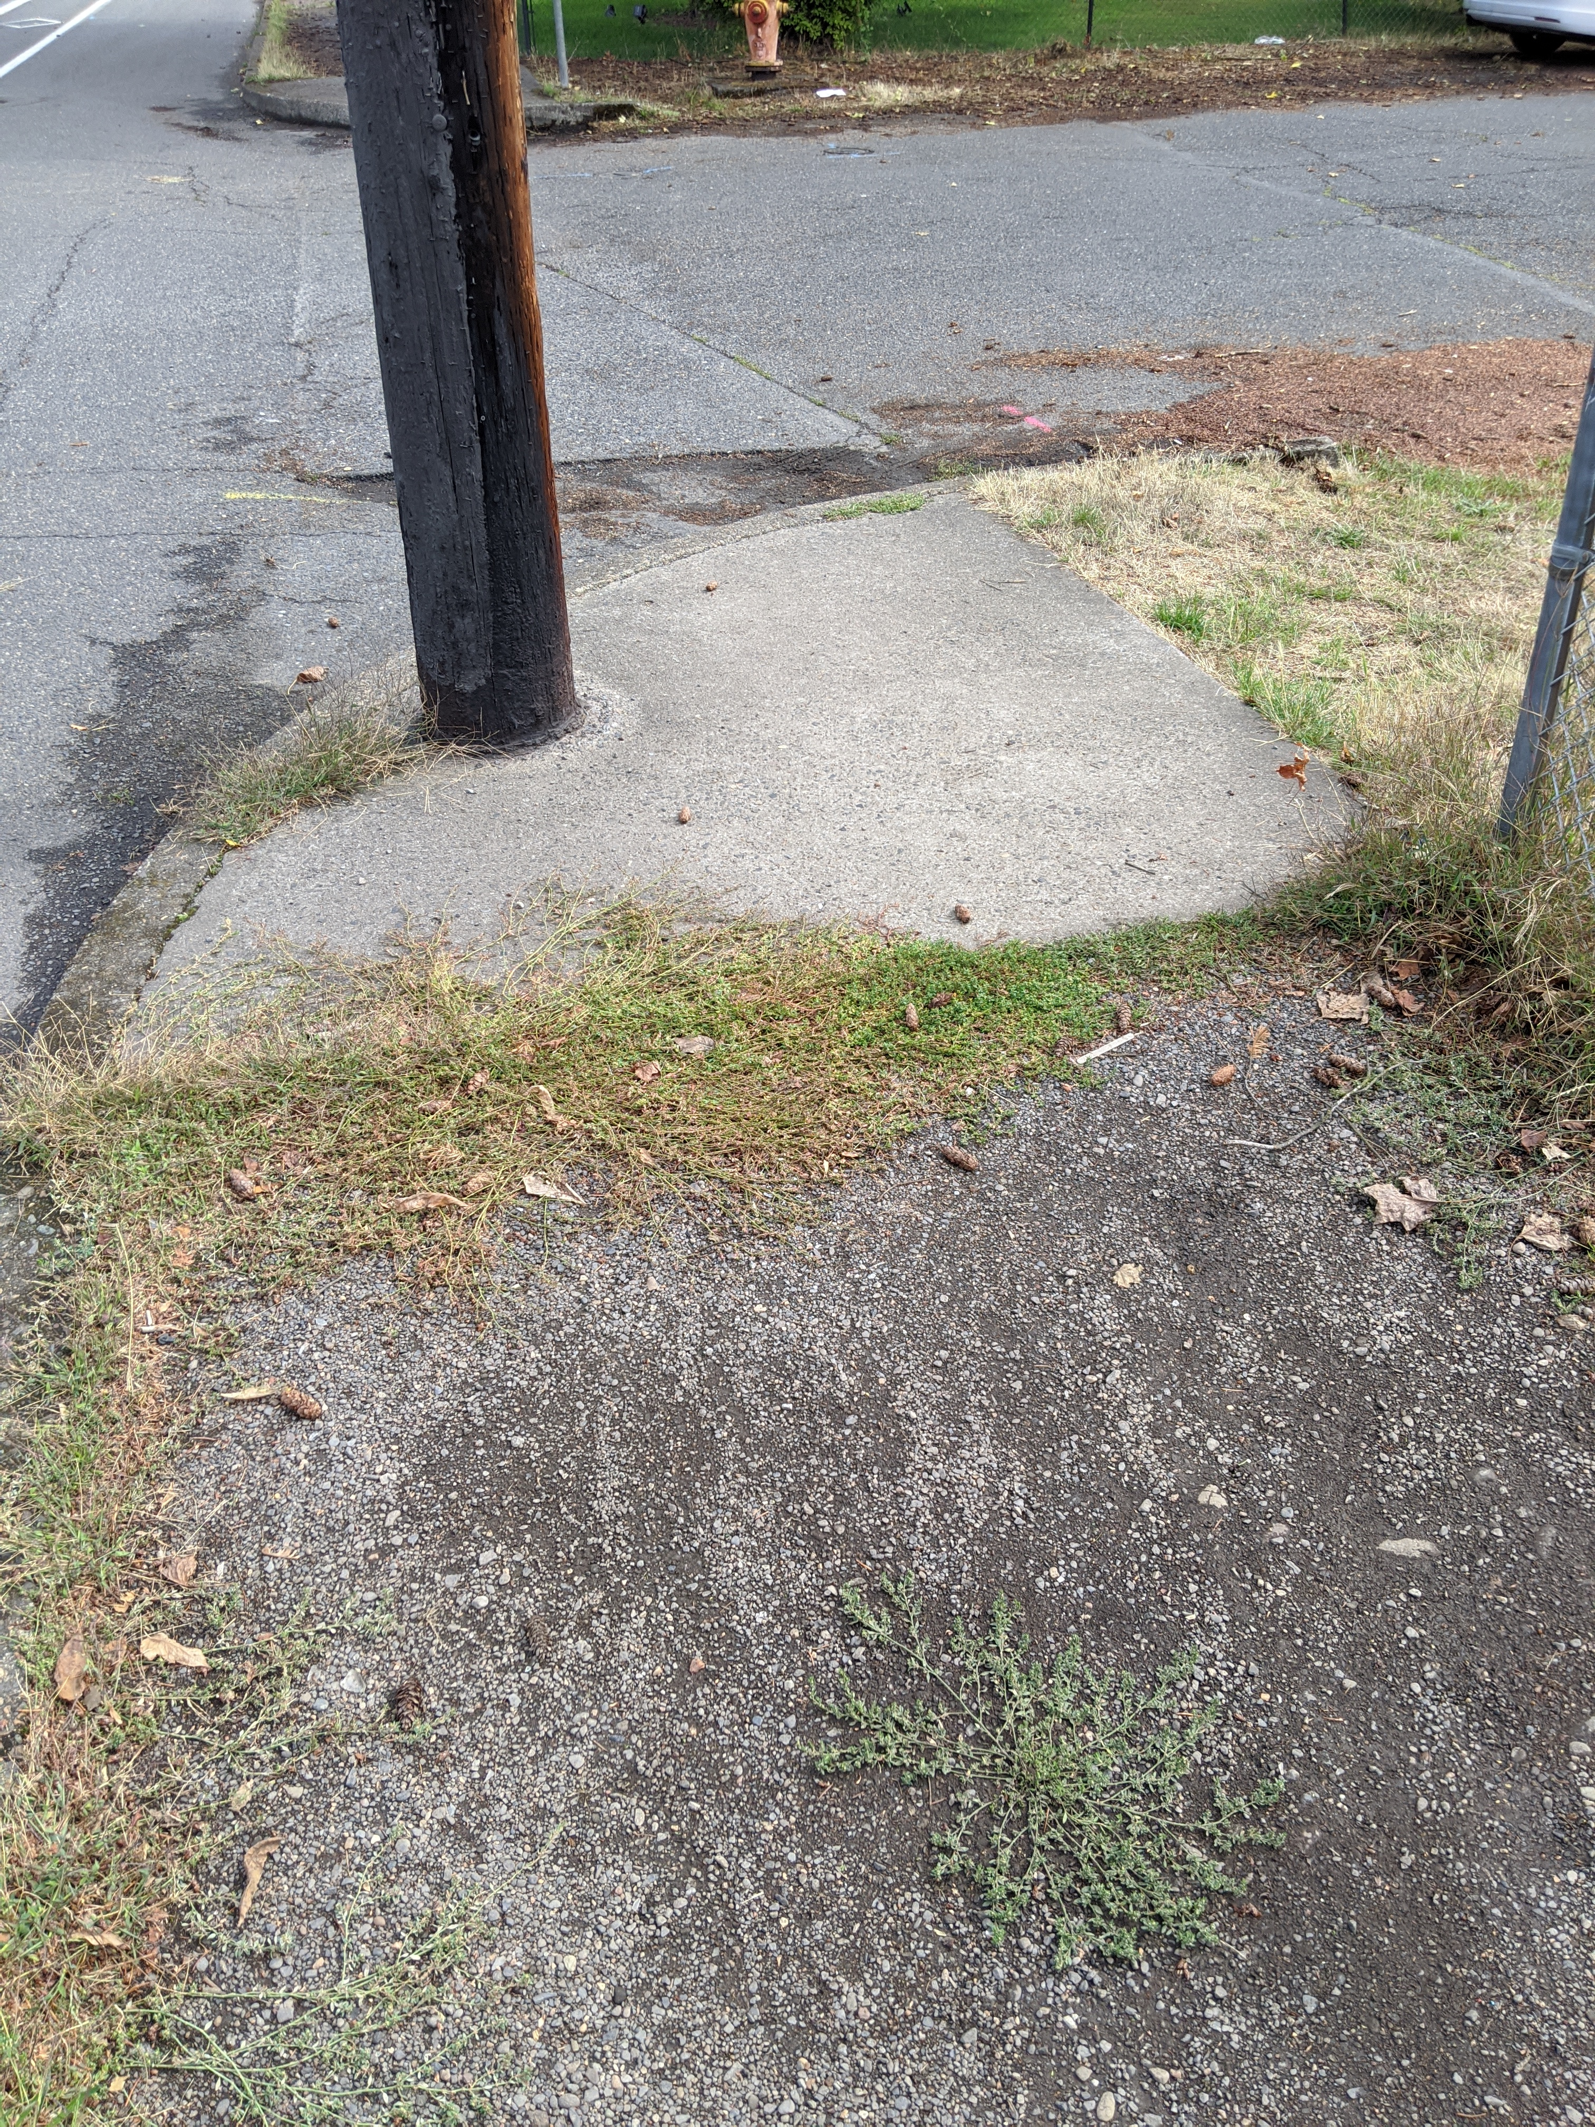
Project Scope
Provide Missing Sidewalks:
SE Flavel and SE Duke
(52nd to 82nd)
Intersection Improvements:
SE 52nd and SE Knapp
SE 72nd and Ogden St
Notes:
Adds full signal (currently all way stop)
Makes all curb ramps ADA compliant
Adds curb extensions on south side of the street
Adds ped crossing along north side of the intersection
Adds green skip striping and bike boxes

Slide 3
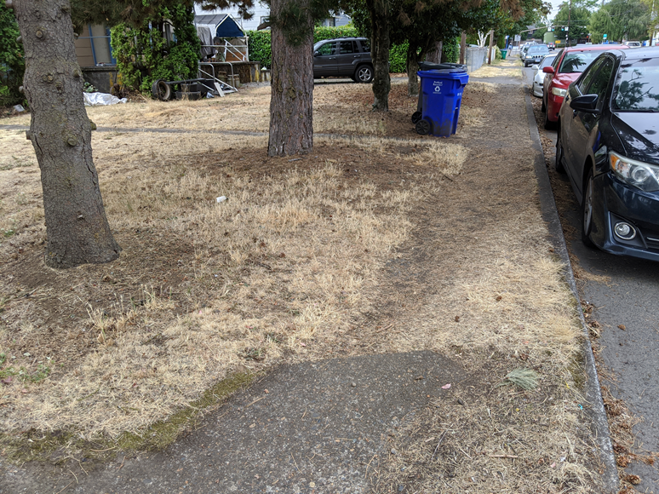
Project Scope cont.
New Signalized Pedestrian Crossing:
SE 82nd and SE Ogden/Knapp St.
Upgrade curb ramps to meet ADA at over 60 locations

Slide 4
Public Involvement Overview
PBOT led planning processes in the Brentwood Darlington area in 2018 which resulted in grant application for federal funding.
The grant was originally not approved but an outpouring of community support reversed that decision.
PBOT has provided regular project updates during the design phase and will provide regular updates in construction.

Slide 5
Right of Way
Authority is given to compensate property owners for necessary easements and, if needed, to condemn.
Permanent ROW and Temporary Construction Easements are needed from eighty-two property owners.
Permanent ROW is needed for construction of the ADA ramps and sidewalk facilities.
Temporary Construction Easements are needed for construction support.
Affected property owners have been informed of the project needs.

Slide 6
Thank You!

