Slide 1



SE 89th Avenue & Taylor Street
Local Improvement District
Resolution of Intent Hearing
October 12, 2022 – Agenda Item #844
Staff presenting: Andrew Aebi, M.B.A.; Local Improvement District Administrator
Photos taken on October 7, 2022 (slide #6) and on September 18, 2021 (slides #7-9)

Slide 2
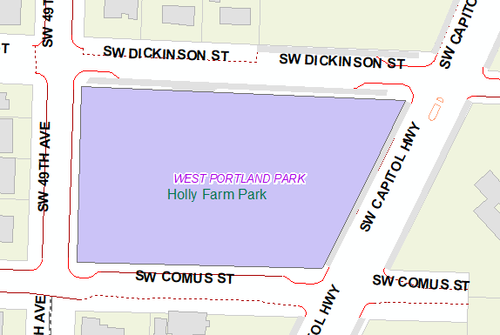
Holly Farm Park – Southwest Portland
Park Built in 2007 With No LID Partnership

Slide 3
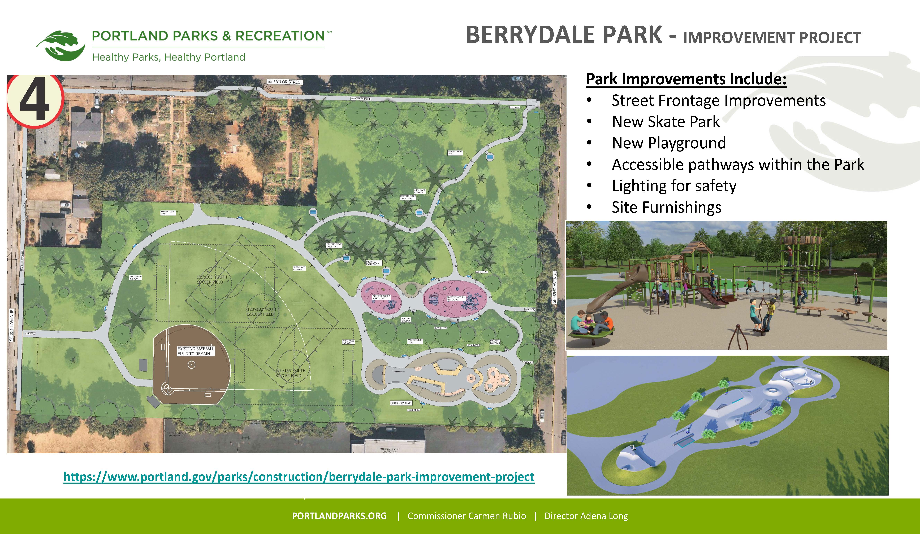
Berrydale Park – Southeast Portland
Park Pending Construction - Potential LID Partnership

Slide 4
Parks – PBOT - Community Partnerships
NE 52nd & Alberta LID: 2013 – 2015
Kʰunamokwst Park in the Cully Neighborhood
SW Dolph-Spring Garden LID: 2016 – 2018
Spring Garden Park in the Multnomah Neighborhood
NE 47th Avenue Phase I LID: 2016 – 2021
Whitaker Ponds Nature Park in the Cully Neighborhood
SE 89th Avenue & Taylor Street LID: 2022 +
Berrydale Park in the Montavilla Neighborhood
$800,000 Portland Parks & Recreation
$23,960 equal shares among 14 properties ($165/mo. over 20 years)

Slide 5
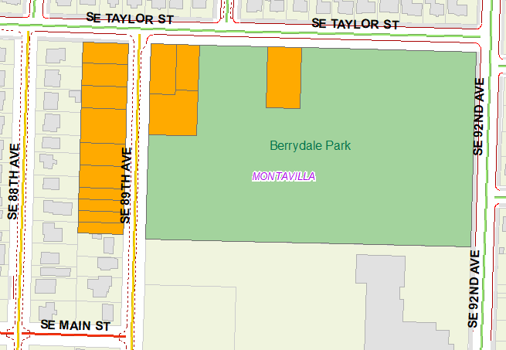
Local Improvement District Map
Nonpark Properties and Berrydale Park

Slide 6
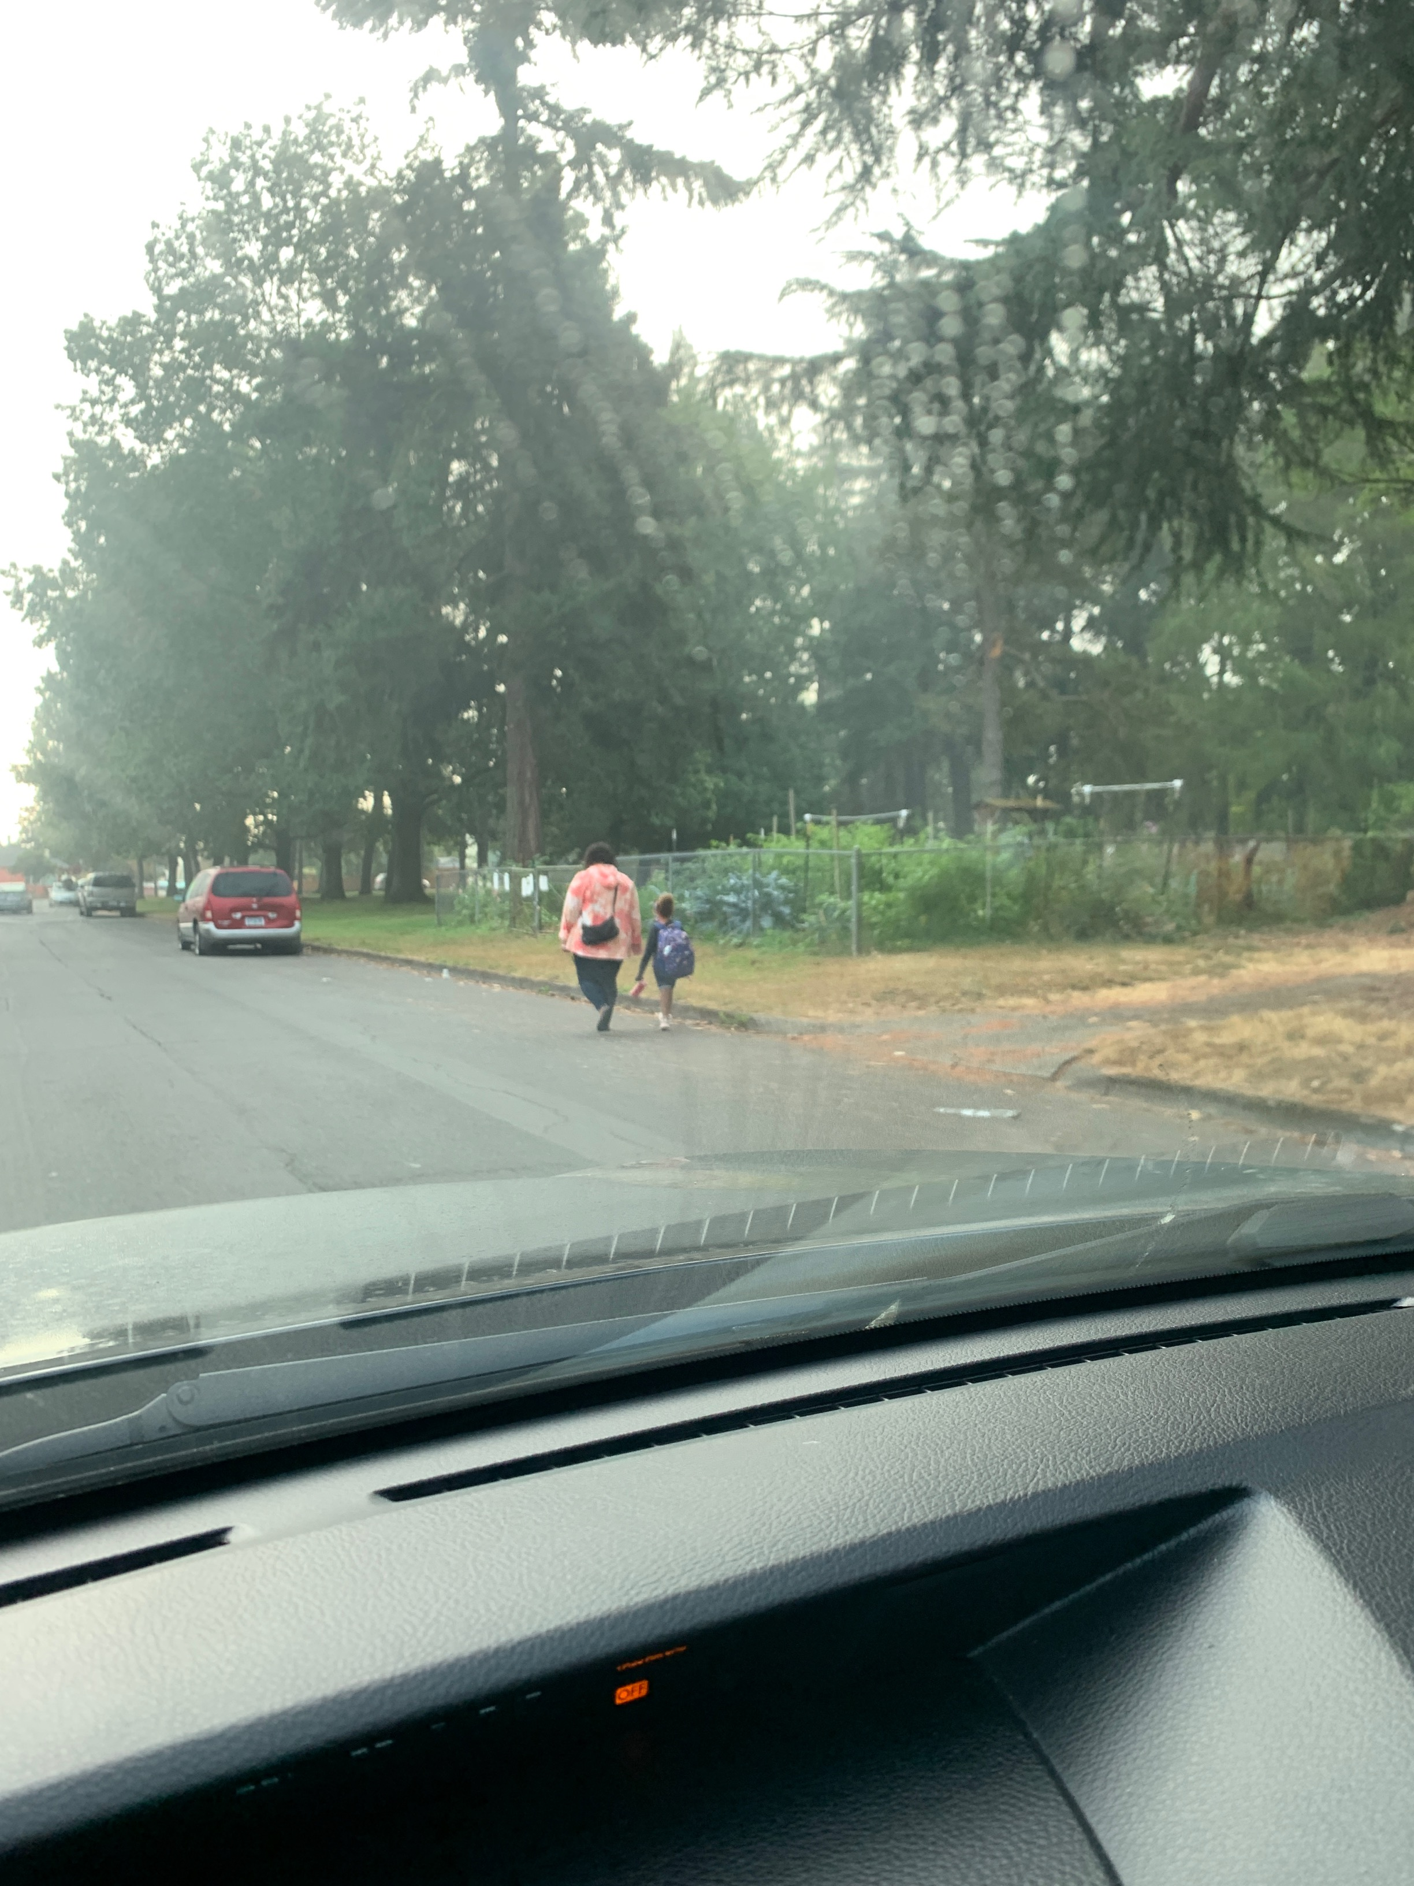
SE Taylor Street: 89th – 92nd Avenues
Looking East: Parent using vision cane with child

Slide 7
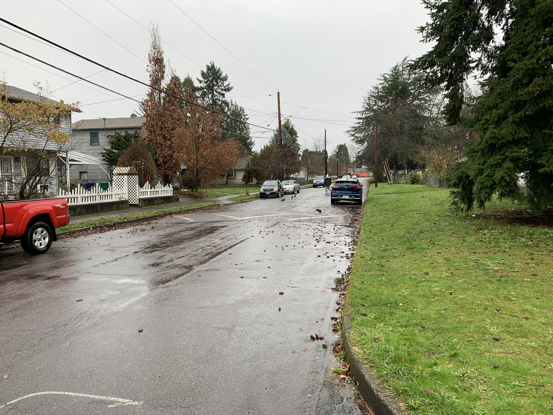
SE Taylor Street: 89th – 92nd Avenues
Looking East: Sidewalk Only Improvement South Side

Slide 8
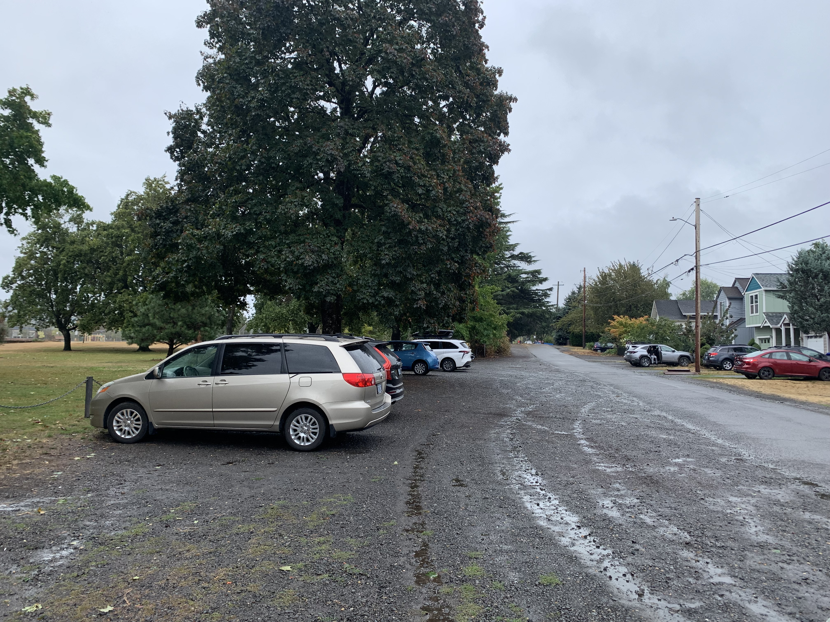
SE 89th Avenue North of Hawthorne
Looking South: Full Street Improvement, Sidewalks

Slide 9
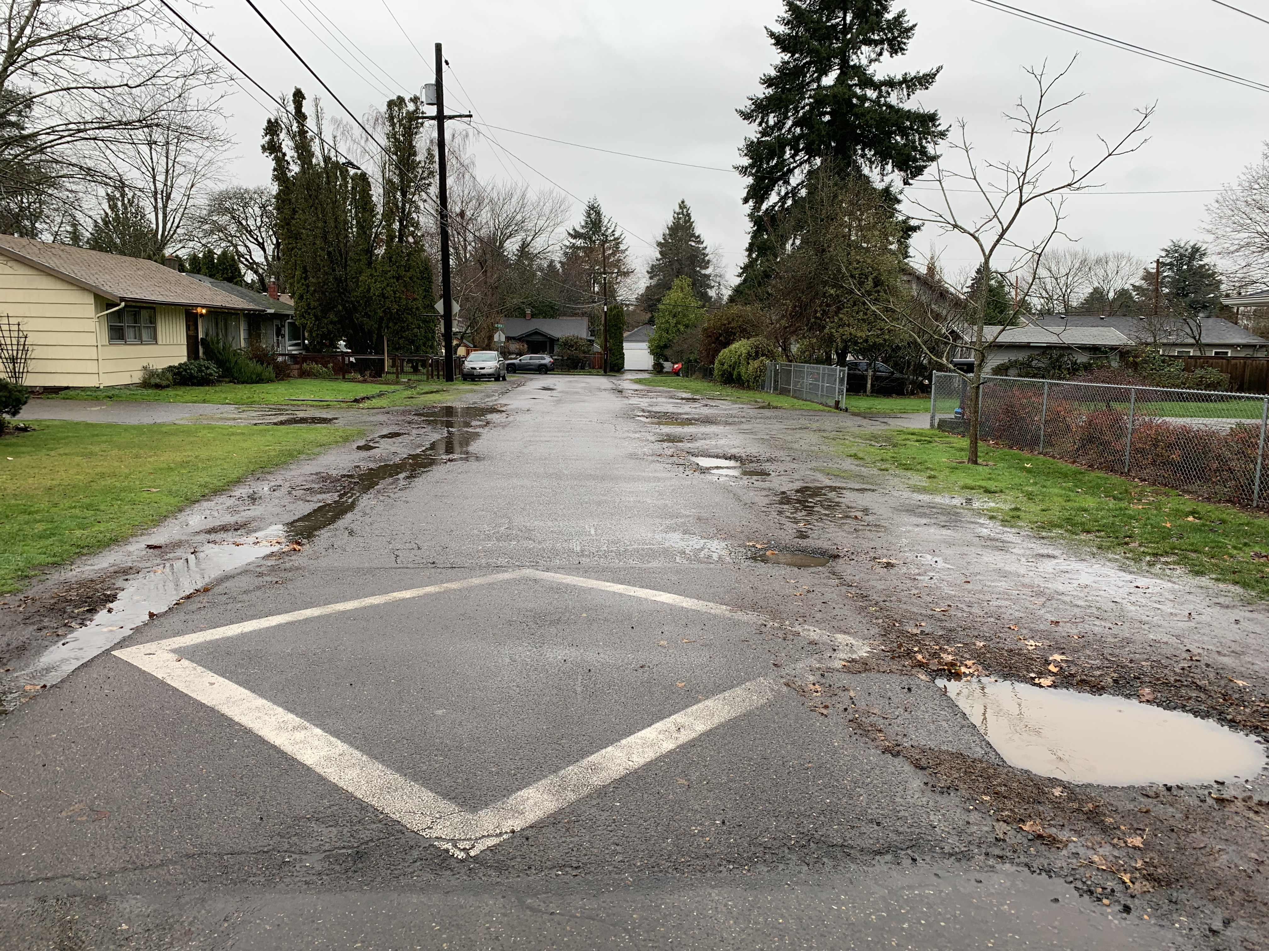
SE 89th Avenue North of Hawthorne
Looking North: Full Street Improvement, Sidewalks

