Slide 1
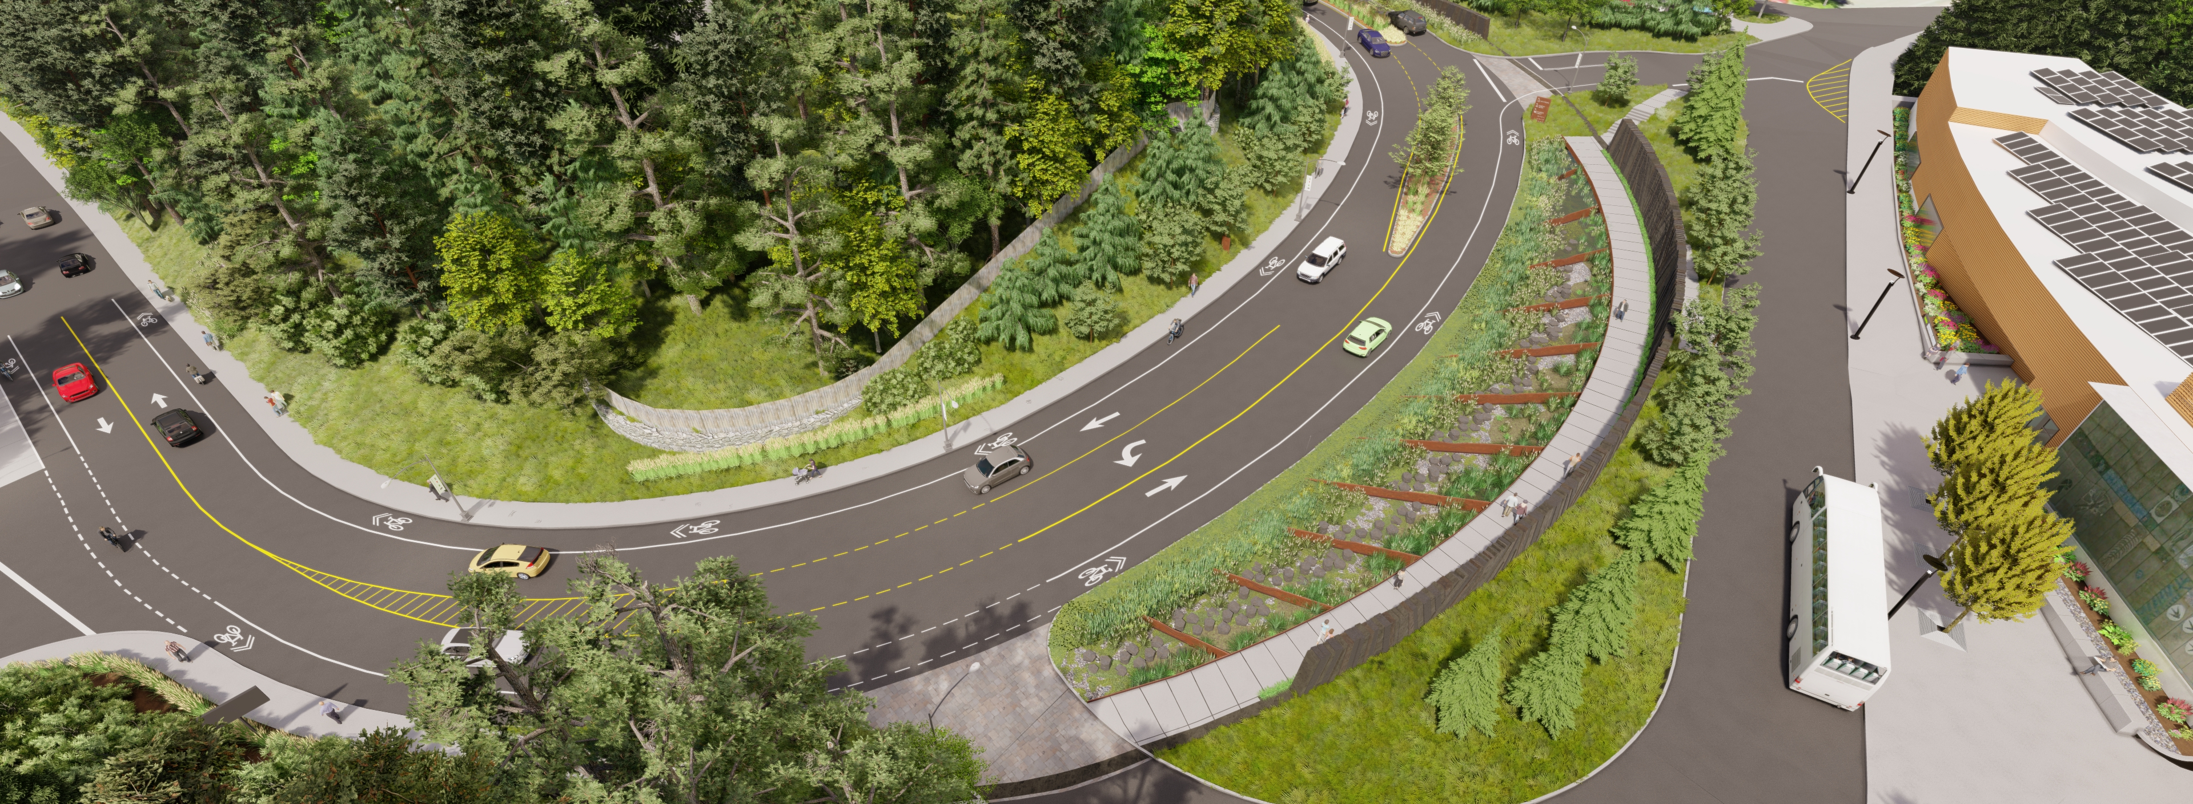
Washington Park South Entry Project
Click to update the date or subtitle – January 1, 2018
Click to update the date or subtitle – January 1, 2018
Click to update the date or subtitle – January 1, 2018
Presenter Name, Title
Presenter Name, Title
Presenter Name, Title
Notes:
Hello Mayor Wheeler and members of Council. My name is Travis Ruybal, I am a Capital Project Manager and Landscape Architect with Portland Parks & Recreation
I am here today to request Council authorization for a competitive bid solicitation and contracting with the lowest responsible bidder for construction of the Washington Park South Entry Project.

Slide 2
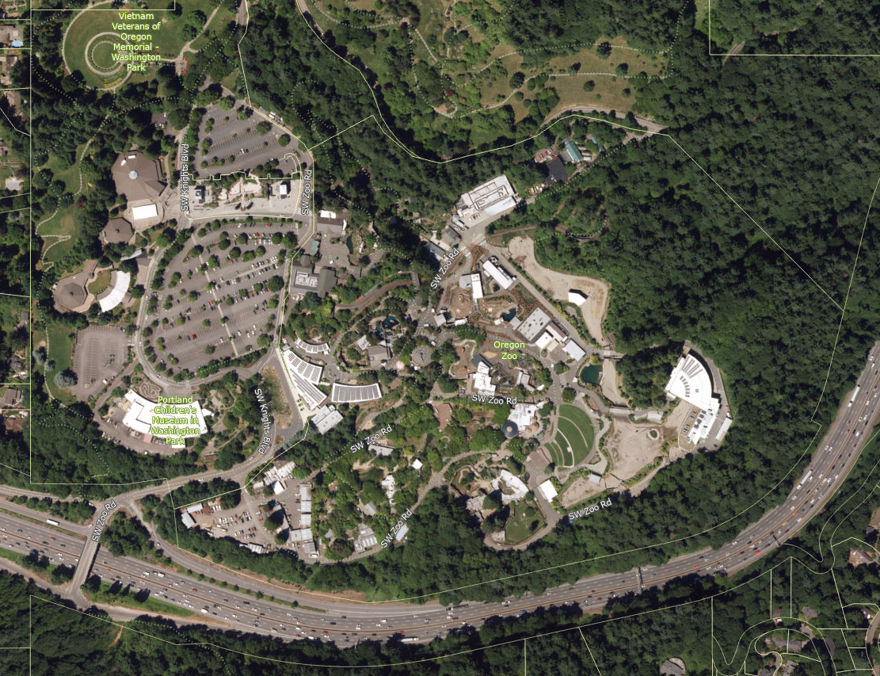
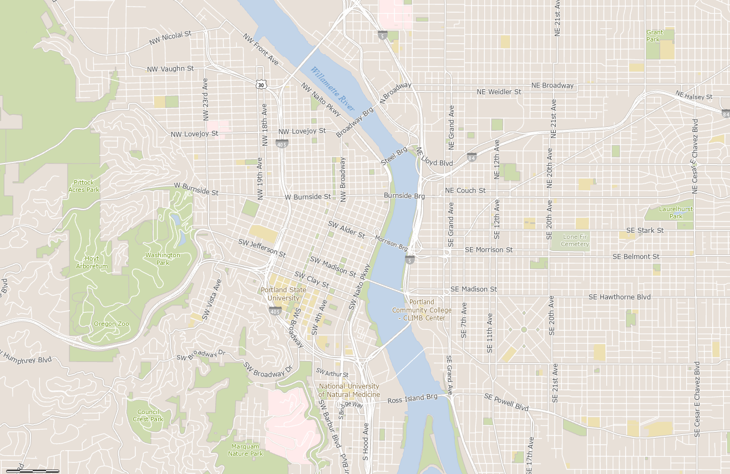
Project Location / Context
Washington Park South Entry
Notes:
Washington Park is a 410-acre park located in SW Portland in the Arlington Heights/Sylvan Highlands neighborhood.
The park is home to the Oregon Zoo, World Forestry Center, the former Portland Children’s Museum building, Hoyt Arboretum, International Rose Test Garden, the Portland Japanese Garden, and several memorials including the Oregon Holocaust Memorial and the Vietnam Veterans of Oregon Memorial, serving as a regional attraction that brings in 3.5 million visitors annually.
In March 2018, City Council unanimously approved the Washington Park Master Plan to strategically guide the future development of the park.
In 2019, this project began working with the community on achieving the first step towards that vision, the South Entry Project, collaborating with key stakeholders and park cultural institutions. This project marks the 1st project to be implemented out of the Washington Park Master Plan

Slide 3
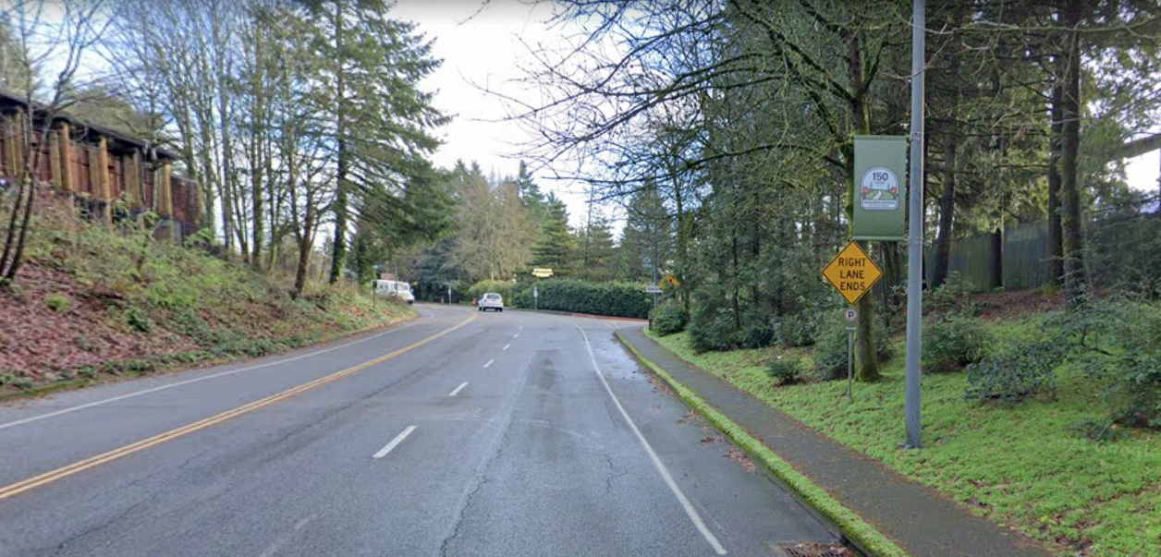
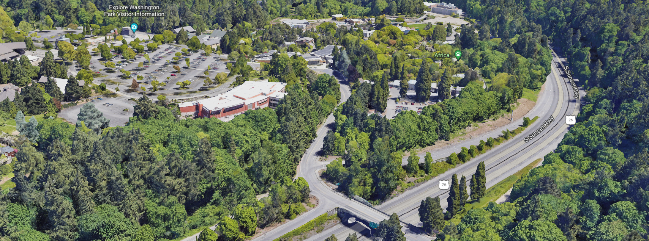
Site Photos / Existing Conditions
Notes:
The current South Entry drive is densely forested with a mix of deciduous and evergreen trees, framing the road and giving a sense of park arrival.
There are multiple decision points, road configurations, and minimal signage at the entry to welcome visitors or provide key wayfinding moments.
The result leads to traffic back-ups; negative interactions between pedestrians, bikes, and cars; and general confusion.
Slopes are very steep on the northwest side of Knights Boulevard, and the only sidewalk, located on the south side of Knights Boulevard, is narrow.
Further down the drive, the road splits at several different locations and there is very minimal directional wayfinding to help visitors navigate their destination.

Slide 4
South Entry Proposed Improvements
Stormwater Management
Grand Entry to the Park
Improved Circulation
Notes:
The project identified three primary goals:
Creation of a Grand Entry to the Park – inspired by community visioning to deliver a long-desired iconic entry to the multiple regional cultural and recreational amenities.
Improved Pedestrian, Bicycle, and Vehicular Access / Circulation – increasing safety and access to the variety of park users and modes.
Stormwater Management – fulfilling land use requirements resulting from the construction of parking located west of the Children’s Museum.

Slide 5
South Entry Proposed Improvements
$5.2 M Construction Costs
Funding Sources
SDC
WA Park Parking
ADA Transition Plan
% for Green Funding
Notes:
The construction cost estimate is $5.2 Million, paid for with SDC funding, WA. Park – Parking Meter Funding, ADA transition plan funding and % for Green Grant Funding ($763,328). Operations and Maintenance budget is anticipated to be approximately $204K per year which will be paid for by levy funding with the expectation that PP&R, through its Sustainable Future efforts, will work with City Council to identify a successor resource to address this ongoing cost post Levy.

Slide 6
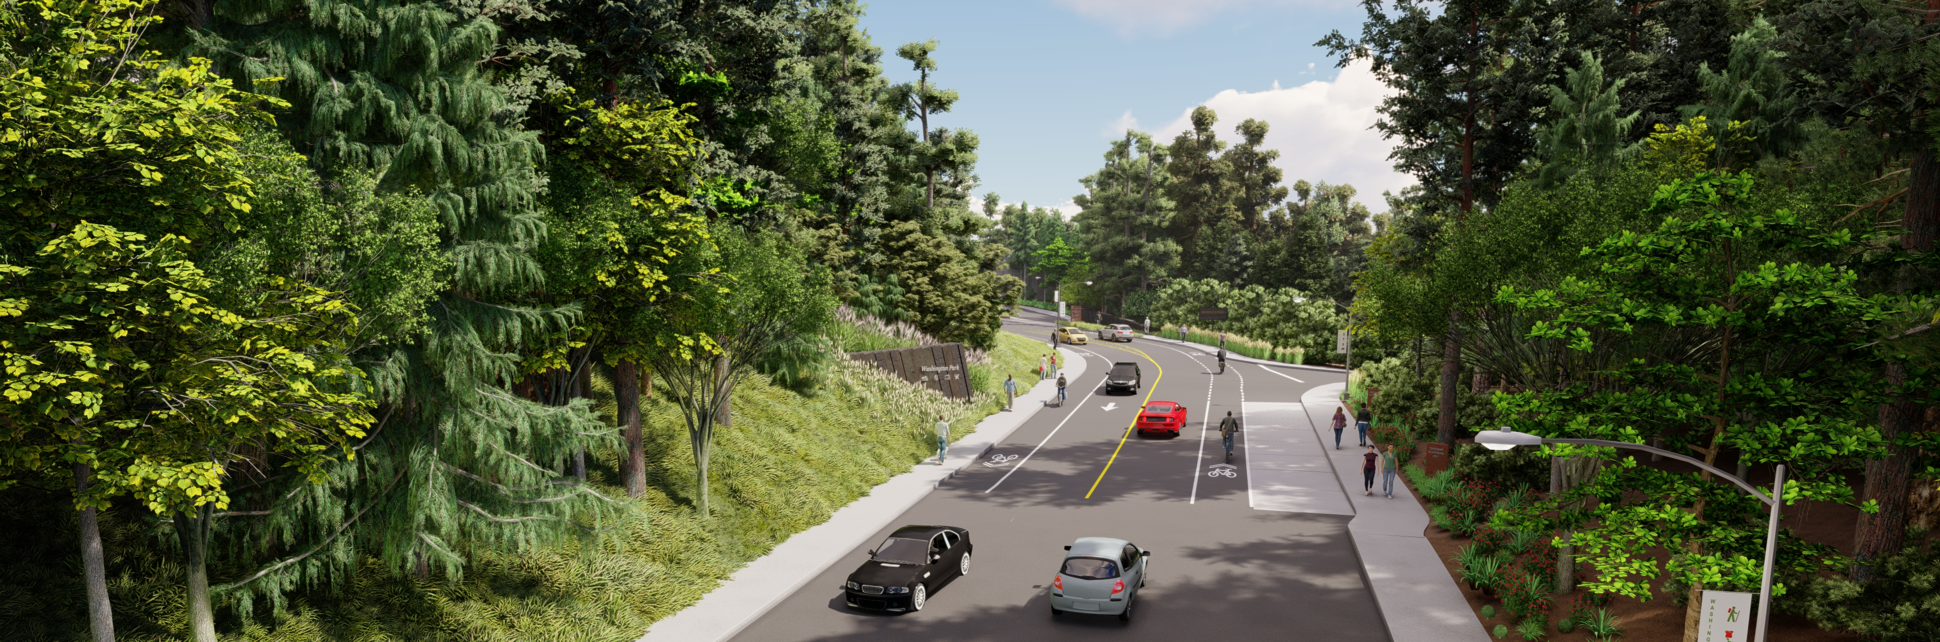
Requested Council Action:
Authorize competitive bid solicitation and contract with the lowest responsible bidder for construction of the South Entry Project (Ordinance)
Notes:
We are here to request that Council Authorize competitive bid solicitation and contract with the lowest responsible bidder for construction of the Washington Park South Entry Project.
With the acceptance of this authority to bid by Council, we will proceed with bid advertisement as soon as possible. The Parks team, in partnership with Procurement services will utilize the standard Subcontractor Equity Program specification which requires 20% of the hard construction costs be subcontracted to certified firms. Of that 20% there is a 14% goal for Disadvantaged, Minority and Women utilization. Procurement’s Inclusive Contracting Manager (Theresa Green) will assist in outreach specifically to minority contractors.
We anticipate construction to start in January 2023, with a completion date by May 2024.
I am happy to answer any questions you might have at this time.

