Slide 1
82ND AVENUE
Authorization to obtain ROW
Portland City Council: September 14, 2022

Slide 2
Today’s Requested Council Action:
Authorize the Bureau of Transportation to acquire certain permanent and temporary rights necessary for construction of the 82nd Avenue Crossings: Klickitat-Lambert, NE/SE Project through the exercise of the City’s Eminent Domain Authority

Slide 3
Near-term Critical Fixes

Slide 4
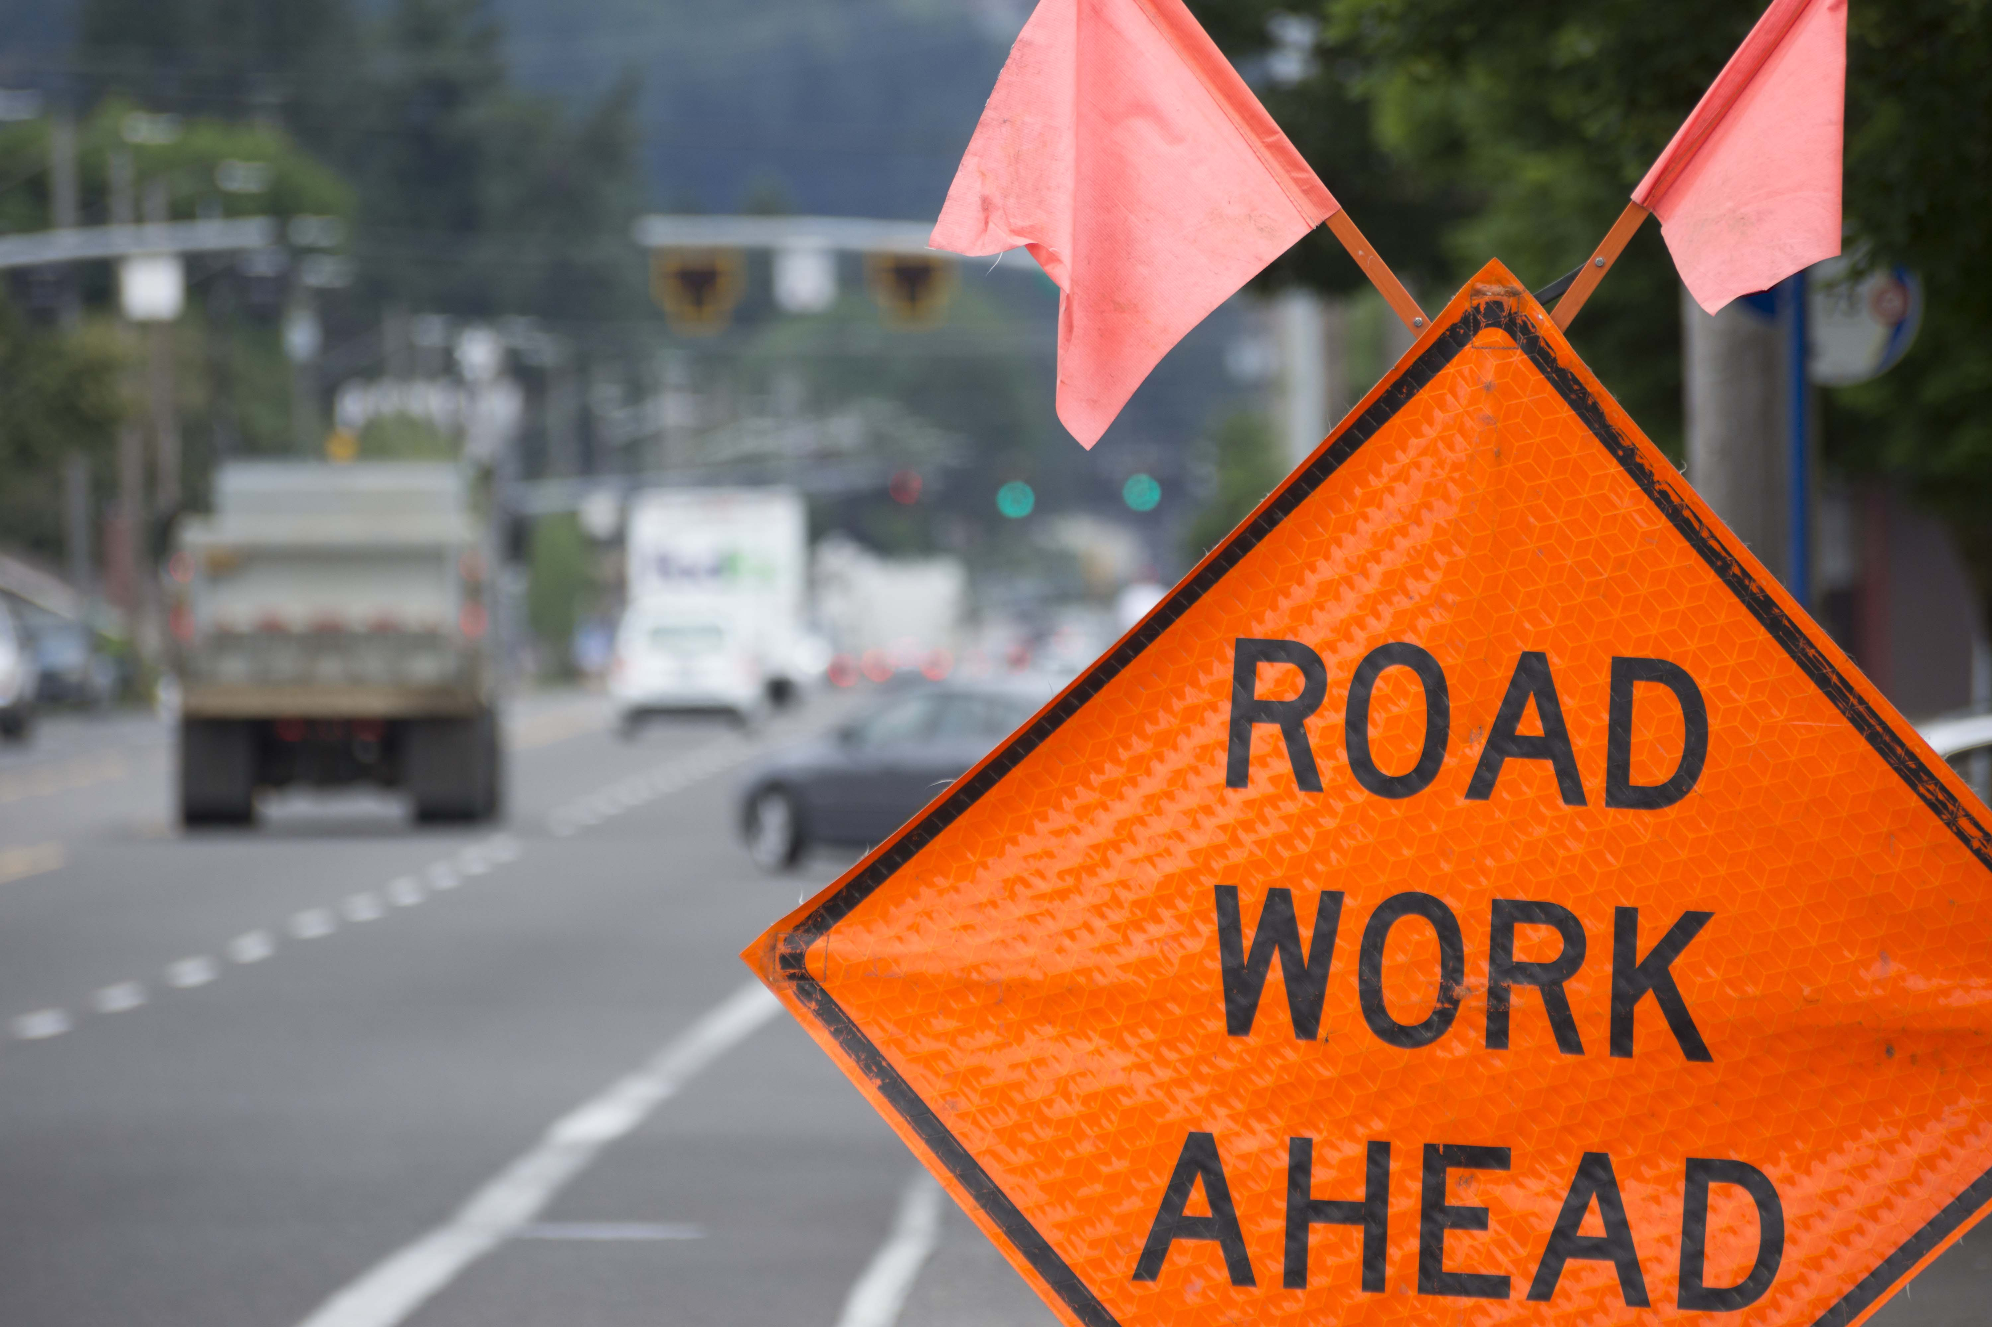
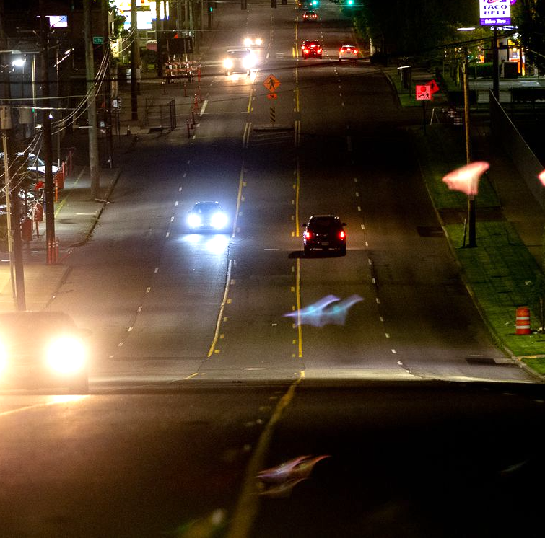
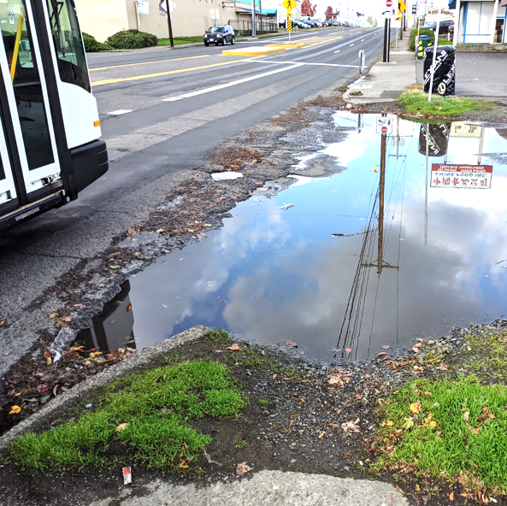
Critical fixes for 82nd Avenue:
Crossings
Lighting
Paving
Corridor safety
Signals
Accessible curb ramps

Slide 5
Near Term Critical Fixes (2023-2026)
Category | Budget
Lighting | $2 - 5 million
Crossings | $12 – 15 million
Corridor Safety | $12 – 15 million
Major Maintenance | $50+ million
TOTAL Funding | $80 million
Paving, Curb Ramps
Traffic Signals

Slide 6
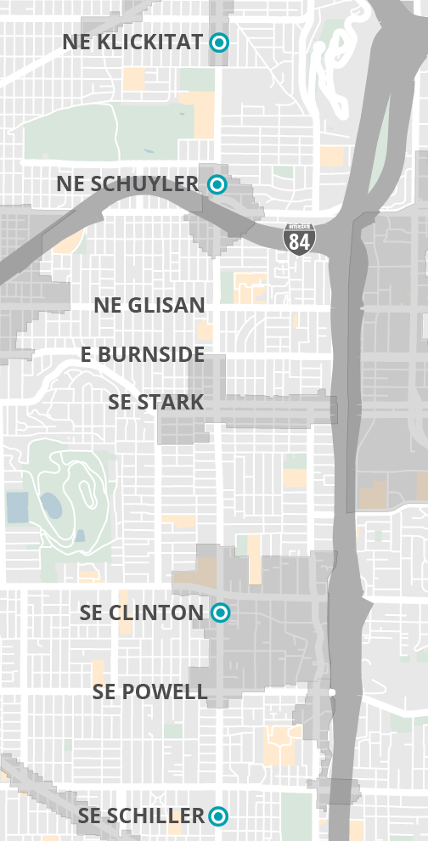
Critical Fixes on 82nd Ave
Crossings
Four New Crossings:
NE Klickitat Street
NE Schuyler Street
SE Clinton Street
SE Schiller Street

Slide 7
Right of Way
•Authority is given to compensate property owners for necessary easements and, if needed, to condemn.
•Permanent ROW and Temporary Construction Easements are needed from fourteen property owners.
•Permanent ROW is needed for construction of the ADA ramps.
•Temporary Construction Easements are needed for construction support.
•Affected property owners have been informed of the project needs.

Slide 8
Learn More
Project website: portland.gov/82nd-avenue
Notes:
Visit project website, sign up for updates on the project.

Slide 9
Thank you

