Slide 1
Secondary Treatment Expansion Project (“STEP”) Phase 2 Construction Amendment (BES Project Number E07947)
Muriel Gueissaz-Teufel, PE, BCEE | Engineering Manager| August 24, 2022
André Baugh, Group AGB, Community Benefits Agreement Lead
Mark Bertolero, Kiewit, Project Manager
MINGUS MAPPS, COMMISSIONER
DAWN UCHIYAMA, INTERIM DIRECTOR

Slide 2
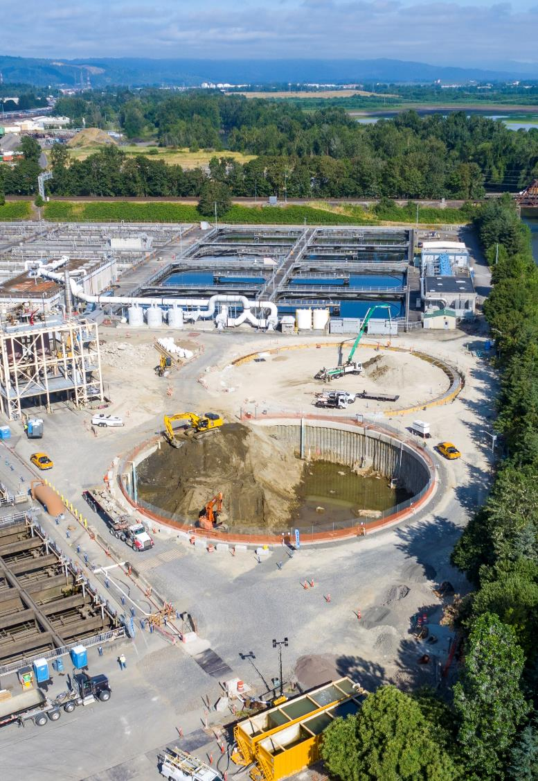
Guaranteed Maximum Price Agreement – Phase 2
Regulatory-Driven improvements at the Columbia Boulevard Wastewater Treatment Plant
Previous Council Authorization November 2020 (first phase)
Work is on ongoing and on schedule, with $100M authorized to date
$515M total authority requested to add second phase of Work
The project implements a Community Benefits Agreement

Slide 3
Procurement and Council History
October 2017, Council approved use of the Construction Manager/General Contractor (CM/GC) alternative contract delivery method (ordinance 188630)
June 2018, Council authorized Design Contract No. 30006543 with CH2M Hill Engineers, Inc. (ordinance 189056A)
June 2018, Council authorized Program Management Support Contract No. 30006509 with Stantec Consultant Services, Inc. (ordinance 189057)
June 2019, City entered Contract 30006509 with Kiewit Infrastructure West for Pre-Construction Services
October 2020, Authority to enter into first phase of construction with Guaranteed Maximum Price Agreement 1
with notification of needed council action in 2022 for a construction estimate of $301M at a 30% design level completion (-80% to + 130% confidence)

Slide 4
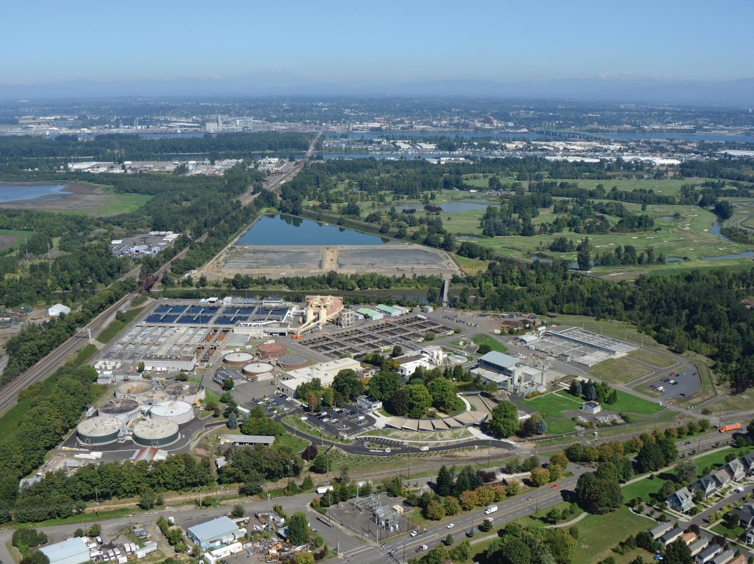
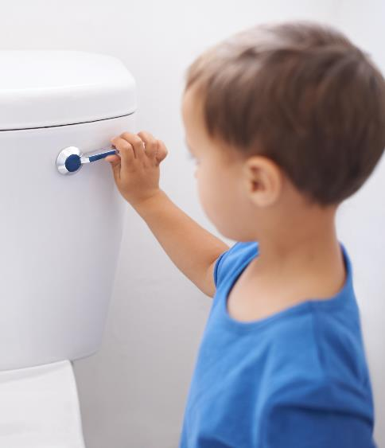
Every Portland resident, business, and visitor relies on the treatment plant.

Slide 5
24 hrs/day, 7 days a week, Rain or Shine, Through Covid, Fires, Snow and Ice
The plant must keep working

Slide 6
How we got here
1952 : Columbia Boulevard Wastewater Treatment Plant (CBWTP) Built
1972 : last major expansion of CBWTP to add secondary treatment

Slide 7
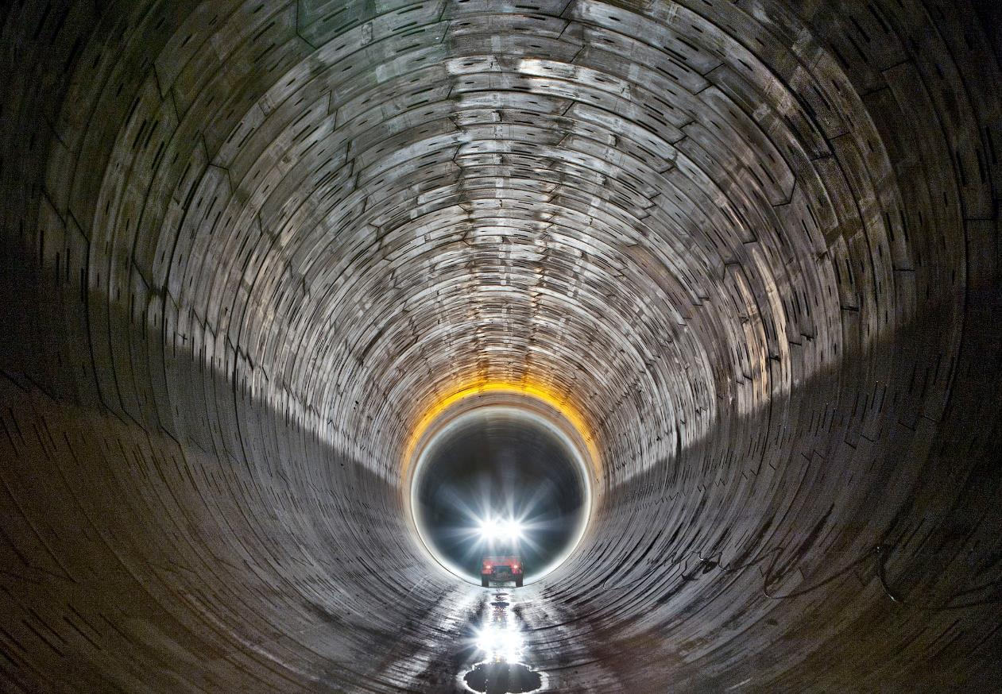
How we got here
1990’s – 2010’s : Combined Sewer Overflow Program implementation to protect public health, the Willamette and Columbia Slough
2011 : “Big Pipes” completed
-> water goes to the treatment plant
2011 Regulatory requirements shift to the treatment plant

Slide 8
Mutual Agreement and Order
1. Chemically Enhance Primary Treatment starts | Sept. 30, 2012
2. Secondary Improvements start | Oct. 31, 2014
3. Monitoring and Analysis Program Report | Dec. 30, 2015
4.a Facilities Plan Update | Dec. 30, 2016
4.b No Feasible Alternative Analysis | Dec. 30, 2016
5. DEQ response to City | Mar. 30, 2017
6. Critical path schedule | June 30, 2017
7. Begin implementing schedule | Sept. 30, 2017
8. Start up of new facilities | Dec. 31, 2024
BES met all the regulatory milestones and remains on schedule

Slide 9
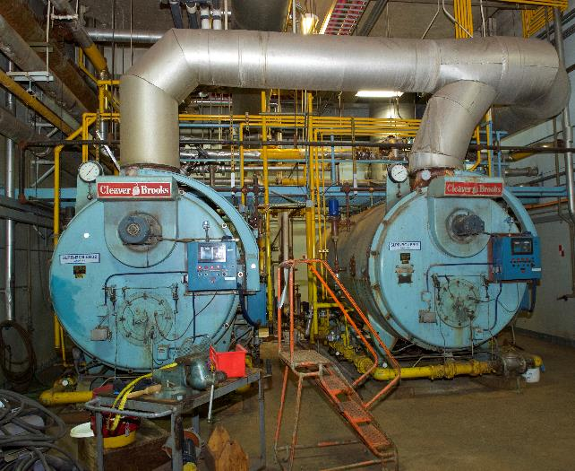
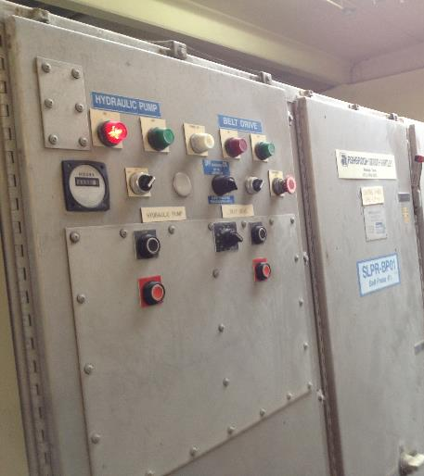
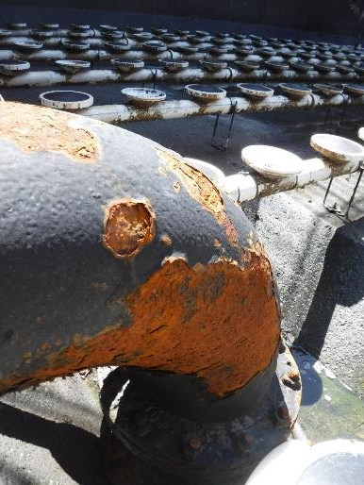
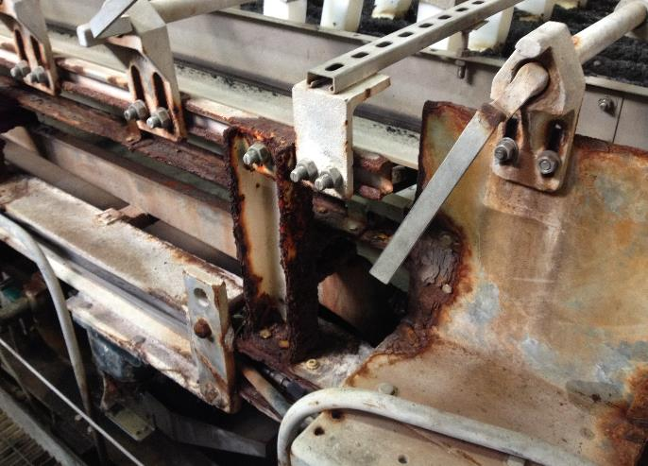
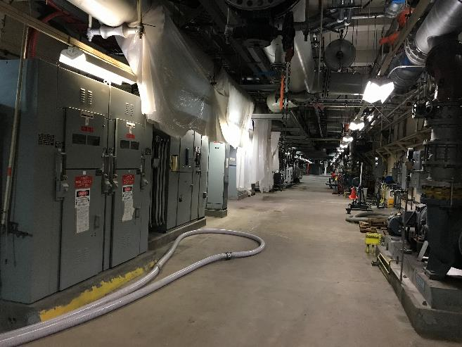
Clarifiers are one driver they are associated with systems that are failing or severely outdated
Aeration basins
Heating boilers from 1970s
Solids Handling Control Panels
Solids Handling System
Tunnel – Electrical System

Slide 10
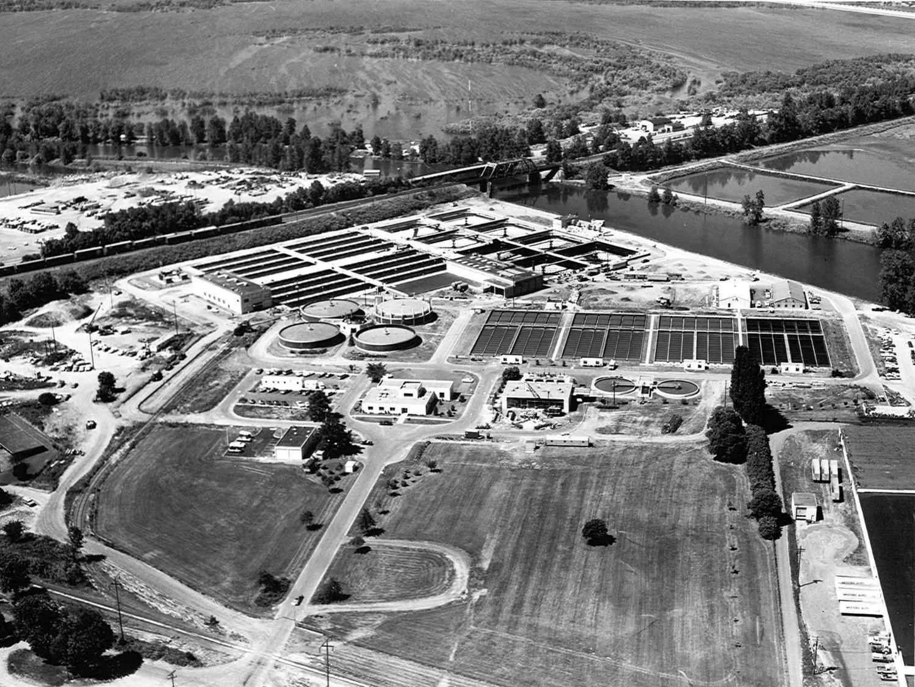
Most of the facilities replaced by STEP were built in 1970s
STEP core project areas

Slide 11
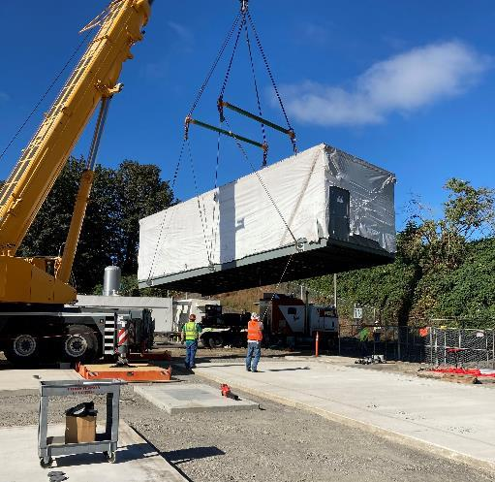
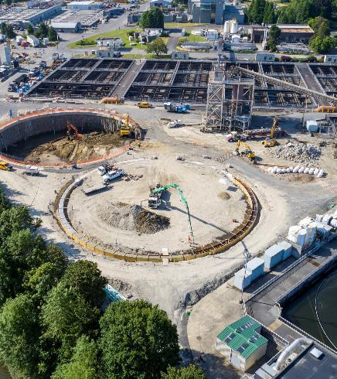
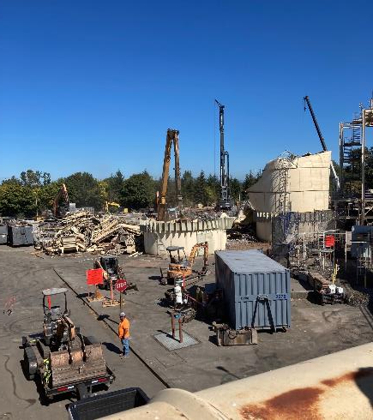
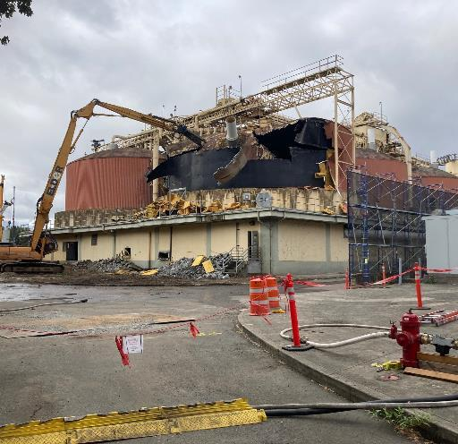
Phase 1 (ongoing) is about getting ready for Phase 2

Slide 12
Phase 2 Scope
It is not easy work

Slide 13
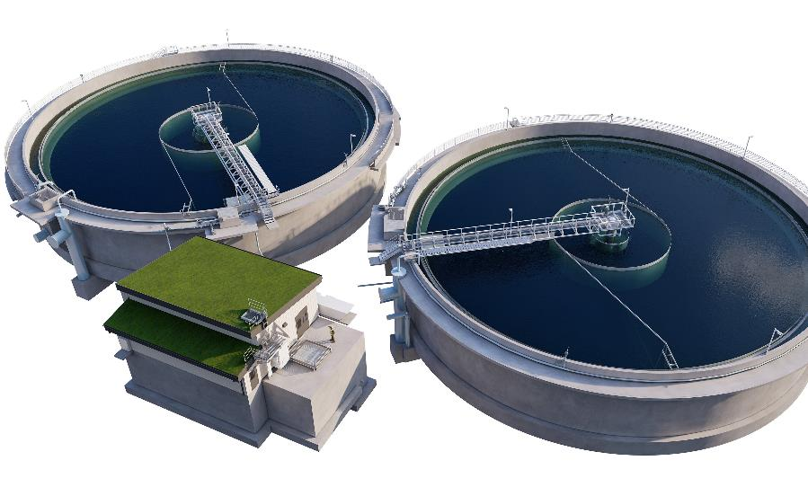
The Largest Clarifiers in Oregon
Phase 1 construction – July 2022
40% more performance
Better performance = better treatment capacity
Seismically resilient construction

Slide 14
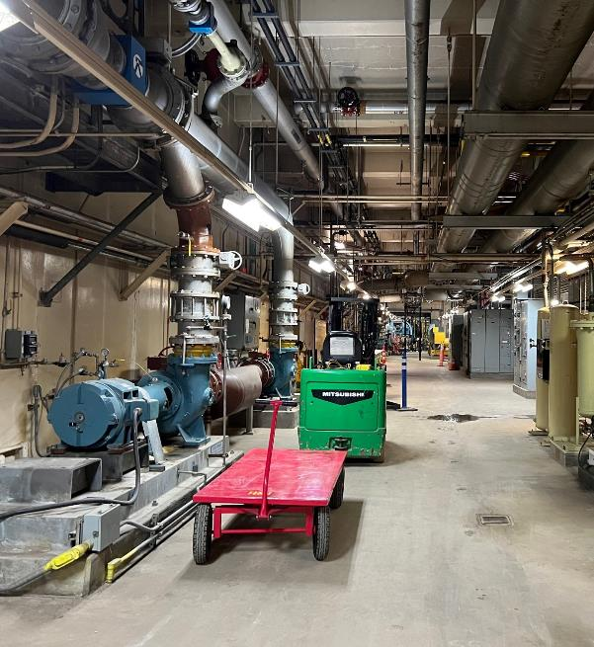
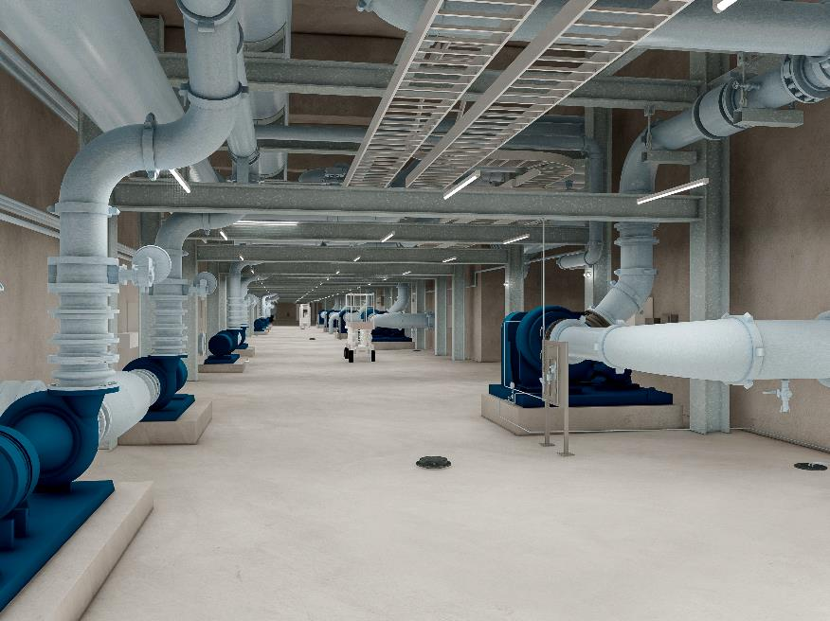
Significant work underground to connect water, gas, power, add resiliency
Today
2025

Slide 15
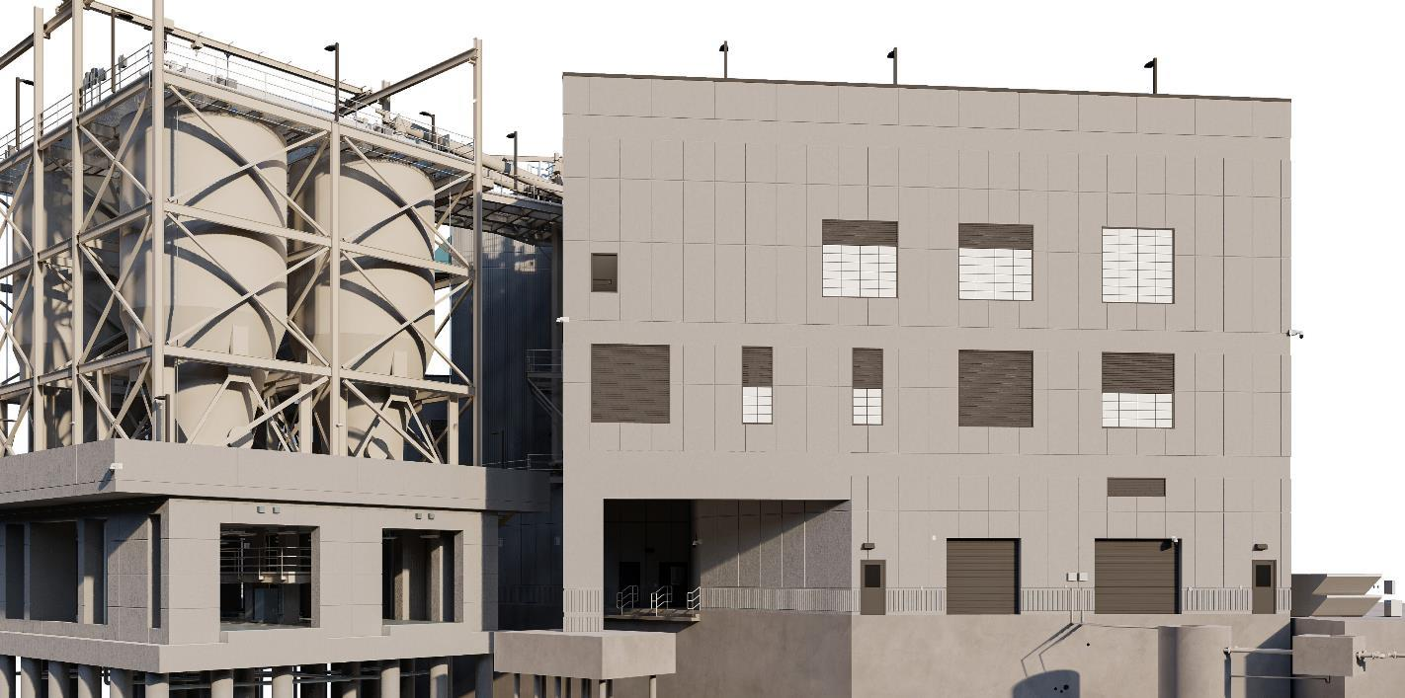
Solids Handling Facility
25% Reduction in Long Distance Hauling cost and carbon emissions
Received Energy Efficiency Incentives from Energy Trust of Oregon
Biofilter to treat odors
Green Roofs
Provides healthy and safer workspace
Seismically Resilient

Slide 16
Solids Handling Facility

Slide 17
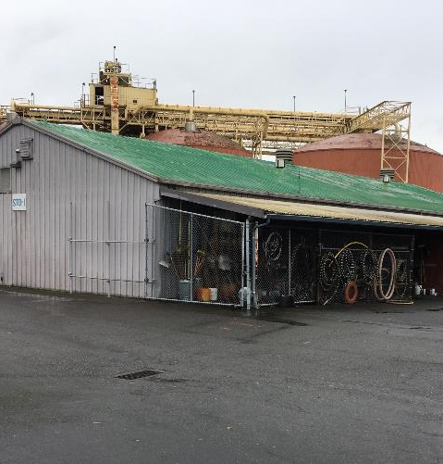
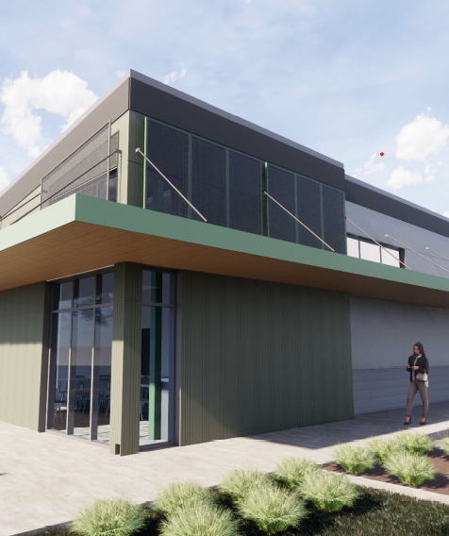
Replacement Shop/Office space

Slide 18
The end game

Slide 19
Cost Estimate Evolution since last Council
$241
$391
$301M
2020 $
30% design uncertainty
Jul 2022
Oct 2020
Jul 2022
Oct 2020

Slide 20
Cost Estimate Evolution since last Council
$241
$391
$301M
2020 $
30% design uncertainty
Jul 2022
$396
$643
2022 $
30% design uncertainty
$495M
Jul 2022
While consumer inflation since 2020 has been 14%, construction industry inflation (steel, PVC, HDPE, concrete, copper, diesel, etc) has been 64%
Oct 2020
Jul 2022
Oct 2020

Slide 21
Cost Estimate Evolution since last Council
$241
$391
$301M
2020 $
30% design uncertainty
Jul 2022
$396
$643
2022 $
30% design uncertainty
$495M
Jul 2022
2022 $
100% design, **current bids
$493M
$515
$396
Uncertainty reduced with increased design level; cost growth controlled through value engineering; current bids and market pricing control the price
Oct 2020
Jul 2022
Oct 2020

Slide 22
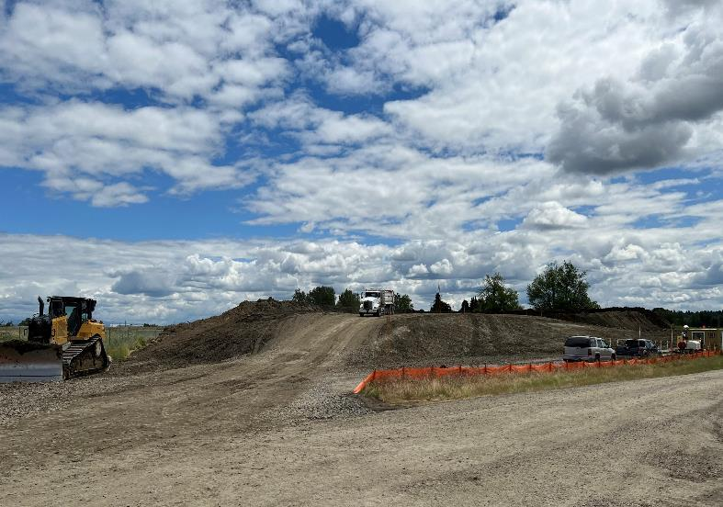
Value Engineering Efforts
Cost savings opportunities
Continuous through Design
$111M in savings realized
Examples:
Ground improvements means and methods: ($17M)
Excavated spoils disposal: ($6.2M)
Raise clarifiers 10 ft, reduce size to 145 ft dia: ($5.7M)
All the way down to replace ductile iron pipe C110 fitting to C153 ($0.06M)

Slide 23
Equity & Diversity: Construction
STEP Community Benefits Agreement Integral to this Amendment
30% Kiewit Performed - 70% subcontracted work
Background on CBA
Performance to date on Phase 1
Proposed Plan

Slide 24
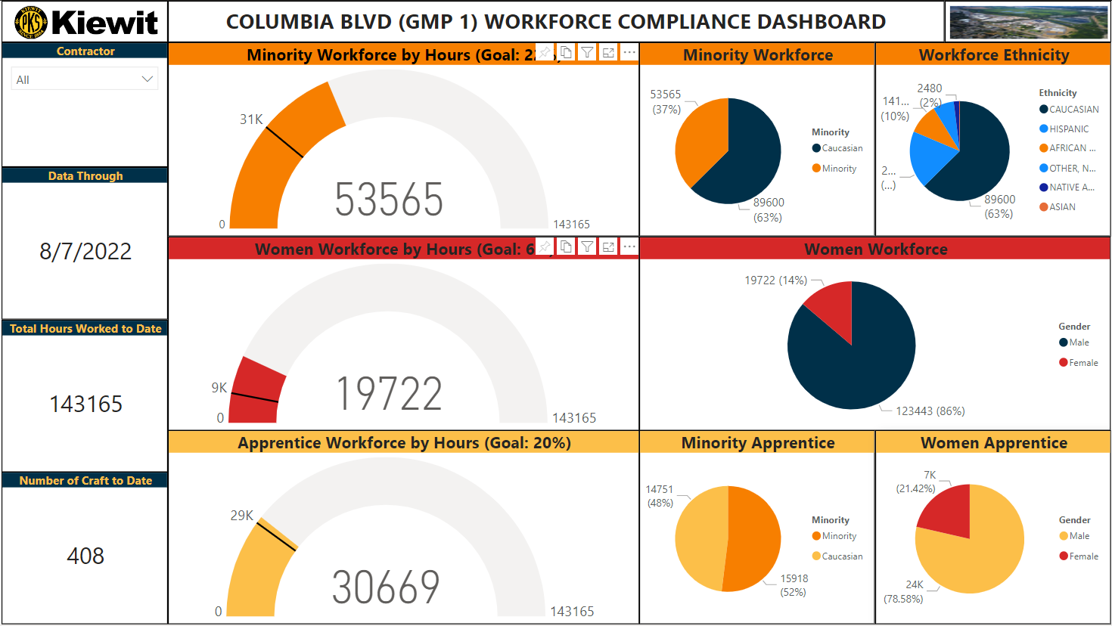
Workforce Diversity and Performance to Date
Notes:
Transition slide will be in front of this.
Workforce performance order of animations in this slide
Highlight the total of 143,165 craft hours worked onsite to date
Highlight the total of 408 people have worked on this project in the trades to date
Highlight the minority workforce by hours section so we can show a goal of 31K hours and actual of 53K hours
Try and make the pie chart full size for the workforce ethnicity (in that pie chart re-label so that it is easier to see the hours associated with each ethnicity)
Highlight the women workforce hours section to highlight the goal of 9K hours and our actual of just under 20K
Highlight the apprentice workforce hours section to highlight the goal of 29K hours and our actual of 30.6K
Highlight the breakdown sections of apprentices to show that over 52% of our apprentices are minorities and over 21% are female.
CBA goals for minority work hours is currently 30,800 hours and we have worked over 53,565 minority work hours on the project to date. The goal for female hours is 8,589 currently and we have worked over 19,722. Apprentices goal hours are 28,633 and we have currently worked 30,669 apprenticeship hours on the project. Included in those apprentice hours are 52% minority-(on a goal of 22%) and 21% female (on a goal of 9%)
Info to have if asked:
Included in those hours is over 14,152 hours with African American crafts people and 26,885 with Hispanic crafts people and 9,760 non-white, and 2,480 native American and 288 Asian.
How many people make up the minority group…how many worked on the project
Is is worthwhile to say that all of this is reported to the LMCOC group on a monthly basis.

Slide 25
Workforce Ethnicity to Date

Slide 26
Subcontractor Diversity to Date
M/W/DBE/ESB contracted work to date $13.3M
39 different M/W/DBE/ESB Businesses
What types of work performed:
Civil Excavation
Demolition
Concrete
Mechanical
HVAC
Utilities

Slide 27
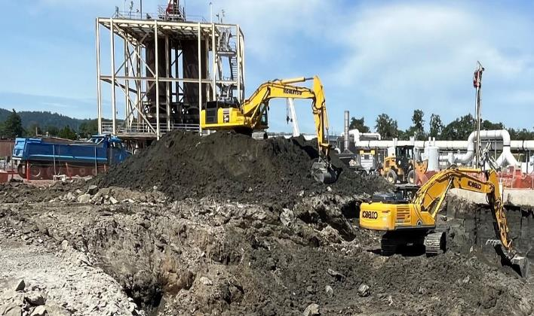
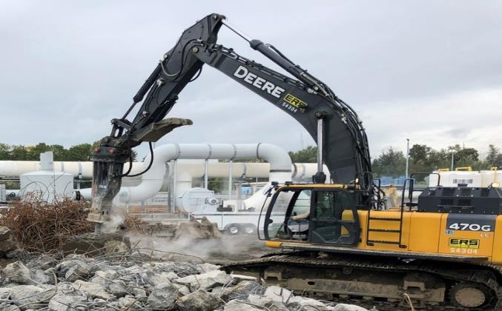
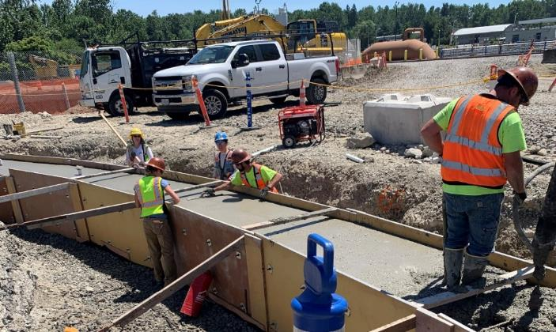
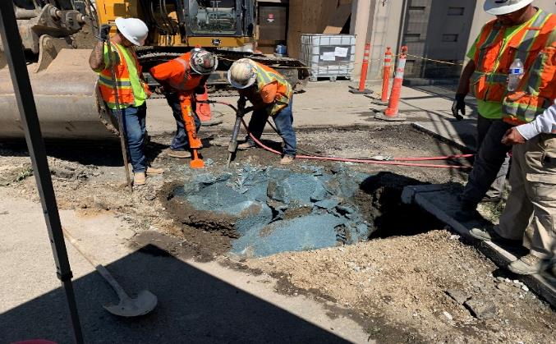
Subcontractor Diversity to Date
NWI
Petrichor
McDonald

Slide 28
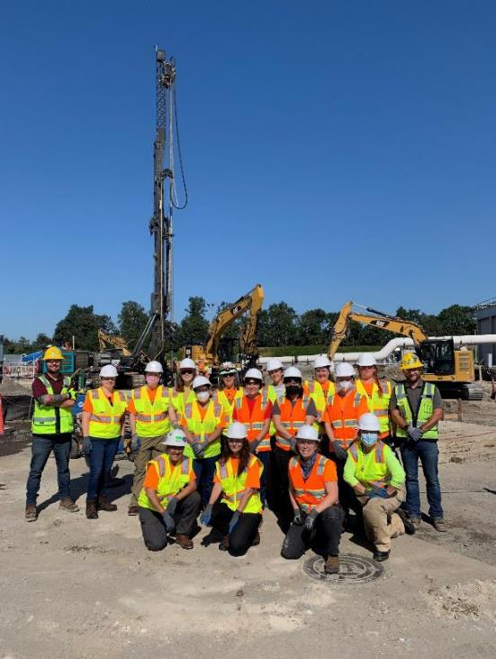
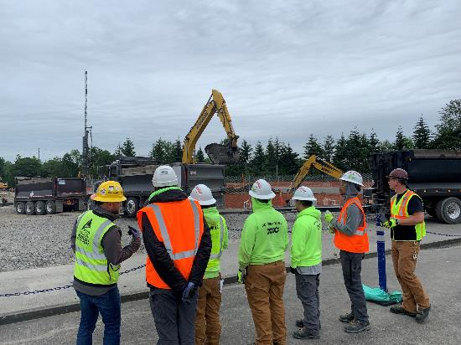
Workforce Diversity Forecast
Planned Project Craft Hours (total project):
750,000 hours
Build on successes of Phase 1
Continue working with CBA advisory Committee
Continue outreach
Oregon Tradeswomen site tour, Aug 2022
Portland Opportunities Industrialization Center site tour, June 2022

Slide 29
Subcontractor Diversity Forecast
M/W/DBE/ESB projected contract value of $79M
80 different M/W/DBE/ESB Businesses
Work Scope Types:
Utility, Structure, Mass Excavation
Structure and Utility demolition
Concrete formwork reinforcing and placement
Mechanical and HVAC
Utility installation/tie-in
Commercial building
Electrical
Architectural
Metals fab/install

Slide 30
SCHEDULE
Nov 2020
Feb 2023
Phase 1 (authorized)
Sep 2022
Dec 2024
Dec 2025
Phase 2 – (this amendment)
Supply Chain issues are challenging our ability to meet the December 2024 regulatory milestone and control costs

Slide 31
Authorization Request
The Chief Procurement Officer is authorized to execute amendment(s) that are approved as to form by the City Attorney’s office and/or change orders to Contract 30007489 as long as the contract not-to-exceed amount is $515,000,000 or less.

Slide 32
Acknowledgments
Current and past Members of the Community Benefits Agreement Advisory Committee :
Community Based Organizations Representatives:
Kelly Haines, Worksystems
Bill Kowalczyk, Portland Youth Builders
Charles Manigo, POIC
Unions Representatives:
Michael A. Burch, NW Carpenters
Twauna Hennessee, NW Carpenters
Nathan “Nate” Stokes, IUOE701
Melvin Norman, NW Carpenters
Sheldon Wormley, Laborers Local 737
Aaron B. Strong, IBEW Local 48
Employers Representatives:
John Jackley, NAMC
Molly Washington, NAMC
Kenechi Onyeagusi, PBDG
J. W. Matt Hennessee, PBDG
Nathaniel Hartley, Professional Lath and Plaster LLC
Thank you

Slide 33
Extra Slides

Slide 34
Market Trends Since October 2020
Construction Inflation follows a different trend than consumer Price Index (CPI); Indices use different consumables as indicators
Notes:
CPI uses :
- Food at home
- Food away from home
- Energy commodities
- Energy services
- Commodities less food and energy
- Services less energy services
- Shelter
- Medical care services
- Transportation service

Slide 35
Market Growth Summary
Consumer Price Index (CPI) | Construction IHS Price Index | Construction Equipment Rental Rate Bluebook
Overall indices increased 14% since 2020 Indices include: - Food at home - Food away from home - Energy commodities - Energy services - Commodities less food and energy - Services less energy services - Shelter - Medical care services - Transportation service | Overall indices increased 64% since 2020 Specific commodities related to the STEP Program increased by 88% since 2020 Indices include: Energy - Natural gas - Crude oil - Diesel Fuel Chemical - HDPE - PVC | Overall operated Bluebook rental rates for construction equipment increased by 75% since 2020 Specific construction equipment related to the STEP Program increased between 1% and 157%
Steel
- Rebar
- Structural steel
- Stainless steel
Nonferrous Metals
- Aluminum
- Copper
- Nickel

Slide 36
Site View

