Slide 1
climate emergency workplan 2022-2025
Implementing the Climate Emergency Declaration
July 20, 2022 | Portland City Council
Donnie Oliveira
Andria Jacob
Director
Climate Policy and Program Manager
Notes:
COMMISSIONER RUBIO

Slide 2
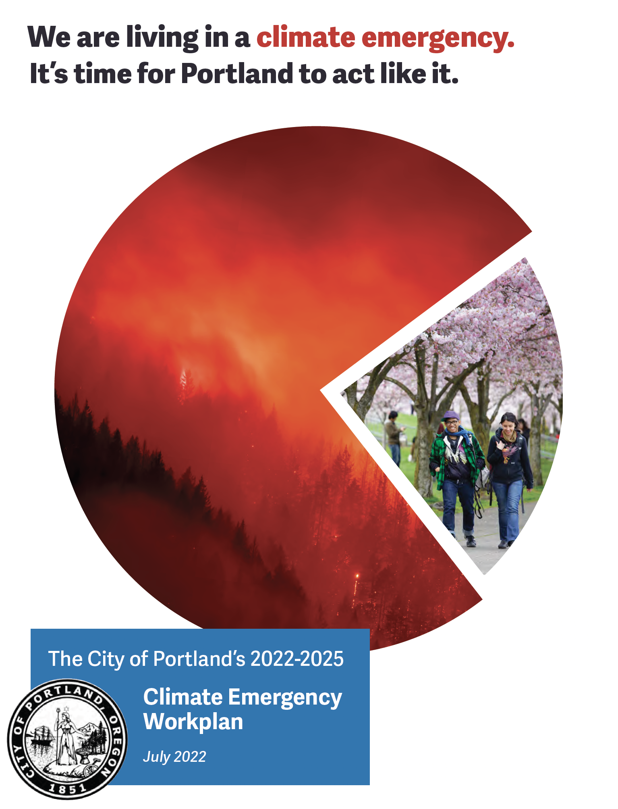
Notes:
DONNIE:

Slide 3
Staff contributors
Notes:
DONNIE
41 staff

Slide 4
“It’s now or never, if we want to limit global warming to 1.5ºC. Without immediate and deep emissions reductions across all sectors, it will be impossible.” -Jim Skea, Co-Chair IPCC Working Group III (April 4, 2022)
Notes:
ANDRIA:
Good afternoon, council and mayor, and thank you for the opportunity to share this work with you today. For the record, my name is Andria Jacob and I’m honored to serve as the Climate Policy and Program Manager for the Bureau of Planning and Sustainability.
I have been working on climate and energy policy and programs for the last eighteen years. I have been part of the bureau’s climate action planning process since the 2009 CAP. I’m proud to present the next iteration of this work on behalf of all my colleagues at the City who show up every day with passion and persistence to ensure a healthy climate for all of us who live here today, for those who will come after us, for those who are already on the frontlines of a changing climate, and for the voiceless.
When it comes to climate science, there are many things we know for certain. The science, the research is irrefutable. The most concrete fact is that we’re running out of time to make the changes required to prevent irreversible damage to the systems that support life on Earth.
Those changes center around both decarbonization and resilience. When I first started working on climate issues, resilience and adaptation very much took a back seat. We focused almost entirely on decarbonization, or mitigation. But just in the span of those 13 years, we have reached the point where we can’t just plan for and invest in decarbonization. We have to focus on resilience and adaptation with equal urgency. Lack of action at the federal level and around the world have brought us to a place where resilience will not be achievable without deep emission reductions.
The Climate Emergency Workplan addresses how we can achieve those reductions. These actions are the steps we have to take to meet our 2030 and 2050 goals - to uphold the climate commitments we’ve made on the international stage
[Paris Agreement - limit temperature rise to 'well below' 2 degrees celsius.]

Slide 5
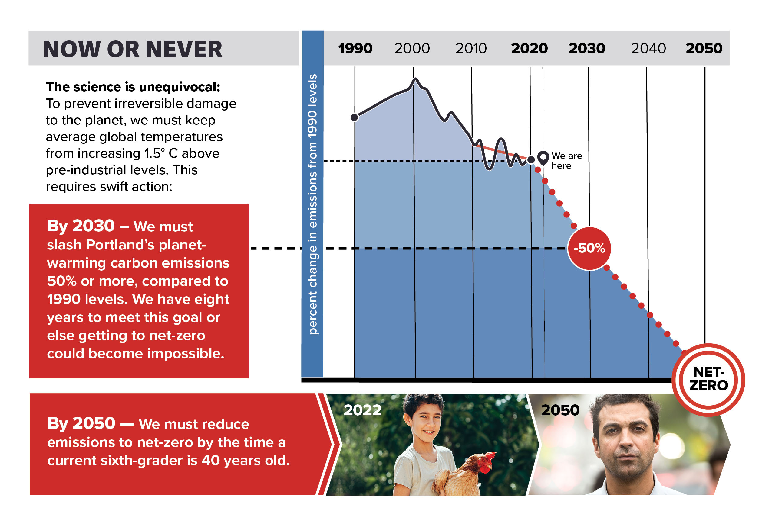
Notes:
ANDRIA:
This graph shows our progress to-date on reducing carbon emissions here in the City of Portland. While we have made some progress, it’s not nearly enough to meet net-zero emissions by 2050. Over the last ten years, we’ve seen a plateau, instead of the drastic decline we need. In order to achieve the ultimate goal of net-zero emissions by 2050, we have to achieve 50% emissions reductions by 2030, less than eight years from now. The science makes clear that our window to act is closing.
The Climate Emergency Declaration that Council passed in 2020 updated the short- and long-range goals and made the 2015 Climate Action Plan obsolete. But the CED is not a climate action plan. This Climate Emergency Workplan will serve as the City’s climate action plan for the next three years. It’s the first coordinated response from the City that outlines actions necessary to reach the Climate Emergency Declaration goals and brings into sharp focus Council’s specific role.

Slide 6
Notes:
ANDRIA:
The severity of the worst-case scenario cannot be minimized or understated. But there is good news – we can do this.
This Climate Emergency Workplan serves as a prescriptive plan outlining the actions we must take to dramatically reduce carbon while simultaneously preparing our most vulnerable communities and making infrastructure investments. These actions not only reduce carbon but bring numerous co-benefits to our communities in the form of new business and workforce opportunities, cleaner air, less traffic congestion, more plentiful, accessible transportation options, and healthier, safer, more comfortable homes and buildings.

Slide 7
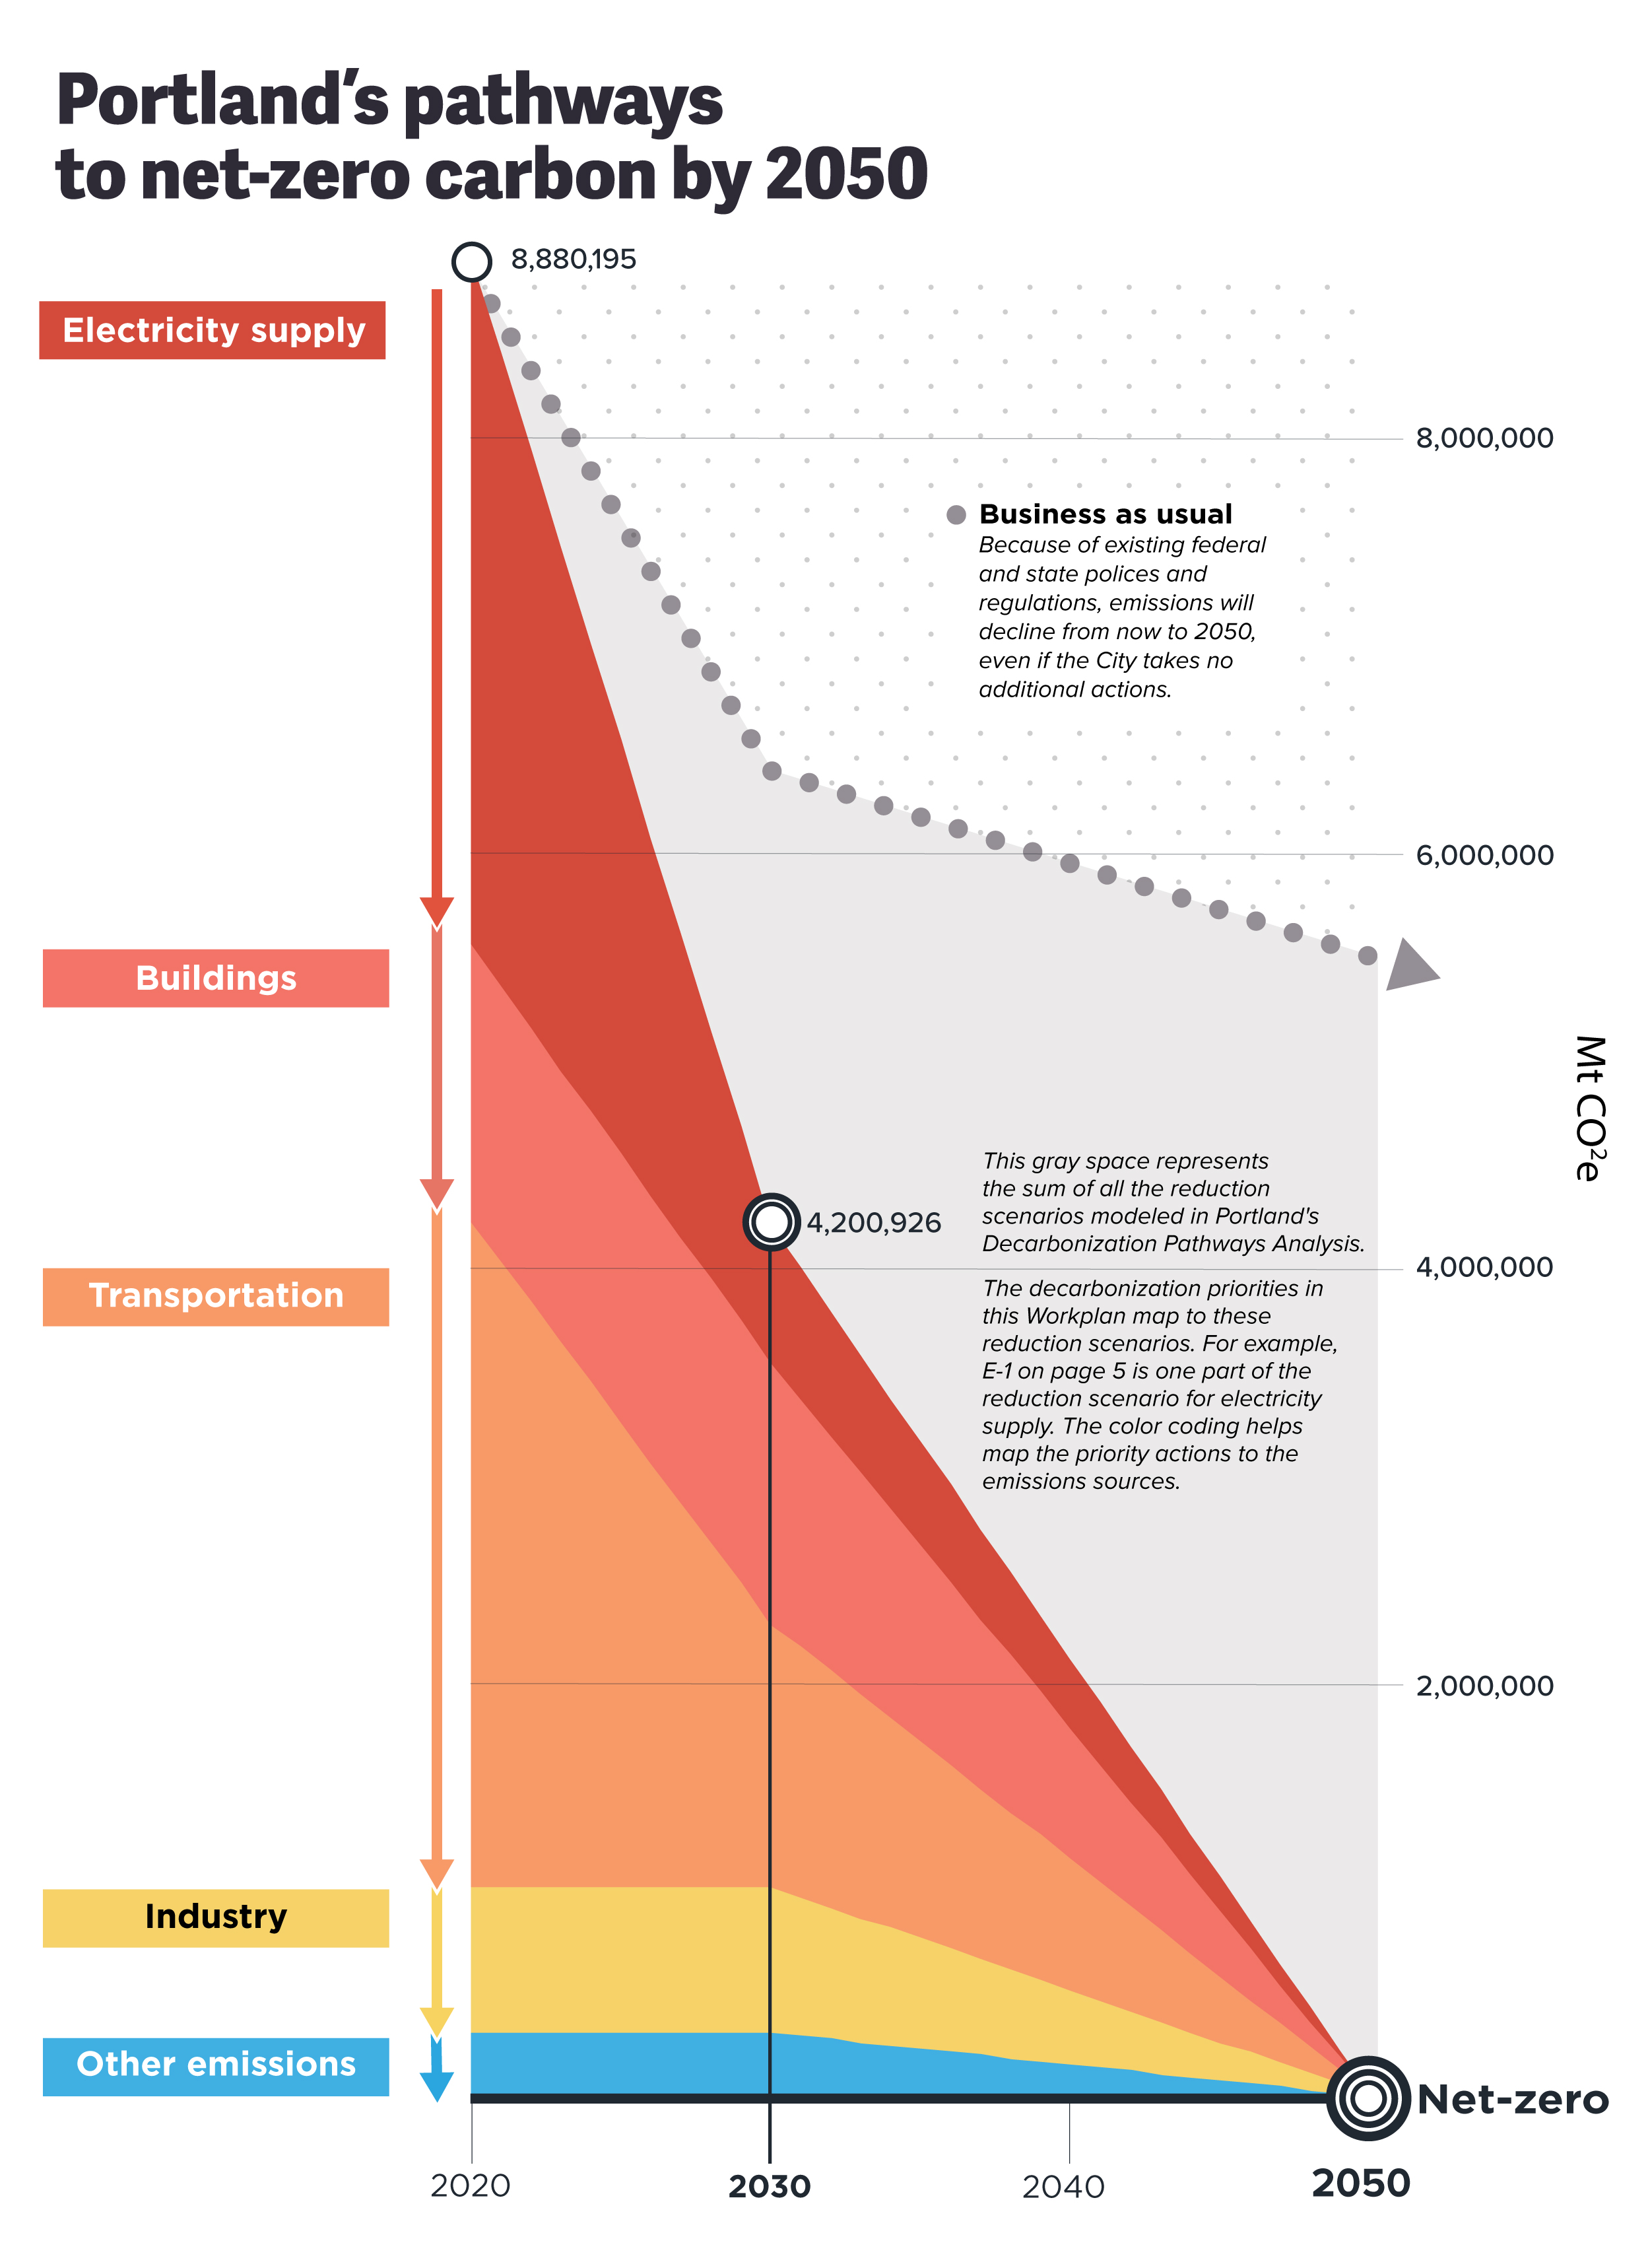
Highest-impact priorities:
• E-1: 100% renewable electricity supply
• T-1 through T-5: Portland Preferred Transportation Policy Scenario
• T-6: Electric vehicles to replace remaining gasoline
• T-9: Renewable biofuels to replace remaining diesel fuel
• I-1: Industrial innovation
Notes:
ANDRIA:
Page 4 of the Climate Emergency Workplan displays the analytical foundation of the decarbonization priorities. In 2020 BPS hired a consultant to build a Decarbonization Pathways model. We call it Pathways for short. The purpose of the tool is to help policymakers and the public visualize the scale and combinations of specific climate strategies (or wedges) needed to get to net zero.
Pathways allows the user to vary the scale of each strategy and to choose combinations of strategies that can achieve the reduction targets. It is a dynamic tool and enables the user to look at any number of different scenarios.
For the CEW, we presented ONE POSSIBLE SCENARIO. It's the middle of the road scenario, which is still pretty aggressive. But it’s not the maximum scenario. Explanation of the Pathways tool is on our website and BPS staff are happy to provide a look under the hood to anyone who wants to dive deeper into the analysis and assumptions.
What it tells us is that there is no single strategy or reduction wedge that gets us to net zero. What gets us there is a cumulative and interactive effect among strategies.
It also tells us which carbon reduction strategies have the greatest impact in reducing cumulative emissions. You will see these priorities map to what’s listed in the Workplan on pages 5-10.
• 100% renewable electricity supply (-12%)
• Portland Preferred Transportation Policy Scenario (-9%)
• Electric vehicles to replace remaining gasoline (-9%)
• Renewable biofuels to replace remaining diesel fuel (-7%) and
• Industrial innovation (-6%).

Slide 8
Priority areas: decarbonization and resilience
Decarbonization
BPS + PBOT
Resilience
BPS, BES, BRFS, JOHS, OMF, PBEM, PBOT, PF&R, PP&R, PWB
Electricity supply
Buildings
Transportation
Fuels
Industry
Land-use
Embodied carbon/food
Cross-sector
Flooding
Trees
Natural resource protection
Wildfire
Health impacts (heat + smoke)
Resilience hubs
Internal policies
Notes:
ANDRIA:
As mentioned, the priority actions are divided among decarbonization and resilience.
BPS and PBOT have purview over most of the decarb actions. More bureaus have a role in accomplishing climate resilience outcomes for our community.
Where decarbonization actions largely contain policy directives and objectives, resilience actions are based in real-time solutions to address impacts our community is already experiencing. Resilience actions are organized by risks, such as wildfire and flooding, and investments in solutions, such as increased tree canopy, natural-resource protection, resilience hubs and more.
Bureau leadership is here today to speak in more depth about the priorities.
HAND OFF TO DONNIE

Slide 9
Bureau presentations
Notes:
DONNIE Handoff to BDs, give some context and introduces Chris. PRESENTATION ORDER:
PBOT (slides 10-16)
OMF (17)
Parks (18)
BES (19)
PBEM (20)

Slide 10
Transportation & Climate Change
Notes:
Thank you, Director Oliveira, Mayor Wheeler and members of City Council.
For the record, I am Chris Warner, Director of the Portland Bureau of Transportation, and I am going to share some more detail about our approach to reducing emissions from the transportation sector while helping build community resilience in the face of more climate extremes, which are already impacting our community.

Slide 11
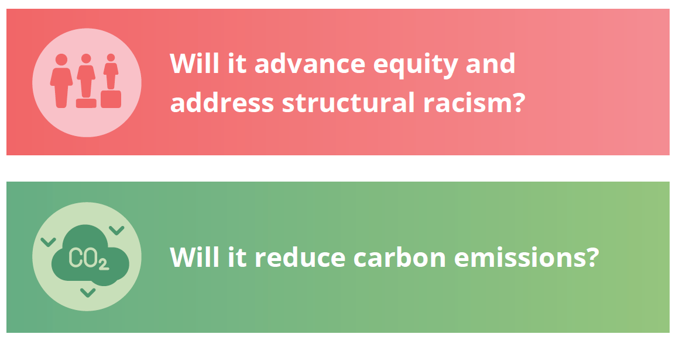
PBOT’S COMMITMENT TO TRANSPORTATION JUSTICE
Source: Portland Bureau of Transportation. 2018. Moving to Our Future: PBOT’s Strategic Plan 2019-2024. https://www.portland.gov/transportation/strategic-plan/strategic-plan-overview.
Notes:
PBOT is committed to advancing equity and climate justice
These two questions are embedded in our Strategic Plan and at the core of all the work we do. We always ask
Will it advance equity and address structural racism?
Will it reduce carbon emissions?
Importantly, how do we understand the intersectionality between those questions in our response.

Slide 12
PORTLAND’S TRANSPORTATION EMISSIONS ARE UP 3% SINCE 1990. WE’RE OFF TRACK AND MUST CHANGE TRAJECTORY FAST TO MEET 2030 GOALS.
1990
2019
2030
Target
Notes:
To set the context, unlike other sectors, Portland’s transportation carbon emissions are heading in the wrong direction.
The latest emissions measurements from 2019 are up 3% since 1990, while City Council has adopted a goal of 50% reduction by 2030. And while the 2020 data reflecting Covid may show temporary gains from decreased demand, just like after the Great Recession, we’re not currently positioned to maintain the reduction as the economy recovers.
In addition, transportation outcomes for Black, Indigenous and People of Color communities continue to be inequitable. In short, we are not on target to achieve our goals.
While the City has adopted a net zero by 2050 goal, the climate science tells us that we must rapidly reduce emissions in the near-term to avoid the most catastrophic climate impacts and make it easier to achieve resilience through adaptation to the changes already occurring in our climate.

Slide 13
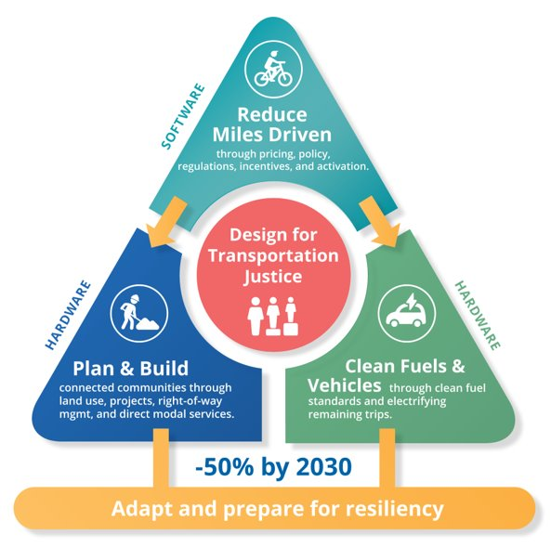
PBOT CLIMATE STRATEGY
Notes:
This triangle shows PBOT’s strategy for reducing transportation emissions by 2030. It has three parts:
First, rapidly reduce the miles that are driven and shift to more multimodal trips like walking, biking and taking transit.
For the motor trips that remain, we must also rapidly transition to cleaner fuels and electric or other no- or low-carbon vehicles.
Finally, we must continue to plan and build connected, complete communities and a transportation system that supports climate friendly trips to make it easier for people and business to meet their needs without having to drive.
With more people able to meet more of their needs without driving, we can reduce the risk of the climate crisis while supporting local economic prosperity, a healthier community and environment, and improved traffic and personal safety on our streets.
At the same time, our community and our transportation system are already facing real impacts and increasing costs from climate change, from extreme heat to flooding. We must plan for, invest in and manage our assets and operations to support community resilience and prepare for more extreme weather now and in the future.

Slide 14
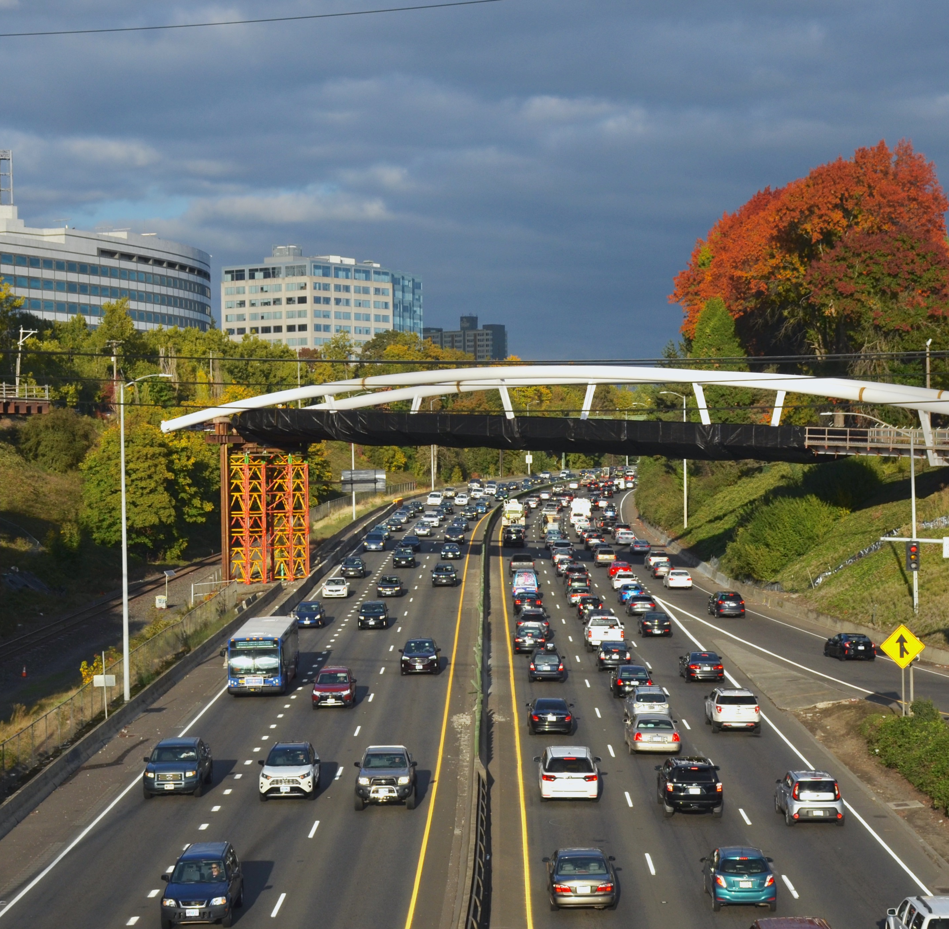
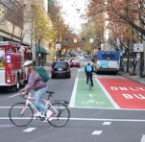
FY 21-22 Accomplishments
1
2
3
4
Blumenauer Bridge and Building a Better 82nd Ave
BIKETOWN Expansion
Rose Lane Transit improvements
Parking Climate & Equitable Mobility Transaction Fee
Photo by Cheyenne Thorpe, OPB
Notes:
Having described our overarching strategy, I want to highlight a few examples of recent accomplishments.
Last month, ownership of 82nd Avenue transferred from the state to the Portland Bureau of Transportation. A critical north-south connection and one of Portland’s high-crash corridors, this transfer and state funding commitments will allow for significant investments and operational changes to improve safety and make it easier to walk, bike and use transit in and around this corridor. While we have much work to do and will need to identify additional funding to truly transform this corridor, we are thrilled to have reached this important first milestone.
Later this month, PBOT is proud to be opening the Congressman Earl Blumenauer Bicycle and Pedestrian Bridge. The Blumenauer Bridge will serve as a vital connection for pedestrians and people biking between two of Portland’s fastest growing neighborhoods—Lloyd and the Central Eastside—and beyond. In the future it will also serve as an important link in Portland’s Green Loop. The bridge will be seismically resilient and serve as a backup route for emergency vehicles over I-84 in the event of an earthquake. Add this is our second recent pedestrian and bike bridge. The Flanders bridge, which opened last summer, provides another critical low stress connection for active transportation users and is also a seismic lifeline.
In January, we expanded our BIKETOWN service area, growing it by 25% and bringing the climate friendly bikeshare further into East and North Portland.
We have also continued to make investments in Rose Lane Transit projects to give buses and streetcars priority on the road, helping more Portlanders get where they need to go more reliably and quickly.
Finally, the Parking Climate and Equitable Mobility Transaction Fee that Council approved this spring sends a small price signal about the costs of driving and will support investments that advance our climate and equity goals. We're especially proud to be investing in the expansion of the affordable housing transportation wallet and helping to make transportation more affordable. It is an exciting step toward using the POEM community Task Force principles to design pricing and investments to be climate friendly and equitable and has been lauded nationally as smart climate policy.

Slide 15
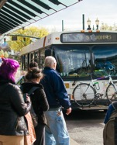
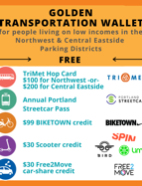
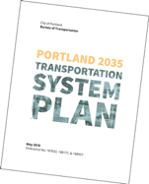
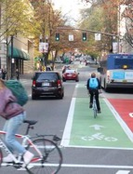
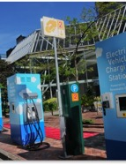
Transportation Workplan Priorities: Decarbonization
1
2
3
4
5
Price and Reinvest for Equitable Mobility
Regulate Demand and Incent Options
Reform Key Policies and Align with Goals
Reallocate and Activate Rights-of-Way
Electrify Centers and Corridors
Notes:
We are proud of all that we have been able to accomplish, especially over such a challenging last few years and at a time when PBOT has had to take a ten percent cut to our discretionary revenues. However, we also know that we have much more work to do.
The priority areas highlighted on this slide should be familiar. We know what we must do to reduce carbon emission and we have highlighted these strategies before.
Yet, there is urgency to accelerate and expand our work in each of these areas, and I want to highlight a few of PBOT's specific items in the workplan before you today.
We will continue making investments to provide safe and accessible low-carbon transportation facilities. We have many millions of dollars of investments already in our project pipeline, yet we still have hundreds of millions of dollars of additional unfunded investments identified in our Transportation System Plan. And we know that each of these as-of-yet-unfunded investments are critical in order to provide a fully accessible and safe system for easy, multimodal travel citywide.
Our workplan also identifies the need to continue to pinpoint new, more financially sustainable revenue sources that are both decoupled from fossil fuel dependence and that send the right price signals about the true cost of driving.
We know that our impact will be greater if we can act as a region and a state, so we are continuing to work with our regional partners to make sure they are pulling in the same direction, both in terms of how revenues are generated as well as in the policies and projects they are advancing to reduce vehicle miles travelled and to electrify the remaining miles.
And, in terms of electrification, we are focused on updates to our codes and rules to enable our utility and other private sector partners to more easily provide charging infrastructure. We are also supporting state efforts to rapidly decarbonize fuels and to prioritize an equitable investment strategy for new federal electrification funds.

Slide 16
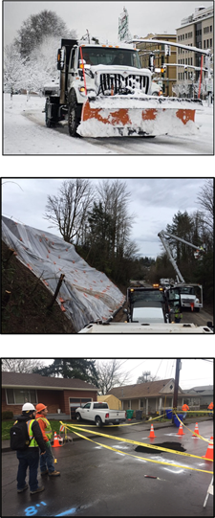
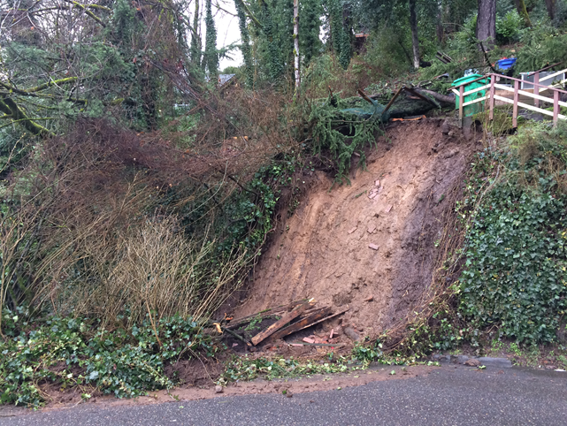
Transportation Workplan Priorities: Resilience
Notes:
It is no longer enough to only focus on reducing greenhouse gas emissions. Climate change is here, and we must also become more resilient.
We have to simultaneously prioritize new ways of planning and building greener infrastructure that supports community resilience, while also responding to the more and more frequent threats to our assets and operations from flooding, landslides, heat and wildfire smoke, and snow and ice.
You will see that the workplan includes specific items like landslide prevention on West Burnside as well as broader and more comprehensive Continuity of Operations planning work to be able to respond to these increasingly frequent extreme weather events.
It will require significant resources to keep Portland safe and moving as the climate continues to change.
With that, I will turn it over to my colleague, Director Long.

Slide 17
Mike Jordan, Chief Administrative Officer, Office of Management and Finance
Notes:
PRESENTATION ORDER:
PBOT
PARKS
BES
OMF
PBEM

Slide 18
Adena Long, Director, Portland Parks & Recreation
Notes:
PRESENTATION ORDER:
PBOT
PARKS
BES
OMF
PBEM

Slide 19
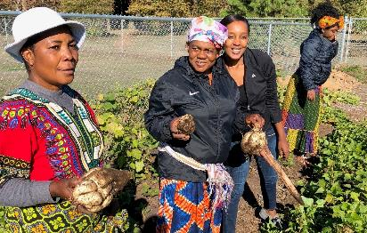
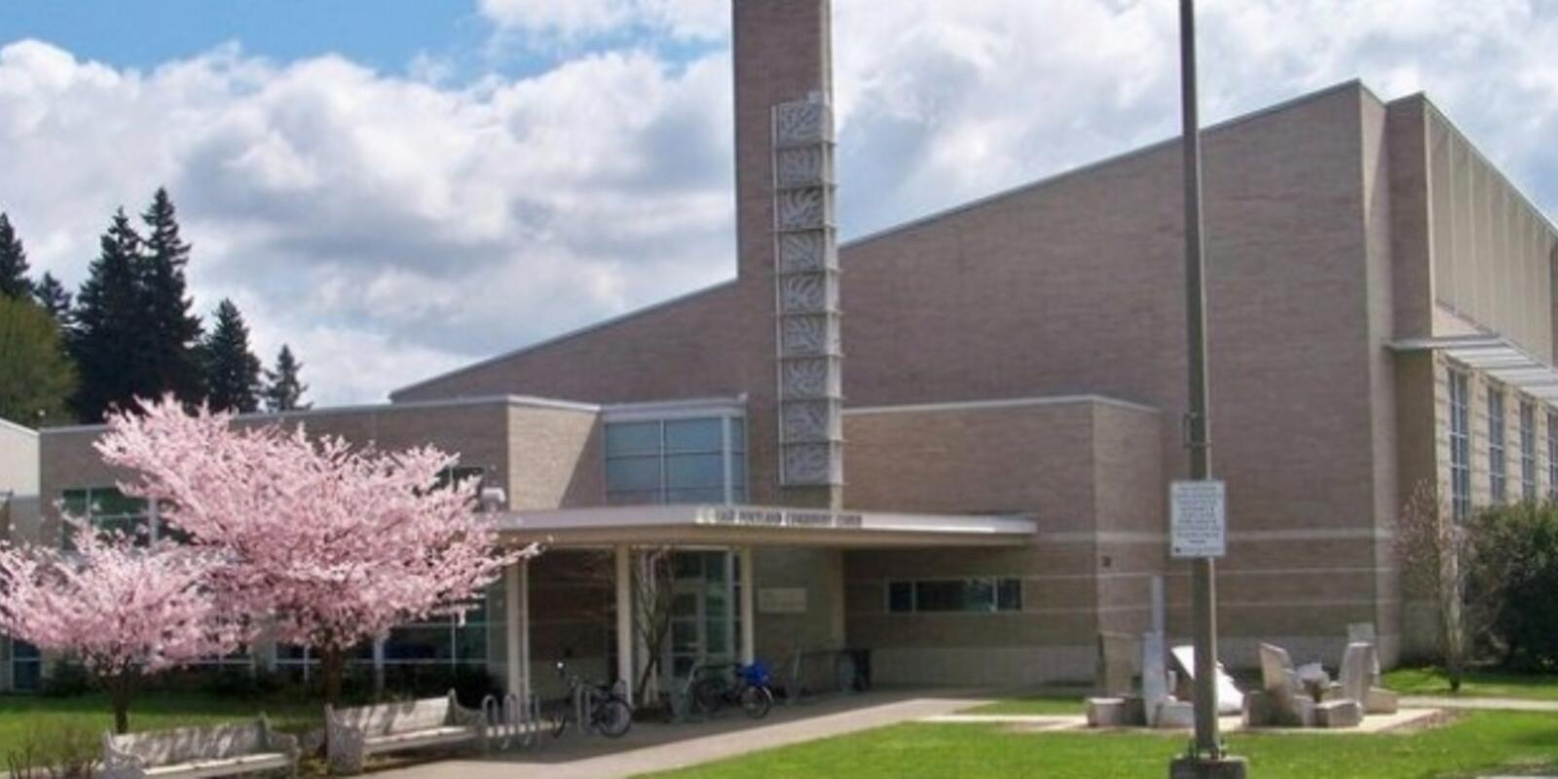
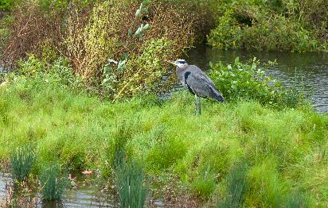
PARKS AND COMMUNITY SPACES
Invest in Trees
Update the Urban Forestry Management Plan and Title 11 Tree Code
Expand tree planting in front-line and priority neighborhoods
Prevent Wildfires through fuels management and collaboration with PF&R and agency partners at the County and State levels
Upgrade Community Centers to create energy-efficient, resilient facilities
Notes:
There are many actions the City and Portland Parks can take within our green spaces and community gathering places. Responsibility for the City of Portland’s Urban Forest resides with the City Forester within PP&R.
Many resiliency priorities are already part of our core mission, including planting trees and caring for our urban forest, caring for and managing wildfire risk in our natural areas, and providing opportunities for shade and access to water both naturally and through interactive fountains, splash pads and pools.
A key climate resilience goal for Portland Parks & Recreation is to invest in TREES. Like cities and nations around the world, increasing tree canopy significantly helps us combat climate change. Trees clean the air, improve the soil, reduce the heat island effect, support wildlife, and improve community health and well-being.
Urban Forestry’s focus is on strengthening protection of existing trees, making them a priority in street design and other development, and setting new goals to expand the urban forest. As a community, we must protect and preserve our tree canopy, because in fact, “the best trees for the planet are the ones already in the ground.”
Work is also underway with partners to better respond to wildfires, through prevention and protection of our green infrastructure. PP&R plans to continue identifying funding for ecological restoration efforts that control invasive plant species in our natural areas, and for vegetation management projects that specifically target ladder fuels. We’ll also continue to work with our partners at Portland Fire and Rescue, Multnomah County Emergency Management, and the Oregon Dept of Forestry in our efforts tor educe wildfire risk and plan ahead to reduce impacts from wildfire events.
PP&R also has opportunities to build climate resilience for places where our community already gathers, our community centers and outdoor spaces. Planned upgrades to community centers will strengthen our resilience, and provide refuge from heat, cold, and wildfire smoke.
PP&R is participating in a number of efforts led by other bureaus, as well, and we are proud to be partners in this collaborative work.

Slide 20
Dawn Uchiyama, Director, Bureau of Environmental Services
Notes:
PRESENTATION ORDER:
PBOT
PARKS
BES
OMF
PBEM

Slide 21
Jonna Papaefthimiou, Chief Resilience Officer, Portland Bureau of Emergency Management
Notes:
PRESENTATION ORDER:
PBOT
PARKS
BES
OMF
PBEM

Slide 22
ANDRIA JACOB
Climate Policy and Program Manager
andria.jacob@portlandoregon.gov
portland.gov/bps/climate-action

