Slide 1


Bond Oversight Committee Meeting
Thursday, August 4, 2022
Notes:
Dr. Holt
Welcome remarks. Review online meeting protocols (next slide).

Slide 2

Welcome! Hybrid Meeting Protocols and Tips
1. Be patient and respectful.
2. Check speakers and microphone work properly. Speak clearly so all attendees can hear you.
3. Mute your microphone/phone when not speaking. Keep in-person side conversations to a minimum.
4. Introduce yourself before speaking.
5. Virtual attendees can use Chat for tech questions and Public Testimony.*
*This public meeting will be recorded, including the chat.
Notes:
Dr. Steven Holt
Let’s learn from each other and make this a respectful, productive space. Hybrid and online teleconferencing may be a brand-new experience. Let’s dive in with humility and understanding as we all learn to navigate this new space.
Give yourself extra time to get set up. Check your headset, microphone, volume level, and if needed, any software that you may need to install.
Mute yourself when not speaking. This prevents feedback and noise disruptions. Also, refrain from side conversations that make it difficult for virtual attendees to hear.
Introduce yourself before speaking. This helps the audience connect the voice to the speaker.
Keep the chat respectful and on topic. Please be aware that this public meeting is recorded, including the chat.

Slide 3
Agenda
TOPIC | LEAD | TIME
Welcome, Roll Call, Minutes | Dr. Steven Holt | 9:30 - 9:35
Public Testimony (2 minutes per person) | Dr. Steven Holt | 9:35 – 9:40
Portland’s Housing Bond Updates | PHB Staff | 9:40 – 9:50
Project Team Presentations | Tanya Wolfersperger | 9:50 – 10:30
Director’s Update | Molly Rogers | 10:30 – 10:40
Closing Remarks | Dr. Steven Holt | 10:40 – 10:45
Notes:
Dr. Holt
Review of meeting agenda, roll call and approve Meeting Summary Notes from April 7th BOC meeting.
Remind guests that they can sign up for Public Testimony in the Zoom Chat or sign-up sheet if attending in person.

Slide 4

Public Testimony
Two minutes per person
Sign up in person or in Zoom Chat
Verbal or written testimony
  Summit written testimony via the Chat feature
Notes:
Dr. Holt
Open meeting for public testimony. Please submit your name in the Zoom Chat or the sign-up sheet if you would like to provide testimony. Individuals will have 2 minutes each to share their comments. As a reminder, this meeting is being recorded which includes information in the Chat.
Ryan/Tanya
Confirm registrations and sign-up sheet for any pre-registered testimony.

Slide 5
Portland's Housing Bond
Updates
Notes:
As part of our quarterly reporting, we will review the project-related milestones and updates included in the Project Progress Dashboard report and the Expenditure Report.
Jill Chen will present the Dashboard report.
Angel Landron-Gonzalez will present the Expenditure report

Slide 6
Bond Projects Dashboard Report
Notes:
Jill Chen
Review Dashboard handout – ALL 2019 BOS in CONSTRUCTION – since the last BOC meeting – closed 3000 Powell in mid Nov, Anna Mann in last day Nov and Joyce in right before Christmas in Dec
Add 2021 Invitational BOS – THANK BOC members for participation in reviews of Invitational BOS
– chart highlights the production totals by project status: open (3 projects), in construction (9 projects) + 3 newly awarded projects in “pre-development”
- highlight any changes in development phases or project schedules.
-

Slide 7
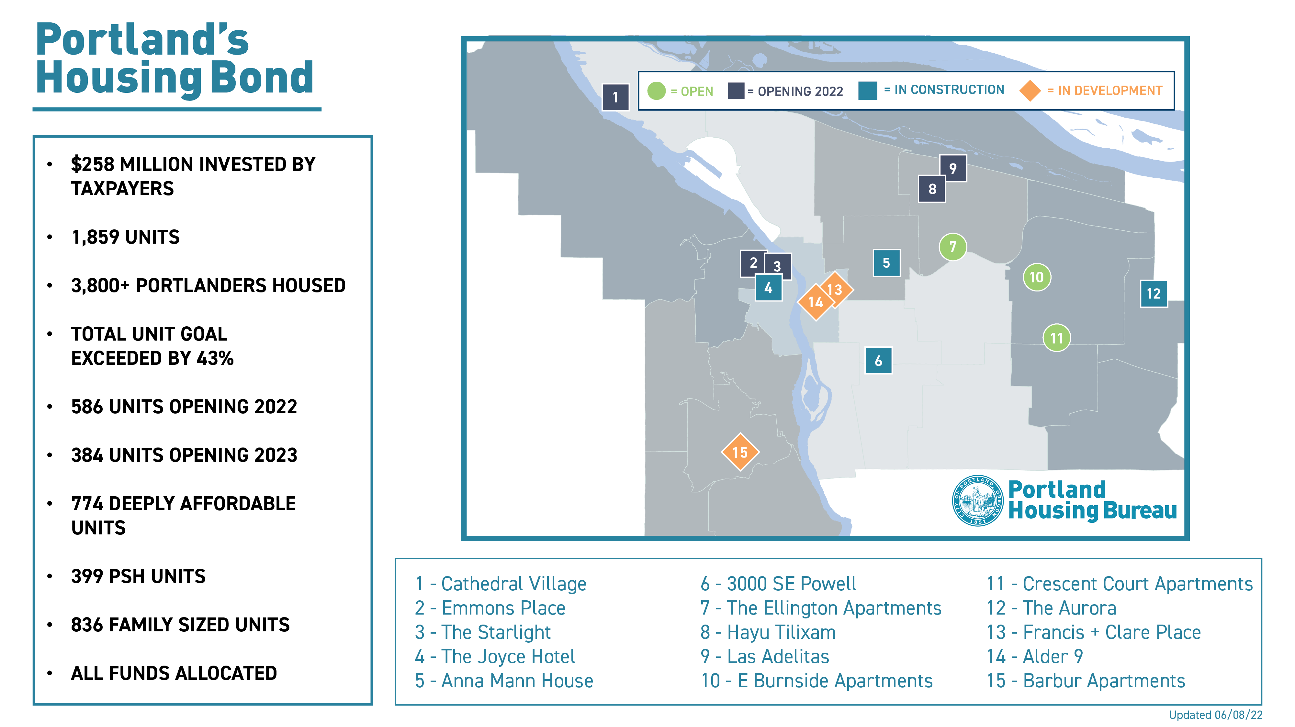
  The Ellington
  3000 SE Powell
  10506 E Burnside St
  5827 NE Prescott
  NW 6th Ave (Westwind)
  SW 11th Ave. (Joyce Hotel)
8

Slide 8
Issues & Risks
Private activity bonds continued constraints through 2024
Cost escalations of 1% per month
Continued supply chain/subcontractor/staffing issues
Funding gaps exacerbated
Multiple openings of PSH projects stressing referral systems
Notes:
Jill Chen
Issues of rising costs and supply chain
Issues related to Private Activity Bonds - GOOD NEWS that all 2019 BOS closed - RISK to 2021 BOS – NOT ON OHCS LIST

Slide 9
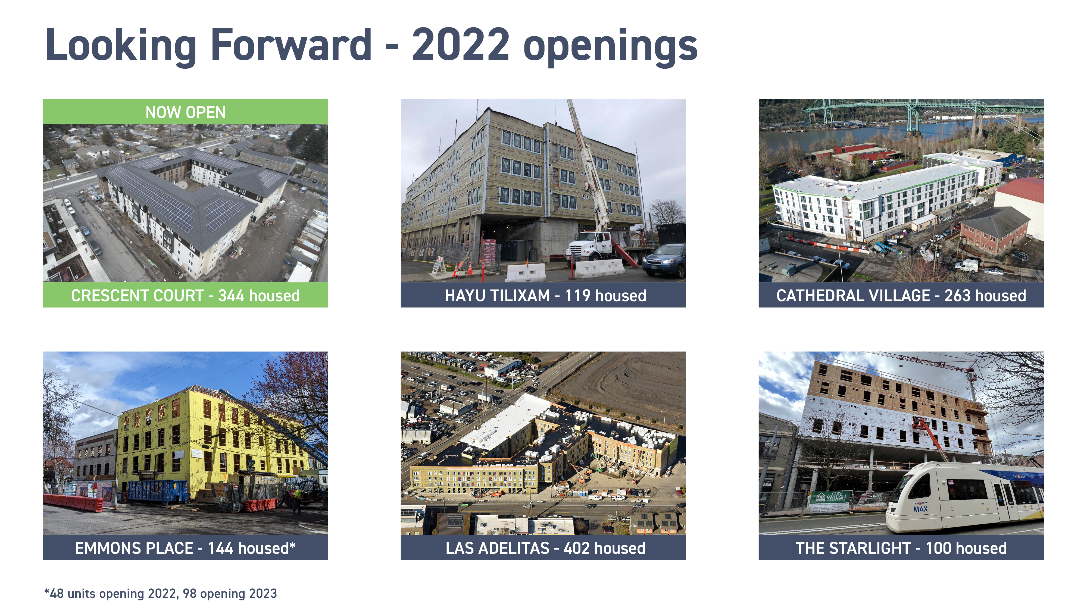
Notes:
Opening 587 affordable units throughout City in 2022 (PHB as a whole will be opening 841 new units plus completion of a rehab)
138 units Crescent Court - May
50 units Hayu Tilixam - August
110 units Cathedral Village – August
48 units Emmons Place (South Bldg ONLY) - October
141 units Las Adelitas – December
100 units Starlight (fmrly, Westwind) – October

Slide 10
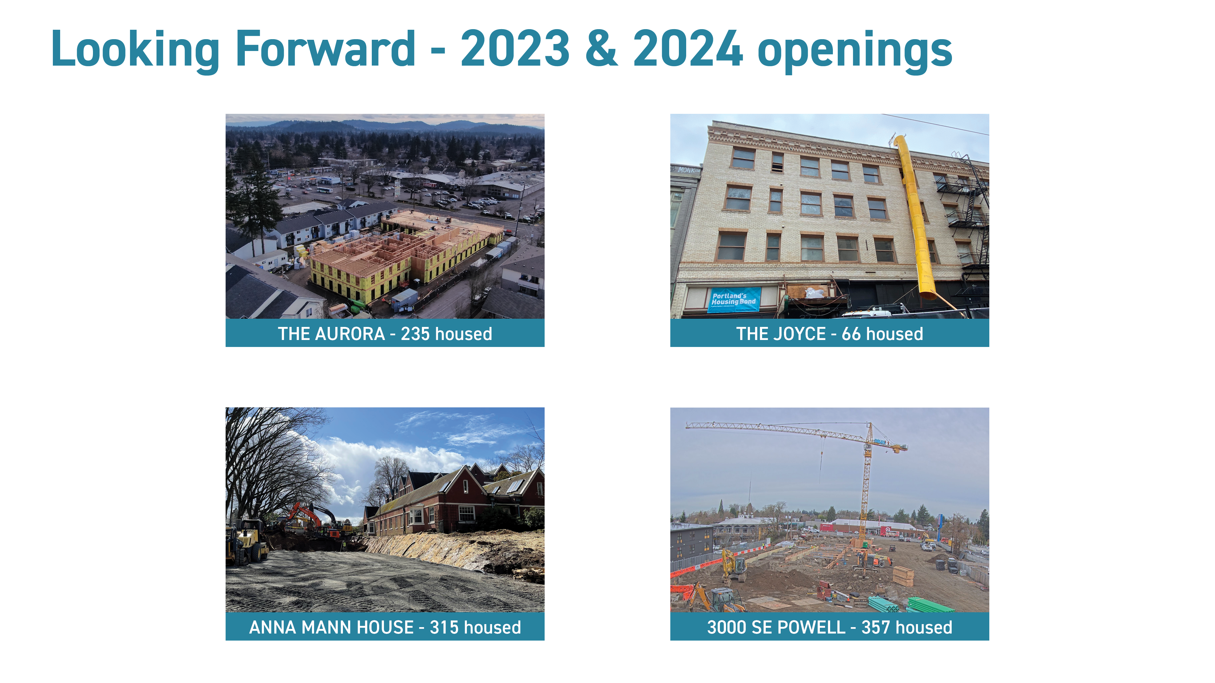
Notes:
93 units Aurora - Feb 2023
66 units The Joyce - April 2023
128 units Anna Mann – bldg South = Feb 2023, Addition = March 2023, North = May 2023
98 units Emmons Place (North Bldg ONLY) – May 2023
206 units at 3000 Powell slipped to Jan 2024

Slide 11
Expenditure Report Highlights (as of 06/30/22)
 | Total $ | % Totals | % Change – last Qtr.
Expended | $137.9M | 52.9% | +10.16%
Committed | $120.3M | 46.2% | +11.45%
Reserved | $167.4K | 0.1% | +0.06%
Remaining* | $0 | 0.0% | n/a
Net Interest/Credits* | $2.28M | 0.9% | +0.17%
*Funds for Future Projects + PHB Admin
(remaining + interest) = $2.28M
Notes:
Angel Landrón-González
The Expended vs. Committed amounts have continued increasing on ongoing constructions.
Compared with the previous report, the Project spending has increased by 26.7M, equivalent to 10.16%, and the Commitments have increased by $30M equal to 11.45%.
The Reserve remains at $167K.
The net Interest/Credits at $2.28M are planned to be used for future projects.
Interest and Credits will continue to grow as the issued but unused bond funds earn additional interest.
Expended and Committed funds include the 7% Program Delivery Fee (PDF).
As noted previously, the Bond Delivery expense percentage has dropped below 7% as the Bond Project Expenses grow. (the % delivery expense for expended and committed will grow for the same reason – it’s a math thing)

Slide 12
Bond Project Team
Presentations
Notes:
Tanya Wolfersperger
Today, team members for Starlight and Francis + Clare Place are joining us to share an update on their projects.

Slide 13
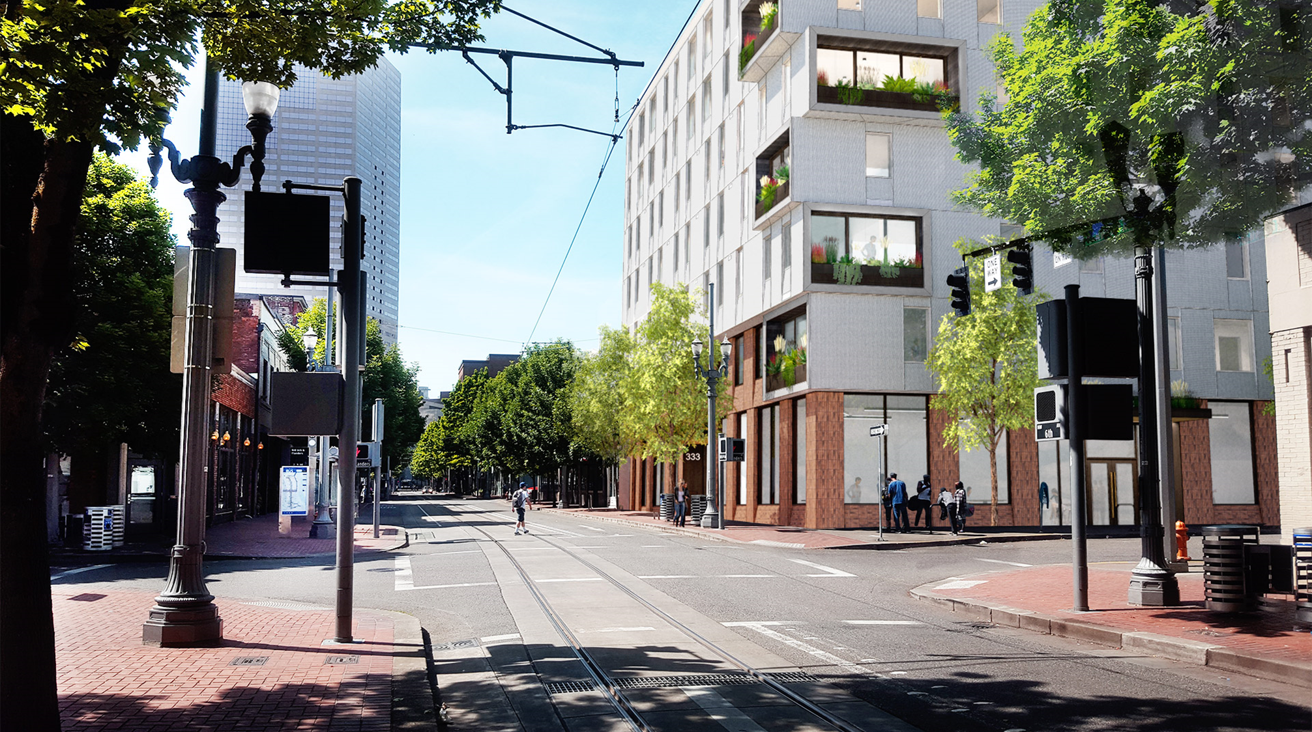


Starlight
Old Town | 355 NW 6th Ave
Central City Concern
Notes:
Mary-Rain O’Meara and Brandon Brezic to present

Slide 14
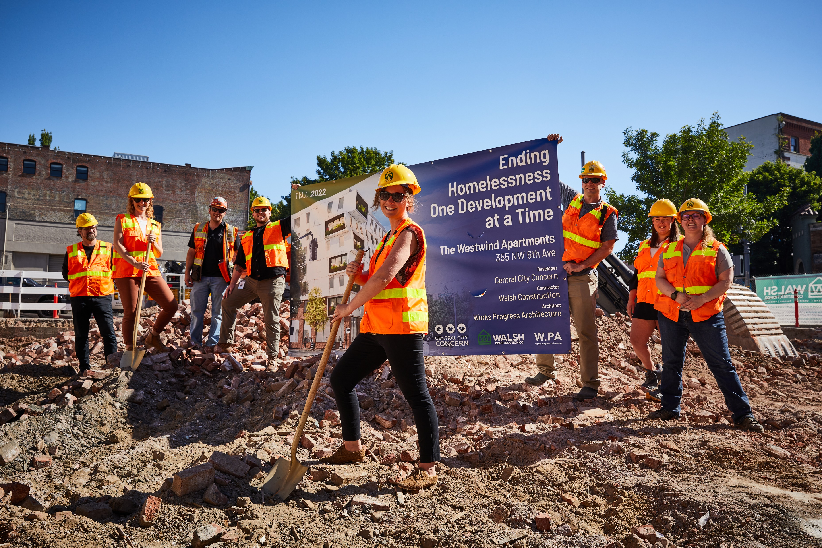
Project Team
  Sponsor/Developer: Central City Concern
  Property Manager: Central City Concern
  Service Providers: NARA, CCC, Imani Center, Flip the Script & Karibu
Project Schedule Milestones
Construction Completion/TCO: October 31st
Lease-up:
  Lease-up kick-off with JOHS July 27th
  JOHS MOU in-process
  Hiring Supportive Services Staff and Building Staff on-going
  Referral Screenings to begin end of August/ Beginning of September
Grand Opening: November 15th
Project Overview

Slide 15
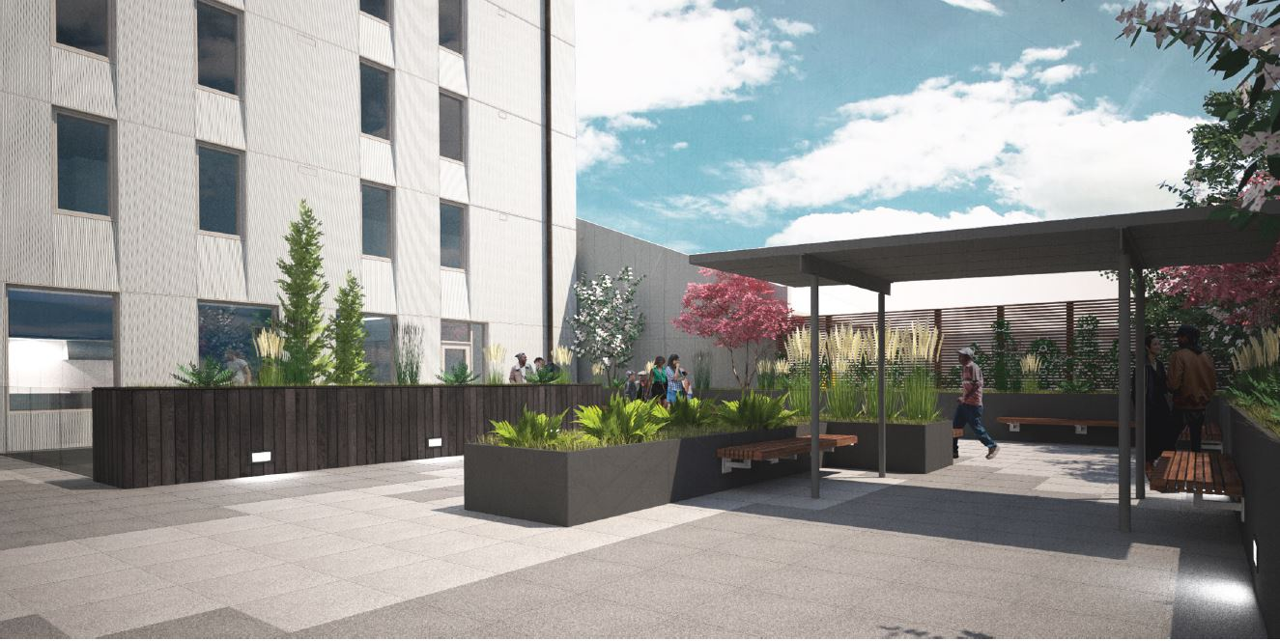
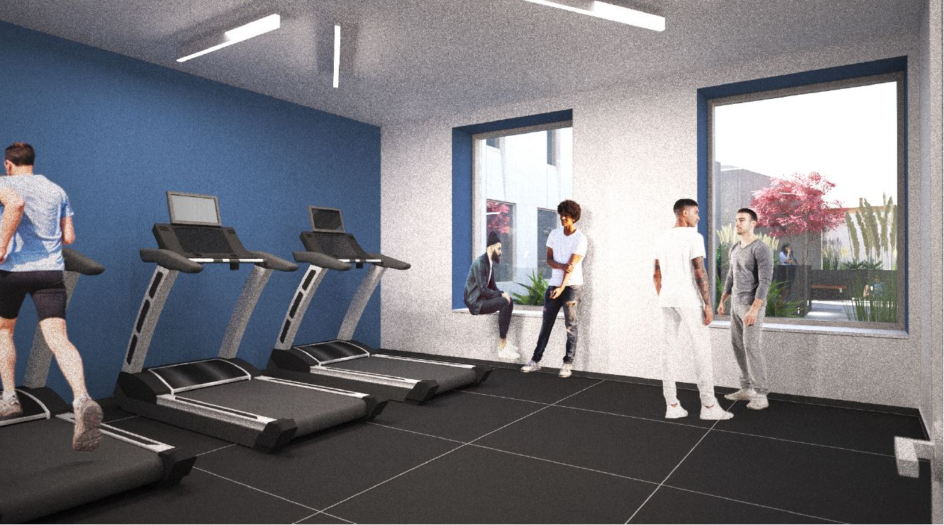
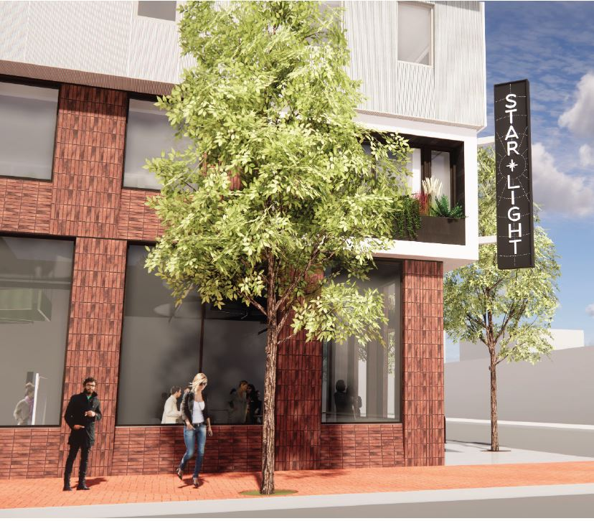
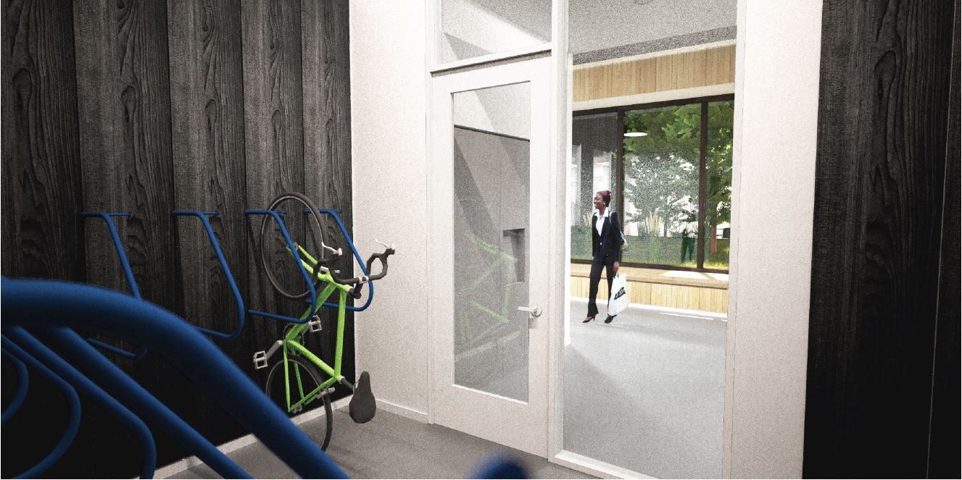
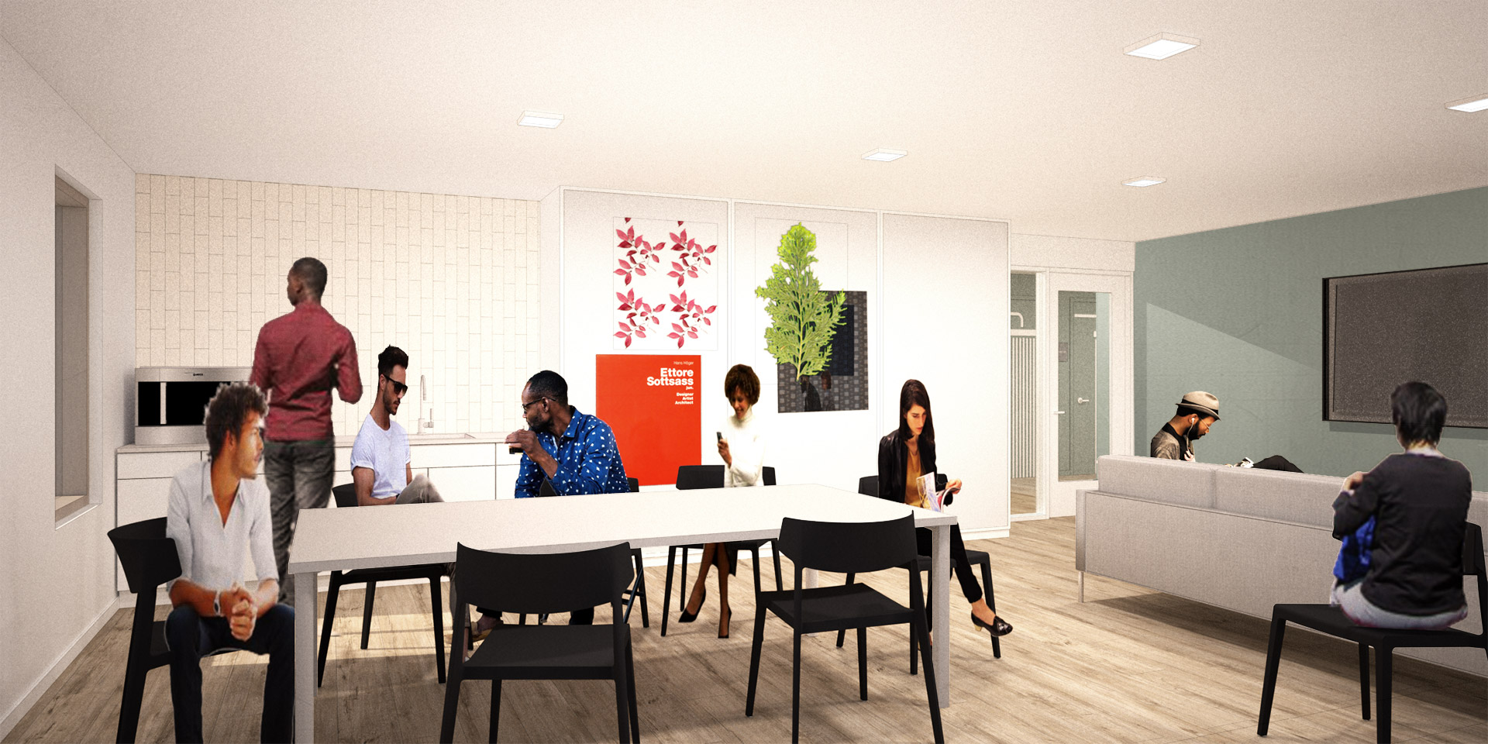
Project highlights
Target Population:
Chronically Homeless
African American and Native American and Alaska Natives
Onsite amenities:
Resident Art Space, Ample Bike Parking, Private Courtyard, Fitness Room, Large Community Kitchen, Resident Lounges on Every Floor, Flexible Classroom Space, 24-hour staffing.
Design features:
Earth Advantage Platinum, 40.0kW PV Solar Array, 8 ADA Units, No On-Site Auto Parking.
Project Overview
Income Restriction | SRO | Studio | Total | PSH
0-30% | 72* | 20 | 92 | 70
31-50% | 0 | 8** | 8
TOTAL | 72 | 28 | 100 | 70
*70 of these units are supported with Project Based Section 8 Vouchers.
Tenant's portion of rent is capped at 30% of income.
**Units will be leased at 50% AMI during initial lease up.

Slide 16

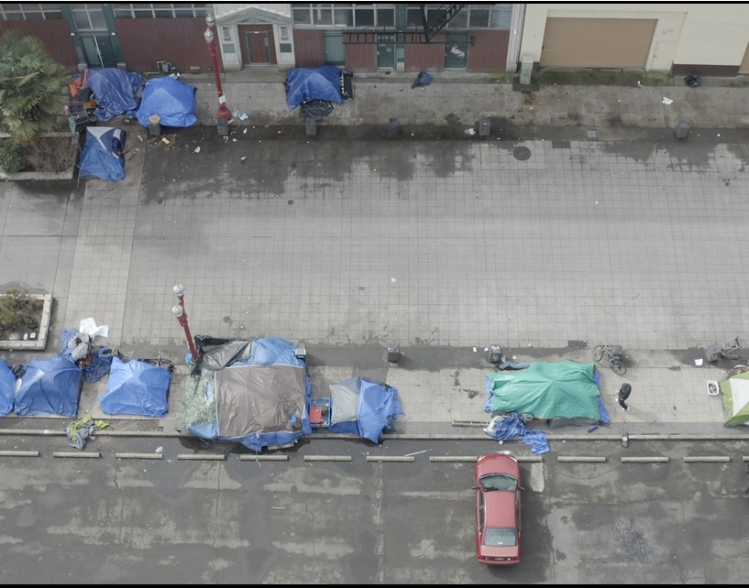


Outreach Strategies to Increase Housing Access for BIPOC/Priority Communities
  Strategy A – Coordinated Access.
  Strategy B – Culturally Specific Referrals via Service Partnerships working with JOHS.
  Strategy C – Geographically Specific Outreach in Old Town.
Marketing and Leasing Strategies and Outcomes

Slide 17
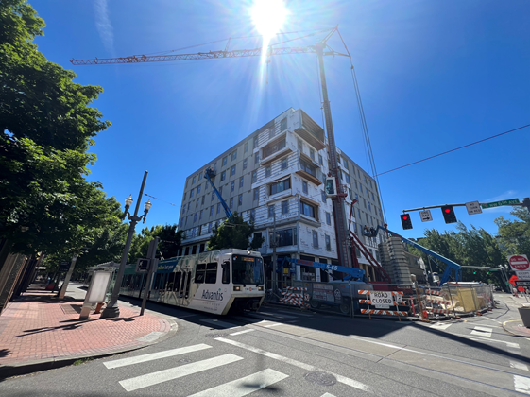
DMWESB-SDV Contracts
General Contractor:
Walsh Construction Co.
Professional Consultants:
Works. Progress Architect, GLI Advisors 3rd Party CM
% Construction Complete:
71.68% as of July 31st
Equitable Contracting Outcomes
 | PHB Goal | Project Outcomes
Hard Cost Contracts | 30% | 31.65%
Professional Services/Soft Costs | 20% | 52%
Notes:
Operation Contracts data is not required by PHB. This is an optional field. Examples of “Operations” contracts could include property management-related vendors, such as landscape maintenance, janitorial services, etc.

Slide 18
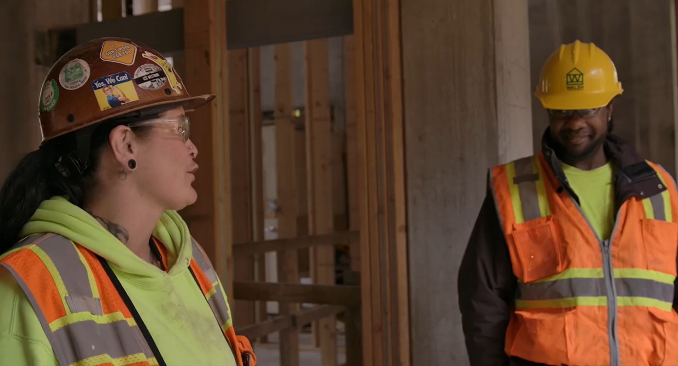

Workforce Diversity
Equitable Contracting Outcomes
 | PHB Goal |  | Project Outcomes
 | POC | Women | POC | Women
Apprentice hours | 22% | 9% | 39.11% | 13.53%
Journey Level hours | 22% | 6% | 59.90% | 2.98%

Slide 19

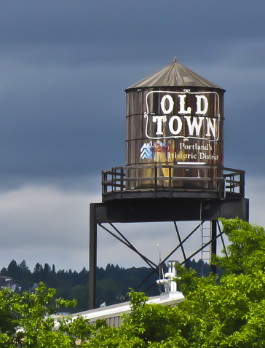
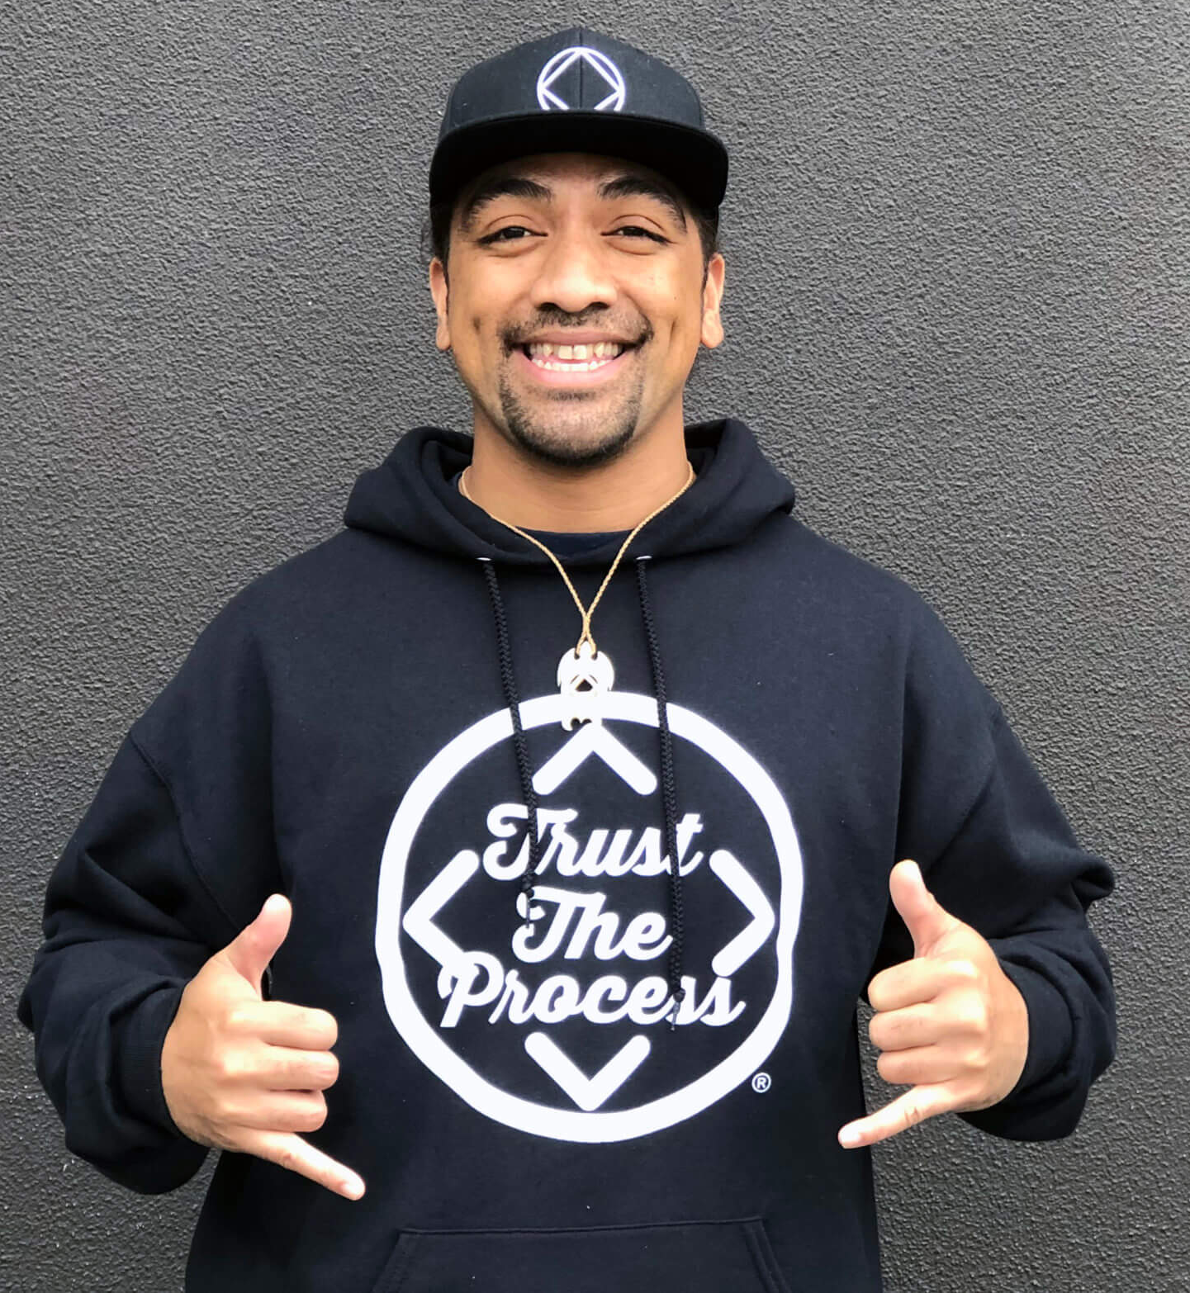
Community Engagement Updates
  Community Engagement Activities
  Old Town Community Association
  CCC Tenant Advisory Committee (TAC)
  Regular updates and engagement with neighbors.
  Engagement Partnerships
  NARA
  Imani Center
  Flip the Script
  Karibu
  Outcomes
  Ground-Floor Community Service Commercial Amenity (Food)
  Outdoor Space and Exercise Space
  In-unit cooktops for SROs
  Security and Safety
  Re-naming - Starlight

Slide 20
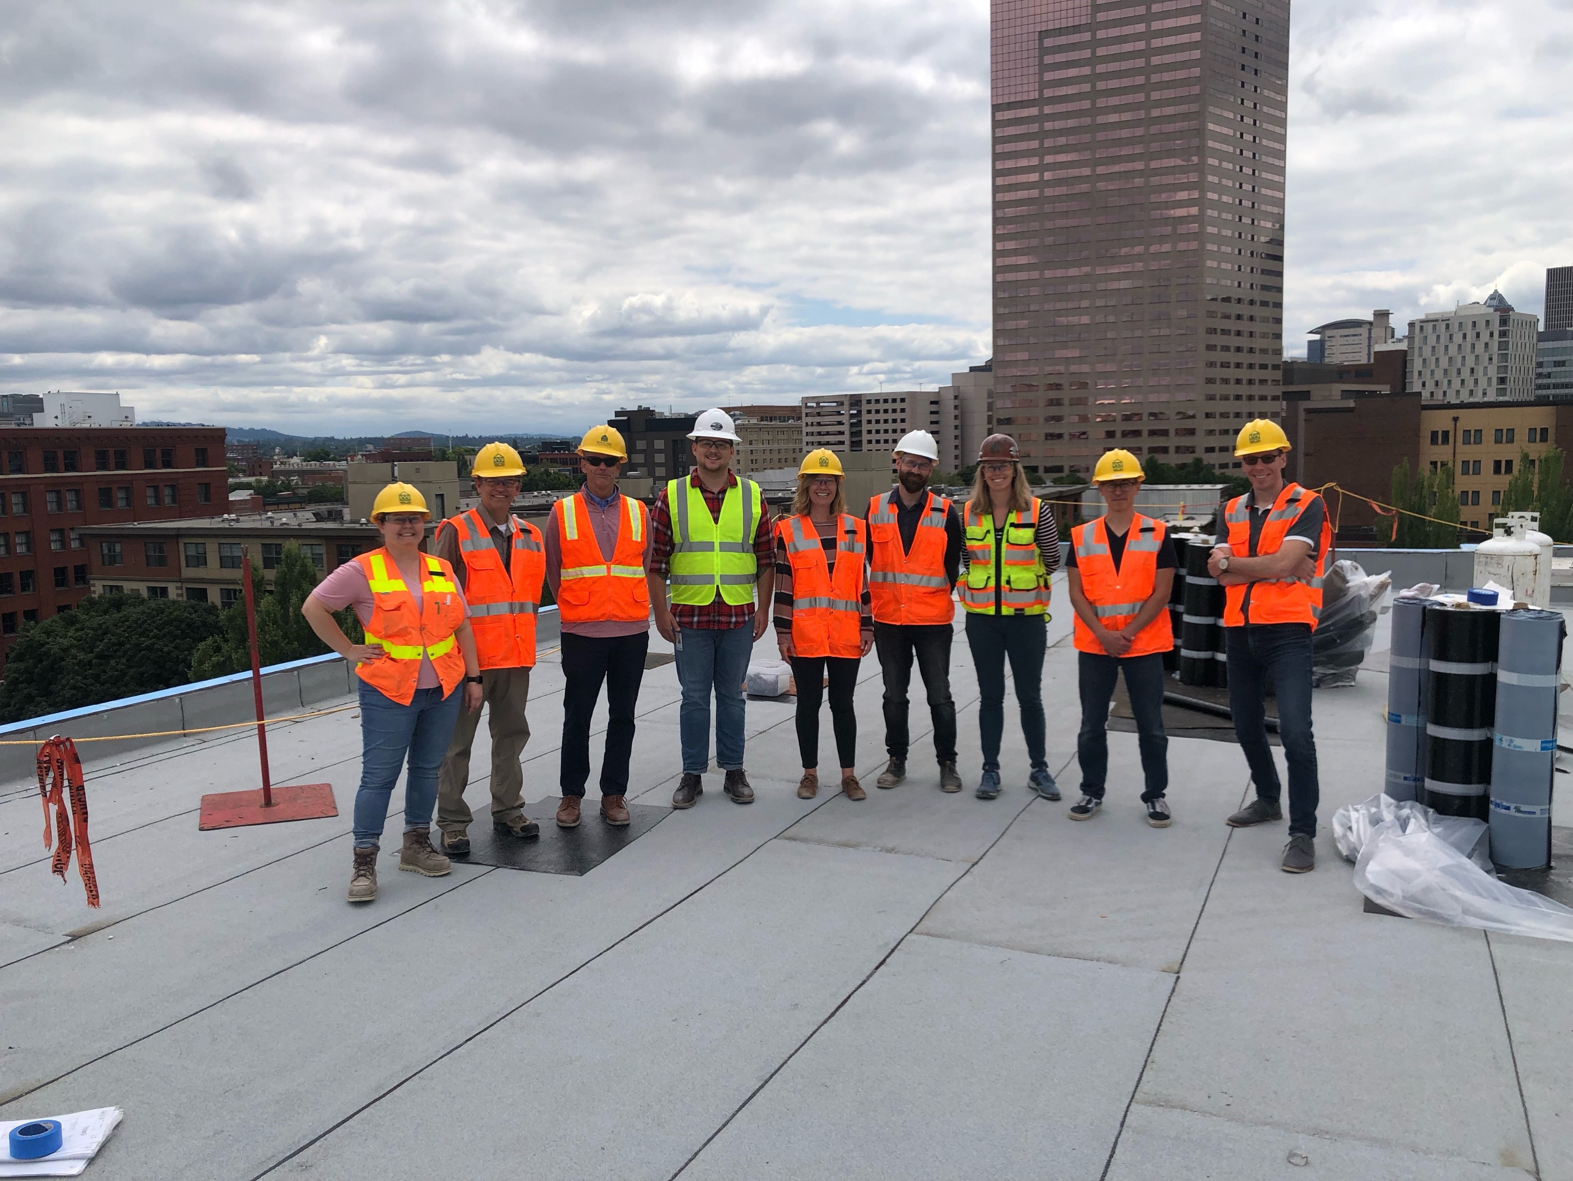
Questions?
Thank you!

Slide 21
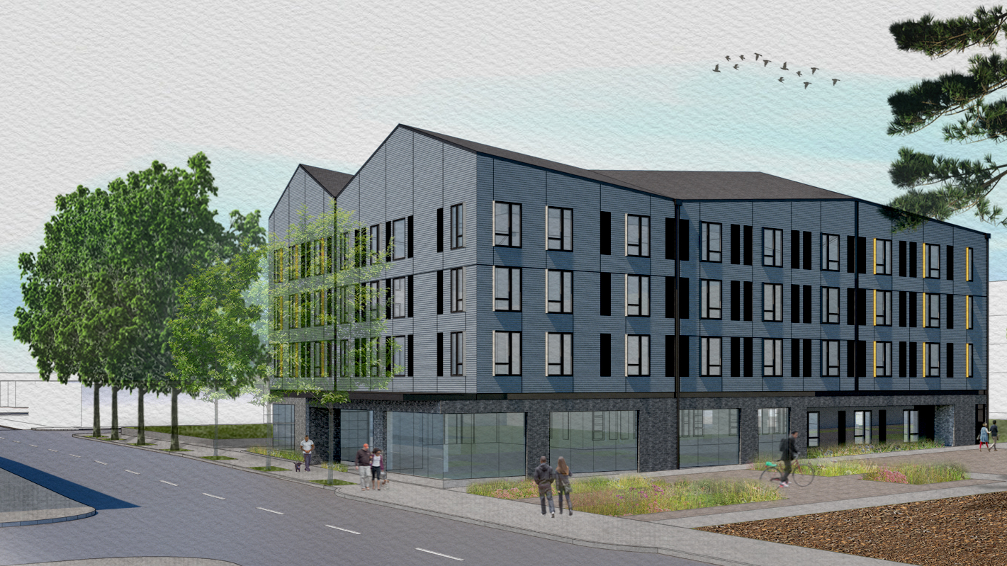
Francis + Clare Place
1131 SE Oak Street
Caritas Housing
Notes:
Travis Phillips and Mac Cunningham to present

Slide 22
Services provided by Catholic Charities of Oregon + NARA
Focus on outreach to communities overrepresented in the houseless population such as Native American/Indigenous and Black/African-American communities.
Francis + Clare Place
Unit Mix
Income Restriction | Studio/ SRO | 1-Bdrm | 2-Bdrm | 3+ Bdrm | Total | Family-size | PSH
0-30% | 54 | 7 |  |  | 61 |  | 61
31-60% |  |  |  |  | 0
Market/ Manager Units |  |  |  |  | 0
TOTAL | 54 | 7 |  |  | 61 |  | 61
Estimated # People Housed: 61-68

Slide 23
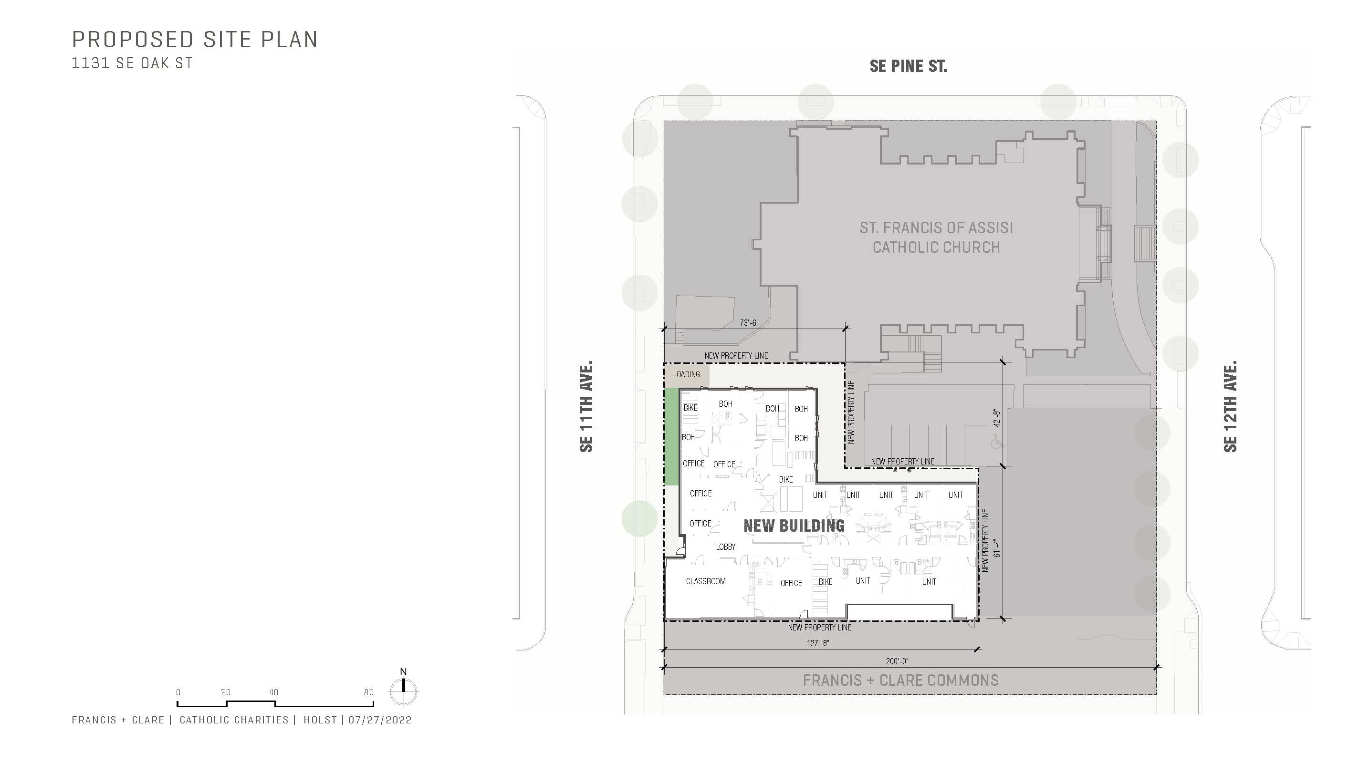
Project Funding Sources
Portland Housing Bonds | $8,349,206
Other PHB funds | $0
Low Income Housing Tax Credits | $10,739,175
Senior Commercial Debt | $2,972,080
OHCS direct funding | $0
Grants | $275,00
Total Funding | $14,372,461
Gap in Funding | $152,567*
Total Project Costs | $24,525,028
* We have several strategies which we are pursuing to fill our gap
Portland’s Housing Bond funding of $8,349,206 is being leveraged roughly 3 times

Slide 24
Currently in Pre-Development
  Working towards 50% Design Development
Partners
  Holst Architecture
  O’Neill/Walsh Community Builders
  Edlen & Company
  Catholic Charities
  NARA
  AfroVillage
Upcoming Milestones
  Land Use Review Application (September 2022)
  Submit for Building Permits (November 2022)
  Bidding (March 2023)
  Closing/Start of Construction (June 2023)
Development Progress

Slide 25
Material Changes
Building was flipped from SE 12th to SE 11th
Outdoor courtyard removed from site plan
Reduction in the number of one-bedroom units and a commensurate increase in the number of studio units

Slide 26
  Tracking roughly over 90% COBID certified firms for professional services
  O’Neill/Walsh Community Builders remain confident in ability to meet COBID goals
DMWESB-SDV Updates

Slide 27
Issues / Challenges
  Determining land use process to create a new legal tax lot
  Increases in construction costs and interest rates
  Challenges with responsiveness and competitiveness of bids due to volume of work in the region

Slide 28

Community Engagement
Highlights:
  Community Advisory Group lead Visioning Process
  Focus groups with folks who have experienced homelessness with residents of existing Catholic Charities properties and clients of NARA and AfroVillage
  Continued engagement with surrounding neighborhood about design changes
<Insert People Pictures>
106Halsey/Gateway Park l 07/10/2019 l Portland Housing Bureau 5

Slide 29
Interim Director’s Update
Notes:
Molly Rogers

Slide 30
Closing
Remarks
Next Meeting Date: October 6, 2022

