Slide 1
S Bancroft & S Texas St Sewer Rehabilitation Project E11504
Joe Dvorak, P.E. | Principal Engineer | Bureau of Environmental Services
Daniel Boatman, P.E. | Project Manager | Bureau of Environmental Services
July 20, 2022
MINGUS MAPPS, COMMISSIONER
DAWN UCHIYAMA, DIRECTOR

Slide 2
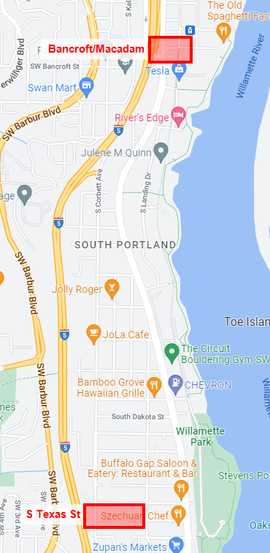
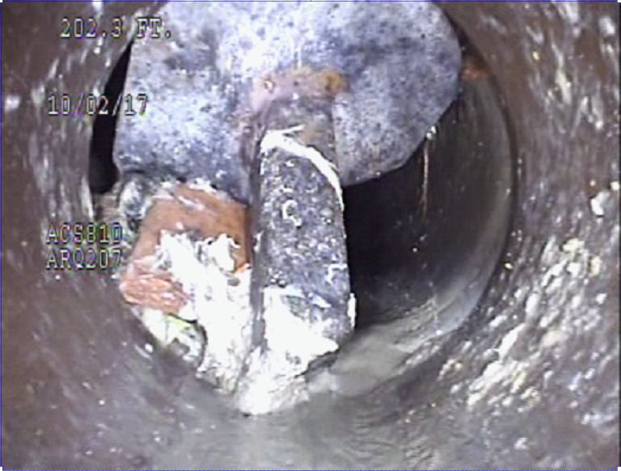
Project Overview
S Bancroft & S Texas St Sewer Rehabilitation
Approx. 1,230 feet of 6”-20” diameter mainline sewer
Age of sewer mains is 100-114 years old
Approx. 240 feet of sanitary service laterals
Time-sensitive work taken from larger project that will be re-advertised at a later date
S Bancroft/Macadam - Multi-bureau coordination to reduce overall City pavement restoration costs where several bureaus have construction work within the same work zone. Work is open trench excavation.
S Texas St - Urgent due to a post through the existing sewer that BES Maintenance Engineering is concerned will cause sewage releases if not repaired prior to Winter 2022-2023. Work is trenchless rehabilitation and open trench excavation.
Notes:
This project will: Increase sewer system capacity and reliability, and Protect public health, property, and the environment by reducing the risk of sewage releases and sewer backups.

Slide 3
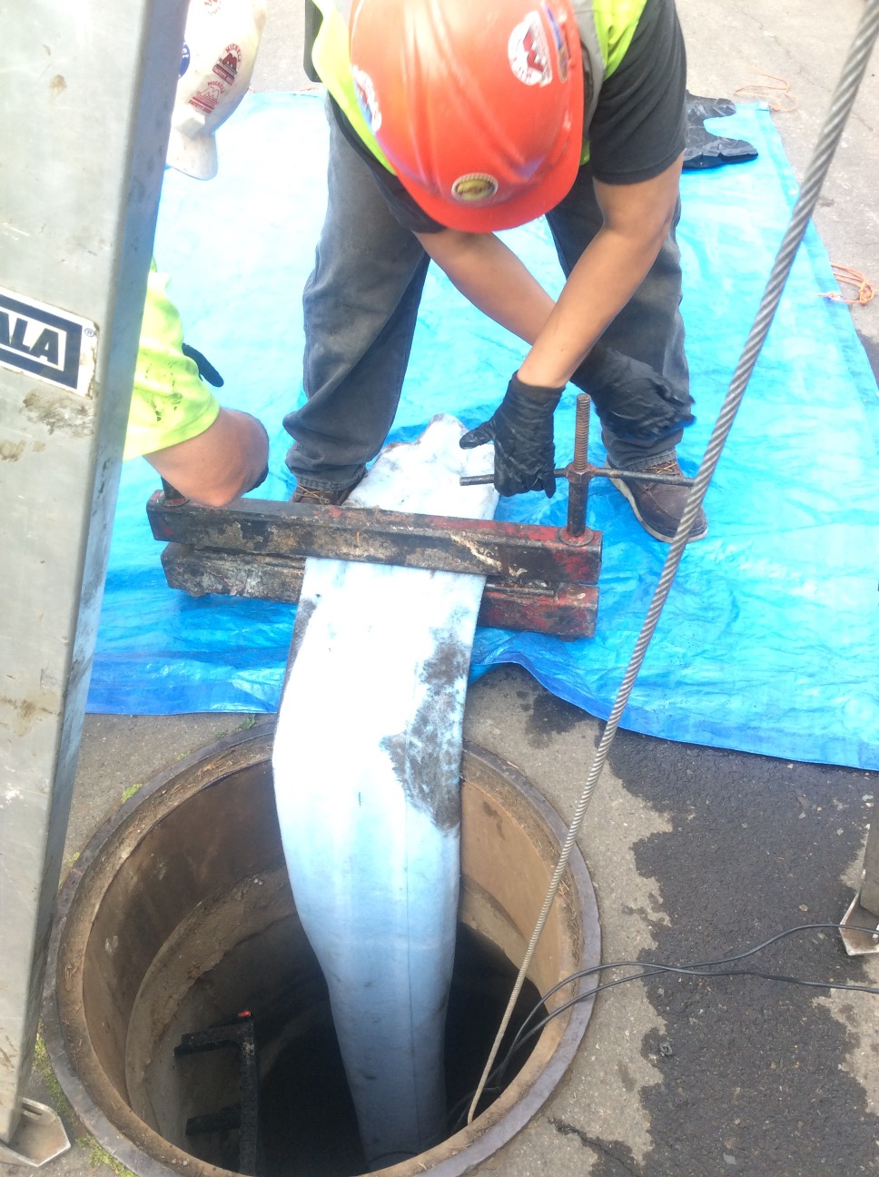
Construction Methods and Scope
Open trench excavation and replacement
Trenchless Rehabilitation
Notes:
Trenchless to reduce impacts and restoration.
Method ft %
CIPP 1893 17%
Spot Repairs 42 0.6% (35’ on CIPP mains)
PB 1580 22%
Sect-CIPP 6 0.1%
Auger Boring 94 1.4%
OC 3345 49%
---------------------------------------
Abandon 1794 -
TOTAL 12439
NCS 1368
TOTAL REHAB 11071

Slide 4
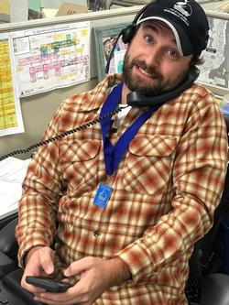
Public Outreach & Impacts
Project Notifications
Flyers, email updates, project webpage, Nextdoor, face to face
Multiple public presentations
Night Work
Macadam/Bancroft
Notes:
Working with outreach firms to assist in public involvement.

Slide 5
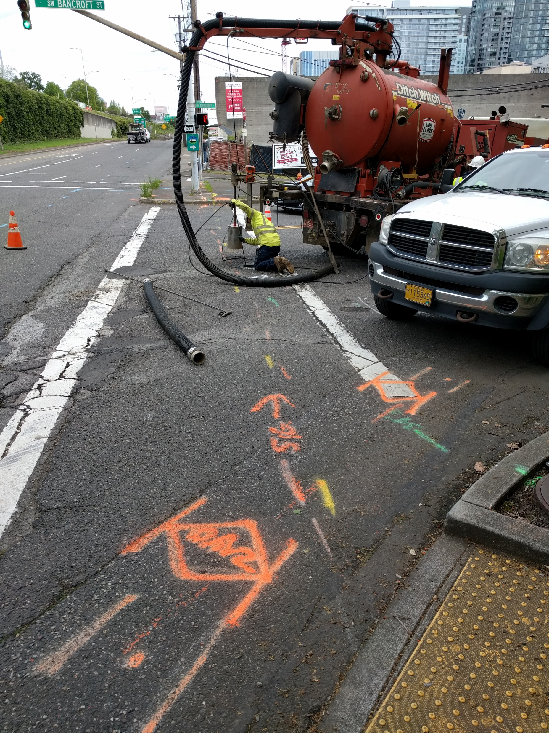
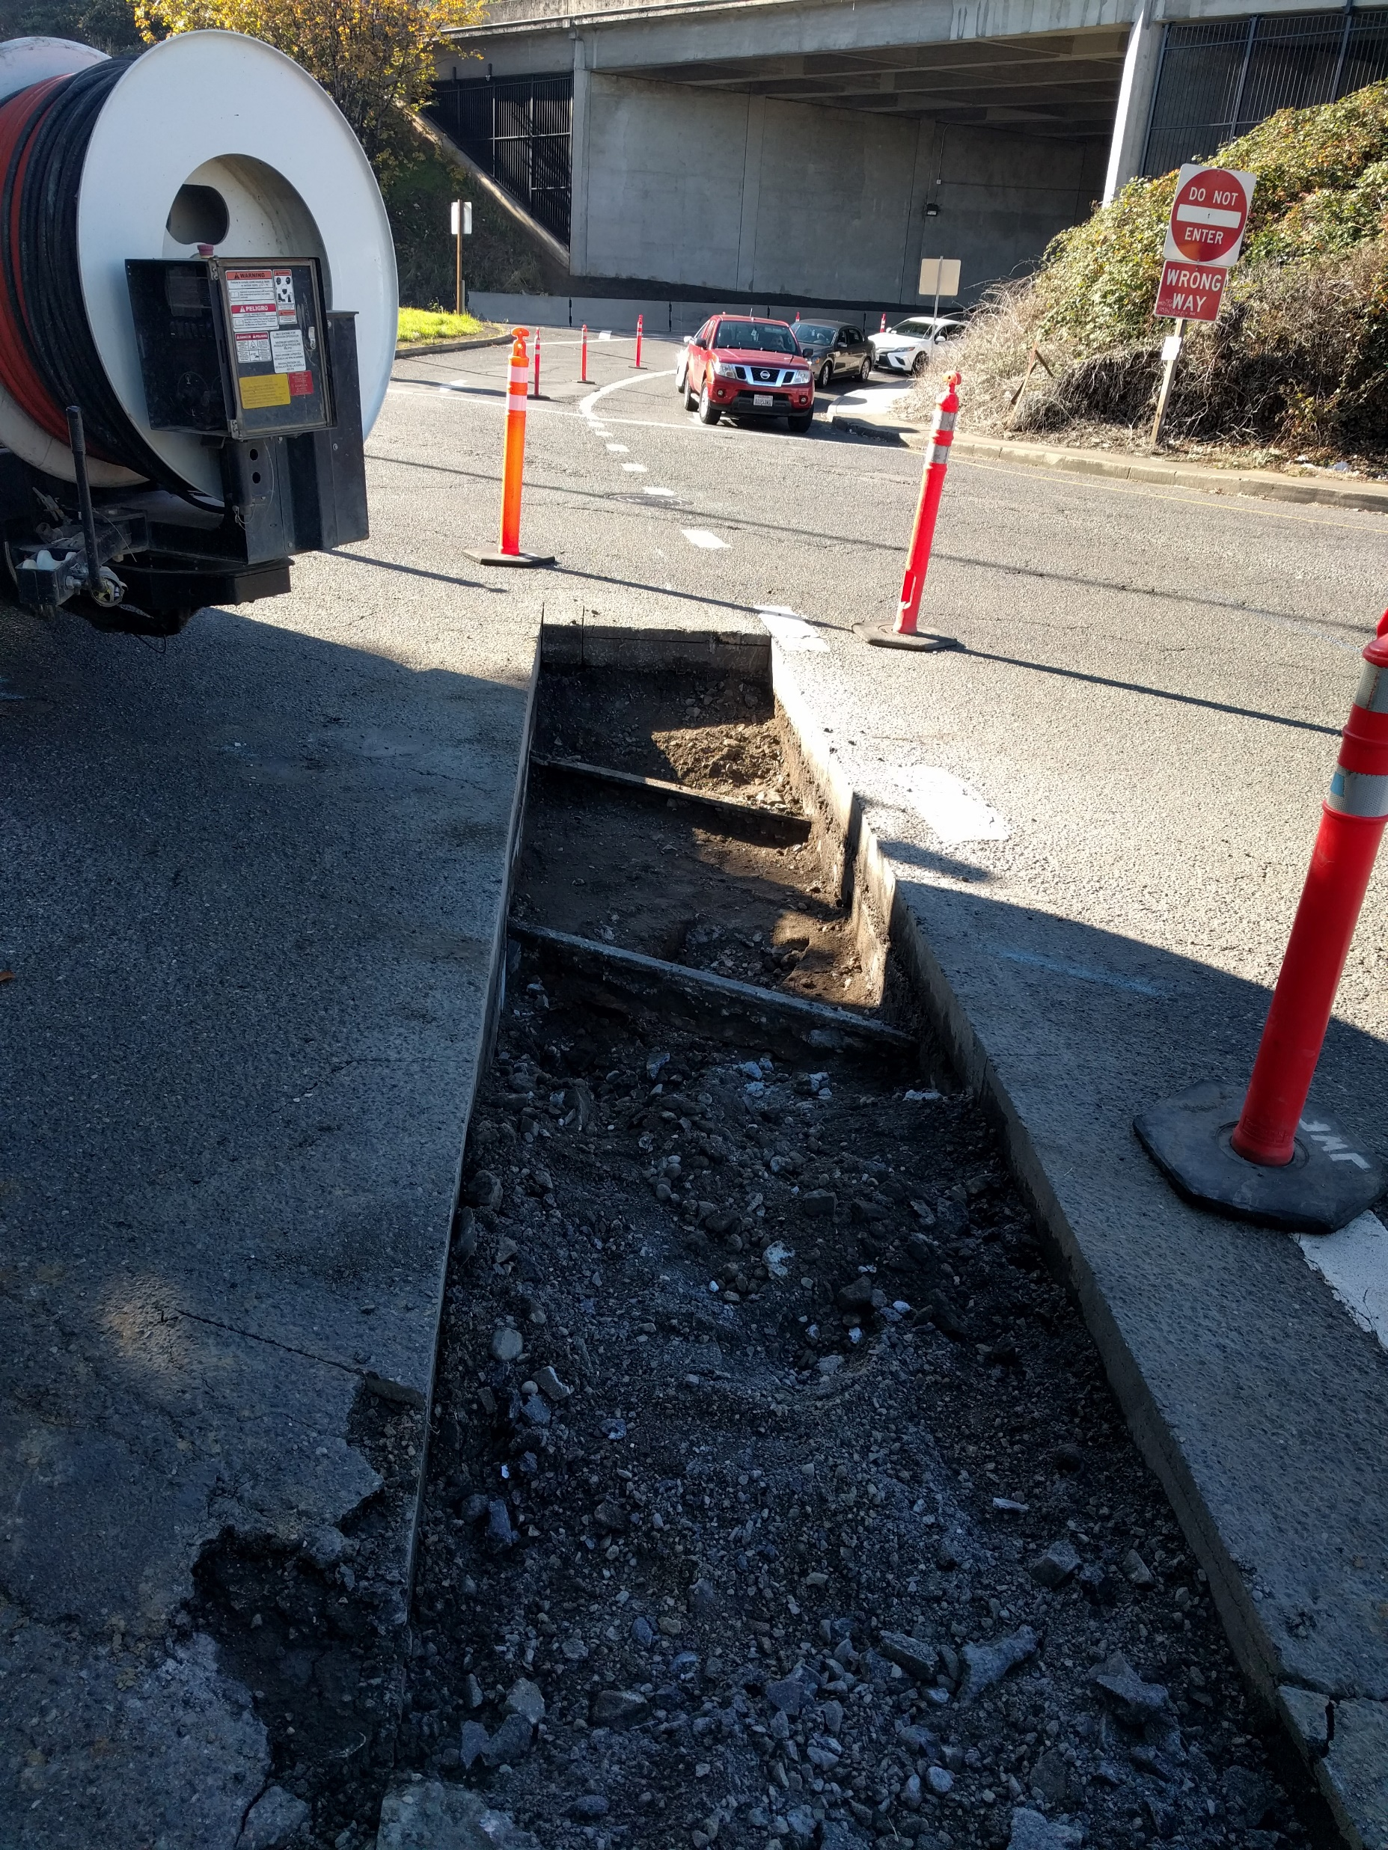
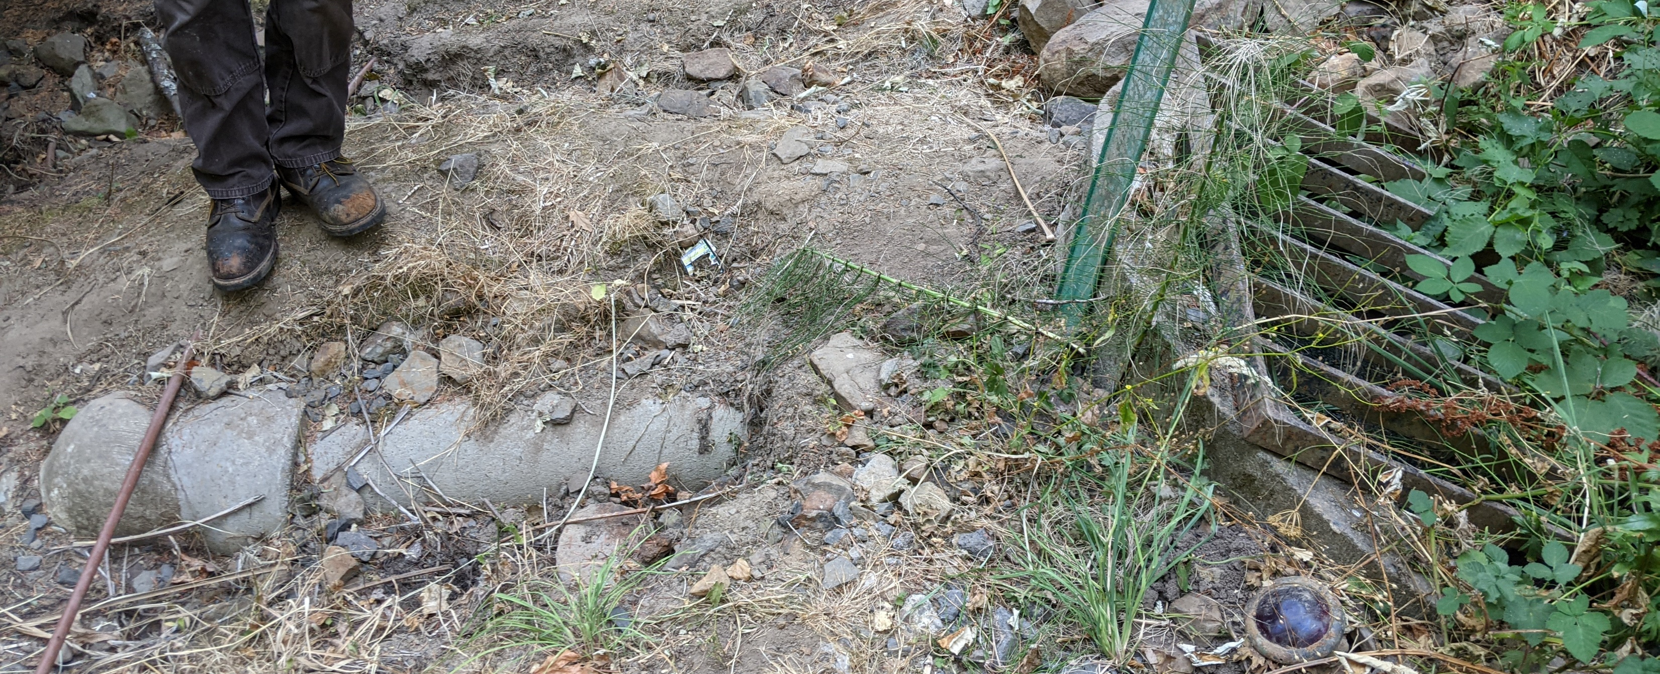
Engineer’s Estimate & Schedule
Engineer’s Estimate:
$1,770,000
Moderate Confidence Level
Advertise Project:
July 2022
Begin Construction:
December 2022
Construction Duration:
180 calendar days

Slide 6
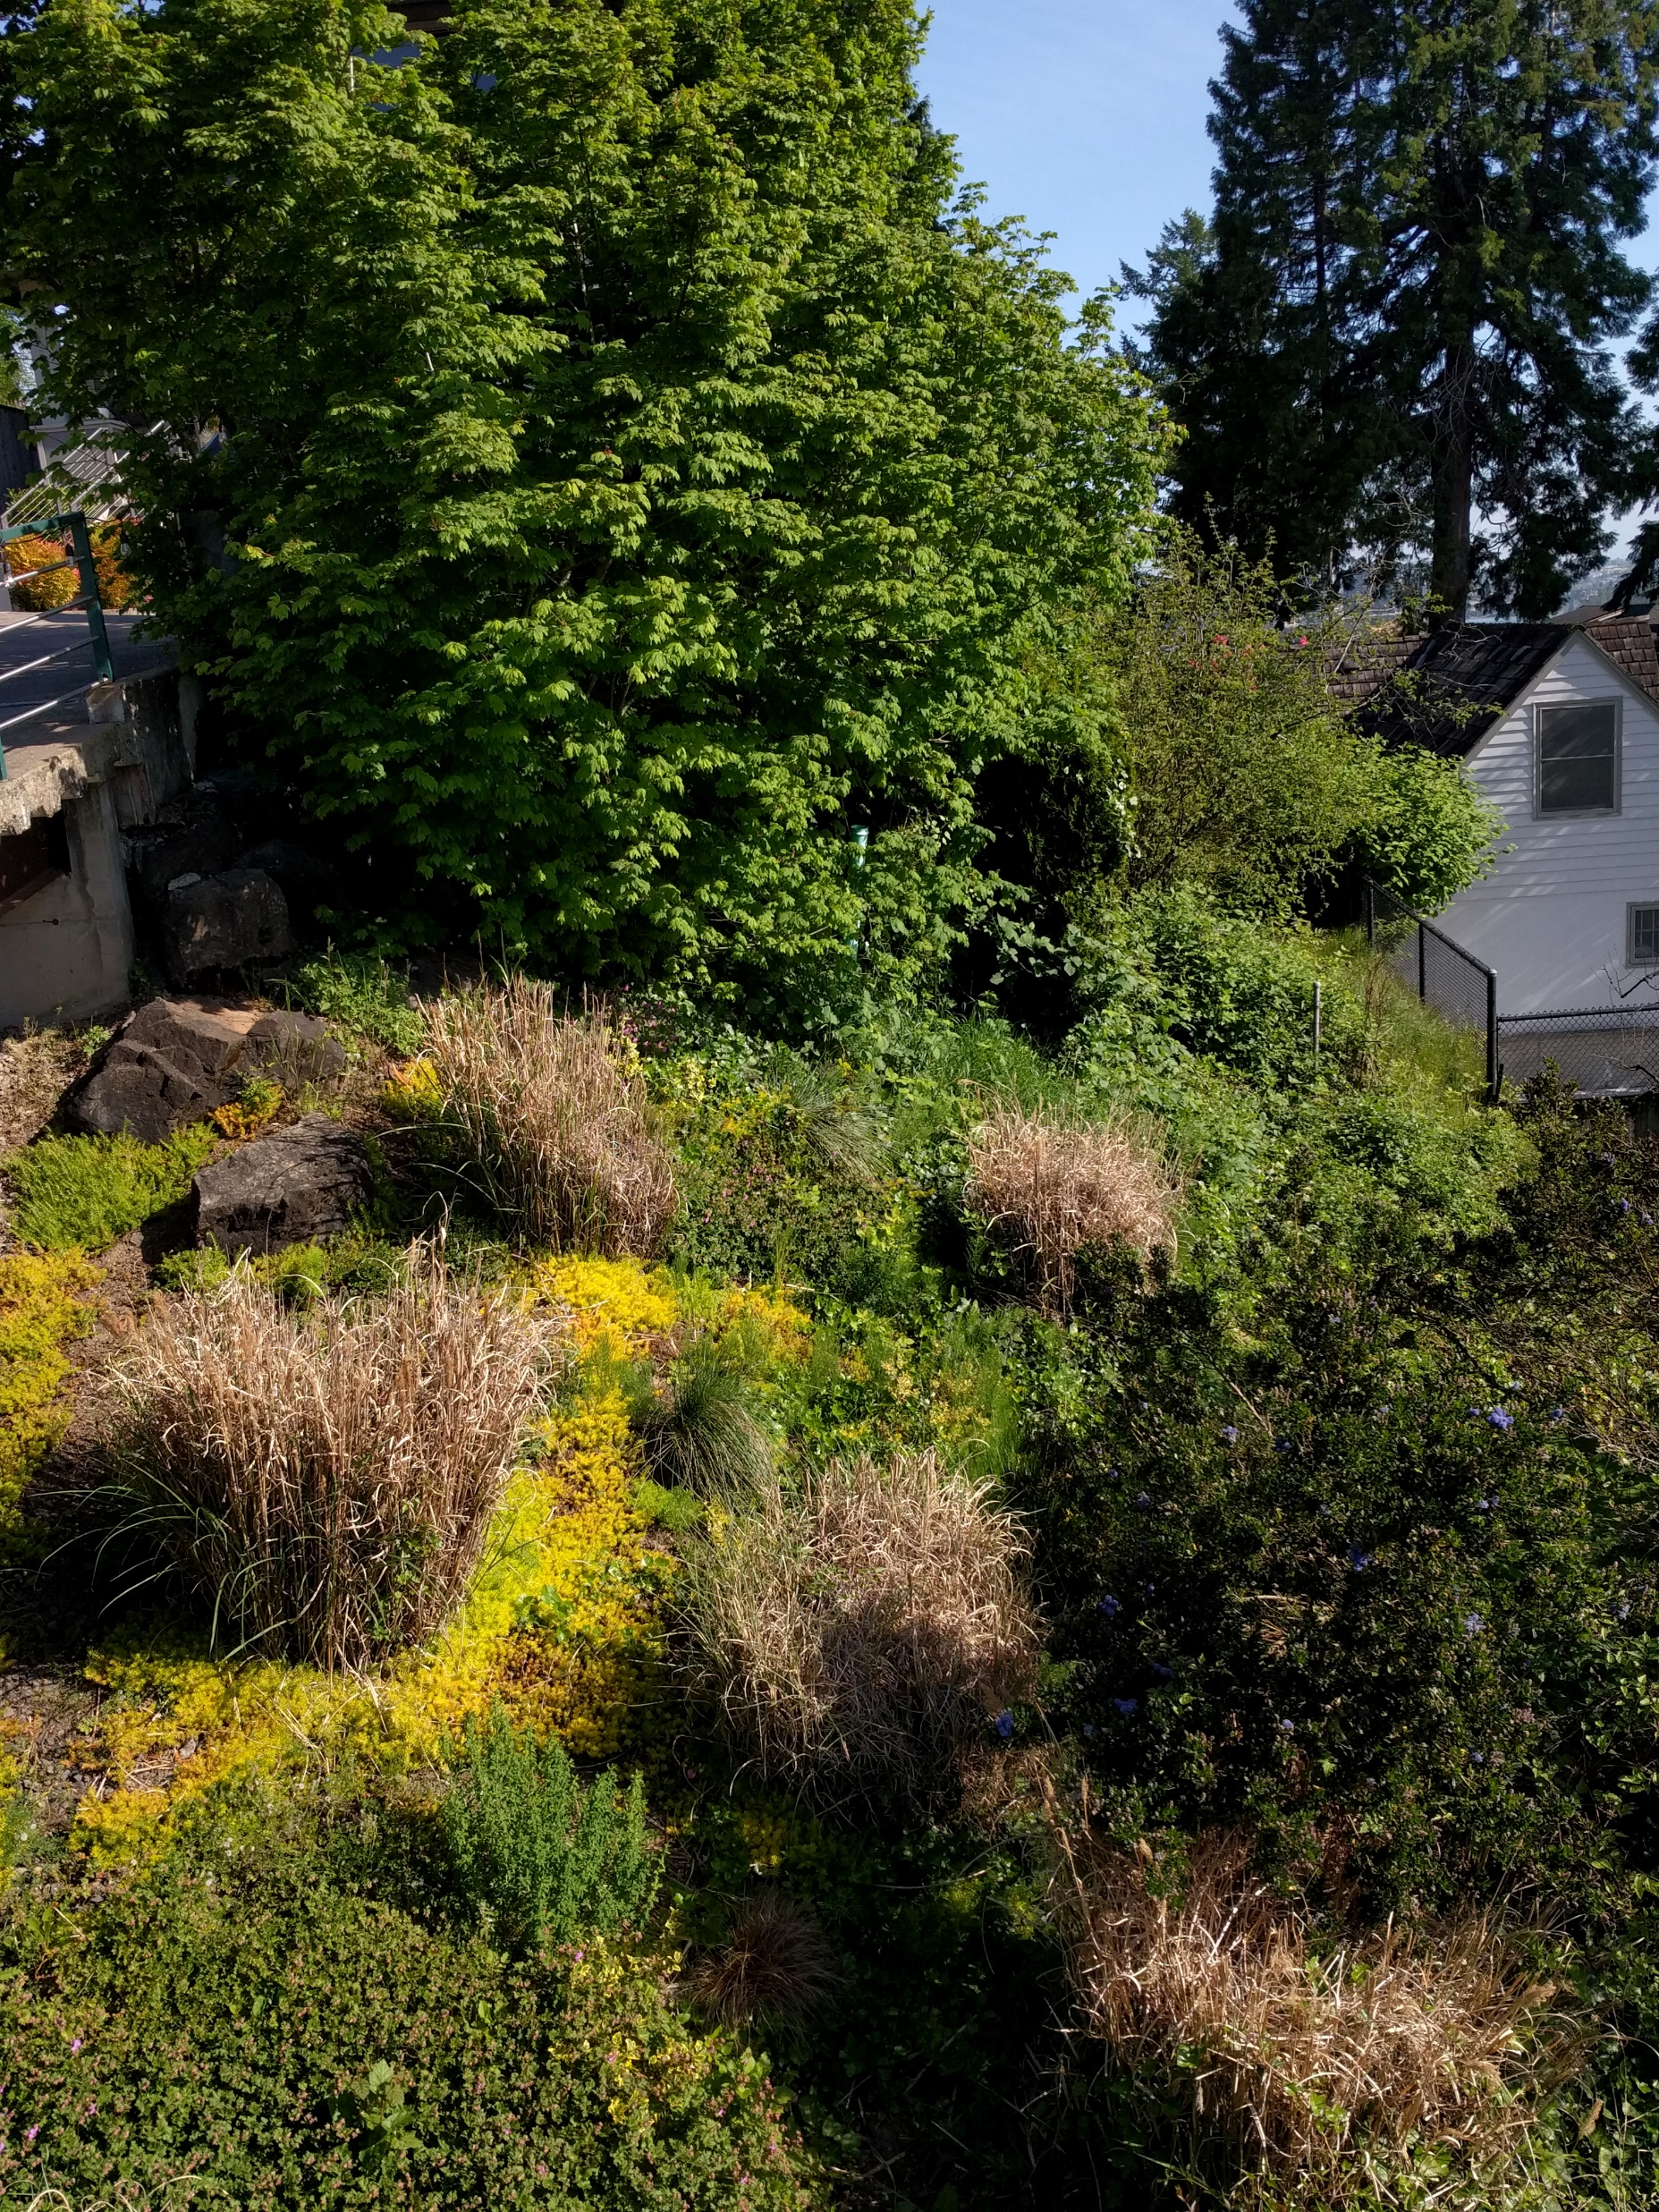
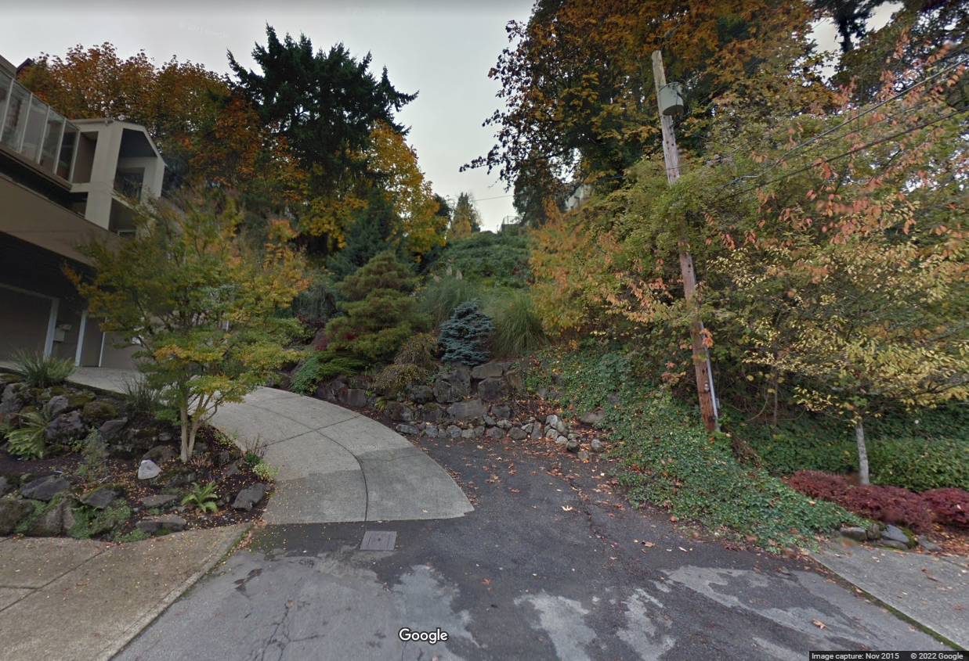
Questions?
S Texas St Right-of-Way

