Slide 1
NE HALSEY ST., NE JONESMORE ST.,
AND NE 81ST AVE. STREET RENAMINGS
Achieving a Consistent Street Name of NE Halsey Street in
Portland, Gresham, Fairview, Wood Village and Troutdale
July 13, 2022: Council Agenda Item ##624
Staff Presenting: Andrew Aebi, M.B.A., Portland Bureau of Transportation

Slide 2
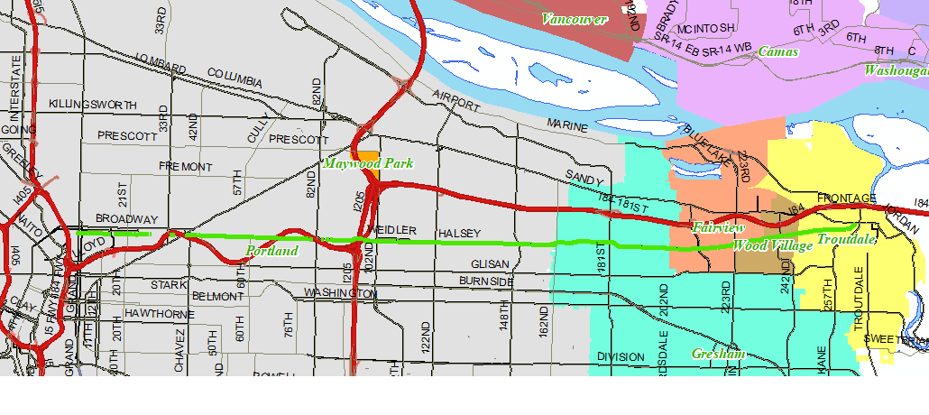
Current NE Halsey Street
in Portland, Gresham, Fairview, Wood Village, Troutdale
2-Block Gap East of NE 81st Avenue (Circled)

Slide 3
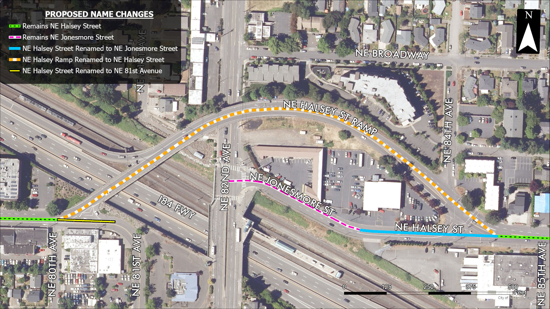
Proposed Street Renamings
Effective October 1, 2023

