Slide 1
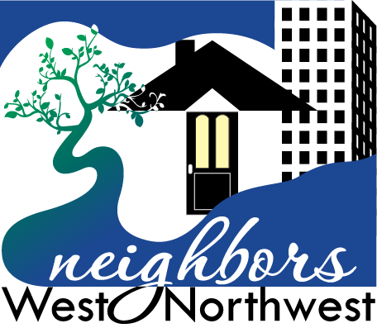
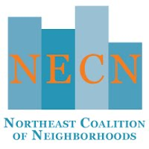
Neighborhood Coalition Program
July13, 2022
Council/Ordinance

Slide 2
FY2022-23 Coalition Office Allocations
ORGANIZATION | BASE FUNDING | SMALL GRANT FUNDING
SE Uplift | $493,418 | $61,971
Neighbors West Northwest | $294,932 | $30,620
Central Neighbors North | $285,133 | $20,395
NE Coalition of Neighborhoods | $303,357 | $30,512
City Run North Office |  | $27,983
City Run East Office |  | $47,500
City Run SW Office |  | $31,019
Totals | $1,376,840 ($1,326,436 -FY2021/22) | $250,000

Slide 3
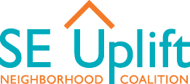
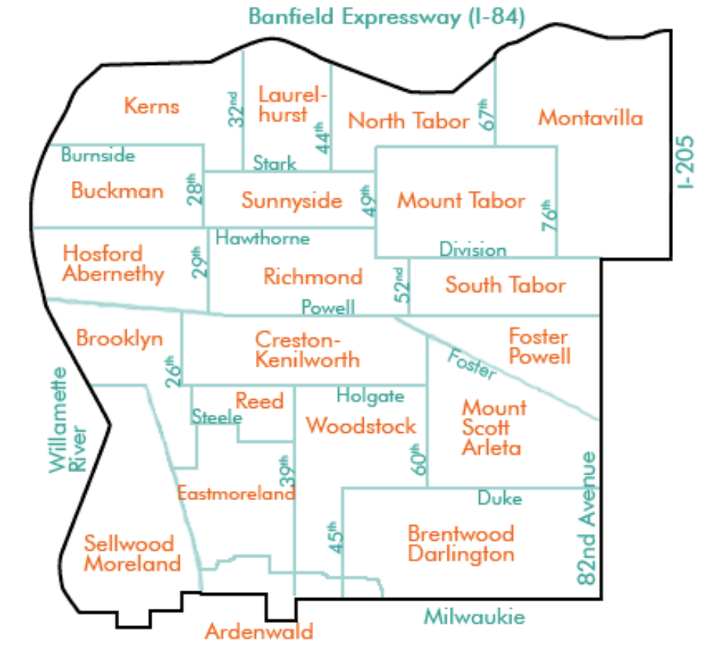
Collaborating with the SE Portland community to build informed, inclusive, and participatory neighborhoods that support our social and ecological well-being since 1968. 20 neighborhoods 1 of Portland’s 7 District Coalition Offices 5 Staff

Slide 4
Building Neighborhood Capacity
for Civic Engagement

Slide 5
Convening Communities to Innovate Solutions
Houselessness Action | Land Use + Transportation

Slide 6
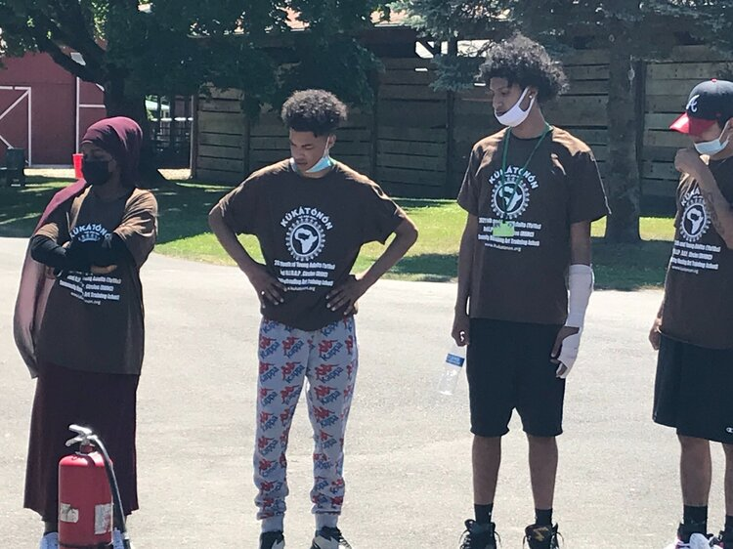
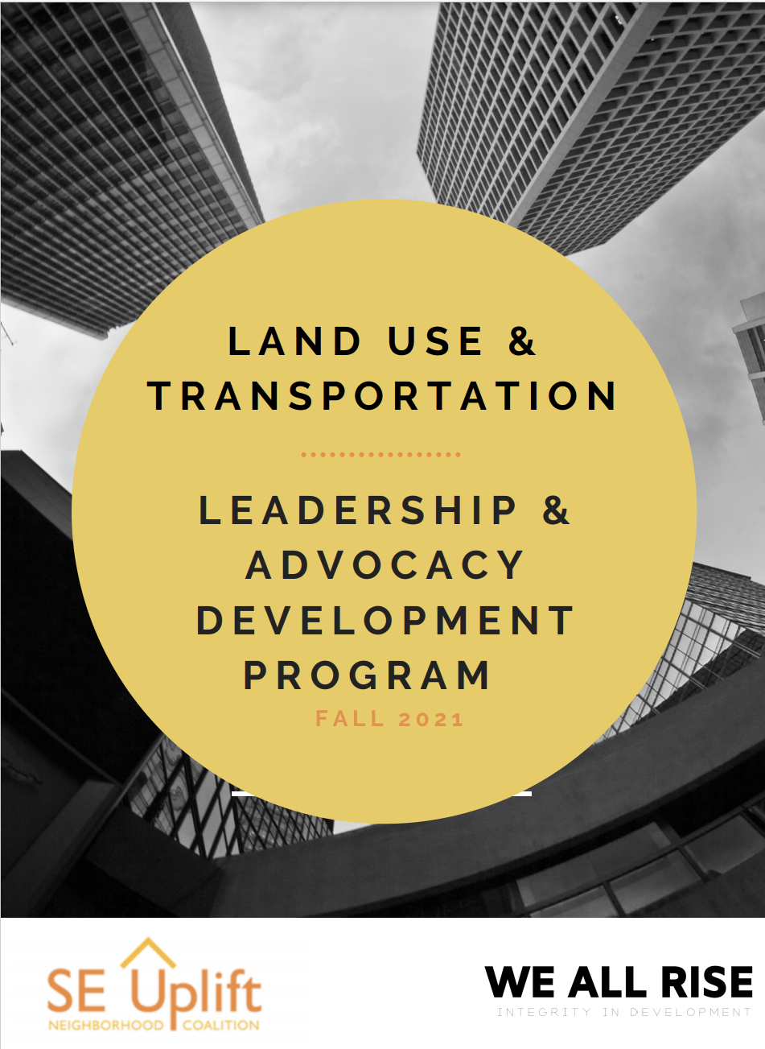
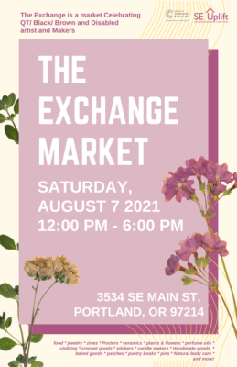
Land Use + Transportation Leadership Academy
Collaborations
Black and Beyond the Binary Collective
Equi Instititute
Kúkátónón Portland - Youth Summer Program
We All Rise

Slide 7
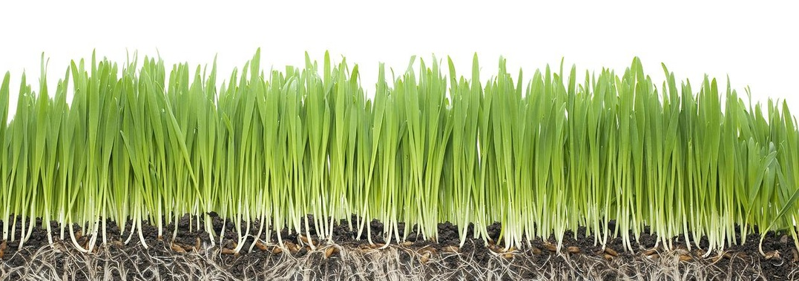
Incubating Grassroots Movements
DEIA-Focused Community Small Grants | Fiscal Sponsorship
African Heritage Education + Engagement Community
Black and Beyond the Binary Collective
Congo Peace Project
Portland United Against Hate
Portland Through a Latinx Lens
United Congolese Community Organization
NW Alliance for Alternative Media + Education
NorthStar Clubhouse
Our Happy Block Coalition
Passion Impact
PDX Women of Color
Samewave Radio
Sunnyside NA
The Tin Can Phone
Unity Futbol Training
(this slides includes only SE Uplift Small Grants in FY21/22)
Brooklyn Mutual Aid Garden
Conscious Growth
Cultivate Initiatives
Creston-Kenilworth NA
Edùcate Ya
Equitable Giving Circle
FolkTime, Inc.
Friends of Brooklyn Park
Montavilla Farmers Market

Slide 8
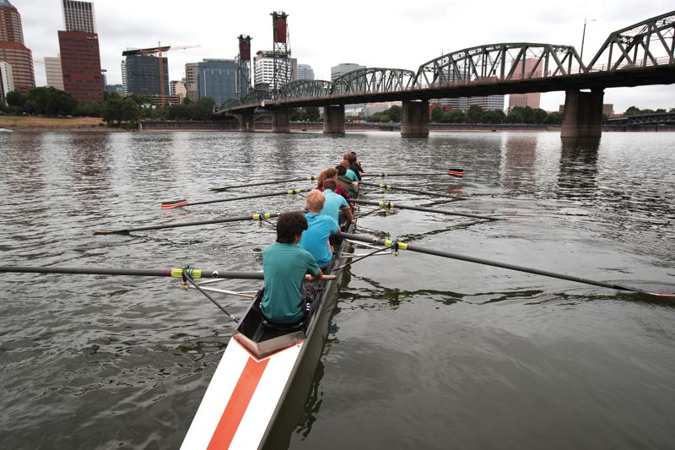
THANK YOU!

