Slide 1
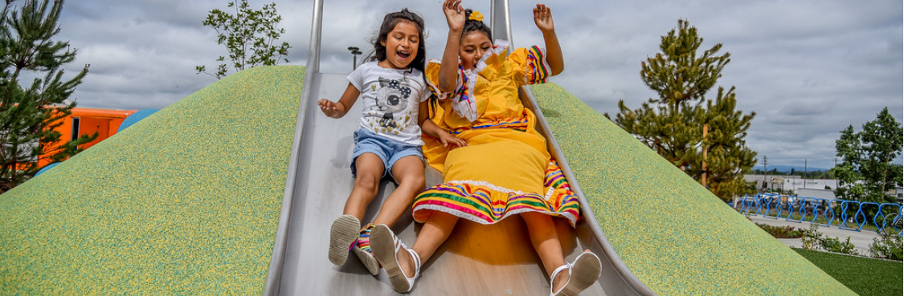
Community Partnership Program and Teen Collaborative Initiative
Click to update the date or subtitle – January 1, 2018
Click to update the date or subtitle – January 1, 2018
Click to update the date or subtitle – January 1, 2018
Presenter Name, Title
Presenter Name, Title
Presenter Name, Title

Slide 2
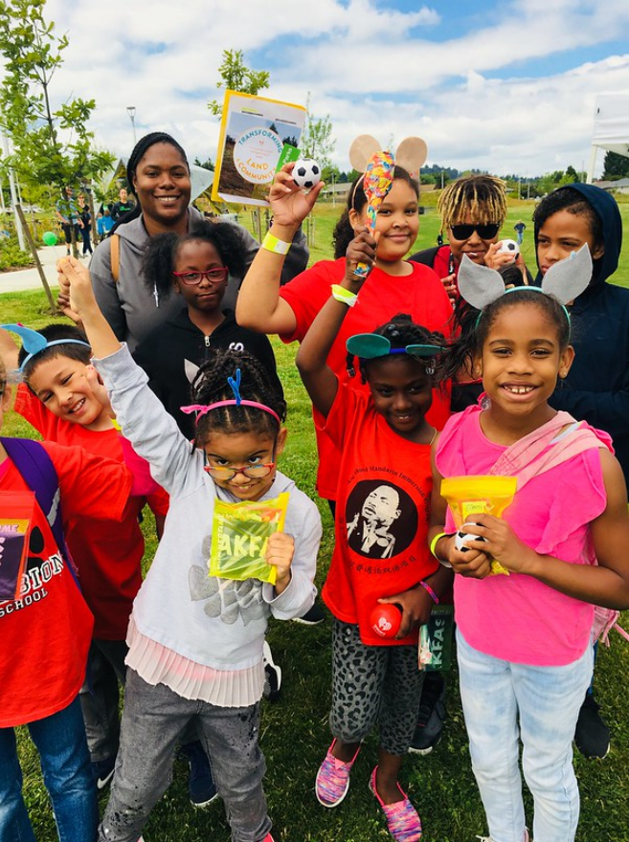
Application and Selection Process
Application window open for a month
PP&R hosted three virtual information sessions
Received 47 eligible applications through the initial Statement of Interest form in Smartsheet
Reviewed and recommended by subject matter experts

Slide 3
Building on Past Success
Teen Collaborative Initiative grants and investments started in 2015
Expansion through the Community Partnership Program
Shared goals to:
  Increase the capacity of youth and teen service organizations to engage and center underserved youth and teens in a broad range of recreational and greening activities.
  Strengthen PP&R’s network of partnerships and increase the capacity of organizations that bring knowledge, expertise, resources, and a focused approach to serving culturally specific communities.
  Expand PP&R’s capacity to reach underserved youth and teens and center equity.

Slide 4








2022-2024 TCI Grantees
Immigrant and Refugee Community Organization
Latino Network
Elevate Oregon
New Avenues for Youth
Portland Opportunities Industrialization Center, Inc. and Rosemary Anderson High School (POIC+RAHS)
Native American Youth and Family Center
Self
Enhancement,
Inc.
The Blueprint Foundation

Slide 5
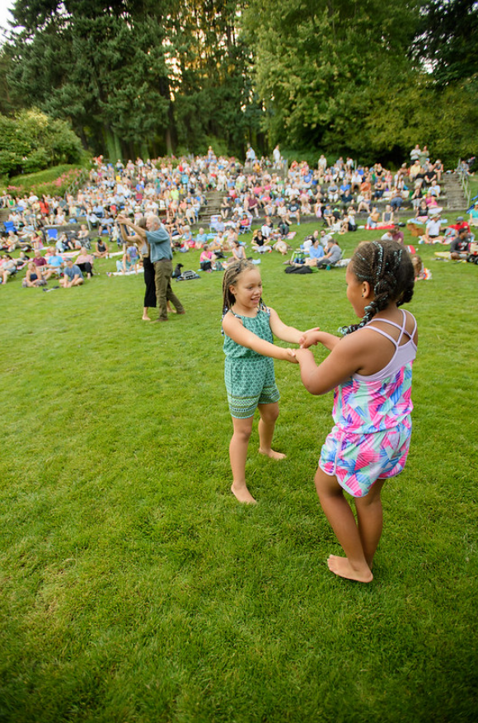
2022-2024 CPP Grantees
All Ages Music Portland, D.B.A. Friends of Noise
Bollywood Dreams Entertainment
BRAVO Youth Orchestras
Friends of Baseball
Friends of Gateway Green
Girls on the Run
Home Forward
Kids N Tennis
Lents Springwater Habitat Restoration Project in partnership with Ecology in Classrooms and Outdoors
People of Color Outdoors in partnership with Columbia Slough Watershed Council
ROSE Community Development
Vanport Mosaic

Slide 6
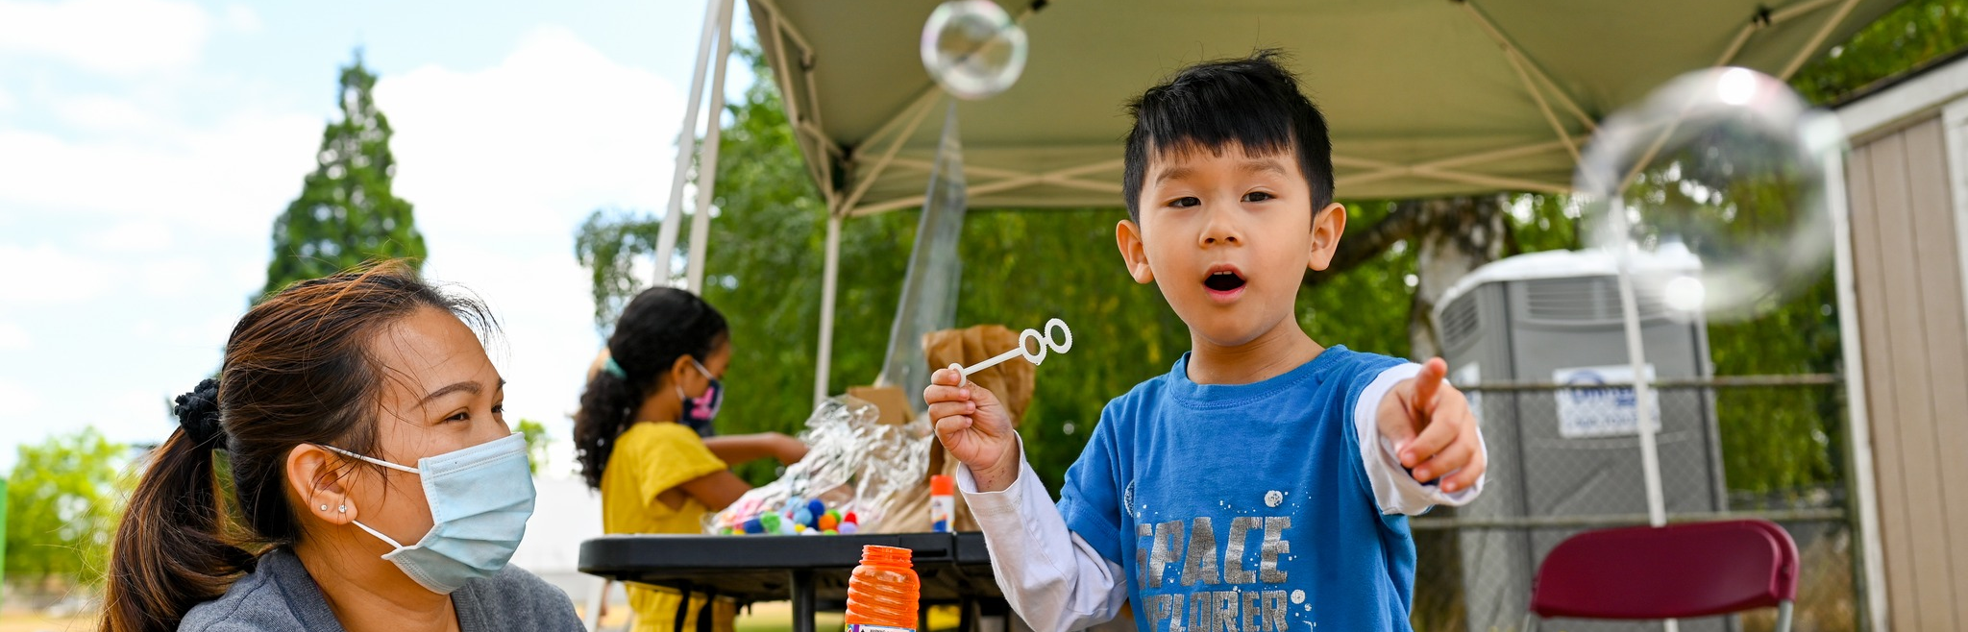
Discussion and Questions

