Slide 1
Residential Infill Project – Part 2
Bringing Portland Into Compliance with State Legislative Mandates for Middle Housing
Morgan Tracy
Sandra Wood
Project Manager
Principal Planner
Shannon Buono
JP McNeil
Senior Planner
City Planner

Slide 2
What are the State mandates?
House Bill 2001 – requires cities to allow duplexes on all lots, and other middle housing (triplexes, fourplexes, cottage clusters, attached houses) on most lots.
Senate Bill 458 – requires cities to process land divisions for middle housing development, so that each dwelling unit can be sold on its own lot.

Slide 3
RIP2 proposals
R10/R20 Zones (catching up with RIP1)
All single dwelling zones
Floor area limits (smaller lots)
Duplexes (all lots)
Triplexes/Fourplexes (some lots)
More ADU options (some lots)
Visitable units
Affordable 4-6 plexes (some lots)
Attached houses (most lots)
Cottage clusters (most lots)
Detached duplexes (most lots)
Modified ‘z’ overlay/update Landslide hazard map
Middle housing land divisions

Slide 4
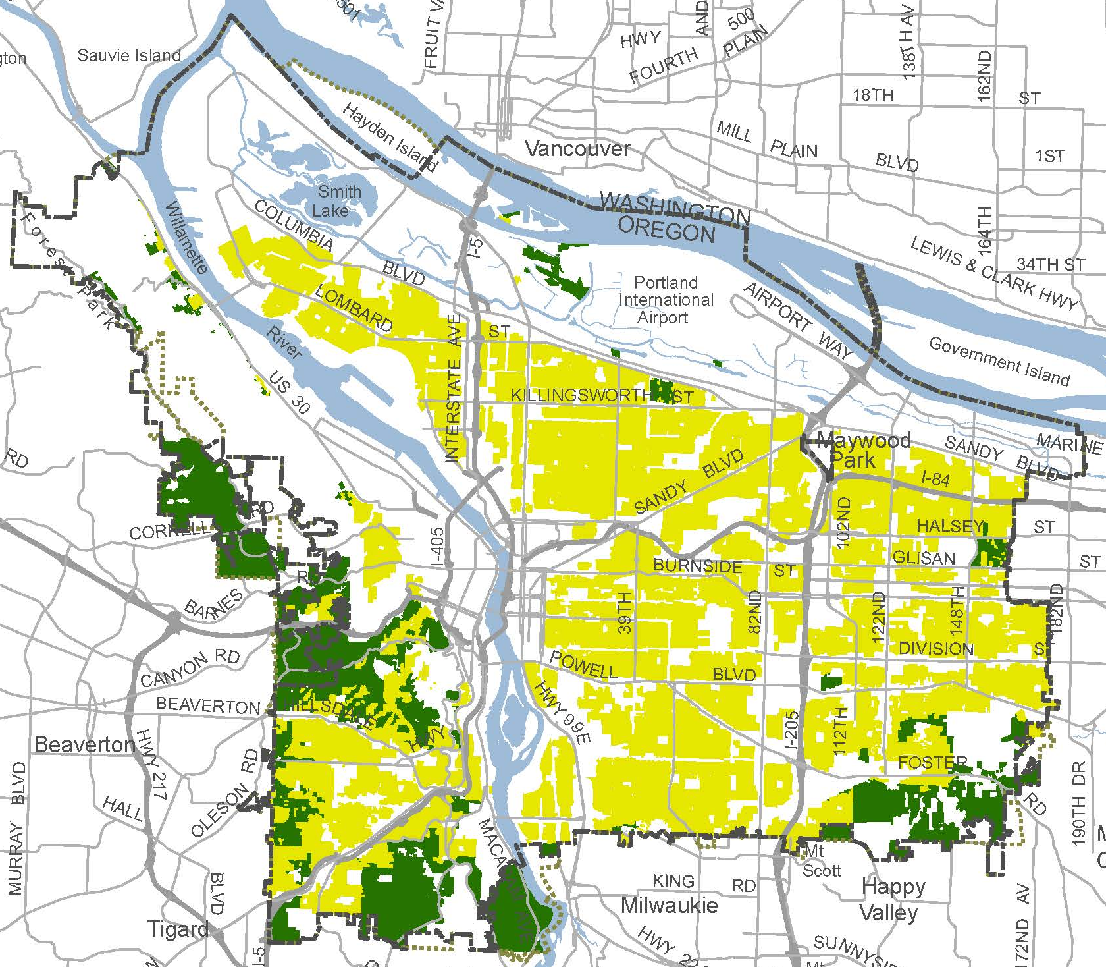
RIP2 scope
Area
RIP2 includes areas that were not part of RIP1 – i.e. R10 and R20 zones.
RIP1&2
R2.5, R5 and R7 zones
(about 134,000 lots)
R10 and R20 zones
(about 16,000 lots)
RIP2

Slide 5
RIP2 scope
Housing types
RIP2 adds more housing types that were not included with RIP1 – i.e. cottage clusters and attached homes, in both RIP1 and RIP2 areas.
RIP2
RIP1

Slide 6
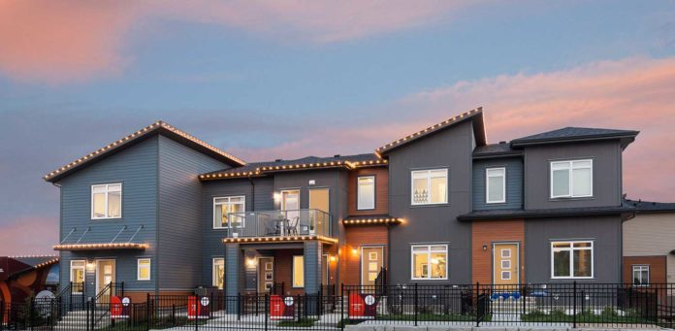
RIP 2 – proposal #7 - Attached Houses
Attached units on separate lots
Higher density (to match triplex/fourplex density)
Look like plexes, but units always arranged side-by side
Regular land division
Credit: Brookfield Residential

Slide 7
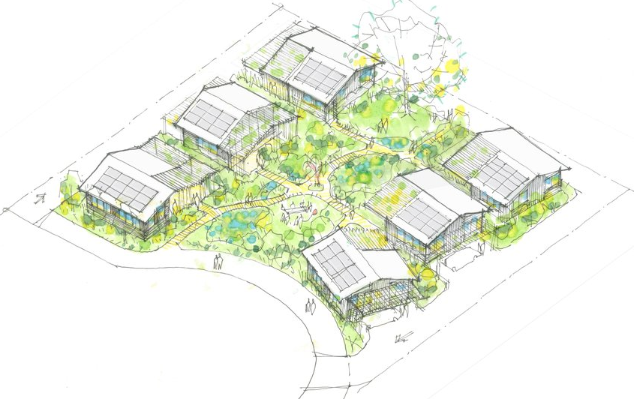
RIP 2 – proposal #8 -Cottage Clusters
3-16 detached units
900 sf footprint max
1,400 sf avg floor area
Common outdoor area
Credit: Propel Studio

Slide 8
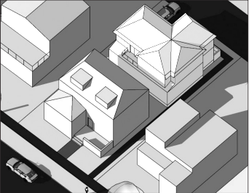
RIP 2 – Proposal #9 - Detached Duplex
Not required by HB2001
On sites with an existing house
25’ max height limit
Eligible for middle housing land division

Slide 9
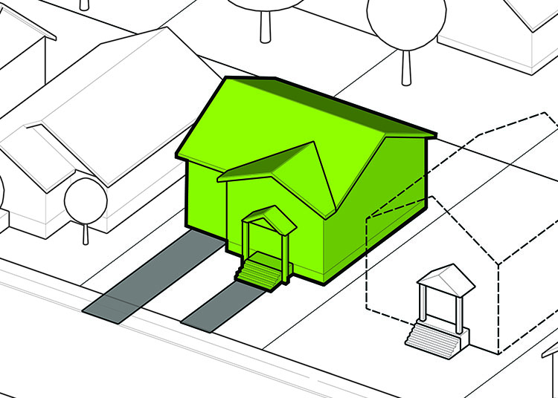
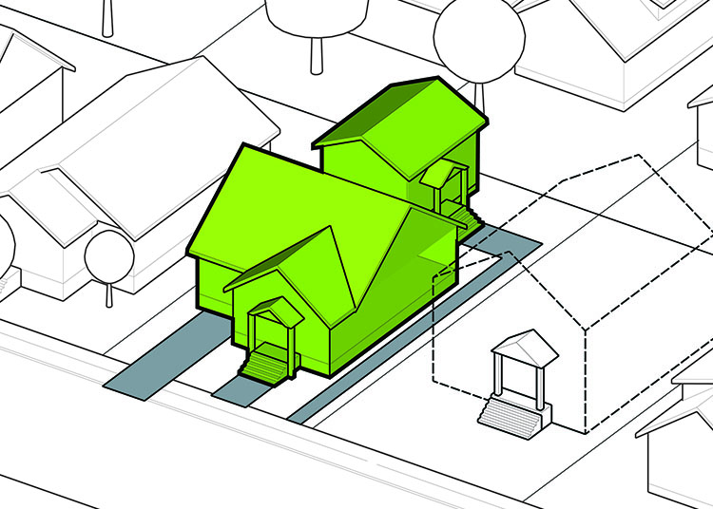
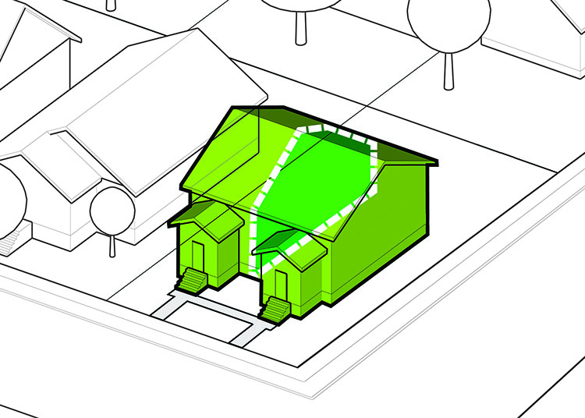
Recap of new housing types added with RIP1 and RIP2
All single dwelling zones
House
House+ADU
Corner duplex
Prior to RIP: house, house w/ADU, corner lot duplex

Slide 10
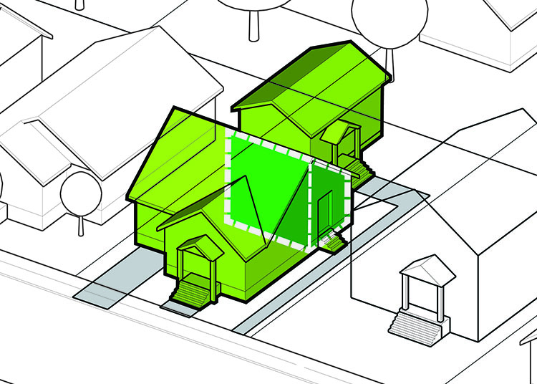
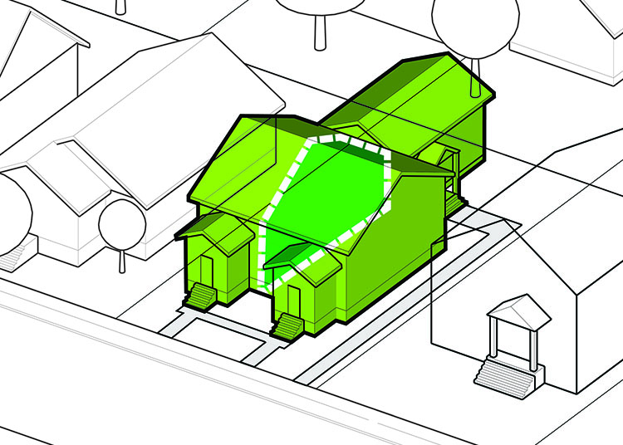
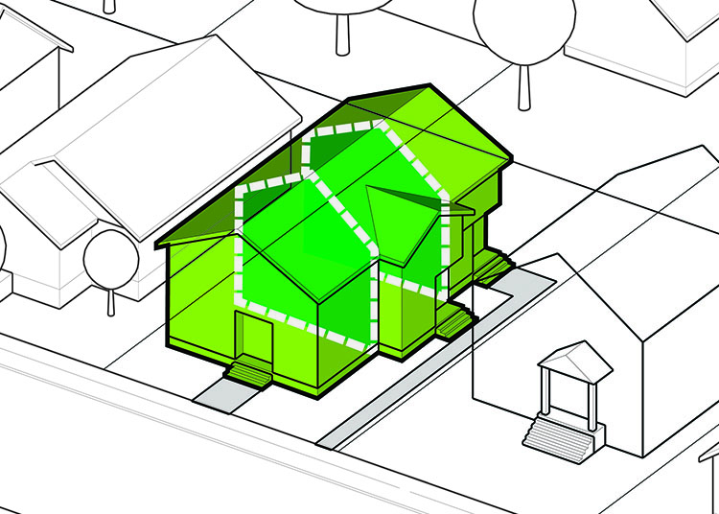
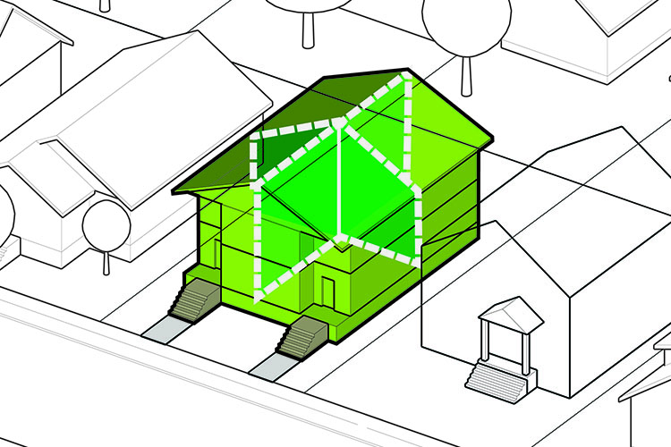
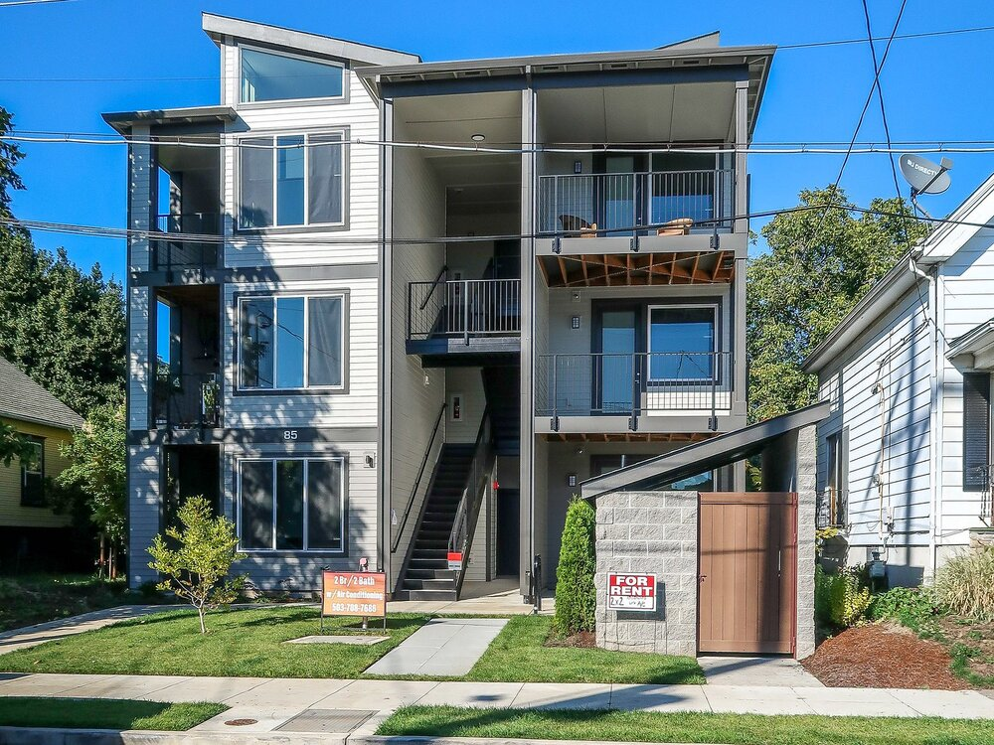
Recap of new housing types added with RIP1 and RIP2
R2.5, R5, R7 zones
House
House+ADU
Corner duplex
Duplex
House+2 ADUs
Duplex+ADU
RIP1
Triplex
Fourplex
Affordable 6plex
RIP1 added: plexes, more ADU options and the deep affordability bonus sixplex

Slide 11
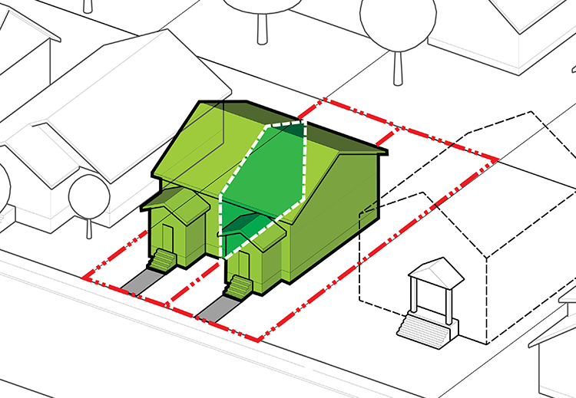
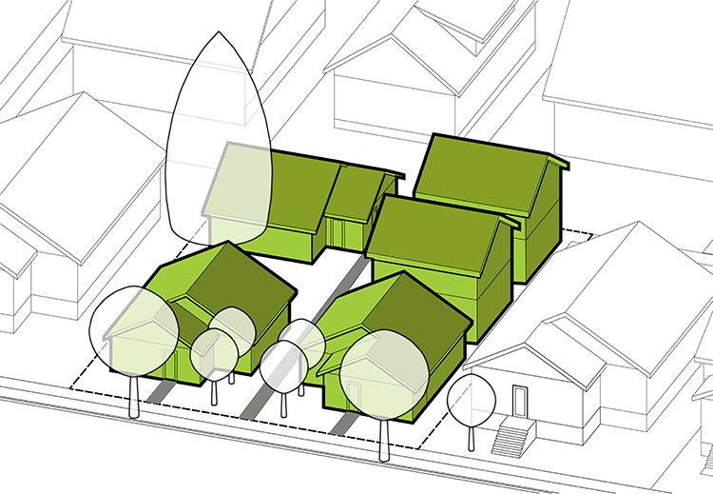
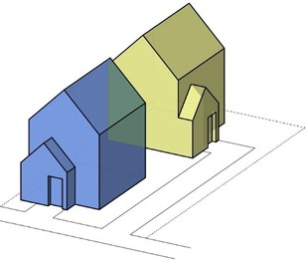
Recap of new housing types added with RIP1 and RIP2
All single dwelling zones
House
House+ADU
Corner duplex
Duplex
House+2 ADUs
Duplex+ADU
Triplex
Fourplex
Affordable 6plex
RIP2
Attached Houses
Cottage Cluster
Detached Duplex

Slide 12
Housing types required by HB2001
In areas of all single dwelling zones
House
House+ADU
Corner duplex
Duplex
House+2 ADUs
Duplex+ADU
Triplex
Fourplex
Affordable 6plex
Attached Houses
Cottage Cluster
Detached Duplex

Slide 13
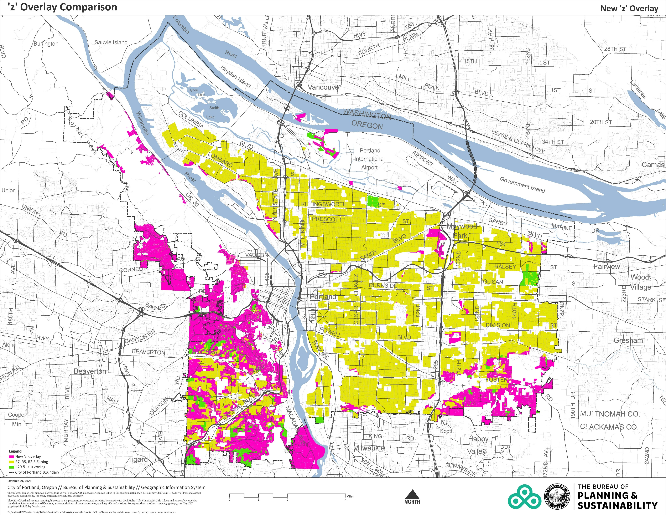
RIP2 Proposal #10 The ‘z’ overlay
Environmental
Landslide
Flood
Wildfire
Airport noise
Future industrial
R2.5, R5, and R7
(~6,000 of 134,000 lots)
R10 and R20
(~12,500 of 16,000 lots)
Proposed ‘z’ Overlay
(~18,500 of 150,000 lots)
Notes:
Mention landslide hazard data update

Slide 14
RIP2 Proposal #11 SB458 – Middle Housing Land Divisions
Zoning requirements apply to parent parcel as a whole
coverage, setbacks, FAR, etc
Building code applies to all lots
Separate utilities to each unit
ADUs not permitted
No min lot size or street frontage requirements

Slide 15
RIP2 Council Schedule
April 21 – Hearing
May 19 – Hearing and vote on amendments
June 1 – 1st Reading/vote
July 1 – Effective date

Slide 16
Morgan Tracy
Project Manager

Slide 17
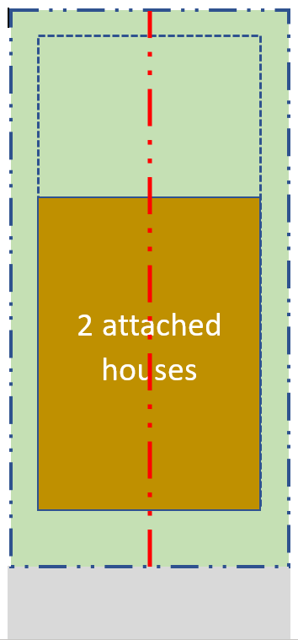
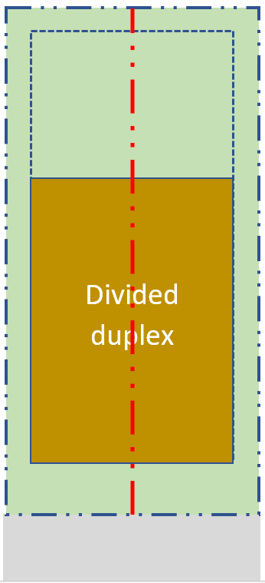
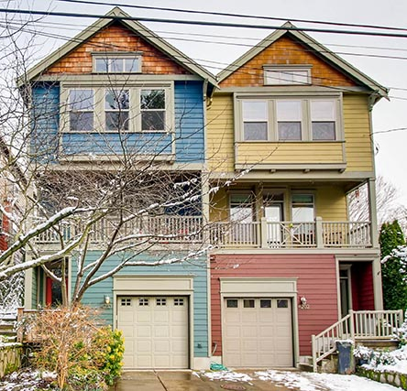
A tale of two land divisions…
Attached houses (regular LD)
Divided plexes (MHLD)
Review criteria apply (e.g. trees)
120 day max review
Lots function independently
Building permit after
No discretionary criteria
119 day max review
Lots reliant on parent parcel
Concurrent building permit

Slide 18
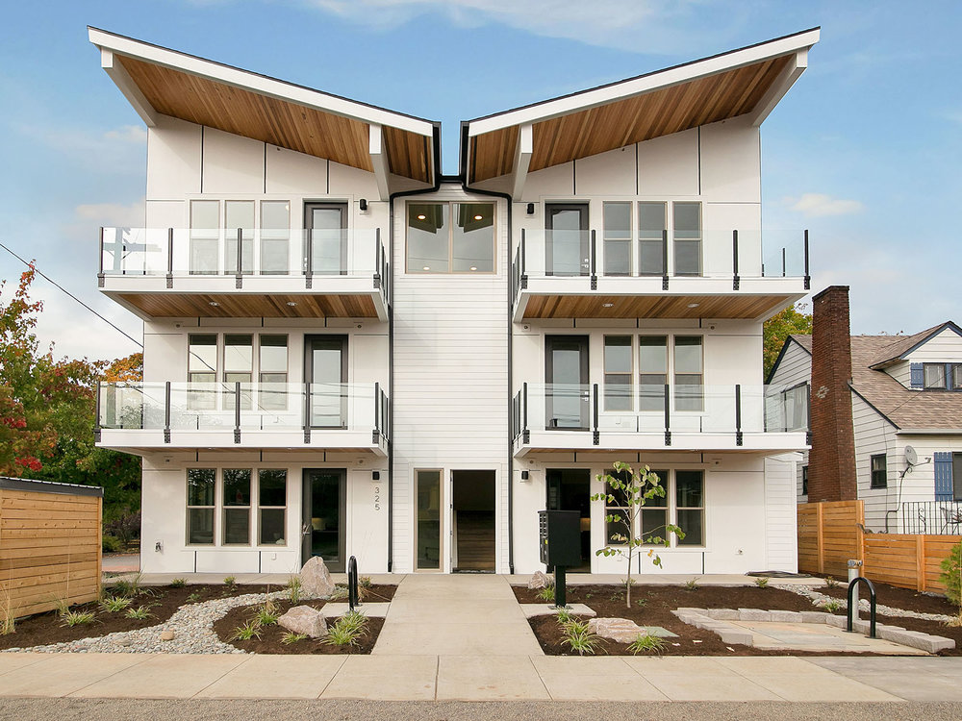
RIP1 - Deeper Affordability 4 to 6 plex
Not required by HB2001
Allow 4 to 6 units when:
½ of the units are at 60% MFI rental or 80% MFI ownership
2 units are visitable
1.2 FAR allowed
35’ height allowed
Standard setbacks, building coverage, outdoor area requirements apply

