Slide 1
Vertical Infrastructure in the ROW:
June 2022 Update
June 2022 Design Commission Briefing

Slide 2
Agenda
Background
  Small Cells
  Timeline
  South Waterfront Poles
  Example Small Wireless Facilities (SWFs)
  Cobraheads/Ornamentals
South Waterfront Poles
  Current Conditions
  New Poles
Discussion and Next Steps

Slide 3
Background
The FCC adopted a Small Cell Order in 2018 that significantly impacts wireless infrastructure deployment in Portland:
  Safe harbor fee of $270/small wireless facility (or recover Portland’s actual costs)
  Limited aesthetic controls
Telecommunications companies must be allowed to install equipment in accordance with the FCC order
Jurisdictions are prohibited from being a barrier to entry

Slide 4
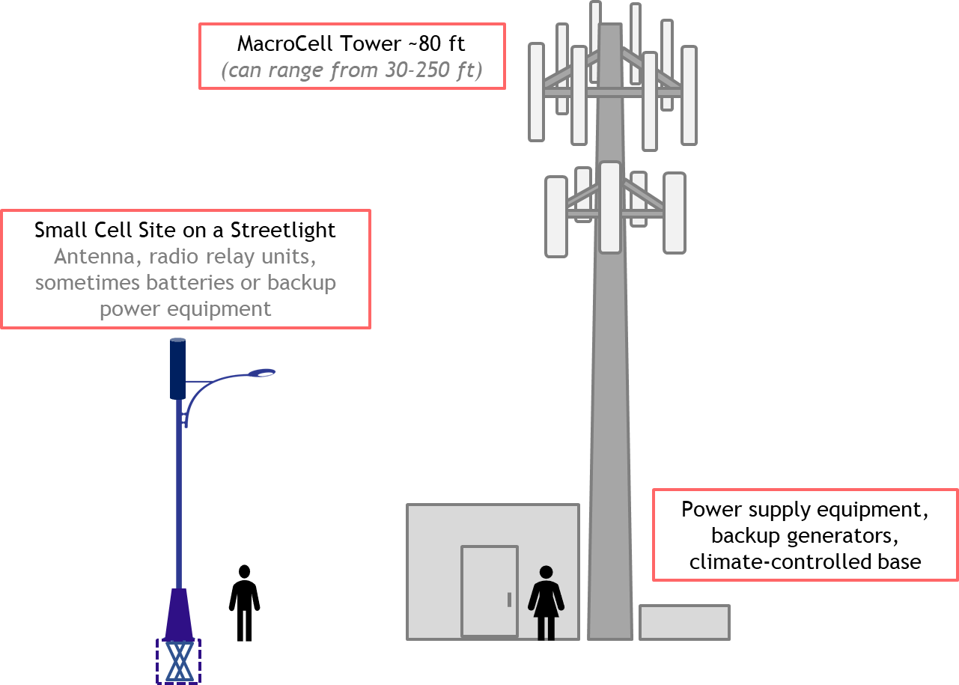
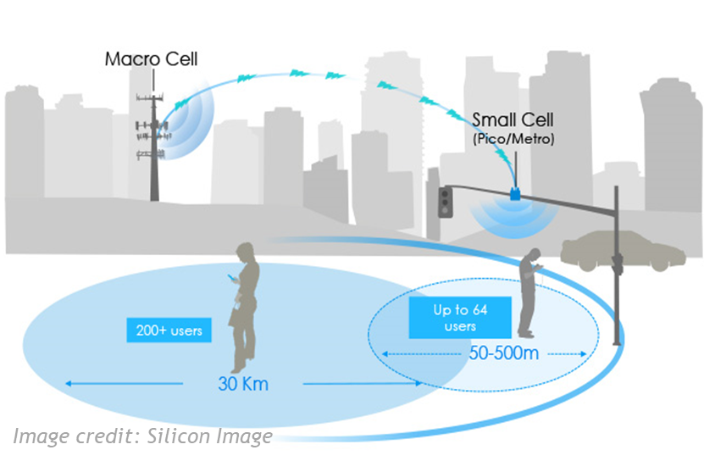
Background: Small Cells
Small cells or distributed antenna systems (DAS) — short range, low‐powered cellular radio access
Small because these mobile base stations have:
  Shorter range and handle fewer calls/sessions
  Not because of physical size

Slide 5
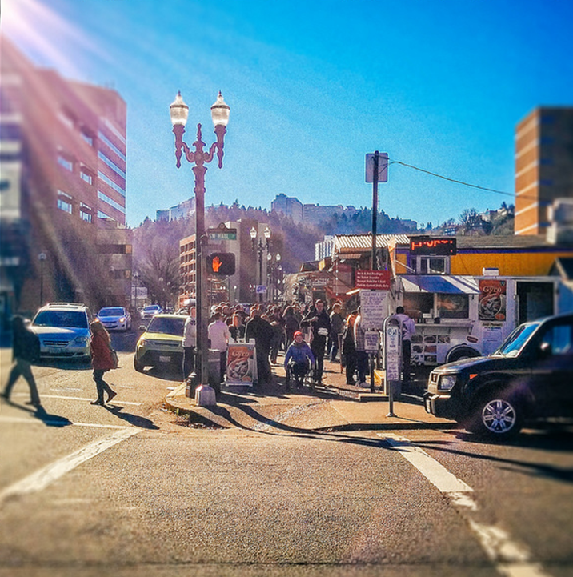
Background: Timeline
In Spring 2018, PBOT staff briefed the Design Commission and Historic Landmarks Commission on the potential impacts that vertical infrastructure (VI) deployments could have on Portland
PBOT staff returned in 2019 to update the Commissions on City of Portland directives established on how we will govern this emerging technology
PBOT released an RFI/RFP in January of 2020 to design a new street light pole standard to be used when replacing ornamentals. Commissioners Brian McCarter and Maya Foty volunteered to join the Advisory Committee. Aero Wireless Group was awarded the contract to develop two streetlight pole designs via two workshops.
In 2021, PBOT staff provided an update to the Design Commission and Historic Landmarks Commission regarding the progress made on the new ornamental light poles. Both Commissions wrote a joint letter of support for the designs.
Now in 2022, we ask for a similar level of support on the South Waterfront poles.

Slide 6
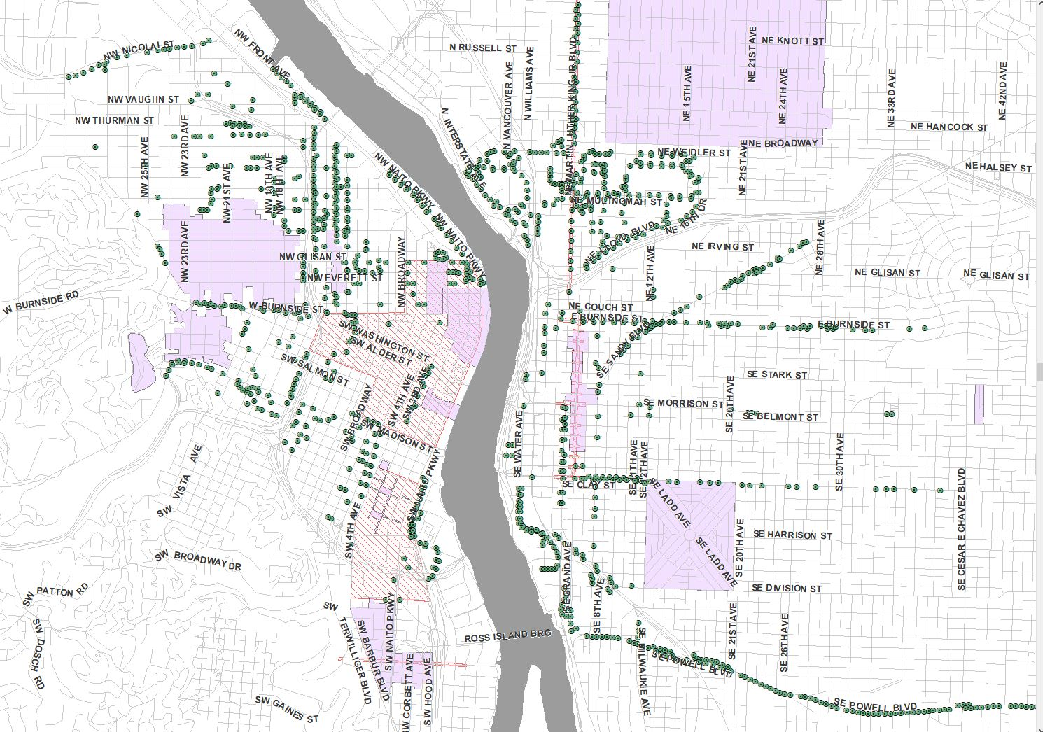
South Waterfront Poles
South Waterfront is a special design district with its own unique set of light poles
Valmont Industries, Inc. currently owns the designs to existing poles in South Waterfront
PBOT staff met with Valmont and decided to modify two of four existing poles in South Waterfront to accommodate small cell equipment

Slide 7
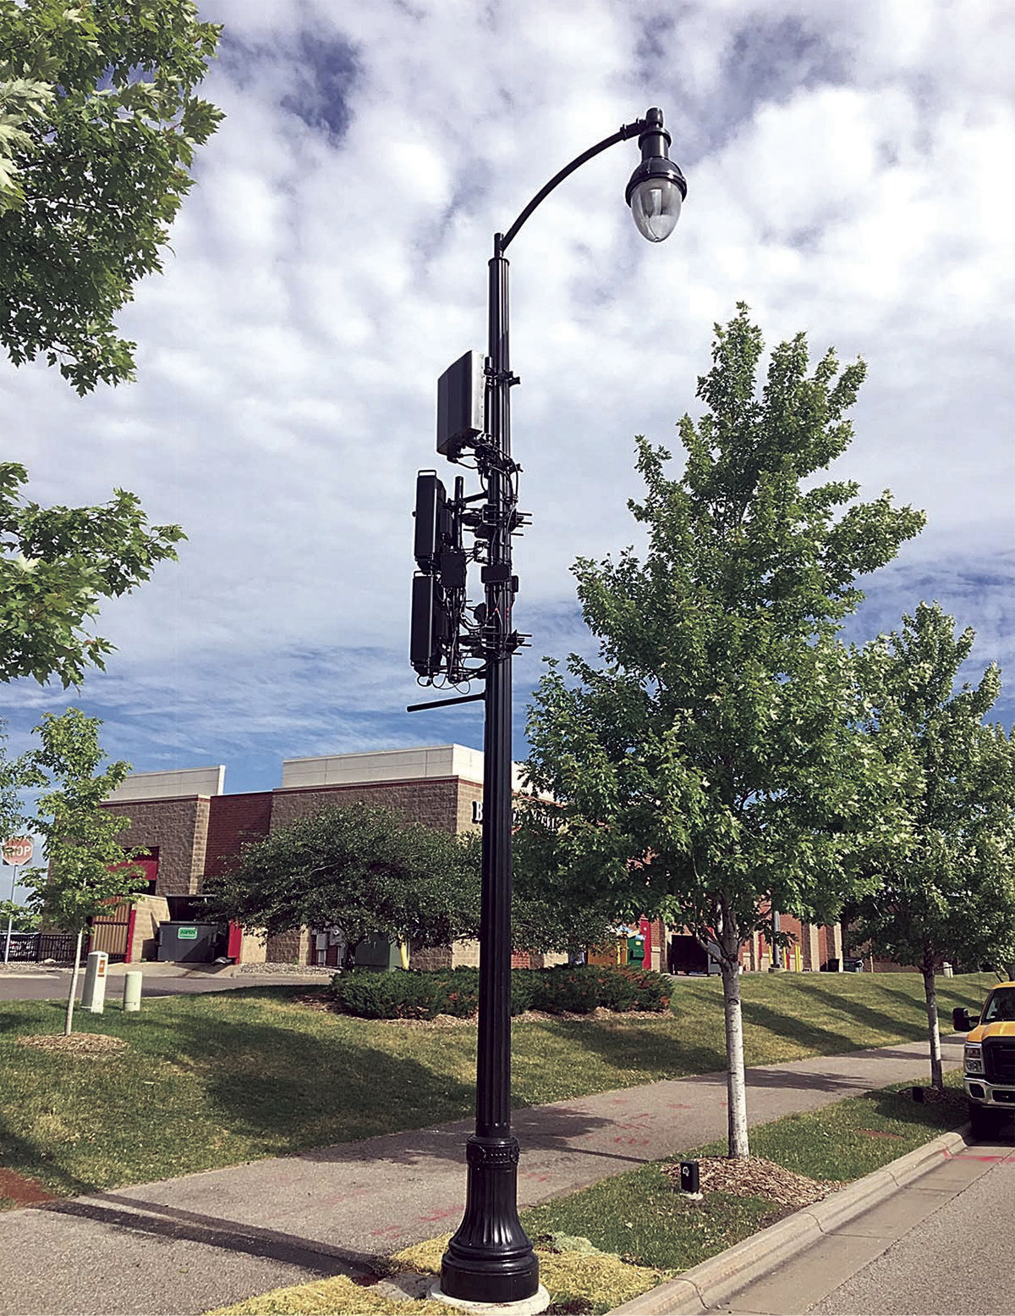
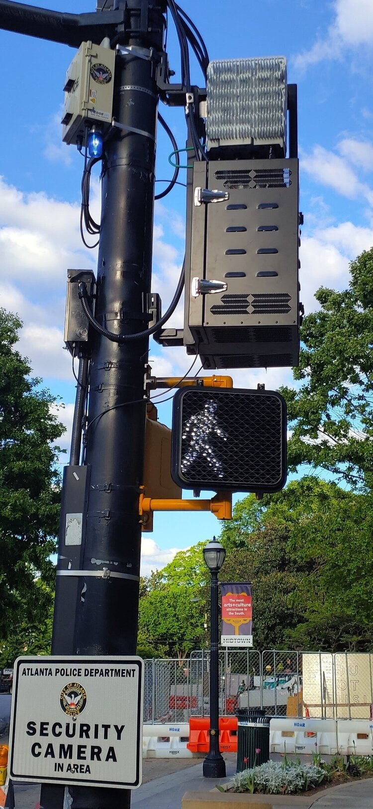
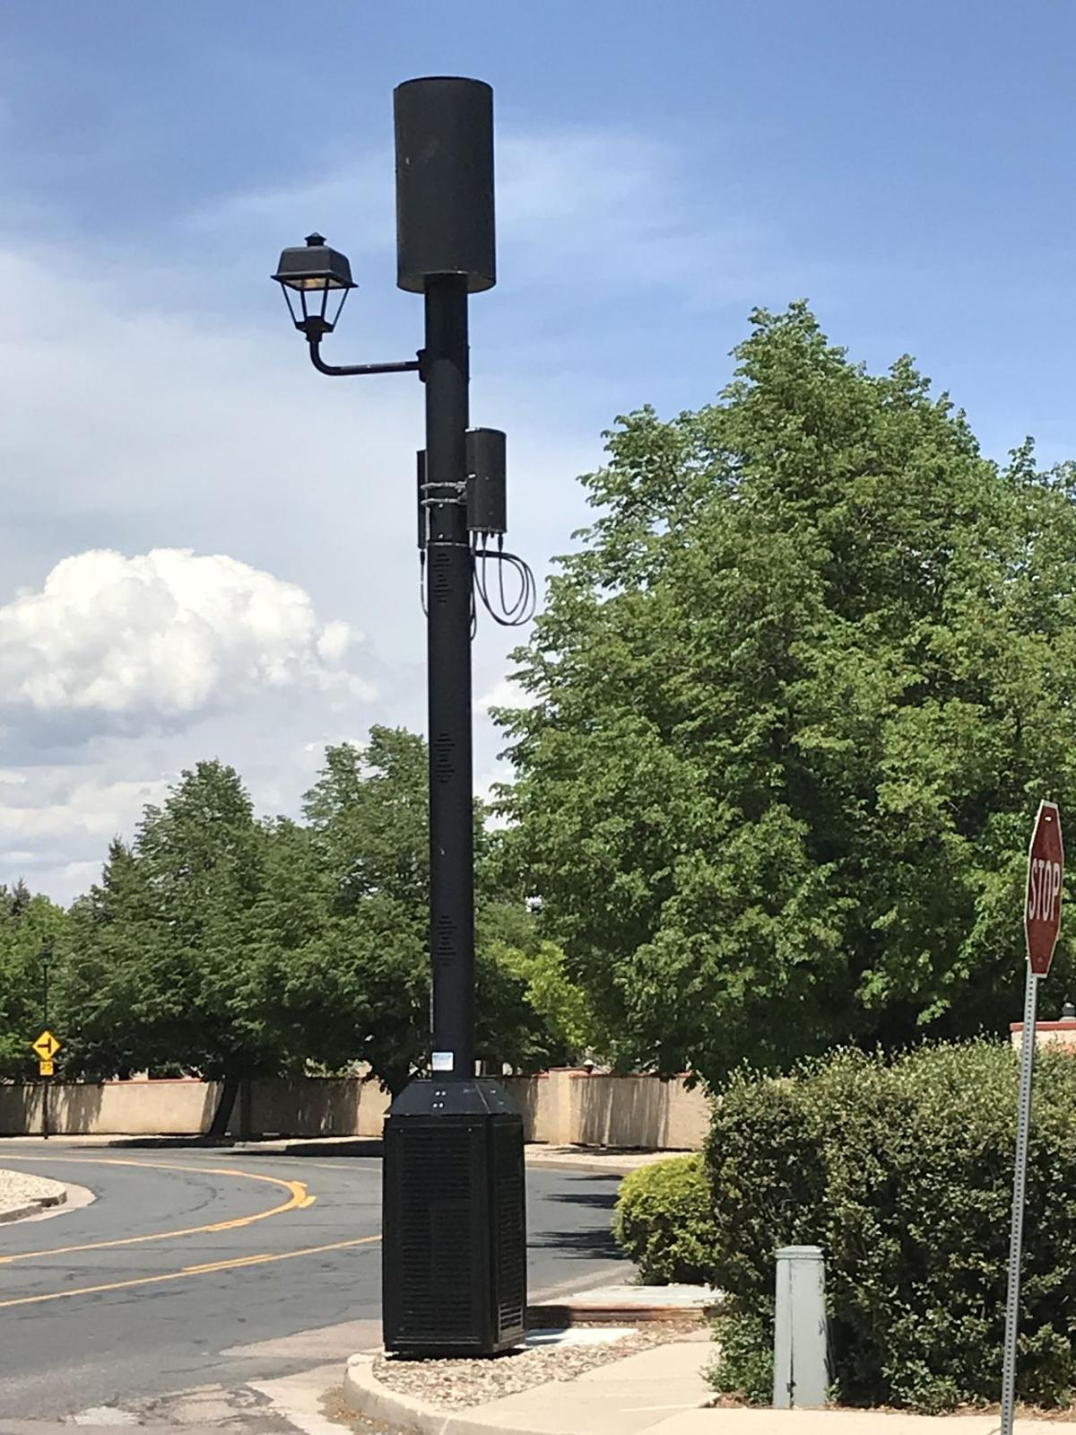
Example Small Wireless Facilities (SWFs)
Colorado Springs
Minnesota
Atlanta

Slide 8
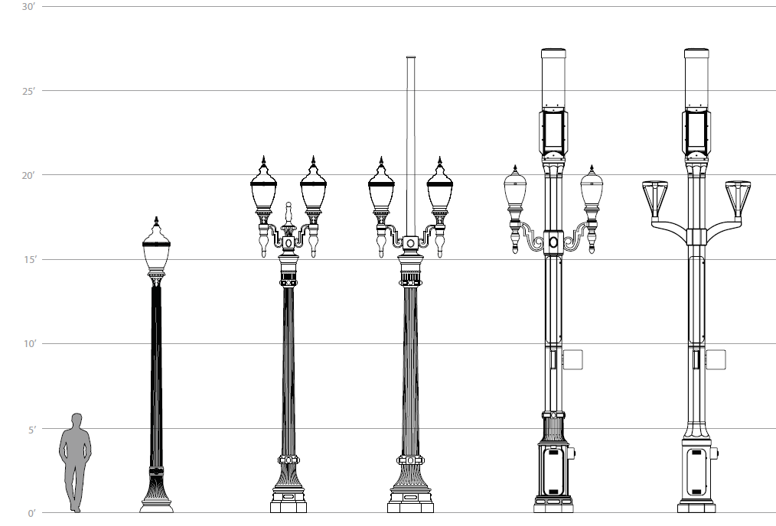
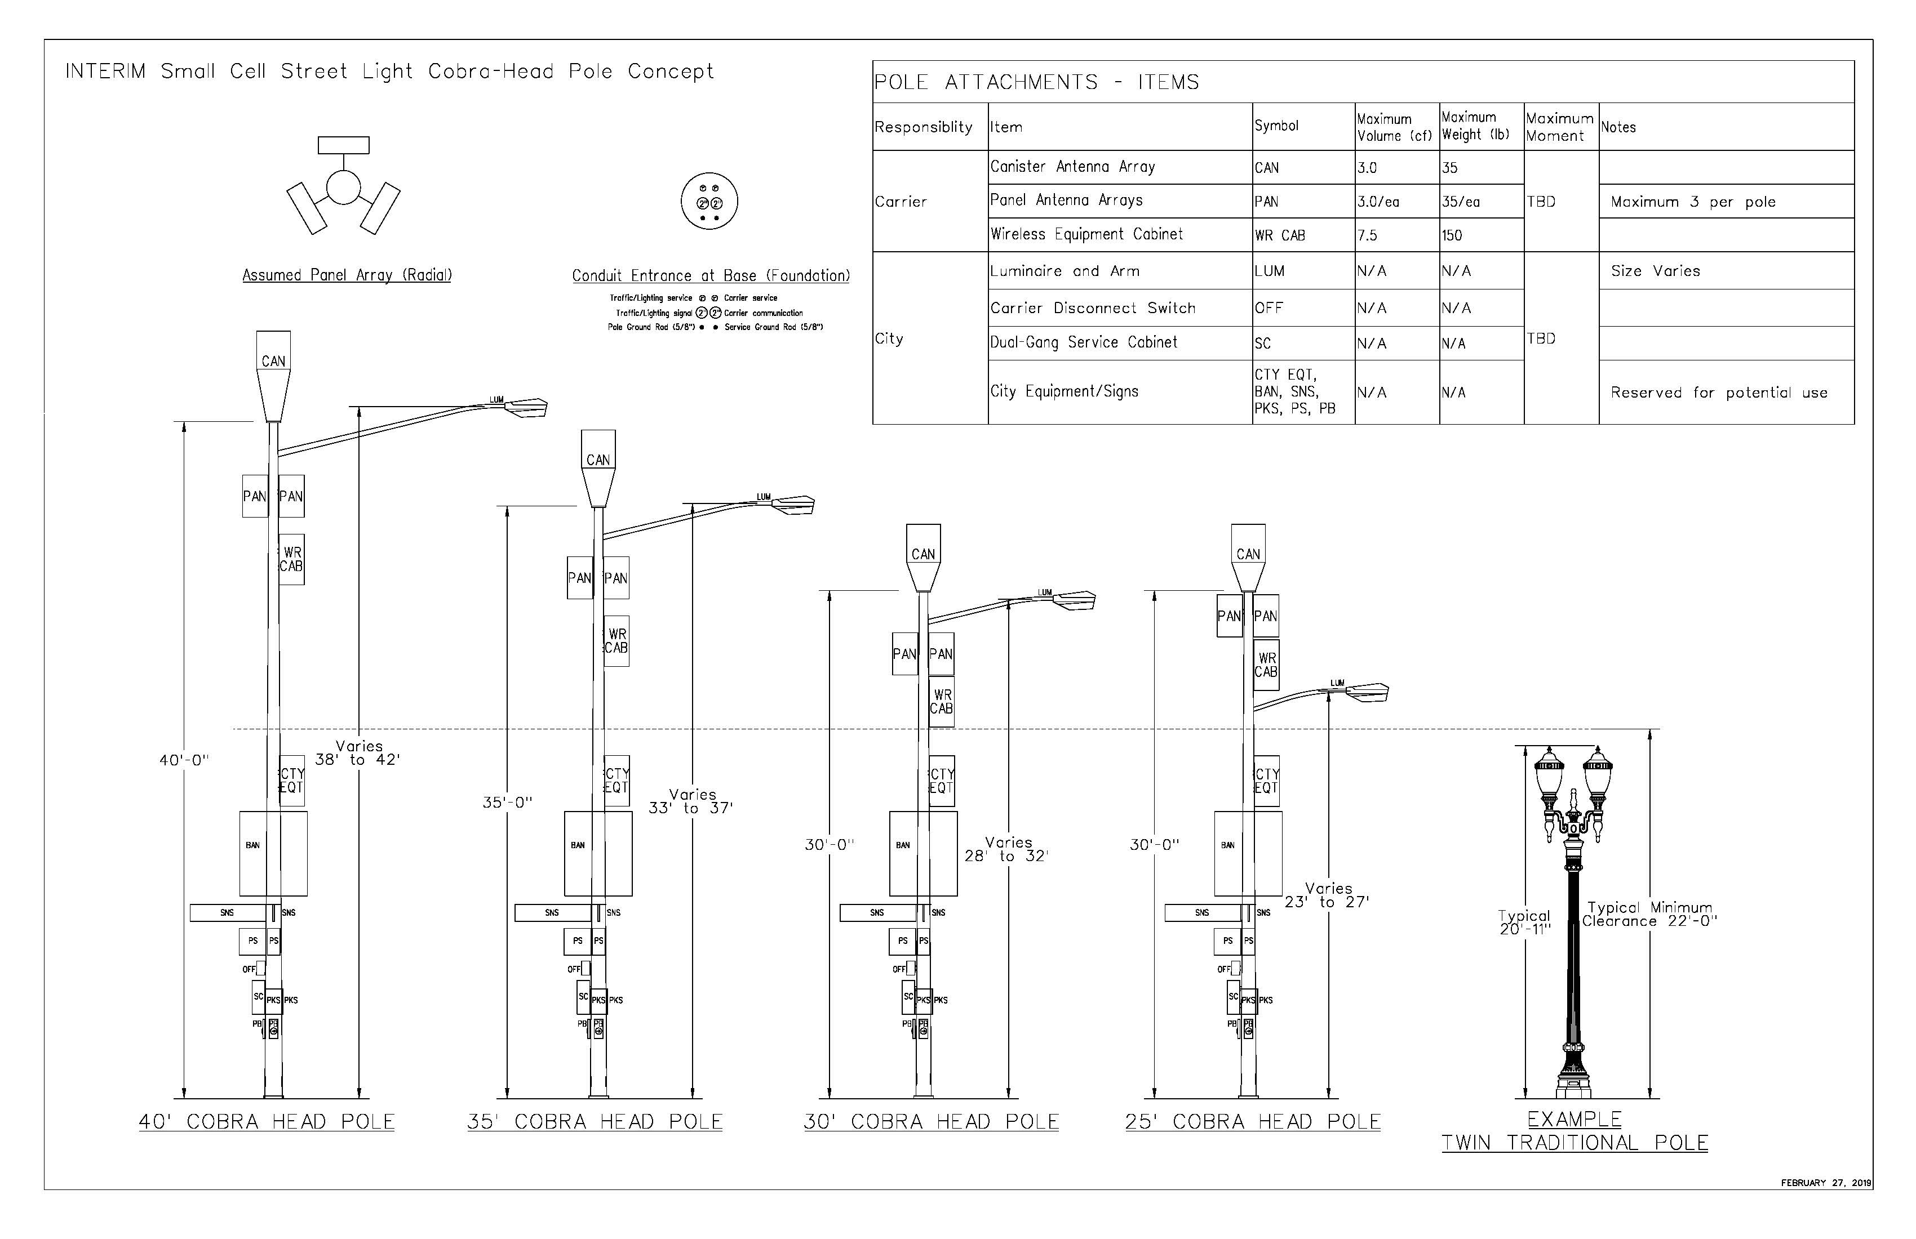
Cobraheads/Ornamentals

Slide 9
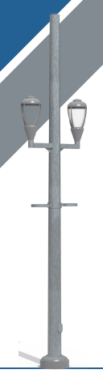
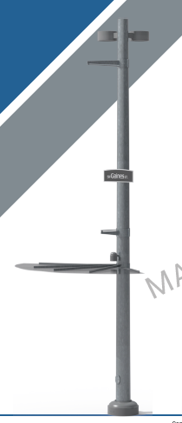
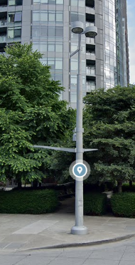
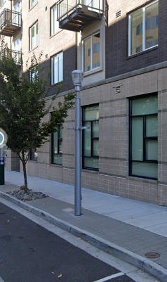
South Waterfront Poles- Current Conditions
PBOT staff have collaborated with Valmont Industries to create a new set of South Waterfront poles capable of accommodating next generation technology and equipment

Slide 10
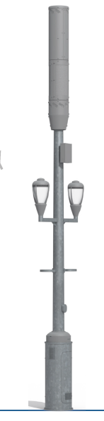
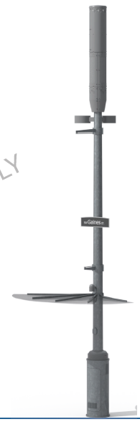
South Waterfront: Updated Poles
Proposed
Proposed
Cantenna
Luminaires
Existing
Existing
Base Cabinet
Twin Luminaire Light Pole Type B Midblock Pole
South Waterfront Type A Corner Street Light Pole

Slide 11
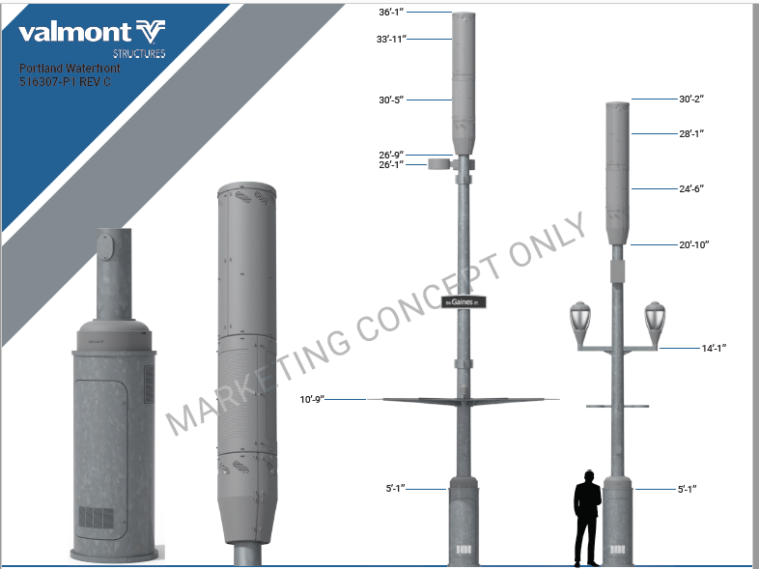
C
C
B
A: base cabinet
B: cantenna
C: dimensions
A

Slide 12
Discussion and Next Steps

Slide 13

Next Steps and Request
PBOT request of the Design Commission and Historic Landmarks Commission:
  Letter of Support endorsing the two new South Waterfront poles
Special thanks to BPS, BDS, OCT and City Attorney’s Office for their continuing support throughout this process.

Slide 14
Contacts
Contact:
PBOT:
Gene Yamamoto
Gene.Yamamoto@portlandoregon.gov
Anne Hill
Anne.Hill@portlandoregon.gov
BDS:
Tim Heron
Tim.Heron@portlandoregon.gov

