Slide 1
Hattie Redmond
Culturally Appropriate PSH Housing
N/NE Oversight Committee Meeting
May 12, 2022
Notes:
Ty

Slide 2
Empowering Black communities since 1945
One of the region’s oldest Black civil rights and service organizations
Committed to African-Americans and others to achieve equality in education, employment, health, economic security and quality of life
Investing in stable housing through workforce development
Providing culturally specific programs and services
Providing powerful advocacy and civic engagement to empower Black communities in Oregon and SW Washington
Forming partnerships with local community to achieve success
Notes:
Ty’s slide

Slide 3
Properties owned by Home Forward
Affordable Housing portfolio – over 6500 apartment homes
Public Housing properties (transitioning to Project-Based Section 8)
Rental Assistance (“Section 8”)
Housing Choice Voucher Program – over 9000 households served in private market
Project-Based Voucher Program
(subsidy remains with the unit)
Founded in 1941 as the Housing Authority of Portland
Largest provider of affordable
housing in Oregon
Committed to serving the citizens of Multnomah County
Partners with more than 100 community agencies in the public, nonprofit and private sectors.
Committed to economic equity and diversity
Notes:
Amanda's slide

Slide 4
Hattie Redmond Partnership –
Homelessness in the Portland metro area disproportionately affects racial/ethnic minority groups. Communities of color experiencing housing instability or chronic homelessness face a myriad of complex social issues that pose barriers to maintaining long term housing stability that this project hopes to alleviate.
Hattie Redmond will provide 60 permanent, culturally specific, studios for chronically homeless individuals with disabilities
This partnership has worked on the development and funding of the project since its inception
Urban League will provide on-going culturally specific supportive services to all residents of the building
Home Forward will own and manage the building for the first 15 years
We have entered into an MOU to transfer ownership after the tax credit investor exists in year 15
Hattie Redmond, with Urban League’s services, will provide the residents: stability, self-sufficiency, self-respect and pride
Notes:
Ty’s Slide

Slide 5
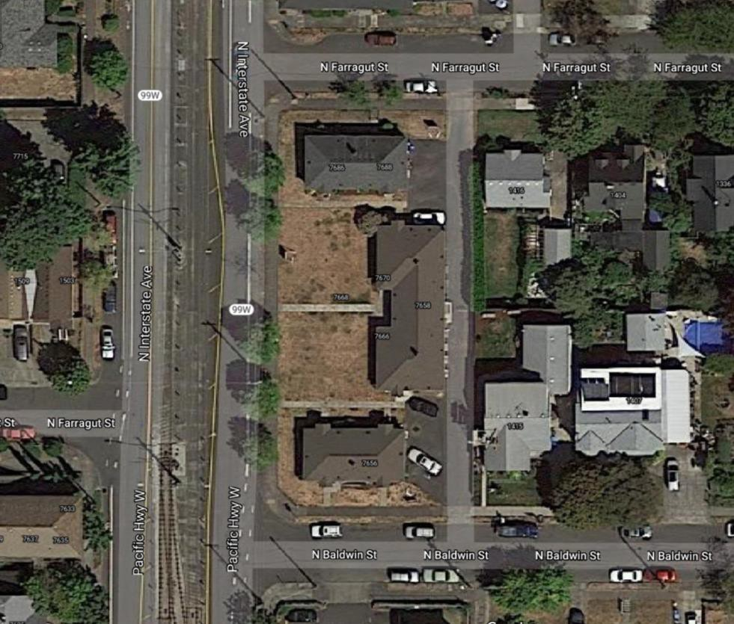
Location
Kenton Neighborhood (N.
Portland)
Full block between N Baldwin & N Farragut on N Interstate.
Near Light Rail, Bus Access, medical services & Fred Meyer
Notes:
Ty’s Slide

Slide 6
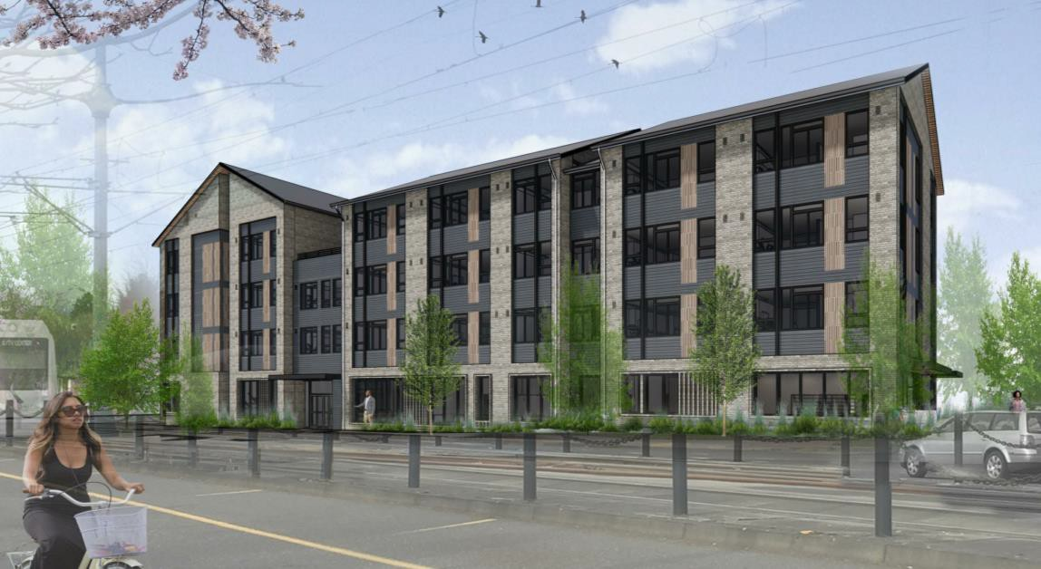
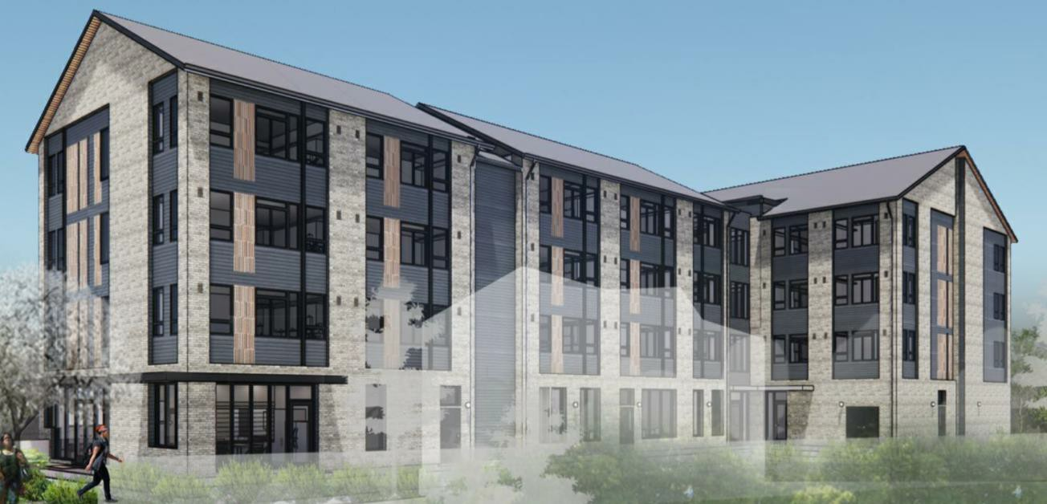
Future Building
Notes:
Amanda – SERA architects worked with UL's staff and existing PSH residents to develop the design. It was important to residents that the building look like a home and not be institutional, so changes were made to the roof line and the entrance area. The architect envisioned a design of fabric woven together to represent HF, UL and our broader community coming together to create a beautiful building that will be well served with rent assistance and supportive services and a great place to live and thrive.

Slide 7
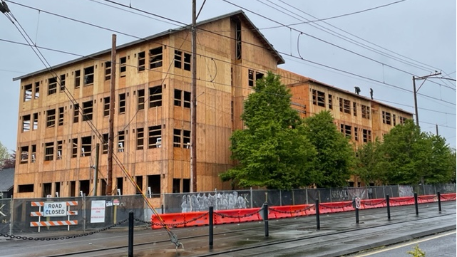
Current Construction Status
Notes:
Amanda – taken last week.

Slide 8
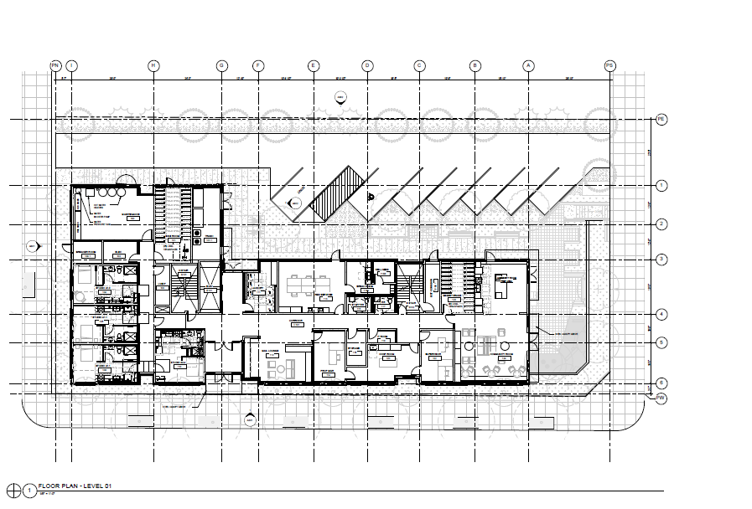
Hattie – Ground Floor
Notes:
Ty – I added this as a visual representation of the next slide which is yours. Ground floor includes – lobby space with computers & mailboxes, offices for UL staff and property management staff, laundry room (no charge for use), bike parking room, maintenance room, community room, community kitchen, outside seating area with a BBQ, 7 parking spaces. The building will also have free wifi for all and solar cells on the roof to help reduce electric costs.

Slide 9
Hattie Redmond Housing Details
Building
4- story, wood framed building
60 studio units of permanent, and culturally specific, supportive housing
Ground floor tenant facilities
Laundry room
Mail lounge
Community Room/Pantry
Resident Services and Property management offices
Bike Storage Rooms
Other Amenities
Outdoor community space with seating and BBQs
Dog run space
Community garden
Onsite parking
Roof terrace
Notes:
Ty’s Slide

Slide 10
Hattie Redmond Services
Resident services and case management will focus on maintaining housing stability and increasing self-sufficiency.
Urban League’s staffing will include:
two full-time case managers
two full-time peer support specialists
their supervisors
a part-time resident services coordinator
Pre-tenancy services will include:
assistance with rental applications
support throughout the screening process
move-in resources/supplies
On-going services include:
On-site peer recovery and mentorship
Assistance accessing benefits and supported employment
Life skills coaching
Notes:
Ty’s Slide

Slide 11
Hattie Redmond Timeline
Oct. 2021
Construction Start October 2021
Aug. 2022
Pre-leasing/Outreach
Oct. 2022
Lease-up Begins
Nov. 2022
Construction Complete
Apr. 2023
Lease-up Complete
Notes:
Amanda

Slide 12
Construction Diversity and Equity Goals
Construction Cost Goals
30% construction costs to COBID
certified firms
10% construction costs to Section 3 businesses
Workforce Goals
20% onsite hours to apprentices
18% onsite hours to minorities
9% onsite hours to females
30% new hires to section 3
individuals
Notes:
Amanda – hiring a contractor and architect who are committed to and experienced in exceeding MWESB goals was front and center in our original RFP to select a contractor and architecture team. project is on track to exceed PHB's goal of 20% MWESB for professional services by getting to 23%. Project participation for hard costs is 38%, exceeding the goal of 30%.

Slide 13
Hattie Redmond Community Outreach
Home Forward & Urban League conducted various focus groups with HAVEN Residents (BIPOC formally homeless individuals) and Urban League staff – June through October 2020
Home Forward sent an informational mailing about the project to the surrounding neighborhood (one-mile radius) – 5/15/20
Home Forward posted signage about the project on the property – 5/21/20
Home Forward & Urban League presented at Kenton Neighborhood Association Meetings – 6/10/20 and 10/14/20
City of Portland sent a Land Use Public Notice to surrounding neighbors for 21-day comment period – 10/2/20
Notes:
Ty’s Slide

Slide 14
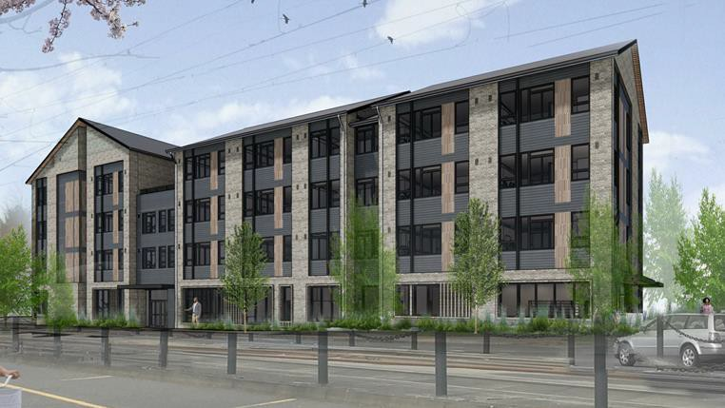
Questions?

