Slide 1

N/NE Affordable Homeownership and Rental: Interstate Maximizing
Thursday, May 12, 2022

Slide 2

Interstate Maximizing = $44M
4
Properties
300/350
Goal for # of Units or Homes
Production Focused
Notes:
Jill

Slide 3
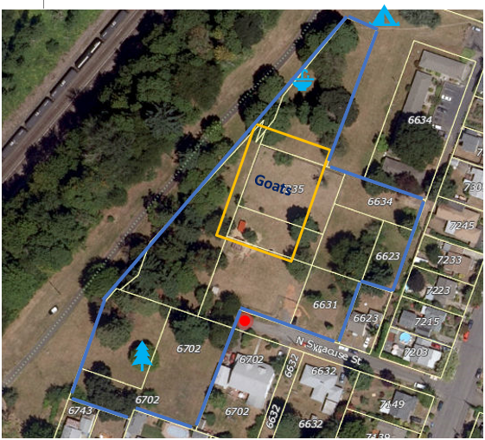
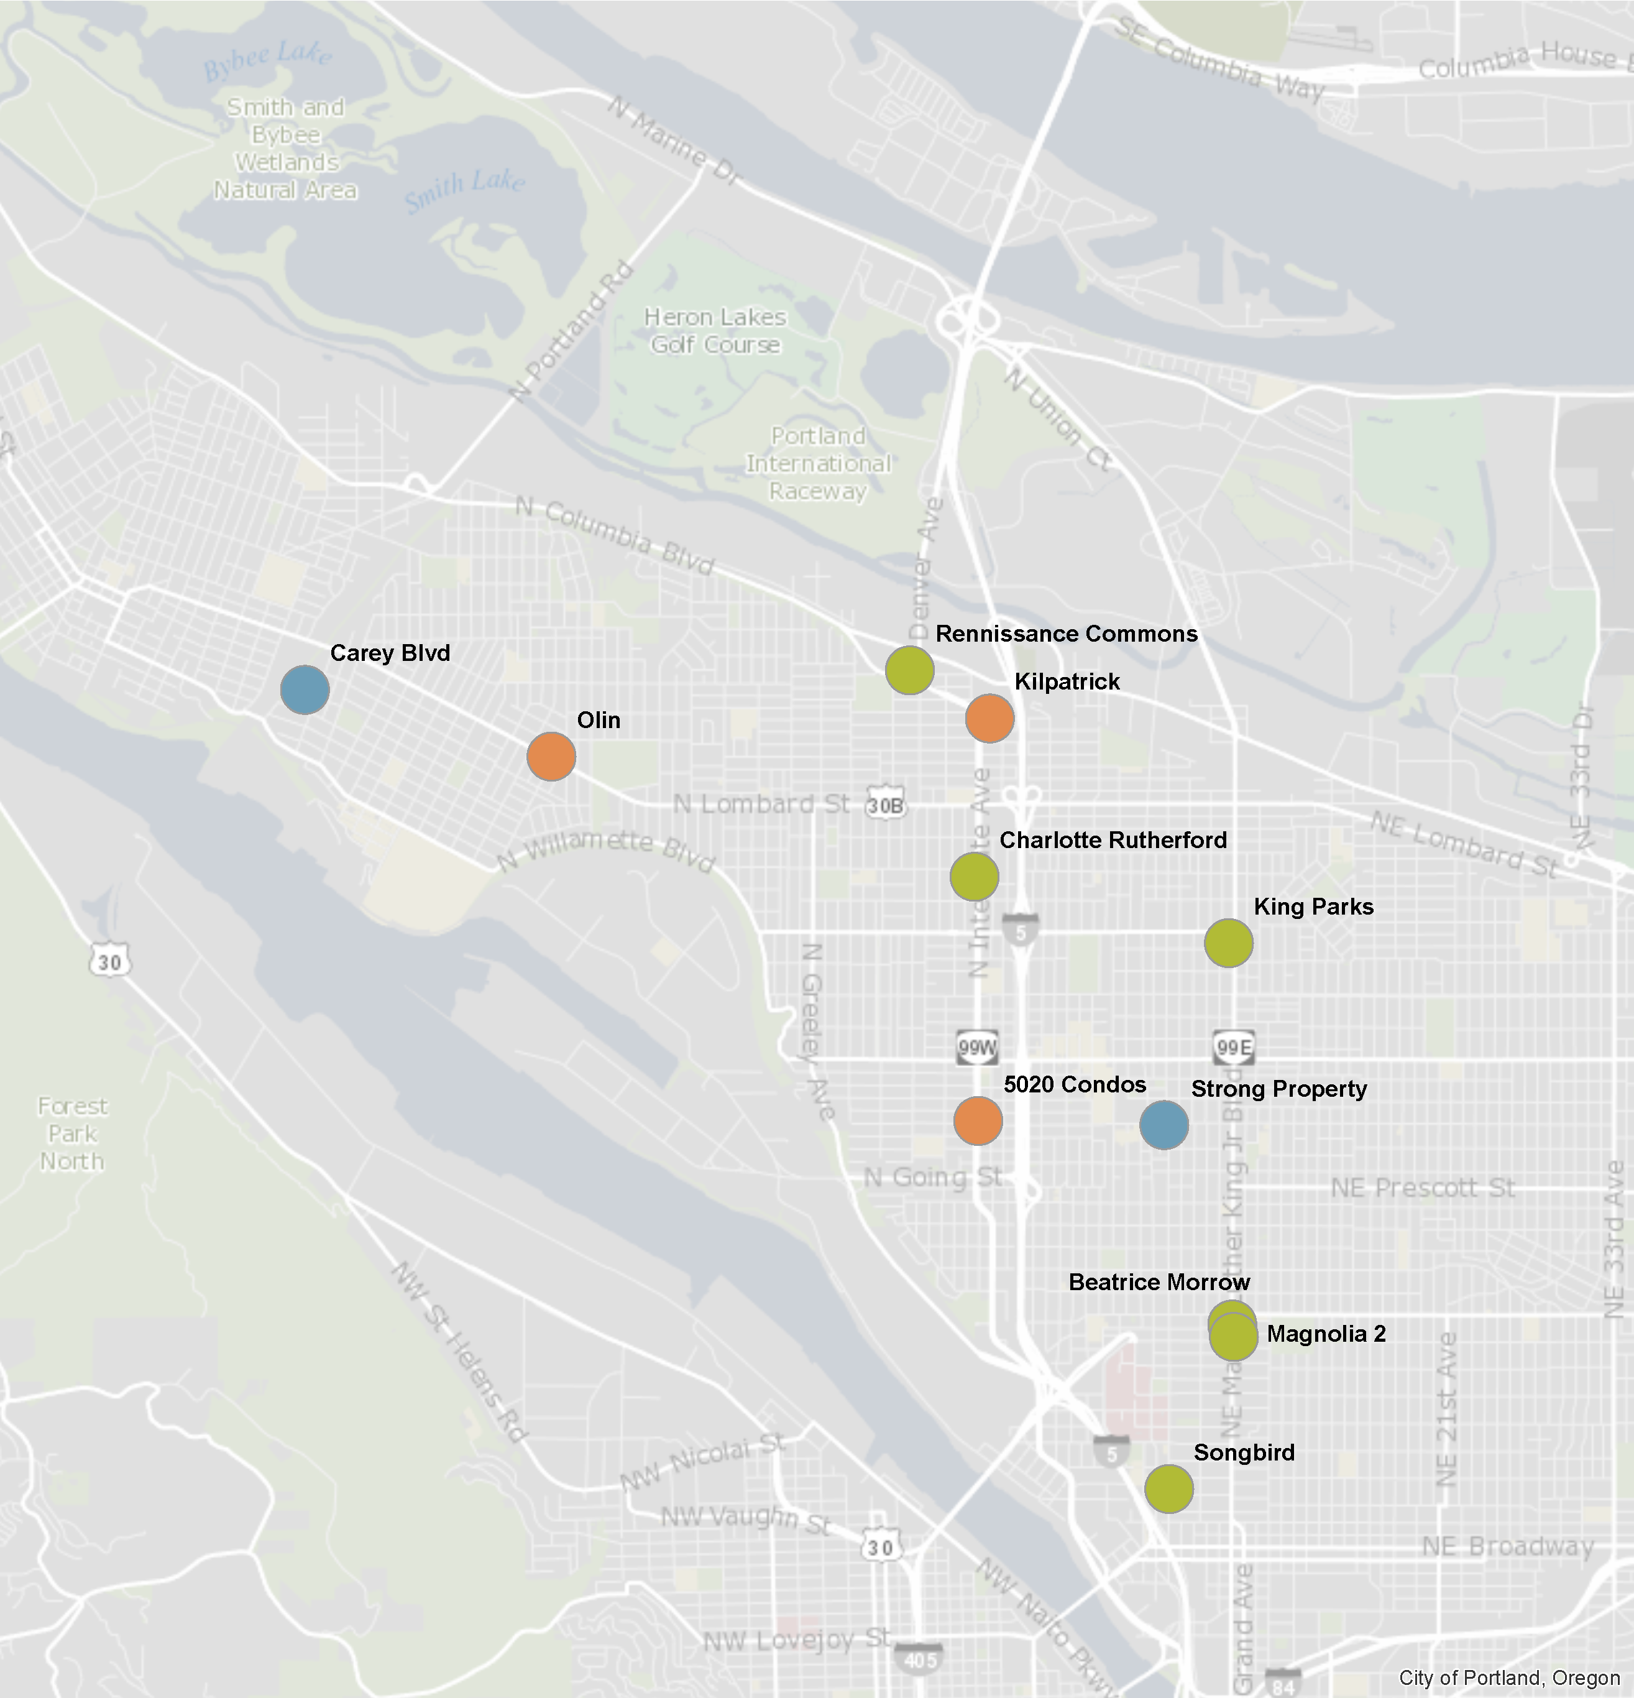
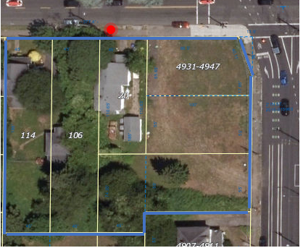
Carey Blvd 2.93 acres or 127,631 SF
Strong .97 acres or 42,133 SF
Williams & Russell 1.7 acres
N/NE Housing Strategy Investments

Slide 4
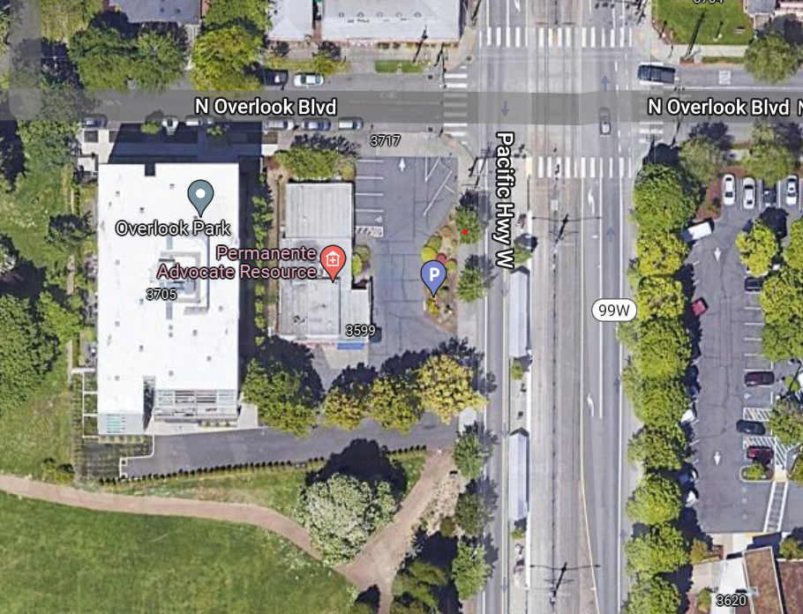
Kaiser 31 acres or 13,400 SF .
Donated Site – Kaiser Overlook

Slide 5
N/NE Properties to Release for Development in 2022
Name of Property | Location | Est. # of Units or Homes
Kaiser Overlook (Kaiser donation) | Interstate | 40-50 rental units
Strong Property | Interstate | 100 rental units
Carey Blvd | N. Portland | 40 homeownership
* Williams & Russell is the 4th Property with Interstate Commitments
Notes:
Jill – change colors

Slide 6
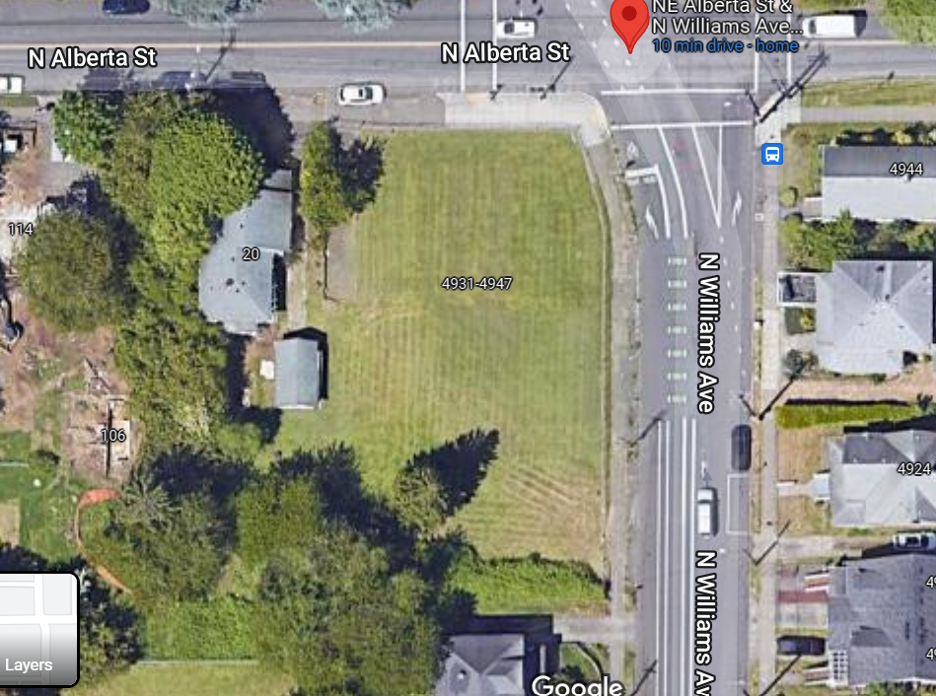
Strong Property – N. Williams and N. Alberta
Strong Family Property was purchased by PHB in 2019
Council committed that the Strong family would be involved in naming rights
Quarter-block lot, making mixing homeownership and rental challenging
Notes:
Jill

Slide 7
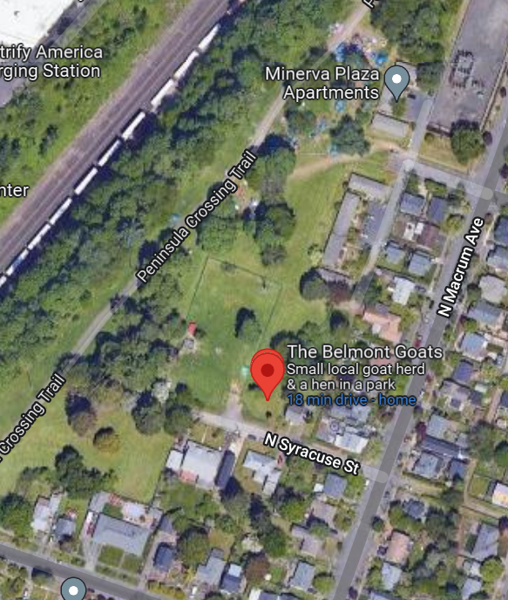
Carey Blvd – N. Syracuse and N. Macum
Goal is 40 + homes for N/NE Preference families for homeownership
Development would not start until 3 years from Fall of 2022
Conceptual analysis needed
Notes:
Jill

Slide 8
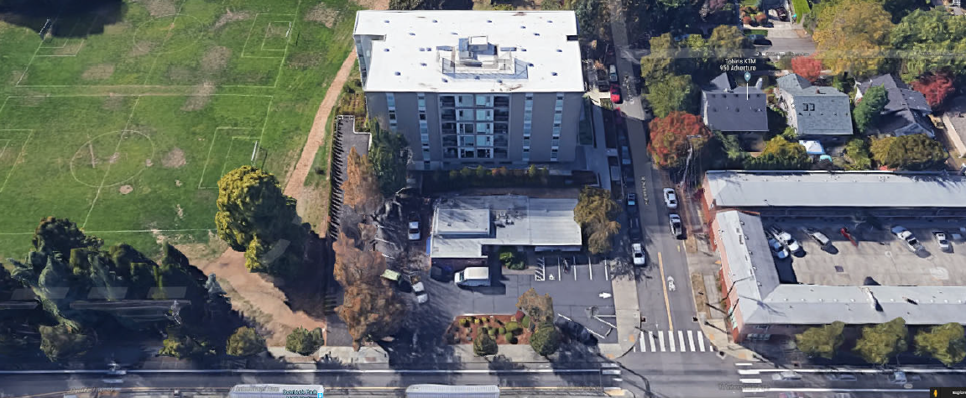
Kaiser Overlook – N. Interstate and N. Overlook
Kaiser Permanente donated parcel of land to PHB in 2021
MOU with Kaiser commits us to releasing property in 2022 solicitation
Right next to Overlook park & across street from Kaiser Permanente
Skinny lot on Interstate MAX lends itself to smaller size units
Notes:
Jill

Slide 9
2022 Proposed N/NE Projects and Investments
Properties to Release: Summer/Fall
Kaiser Overlook
Strong Property
Estimated 180 + Total New Units or Homes
  Combination of ICURA TIF + Metro Bond
40-50 units
100 units
Properties to Release: Fall/Winter
Carey Blvd
40 homes
Notes:
Jill

Slide 10
Proposed Next Steps
Summer Release of Kaiser & Strong Property
  To get in the queue for State competitive rental funding
Fall release of Carey Boulevard
  Homeownership focused, not the same urgency as with rental
  Would allow for further property conceptual site analysis and engagement on configurations options
Convene ad hoc subcommittee of N/NE Oversight for Kaiser and Strong in June/early July
Conceptual site analysis to be conducted this summer/fall on Carey Blvd.
Deeper community engagement would commence for all three properties in fall/winter once the developers are selected
Notes:
Jill or Molly

Slide 11
Strong – Questions for Oversight Committee
Should we ask proposers to explore a mixed-use site – homeownership and rentals – if they are able to do both with available financing?
What population(s) would be best served by this location and supports N/NE Housing Strategy?
Should the property provide a range of unit sizes? If so, what size units would be priority?
Notes:
Leslie

Slide 12
Kaiser – Questions for Oversight Committee
Questions:
What population(s) would be best served by this location?
Given challenges of vouchers and Preference Policy, is there a benefit to some vouchers at this site?
If vouchers, should we request a particular preference that is not geographically based?
Location near health care facility
Smaller unit size due to land
Notes:
Leslie
What population(s) would be best served by this location, proximity to Kaiser, and smaller unit sizes and supports the N/NE Housing Strategy?
Given the challenges of federal Project Based Section 8 vouchers for N/NE Preference Policy families, is there a benefit for some PBVs at this project to serve extremely low-income households?

Slide 13
Questions
Notes:
Leslie – do we want to ask for volunteers to join ad hoc subcommittee?

Slide 14
Carey Questions for Oversight Committee
What population(s) would be best served by this location and supports N/NE Housing Strategy?
Should the site provide a range of home sizes? Some more than others?
Notes:
For later – when we do community engagement for Carey

