Slide 1
82ND AVENUE
Investment Program
Portland City Council: April 28, 2022

Slide 2
Agenda:
Welcome & Introduction
Transfer Agreement
Near-term Critical Fixes
Future Investment
Invited Testimony
Notes:
Chris w

Slide 3
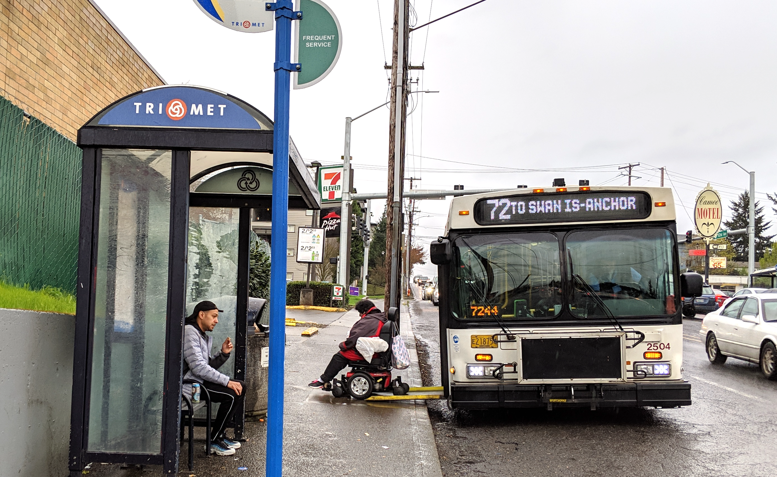
Why this matters to Portlanders
82nd Avenue is one of Portland’s most important streets.
Notes:
This transfer matters to Portlanders because this street serves our city’s most diverse neighborhoods and business districts. It is the geographic center of the region and every day, tens of thousands of Portlanders rely on it to get to work and school, to shop and to travel to the nearby parks, libraries and other neighborhood destinations. TriMet buses that travel the corridor are some of the busiest in the region and ridership remained strong during COVID. In short, 82nd Avenue is one of Portland’s most important streets.

Slide 4
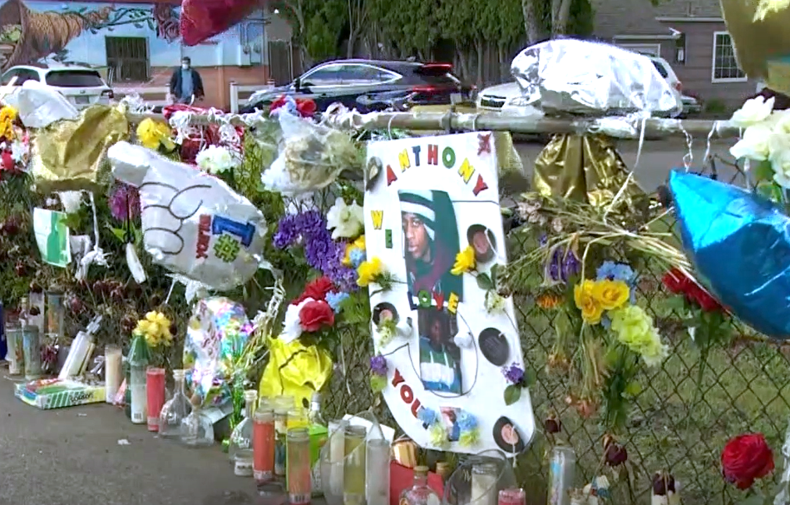
Why this matters to Portlanders
82nd Avenue is one of Portland’s most dangerous streets.
Notes:
Tragically, it is also one of Portland’s most dangerous streets. 19 people have died on 82nd Avenue between 2007 and January 2022. In 2021, two pedestrians were killed in just one month while trying to cross the street. In response, ODOT and PBOT have worked together to reduce speeds and build pedestrian crossings. We must do better and we have an imperative to act quickly.

Slide 5
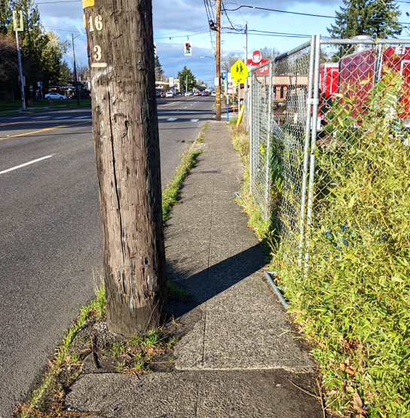
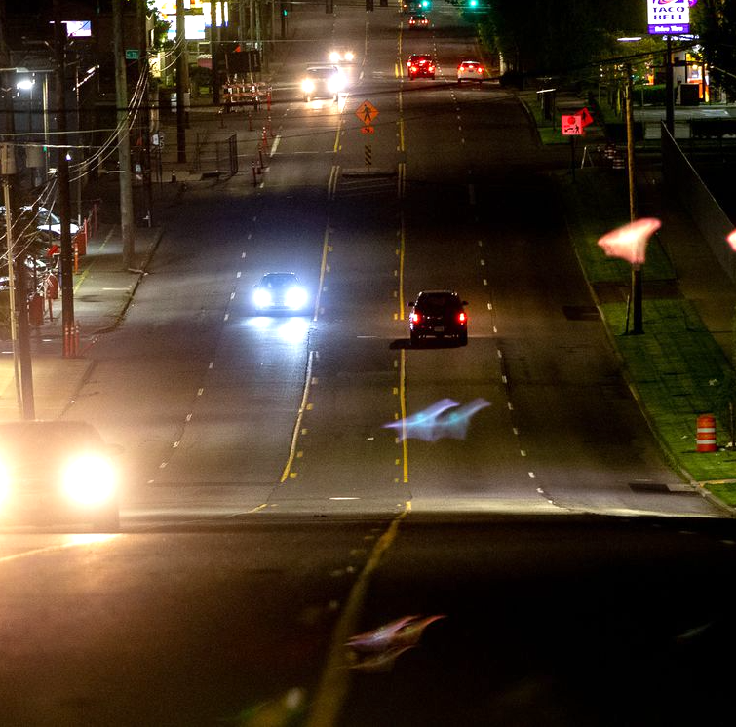
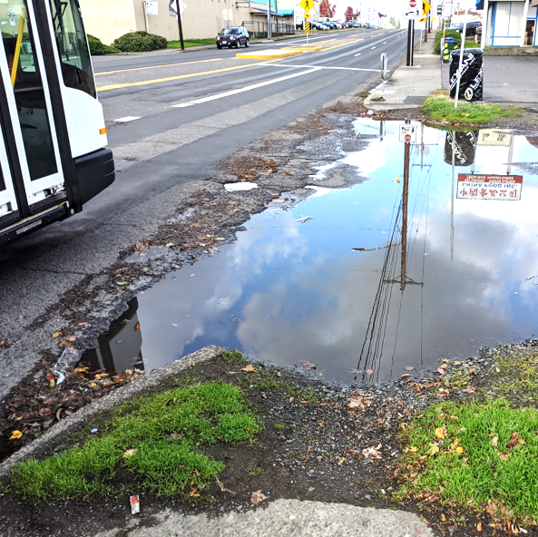
Why this matters to Portlanders
82nd Avenue needs critical repairs.
Notes:
Almost every part of 82nd Avenue—pavement, sidewalks and curbs, traffic signals, street lighting—need significant repairs.

Slide 6
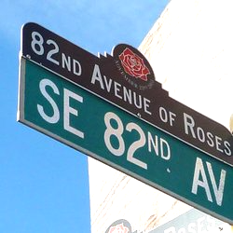
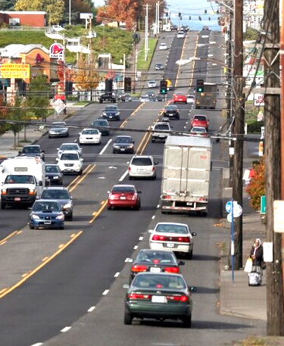
Jurisdictional Transfer of 82nd Avenue
Possibly move text to speakers notes?
The jurisdictional transfer of 82nd Avenue is the culmination of years of work by community leaders and elected officials.
It will allow PBOT to:
  Make critical safety repairs in the near-term
  Manage the vision for 82nd Avenue’s future as a Civic Corridor
Notes:
Chris W
The jurisdictional transfer of 82nd Avenue is a reaction to these conditions and is the culmination of years of effort by community leaders and elected officials.
The historic funding allocation from the state legislature means that PBOT can address critical safety and maintenance needs in the near-term
City ownership will support the community in realizing the potential of the street to be a true civic corridor, and the committed funding from ODOT will allow us to begin investing in that vision.
Working together with other City bureaus and community partners, we can establish community stabilization resources to help promote equitable development
In short, this transfer will support the realization of a long-held community vision for 82nd Avenue to better serve the people who live, work, attend school, worship and meet their daily needs in the vital corridor.

Slide 7
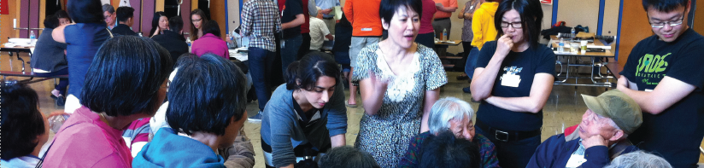
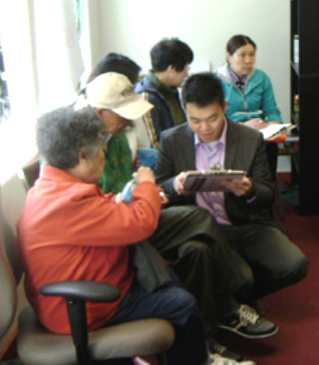
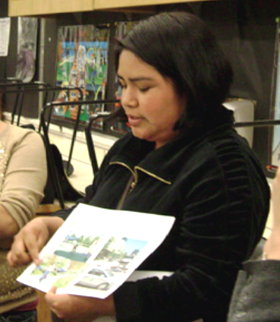
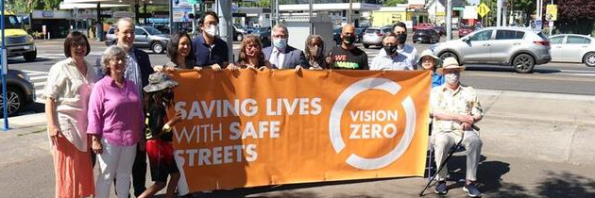
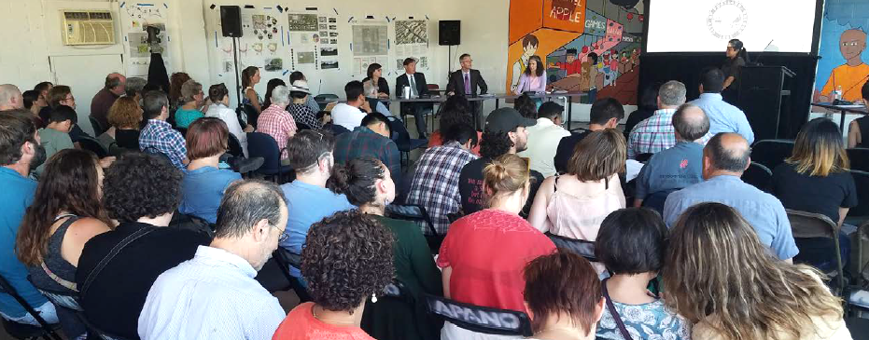
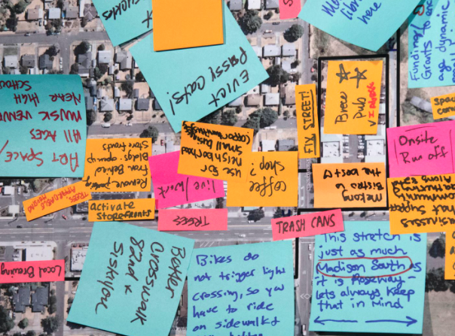
Notes:
Chris W
Community-led efforts have made this possible. Community members have advocated for safety improvements along 82nd Ave and for the transfer

Slide 8
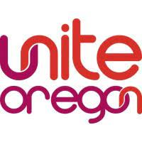










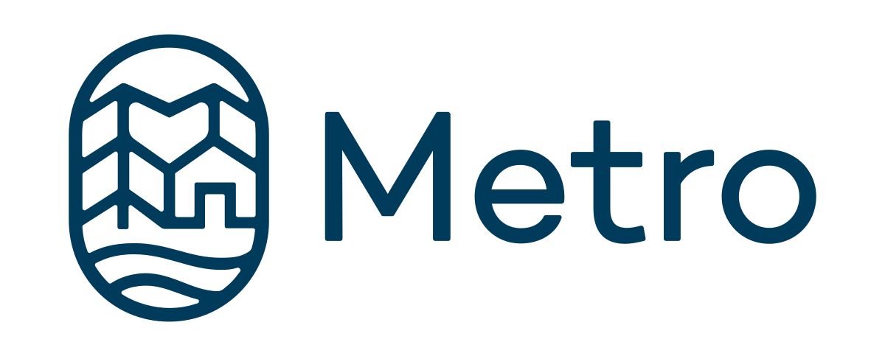






Partners in Building a Better 82nd Avenue
Reimagine 82nd Avenue Funded Partners
Plus Many Early Participants
Government Partners
Notes:
Whole city approach to making 82nd a great place
Partnering with funded community organizations including R82 and APANO’s work to develop affordable housing
This project represents an opportunity for the City – PBOT and our partners at BES, BPS, Parks, Civic Life, Prosper and Housing -- to work in partnership with community members and established community organizations. Meeting the vision for an equitable civic corridor will require the entire city’s efforts. We will need other partners – philintropic, institutional and community-based organizations. With the legislature’s allocations of federal funding to Oregon Walks for the Re-Imagining 82nd Avenue project and to APANO to begin land acquisition for affordable housing, we are set up for success.
I am directing PBOT staff to show up as partners with our community members. This means that PBOT is taking an active role in organizing the City to respond to the needs in the corridor including short-term and long term corridor stabilization. We can’t do it alone. But we are setting the table to bring community partners and the City together to tackle this important challenge together. In addition to three coordinated ARPA asks that help us address immediate needs in the short term, we have been working in partnership to create a plan for long term strategies that focus on building individual wealth, access to needed housing, small business growth, and other resources of well-being that will help people remain stable, resilient, and rooted in their communities.

Slide 9
Today’s Requested Council Action:
Approve the 82nd Avenue Jurisdictional Transfer
Direct the Transportation Commissioner to sign the jurisdictional transfer agreement (effective June 1, 2022)
Accept $80 million in American Rescue Plan Act (ARPA) funding from the State
1
2
Notes:
Chris W
Today, we are asking you to approve an ordinance that will direct Commissioner Hardesty to sign to IGAs. The first IGA will transfer 82nd Avenue to the City of Portland on June 1, 2022. The second will direct the City to accept $80M in American Recovery Plan Act funding from ODOT.
Now, I will hand it off to my staff Kristin Hull and Julia Reed who will walk you though the details of the transfer and PBOT’s strategy for investing the first $80M in funding.

Slide 10
Transfer Agreement
Notes:
Kristin from here

Slide 11
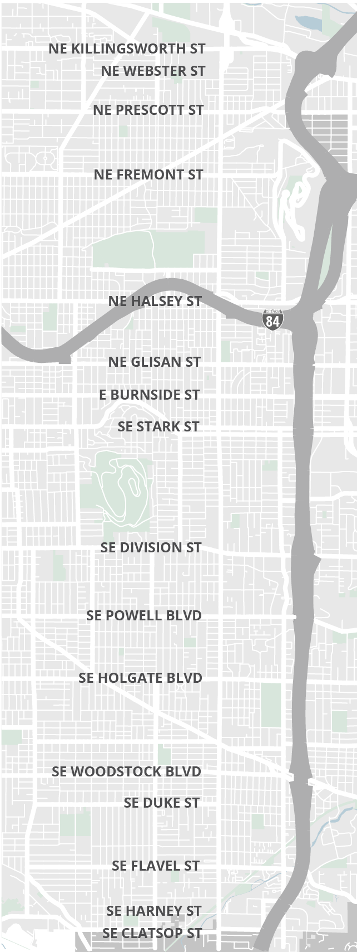
What is transferring?
82nd Avenue from NE Killingsworth to SE Clatsop
  Some sidewalks will transfer, others are already owned by the City
  Stormwater assets
ODOT retains ownership of:
  82nd Avenue bridge over I-84 and railroad
  Intersection and signals at NE Killingsworth, NE Webster & SE Powell
Transfer date: June 1, 2022
Notes:
The legislature directed this transfer the 2021 session. Since then, ODOT and the City have been working together to define the terms of the transfer. With this transaction, the CIty will take ownership of 82nd Avenue from south of NE Killingsworth to the County line at SE Clatsop Street. This section is 7 miles and includes all roadway assets including stormwater assets. BES has been a partner in understanding the condition of the stormwater assets and cost to bring those assets to a state of good repair.

Slide 12

Funding for 82nd Avenue Transportation Improvements
$185M for 82nd Avenue Transportation Improvements
82nd Avenue Transportation Needs
$80 million
From Oregon State Legislature
Must be used by 2026
$70 million
Oregon Department
of Transportation
$35 million
City of Portland
Critical Fixes
Future Investments
Notes:
There is a lot of investment needed along 82nd Avenue; we don’t have enough $$ to do everything we want but the money we do have includes:
$185M for Transportation Improvements
$80M is American Rescue Plan Act or ARPA funds. Use it or Lose it Funding. Must be used by 2026.
$70M from ODOT. $66M will be available for the longer term building a better 82nd, ODOT invested $3.35M in safety projects in 2021 and we will use some of the state funding to augment existing paving projects that ODOT was already advancing prior to the transfer.
Not subject to same time constraints.
In this agreement, the City commits to $35M in investment in the corridor. We will make this investment over time through our CIP program that leverages grant funding, SDCs, gas tax and other city and bureau funding sources.
This funding is for capital projects to improve the condition of 82nd Avenue and address safety issues. This is also a major new asset to maintain which will likely cost $800
82nd Avenue is a new asset for PBOT to maintain. $800k/year in maintenance costs. The biggest cost for PBOT is including 82nd Avenue in our snow and ice response but it also includes things like repaving the street, spot asphalt repairs, re-striping lane markings and crosswalks, operating and maintaining signals.
The transfer funding is designated for capital projects which will improve the condition of the assets in the corridor but will not address the ongoing maintenance costs for 82nd Ave.
While this is an important change for the community and PBOT, it adds to an already huge maintenance backlog.

Slide 13
Near-term Critical Fixes

Slide 14
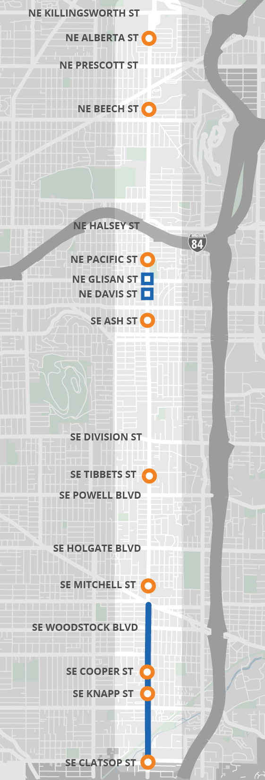
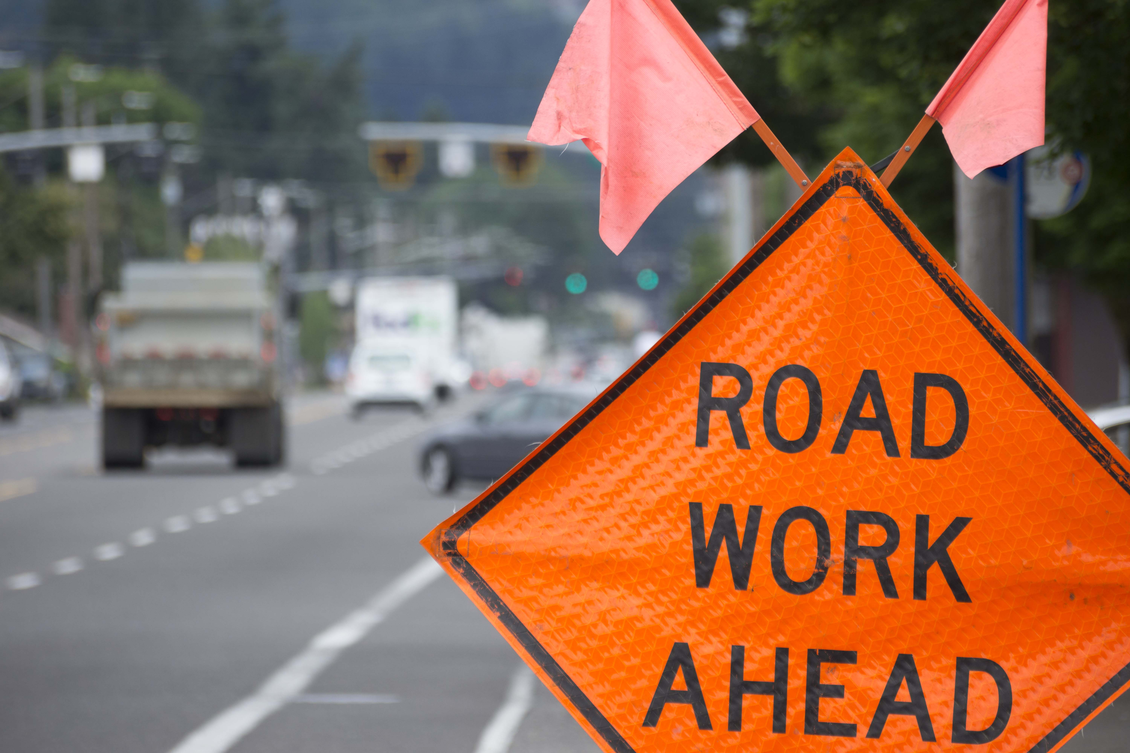
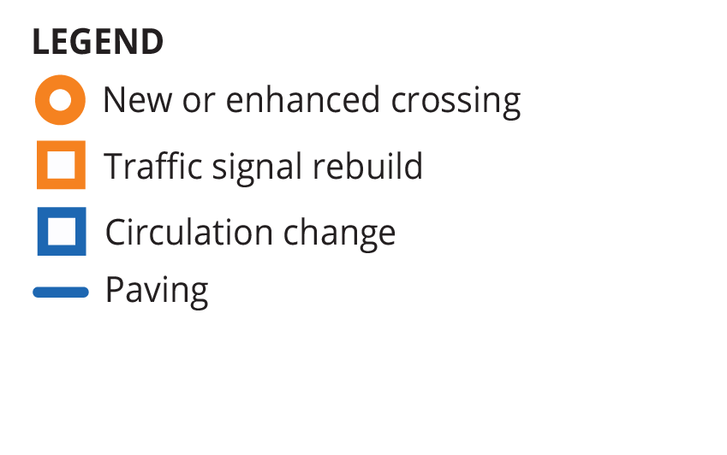
Improvements already funded (2022-2024)
82nd Ave
New pedestrian crossings along the corridor, enhanced with flashing beacons or signals
Traffic signal rebuilds at NE Davis St and NE Glisan St
Repaving south of SE Foster Rd to city limits
Notes:
Also includes many other street improvements connecting to 82nd; highlight Jade Montilla connected centers project
NE Alberta
NE Beech
NE Pacific
SE Ash
SE Tibbets
SE Mitchell
SE Cooper
SE Knapp
SE Clatsop

Slide 15





Near Term Critical Fixes (2023-2026)
Category | Budget
Lighting | $2 - 5 million
Crossings | $12 – 15 million
Corridor Safety | $12 – 15 million
Major Maintenance | $50+ million
TOTAL Funding | $80 million
    Paving, Curb Ramps
    Traffic Signals
Notes:
LIGHTING
For safety throughout the corridor
Currently in design phase led by Signals and Street Lighting
Project will fill all street lighting gaps along 82nd Ave by 2023/2024
CROSSINGS
Enhanced pedestrian crossings (signals or beacons) at regular intervals
CORRIDOR SAFETY
Corridor safety enhancements (striping, signage, signal timing, access management)
MAJOR MAINTENANCE
Pavement, stormwater, traffic signal, and curb ramp repair and reconstruction

Slide 16
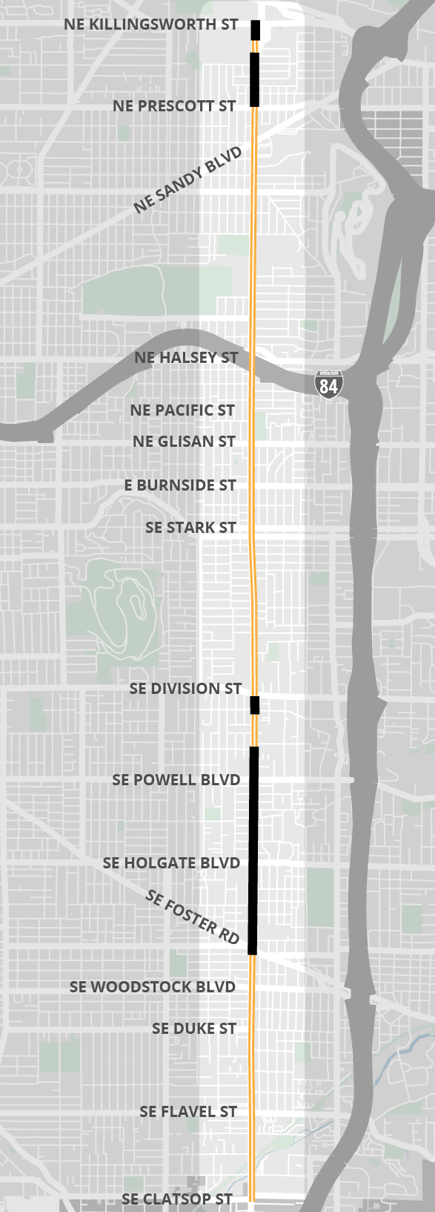
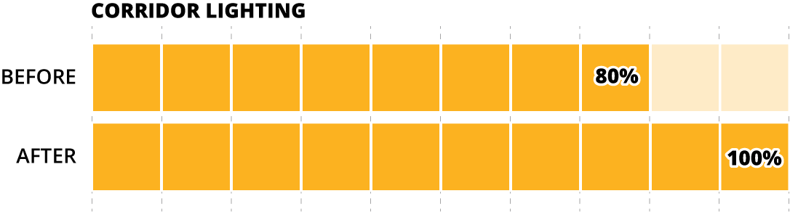

Critical Fixes on 82nd Ave
Lighting
Add street lighting to improve
visibility for everyone
Construction in 2022-2023
Existing Street Lighting
Lighting Gaps Filled by Next Year
Notes:
Emphasize safety benefits of this investment
Wide roads like 82nd Ave benefit from closely-spaced streetlights to improve visibility for everyone
Project will fill all identified street lighting gaps the entire length of the corridor
Construction in 2022-2023

Slide 17
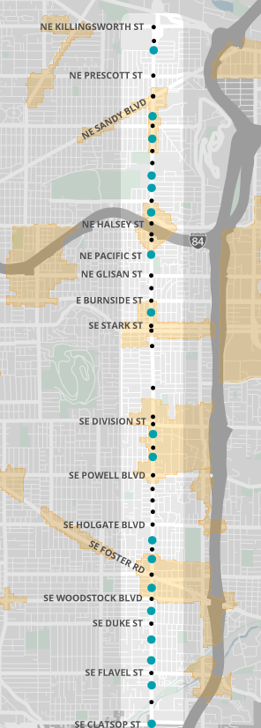
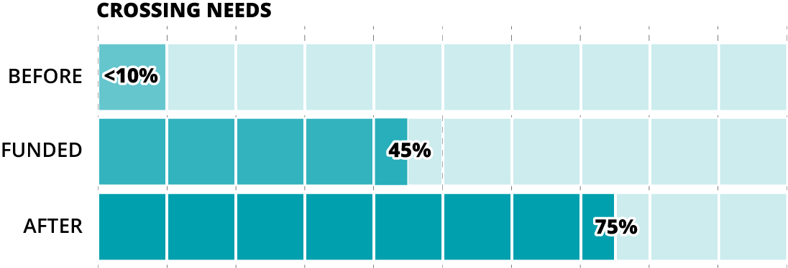
Critical Fixes on 82nd Ave
NE ALBERTA ST
Crossings
18 new crossings
(Including two recently completed)
Existing signal or beacon
Funded signal or beacon
Pedestrian District
Notes:
Emphasize safety benefits of this investment
Fewer crossings between Stark and Division. This section has lower equity, lower safety need, lower activity, centers north and south of here
Eight new pedestrian crossings enhanced with signals or beacons, identified in 2019 adopted plan
Seven locations prioritized based on safety, equity, access to destinations, and feasibility to construct by 2023-2024
One additional crossing at SE Rhone St will be delivered as part of Phase 1 repaving project in 2025-2026
Two recently completed
Nine enhanced crossings funded already before Phase 1
Seven additional enhanced crossings funded in Phase 1 for construction in 2023-2024 timeframe

Slide 18
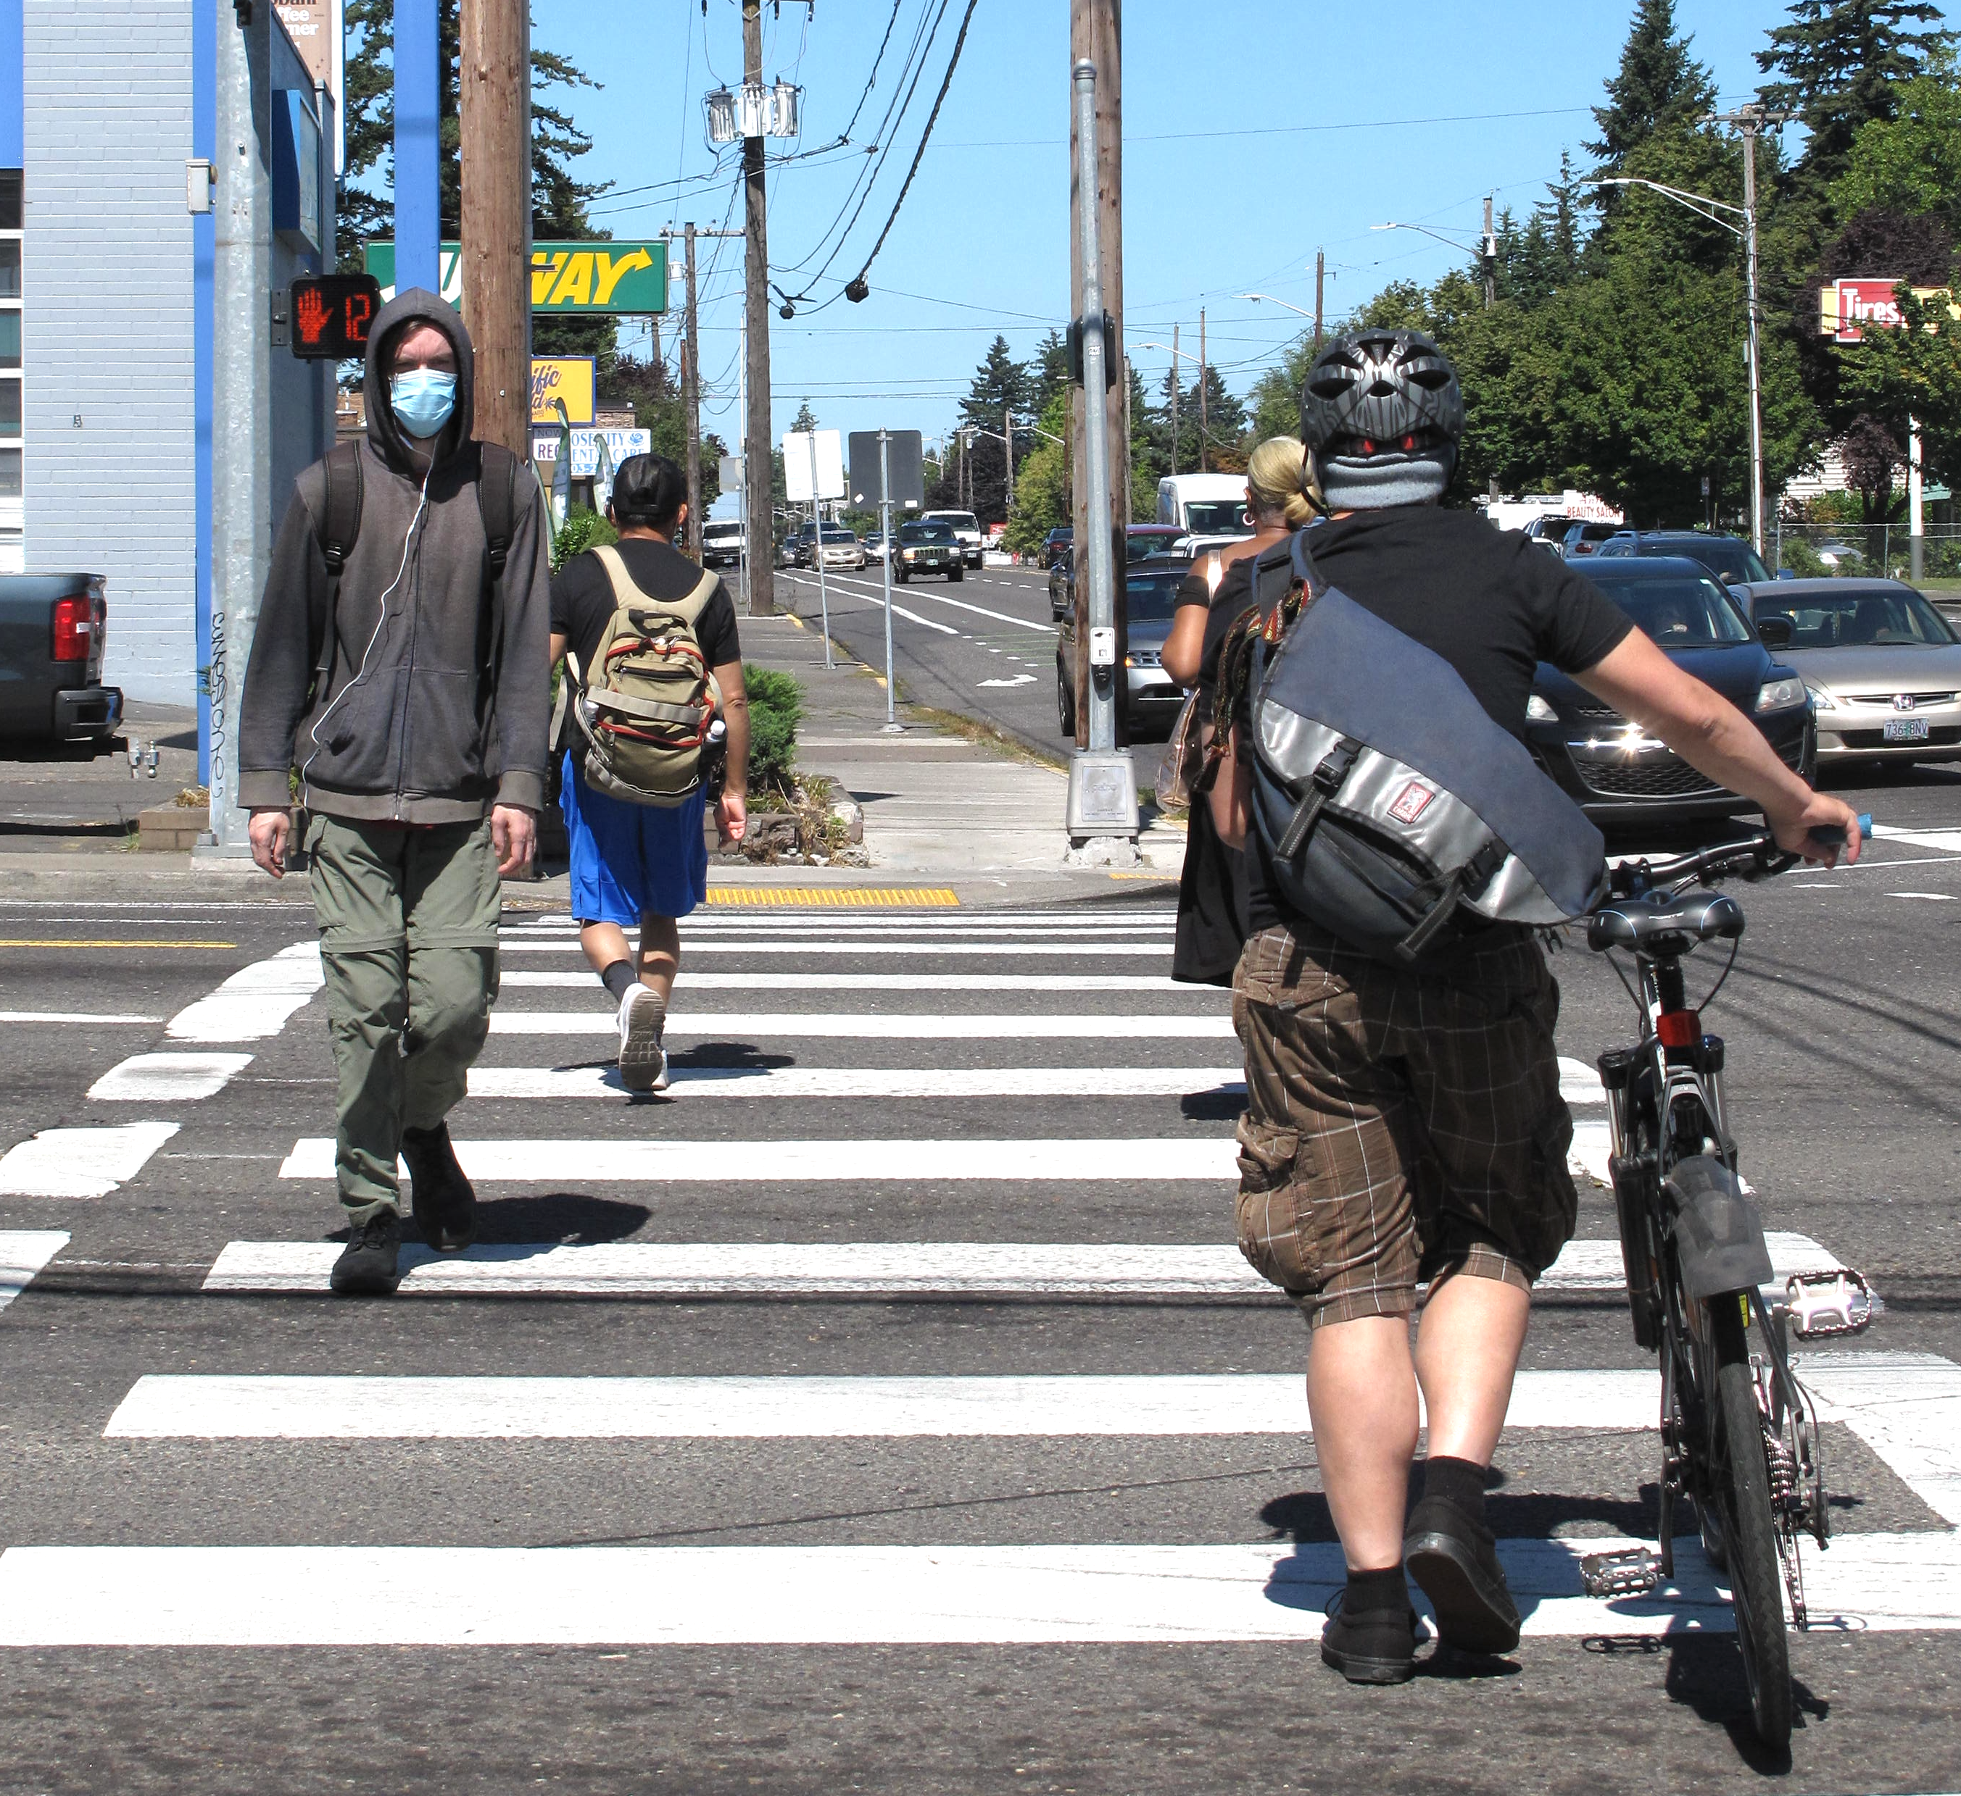
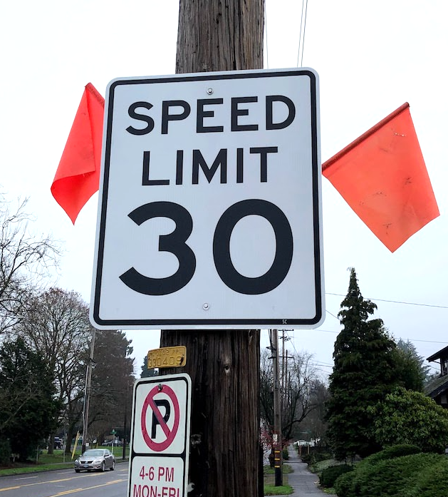
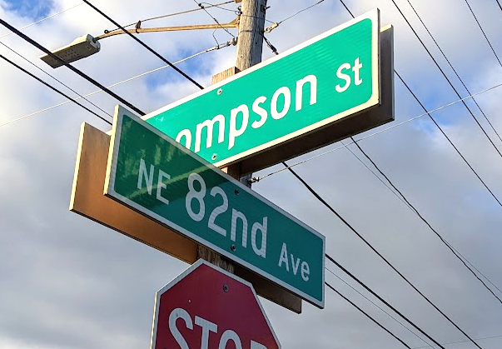
Critical Fixes on 82nd Ave
Corridor Safety Improvements
Signal timing to reduce speeding
Improve visibility by updating signs, roadway striping, and signal heads
Implementation in 2022-2023
Notes:
Reduce speeds and improve safety: improvements to signal timing, vehicle detection, communication equipment, and other technological enhancements to
Improve visibility by updating signs, roadway striping, and signal-heads and improve overall safety along the corridor and reduce future maintenance costs
Implementation in 2022/2023, with additional adjustments to signal timing in 2024/2025
Reduce speeds and improve safety through signal timing, vehicle detection/ communication equipment, and other technological enhancements to
Update roadway striping, traffic signs, street name signs, and signal-heads to improve visibility and improve overall safety along the corridor and reduce future maintenance costs
Implementation in 2022/2023, with additional adjustments to signal improvements in 2024/2025

Slide 19
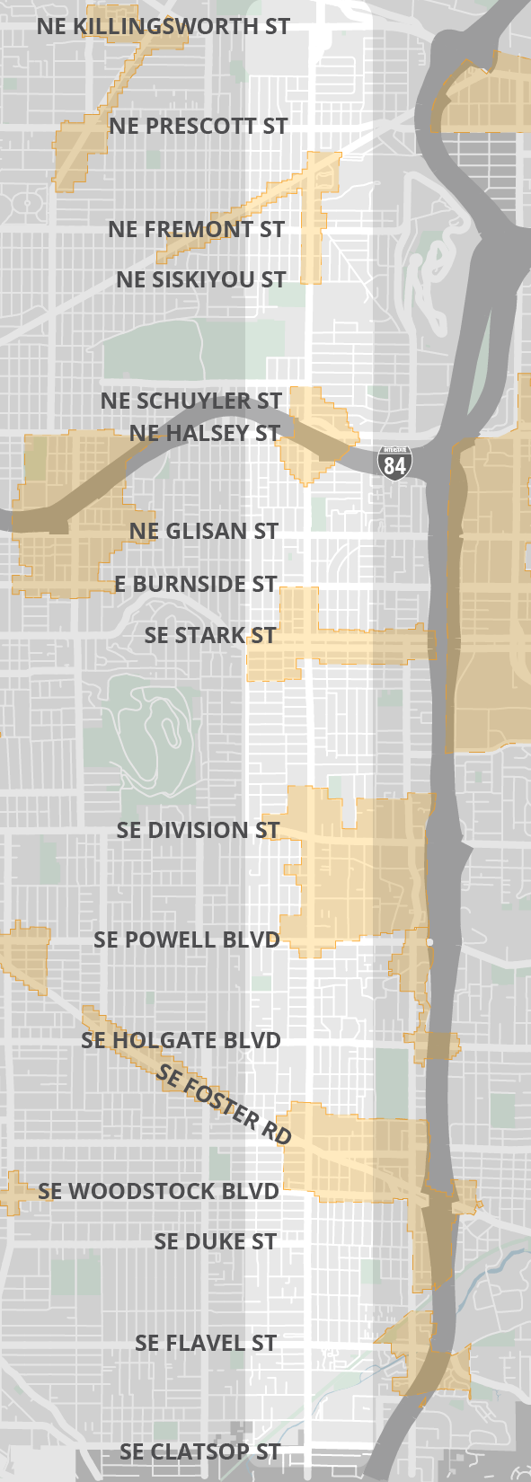
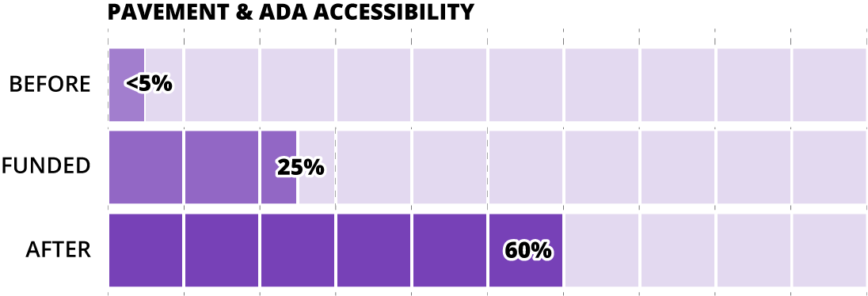
Critical Fixes on 82nd Ave
Major Maintenance
1.5 miles of repaving is already funded by ODOT (south of Foster)
2 more miles of repaving funded by ARPA
  NE Siskiyou to NE Schuyler
  SE Division to SE Foster
Curb ramps will be upgraded along with repaving projects
Paving & Curb Ramps
PAVEMENT AND CURB RAMPS
Pedestrian District
Notes:
Repave some segments of 82nd Ave to a state of good repair to fulfill jurisdictional transfer agreement
The segments were selected based on:
Which areas were in the greatest need of paving
Where low ROW acquisition would be needed to reduce budget risk
Serving equity needs
Serving Centers (e.g., Jade, Lents) and other major destinations (e.g., Eastport Shopping Center, McDaniel High School)
Areas of high safety need
SE Foster Rd to just north of Division St in Lents and Jade District areas
NE Schuyler St to Siskiyou St segment near McDaniel High School
Accessibility upgrades to all curb ramps along the segments being repaved

Slide 20
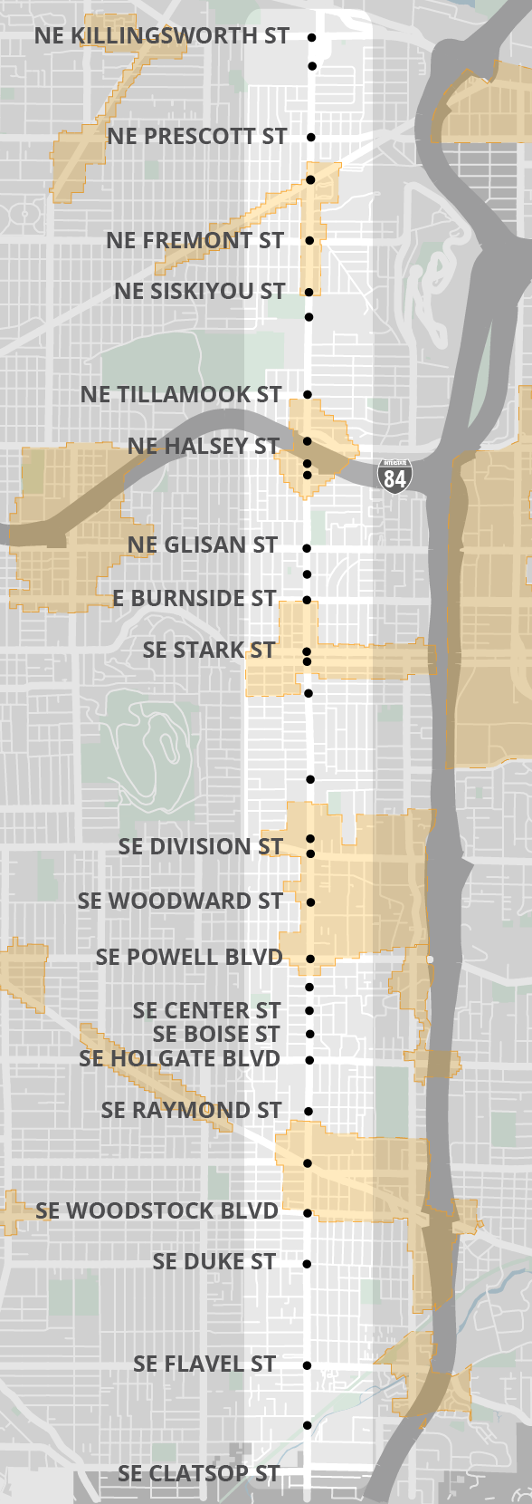
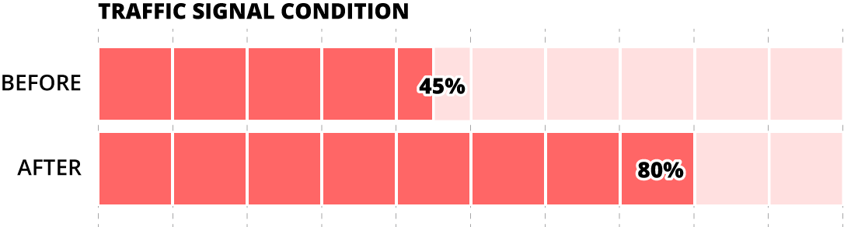
Critical Fixes on 82nd Ave
Major Maintenance
9 signal rebuilds
Projects will include accessibility upgrades and safety enhancements
Existing signal
Traffic Signal Rebuild
Pedestrian District
Notes:
Getting us to 80%
15 signal rebuilds have been completed or are funded

Slide 21
Future Investments

Slide 22
Timeline
Near-term: Critical Fixes
PLANNING
DESIGN
CONSTRUCTION
We Are Here
Future Investment
PLANNING
DESIGN
CONSTRUCTION
Community Events
2021(& earlier) | 2022 | 2023 | 2024 | 2025 | 2026 | 2027 | 2028
Notes:
At same time, we’re acting on near term priorities we’re engaging in community conversation

Slide 23
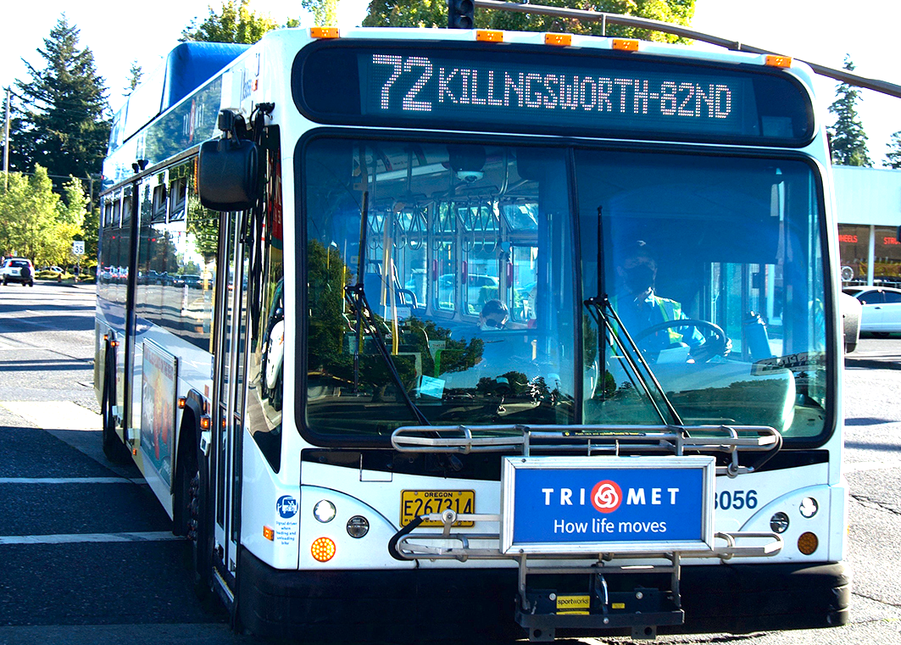
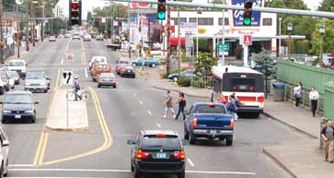
Key Outcomes
  Confirm community-supported vision
  Finalize implementation-ready project list
  Position for federal transit funding
  Support community and small businesses
Notes:
Key Outcomes:
Confirm community-supported vision
Finalize implementation-ready project list starting in 2026
Position for federal transit funding and how the civic corridor supports transit
Support community and small businesses both supporting businesses and

Slide 24
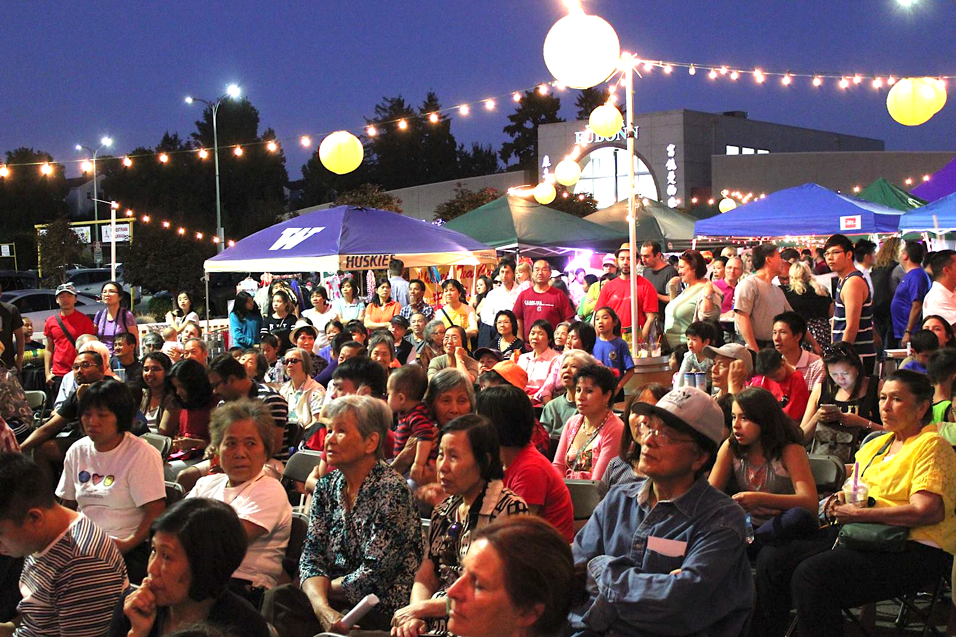
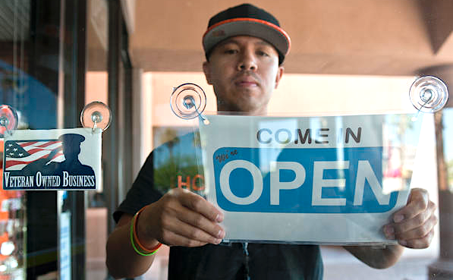
Support for Community
& Small Businesses
  Ideas include:
  More affordable housing
  Workforce training/ apprenticeship program
  Local hiring and disadvantaged business contracting
  Small business technical support
Notes:
Centering needs of community and small businesses in a different way and that means:
More affordable housing
+
Corridor continues to be a place where people in ths community can live and shorp and worship

Slide 25
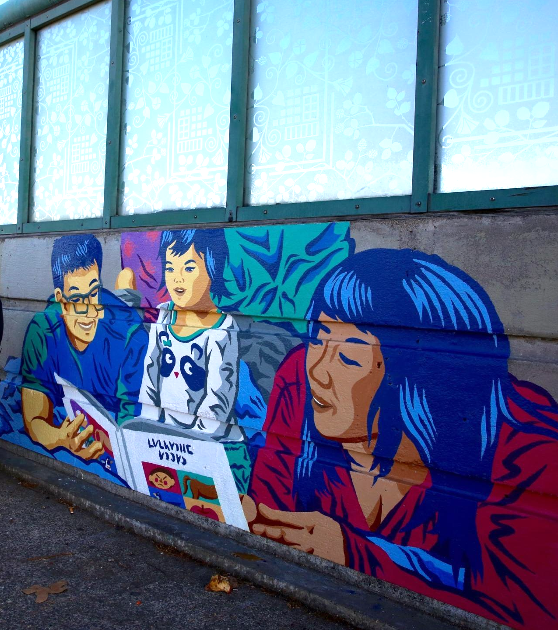
Community Engagement
  Online and In-Person Open Houses
  Community Focus Groups
  Establish Community Advisory Committee
  Street Fairs/Community Events
  Coordination with Oregon Walks, APANO, OPAL, Verde, Unite Oregon and other partners
Notes:
Core of community events is coordinating with CBOs to make sure we’re centering the needs of community
While we’re implemenitg near term fixes wer’e doing community palnnign which is both transit transportation and

Slide 26
Learn More
Project website: portland.gov/82nd-avenue

Slide 27
Invited Testimony

Slide 28
Thank you

