Slide 1
Groundwater Pump Station
Motor Controller Centers (MCC) Replacement Project
Jodie Inman, P.E.
Chief Engineer

Slide 2
Groundwater Program Background
Primary back up to the Bull Run supply
Since construction in 1983, groundwater has been used for
Emergency events
Summer augmentation – climate tool
Goals for Groundwater projects:
Repair and replace to maintain readiness
Ensure compliance with water quality and regulations

Slide 3
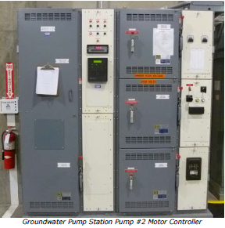
Why we’re replacing these components
39 yrs old, well past expected useful life of 25-30 yrs
Have had several failures
Replacement parts hard to find
Replacing 8 motor controller centers
6 large pumps
2 smaller “jockey” pumps
Improve staff safety
Improve reliability
The new motor controller centers will help make sure the groundwater supply is available when we most need it.
Notes:
Large pumps, 6-2350 HP, 12,000 gpm main pumps, 18 MGD
Jockey pumps, 2-500 HP 3,300 gpm, 6 MGD
MCC’s include:
Higher voltage (medium- 4160 V) component that runs the motors and a low voltage (120V) component which runs the controls
Step down transformer in each cabinet.
No property or easements required, in GWPS behind locked gate.

Slide 4
Request
Authorize bid solicitation and contracting with the lowest responsive and responsible bidder for construction of the Groundwater Pump Station MCC Project.
Estimated cost: $2,425,000
Confidence level: High
Start date: Fall 2022 or Winter 2023

Slide 5
Questions?
Jodie Inman
503 823-1289
portland.gov/water/PenridgeMain
PortlandWater
PortlandWaterBureau
PortlandWaterBureau
E-News: eepurl.com/gcWEjj

