Slide 1
2035 Comprehensive Plan
Policy 5.35 Inclusionary housing
Use inclusionary zoning and other regulatory tools to effectively link the production of affordable housing to the production of market-rate housing. Work to remove regulatory barriers that prevent the use of such tools.
Matthew Tschabold Policy and Planning Manager
Cassie Graves Development Incentives Coordinator
April 20, 2022

Slide 2
Portland’s Inclusionary Housing Units
Projected Minimum:
Confirmed 60% AMI Units:
Confirmed 80% AMI Units:
Undetermined:
1,556 units
984 units
501 units
71 units
City of Portland, Portland Housing Bureau, April 2022

Slide 3
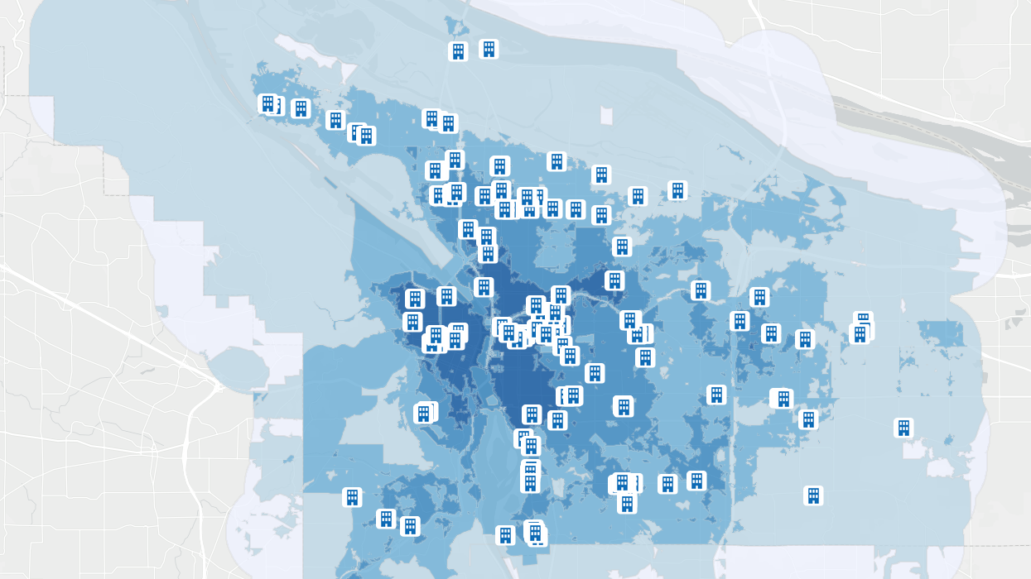
IH MULTE Applications
SE 27th & Division Apartments
2680 SE Division St
City of Portland, Portland Housing Bureau, April 2022

Slide 4
SE 27th & Division Street
Project Overview
Developer Options
15% of units at 80% AMI
8% of units at 60% AMI
Fee-in-lieu
Off-site
Bedroom reconfiguration
Building
52-unit building (Avg. SqFt: 367 studio, 539 one-bed, and 702 two-bed)
IH Units: 1 Studio, 2 Two-Bedroom at 60% AMI
Rents
Similar market-rate*: $1,380 (studio); $2,125 (2 bedroom)
IH maximum: $1,015 (studio); $1,509 (3 bedroom)
Property Tax Exemption
$1,041 per IH unit, per year (for 10 years)
$105 per year of affordability (for 99 years)
Housing Bureau recommends approval as IH rents are below new construction rents and there is a need for affordable 2-bedroom units in this neighborhood.
*Market estimates today, market rents may be higher after construction

Slide 5
Questions?

