Slide 1
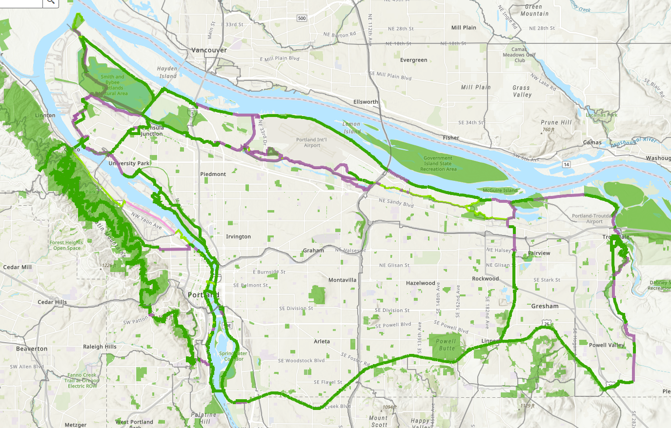
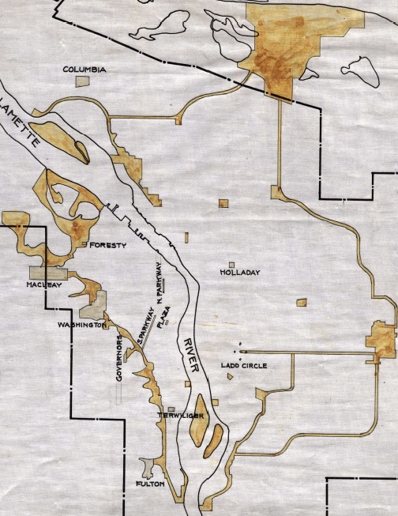
Shown here is the 1903 Olmsted Plan (C.P. Keyser edition) overlaid on a map of the 40 Mile Loop. The 40 Mile Loop is actually 150 miles long and is inclusive of the Cities of Portland, Gresham, Fairview and Troutdale, making it our first regional trail.

