Slide 1
Reassignment and Leasing of SW Main St between SW Naito Pkwy and SW 1st Ave
Asset Management
Notes:
Reassign a 1-block segment of SW Main Street to PBOT
Approve a below-market rate lease to Multnomah County of a portion of the SW Main Street R/W

Slide 2
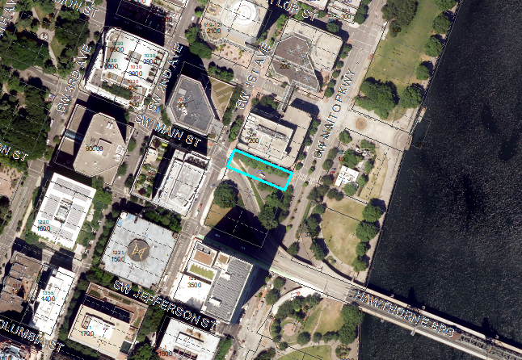
SW Main St. right-of-way to be reassigned to PBOT
Notes:
Overhead view of the street segment
Also shows small triangular portion of the parking lot that Parks leases from the County

Slide 3
History
On May 29, 1987, the City of Portland and Multnomah County entered into a lease for County property near the west end of the Hawthorne Bridge, with the intention of the City combining the land with SW Main Street right-of-way for the development of a surface parking lot.
On June 4, 1987, Portland City Council passed Ordinance 159738 authorizing the closure of SW Main Street between SW 1st Avenue and SW Front Avenue (now SW Naito Parkway), for development of a public parking lot.
The Ordinance also assigned operation and management of the parking lot from PBOT to the Bureau of Parks and Recreation.
In April of 2015, the Multnomah County Board of Commissioners approved the Hawthorne Bridgehead site for the central courthouse. On October 18, 2017, the City issued the building permit for the new courthouse, and on October 5, 2020, the new courthouse opened.
During the planning process for the new central courthouse, the County notified the City that it would be terminating the lease for County’s portion of the public parking lot and would be seeking to use the area to serve the needs of the new central courthouse, located one block to the south.
The County subsequently requested to lease the City’s portion of the SW Main Street parking lot, resulting in negotiations with PBOT and Parks to identify a workable solution for all three agencies.
Notes:
Just described the first half of the bullet points.
Second half address the construction of the new County Courthouse, the County’s need for a secured parking lot that serves prisoner transport vehicles and security escorts for judges, and finally that the County, Parks, and PBOT have all worked towards a mutually beneficial outcome.

Slide 4
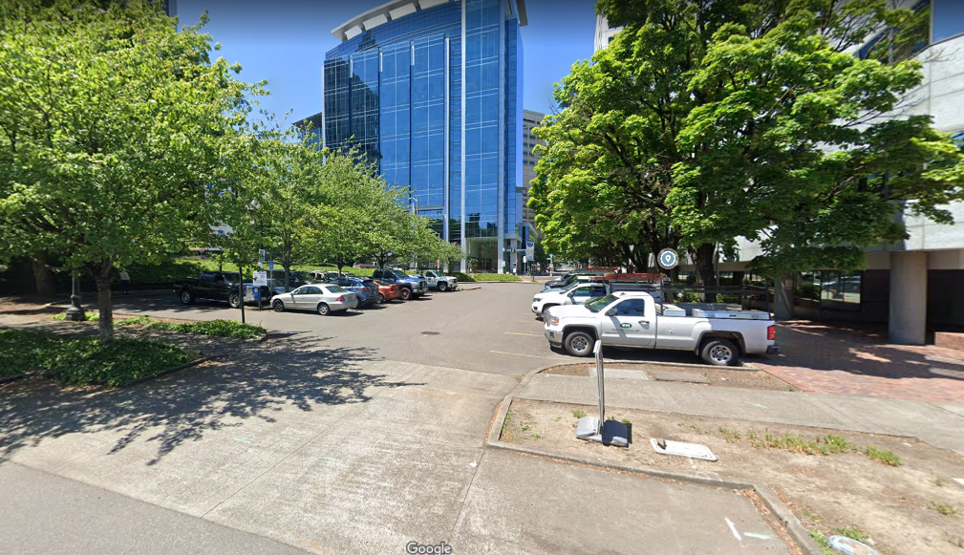
Right-of-Way to be reassigned to PBOT, then leased to County

Slide 5
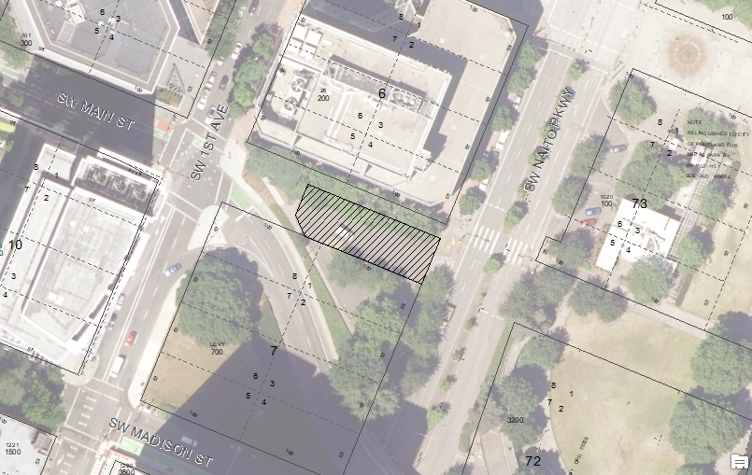
Overview of SW Main St Right-of-Way to be Leased
Notes:
The first ask of Council is to reassign the r/w to PBOT, with the second ask being a below market lease rate for the County.
Other than being a good partner to the County, what’s in it for the City above and beyond an annual rent of $2,750?

Slide 6
Salient details
Reassign the operation and management of SW Main Street between SW Naito Parkway and SW 1st Avenue to PBOT.
PBOT will lease a portion of the SW Main Street right-of-way to the County at the rate of $2,750 per year, for a 10-year period, prior to charging a market rate.
In lieu of paying a market rate for the first 10 years of the lease, the County, PBOT, and Parks agreed to the following items:
  The County would fund, design, and construct a multi-use path along the north side of the proposed parking lot within the SW Main Street right-of-way, between SW Naito Parkway and SW 1st Avenue;
  The County would compensate Parks $19,731 for future improvements to a nearby parking lot;
  The County would construct approximately 500lf of conduit in SW Naito Parkway for PBOT; and
  The County would execute a Quitclaim Deed releasing reversionary interests in multiple properties assigned to both PBOT and Parks.

Slide 7
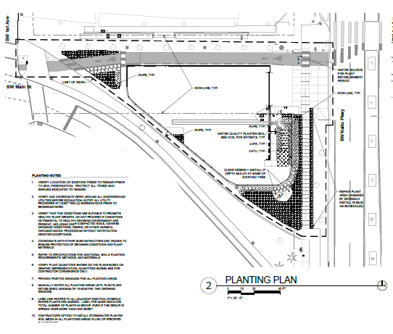
Overview of Multi-Use Path Plans

