Slide 1
NE 47th Avenue Phase I
Local Improvement District
Final Assessment Hearing
March 2, 2022 – Agenda Item #147
Staff presenting: Andrew Aebi, M.B.A.; Local Improvement District Administrator
Jodie Inman, P.E., Chief Engineer; PWB; and Paul Suto, P.E., Chief Engineer, BES

Slide 2
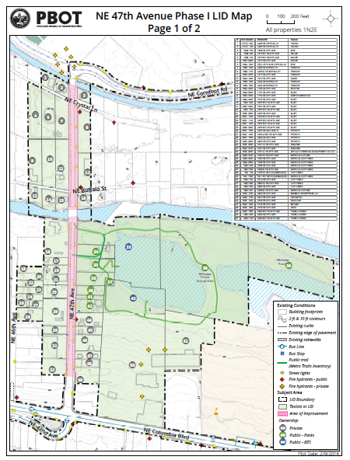
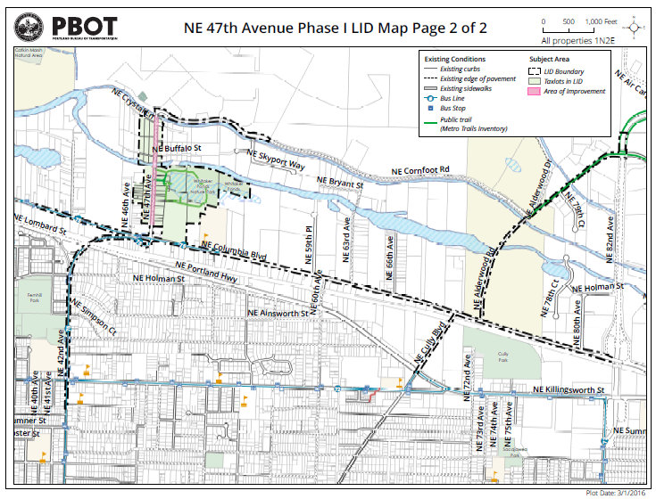
Map and Project Limits
North of Columbia Blvd. to South of Cornfoot Rd.

Slide 3
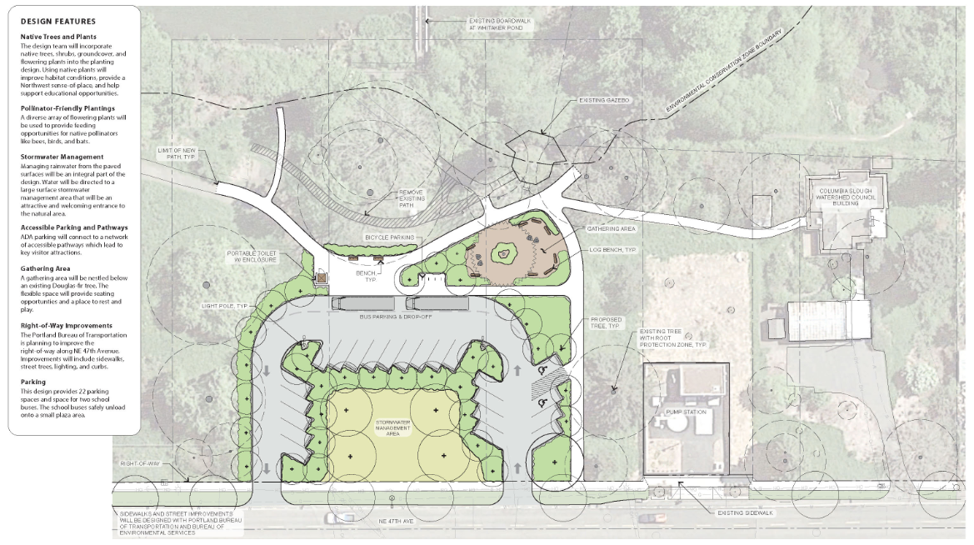
Portland Parks & Recreation
Whitaker Ponds Nature Park: First Partnership in LID

Slide 4
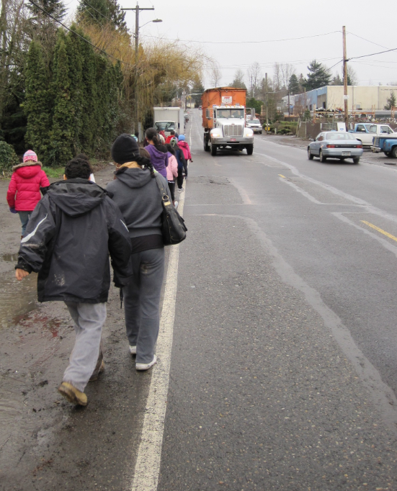
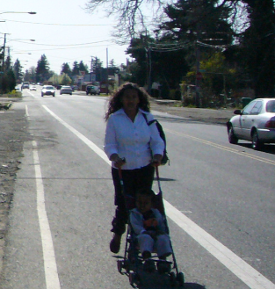
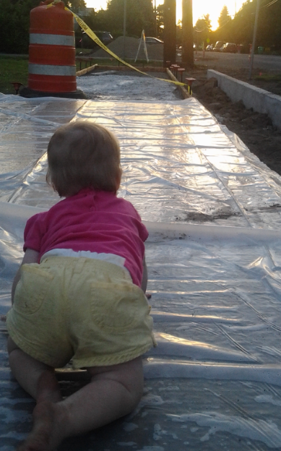
NE 47th Ave., Cully Blvd. & Prescott St.
Left: 2/01/10 Middle: 3/18/10 Right: 9/10/13

Slide 5
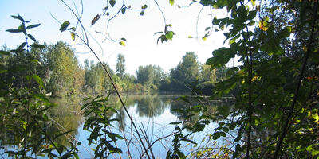
Portland Parks & Recreation
Whitaker Ponds Nature Park: Dedicated in May 2018

Slide 6
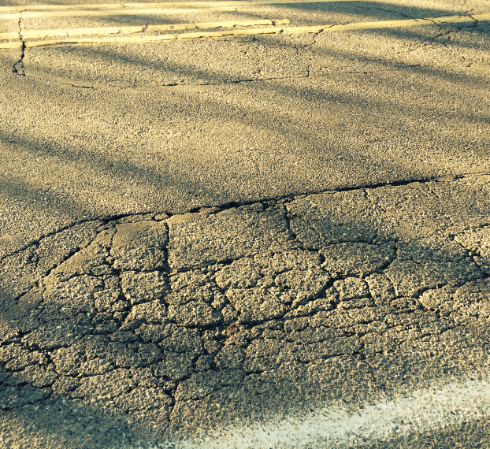
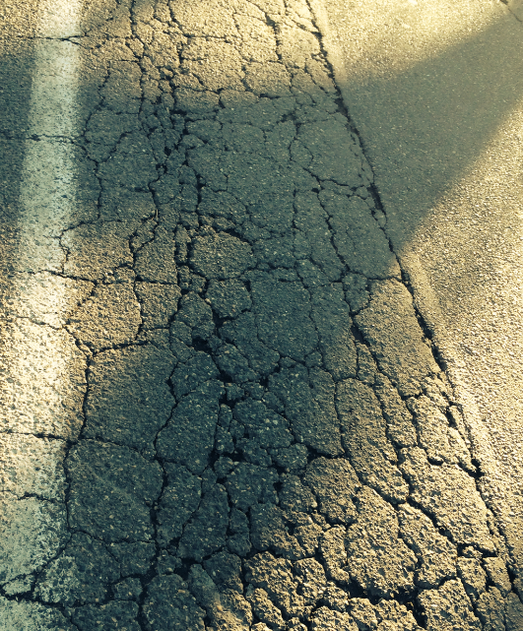
Pavement Condition as of 11/27/15
3 segments were worst 0.9%, 2.8%, 26.1% in City

Slide 7
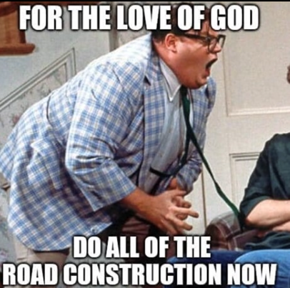
Only one disruption and one detour
Reconstructed roadway, replaced water main,
extended sanitary and stormwater sewers in single project

Slide 8
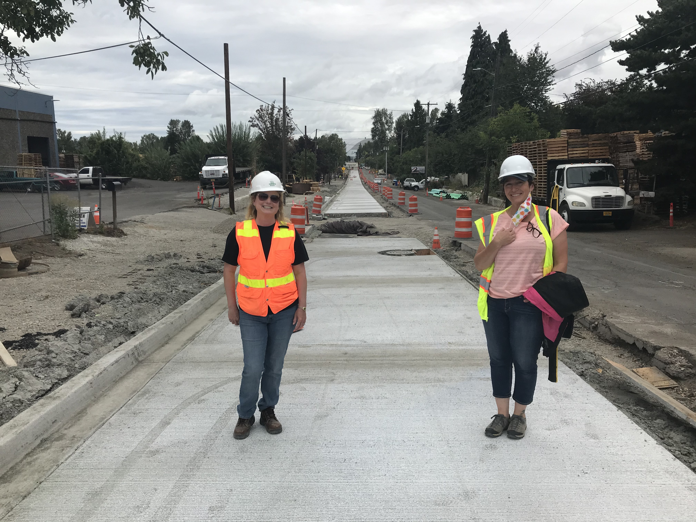
During construction on 8/21/20
Concrete roadway replaces failed asphalt

Slide 9
NE 47th Avenue Phase I LID
Coordinated New Multimodal Infrastructure
1) Fully reconstructed Priority Truck Street on Nat’l Hwy. System
2) Built temporary signal at NE Alderwood & Columbia for detour
3) Added sidewalks on both sides in lieu of walking on fog line
4) Added physically-separated bicycle facilities on both sides
5) Extended stormwater sewer
6) Added surface stormwater management facilities
7) Added dry line sanitary sewer, water main (subsequent to initiation of LID)
8) Added street lighting
9) Fully integrated with new Whitaker Ponds park improvements

Slide 10
Cully Association of Neighbors
Street Surface Types Versus Citywide (as of 6/30/21)
Paved With Curb:
54.2% of street centerline in Cully vs. 77.8% Citywide
30% less likely for a street in Cully than Citywide
Paved Without Curb (previously including NE 47th Avenue):
34.7% of street centerline in Cully vs. 16.9% Citywide
More than twice as likely for a street in Cully than Citywide
Unpaved:
9.1% of street centerline in Cully vs. 2.7% Citywide
More than three times more likely for a street in Cully than Citywide;
including NE Crystal Lane and NE Buffalo Street adjacent to NE 47th Avenue

Slide 11
Cully Association of Neighbors
Community Burdened by Inadequate Infrastructure
Single Mother: 297% of Citywide Average
African American: 239% of Citywide Average
Latino: 236% of Citywide Average
Family Households in Poverty: 236% of Citywide Average
Youth: 118% of Citywide Average
Household Size: 116% of Citywide Average

Slide 12
NE 47th Avenue Phase I LID
Financial Overview of Construction
$ 497,000 Mobilization
$ 489,000 Traffic Control Including Flagging
$ 332,000 Pollution Control Plan & Contaminated Media
$ 78,000 NE Alderwood & Columbia temporary traffic signal
$1,396,000 Subtotal
$4,778,000 Other construction costs (incl. full pavement rebuild)
$6,175,000 Total Construction (2/3 of total project costs)
$ 676,000 BES Sanitary Sewer Construction (48.4% of subtotal)
$ 859,000 PWB Water Main Construction (61.5% of subtotal)

