Slide 1
Black Youth Leadership Fund
February 23, 2022
Niyati Desai, Director of Community Engagement

Slide 2
OCF's Mission, Vision, and Values
Notes:
Eva
Read

Slide 3
What does OCF do?
Promotes philanthropy
Builds permanent charitable resources
Acts as intermediary organization
Promotes community development and local leadership
Supports nonprofit capacity building and sustainability

Slide 4
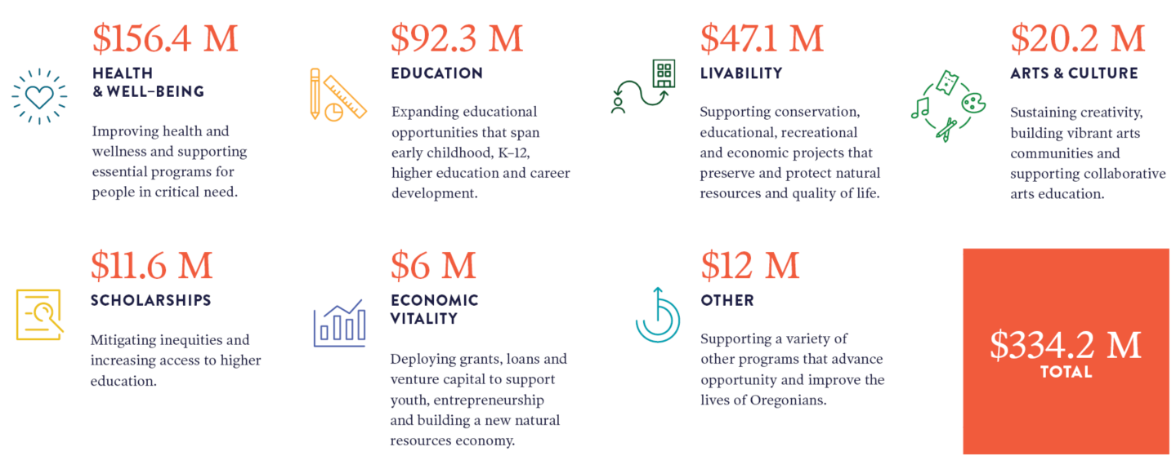
The Impact of OCF in 2021

Slide 5
Overview
OCF ROLE IN BLACK YOUTH LEADERSHIP DEVELOPMENT PROGRAM:
Fund Setup & Gift Processing
Grant vetting and distribution
Staffing and Support
COMMUNITY ADVISORY COMMITTEE
REPORTING AND MEASURES
BUDGET

Slide 6
OCF Fund Setup & Gift Processing
OCF will set up a wholly expendable community advised fund to hold and distribute grant funding
Fund’s primary purpose is to distribute grants to eligible organizations based on youth developed recommendations via the Community Advisory Committee approval
Fund will have a unique URL and will be open to additional philanthropic tax-deductible contributions, however OCF does not fundraise
OCF will send gift acknowledgement letters to any donors who contribute to the fund
Annual reports on additional contributions will be provided. Interim reports available upon request.

Slide 7
Grant Vetting and Distribution
OCF will provide vetting services of grant applicants and project grantees
Eligibility
Mission alignment
Confirmation of active status with Oregon Department of Justice
Contact information
OCF will distribute Grant Award letters and grant funds to each approved grantee

Slide 8
Staffing Support
OCF will designate a relationship manager who will serve as primary OCF contact for this Fund and the appointed Chair and Black United Fund
Relationship Manager will:
Participate in minimum of (2) Community Advisory Committee meetings
Support agenda setting and meeting facilitation, as needed
Move grant recommendations forward for OCF Board of Directors approval
Participate in project grantee review by City, as requested

Slide 9
Community Advisory Committee
Roles and responsibilities:
Advisory Council functions as an advisory committee to the City of Portland and OCF Board of Directors.
Support and guide the work of Black United Fund and Dr. Mitchell
Review and approve youth-developed grant recommendations per R.I.S.E program
Present grant recommendations to OCF Relationship Manager for Board approval

Slide 10
Community Advisory Committee - proposed membership
Committee members are volunteers
(1) City appointed member who represents the office overseeing these funds
(3-5) Community representatives
OCF relationship manager (non-voting)
City will appoint a Fund Advisor/Chair who will serve as primary point of contact and liaison for Oregon Community Foundation, City of Portland, and Black United Fund
Chair will have access to OCF fund account to track incoming donations grant expenditures and fund balance

Slide 11
Data collection and measures
Reporting:
End of year grantmaking report
Annual fund balance statement
Interim reports upon request
Measures:
# of grants distributed
Total amount of funds distributed annually
Total amount of additional funding secured

Slide 12
Grant Budget
Total requested: $196,750
$5,900
OCF Fund Fee 3%
Relationship management, programmatic support and participation in the advisory committee
$190,850
Grantmaking per recommendations via Community Advisory Committee
Distributed upon approval by OCF Board of Directors

