Slide 1
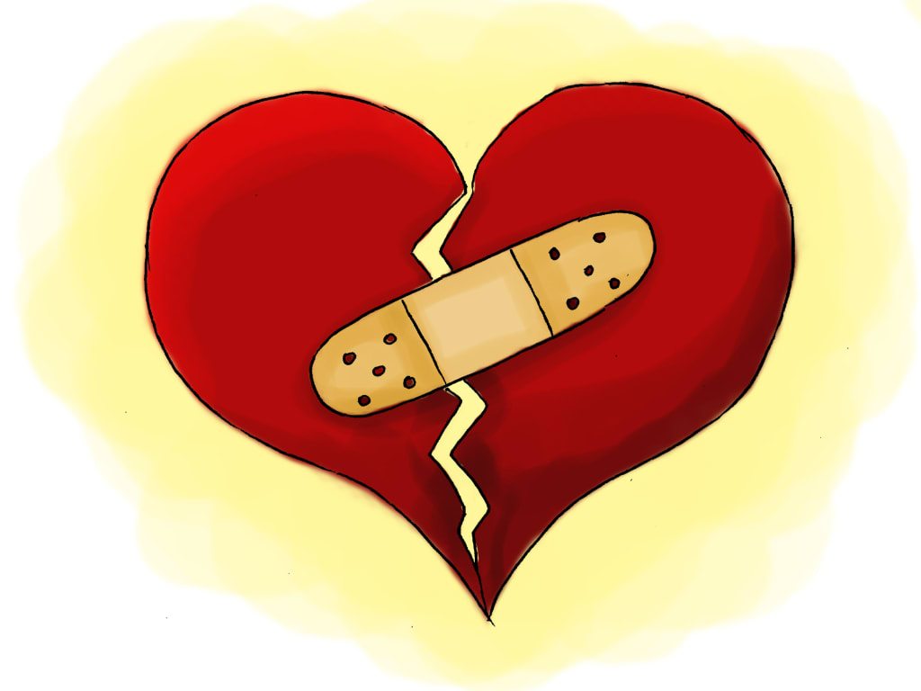
When Will We Learn?
It’s Not Their Heads,
It’s Their (Broken) Hearts
A research-informed, healing-centered
path that works for Black youth!
An equity-grounded presentation by
with guest presenters from
I Am MORE (Making Ourselves Resilient Everyday)

Slide 2
Award-winning former newspaper journalist for 25 years
Former high school teacher
Visionary founder of I Am M.O.R.E. (Making Ourselves Resilient Everyday)
3x SEL awardee NYC-based NoVo Foundation
Creative Revolutionist™, i.e., Poet Playwright, Artist, Author, Performer, etc.
Trauma-Informed /SEL expert
2021 Gladys McCoy Lifetime Achievement Awardee – Mult. Cnty
2019 Spirit of Portland Award

Slide 3
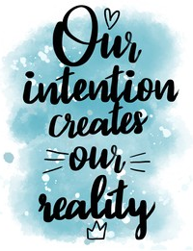
Please set an intention
What is intention? It is a purposeful awareness of how you want to experience something.
When you set an intention for our time together today, you picture in your mind what you intend to walk away with.
Please post your intention
for this session in the chat, i.e.
I will embrace change.
I will act with courage.
I will accept the challenge.
I will do the necessary hard work.
GROUNDING
STORYTELLING
(Personal & Collective)
Cooperative learning
Share tools & Ideas
answer questions in Chat, if we have time
EMAIL materials

Slide 4
It will further explain the WHY behind the programming.

Slide 5
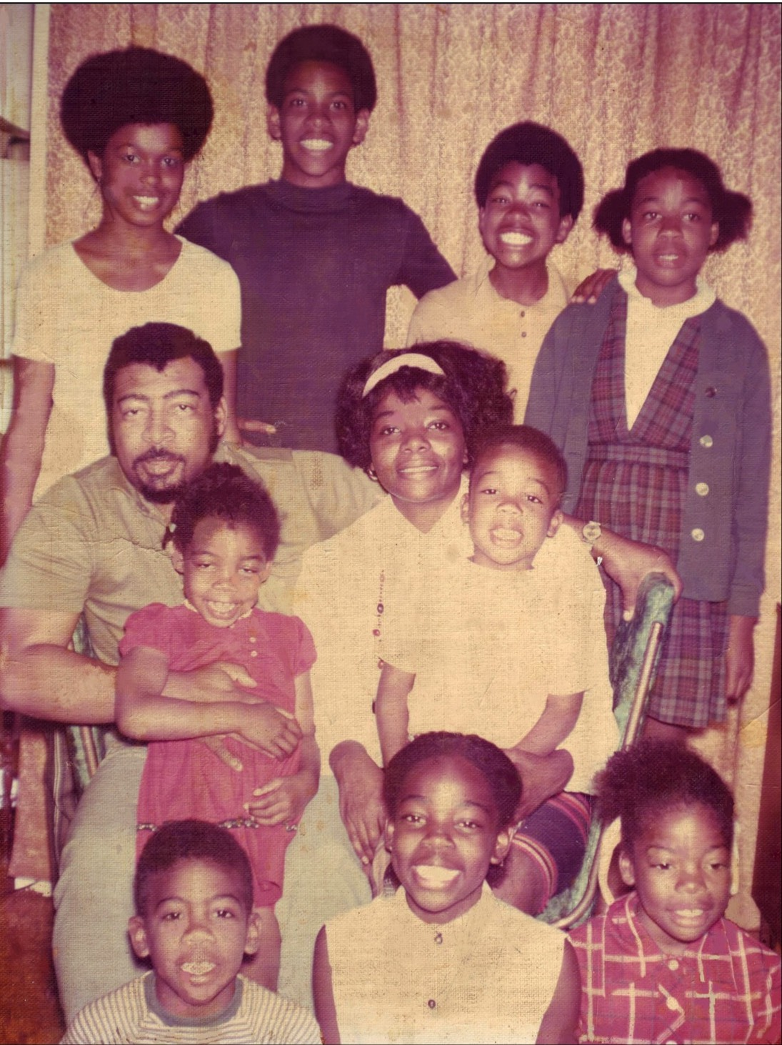
Invisible ME
I was a middle child...a punctuation mark, always looking for a purpose to fill…
I was bullied at home & school for:
Black skin
Big lips
Big feet
Wide shoulders
Coarse hair
A gap in my front teeth

Slide 6
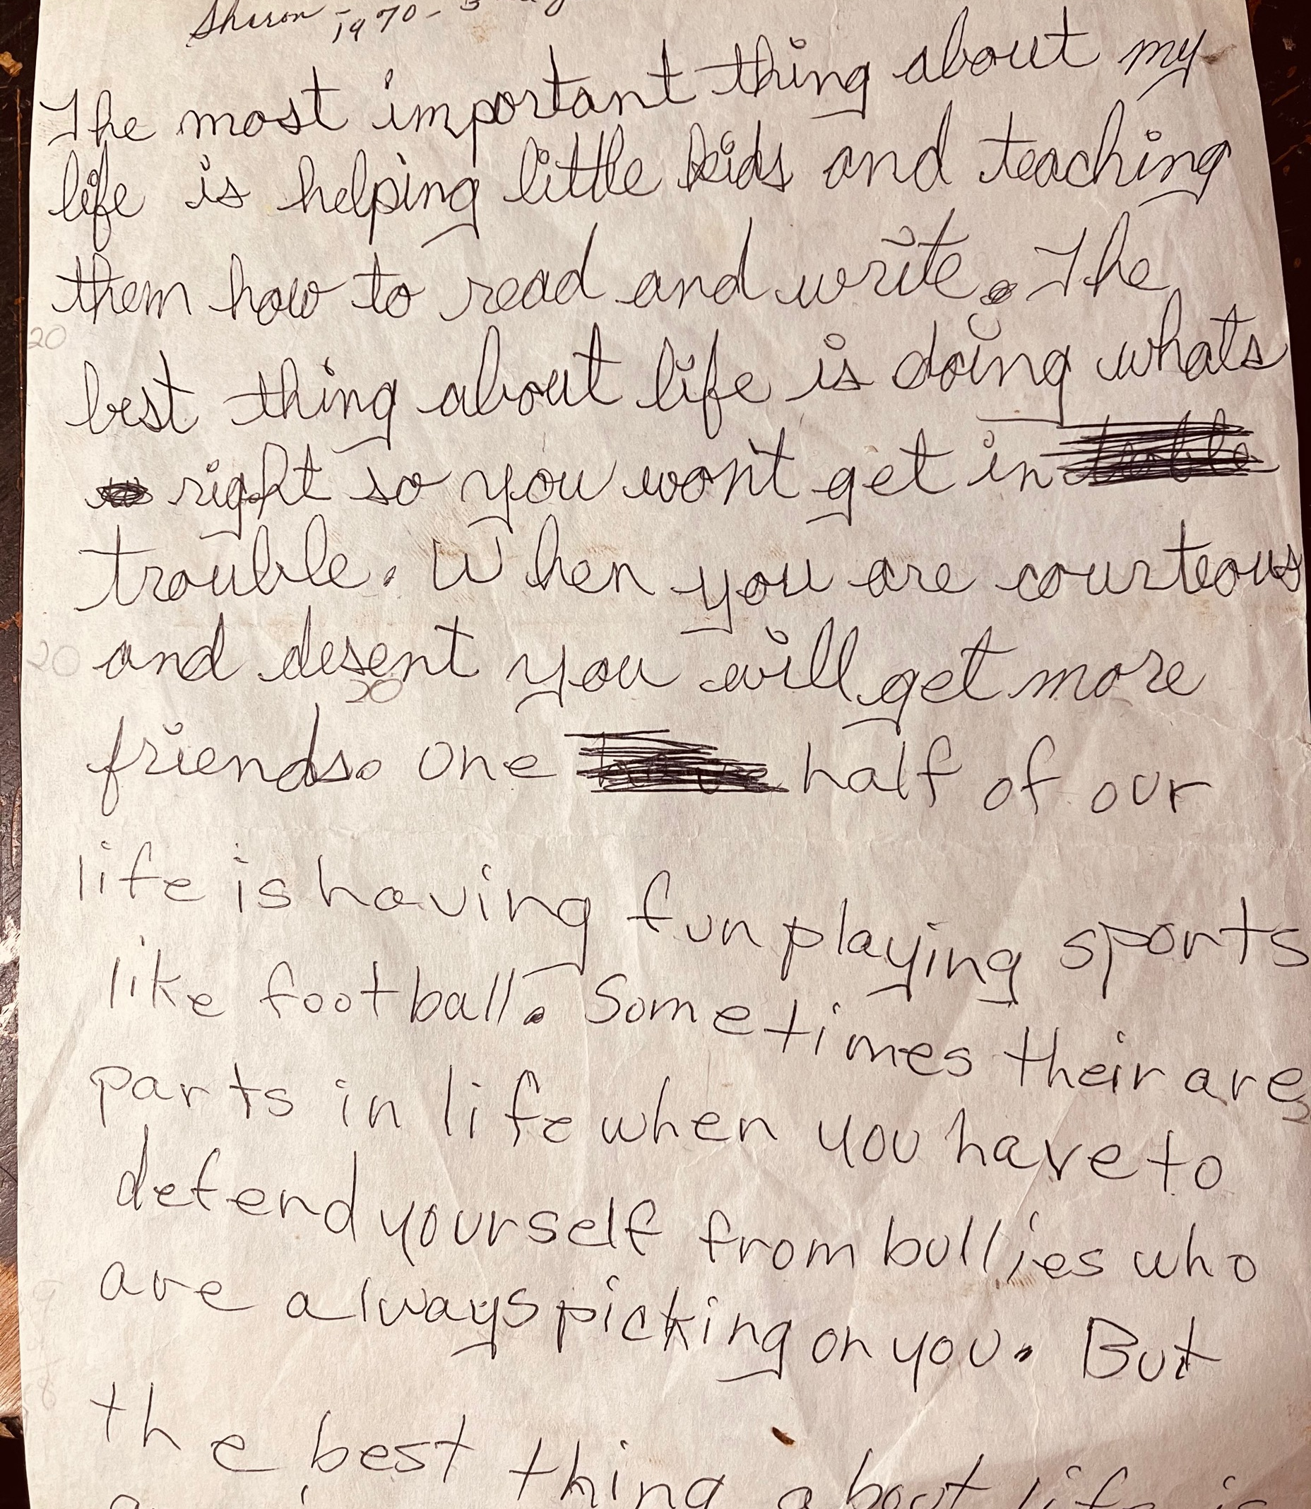
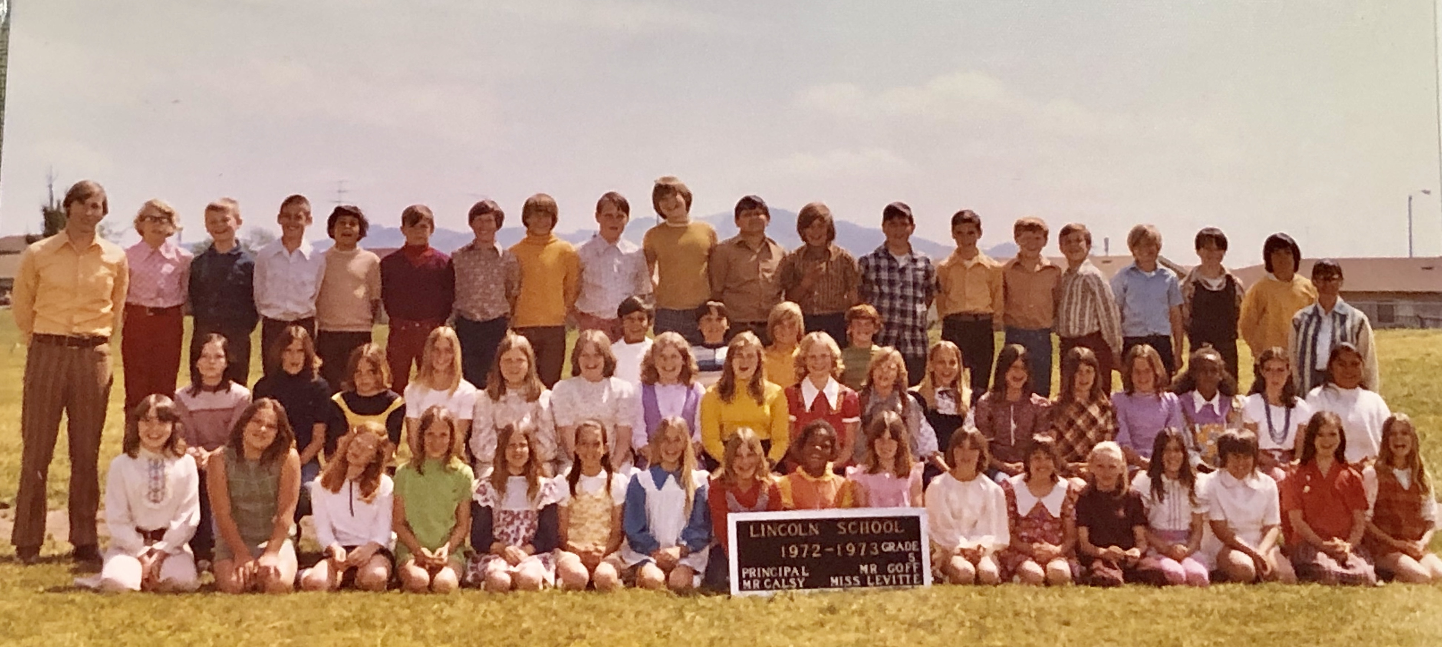
I never fit in...
School was a place of constant suffering, trauma, and isolation.

Slide 7
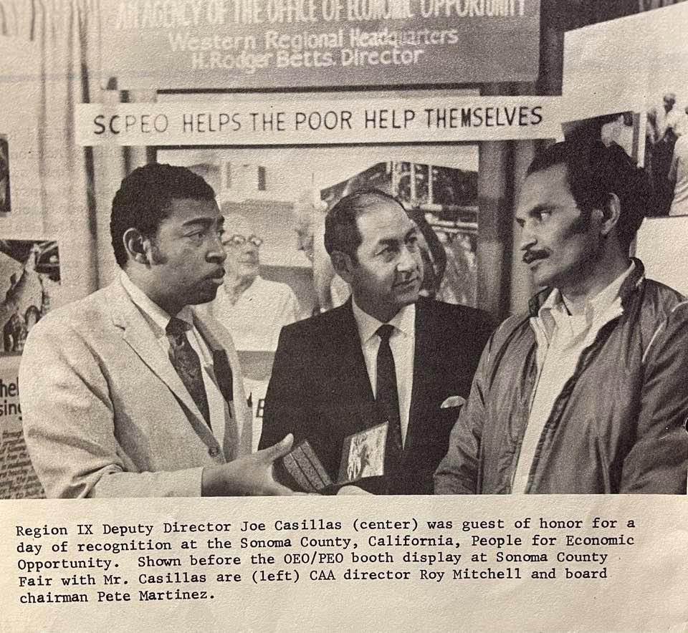
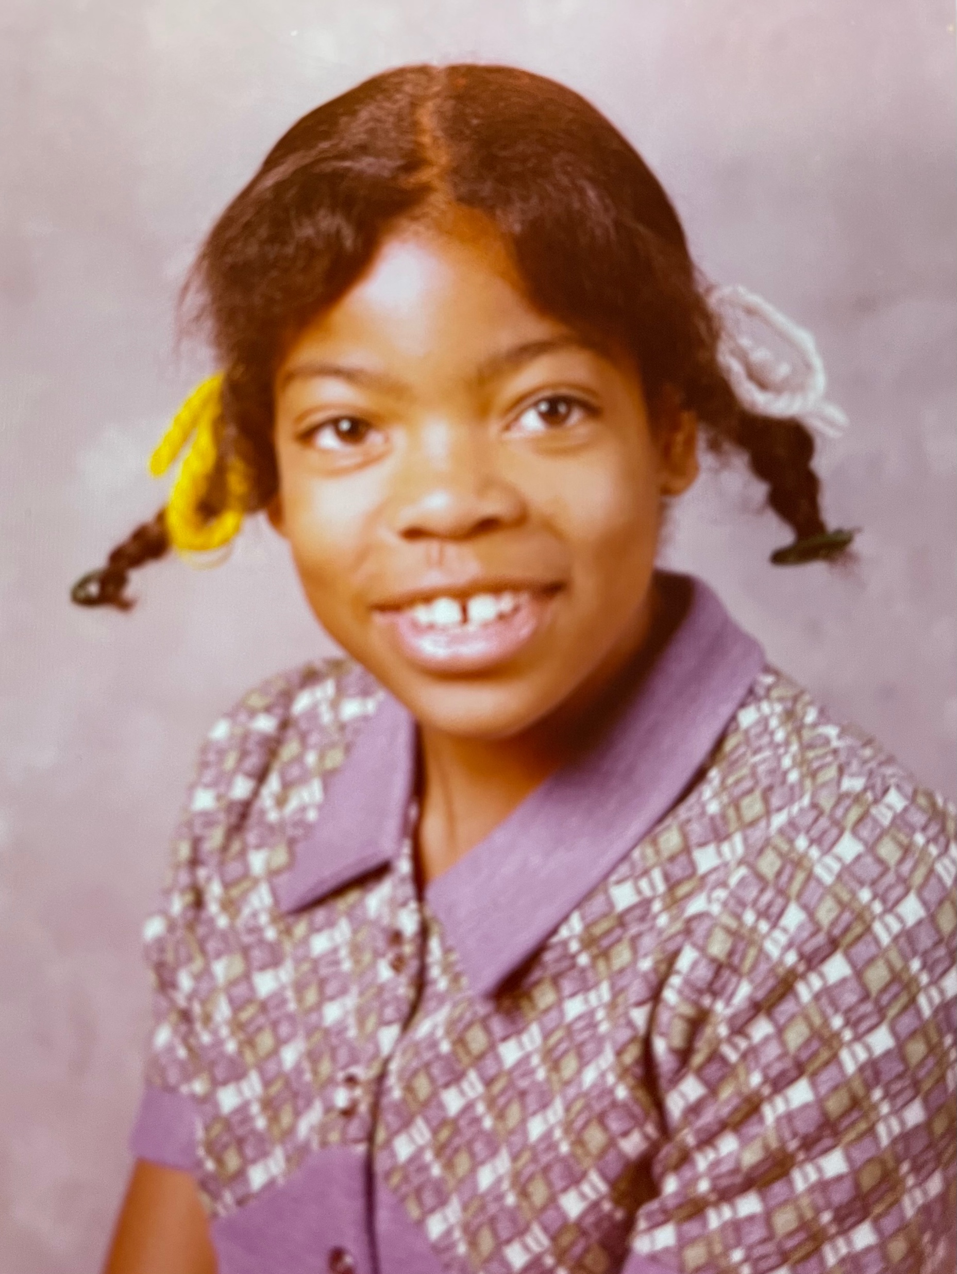
Grief & Trauma were constant companions
Age 11
Racism led to my father’s untimely death
in white-only hospital
Age 13
First considered suicide, believing my life didn’t matter to anyone
My mother – who had been pregnant for nine
years in a row - was emotionally unavailable.

Slide 8
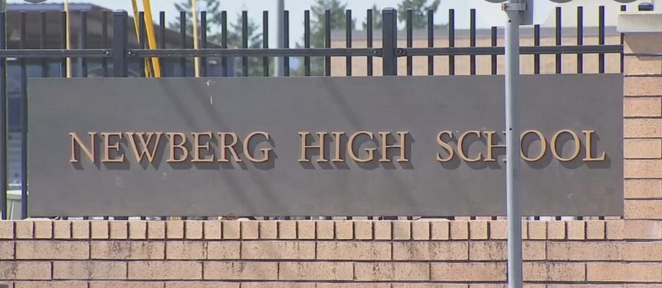
Grief & Trauma Continued
I smiled less & less
Age 15
Run over by a car at Unthank Park.
In Emanuel hospital for 3 months. Very depressed, isolated.
Age 14
Moved from northern California to rural Oregon
I was spit on. Bullied. Shunned by white students.
Beat up by star football player while my
homeroom teacher & classmates watched.
Was told by teachers that I was not college material.

Slide 9
Age 18
Had Black teachers for first time
I finally felt a sense of belonging
Kidnapped and raped by adult stranger
Age 20
Felt isolated & deeply depressed
I put a gun to my head
I felt like no one cared

Slide 10
Mother wound / abandonment
Grief / Withdrawn / Sleeplessness
Shame / Low self-esteem / Shy
Imposter syndrome
Mistrusting / Suspicious of others
Emotionally Detached
Pessimistic / Resentful / Angry
Addictive negative habits
Self-sabotaging / Depressed
Distracted / Envious of others
Anxious / Distrustful / Quiet
Self-critical /Judgmental
Let’s take a moment to acknowledge to yourself any commonalities within my journey that you have experienced yourself.

Slide 11
Ever since childhood, my amygdala in my brain
(fight, flight, freeze, fiddle about, etc.)
has been in constant high alert.
Now imagine if I was
in your classroom...
Or an abused teenager in
any existing Portland youth-development programming...
Or a lonely, angry teenager who joined a gang just to fit in…
how would any of your existing tools helped me?

Slide 12
I needed
I didn’t need more discipline, money, friends or outside approval to get my life on track...

Slide 13
Black youth Are
THE most prodigiously traumatized
Adolescent group

Slide 14
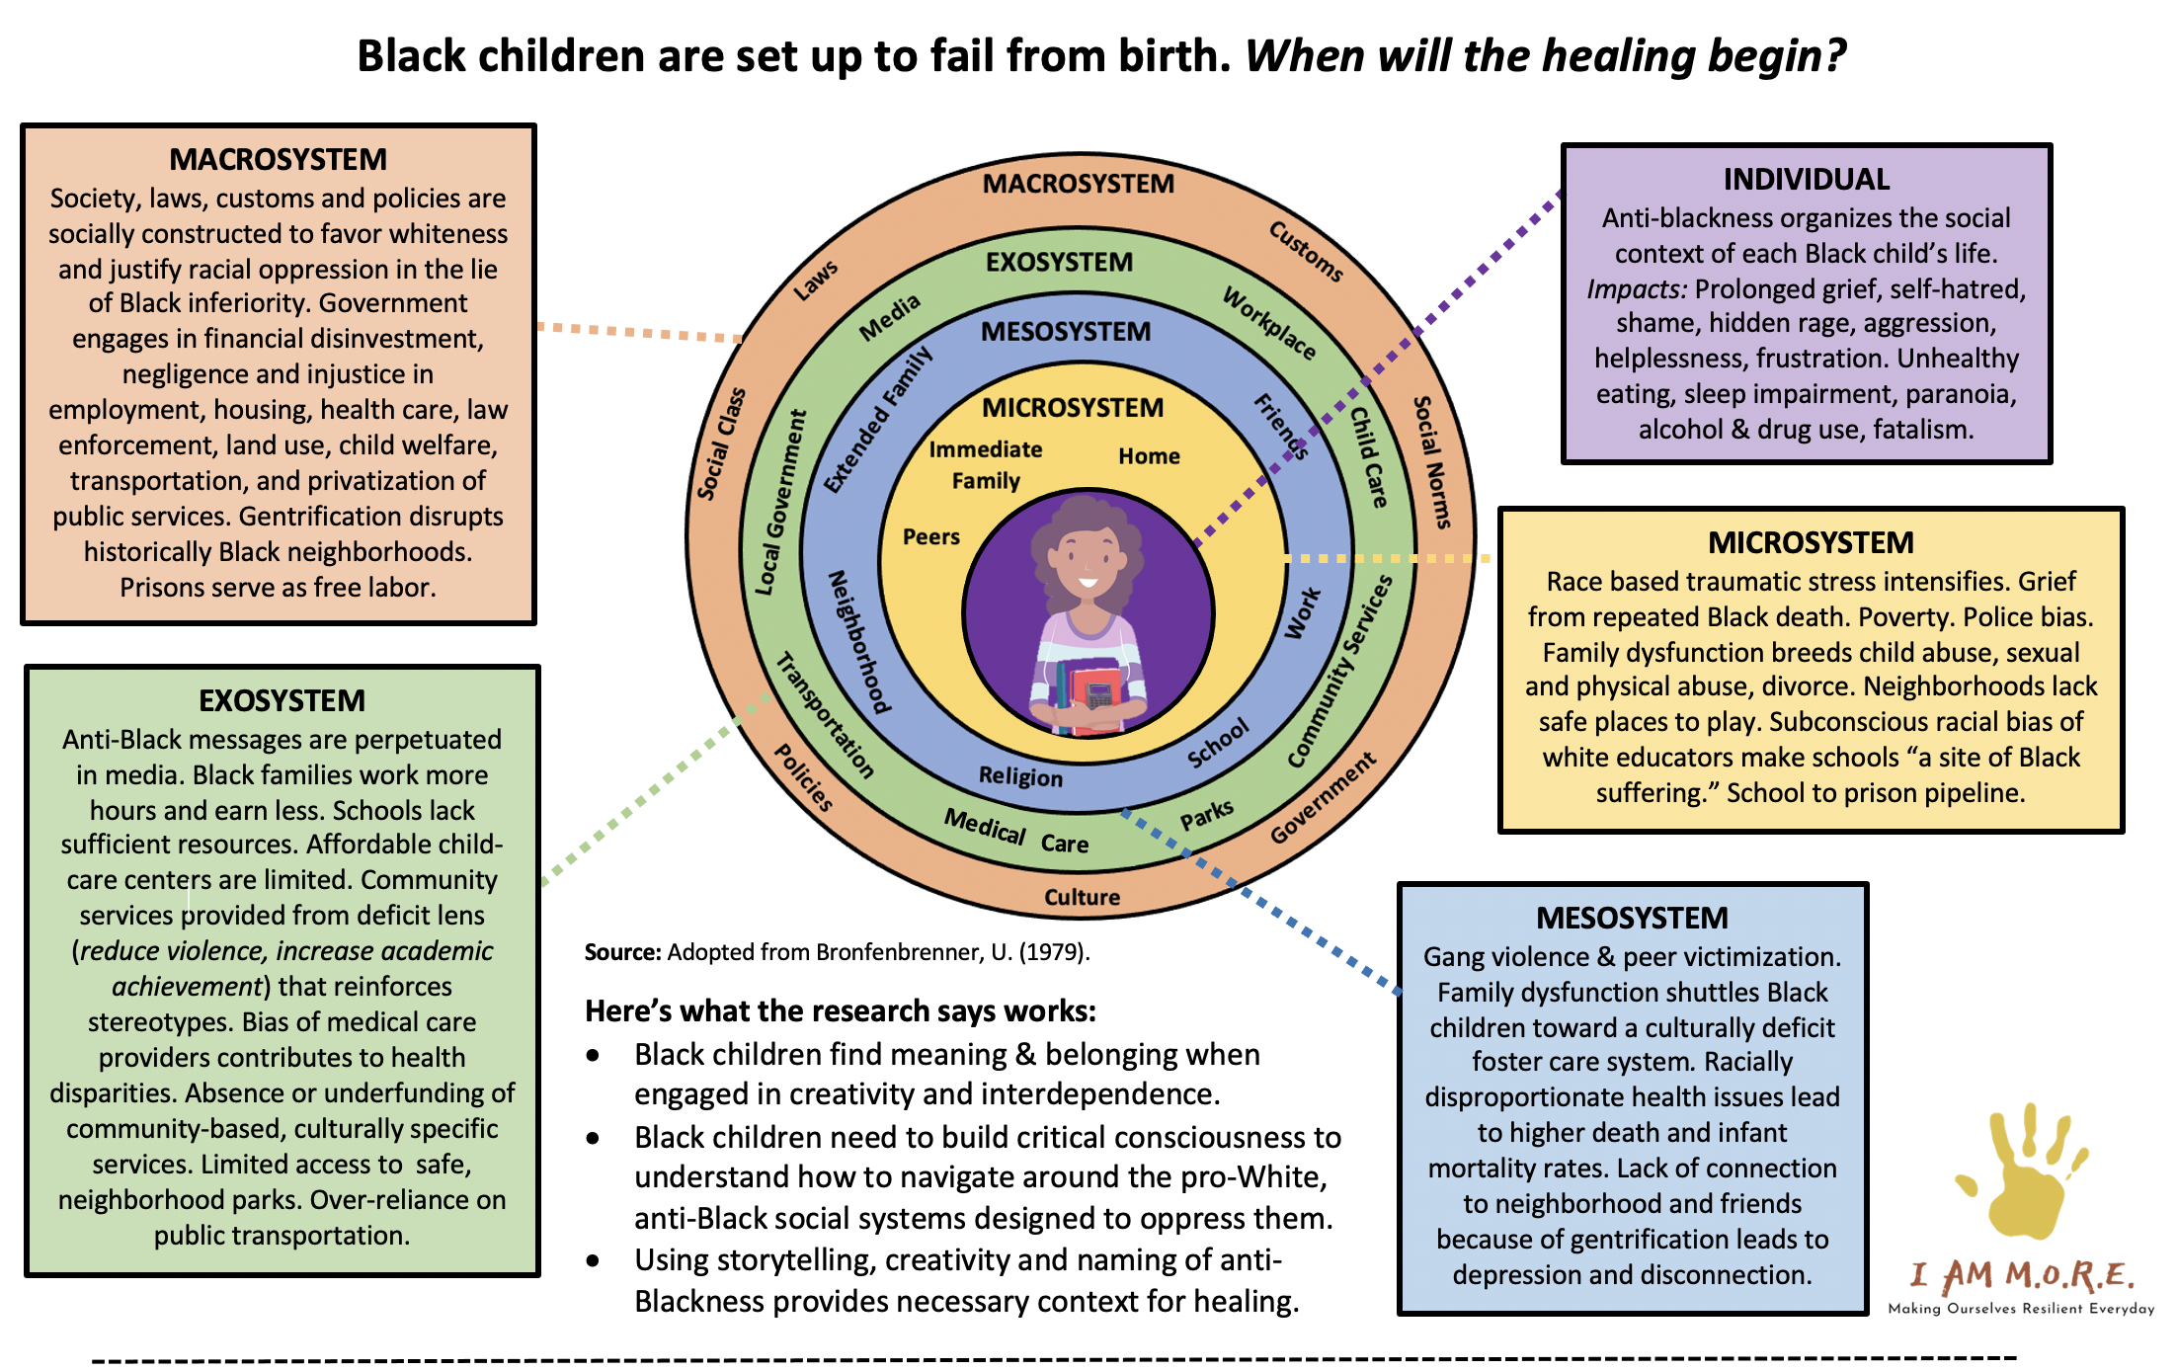
Adapted from Bronfenbrenner, U. (1979).
Sources: Alim & Paris, 2015; Assari et al., 2017; Bennett et al., 2004; Brody et al., 2014; Carter et al., 2005; Coles, 2020; Comas- Díaz; Davis, 2008; DeGruy, 2017; Dumas, 2014; Evans, 2004; Hall & Neville, 2019; French et al., 2020; Ginwright & Cammarota, 2009; Gym 1994; Grills et al., 2016; Grinage, 2019; Gump, 2010; Hardy, 2013; Hyland, 2015; Jackson et al., 2010; Johnson et al., 2019; Kaholokula, 2016; Ladson-Billings, 1992; Legette et al., 2020; Love, 2019; Masten, 2014; Paris & Alim, 2017; Reuf & Fletcher, 2004; Roediger, 1994; Rucker et al., 2010; Shonkoff et al., 2012; Tatum, 2003; Williams et al., 2019; and Wilson, 2002.

Slide 16
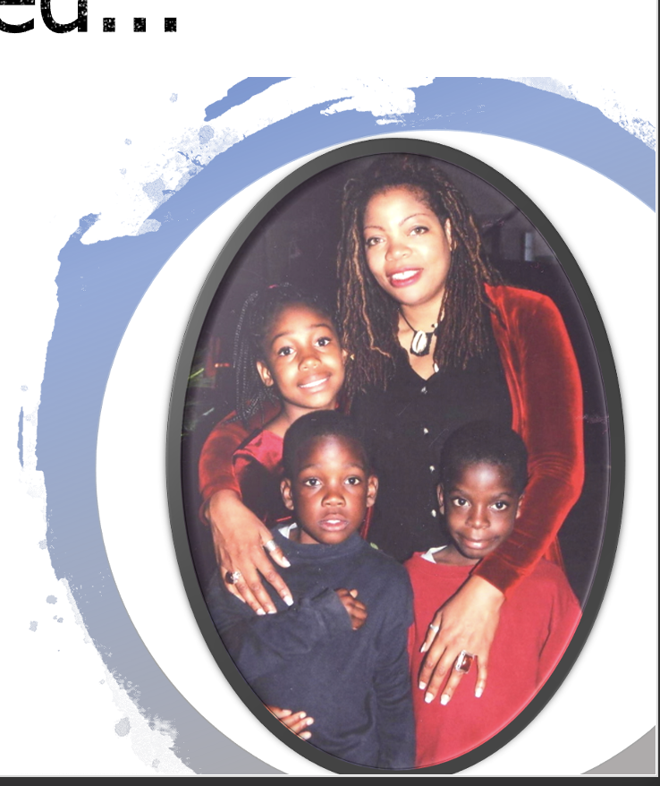

Slide 18
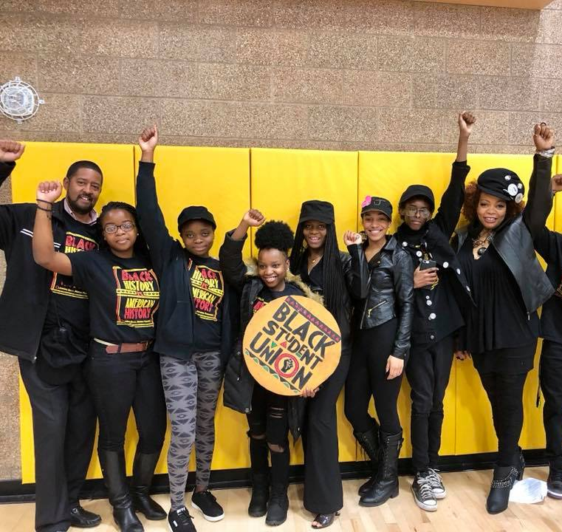
Becoming a teacher helped me define my purpose
I am rooted in offering culturally empowering healing-centered programming because...
I have endured a lifetime of racial oppression & other forms of trauma.
And when I became the only Black teacher at Oregon’s most diverse high school, I saw a similar woundedness in other Black youth.

Slide 19
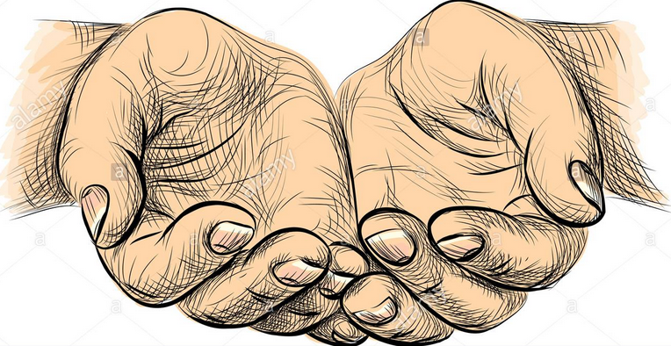
Then, while pursuing my doctoral degree,
I started to understand that because of trauma,
I had spent my whole life in survival mode,
ignoring or coddling my woundedness
instead of healing from it.

Slide 20
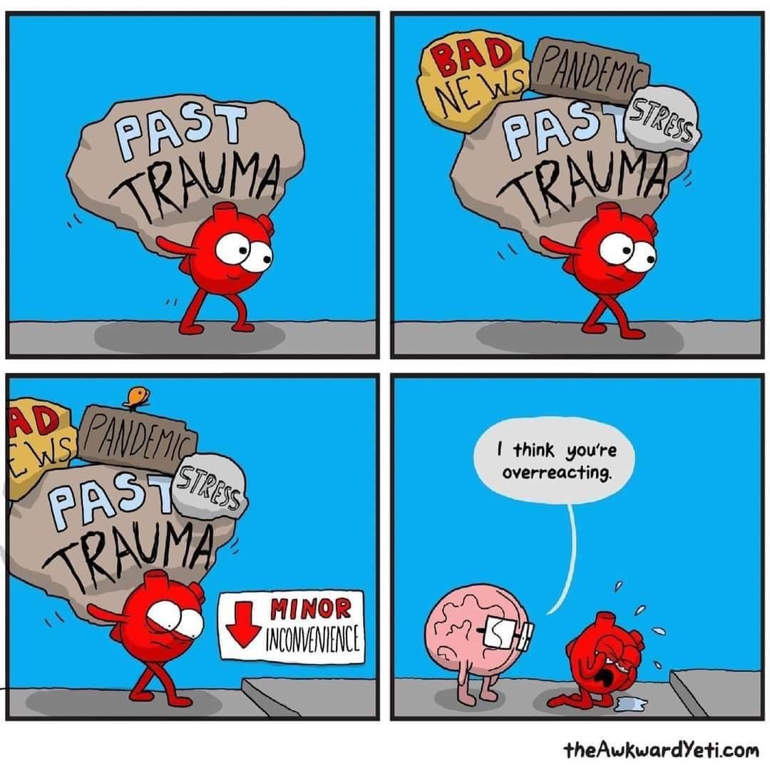
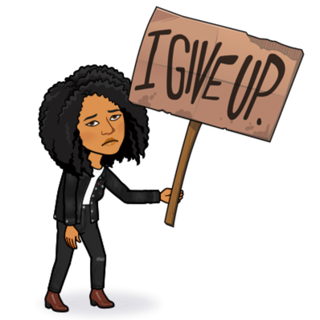
THEN, the pandemic happened.
And then, while bicycling
in Sept 2020, I got
hit by a car for a
second time.
It was time for a change.

Slide 22
Trifecta Seal of Approval
Research Based
Theory Based
Evidence Based
Also, we are centered on:
Healing. Connection. Creativity. Belonging.

Slide 23
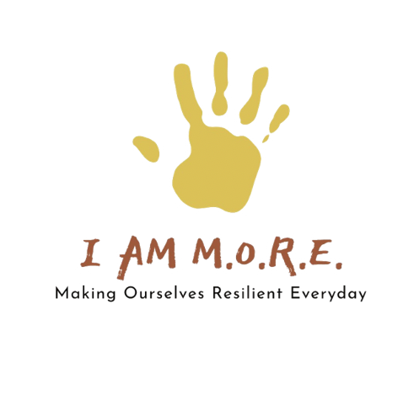
Step 1 – Inside-out

Slide 26
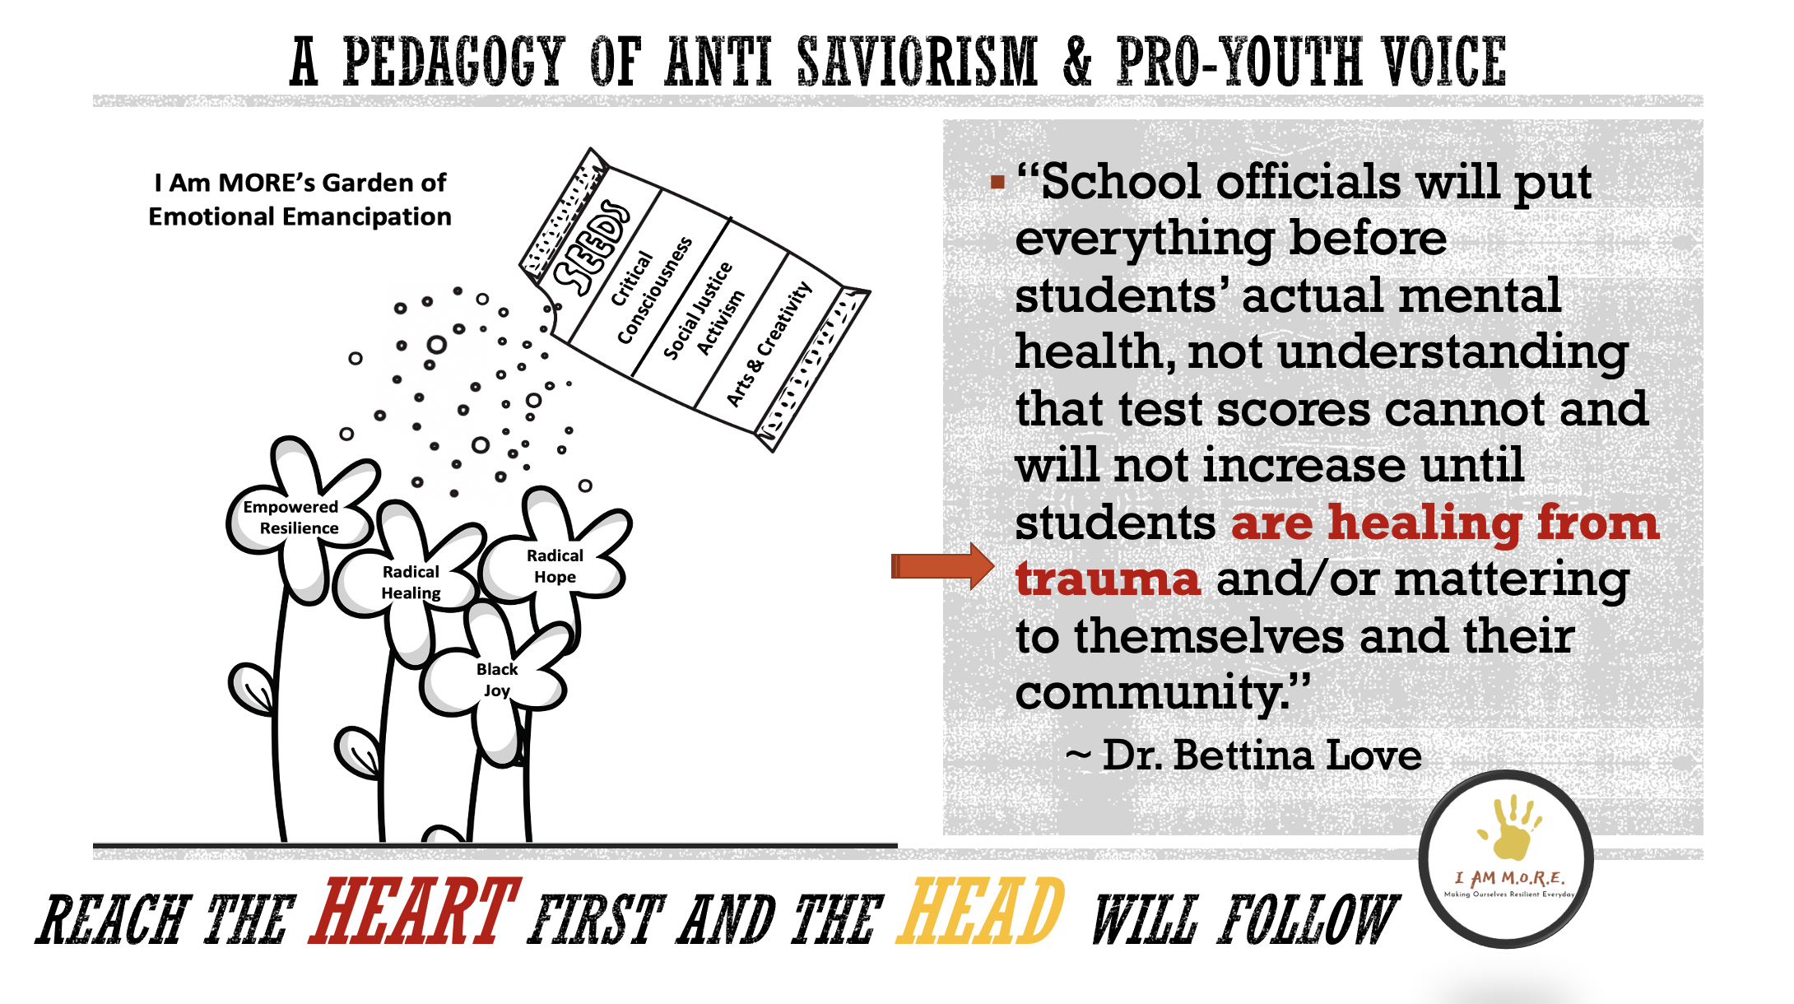

Slide 27
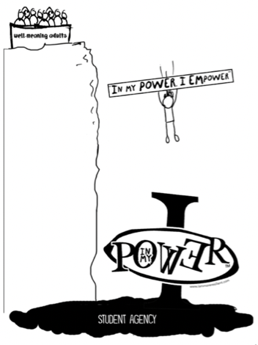
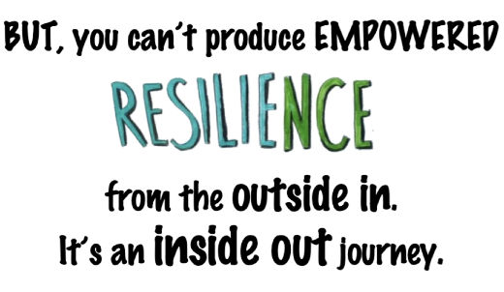

Slide 29
WHAT is DIFFERENT?
Community space
Black elder mentorship
Entrepreneurship
Service learning
VIBE-In Collective
Full-time staff
Year-round programming
Publishing company

Slide 30
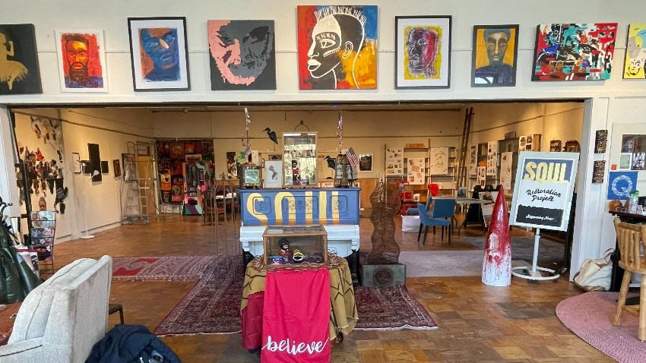
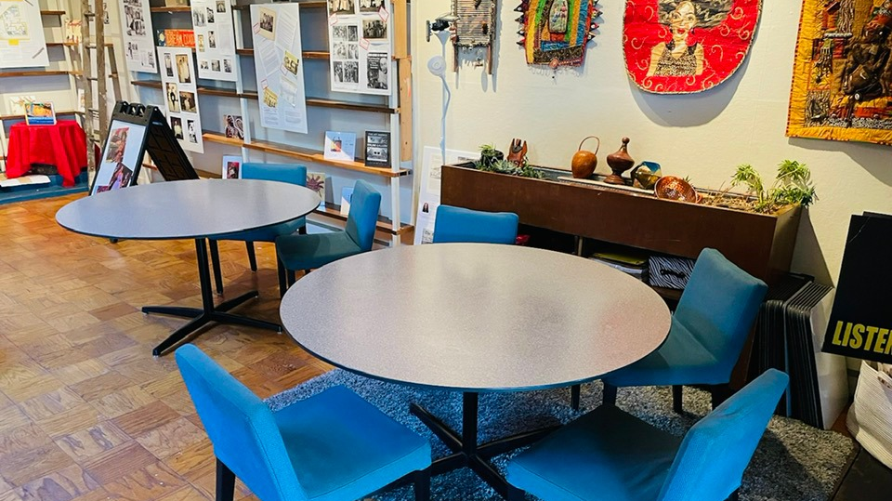
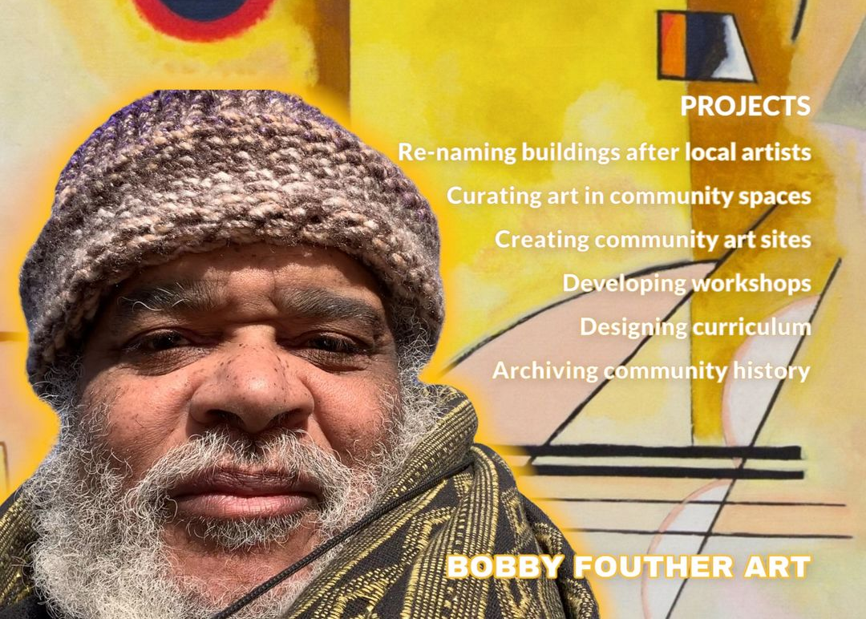
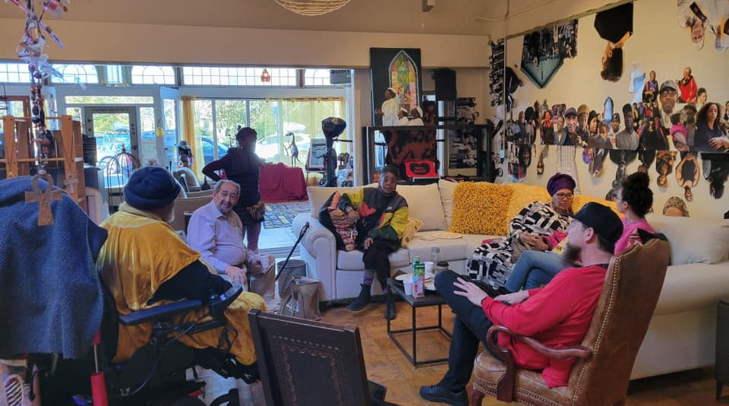
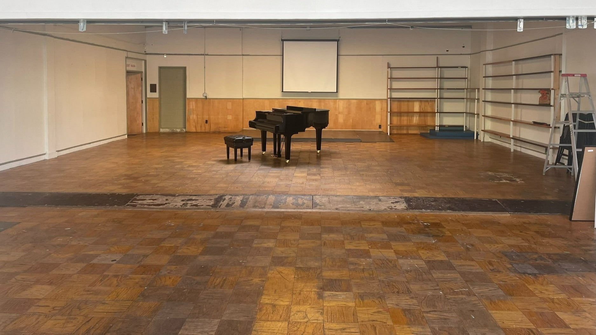

Slide 31
WHAT is DIFFERENT?
Community space
Black elder mentorship
Entrepreneurship
Service learning
VIBE-In Collective
Full-time staff
Year-round programming
Publishing company

Slide 32
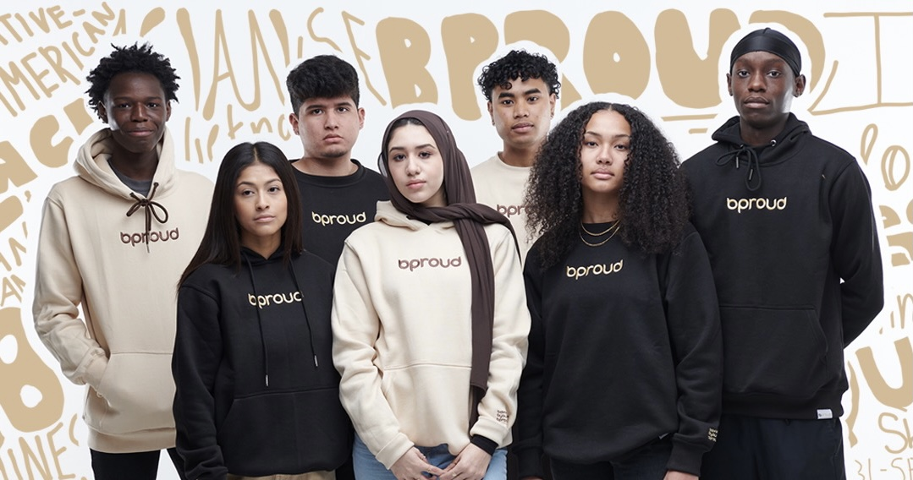
https://bproud.shop

Slide 33
WHAT is DIFFERENT?
Community space
Black elder mentorship
Entrepreneurship
Service learning
VIBE-In Collective
Full-time staff
Year-round programming
Publishing company

Slide 34
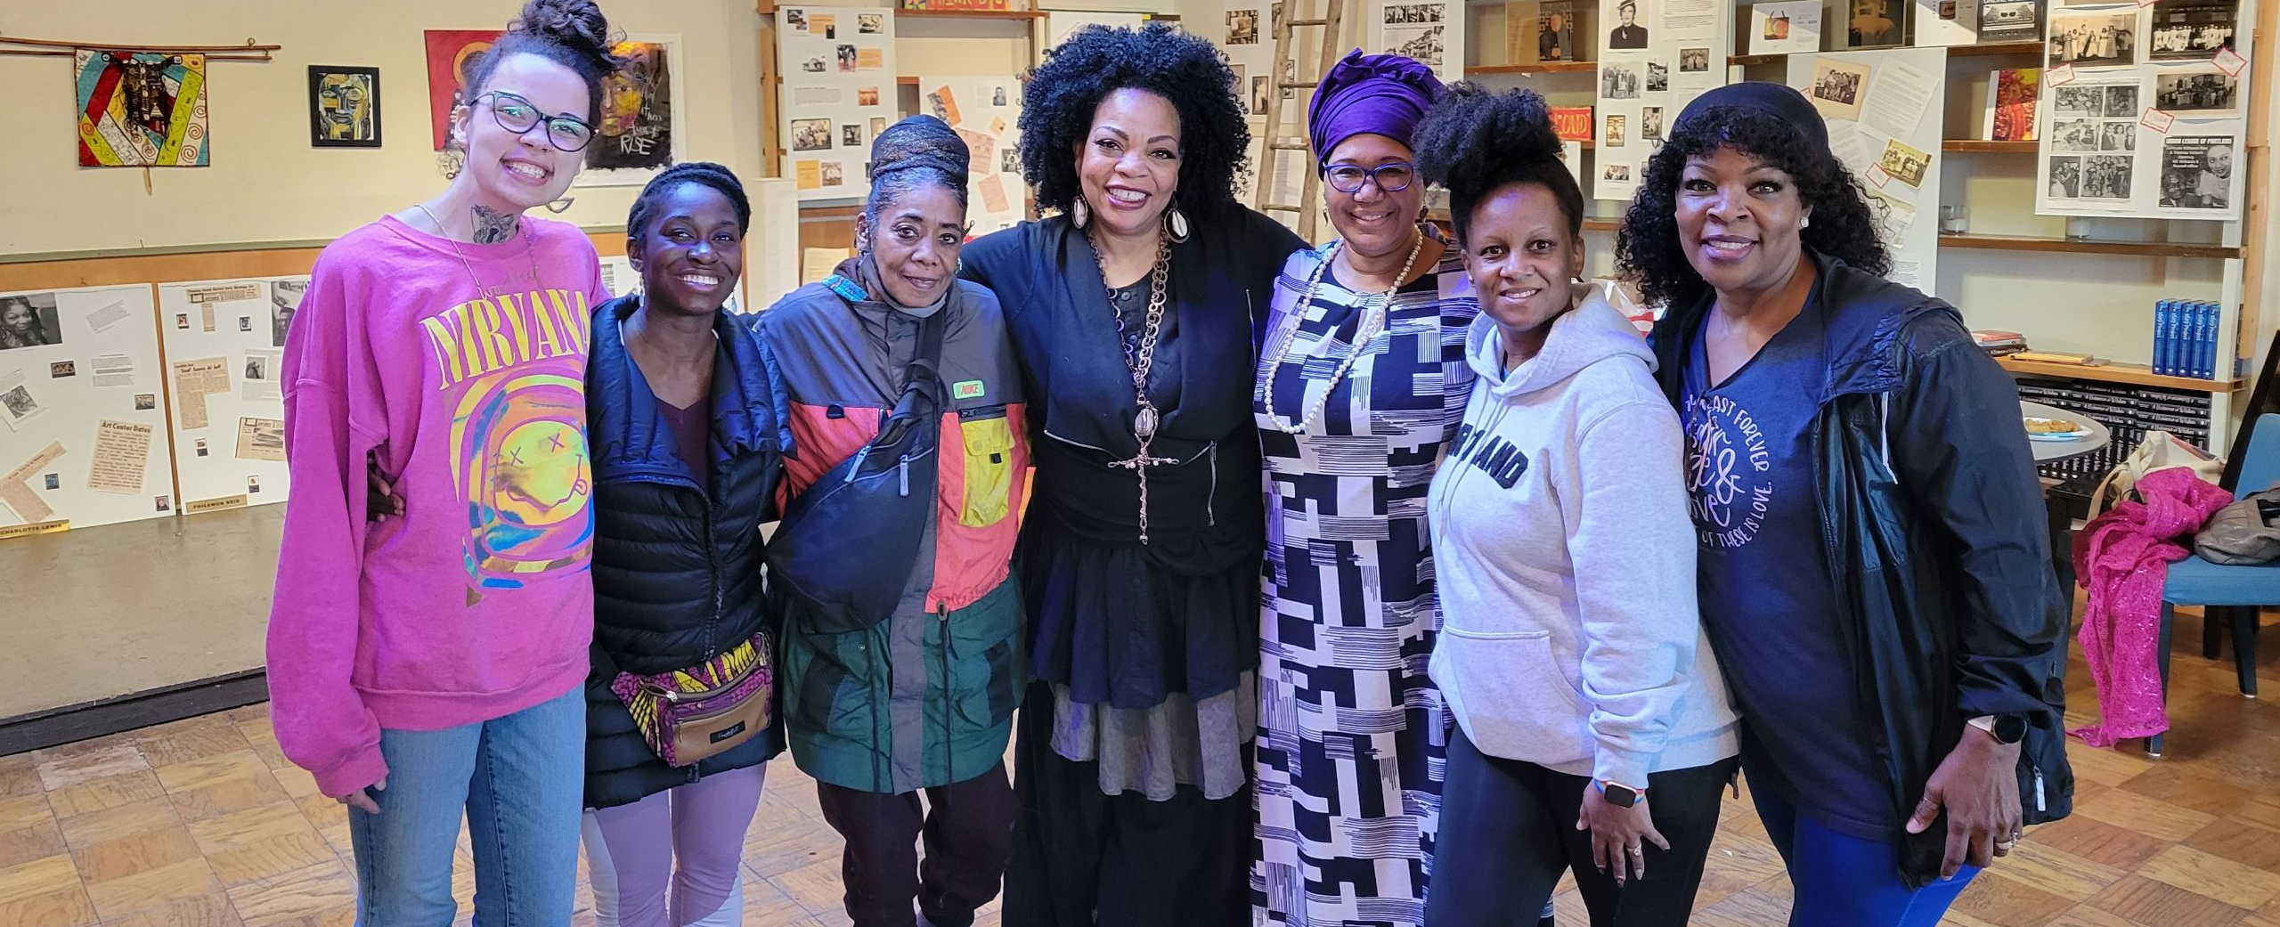
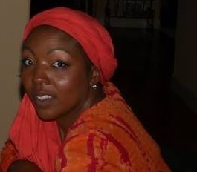
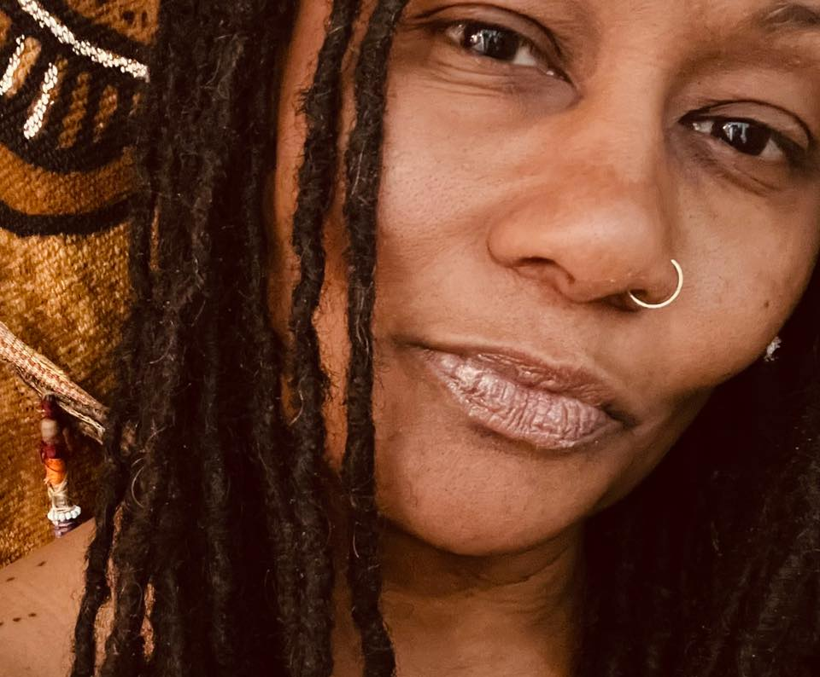
Linda Mitchell-Duncan
Sunshine Dixon
Morrison Joy
Elias
Moreno-Lothe
Cole Reed

