Slide 1
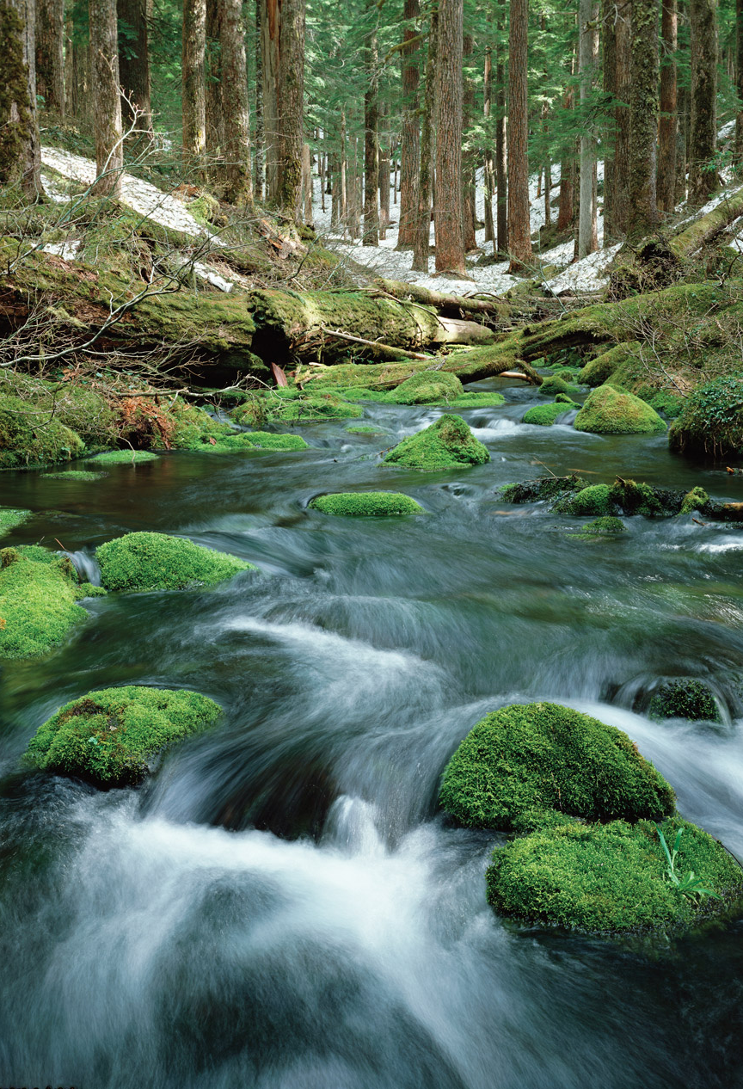

North Jantzen Avenue
Water Main Replacement Project
Jodie Inman, P.E.
Chief Engineer

Slide 2
Distribution Mains Program Background
Approximately 2,250 miles of water main
Asset Management used to identify projects based on condition and risk
Main replacement goal of 35,000 to 50,000 ft/yr
Goals of distribution main contract projects:
  increase footage replaced to meet asset management goal
  providing different sized contract opportunities to the community
Notes:
Approximately 2,250 miles of water main
The Portland Water Bureau uses Asset Management to identify main replacement projects based on condition and risk.
Asset Management identified a main replacement goal of 35,000 to 50,000 ft/yr
This project is one of several contract projects coming forward with goals of:
increasing footage replaced
providing different

Slide 3
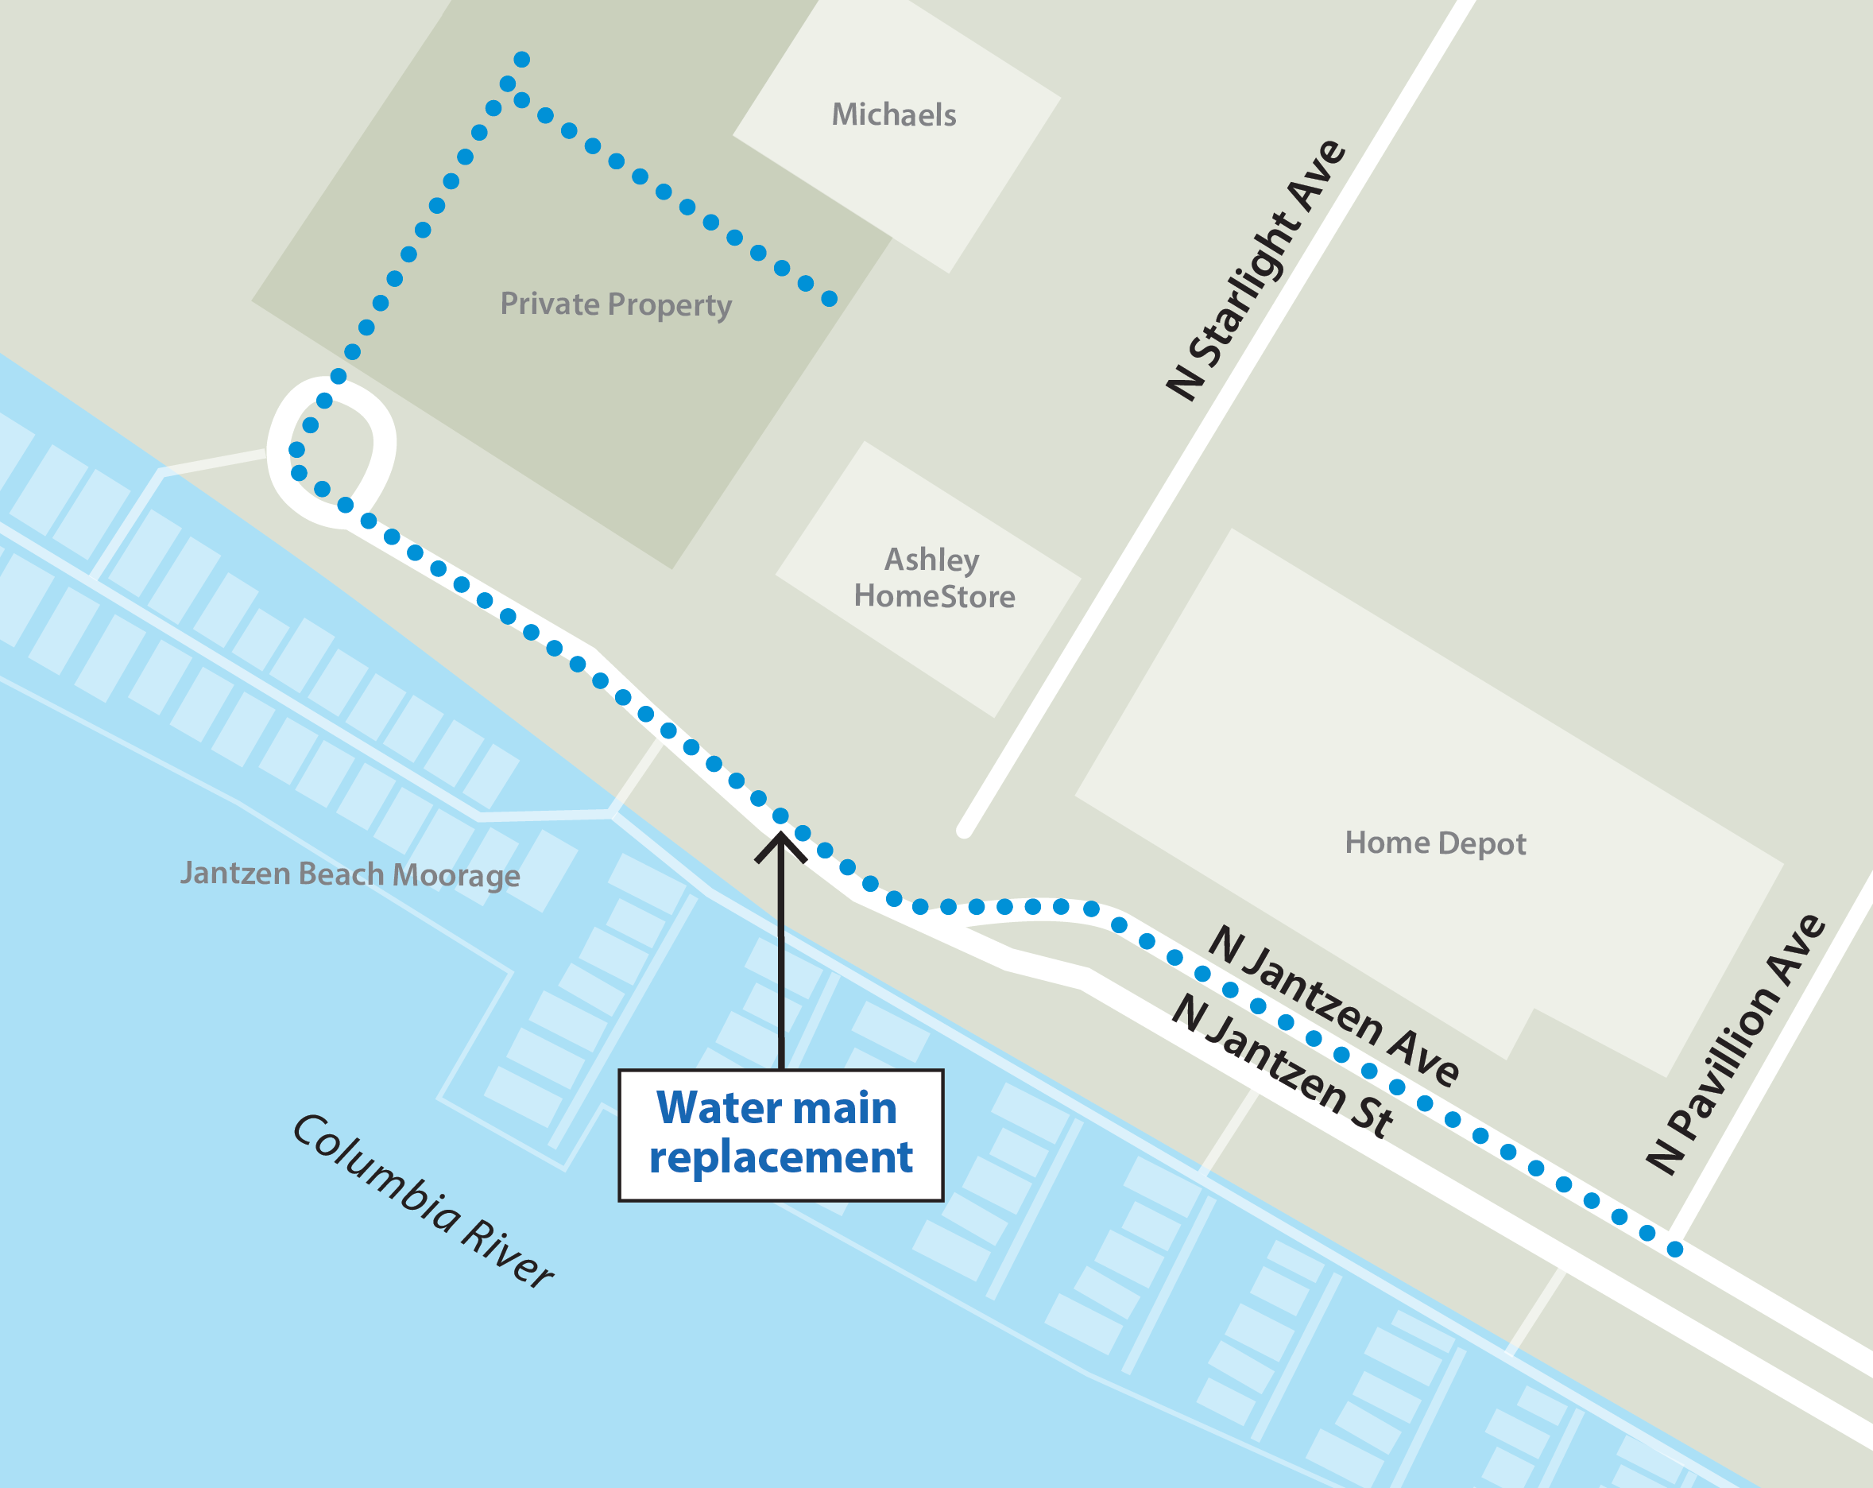
Why we’re replacing this water main
Fix aging pipes
  2,200 lf of new main
Improve seismic resiliency
  Install earthquake resistant pipe
Protect against contamination
  Install backflow devices
Improve fire protection
  Add fire hydrant
The new pipe will help make sure water is safe and reliable for generations to come.
Notes:
Identified as being needed with the Hayden Island Master Plan
This project will:
Replace water mains in the area that have a history of leaks and breaks.
Make the water system more resilient in an earthquake
In addition to the leaking main, several water services in the area lack backflow devices. These devices are required by law to keep our water supply safe from contaminants. We will install backflow devices on services that need them to bring them up to City code. This will make sure your water stays clean even if there is an unexpected reverse of water flow.
Backflow is required by the Oregon Health Authority and prevents unwanted flow from the private side of the meter into the public water system.
Improve water flow and supply to fight fires

Slide 4
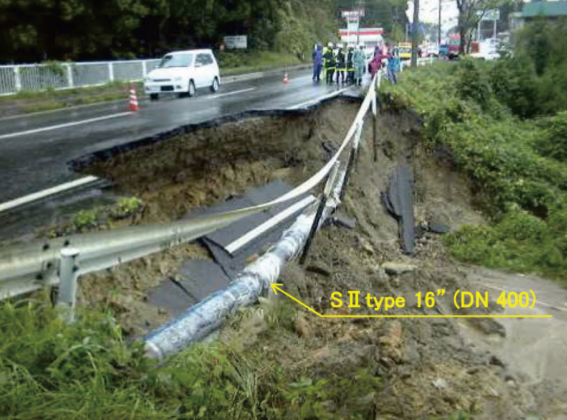
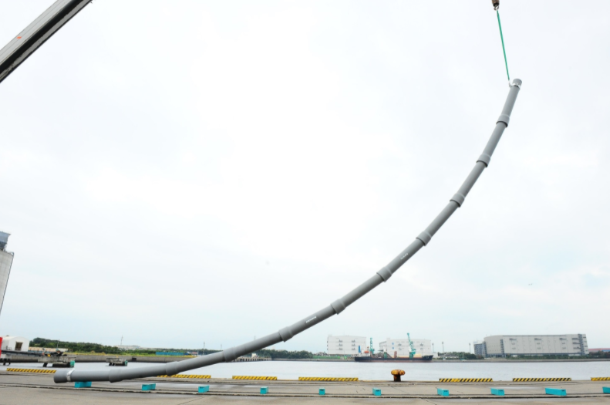
What is earthquake resistant pipe?
Photos from Kubota Membrane Corporation
Notes:
Project Fact:
After a seismic event, the ground in this area could spread apart 10 ft or sink by a foot or more.
Earthquake resistant ductile iron pipe, or ERDIP, has a special joint that allows the pipes greater rotation as well as the ability to contract (be pushed in) or expand (be pulled out).
Has a demonstrated history of performance in Japan with earthquakes and tsunami.
Key part of implementation of the Water Bureau’s Seismic Implementation Plan and bringing into compliance with the 2013 Oregon Resilience Plan.

Slide 5
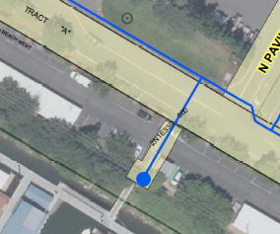
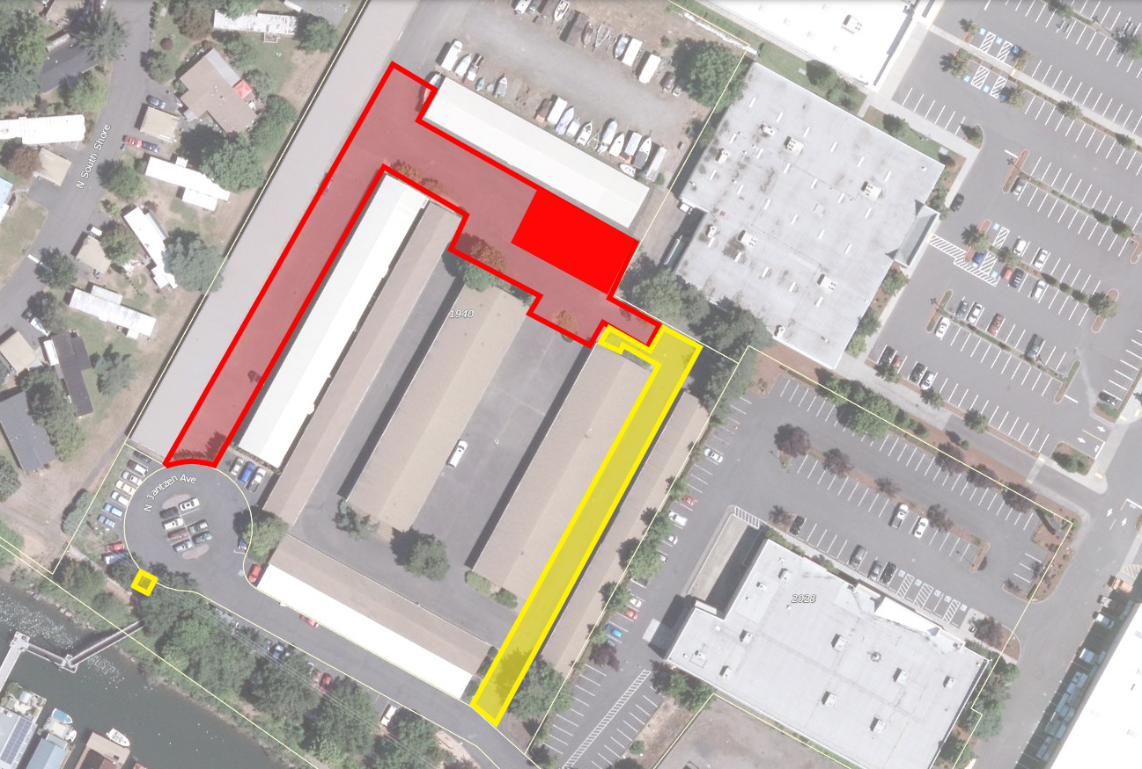
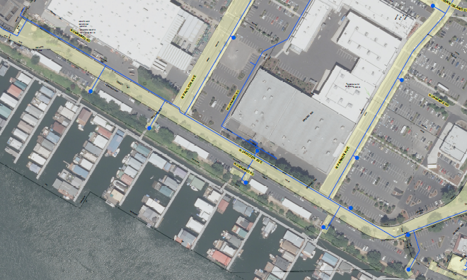
Easements & Property
Temporary
Construction Easement
Solid Color = Staging Area
Permanent Easement
Permanent Hydrant Easement
Notes:
Hayden Island is mostly private with easements instead of public right of ways.
Project is primarily in existing easements.
Need temporary and permanent easements from property owners.
Appreciate general support of the property owners and willingness to work with us. Been talking and working with property owners for a while.
Intent and preference is to come to an agreeable settlement with property owners.
Obtained Council approval (Ordinance 189120) for Condemnation to ensure both parties participate in meaningful negotiations.
Have reached completion on one and are working with the other.
Project will not be bid until easement and property issues are resolved.

Slide 6
Request
Authorize bid solicitation and contracting with the lowest responsive and responsible bidder for construction of the North Jantzen West of N Pavilion Ave Water Main Improvement Project.
Estimated cost: $1,326,698
Start date: Fall 2022 or Winter 2023
Notes:
Will not put out to bid until all easements and property issues are addressed.

Slide 7
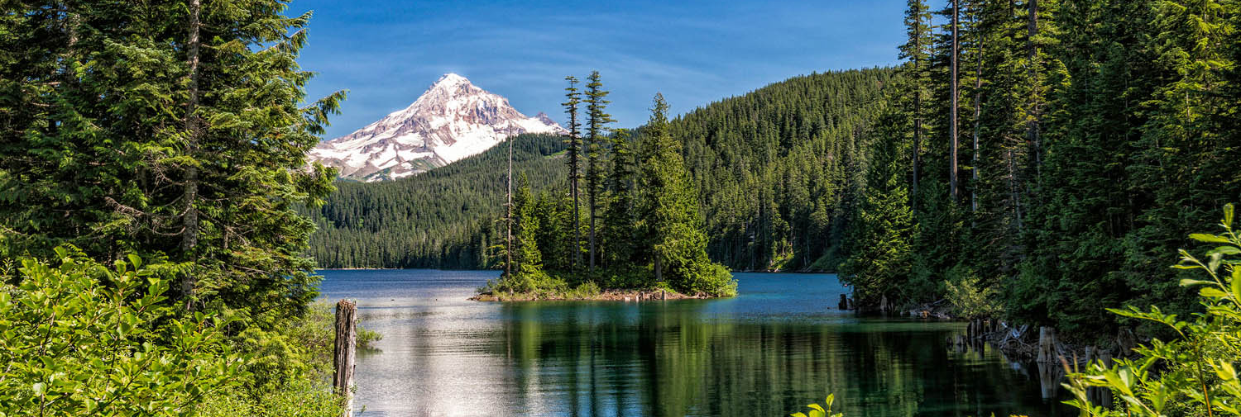




Questions?
Jodie Inman
503 823-1289
portland.gov/water/JantzenMain
PortlandWater
PortlandWaterBureau
PortlandWaterBureau
E-News: eepurl.com/gcWEjj

Slide 8


Backflow
LAWN IRRIGATION SYSTEMS
SWIMMING POOLS
BACKFLOW PREVENTER
INDUSTRIAL SYSTEMS
PUBLIC DRINKING WATER SUPPLY
MEDICAL SYSTEMS
Clean water
HEATING + COOLING
Backflow preventers keep contaminants from flowing back into the drinking water supply.
FIRE + SPRINKLER SYSTEMS

Slide 9
