Slide 1
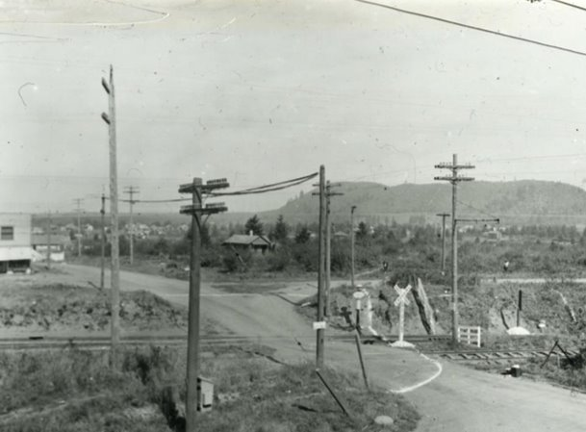
NE/SE 82nd Ave Pedestrian Crossing Project
Portland City Council January 17th, 2022
1932
Notes:
A 1932 photo from the City Archives, taken at present-day SE Martin Luther King Jr. Blvd (formerly Union Ave) and Washington Street. The men in the middle of the intersection are repairing the sewer. In the background you can see “H. Smith Produce,” and “Whitely and Clark Co.” stores.

Slide 3
Project Scope
Install a new RRFB (currently all way stop)
Makes all curb ramps ADA compliant
Adds pedestrian marked crossings
Includes an island on the 82nd/Beech location
Notes:
Adds full signal (currently all way stop)
Makes all curb ramps ADA compliant
Adds curb extensions on south side of the street
Adds ped crossing along north side of the intersection
Adds green skip striping and bike boxes

Slide 4
82nd Ave and Beech

Slide 5
82nd Ave and Ash

Slide 6
Public Involvement Overview
Through the ODOT-led planning process (2018) on 82nd Ave, PBOT identified priority enhanced crossing locations. These were vetted with the community through the planning process and included in the ODOT 82nd Avenue of Roses Implementation Plan. The crossing location recommendations included Ash and Beech intersections.
The City conducted interviews with property owners, business owners, and community members, as well as market research to better understand barriers to redevelopment.
PBOT is currently working on design and has been in contact with adjacent property owners.

Slide 7
Right of Way
Authority is given to compensate property owners for necessary easements and, if needed, to condemn.
Permanent ROW and Temporary Construction Easements are needed from eight property owners.
Permanent ROW is needed for construction of the ADA ramps.
Temporary Construction Easements are needed for construction support.
Affected property owners have been informed of the project needs.

Slide 8
Thanks!

