Slide 1

2035 Comprehensive Plan
Policy 5.35 Inclusionary housing
Use inclusionary zoning and other regulatory tools to effectively link the production of affordable housing to the production of market-rate housing. Work to remove regulatory barriers that prevent the use of such tools.
Matthew Tschabold Policy and Planning Manager
Dory Van Bockel Development Incentives Manager
December 15, 2021

Slide 2
Portland’s Inclusionary Housing Units
Projected Minimum:
Confirmed 60% AMI Units:
Confirmed 80% AMI Units:
Undetermined:
1,623 units
1,105 units
439 units
79 units
City of Portland, Portland Housing Bureau, November 2021

Slide 3
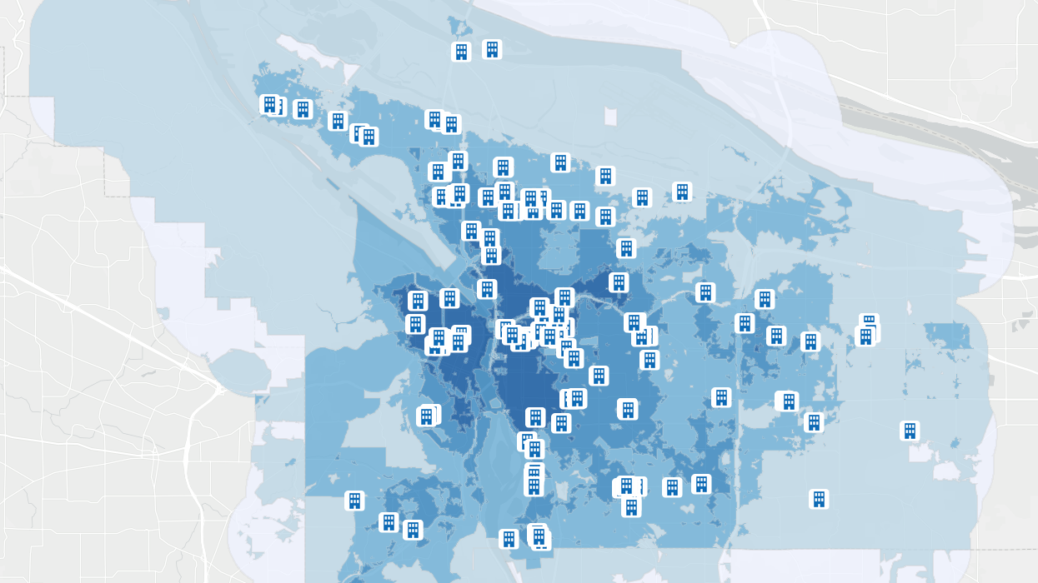
IH MULTE Applications
December 15, 2021
The Gabriel
4525 SW California Street
City of Portland, Portland Housing Bureau, November 2021

Slide 4

The Gabriel
Project Overview
Developer Options
  15% of units at 80% AMI
  8% of units at 60% AMI
  Fee-in-lieu
  Off-site
  Bedroom reconfiguration
Building
121-unit building (Avg. SqFt: 626 studio, 697 one-bed, 970 two-bed, and 1,114 three-bed)
  4 IH 3-bedroom units at 60% AMI
Rents
Neighborhood: $1,596* for three-bed
IH rent max: $1,509 for three-bed
Property Tax Exemption
$364 per IH unit, per year (for 10 years)
  $34 per year of affordability (for 99 years)
Housing Bureau recommends approval as IH rents are just below market and will increase more slowly than market rate rents, and there is a significant demand for affordable 3-bedroom units in this area of the city.
*Market estimates today, market rents may be higher after construction

Slide 5
Questions?

