Slide 1
Columbia Boulevard Wastewater Treatment Plant Blower System and Building Improvements Project Council Item 905
Bhargavi Ambadkar, P.E.
Division Manager
Cyrus Osborn, P.E.
Project Manager
12/15/2021
MINGUS MAPPS, COMMISSIONER
MICHAEL JORDAN, DIRECTOR

Slide 2
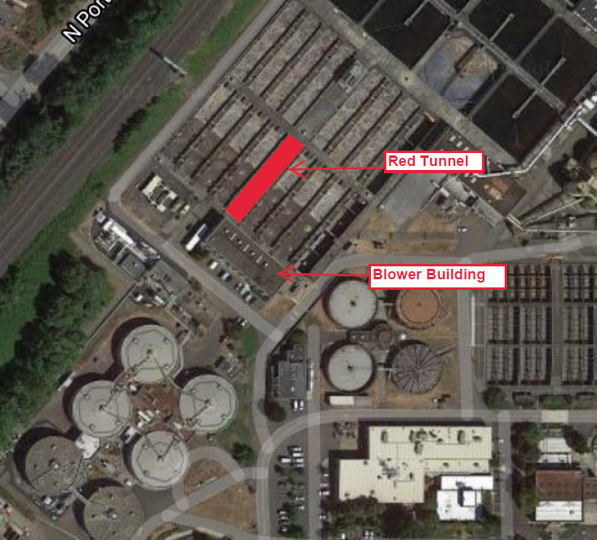
Project Location
Blower Building
CBWTP Aerial View

Slide 3
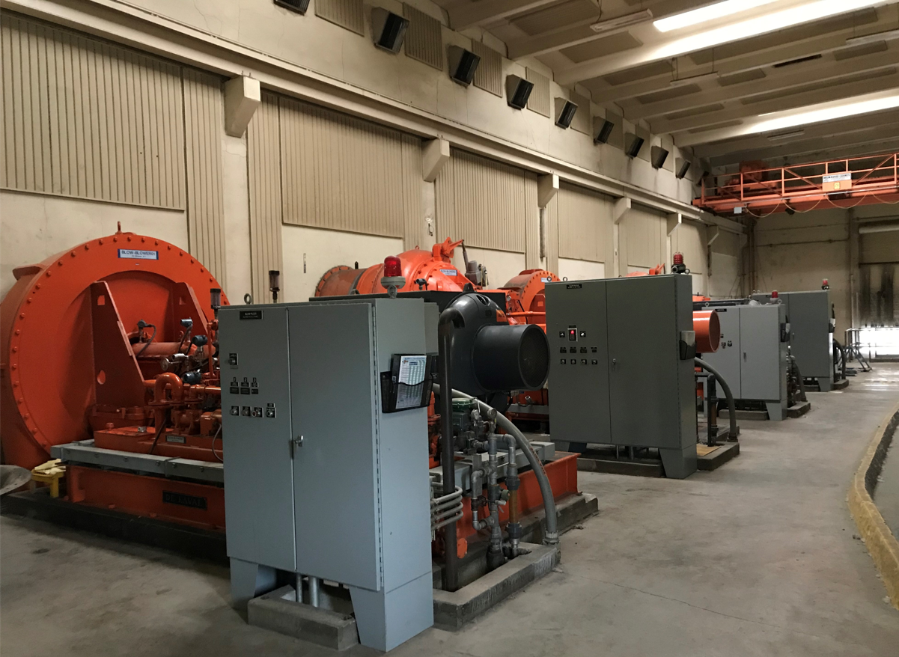
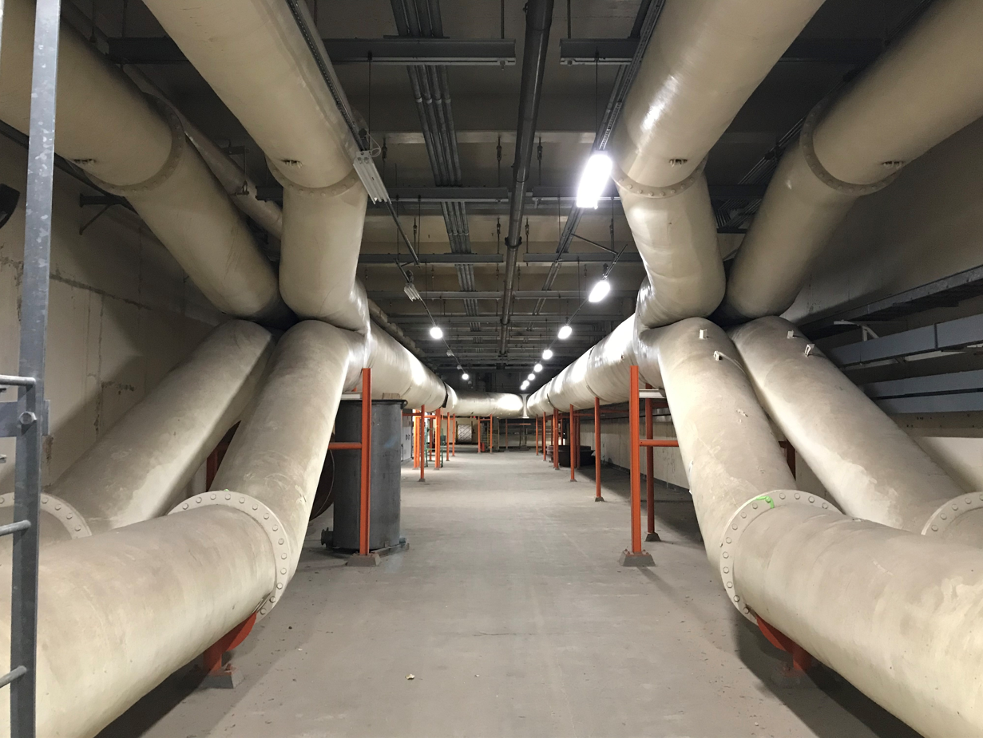
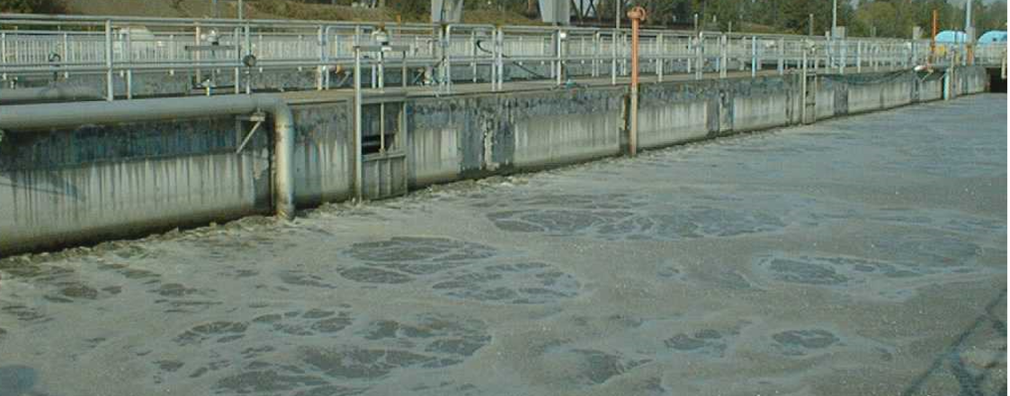
Project Background
Red Tunnel
Blower Building Interior
Aeration
Basin

Slide 4
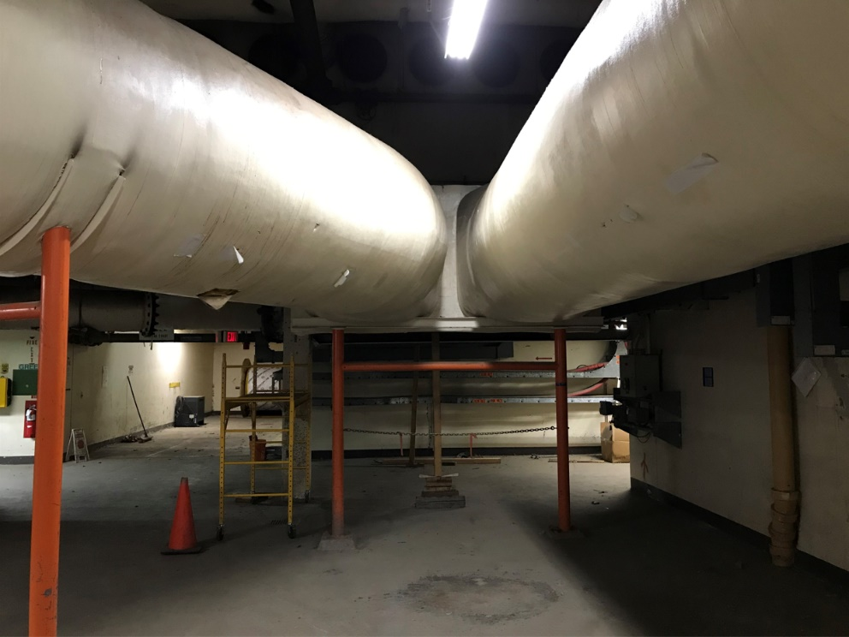
Problems with Existing Blower System
Age and functionality of system
Ducting leaks and single point of failure
Need roof replacement and seismic upgrades
Distribution System Single point of Failure
Deteriorated Roof
Notes:
4

Slide 5
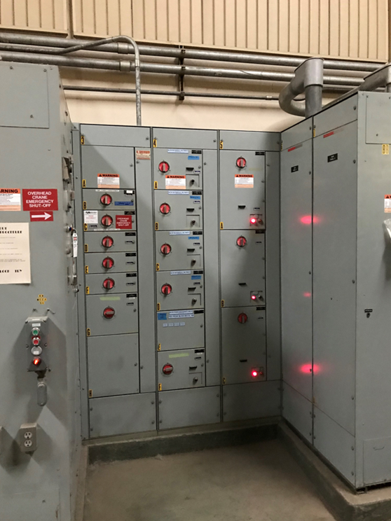
Project Objectives
Optimized blower and aeration performance.
Cost effective seismic upgrades.
New roof.
Upgrade Control Room.
Original Electrical Gear
Notes:
5

Slide 6
PTE Contract and Future Council Action
Carollo Engineers Inc. was selected in accordance with City Code 5.68—Negotiated fee $4,374,679. High Confidence.
COBID participation in this contract is 42.9%. The Minority Owned Business and Women Owned Busines participation is 39.9%.
Total project Cost Estimated at $20 Million—Majority Construction
Anticipated Council Action: 2024 Authorize Construction Solicitation
Construction Anticipated to Start in 2025

Slide 7
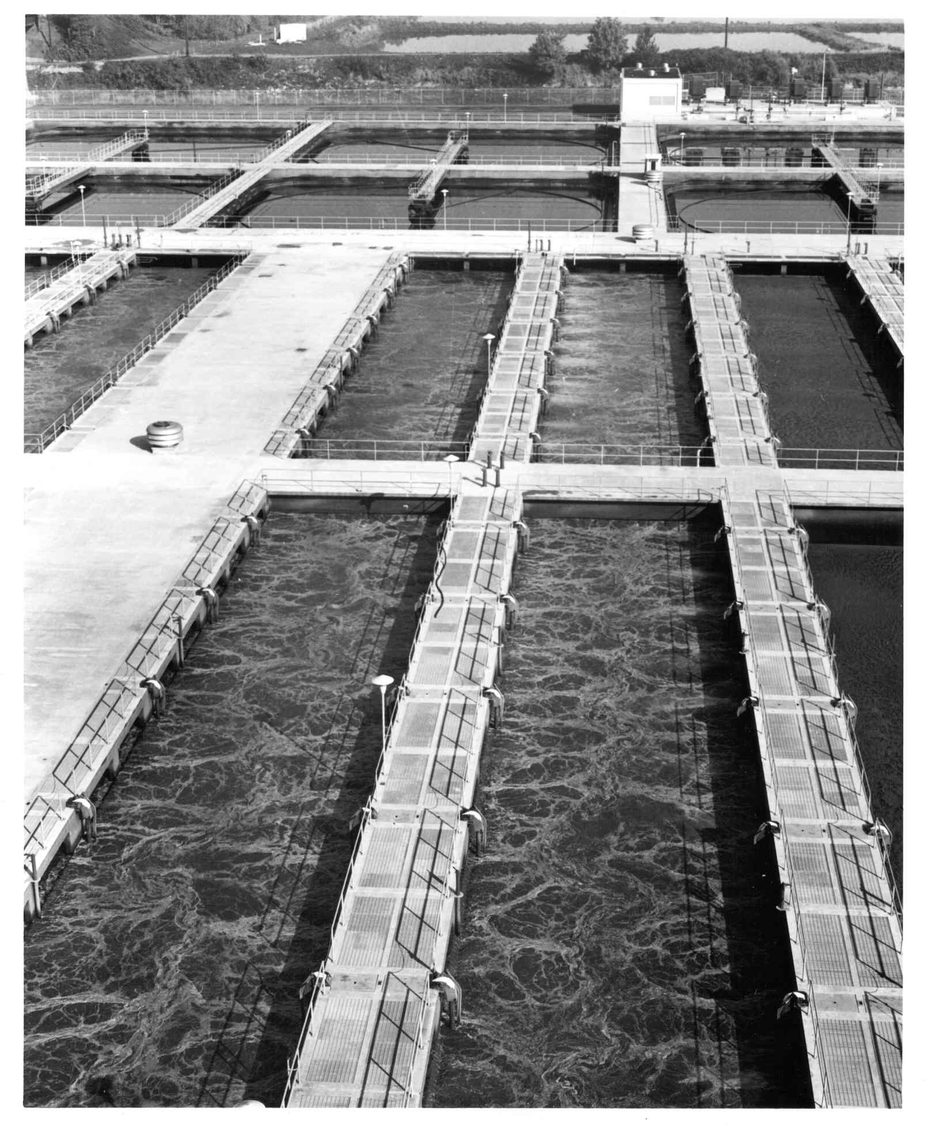
Questions
Thank you

Slide 8
PTE Contract and COBID Participation
Carollo Engineers Inc.--Negotiated fee $4,374,679
COBID CERTIFIED SUBCONSULTANT | CERTIFICATION | AREA OF WORK | OWNERSHIP | AMOUNT
Concise Communications, Inc. | MBE/WBE/ DBE/ESB | Technical Writing | Female/ Asian Pacific | $8,170
NNA Landscape Architecture, LLC | MBE/DBE/ESB | Eco-roof/ Landscape Architecture | Male/ Asian Pacific | $49,580
Elcon Associates, Inc. | MBE/DBE | Electrical Instrumentation | Male/ Asian Pacific | $877,252
Emerio Design, LLC | MBE/DBE |  | Male/ Subcontinent Asian | $48,195
SEFT Consulting Group, LLC | MBE/ESB | Structural/ Resiliency | Male/ Asian Pacific | $297,417
The Formation Lab | WBE/DBE/ESB | D/M/W/SDV/ESB Coordinator, Equity Lead | Female/ Asian Pacific | $45,355
Perimon Group, LLC | WBE/ESB | Project CD Lead and Process Mechanical Drafting | Female/ Caucasian | $175,638
The Greenbusch Group, Inc. | WBE | Building Mechanical (HVAC/Plumbing) | Female/ Caucasian | $243,150
Strongwork Architecture, LLC | ESB | Building Architecture | Male/ Caucasian | $131,998
 |  |  | Total | $1,876,755

