Slide 1
PIR Pump Station FEMA Grant (Ordinance to Apply for and Accept Grant Funds)
James Allison | Capital Projects Manager | Bureau of Environmental Services
December 15, 2021
MINGUS MAPPS, COMMISSIONER
MICHAEL JORDAN, DIRECTOR

Slide 2
Project Requirements and Background
PIR Pump Station is nearing the end of useful life.
PIR Pump Station is operated by Peninsula Drainage District #1 (PEN 1), an Oregon Special District that maintains levees, pump stations and other drainage assets.
PEN 1 annual land value tax assessments provide inadequate funding for large, capital projects.
PIR Pump Station protects City of Portland assets.
This project is about leveraging federal funding for flood prevention infrastructure that maintains public facilities and their operations.
The project supports the Levee Ready Columbia effort.

Slide 3
Project Objectives
Desired outcome of project: secure FEMA funding and design/permit new pump station
Make progress on City’s Mitigation Action Plan
Protect City assets and functions
Ancillary objective: Establish stronger partnership between City of Portland, PEN1 and the Levee Ready Columbia partners as we move to a modernized governance structure under the new Urban Flood Safety & Water Quality District

Slide 4
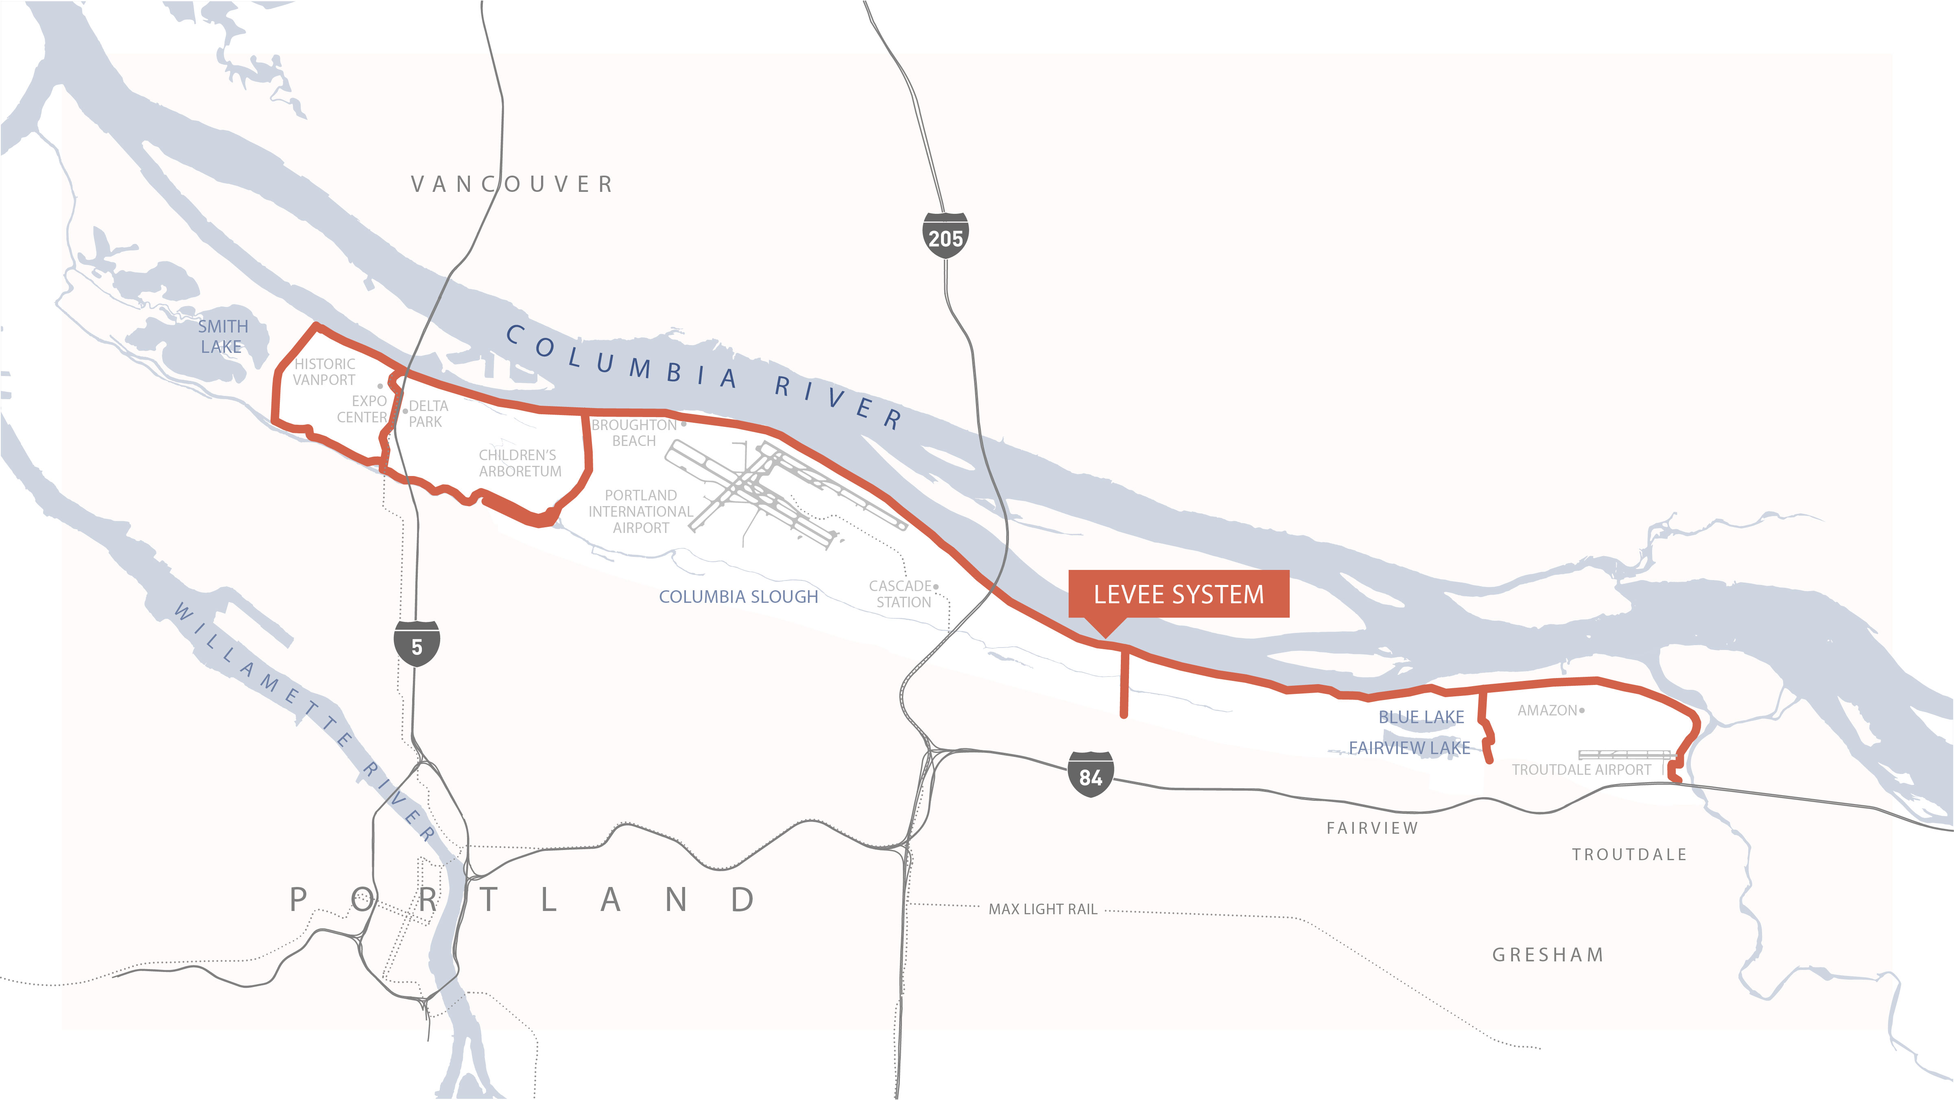
Project Overview

Slide 5
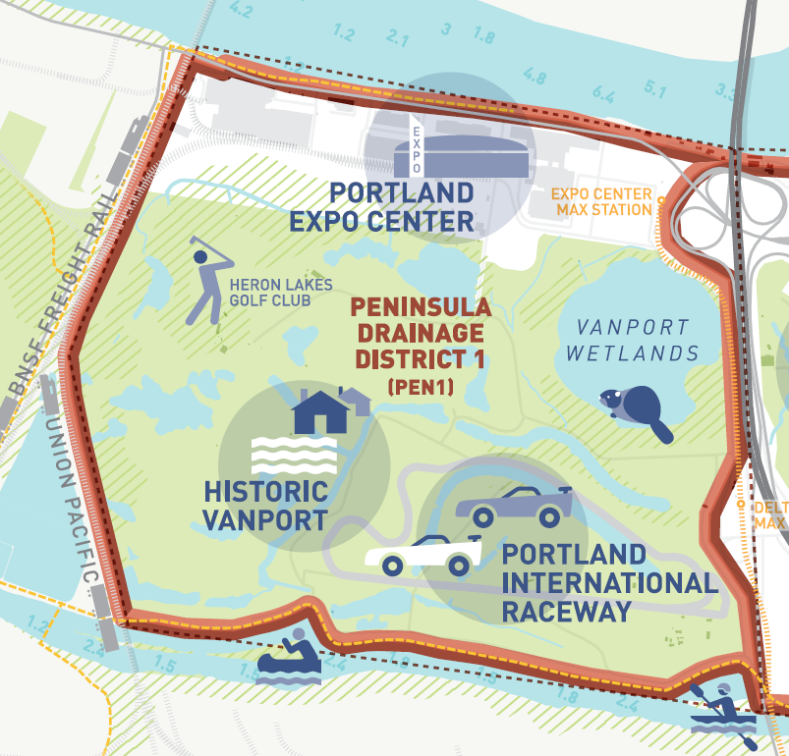

Slide 6
PUMP STATION PHOTOS?

Slide 7
Goals, Overview and City Values
FEMA grant program: reducing risk caused by natural hazards, such as severe weather, seismic activity, and wind
Design a modern pump station that addresses climate change contingencies
Energy efficiency upgrades
Design and operation considerations respond to water quality and ecosystem considerations

Slide 8
Project Budget and Schedule
Project Budget:
$2,300,000 for planning, design and permitting
$1,750,000 federal sponsorship (~75%)
$550,000 City local match (~25%) (appropriated from general fund set-aside for Levee Ready Columbia support)
Project Schedule:
Grant application is due January 29, 2022. City grant application to FEMA does not obligate the City to provide match funding until the grant is accepted by the City.
Planning: July – October 2022
Design and Permitting: October 2022 – December 2024
Anticipated grant for construction by UFSWQD: 2025

Slide 9
Portland Bureau of Emergency Management
BES and MCDD/PEN 1 are strong partners in mitigation planning as well as emergency response efforts
Project is in the City’s Mitigation Action Plan
Project builds resilience for the City, ensuring essential flood protection functions continue as the climate changes

Slide 10
PEN 1 and Levee Ready Columbia
Value of City partnership with PEN 1 and Levee Ready Columbia
PIR Pump Station is the only pump moving water out of PEN 1.
Pump station is at risk of failing.
Failure would impact PIR and Heron Lakes Golf Club.
Also, Tri-Met Yellow Line MAX, Metro Expo, private businesses.
Replacement is a goal of Levee Ready Columbia.
Replacing the station reduces risks of cascading levee failures.
Without City support, replacement is likely to be delayed.

Slide 11
Questions
Thank you

