Slide 1
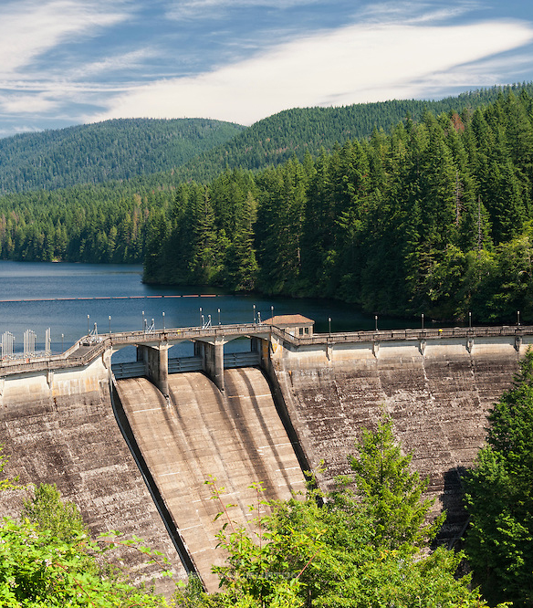
Proposed Administrative Rules for City Lands in Bull Run
A New Process for Assessing and Mitigating Environmental Impacts of Water Bureau Projects
Council Hearing
December 2021

Slide 2
How we got here
2019
City Charter Amendment
Directed Water Bureau to “seek to avoid, then minimize and mitigate” environmental impacts of bureau projects on City land in Bull Run Closure Area
2020
City Code Updates
Added new requirement to prepare documents that identify and avoid or reduce potential impacts
2021
Draft Administrative Rules
Define how Water Bureau will identify potential impacts and, when needed, document actions to avoid or reduce significant impacts

Slide 3
Why a Council Hearing Today?
The 2020 Title 21 Update Ordinance authorized Director Solmer to adopt the rules.
The Council action today is to vote on accepting the Report to Council, not to adopt the rules.

Slide 4
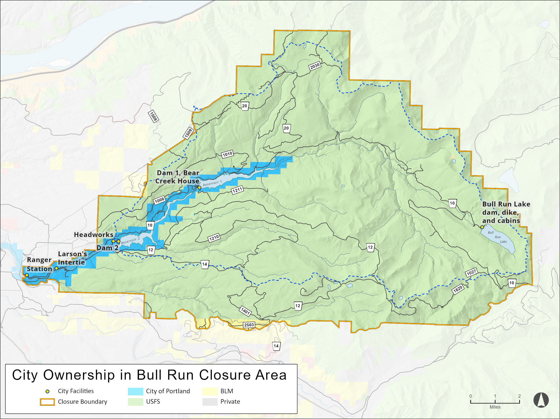

Slide 5
Goals
Protect City lands in a manner consistent with adjacent federal lands in Bull Run
01
Consider potential impacts early so that they can be avoided or reduced when designing City projects
02
Increase transparency of City protection measures by making documents available for review and comment
03

Slide 6
What the draft rules do
Define which types of projects require detailed assessment using new process
Define which types of routine projects are exempted because they are addressed by current protections
Define what questions need to be answered to identify potential impacts
Define how actions to avoid or reduce potential significant impacts are to be documented

Slide 7
Range of potential impacts
Water Flow and Water Quality
Fish and Wildlife
Riparian Reserves
Vegetation
Soils and Hillslopes
Cultural Resources
Noise and Disturbance
Fire Risk
Hazardous Materials

Slide 8
Water Bureau Projects
Water Bureau publishes online a list of active projects four times per year
Purpose of the list is to disclose the activities occurring within the Bull Run Closure Area
Examples of typical Water Bureau projects: road repairs, culvert replacements, water pipeline replacements, repairs or replacements of dam-related equipment

Slide 9
How impacts will be avoided or reduced
Comply with existing City, County, State and Federal requirements
Apply existing Water Bureau standard operating procedures
Apply existing regulatory compliance plans
Develop and apply new standard operating procedures and regulatory compliance plans

Slide 10
Examples of existing City requirements
Bull Run Closure Area Special Requirements (contract provisions)
Tree Protection SOP
Invasive Plants SOP
Aquatic Invasive Species SOP
Wet Weather Construction SOP
Hazardous Materials Spill Reporting, Storage and Disposal SOP
Northern Spotted Owl Guidelines
Fire Season Requirements
Bull Run Water Supply Habitat Conservation Plan

Slide 11
Schedule and process for adopting the rules
City Council directed the Water Bureau to adopt these rules by December 31, 2021.
The Title 21 ordinance directed the Water Bureau to hold a Council hearing prior to adopting the rules.
Director Solmer will adopt the rules prior to the December 31 deadline.

