Slide 1
E11009 Stark Trunk Relief Structure – OF37/WZ01 Project Acquiring Temporary Property Rights Council Item 819 Portland City Council | November 17, 2021
Joe Dvorak, P.E.,
Engineering Manager
Amy Dunning, P.E.,
Project Manager
Kevin Balak
PBOT Right of Way Agent
MINGUS MAPPS, COMMISSIONER
MICHAEL JORDAN, DIRECTOR
Notes:
Good morning/afternoon and thank you for your time. This presentation is for the request to acquire temporary property rights for the construction of the Stark Trunk Sewer Relief Structure.

Slide 2
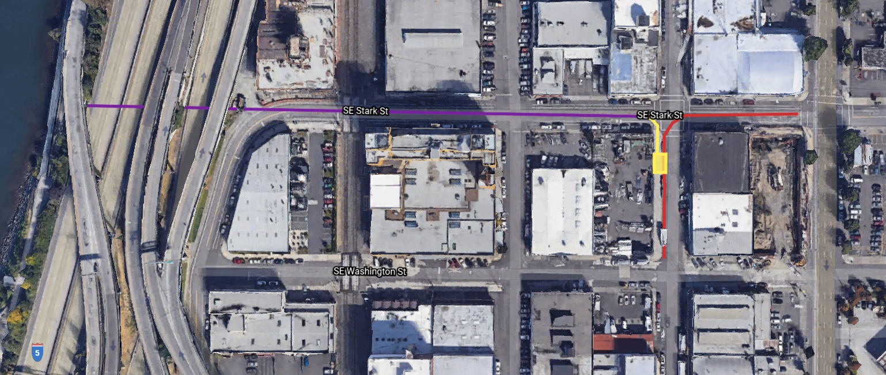
Project Overview
OUTFALL 37
STARK TRUNK
STARK TRUNK
RELIEF STRUCTURE
Project objective
Alleviate surface flooding during large storm events when Eastside CSO Tunnel is full.
PROJECT SCOPE
Install a relief structure and outlet conduit to divert flows from the Stark Trunk to Outfall 37.
Notes:
The Project is located in SE Portland at the intersection of SE Stark Street and SE 3rd Avenue. This area experienced flooding during large storm events in 2015 when Eastside CSO tunnel levels were high. Our project objective is to alleviate this surface flooding.
To accomplish this goal, we will construct a relief structure and outlet pipe (shown in yellow). During large storm events, flows will be directed from the Stark Trunk (shown in red) to Outfall 37 (shown in purple) and out to the Willamette River instead of discharging to the street.

Slide 3
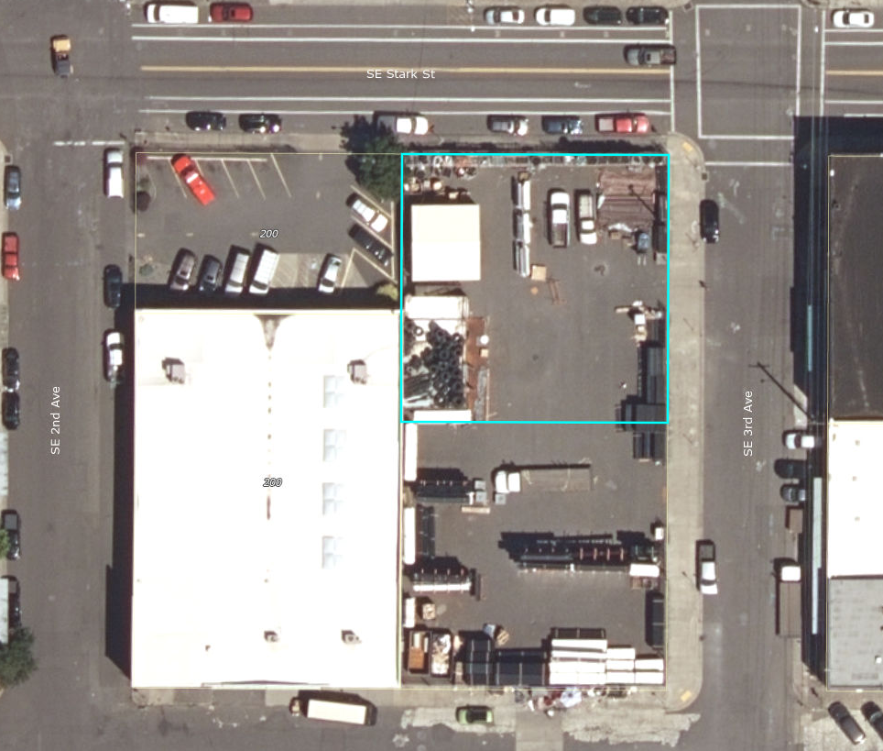
Construction on Private Property
CONSTRUCTION LOCATION
Permanent improvements located within the public right of way.
Temporary construction easements (TCE) on private property needed for shoring and construction access.
PUBLIC OUTREACH
Directly contacted property owner.
City providing owner with temporary storage area within the public right of way
Continued outreach during construction.
Approx. 600 sq.ft. TCE
Approx. 1,200 sq.ft. TCE
Notes:
The new relief structure will be located over top of the existing, Stark Trunk which is a large diameter sewer in SE 3rd Avenue. While all of the proposed permanent improvements will be located within the public right-of-way, a temporary construction easement (TCE) will be required on the adjacent property for construction activities including shoring and access.
As shown in this aerial image, the adjacent property serves as a material storage area. We have conducted public outreach with the property owner throughout the design process, including meetings at the project site. In order to minimize the TCE area and impacts to the business, we have come up with two different TCE’s that will be activated sequentially with different phases of construction. These are shown in red and green in this image.

Slide 4
Temporary Construction Easement
EASEMENTS
Two (2) temporary construction easements phased with construction in SE 3rd Ave and SE Stark St.
Market value determined by an administrative determination of just compensation appraisal.
SCHEDULE
Acquire possession of this property interest by May 2022, coinciding with Construction Notice to Proceed.
Notes:
Here we have plats for the proposed TCE’s. As I mentioned, these will be active during different phases of construction with minimal overlap in time.
This agenda item gives PBOT authority to compensate the affected property owner for the temporary construction easements associated with the Stark Trunk Relief Structure Project, and if necessary, to condemn for these property rights. The owner has been informed of the project and the need for these certain property rights.
Market value will be determined by an independent appraiser. PBOT will then make a written offer of just compensation and negotiate with the property owner on the City’s behalf. PBOT is also proactively providing relocation assistance to the Owner. The project team has formulated a plan to relocate the Owner’s material during construction and temporarily reconfigure access and circulation through the site to reduce impacts to the business.
The easements will need to be secured in time to issue Notice to Proceed to the Contractor in May, 2022.

Slide 5
Questions
Q & A

