Slide 1
Cantu, et. al. v. City of Portland, et. al.
USDC of Or. Case No. 3:19-cv-01606-SB

Slide 2
August 4, 2018
Far Right groups chose Portland for another rally because of our City’s professed progressive, multi-cultural values, and because of our Police Bureau’s history of preferential treatment for groups like theirs.
In the previous months, PPB used violent tactics to clear out antifascist protesters opposing the presence and tactics of groups like the ones gathering on August 4, 2018. While antifascists met violence, the Far Right met deference.

Slide 3
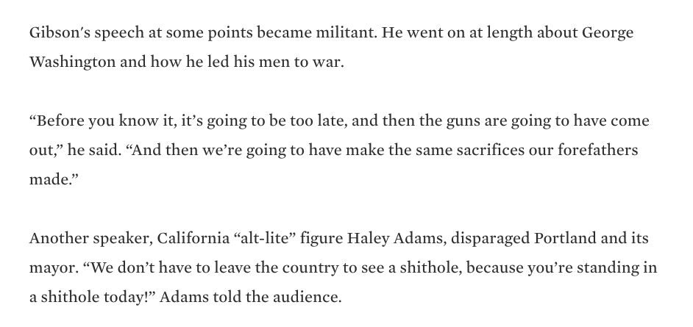
What kind of deference?
Southern Poverty Law Center, Portland far-right rally once again quickly turns violent as march becomes a riot (July 3, 2018)

Slide 4
What kind of deference?
Katie Shepherd, Senate Candidate Joey Gibson Has Moved His Next Portland Protest to a Place Where Right-Wing Marchers Can Carry Guns, Willamette Week (July 27, 2018).

Slide 5
What kind of deference?
Katie Shepherd, Portland Police Found Right-Wing Protesters With a Cache of Long Guns Atop a Parking Garage.
Why Didn’t the Mayor Know?, Willamette Week (October 16, 2018)

Slide 6
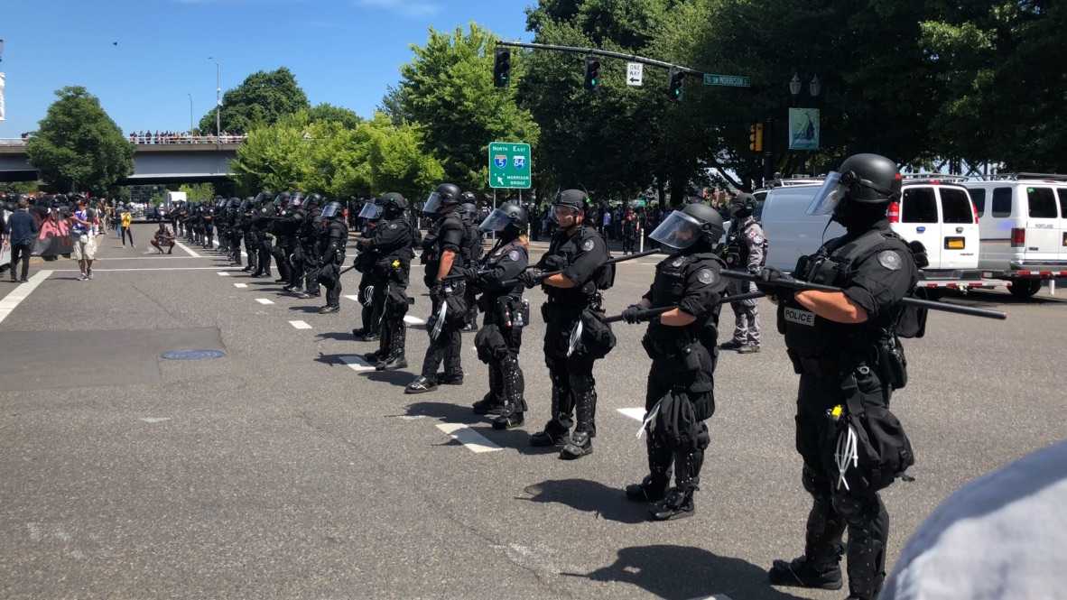
Aaron Cantu
Mr. Cantu peacefully assembled on SW Naito Parkway along with the other antifascist protestors. Immediately, he found a heavy police presence trained primarily on the antifascist protestors.
Notes:
Aware that Gibson had called for his members to come armed and having heard of the violence perpetrated by Patriot Prayer members and PPB at past
demonstrations, Mr. Cantu wore a bicycle helmet on his head.

Slide 7
Joey Gibson and the Far Right Ignore Orders

Slide 8
Antifascists Move to Respond, Face Police

Slide 9
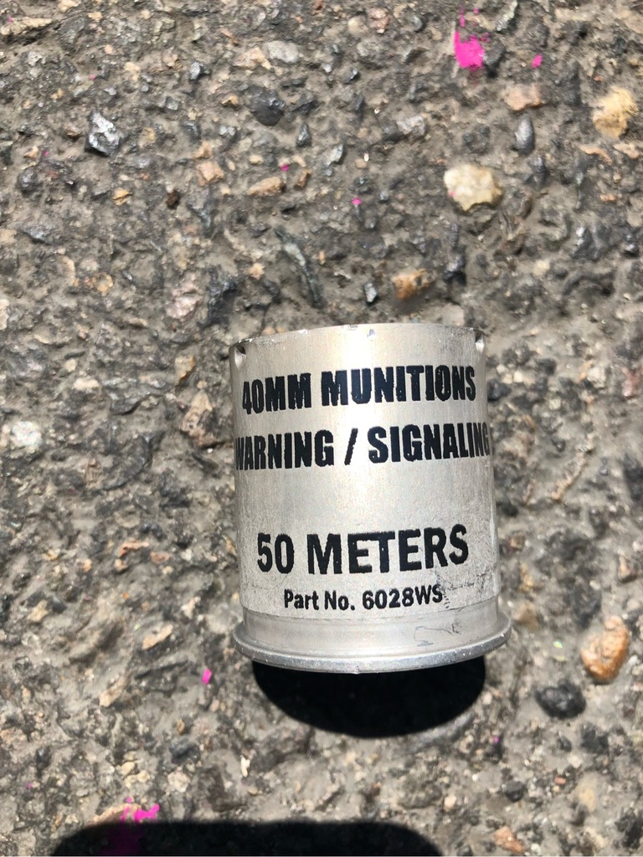
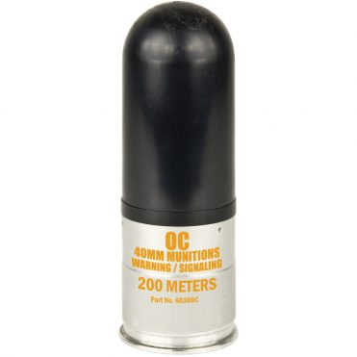
“Aerial Distraction Devices”
High velocity projectiles that can travel as fast as 200 mph
Notes:
the lowest payload version of an AW/MS travels at a velocity of 145 fps (98.86 mph), and higher range versions can travel at speeds up to 300 fps (204.55 mph). As mandated by the United States
Consumer Product Safety Commission, commercially available bicycle helmets are only tested to withstand impacts at velocities of 20 fps (or 13.64 mph)7, or significantly below the minimum speed threshold of the weapons being employed.

Slide 10
PPB is trained not to shoot at people’s heads
Katie Shepherd, Portland Police Suspend Use of “Flash-Bang” Grenades After Reports That Several Protesters
Were Severely Injured By the Weapons, Willamette Week (August 6, 2018).

Slide 11
PPB Aimed at the Crowd’s Heads

Slide 12
Aaron is struck in the head

Slide 13
Taken to the hospital

Slide 14
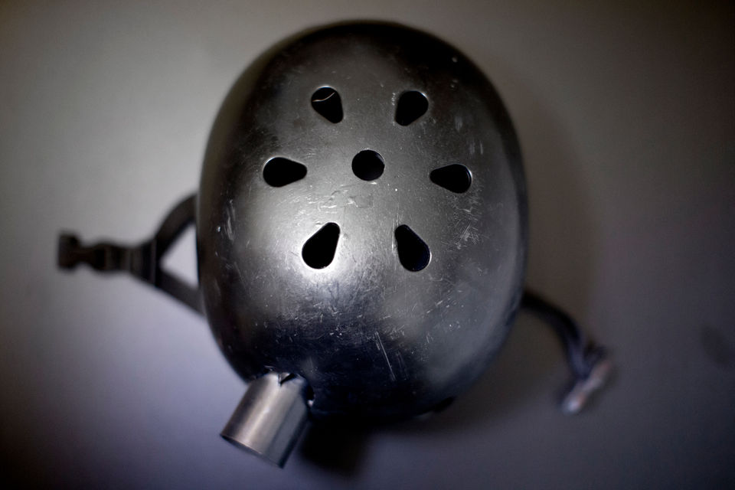
Shane Kavanaugh and Beth Nakamura, 'It felt like a war zone': Portland protester hit in head by police flash-bang speaks, The Oregonian (Aug 11, 2019)

Slide 15
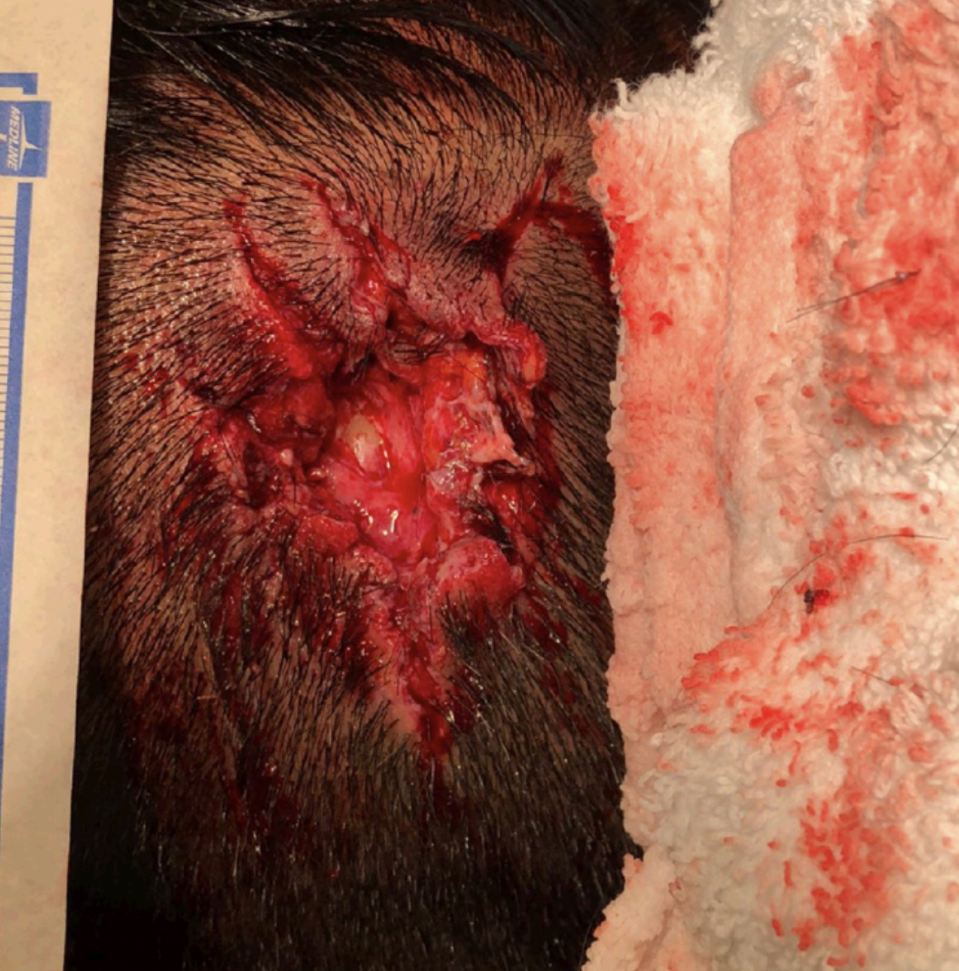

Slide 16
Meanwhile… The Alt-Right Cheer
Vice News, Patriot Prayer Is Dragging Antifa Into An Unwinnable PR War (HBO)

Slide 18
No Accountability

