Slide 1



Cannabis Emergency Relief Fund (CERF)
Jo Ann Hardesty, Commissioner
Michael Montoya, Interim Director
Dasheeda Dawson, Supervisor
Christina Coursey, Licensing & Policy Coordinator

Slide 2
Cannabis emergency relief fund
(CERF)
The Cannabis Emergency Relief Fund (CERF) has been approved to provide $1.33 million in grants to small licensed Cannabis businesses within Portland city limits and to Cannabis industry workers economically impacted from Covid-19, vandalism, robberies, wildfire, and the residual effects of illness, trauma, and grief suffered from such impacts. ​

Slide 3
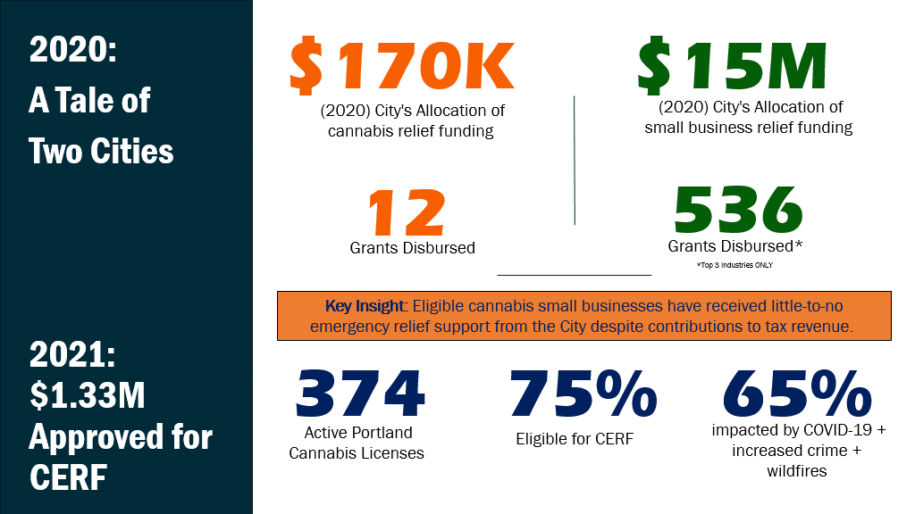

Slide 4
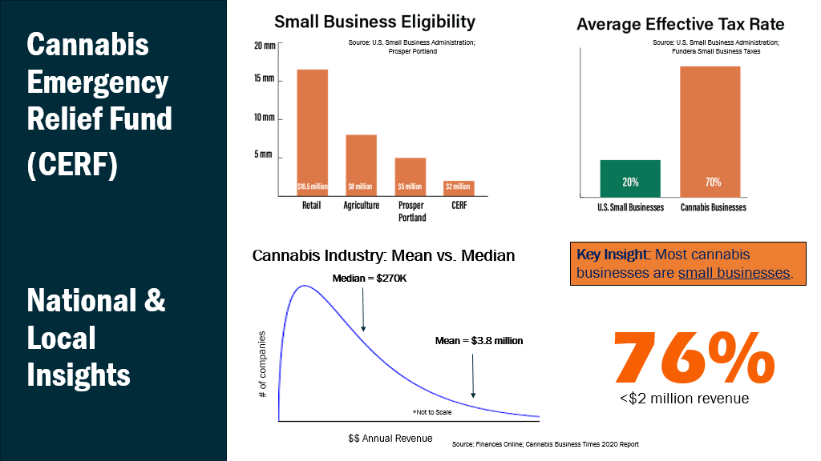

Slide 5
OLCC Reported Crime Data

Slide 6
CERF
Details
Details of CERF derived from assessing the needs of the industry, analyzing data trends, researching successful small business relief programs across the country, and speaking with cannabis industry advocates. ​
Three uniquely selected Community Partners will administer and disburse funds. Partners are approved for up to 20% for administrative overhead costs for marketing, outreach, intake, processing, verification, payment, and reporting. ​
Emergency funds will be available starting February 1, 2022 and must be fully disbursed by June 2022. ​
Funds are prioritized for historically disadvantaged populations (Minority, Women, Veteran, Small and/or Low-Income) and will be disbursed based on level of need ​
Individuals are eligible for up to $5,000 in emergency relief ​
Businesses are eligible for up to $25,000 in emergency relief ​
Individuals and entities may only qualify for and receive funds ONE TIME in the FY ​

Slide 7
Business Eligibility
Business is located in the City of Portland.
Business headquarters must be located in Oregon and business must be doing business in Portland, Oregon.
Business must be a licensed, cannabis business in good standing with the City of Portland Cannabis Program AND
Historically Disadvantaged-owned OR
Hold three (3) or less pending or active Marijuana Regulatory Licenses by Oregon Liquor Control Commission (OLCC) AND
Annual total revenue of less than $2mill
Business has at least one full time employee (unless sole proprietorship/owners may also count as an employee).
Applicants employees must be on their payroll and have payroll taxes withheld. Independent Contractors do not count toward employee numbers
Be registered, current, and in good standing with the Oregon Secretary of State Office
Be current and in good standing with local, state, and applicable federal taxing and licensing authorities.
Applicable licenses be compliant and in good standing with local and state licensing agencies.
Meet program technical requirements including ability to provide financial records.
Certify intent to remain in operation for at least six months.
One-time eligibility within the fiscal year.
Funds must be applied only to licensed business and/or its employees within Portland.
Not eligible for expenses covered by other grants and/or insurance.

Slide 8
Individual Eligibility
Working in the City of Portland
Must be working on behalf of an OLCC licensed producer, processor, wholesaler, or retailer, including the licensees working in a licensed business or managing information in CTS, AND
  Have an approved and active OLCC Marijuana Worker Permit, AND
  Be part of a historically disadvantaged population, OR
  Annual Income does not exceed 80% of median income for City of Portland metro area
OR Must have previously worked on behalf of an OLCC licensed producer, processor, wholesaler, or retailer and laid off and/or terminated after March 2020, AND
  Have proof of an OLCC Marijuana Worker Permit expired after March 2020
  Be part of a historically disadvantaged population, OR
  Annual Income does not exceed 80% of median income for City of Portland metro area

Slide 9
Eligibility Expenses
Personal Protective Equipment associated with Covid-19
Rent or mortgage payments on real property
Other expenses reasonably necessary to keep the Eligible Business operational, and to safely meet local, state, and federal COVID-19 mitigation
Utility expenses
Telephone & Internet expenses
Business Insurance
Maintenance and repairs needed to restore premise following damage from vandalism or break-in
Increased security measures needed to maintain safe working environment (does not include armed security guards or purchase of firearms or other weapons)
Payroll costs and expenses
Expenses associated with employees need for time off due to Covid-19 for self or to care for dependents (Not to exceed two (2) weeks or 80 hours of pay)
Expenses to cover trauma or grief counseling associated with robberies or wildfire
Cost to cover medical expenses due to Covid19 for self or dependents
Cost to cover past due balances of Marijuana Regulatory Licenses in order to remain in compliance
OLCC Marijuana Worker Permit costs

Slide 10
Examples of Documents needed
Certificate of good standing from Oregon Secretary of State
OLCC documentation showing licenses and/or permits in good standing
Federal/State tax records filed for 2020 and/or 2021
Proof of current employment status and/or termination after March 2020
Profit and Loss Revenue Forms
Verification of rent/mortgage expenses
Bills for cost of doing business (utility, telephone, internet, etc.)
Certified payroll documentation
Documentation showing expenses incurred due to business interruption caused by Covid-19, vandalism, robbery, wildfire etc.
Verification of expenses not covered by insurance
Bank or credit card statements
Invoices, purchase orders, receipts

Slide 11
In house Vs. Community partner
In House
Partner Disbursal
$206K - $233K estimated for minimum personnel cost per year
  CERF Coordinator
  CERF Support Specialist
18-24 months: Funds disbursed by June 2023 earliest
$266K Administrative costs with maximum of 20% in approved budget
  $201K estimated based on selected partners
6 months: Funds disbursed by June 2022 latest
Supporting & stimulating community-based organizations

Slide 12
Community partner selection
Three uniquely selected Community Partners will administer and disburse funds. Partners will only be allowed to utilize funds to administer CERF.
Community Partners are approved for up to 20% to cover administrative overhead costs. Admin cost is for marketing, outreach, intake, processing, verification, payment, and reporting for CERF.
Plan allows City to support relief efforts while only managing community partners' compliance and is lower in costs than doing it in-house.
Organizations selected as community partners are led by historically disadvantaged populations. Relief funding being prioritized for recipients, also prioritizing the partners selected.
Firsthand knowledge of Cannabis industry, the owners and workers.
NuLeaf has funded more than $500,000 to Cannabis businesses to date
Modeled after umbrella grant agreement made effective on December 15, 2020 between City of Portland and Causa of Oregon for $1.75 million

Slide 13



CERF Community partners
NuLeaf Project ($680,000) ​
Mission is to build generational wealth via the legal cannabis industry for the communities disproportionately harmed by cannabis criminalization – Black, Indigenous, and Latina/o/x communities. ​
To date, NuLeaf Project has funded more than $500,000 to cannabis businesses 100% owned by founders of color and/or founders arrested for cannabis. ​
Under the incubation of NuLeaf Project and a dedicated $150,000, Cannabis Workers Coalition will help extend relief support specifically to individuals working in the cannabis industry. ​
The Cannabis Workers Coalition (CWC) is a non-profit community- based work center that organizes and provides support to low wage workers by reducing barriers to access by educating employers and industry leaders on how to implement fair and equitable workplace conditions and shift toward more inclusive systemic practices. ​
The Initiative ($350,000) ​
The Initiative is an accelerator program and platform with a special focus on conducting research in order to understand how to create meaningful cannabis social equity programs. Organization has accelerated fifteen female led companies and, during the pandemic, completed one of the most comprehensive white papers and national databases examining all local and state social equity programs, funding allocated by those jurisdictions and indicators of success for social equity licensees.
Oregon Cannabis Association ($300,000) ​
The Oregon Cannabis Association (OCA) is a diverse group of cultivators, processors, retailers, entrepreneurs, and allied businesses. ​OCA’s mission is to help one another thrive through networking events, educational workshops, and political representation. Connect. Learn. Grow. ​

