Slide 1
E11004 Carolina Trunk WZ 01/03 Rehabilitation Project Request for Exemption from Competitive Bidding
Todd Martinez, P.E.
Project Manager
Yang Zhang, P.E.
Design Manager
Council Item#: 802
Date: November 10, 2021
Mingus Mapps, Commissioner
Michael Jordan, Director

Slide 2
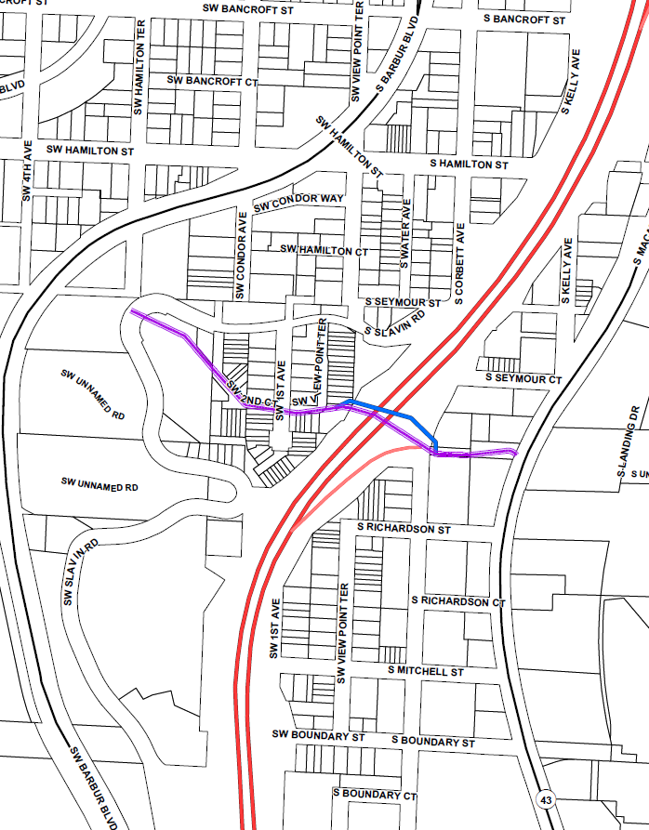
PROJECT OVERVIEW
Project Location
SW Portland
Crossing beneath highway I-5
CAROLINA TRUNK WZ 01/03
Built in 1930s
42-in Horseshoe-shaped Concrete Pipe
Approx. 1,600 ft long
PROJECT SCOPE
Rehabilitate the existing trunk crossing I-5
Install a new trunk crossing I-5 parallel to existing trunk
Replace the existing downstream trunk
Rehabilitate the existing upstream trunk
Separate sanitary sewer and stormwater
Carolina Trunk Upstream of I-5
Carolina Trunk Downstream of I-5
Carolina Trunk Crossing I-5
Carolina Work Zone 3
Carolina Work Zone 1
Carolina Trunk
Proposed New Trunk

Slide 3
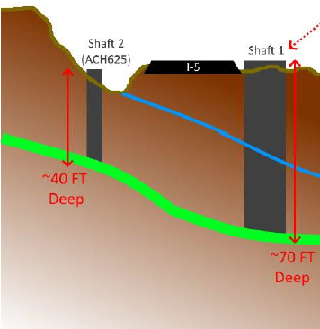
PROJECT CHALLENGES
Sophisticated Field and subsurface conditionS
Deep shaft excavation with high groundwater
Trenchless large utility construction crossing a major highway
Work in environmental zone, on private properties and in proximity to a major highway,
CONSTRUCTION CONSTRAINTS
Limited construction access
Tight construction space
Complex sewer flow bypass coordination
Complex traffic control on busy streets and highway
STAKEHOLDERS AND PUBLIC INVOLVEMENT
ODOT and PBOT ROW
Other public agencies
Construction easements on private properties
Night work and traffic control impact

Slide 4
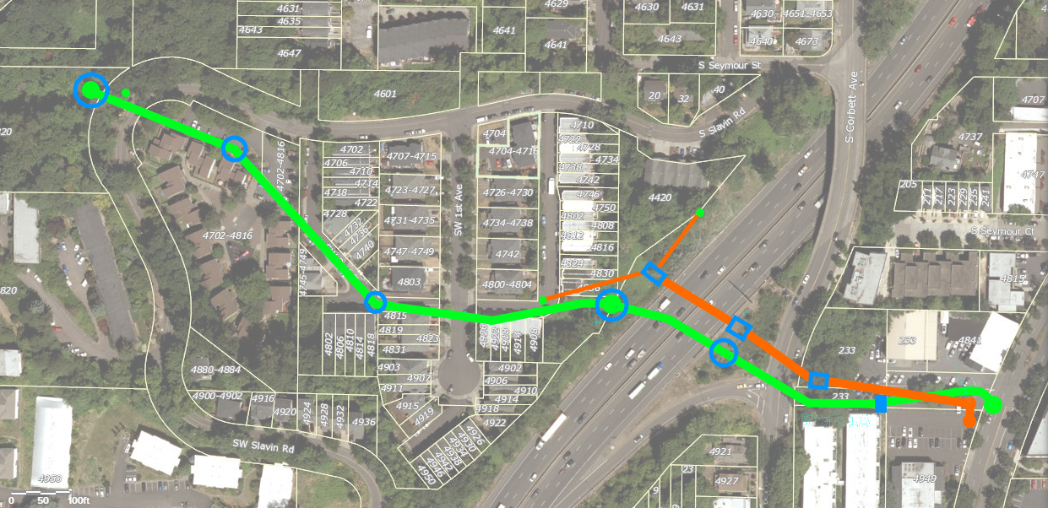
ALTERNATIVE DELIVERY SEQUENCING
Approach | Phase 1 | Phase 2
CM/GC (Single Procurement) | New Trenchless Crossing I-5 Crossing Rehab Downstream replacement | All other elements
UPSTREAM REHAB
NEW TRENCHLESS CROSSING
I-5 CROSSING
REHAB
DOWNSTREAM REPLACEMENT

Slide 5
PROJECT COSTS & SCHEDULE
Approach | Construction | Total Project
CM/GC Delivery | Approx. $20 M * | Approx. $30 M
* Class 5 ranges (-20% lower to +50% higher) not shown
 | Start Design | Start Design | Procurement (GMP) * | Final Design | Start Construction | End Construction
CM/GC |  | DEC 2021 | NOV 2023 | JAN 2024 | NOV 2023 | DEC 2024
* Guaranteed Maximum Price (GMP) will be prepared by GC based on 90% design

Slide 6
Construction Manager/General Contractor (CM/GC)
Early Contractor involvement:
Schedule efficiencies
Value engineering
Reduce construction uncertainties and risks
Implement a Community Equity and Involvement Plan
Committee Oversight and Reporting
Workforce Goals:
Apprenticeship – 22% M, 9% W
Journey-level – 22% M, 6% W
Subcontracting Goals
COBID Certified Firms – 22% overall, 12% M/D, 5% W

Slide 7
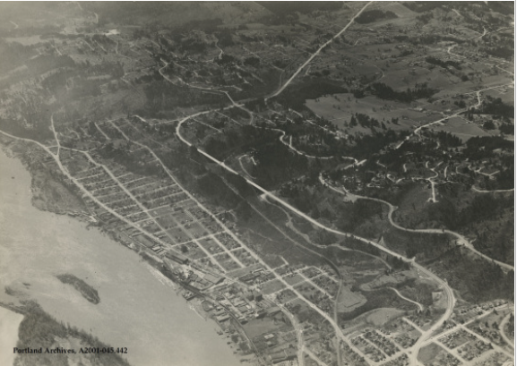
Recommendation
Accept the factual findings
Authorize an exemption from competitive “low-bid” procurement
Questions?

