Slide 1
The Anna Mann
Shannon Callahan, PHB Director
November 3, 2021
Portland's Housing Bond

Slide 2
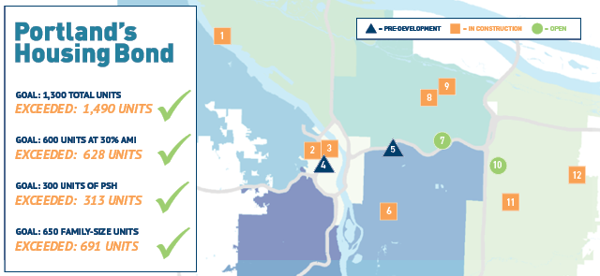
Bond Goals Met!

Slide 3
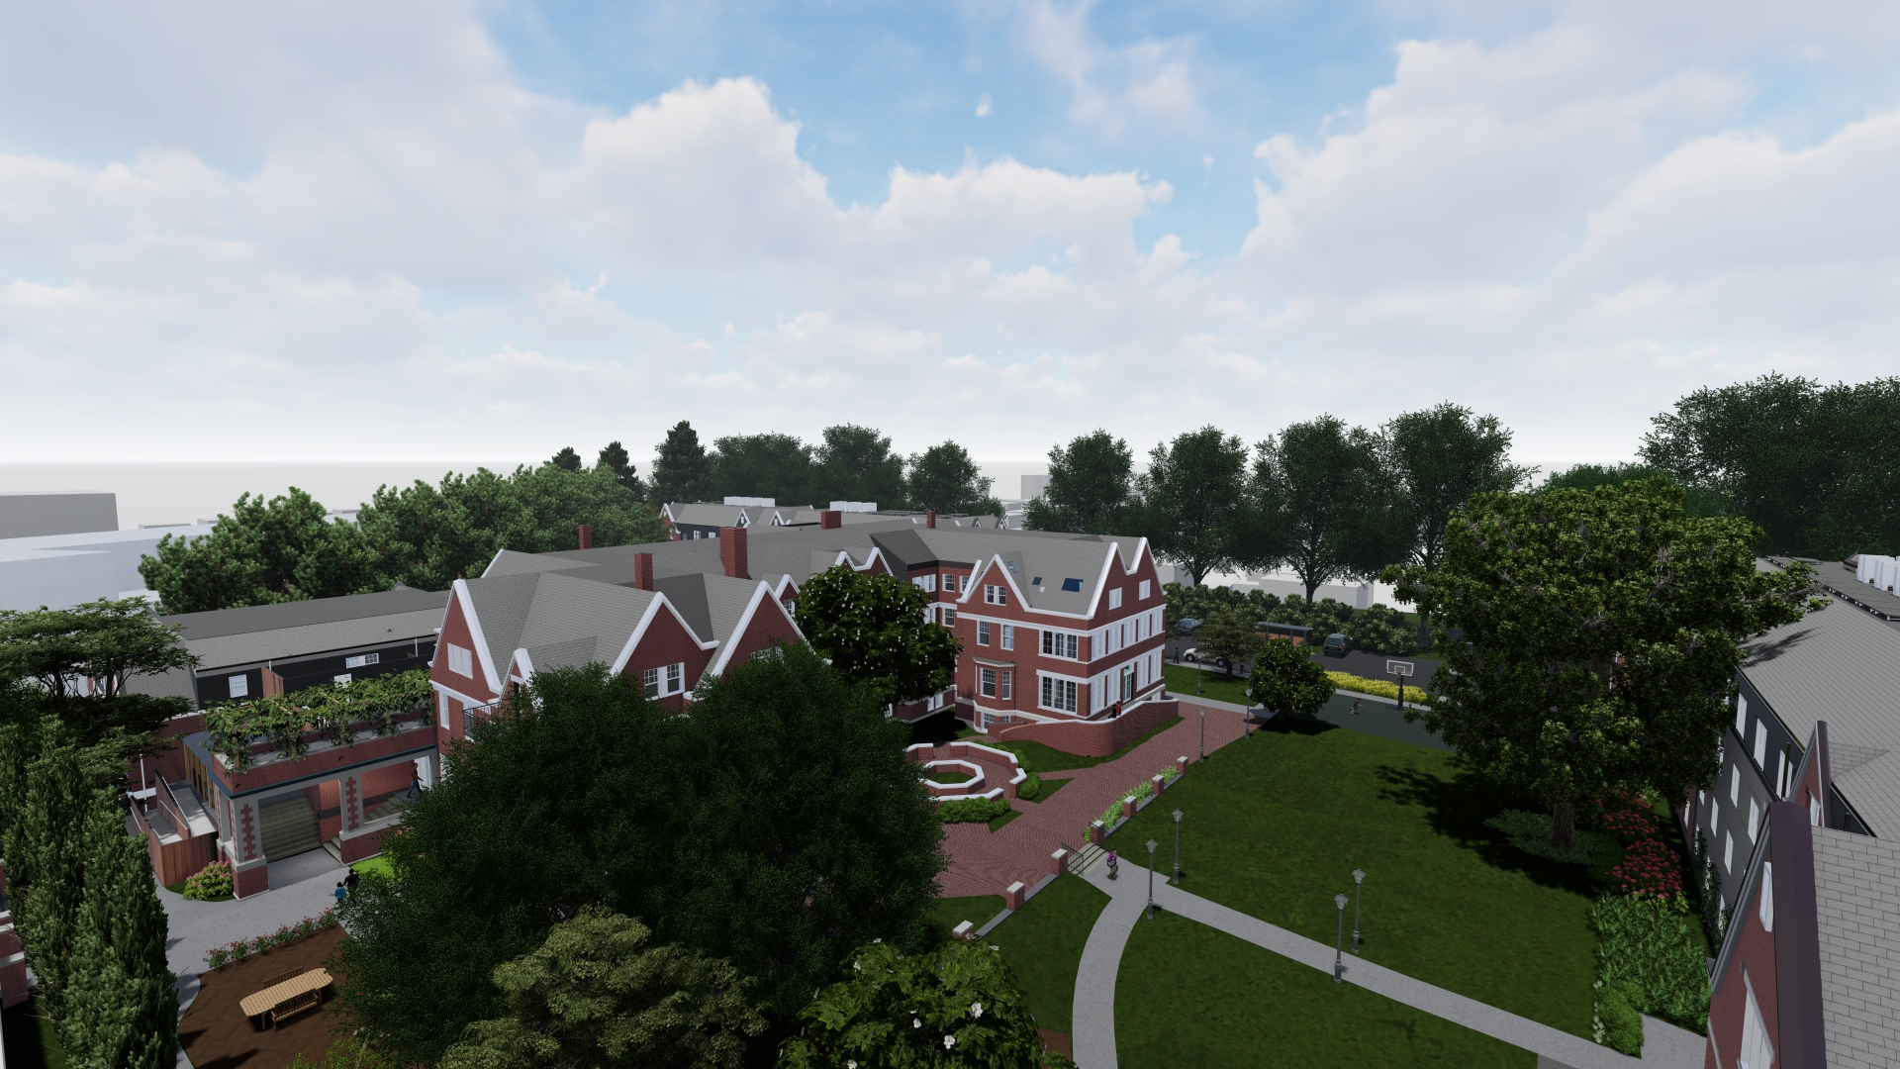
The Anna Mann
1021 NE 33rd Ave
Portland

Slide 4
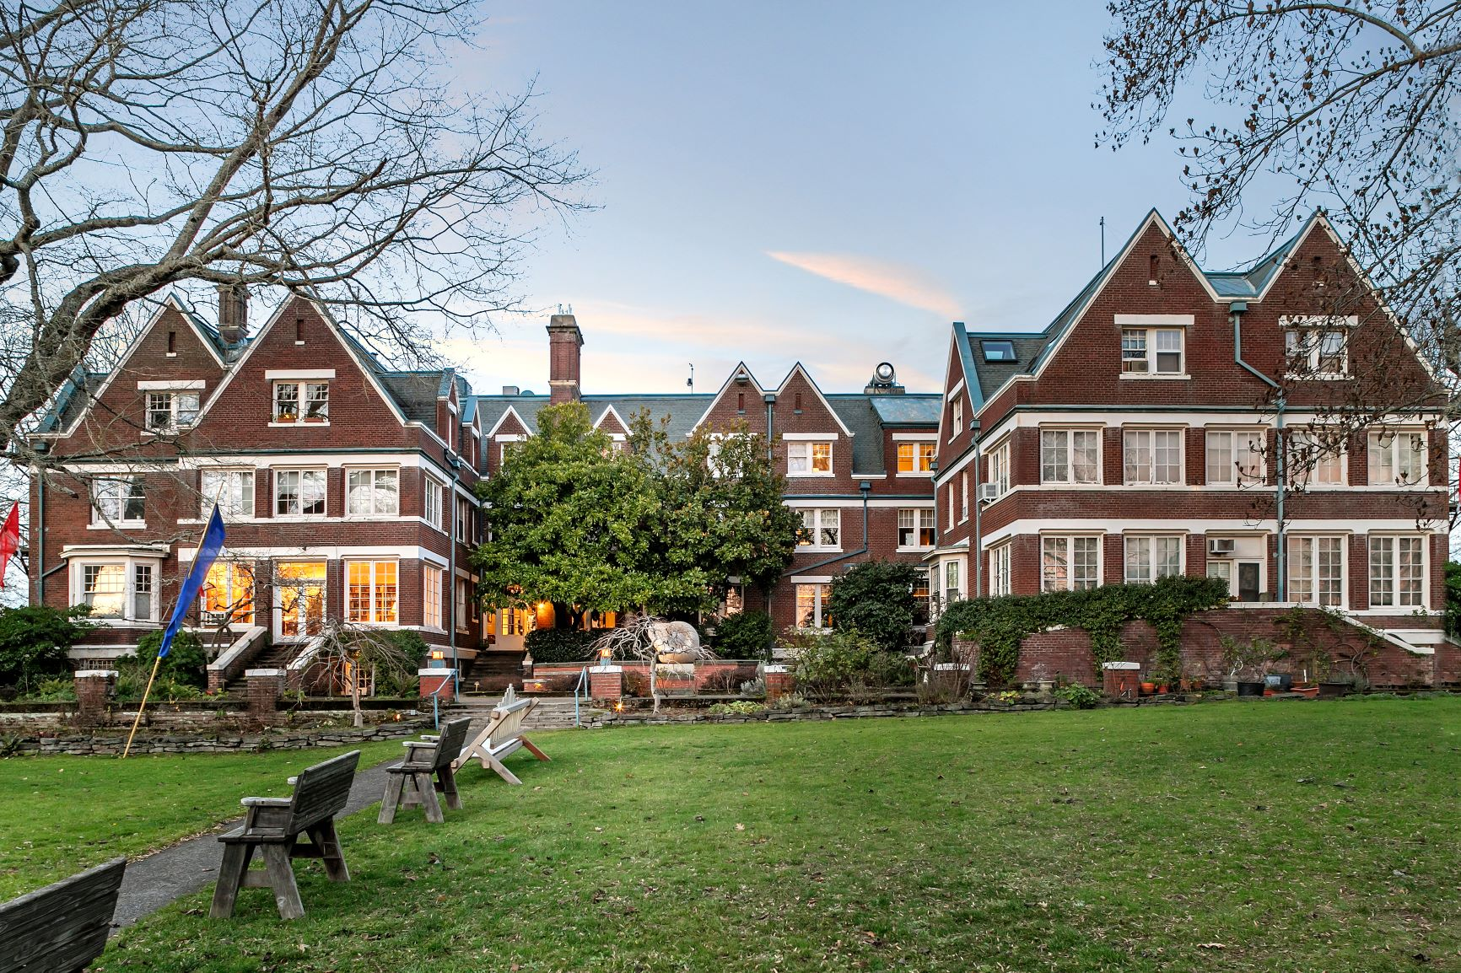
Located in Laurelhurst Historic District (Opportunity Score 5)
Repurposes a National Historic Landmark
Within walking distance of parks, schools and retail
On target to exceed PHB's Equity in Contracting goals
Target Earth Advantage Gold
Construction start Dec 2021 – Leasing start Summer 2023
Project Highlights

Slide 5
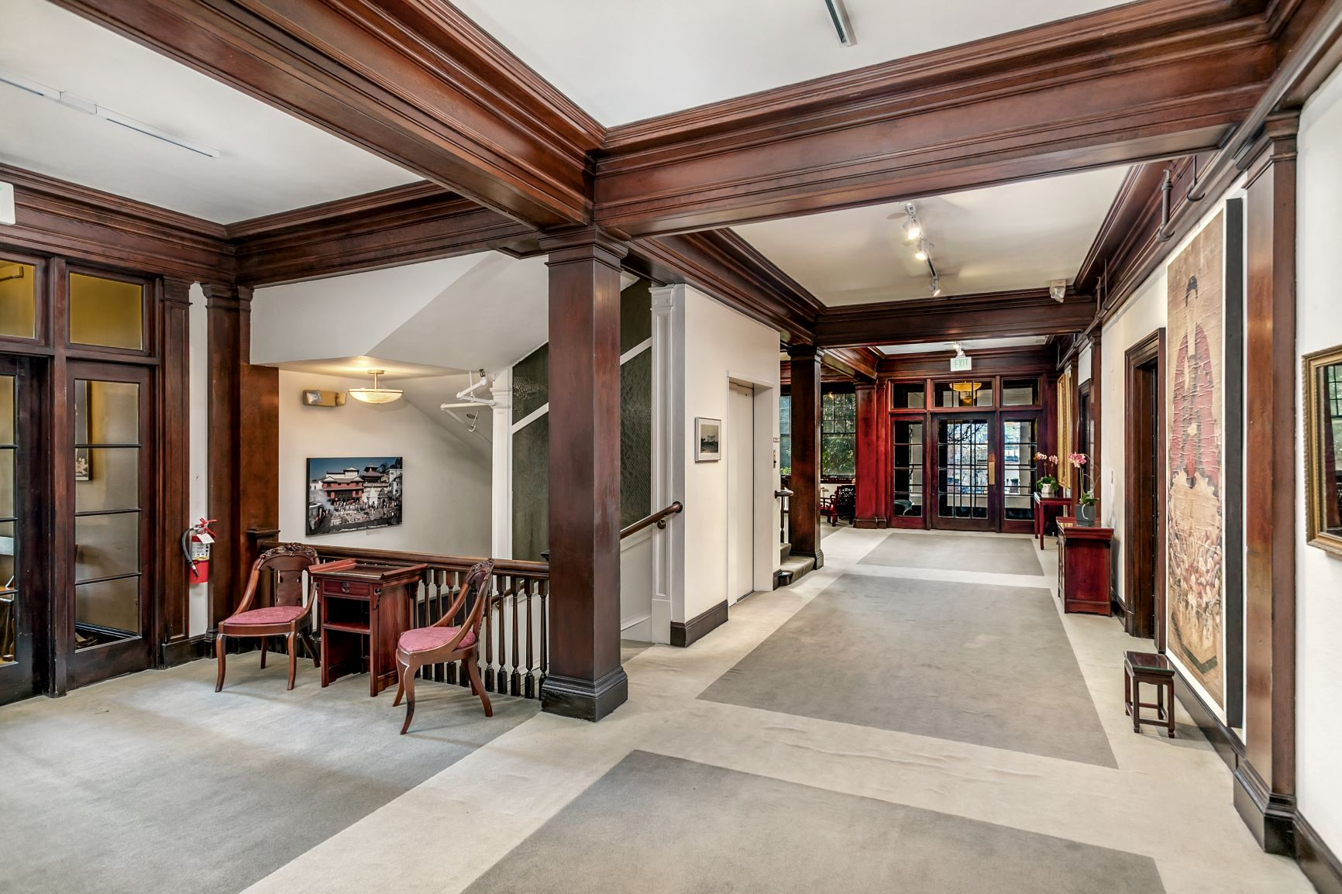
Historic building plus two newly constructed buildings on 3-acre site with green space
128 affordable units & mgr. unit to house 315 people
Priority Communities Served:
Families - Includes 2, 3 & 4-bedroom units
Very low-income households & those at risk of homelessness
BIPOC community
Project Highlights

Slide 6
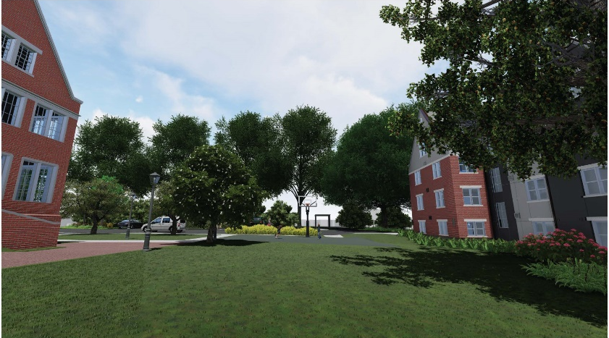
128 affordable units
66 1BR
48 2BR
13 3BR
1 4BR
Rents range from
$476 (1BR 30% AMI) to
$1450 (4BR 60% AMI)
12 units of PSH; Supportive Services from IRCO/New Narrative/IHI
42 units for residents at 30% AMI or below
63 parking spaces
Project Details

Slide 7
Project Services
Joint Office of Homeless Services provides $10,000/unit in operational support for 12 Permanent Supportive Housing (PSH) units
IRCO provides culturally specific support services
New Narrative provides support services for homeless and those exiting homelessness
IHI assists in supportive services (1 FTE)
106Halsey/Gateway Park l 07/10/2019 l Portland Housing Bureau 5

Slide 8
Project Funding Sources
Portland Housing Bonds | $12,544,000
CDBG (PHB) | $8,000,000
KeyBank Low Income Housing Tax Credits & Historic Tax Credits | $23,969,920
Freddie Mac Permanent Loan | $7,885,928
IHI Deferred Developer Fee and Contribution | $3,600,000
OHCS Weatherization Grant | $83,287
SDC Exemptions | $1,865,081
Total Project Costs | $57,947,266
PHB funding = $20.5 million, leveraged 2.8 times

Slide 9
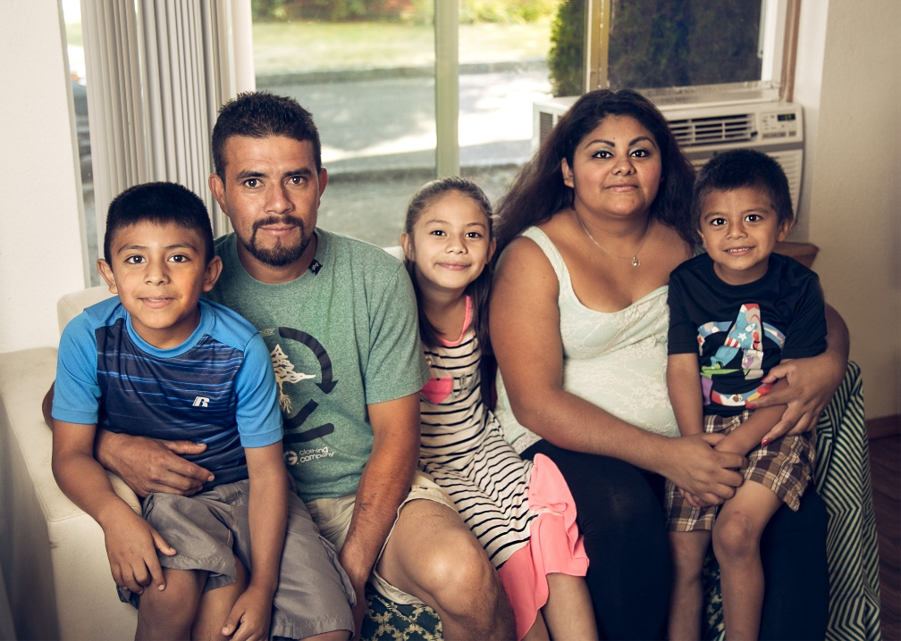
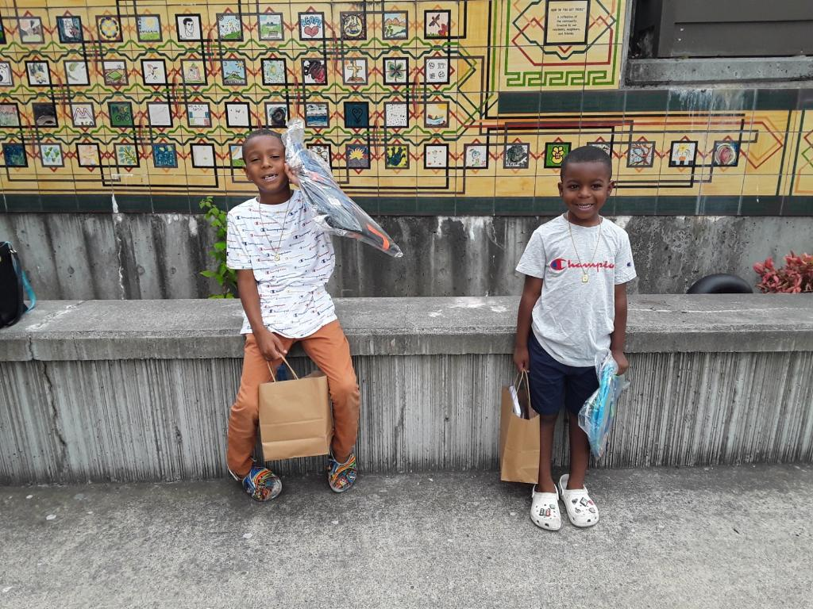
Summary
Authorize:
Funding in an amount not to exceed $20,544,000
Director of PHB to execute all documentation needed to advance this project
9
Anna Mann | November 3, 2021 | Portland’s Housing Bond
Division Street Apartments 04/22/2020 Portland Housing Bureau 5
Notes:
Ordinance(s) ask for BOS funding for new construction + conveyance of the land via DDA

